Slide 1
Administration
Project 3 Due Sunday
Partner Evaluations
Project 3 FAQ Guide Posted (IA Project 3 – Final)
Project 4 Coming Soon
Remember Team Setup
“Late Features”
Project-Based Grade Improvements
Mid-Course Survey
Anonymous Qualtrics Link
60%+ Response Rate => Extra Final Curve

Slide 2
Page Replacement Algorithms
Optimal page replacement algorithm
Not recently used page replacement
First-In, First-Out page replacement
Second chance page replacement
Clock page replacement
Least recently used page replacement
Working set page replacement
WSClock page replacement

Slide 3
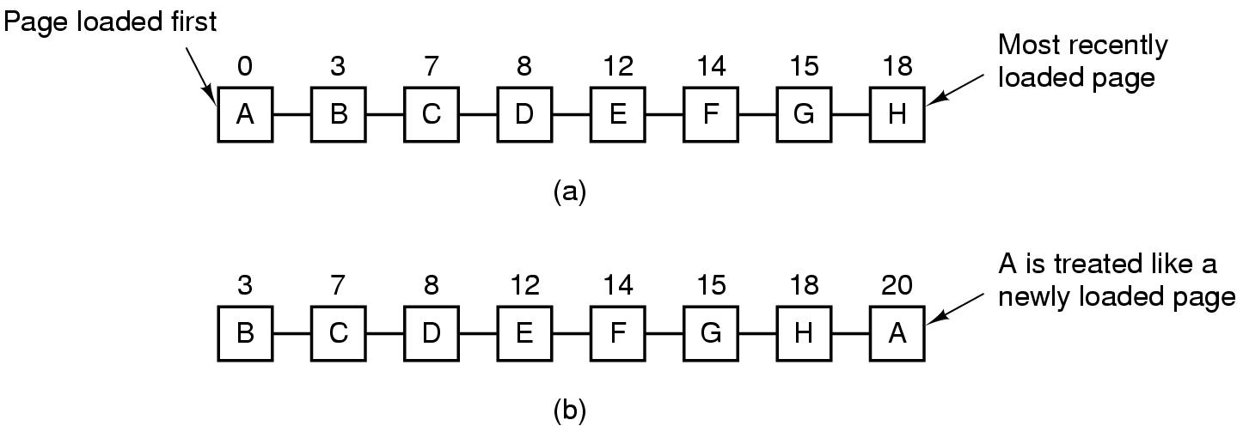
Second Chance Algorithm

Slide 4
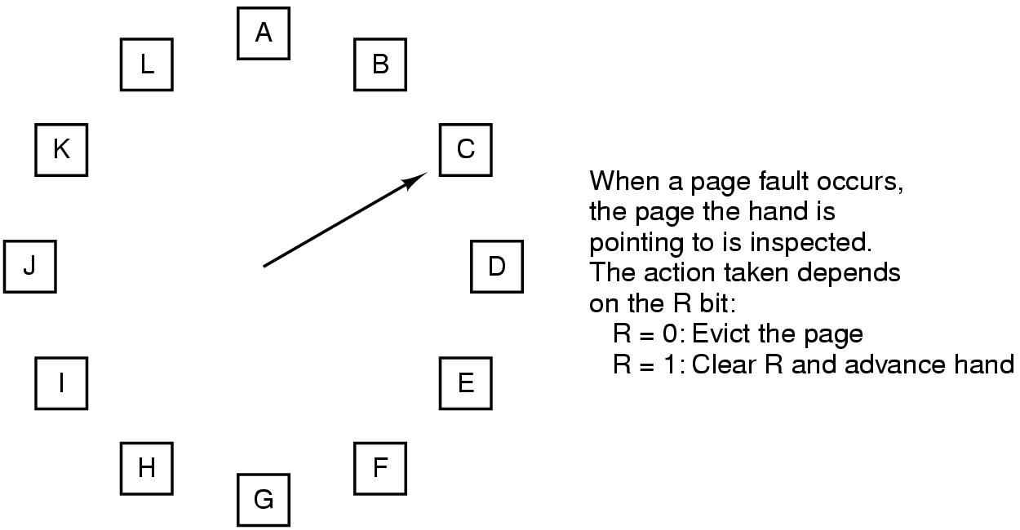
The Clock Page Replacement Algorithm

Slide 5
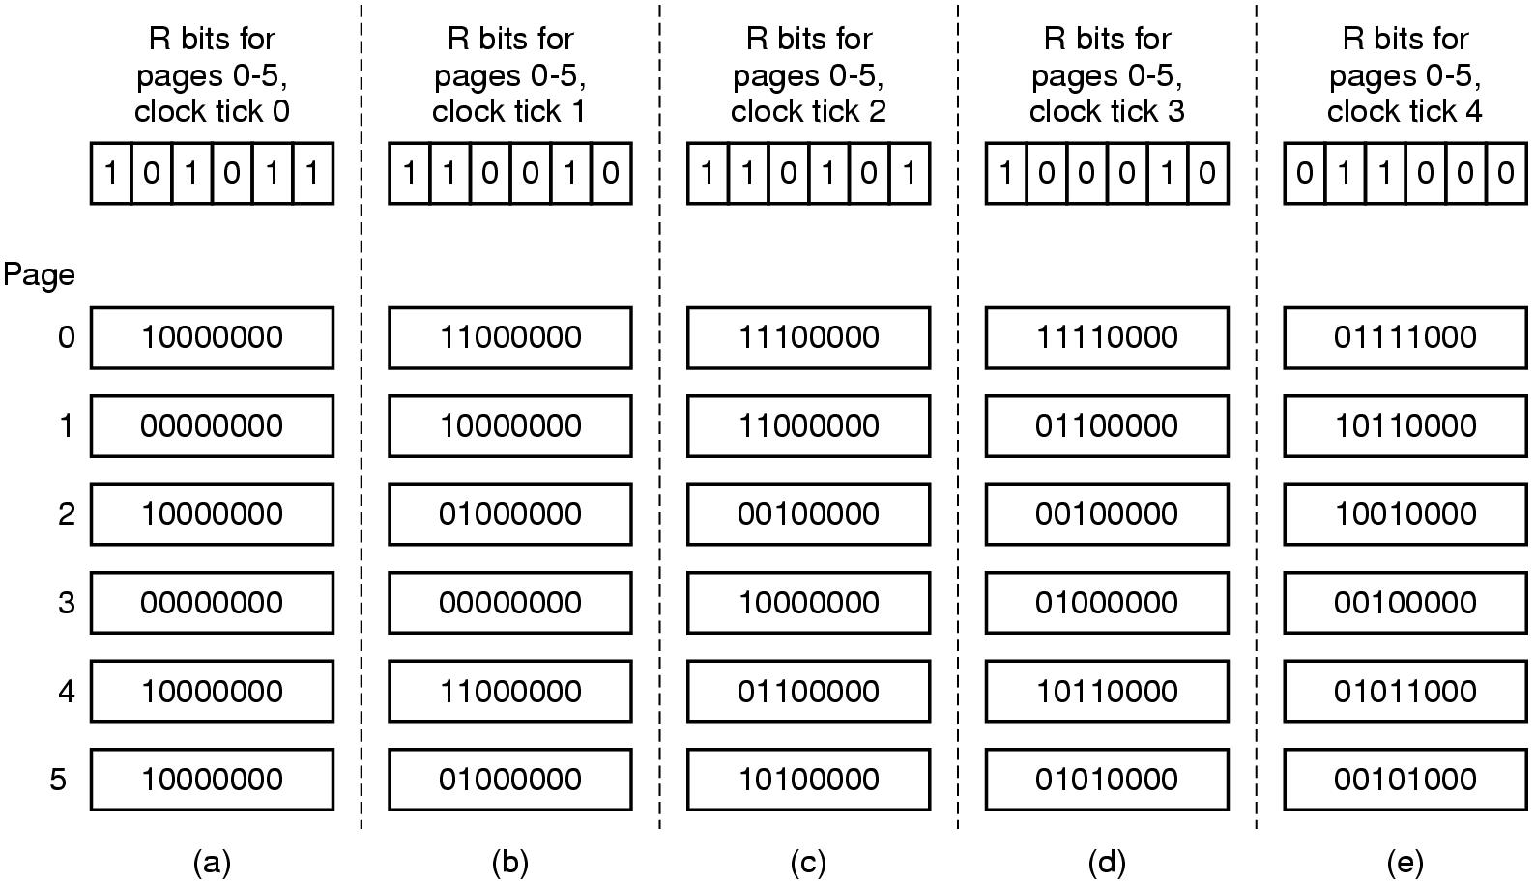
Simulating LRU in Software (Aging Shifts)

Slide 6
Caching Principles and Paging Performance

Slide 7
Fundamental Observation
Paging allows us to treat physical memory as a cache of virtual memory
Therefore, all of the principles and issues of caches apply to paging
… especially paging performance

Slide 8
Definition — Cache
A small subset of active items held in small, fast storage while most of the items remain in much larger, slower storage
Includes mechanisms for
Recognizing what items are in the cache and for accessing them quickly
Bringing things into cache and throwing them out again

Slide 9
Paging — Two Examples of Caches
Paged Virtual Memory
Very large, mostly stored on (slow) disk
Small working set in (fast) RAM during execution
Page Table(s)
Multiple levels of tables in practice
Very large, mostly stored in (slow) RAM
Small working set translations memoized in (fast) TLB registers

Slide 10
Caching is Ubiquitous in Computing
Transaction processing
Keep records of today’s departures in RAM or local storage while records of future flights are on remote database
Program execution
Keep the bytes near the current program counter in on-chip memory while rest of program is in RAM
File management
Keep disk maps of open files in RAM while retaining maps of all files on disk
Game design
Keep nearby environment in cache of each character
…

Slide 11
Caching issues
When to put something in the cache
What to throw out to create cache space for new items
How to keep cached item and stored item in sync after one or the other is updated
How to keep multiple caches in sync across processors or machines
Size of cache needed to be effective
Size of cache items for efficiency
…

Slide 12
General Observation on Caching
We create caches because
There is not enough fast memory to hold everything we need
Memory that is large enough is too slow
Performance metric for all caches is EAT
Effective Access Time
Goal: make overall performance approach cache memory performance
By taking advantage of locality — temporal and spatial
By burying a small number of accesses to slow memory under many, many accesses to fast memory

Slide 13
Definition – Effective Access Time (EAT)
The average access time to memory items, where some items are cached in fast storage and other items are not cached…
…weighted by p, the fault rate
0 ≤ p < 1
EAT = (1-p) * (cache access time) + p * (non-cache access time)

Slide 14
Goal of Caching
To take advantage of locality to achieve nearly the same performance of the fast memory when most data is in slow memory
Select size of cache and size of cache items so that p is low enough to meet acceptable performance goal
Usually requires simulation of a suite of benchmarks

Slide 15
Application to Demand Paging
Page Fault Rate (p)
0 < p < 1.0 (measured in average number of faults / reference)
Page Fault Overhead
= fault service time + read page time + restart process time
Fault service time ~ 0.1–10 μsec
Restart process time ~ 0.1–10–100 μsec
Read page time ~ 8-20 milliseconds!
Dominated by time to read page in from disk!

Slide 16
Demand Paging Performance (continued)
Effective Access Time (EAT)
= (1-p) * (memory access time) + p * (page fault overhead)
Want EAT to degrade no more than, say, 10% from true memory access time
i.e., EAT < (1 + 10%) * memory access time

Slide 17
Performance Example
Memory access time = 100 nanosec = 10⁻⁷
Page fault overhead = 25 millisec = 0.025
Page fault rate = 1/1000 = 10⁻³
EAT = (1-p) * 10⁻⁷ + p * (0.025)
= (0.999) * 10⁻⁷ + 10⁻³ * 0.025
≅ 25 microseconds per reference!
I.e.,
250 * memory access time!

Slide 18
Performance Goal
To achieve less than 10% degradation
(1-p) * 10⁻⁷ + p * (0.025) < 1.1 * 10⁻⁷
(isolate p below desired fast proportion) i.e.,
p < (0.1 * 10⁻⁷⁾ / (0.025 - 10⁻⁷)
≅ 0.0000004
I.e.,
1 fault in 2,500,000 accesses!

Slide 19
Working Set Size
Assume average swap time of 25 millisec.
For memory access time = 100 nanoseconds
Require < 1 page fault per 2,500,000 accesses
For memory access time = 1 microsecond
Require < 1 page fault per 250,000 accesses
For memory access time = 10 microseconds
Require < 1 page fault per 25,000 accesses

Slide 20
Object Lesson
Working sets must get larger in proportion to memory speed!
Disk speed ~ constant (nearly)
I.e., faster computers need larger physical memories to exploit the speed!
But now larger memory data structures and longer algorithm durations…

Slide 21
Practical Consideration
What is first thing to do when the PC you bought last year becomes too slow?
What else might help?
Can we do the same analysis on TLB performance?

Slide 22
TLB fault performance
Assumptions
m = memory access time = 100 nsec
t = TLB load time from memory = 300 nsec = 3 * m
Goal is < 5% penalty for TLB misses
I.e., EAT < 1.05 * m
How low does TLB fault rate need to be?

Slide 23
TLB fault performance
Assumptions
m = memory access time = 100 nsec
t = TLB load time from memory = 300 nsec = 3 * m
Goal is < 5% penalty for TLB misses
I.e., EAT < 1.05 * m
EAT = (1-p) * m + p * t < 1.05 *m ⇒
p < (0.05 * m) / (t – m)
= 0.05 * m / 2 * m
= 0.025
I.e., TLB fault rate should be < 1 per 40 accesses!

Slide 24
TLB fault performance (continued)
Q: How large should TLB be so that TLB faults are not onerous, in these circumstances?
A: Somewhat less than 40 entries
Assuming a reasonable degree of locality!

Slide 25
Summary of this Topic
A quantitative way of estimating how large the cache needs to be to avoid excessive thrashing, where
Cache = Working set in physical memory
Cache = TLB size in hardware
Applicable to all forms of caching

Slide 26
Review — Four Fundamental Abstractions
Processes and threads
This course
Virtual memory
This course
Files and persistent storage
CS 4513 with intro in this course
Sockets and connections
CS 3516 (Computer Networks)

Slide 27
Discussion Questions
Why is the eviction policy for pages important? Why don’t we do anything forward-looking to help us evict the right thing?
Is the Effective Access Time calculation sufficient for determining the appropriate sizes of different levels of the memory hierarchy? Why or why not?
Are the working set sizes and heuristics reasonable? How can we have such high hit rates?

Slide 28

The End is Near

