Slide 1
Administration
Project 4
Teammates
Checkpoint: Friday, Feb 23rd Final: Wednesday, Feb 28th
Grading on Project Based Learning
Quiz Average Curves and First Late Day Refunded
Functional & Clean Code For Remaining Project Points: Extra Credit Late-Features
Use OH to demonstrate full functionality, clean code, & late extra feature(s)
Correctly describe & demo late feature implementation
Email Chao (cwang17@wpi.edu) when fully presentable
Project 3: Aging LRU Bit Set & Right Shift Replacement Policy (Previous Class)
Project 2: 3rd simple sport with 10 threads (20 total for game), continuous simulation with Control-C handler for proper shutdown
Discussion Questions (+Project 3, Past Quizzes?)

Slide 2

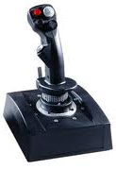
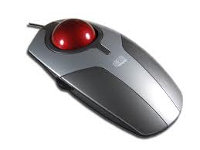
Input and Output

Slide 3
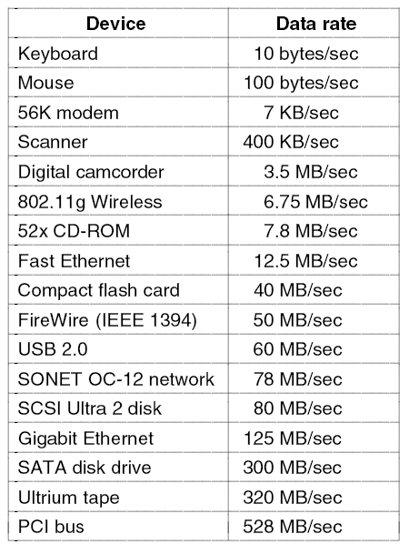
I/O Devices

Slide 4
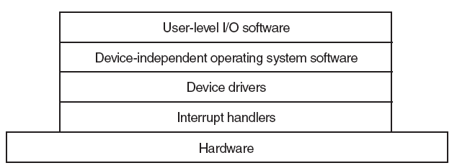
I/O Software Layers

Slide 5
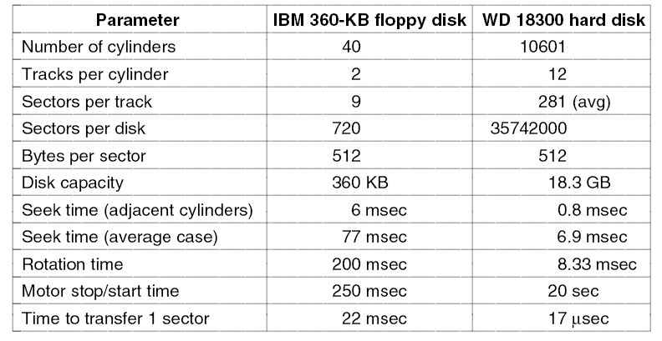
Magnetic Disks

Slide 6
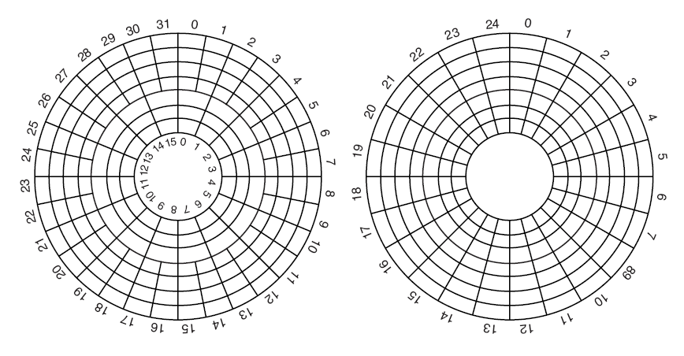
Magnetic Disks

Slide 7
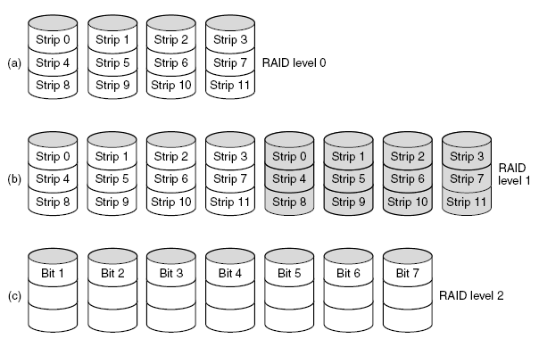
RAIDs and SLEDs
Striping
Mirroring
Bits with parity/error handling within each byte

Slide 8
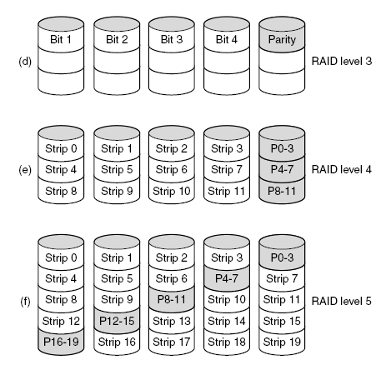
RAID (2)
Bits with parity handled separately
Strips, with parity on dedicated drive
Strips, with parity distributed across drives

Slide 9
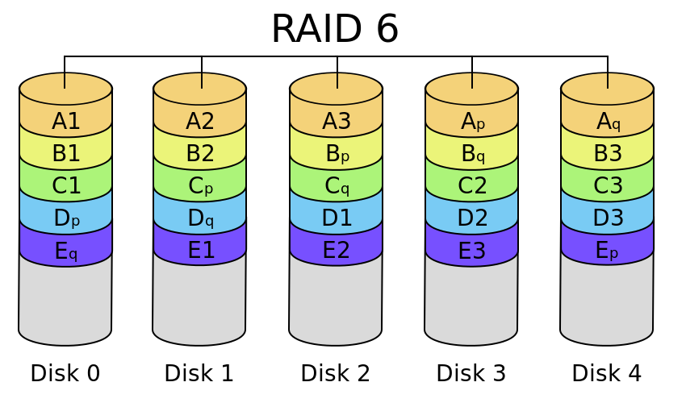
Our RAID goes up to 6…

Slide 10
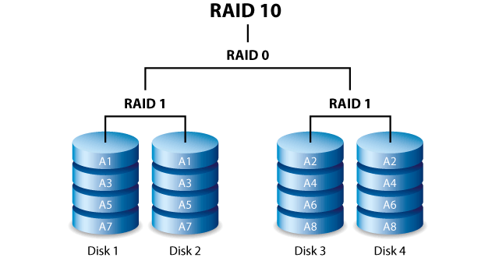
RAID 10? Is that like “Windows 10”?

Slide 11
Disk Arm Scheduling Algorithms
Read/write time factors
Seek time (the time to move the arm to the proper cylinder).
Rotational delay (the time for the proper sector to rotate under the head).
Actual data transfer time.

Slide 12
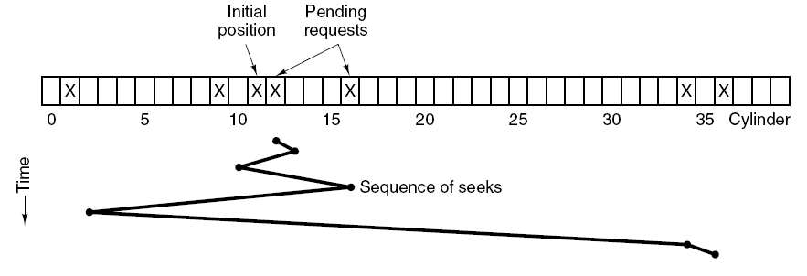
Disk Arm Scheduling Algorithms
Shortest Seek First (SSF)

Slide 13
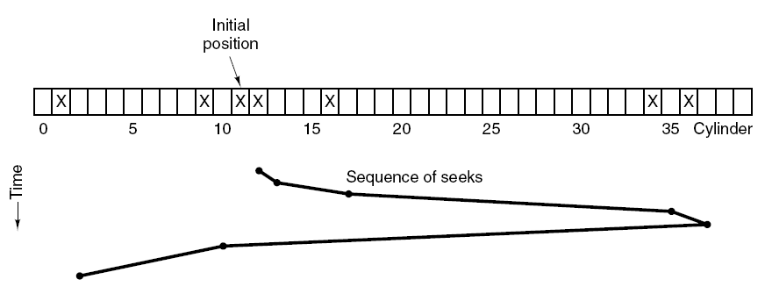
Disk Arm Scheduling Algorithms (3)
Elevator algorithm

Slide 14
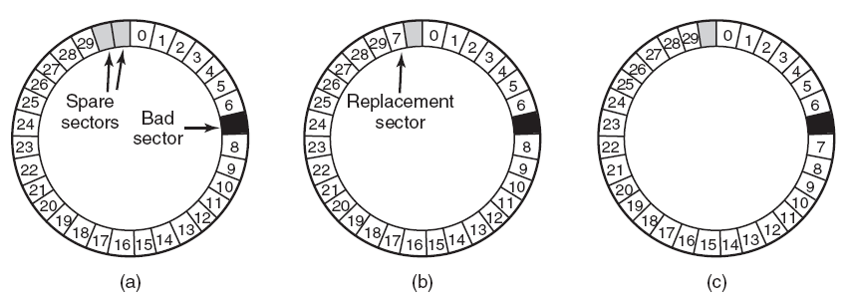
Error Handling

Slide 15
Controlling an I/O Device
A function of host CPU architecture
Two extremes:
Special instructions
Memory-mapped
Special I/O instructions
Opcode to stop, start, query, etc.
Separate I/O address space
Kernel mode only
Memory-mapped I/O control registers
Each register has a physical memory address
Writing to data register is output
Reading from data register is input
Writing to control register causes action
Can be mapped to kernel or user-level virtual memory

Slide 16
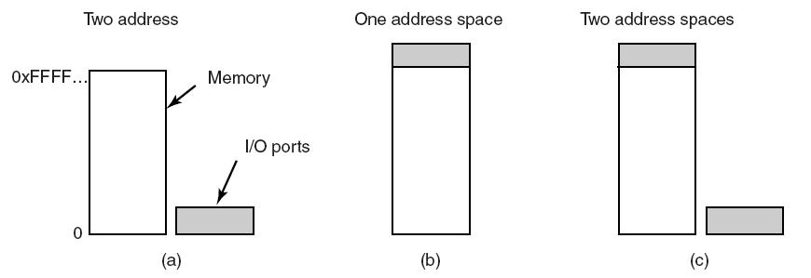
Memory-Mapped I/O (1)

Slide 17
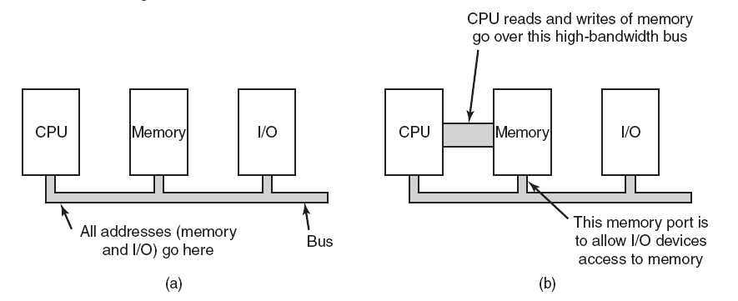
Memory-Mapped I/O (2)

Slide 18
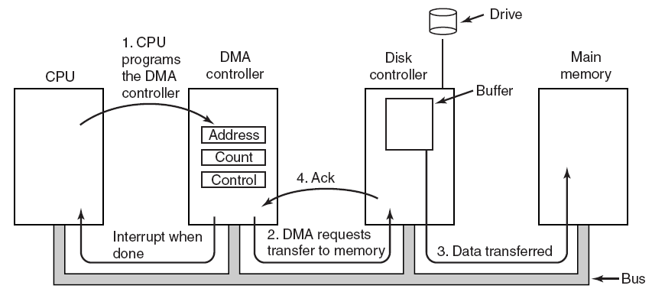
Direct Memory Access (DMA)

Slide 19
Three common ways of I/O
Programmed I/O
Interrupt-Driven I/O
I/O using DMA

Slide 20
Programmed I/O (Polling)
Used when device and controller are relatively quick to process an I/O operation
Device driver
Gains access to device
Initiates I/O operation
Loop testing (busy wait)
If there are more I/O operations, repeat
Used in following kinds of cases
Service interrupt time > Device response time
Device has no interrupt capability
Embedded systems where CPU has nothing else to do

Slide 21
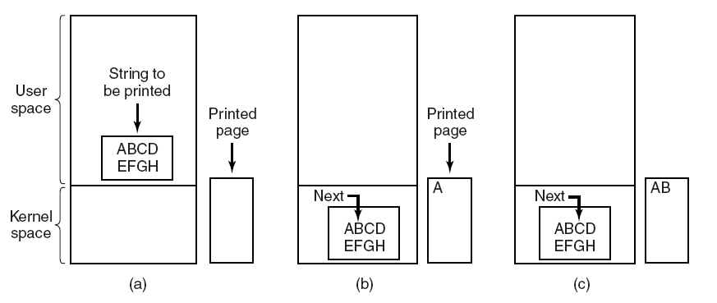
Programmed I/O

Slide 22
Programmed I/O Example — Bitmapped Keyboard & Mouse
Keyboard and mouse buttons implemented as 128-bit read-only register
One bit for each key and mouse button
0 = “up”; 1 = “down”
Mouse “wheels” implemented as pair of counters
One click per unit of motion in each of x and y directions
Clock interrupt every 10 msec
Aside: 120 WPM -> 12 keys/second -> 1 key every 83 msec
Practically the maximum human response rate
Reads keyboard register, compares to previous copy
Determines key and button transitions up or down
Decodes transition stream to form character and button sequence
Reads and compares mouse counters to form motion sequence

Slide 23
Other Programmed I/O examples
Check status of device
Read from disk or boot device at boot time
No OS present, hence no interrupt handlers
Needed for bootstrap loading of the inner portions of kernel
External sensors or controllers
Real-time control systems

Slide 24
Interrupt-Driven I/O
Interrupts occur on I/O events
Operation completion
Error or change of status
Interrupt
Stops CPU from continuing with current work
Saves some context
Restarts CPU with new address & stack
Set up by the interrupt vector
Target is the interrupt handler
ex. X86 Interrupt Descriptor Table (IDT)
Processor participates in every byte transferred!

Slide 25
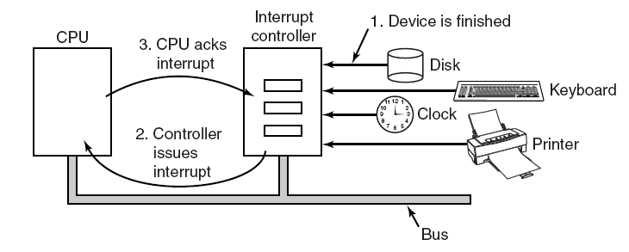
Interrupts Revisited

Slide 26
Precise and Imprecise Interrupts
Properties of a precise interrupt
PC (Program Counter) is saved in a known place.
All instructions before the one pointed to by the PC have fully executed.
No instruction beyond the one pointed to by the PC has been executed.
Execution state of the instruction pointed to by the PC is known.

Slide 27
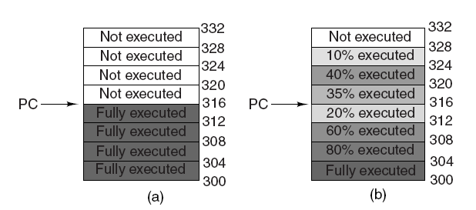
Precise and Imprecise Interrupts

Slide 28
Interrupt Handlers
Save registers not already been saved by interrupt hardware.
Set up a context for the interrupt service procedure.
Set up a stack for the interrupt service procedure.
Acknowledge the interrupt controller. If there is no centralized interrupt controller, re-enable interrupts.
Copy the registers from where they were saved to the process table.

Slide 29
Interrupt Handlers
Run the interrupt service procedure.
Choose which process to run next.
Set up the MMU context for the process to run next.
Load the new process’ registers, including its PSW.
Start running the new process.

Slide 30
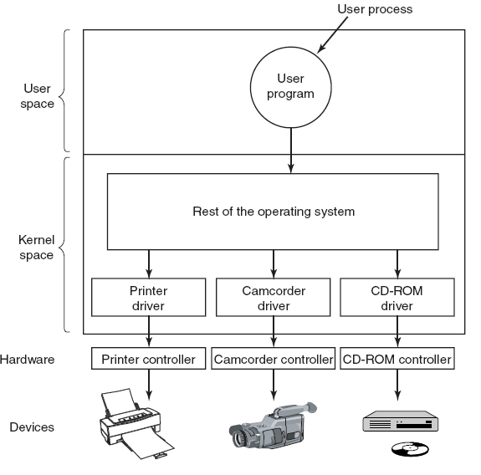
Device Drivers
Logical positioning of device drivers.
In reality all communication between drivers and device controllers goes over the bus.

Slide 31
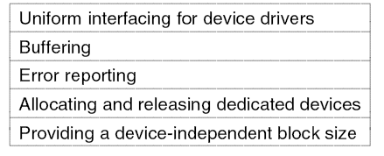
Device-Independent I/O Software
Functions of the device-independent I/O software.

Slide 32
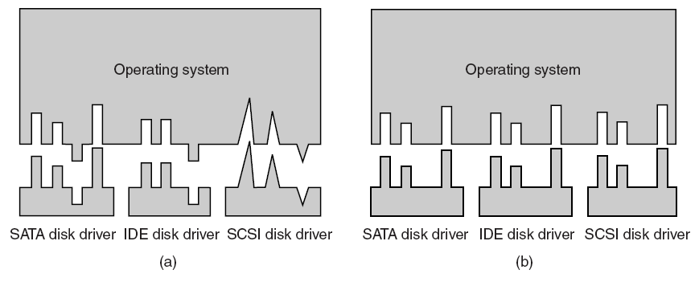
Uniform Interfacing for Device Drivers

Slide 33
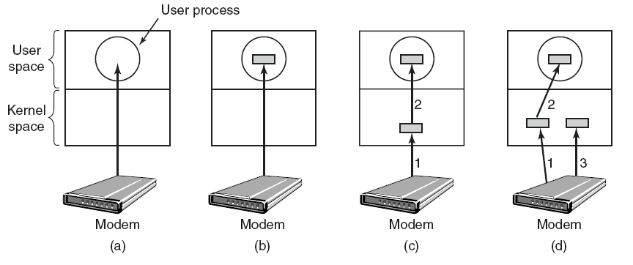
Buffering

Slide 34
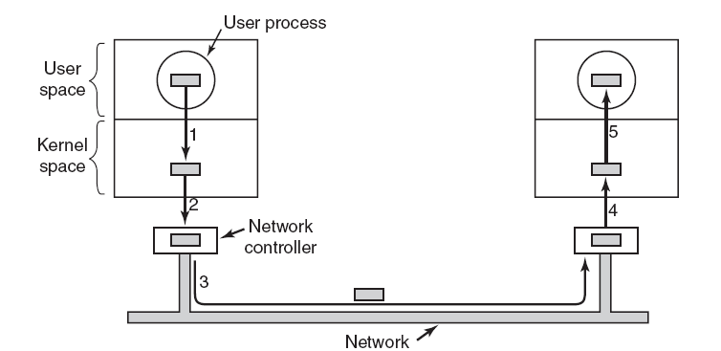
Buffering Gone Amok

Slide 35
Discussion Questions
The “I” in RAID can stand for “independent” or “inexpensive.” Does this distinction actually matter? What are the implications of these two terms?
Isn’t “Programmed I/O” the same thing as busy-waiting? If so, would it be acceptable when that wasn’t okay for our Project 2?
What percentage of device-drivers are designated as OS-independent? How can users tell which drivers are OS-dependent and which are OS-independent?

Slide 36

The End is Near

