Slide 1
Administration
Course Evaluations
Tuesday: Class as-a-whole, Instructor
Friday: TAs
Project 4
Checkpoint: Friday (Tonight)
Final Submission: Wednesday
Discussion Questions

Slide 2
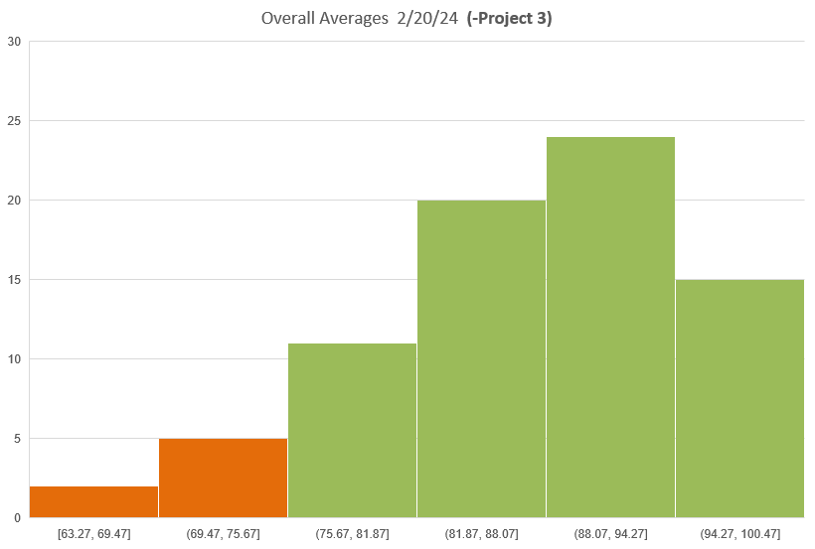
Class State

Slide 3
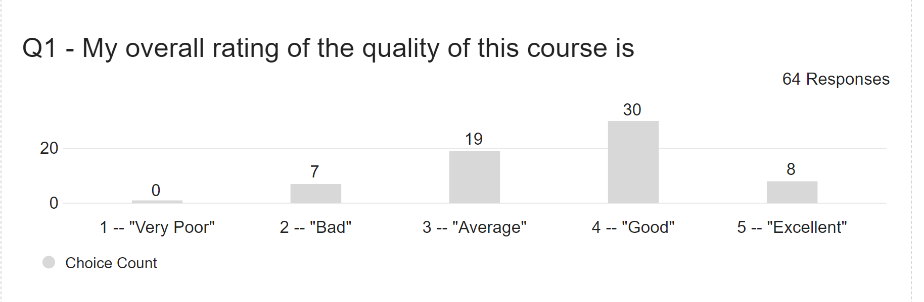
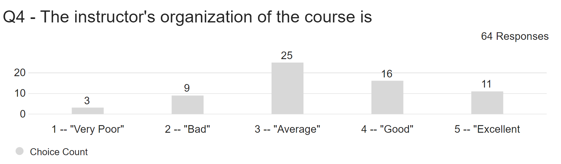
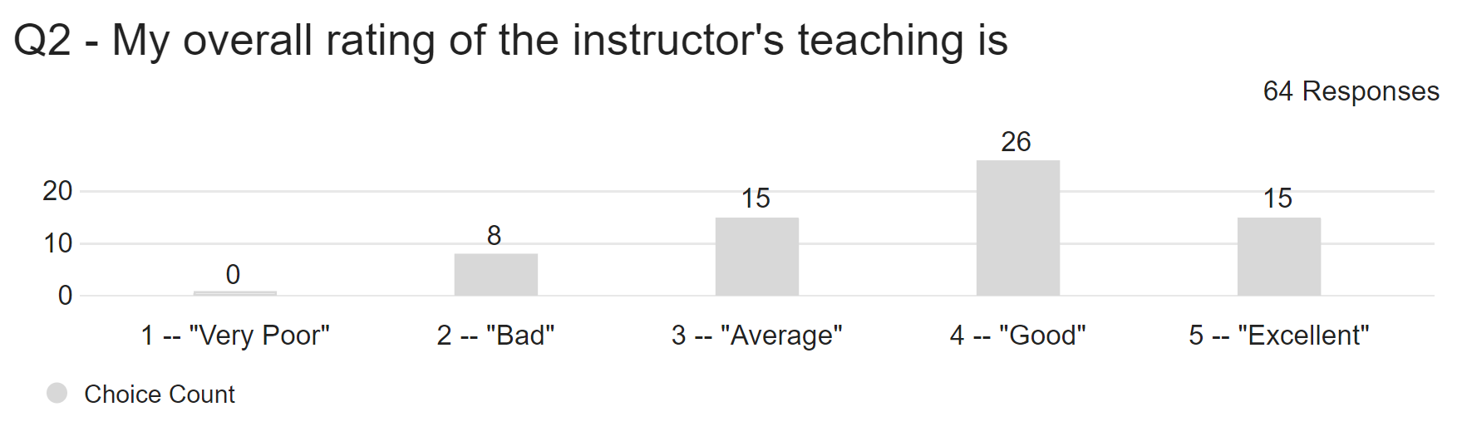
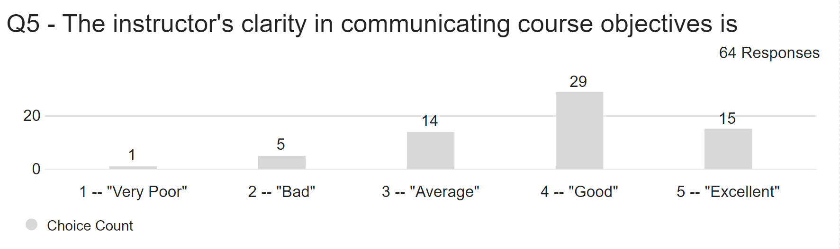
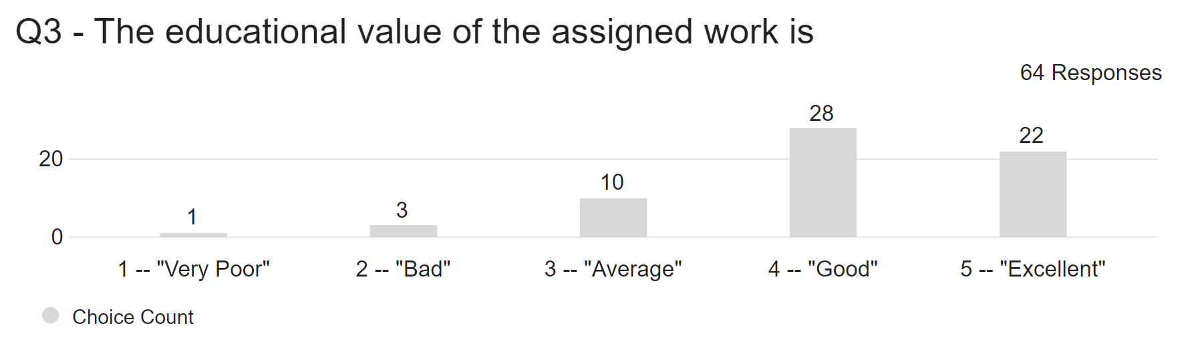
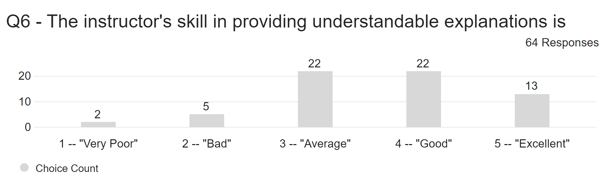
Class State

Slide 4
PollEV Review Questions!
PollEv.com/wpi3013c01

Slide 5
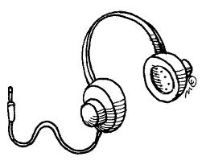
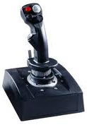
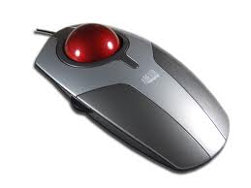
Input and Output

Slide 6
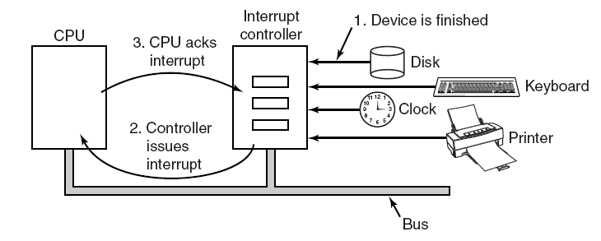
Interrupts Revisited

Slide 7
Precise and Imprecise Interrupts
Properties of a precise interrupt
PC (Program Counter) is saved in a known place.
All instructions before the one pointed to by the PC have fully executed.
No instruction beyond the one pointed to by the PC has been executed.
Execution state of the instruction pointed to by the PC is known.

Slide 8
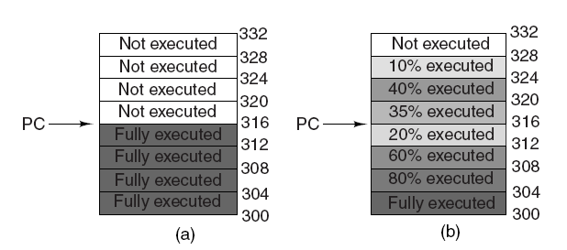
Precise and Imprecise Interrupts

Slide 9
Interrupt Handlers
Save registers not already been saved by interrupt hardware.
Set up a context for the interrupt service procedure.
Set up a stack for the interrupt service procedure.
Acknowledge the interrupt controller. If there is no centralized interrupt controller, reenable interrupts.
Copy the registers from where they were saved to the process table.

Slide 10
Interrupt Handlers
Run the interrupt service procedure.
Choose which process to run next.
Set up the MMU context for the process to run next.
Load the new process’ registers, including its PSW.
Start running the new process.

Slide 11
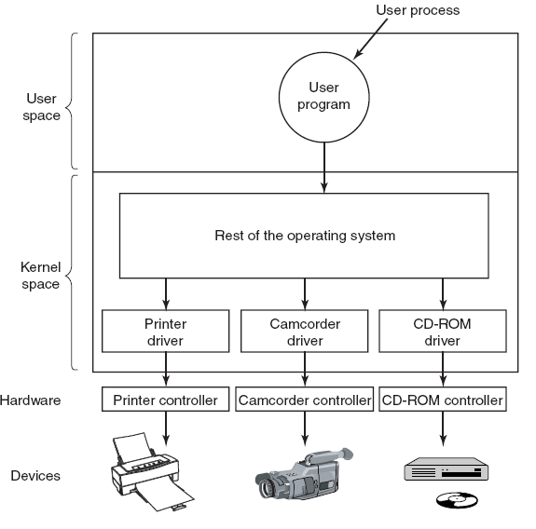
Device Drivers
Logical positioning of device drivers.
In reality all communication between drivers and device controllers goes over the bus.

Slide 12
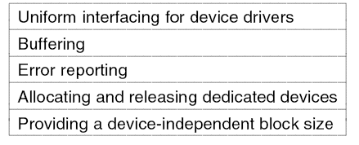
Device-Independent I/O Software
Functions of the device-independent I/O software.

Slide 13
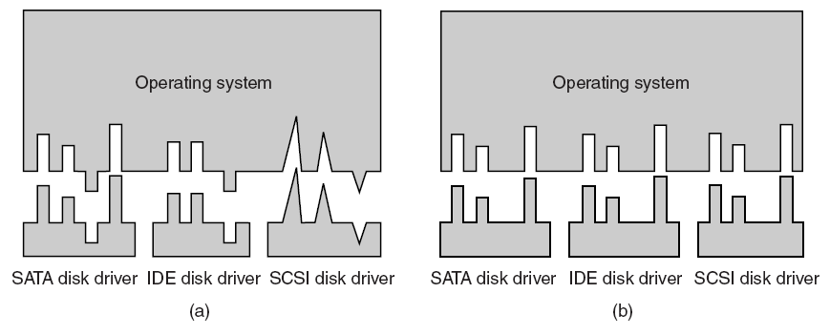
Uniform Interfacing for Device Drivers

Slide 14
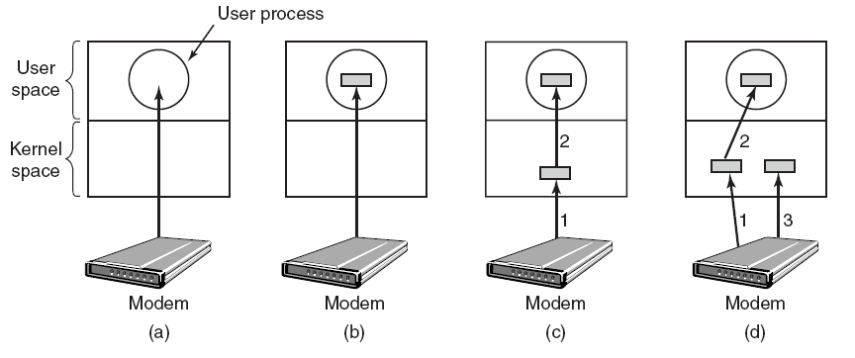
Buffering

Slide 15
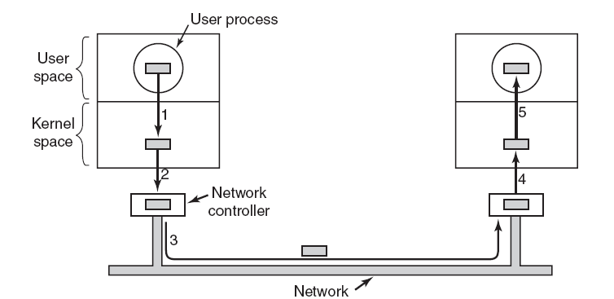
Buffering Gone Amok

Slide 16
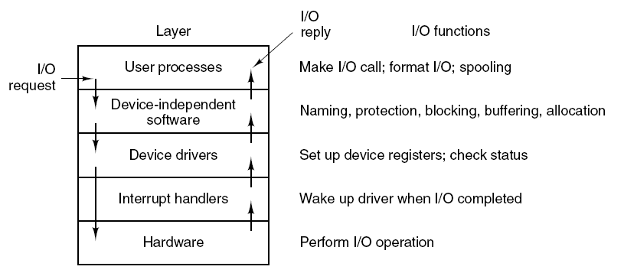
User-Space I/O Software

Slide 17
A Special kind of Device The Graphical User Interface
aka, the bitmapped display
In IBM language: “all points addressable”
300K pixels to 2M 33.2M pixels (8k TV)
Each pixel may be separated written
Collectively, they create
Windows
Graphics
Images
Videos
Games

Slide 18
GUI Device — early days
Bitmap in main memory
All output via library routines to bitmap
Entirely (or mostly) in user space
Controller, an automaton to do:–
D-A conversion (digital to analog video)
60+ Hz refresh rate
“clock” interrupt at top of each frame
CPU
Main Memory
Video
Bitmap
Digital to Analog

Slide 19
GUI Device — Displaying Text
Font: an array of bitmaps, one per character
Designed to be pleasing to eye
bitblt: (Bit-oriented Block Transfer)
An operation to copy a rectangular array of pixels from one bitmap to another
A
B
C
D
E
F
…
Bitmap
Dog
bitblt

Slide 20
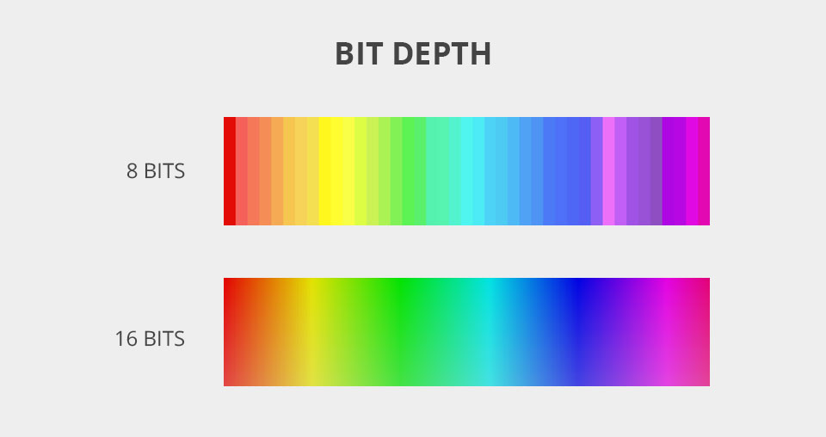
GUI Device – Color
Monochrome: one bit per pixel
foreground vs. background
Color: 2-32 bits per pixel
Direct vs. Color palette
Direct: (usually) 8 bits each per Red, Green, Blue
Palette: a table of length 2^{p}, for p-bit pixels
Each entry (usually) 8 bits each for RGB
8-bit-vs-16-bit-depth.jpg (960×508) (fixthephoto.com)

Slide 21
GUI Device – Cursor
A small bitmap to overlay main bitmap
Hardware support
Substitute cursor bits during each frame
Software implementation
Bitblt area under cursor to temporary bitmap
Bitblt cursor bitmap to main bitmap
Restore area under cursor from temporary bitmap
Very, very tricky!
Timing is critical for smooth appearance
Best with “double-buffered” main bitmap

Slide 22
GUI Device – Window
A virtual bitmap
size, position, clipping boundaries
font, foreground and background colors
A list of operations needed to redraw contents
Operations to window itself:
write(), refresh()
Called by application to add/change information
Called by window manager to redraw current contents

Slide 23
GUI Device — Text Window
Character terminal emulated in a window
RS-232 character set and controls
/dev/tty
Operates like a character terminal with visible, partially obscured, or completely covered

Slide 24
Modern GUI Devices
Main Memory
Level 2 cache
CPU
Bridge
AGP Port
Graphics card
Moni- tor
“Killer” Protocols (Big Business Value)
Legacy…
PCI bus
ISA bridge
IDE disk
Ether- net
SCSI
USB
ISA bus
Mouse
Key- board
Modem
Sound card
Printer

Slide 25
Modern GUI Devices (continued)
CPU
Bridge
Graphics card
Moni- tor
“Double-buffered” bitmap in Graphics card
Graphics and information written/drawn in back buffer
Monitor refreshes from main buffer (60+ Hz)
Refresh interrupt at start of every frame
Bitblt to substitute cursor
CPU writes text, etc.
Graphics processor (GPU) draws images, vectors, polygons
Window manager orders redraw when necessary

Slide 26
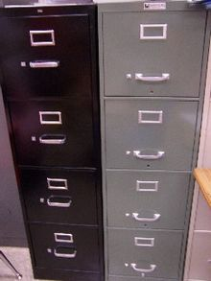
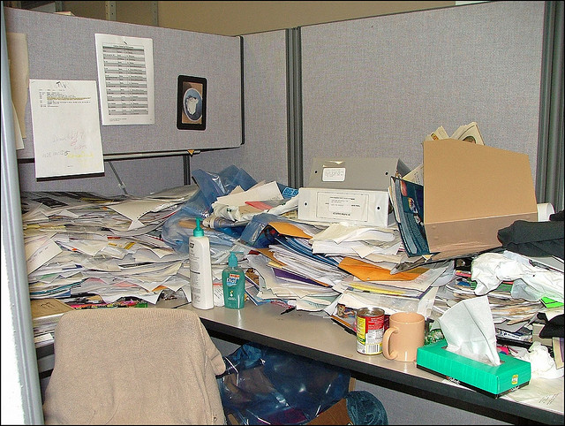
File Systems

Slide 27
File
The third major abstraction of almost all operating systems
An organizing abstraction
The way information is organized, stored, kept for a long time, and updated
Different views:
User perspective: a name, collection of data
System perspective: container of data blocks

Slide 28
Ambiguity: Container or Data?
Example: You e-mail a document to me
Do we have the same file?
Later, how can we ensure we are using the same version of the document?
Windows/Outlook/Exchange/MacOS:
Time-stamp is a pretty good indication that they are
Time-stamps preserved on copy, drag and drop, transmission via e-mail, etc.
Unix/Linux
By default, time-stamps not preserved on copy, ftp, e-mail, etc.
Time-stamp associated with container, not with information

Slide 29
Attributes of Files
Name:
Although the name is not always what you think it is!
Type:
May be encoded in the name (e.g., .cpp, .txt)
Dates:
Creation, updated, last accessed, etc.
(Usually) associated with container
Better if associated with content
Size:
Length in number of bytes; occasionally rounded up
Protection:
Owner, group, etc.
Authority to read, update, extend, etc.
Locks:
For managing concurrent access
…

Slide 30
Definition — File Metadata
Information about a file
Maintained by the file system
Separate from file itself
Usually attached or connected to the file
E.g., in block # –1
Some information visible to user/application
Dates, permissions, type, name, etc.
Some information primarily for OS
Location on disk, locks, cached attributes

Slide 31
Observation
Some attributes are not visible to user or program
E.g., location
Location is stored in metadata
Location can change, even if file does not
Location is not visible to user or program

Slide 32
Is Location a File Attribute?
Example 1:
mv ~tha/index.html ~tha/public_html/
Does location of file on disk change?
Example 2:
System moves file from disk block 10,000 to disk block 20,000 (e.g., during defragmentation)
System restores a file from backup
May or may not be reflected in metadata

Slide 33
File Name Attribute
Not attached to file in most modern systems
Stored in directory
Unix/Linux: file may have multiple names
Example: hard links
Windows: file normally has only one name
Still stored in directory
May be changed without touching the file!

Slide 34
Links
Symbolic (soft) links
Uni-directional relationship between a file name and the file
Directory entry with text of absolute or relative path for source
If the source file is deleted, the link exists but points to nowhere!
Hard links
Bi-directional relationship between file names and file
A hard link is directory entry that points to a source file’s metadata
Metadata maintains reference count of the number of hard links pointing to it – link reference count
Link reference count is decremented when a hard link is deleted
File data is deleted and space freed when the link reference count goes to zero

Slide 35
Unix-Linux Hard Links
File may have more than one name or path
rm, mv —directory operations, not file operations!
The real name of a Unix file is internal name of its metadata
Known only to OS!
Hard links are not used very often in modern Unix practice
Exception: Linked copies of large directory trees!
When building your Linux kernel in systems work
(Usually) safe to regard last element of path as name of file

Slide 36
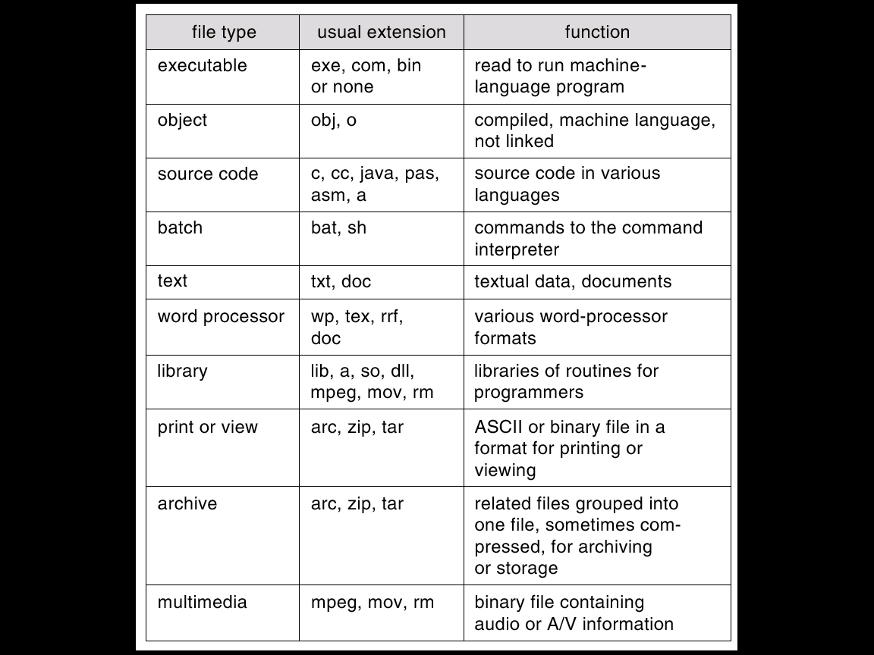
File Types
File type may be tattooed on file as an attribute
Or it may be embedded in file name by convention

Slide 37
Traditional Operations on Files
Open, Close
Read, Write, Truncate
Seek, Tell
Create, Delete

Slide 38
File – a very powerful Abstraction
Documents, code
Databases
Streams
Input, output, keyboard, display
Pipes, network connections, …
Virtual memory backing store
Temporary repositories of OS information
…
Any time you need to remember something beyond the life of a particular process/computation

Slide 39
Methods for Accessing Files
Sequential access
Random access
Keyed (or indexed) access
Hardly ever used (outside a DBMS) now

Slide 40
Sequential Access Method
Read all bytes or records in order from the beginning
Writing implicitly truncates
Cannot jump around
Could possibly rewind or back up for some media
Appropriate for certain media or systems
Magnetic tape or punched cards
Video tape (VHS, etc.)
Unix-Linux-Windows pipes
Network streams

Slide 41
Random Access Method
Bytes/records can be read in any order
Writing can
Replace existing bytes or records
Append to end of file
Cannot insert data between existing bytes!
Seek operation moves current file pointer
Maintained as part of “open” file information
Discarded on close
Typical of most modern information storage
Data base systems
Randomly accessible multi-media (CD, DVD, etc)
…

Slide 42
Keyed/Indexed Access Methods
Access items in file based on the contents of (part of) an item in the file
Provided in older commercial operating systems
IBM ISAM
(Usually) handled separately by modern database systems

Slide 43
Directory: A Special Kind of File
A tool for users and applications to organize and find files
User-friendly names
Names that are meaningful over long periods of time
The data structure for OS to locate files (i.e., containers) on disk

Slide 44
Directory structures
Single level
One directory per system, one entry pointing to each file
Small, single-user or single-use systems
(very, very old) PDAs, cell phones, etc.
Two-level
Single “master” directory per system
Each entry points to one single-level directory per user
Uncommon in modern operating systems
Hierarchical
Any directory entry may point to
Individual file
Another directory
Recursively friendly tree
Common in most modern operating systems

Slide 45
Directory Considerations
Efficiency: locate a file quickly
Naming: convenient to users
Overloading names across users
Separating names across users
Uniqueness only within a directory
User’s language
Grouping: logical grouping of files by properties
e.g., all Java programs, all games, …

Slide 46
Directory Hierarchies
Most systems support idea of current (working) directory
Absolute names – fully qualified from root of file system
/usr/group/foo.c, ~/kernelSrc/config.h
Relative names – specified with respect to working directory
foo.c, bar/bar2.h
Special entries
Essential for maintaining integrity of directory system
The working directory itself: . (period character)
Parent in hierarchy: .. (two period characters)
Convenience and abstraction
The current root of filesystem: / (forward slash)
The current user’s home directory: ~ (tilde character)

Slide 47
Directory Organization
Modified Hierarchical – Acyclic Graph (no loops) and General Graph
Allow directories and files to have multiple names
Links are file names (directory entries) that point to existing (source) files

Slide 48
Path Name Translation
Assume that I want to open “/home/tha/foo.c”
fd = open("/home/tha/foo.c", O_RDWR);
File System does the following
Opens directory "/" – the root directory is in a known place on disk
Search root directory for the directory home and get its location
Open home and search for the directory tha and get its location
Open tha and search for the file foo.c and get its location
Open the file foo.c
Note that the process needs the appropriate permissions at every step
…

Slide 49
Path Name Translation (continued)
…
File Systems spend a lot of time walking down directory paths
This is why open() calls are separate from other file operations
File System attempts to cache prefix lookups to speed up common searches –
“~” for user’s home directory
“.” for current working directory
Once open, file system caches the metadata of the file

Slide 50
Directory Operations
Create
Add, Delete entry
Find, List
Rename
Link, Unlink
Destroy

Slide 51
Directories – Solving Problems
Orphan: a file not named in any directory
Cannot be opened by any application (or even OS)
May be nameless ☹
Tools
fsck – check and repair file system, find orphans
chkdsk on Windows
Delete_on_close attribute (in metadata)
Temporary file

Slide 52
Summary
Fundamental mechanism for interpreting file names in an operating system
Widely used by system, applications, and users

Slide 53
Discussion Questions
What role could a graphics card play if we continued to use CPU-generated bitmaps? What do we do instead?
Are directories just an organizational namespace for users or do they do more? Does it have to be that way?
How do you undelete a file in Linux?

Slide 54

The End is Near

