Slide 1
Administration
TA Course Evaluations
Discussion Questions
Wrap-up

Slide 2
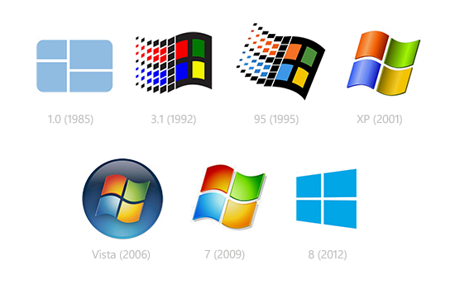


Kernel Mode in Windows
Microsoft Windows 1.0

Slide 3
Writing Kernel Code in Windows
Goal: Understand how Microsoft allows third-parties to write Windows kernel code
Understanding the build/test environment
Learn how debugging output works
Windows Driver Kit/Foundation
Our Favorite Friends: Synchronization primitives

Slide 4
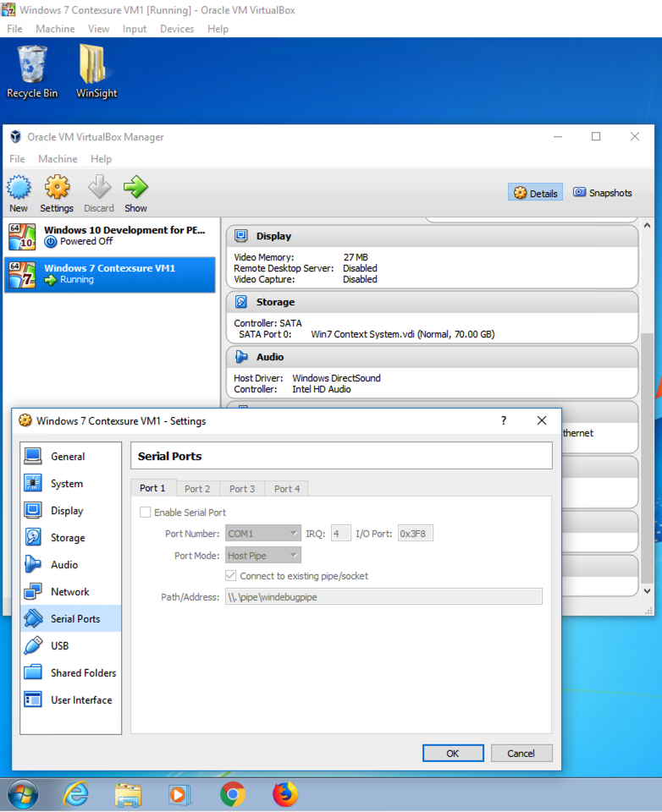
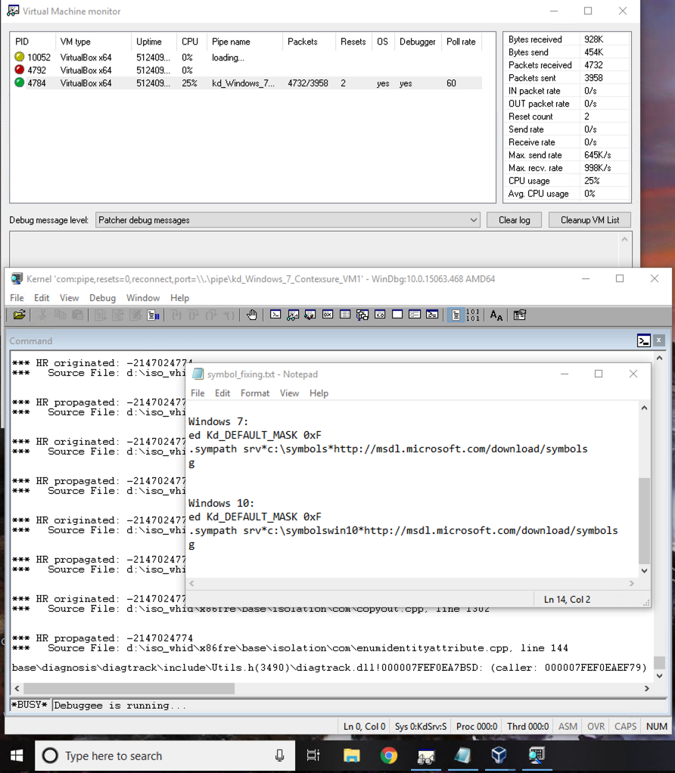
Preliminaries: VMs = Friends
Virtual Machine (dev), Windows 7
Host Computer, Windows 10

Slide 5
Preliminaries: VMs = Friends
VirtualBox VM (70GB)
Mount shared folder
VirtualKD Extension
Available at: http://virtualkd.sysprogs.org
Boasts “45x faster Windows kernel debugging with VMs”
Creates special serial port to host OS
Virtual Machine (dev), Windows 7

Slide 6
Preliminaries: VMs = Friends
VirtualKD WinDbgHost Monitor
Inspect each VM
Allows connection to debugger
Normal Windows debugger used for kernel messages
Changing mask allows DbgPrint messages to reach host console
Much like kprintf in Linux
Host Computer, Windows 10

Slide 7
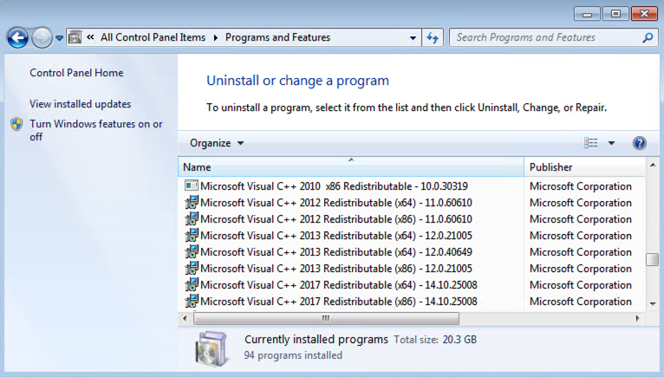
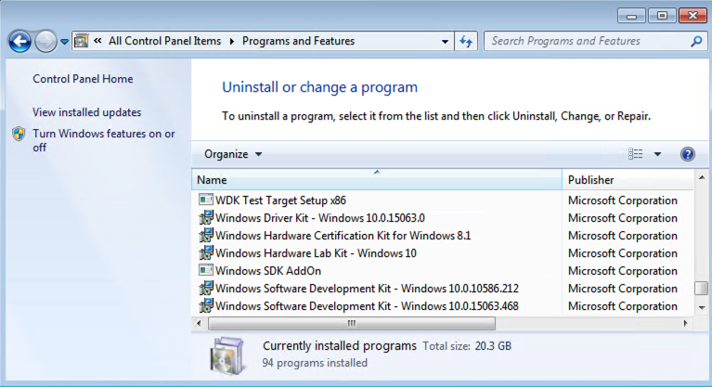
Preparing for Windows Kernel Development
Visual Studio 2015
Later versions lack legacy support
Software Development Kit (SDK) for Windows 10
Windows Driver Kit for Windows 10

Slide 8
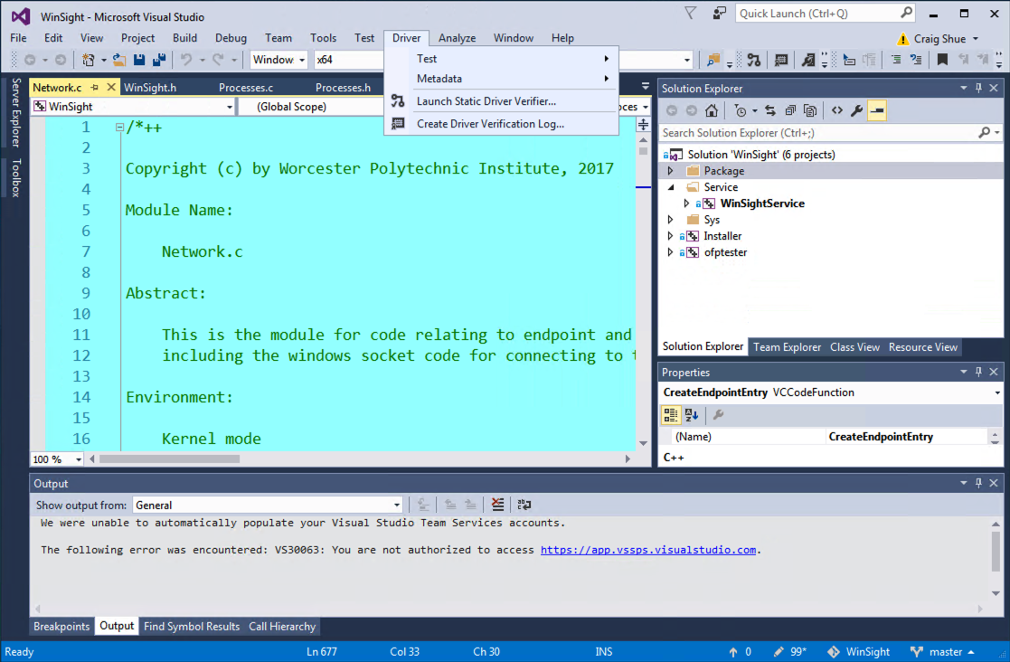
Visual Studio Build Environment
Driver menu in GUI indicates successful SDK, WDK installation

Slide 9
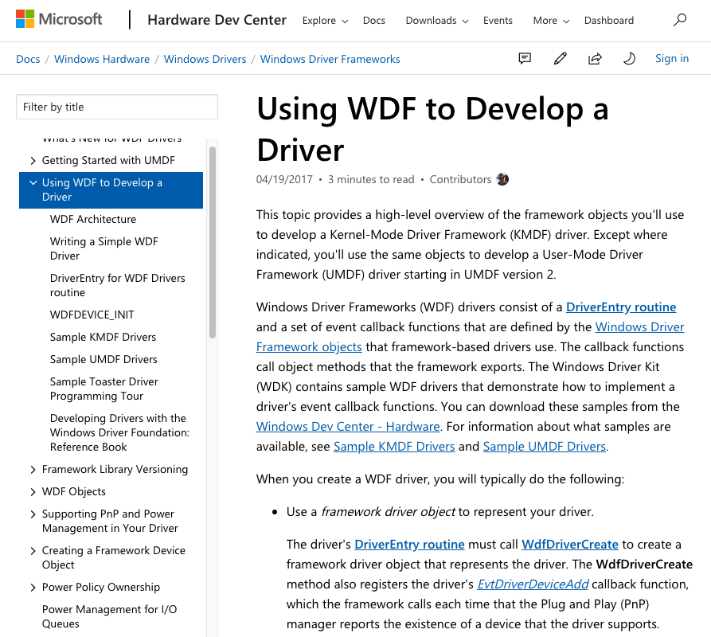
Windows Driver Kit and Framework
Windows Driver Kit
A toolset and API for communicating with the kernel
Windows Driver Framework
Tools and libraries for Windows 2000 and later
Kernel-Mode Driver Framework
User-Mode Driver Framework

Slide 10
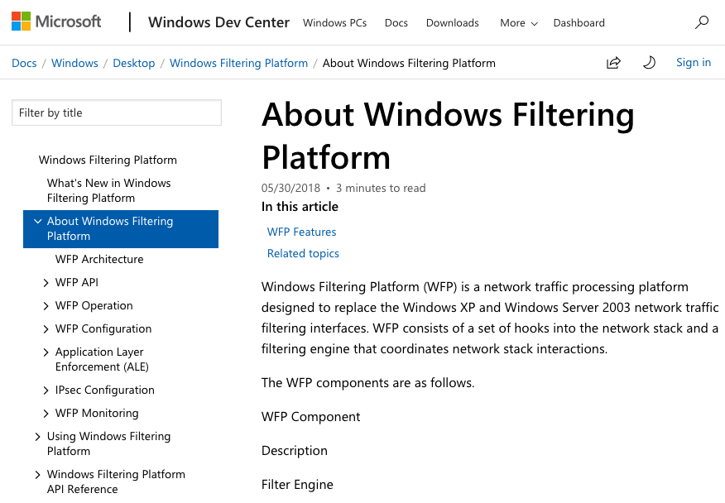
Case Study: Windows Filtering Platform
Allows third-party developers to write firewall software
Comes with sample code …

Slide 11
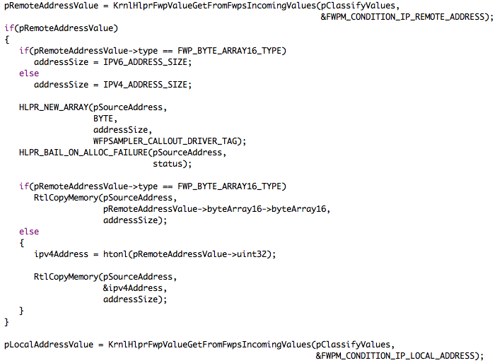
Sample Code
Windows Driver Samples
Posted on GitHub
Contains samples of audio, filesystem, network, and other drivers
Substantial use of own functions and sparse commenting
Function names are at least verbose

Slide 12
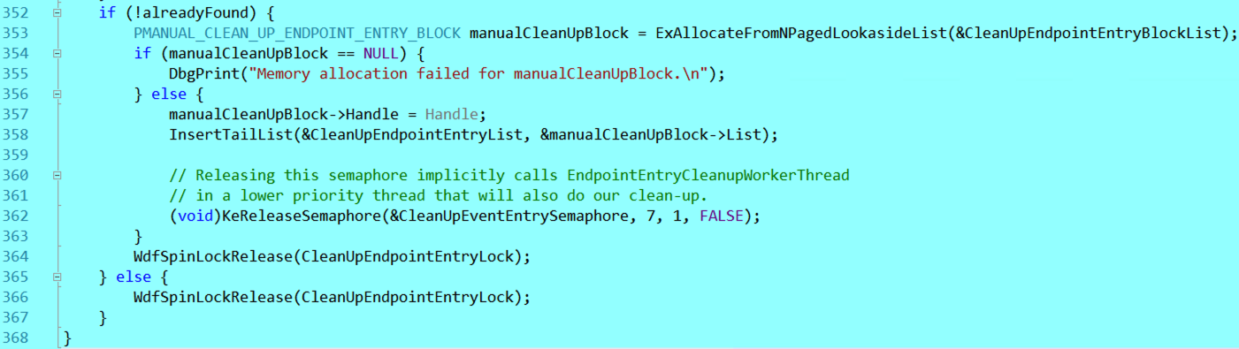
Debugging Printf-style
The DbgPrint function prints directly to the host debugger when code runs

Slide 13
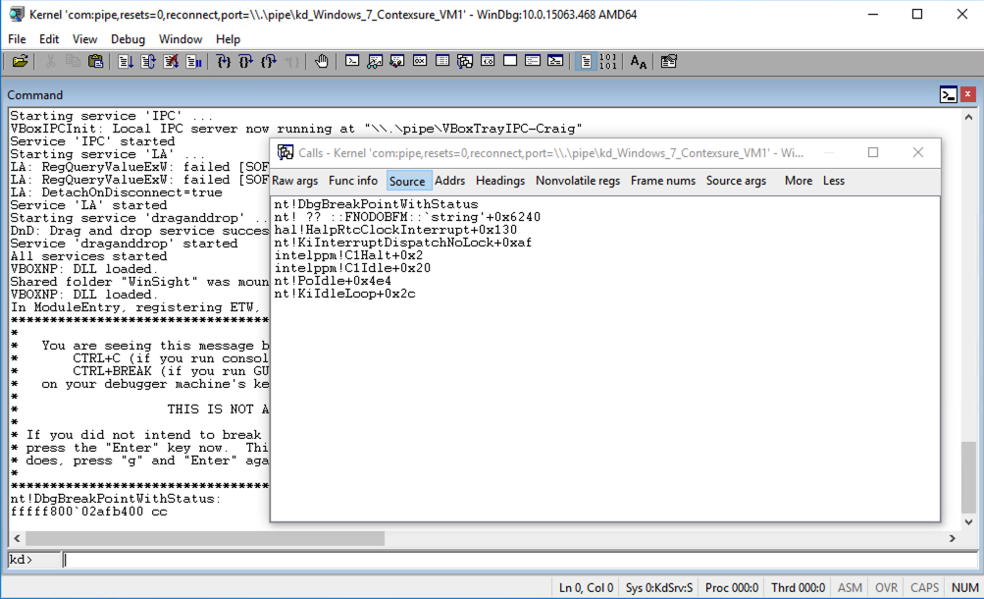
GDB/DDD-style Debugging
WinDbg allows manual breakpoints and review of call stack and memory
During breakpoint, VM is frozen

Slide 14


Memory Allocation
Allocating from a predetermined list: ExAllocateFromNPagedLookasideList
Allocating Malloc-style
Freeing Memory

Slide 15
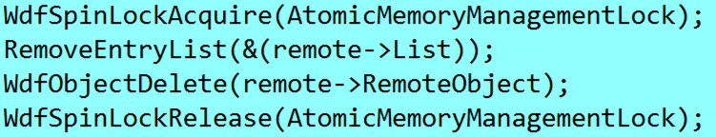
Spinlocks for Mutual Exclusion

Slide 16
Phenomenal Power’s Drawbacks
Interrupt Request Levels (IRQLs)
Normal code at PASSIVE level
Page faults at APC level
Thread scheduler at DISPATCH level
Impact of grabbing a spinlock?
IRQL set to DISPATCH
Page faults?
☹
IRQL | X86 IRQL Value | Description
PASSIVE_LEVEL | 0 | User threads and most kernel-mode operations
APC_LEVEL | 1 | Asynchronous procedure calls and page faults
DISPATCH_LEVEL | 2 | Thread scheduler and deferred procedure calls (DPCs)
CMC_LEVEL | N/A | Correctable machine-check level (IA64 platforms only)
Device interrupt levels (DIRQL) | 3-26 | Device interrupts
PC_LEVEL | N/A | Performance counter (IA64 platforms only)
PROFILE_LEVEL | 27 | Profiling timer for releases earlier than Windows 2000
SYNCH_LEVEL | 27 | Synchronization of code and instruction streams across processors
CLOCK_LEVEL | N/A | Clock timer
CLOCK2_LEVEL | 28 | Clock timer for x86 hardware
IPI_LEVEL | 29 | Inter-processor interrupt for enforcing cache consistency
POWER_LEVEL | 30 | Power failure
HIGH_LEVEL | 31 | Machine checks and catastrophic errors; profiling timer for Windows XP and later releases

Slide 17
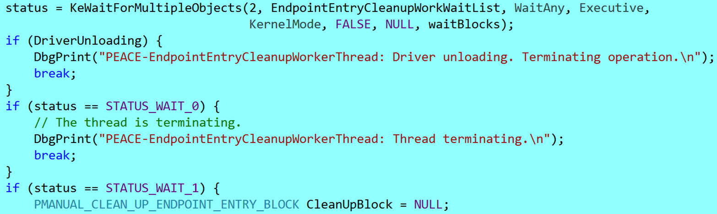
Attaining Strategic Unimportance
The clean-up thread:
The wait list:

Slide 18
Discussion Questions
In the Windows firewall example, how many network cards does the approach support? How can you tell?
Is Microsoft’s approach with drivers and documentation examples the only way to modify a closed-source kernel? How else could it be done?
What are the security implications of writing a driver in Windows?

Slide 19

The End is Near

Slide 20
Project 5: Windows Firewall
Implement a firewall in the Windows kernel using the Windows Filtering Platform
Drop all traffic not to 130.215.0.0/16
Print to log every time a packet is dropped
Due Thursday at 11:59pm
Last Demos: Friday at 4pm
… just kidding…

