Slide 1
Administration
Project 0: Due tonight!
Project 1 Posted:
Partner requests to sign up for team at end of assignment
Checkpoint: This Friday Jan. 19th 11:59pm (showing progress)
Due: Next Tuesday Jan. 23rd at 11:59pm (fully complete)
Forum:
See SCP post for downloading zip to submit from Browser VMs
Good exercise for working with remote machines
Office hours are being posted on IA/Syllabus
Timory: M 11-12pm, W 1-2:30pm in FL A22 Basement
Sapphire: R 10am-1pm in UH 446
Chao: TBD
Taylor: in office FL143:
M 1-3pm, W 11am-12pm & 4-5pm, R 2-5pm
Except Thus Feb 22nd (Academic Advising Day)

Slide 2
Project Questions?
Project 0
Project 1 Now Posted

Slide 3
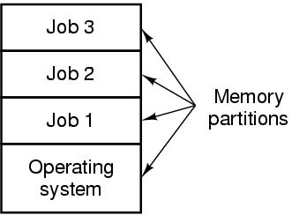
Multiprogramming

Slide 4
Activity – Multiprogramming
Actors:
Processor
Cache
Main Memory
Magnetic Disk
Job 1 Task
Job 2 Task

Slide 5
Activity – Multiprogramming
Job 1: compute, request disk I/O, compute, cache retrieval, compute, memory access, compute, disk I/O, terminate
Job 2: compute, cache retrieval, compute, disk I/O, compute, memory access, compute, terminate

Slide 6
The Read System Call
Implement the following user program in user code, a read library, and the kernel
int num_bytes;
char *buffer;
int file_descriptor;
read(file_descriptor, buffer,
num_bytes);

Slide 7
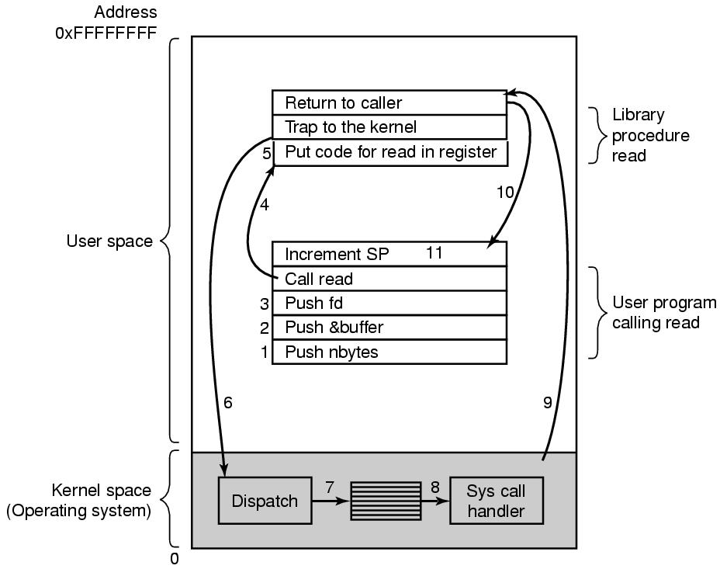
System Calls

Slide 8
Instructions
User Program
Hand to stack num_bytes, buffer, file_descriptor
Call read library
Read Library
Store the syscall value for “read” in a register
Trap to the Kernel
Kernel Dispatcher
Catch trap to kernel (“dispatcher”)
Read register value to understand which syscall it is
Kernel Syscall Handler (“Read”)
Run that syscall code
Return to the caller (switch back to user mode)
Read library
Return to caller
User Program
Increment stack pointer

Slide 9
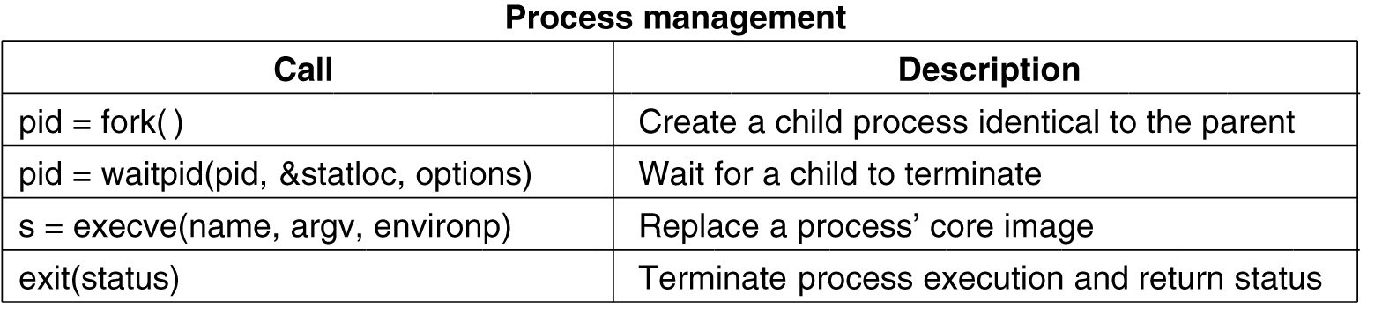
System Calls for Process Management

Slide 10

Parenting, Linux/Unix-Style
int child = fork();
I want to be just like you, parent process 5!
PID: 5
PID: 6

Slide 11
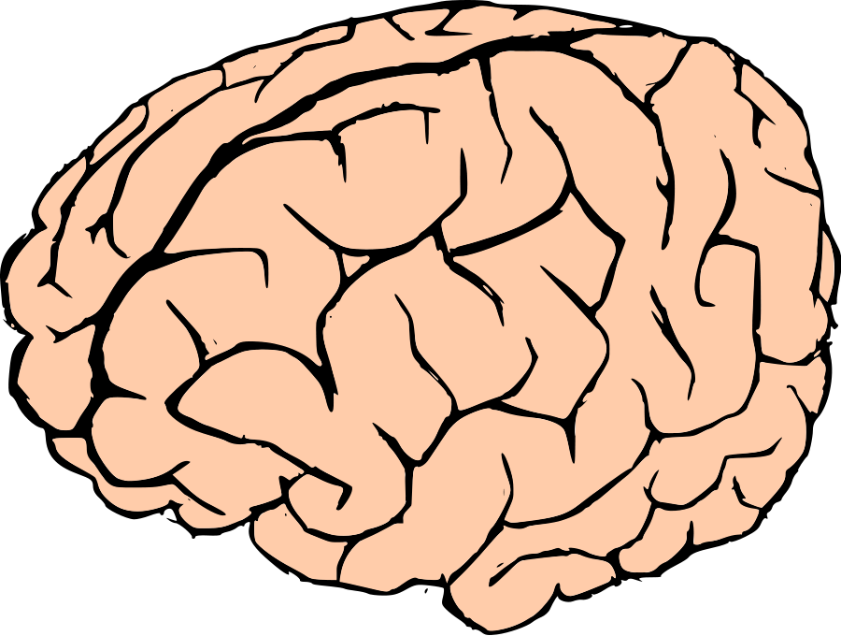
Parenting, Linux/Unix-Style (2)
No, you should be your own process!
PID: 5
exec()
Oh, okay….
if (child == 0) {
execvp(“/doit”, NULL);
}
/doit
PID: 6
PID: 6

Slide 12

Parenting, Linux/Unix-Style (3)
Every parent should outlive their children!
PID: 5
… lalala life …
x
x
Dead PID: 6
PID: 6

Slide 13
Parenting, Linux/Unix-Style (4)
Don’t worry, I’ll wait() on you!
PID: 5
status = wait();
x
x
Dead PID: 6

Slide 14
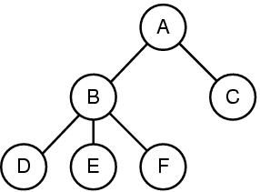
Processes: Time Sharing the CPU

Slide 15
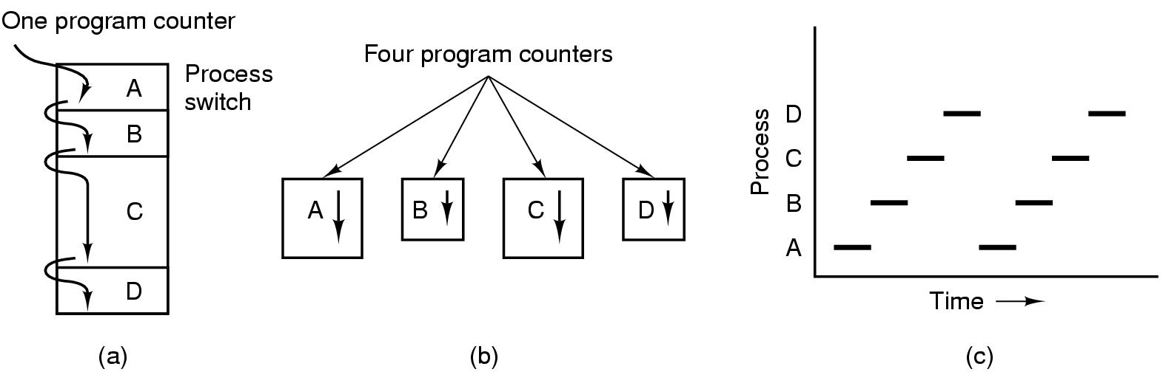
The Process Model
Context Switch

Slide 16
Process Creation
Events which cause process creation:
System initialization.
Execution of a process creation system call by a running process.
A user request to create a new process.
Initiation of a batch job.

Slide 17
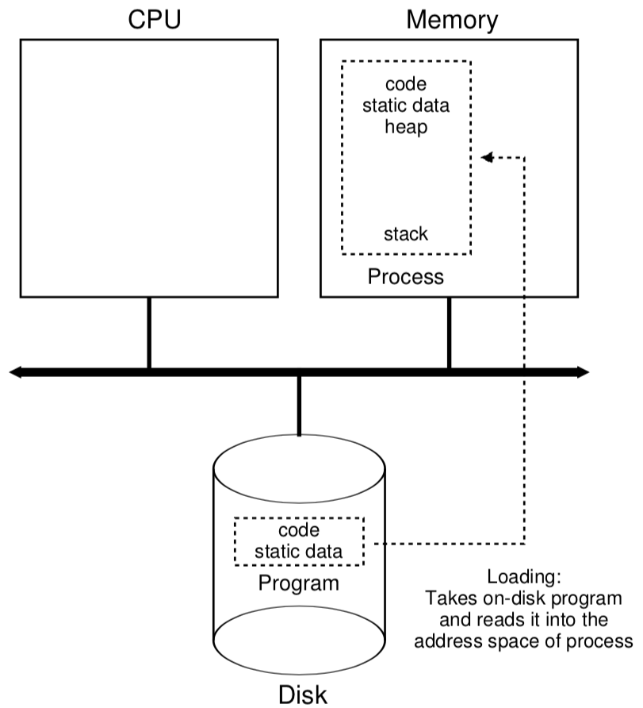
From Program to Process
Loading Process:
Eager?
Lazy?

Slide 18
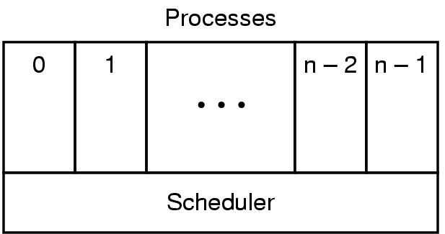
Implementation of Processes (1)
Figure 2-3. The lowest layer of a process-structured operating system handles interrupts and scheduling. Above that layer are sequential processes.

Slide 19
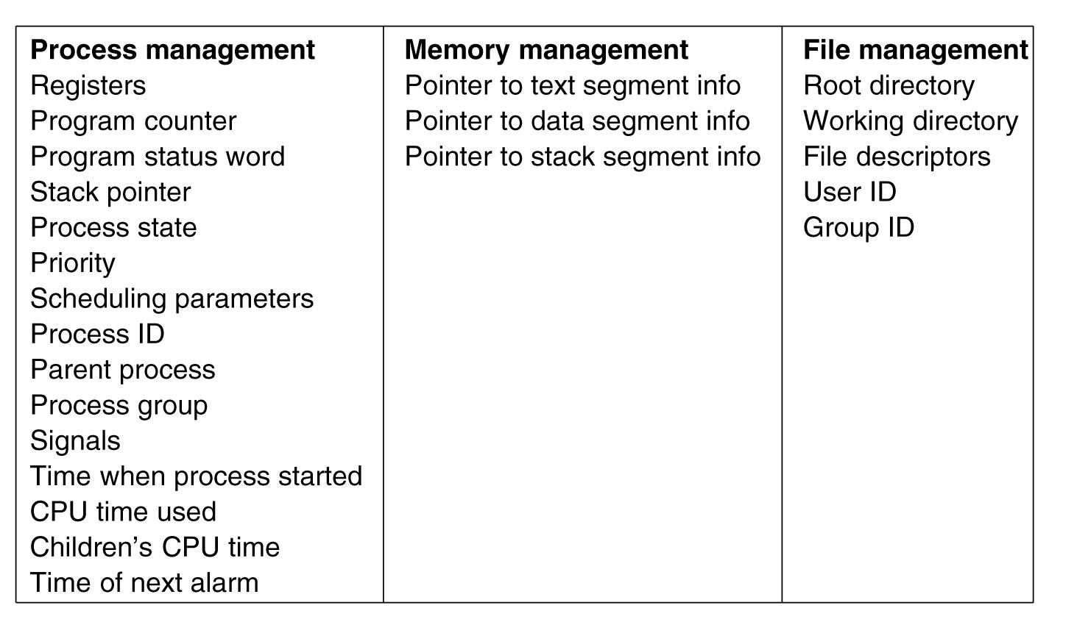
Implementation of Processes (2)

Slide 20
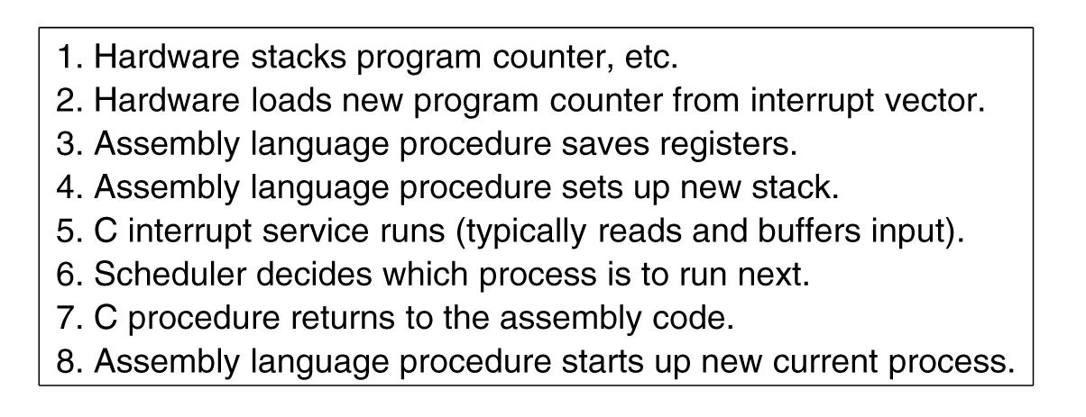
Implementation of Processes (3)
Interrupt processing

Slide 21
Process Termination
Events which cause process termination:
Normal exit (voluntary).
Error exit (voluntary).
Fatal error (involuntary).
Killed by another process (involuntary).

Slide 22
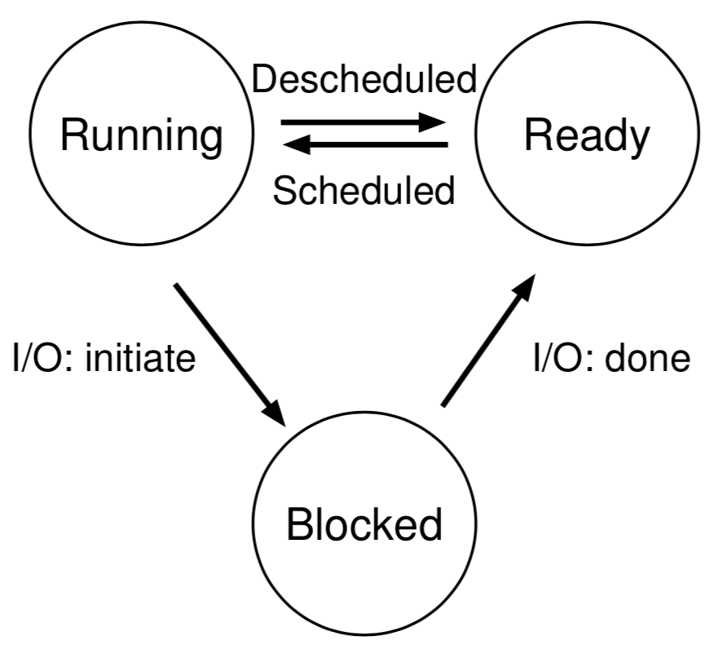
Process States

Slide 23
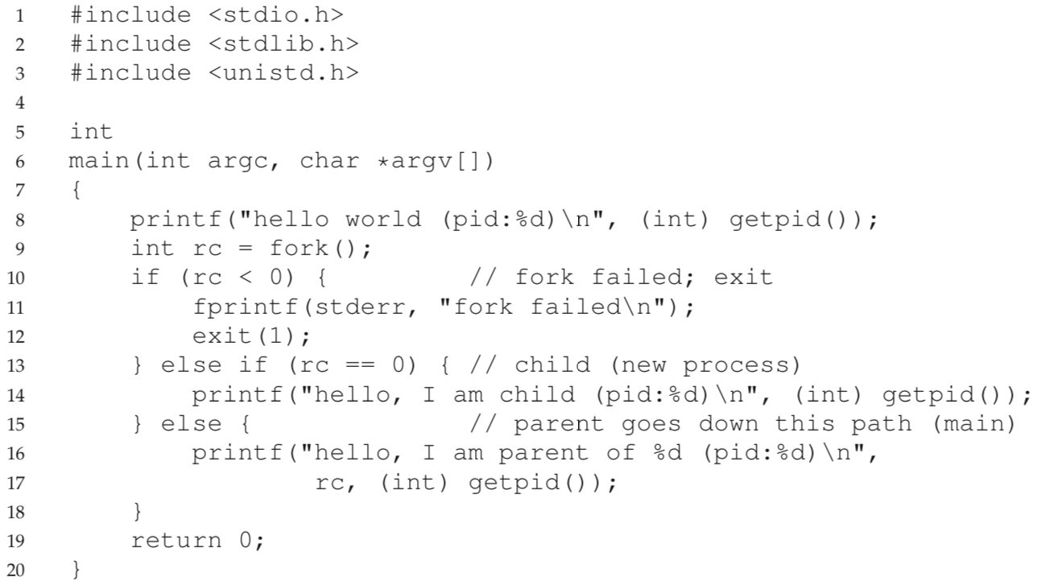
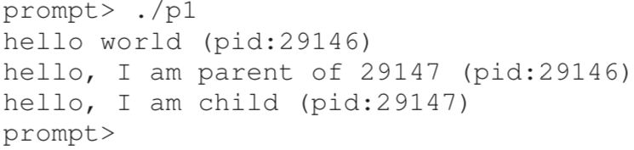
fork()

Slide 24
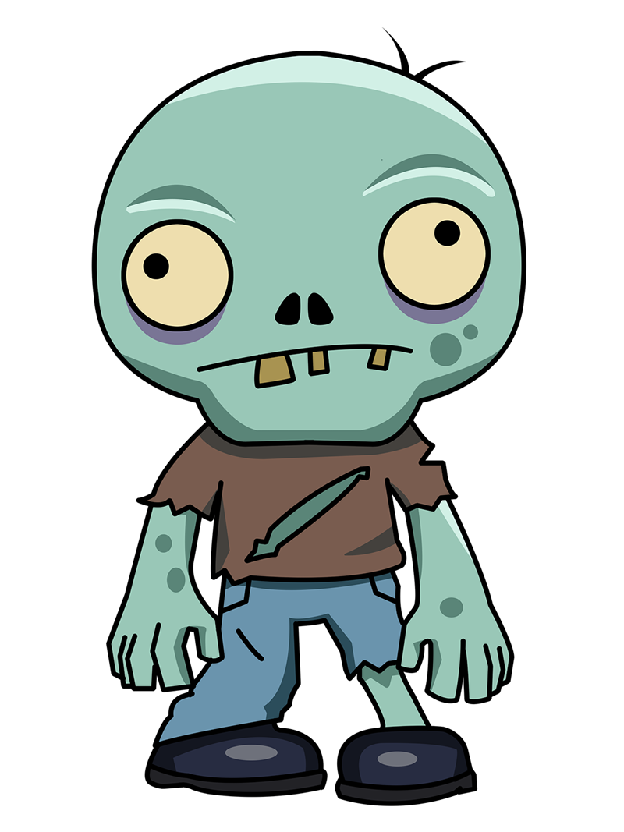
wait() and exec()
exec()
“You should have wait()’ed!”

Slide 25
System Calls for File Management

Slide 26
System Calls for File Management

Slide 27
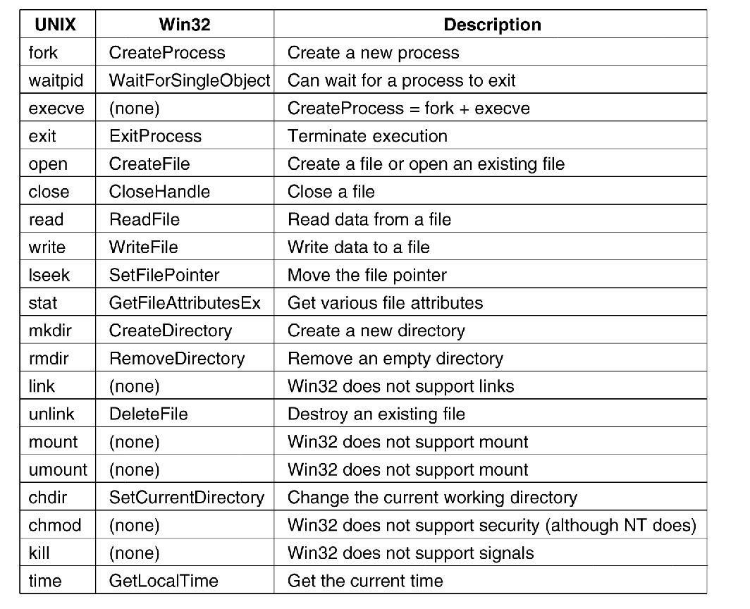
Windows Win32 API

Slide 28
Discussion Questions
Is the parent/child and the fork/wait model essential for an operating system?
How do process states and the notion of multiprogramming relate? What particular state is the secret to multiprogramming’s success?
What really is a process? What’s a program? How do they relate?

Slide 29

The End is Near

