Slide 1
Administration
Project 1:
Teammates (Teams Must Signup on IA)
Checkpoint today
Final submission: Next Tuesday
Office hours:
Record attendance (IA Tools -> Office Hours)
Points!
You can backdate appointments in past
Topics help direct lecture announcements & updates

Slide 2
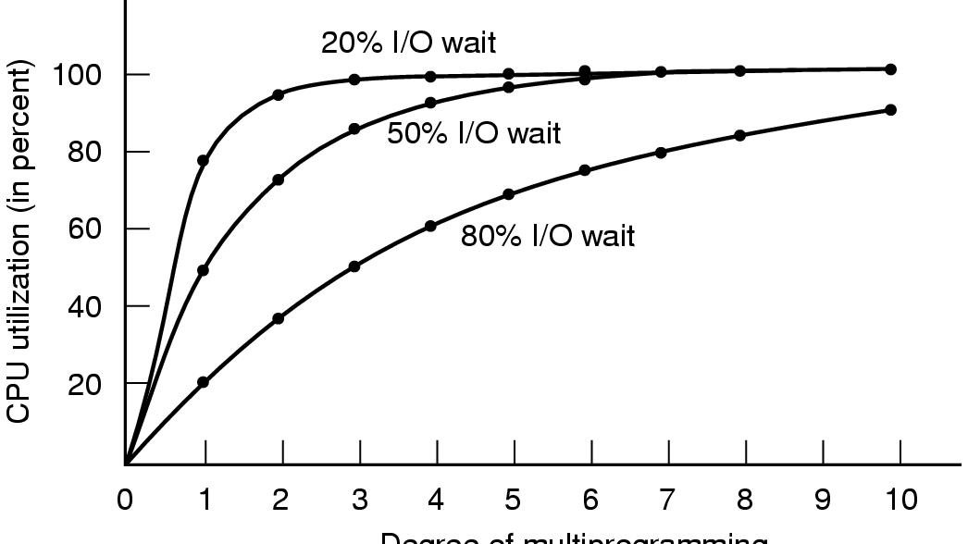
Modeling Multiprogramming
Degree of multiprogramming

Slide 3
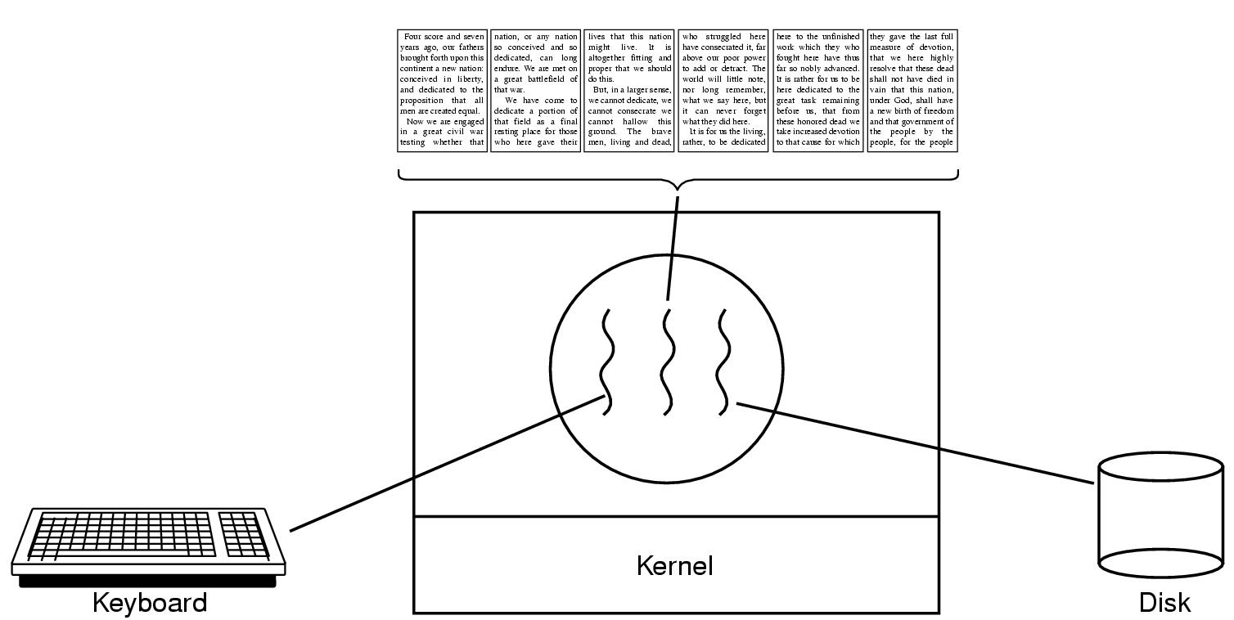
Thread Usage (1)
Figure 2-7. A word processor with three threads.

Slide 4
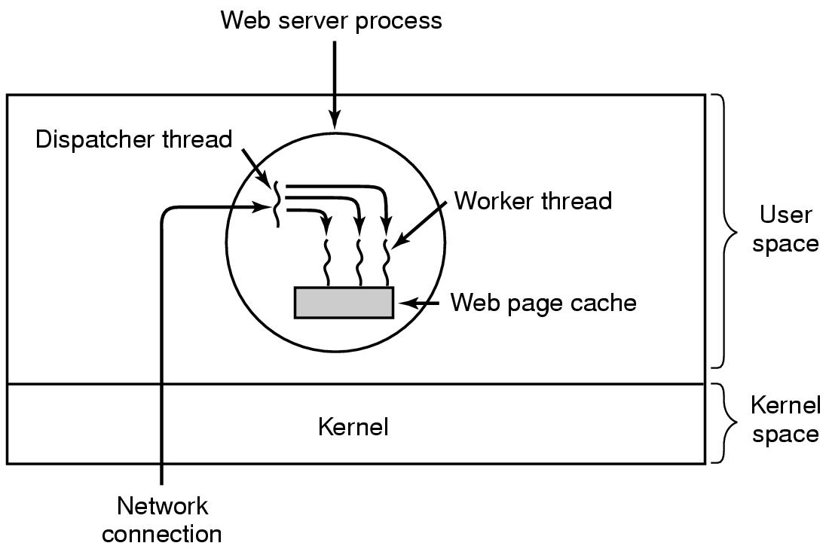
Thread Usage (2)
Figure 2-8. A multithreaded Web server.

Slide 5
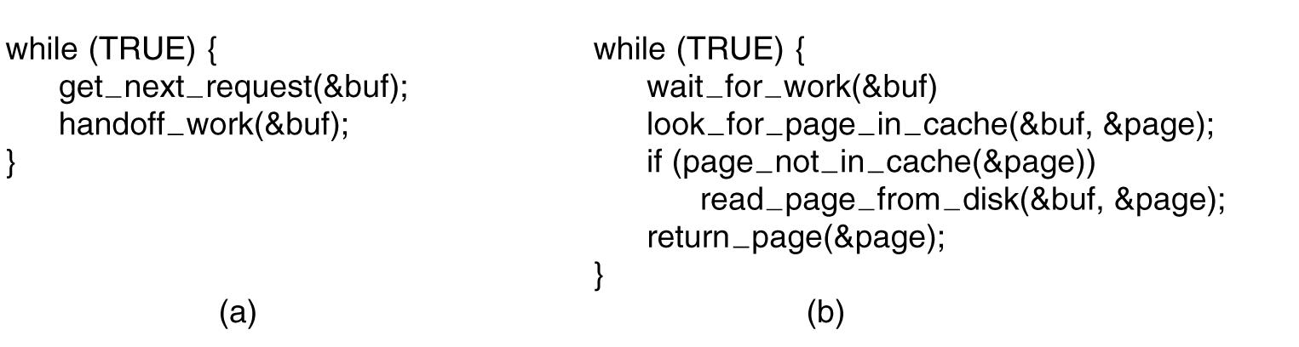
Thread Usage (3)
Figure 2-9. A rough outline of the code for Fig. 2-8. (a) Dispatcher thread. (b) Worker thread.

Slide 6
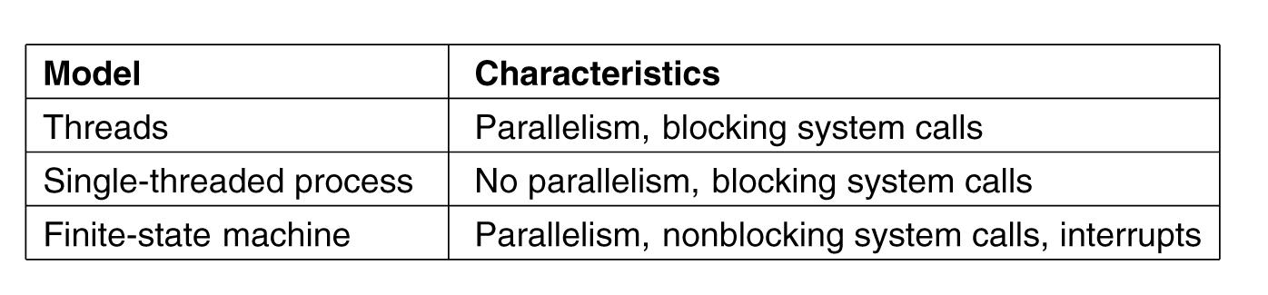
Thread Usage (4)
Figure 2-10. Three ways to construct a server.

Slide 7
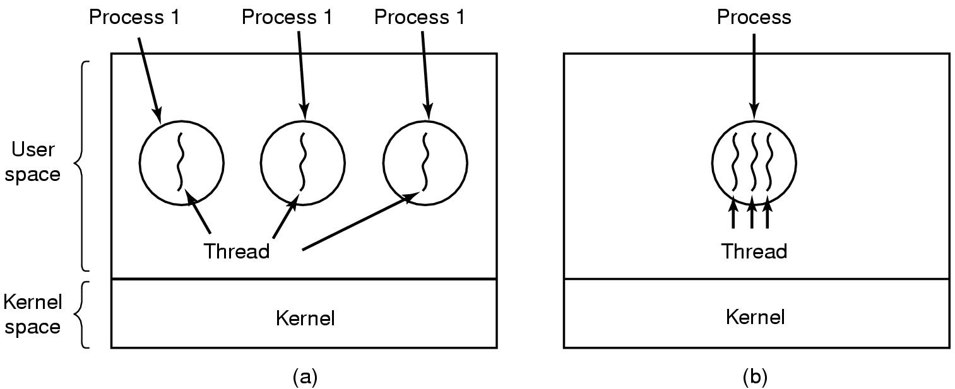
The Classical Thread Model (1)
Figure 2-11. (a) Three processes each with one thread. (b) One process with three threads.

Slide 8
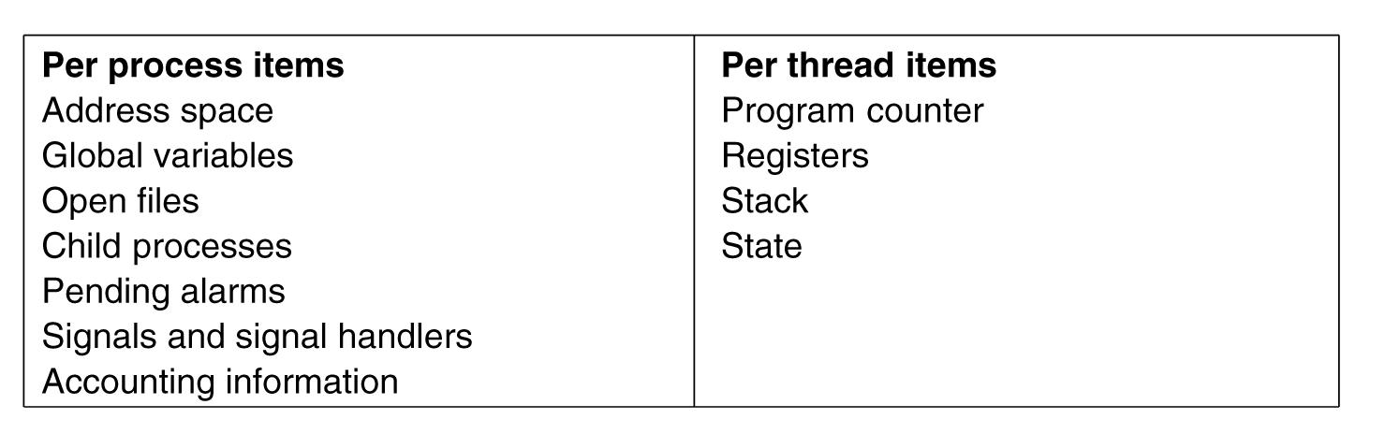
The Classical Thread Model (2)
Figure 2-12. The first column lists some items shared by all threads in a process. The second one lists some items private to each thread.

Slide 9
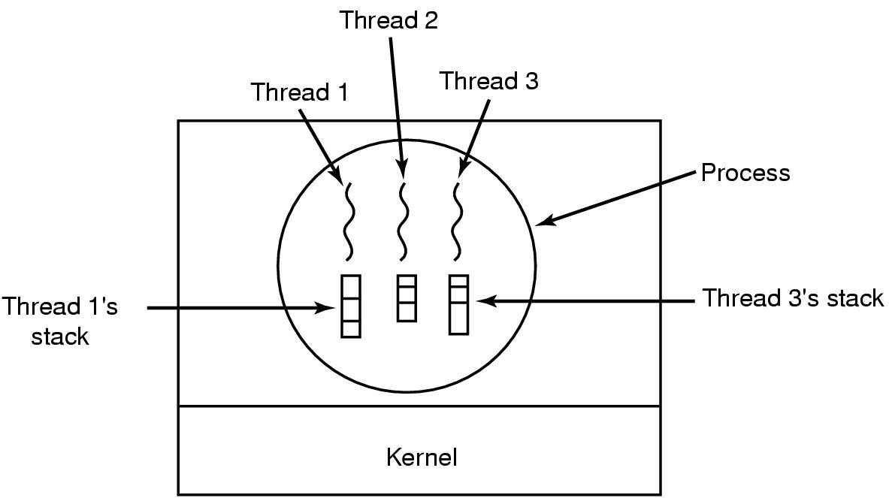
The Classical Thread Model (3)

Slide 10
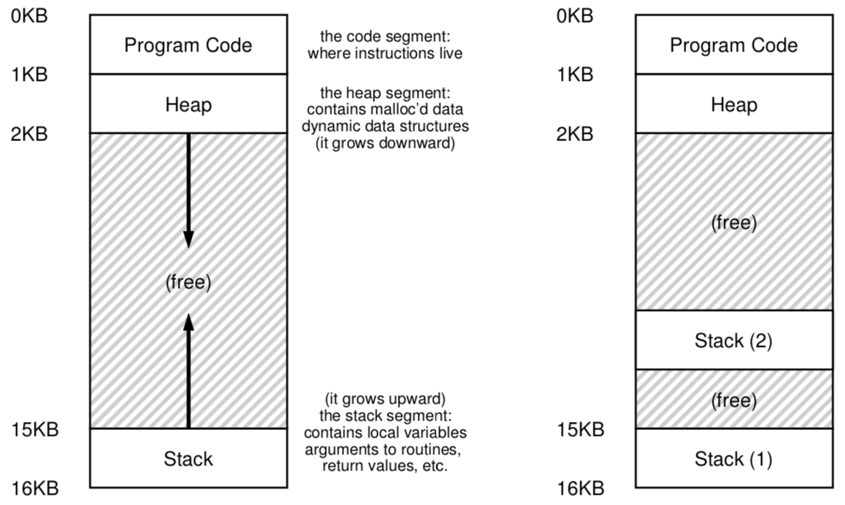
Single and Multi-threaded

Slide 11
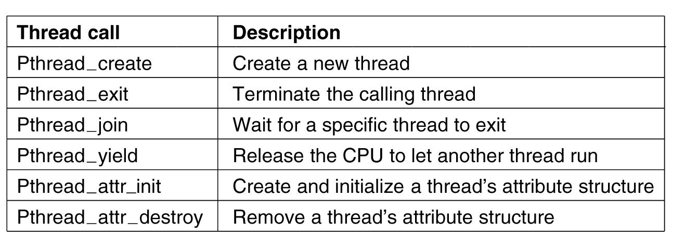
POSIX Threads (1)
Figure 2-14. Some of the Pthreads function calls.

Slide 12
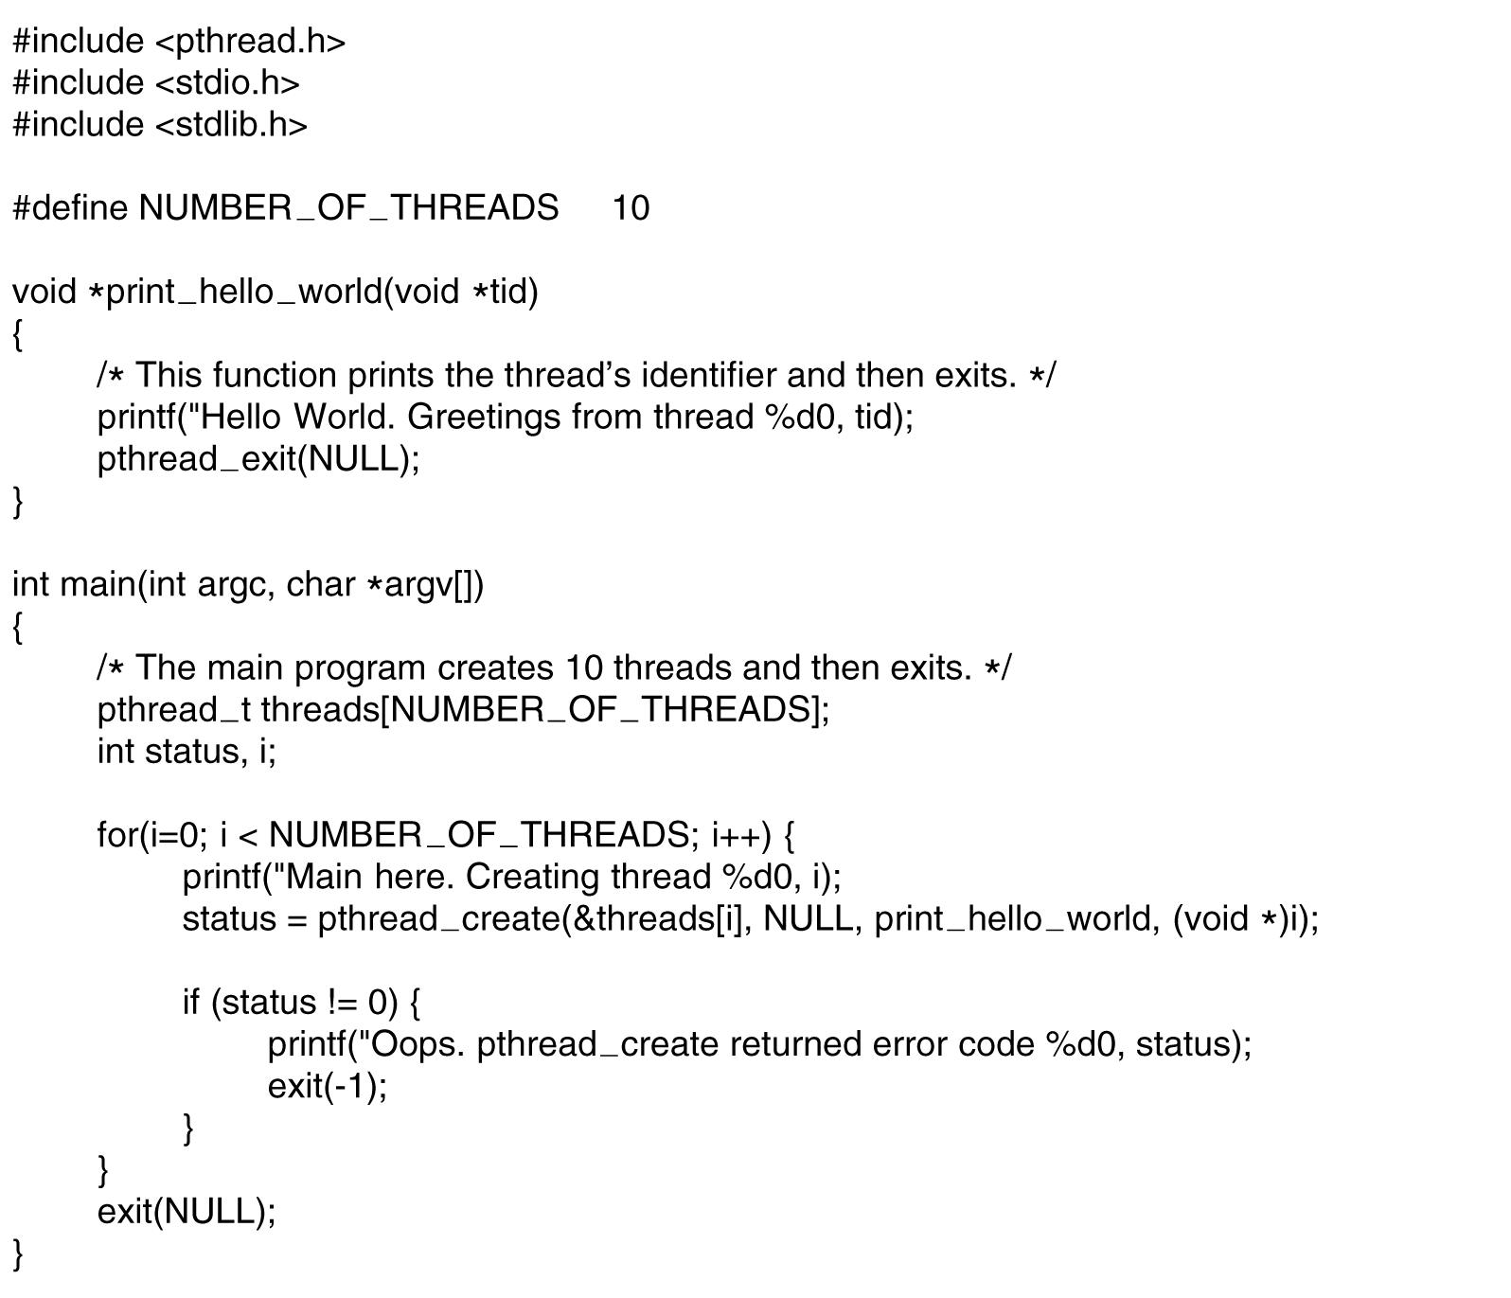
POSIX Threads (2)
Figure 2-15. An example program using threads.

Slide 13
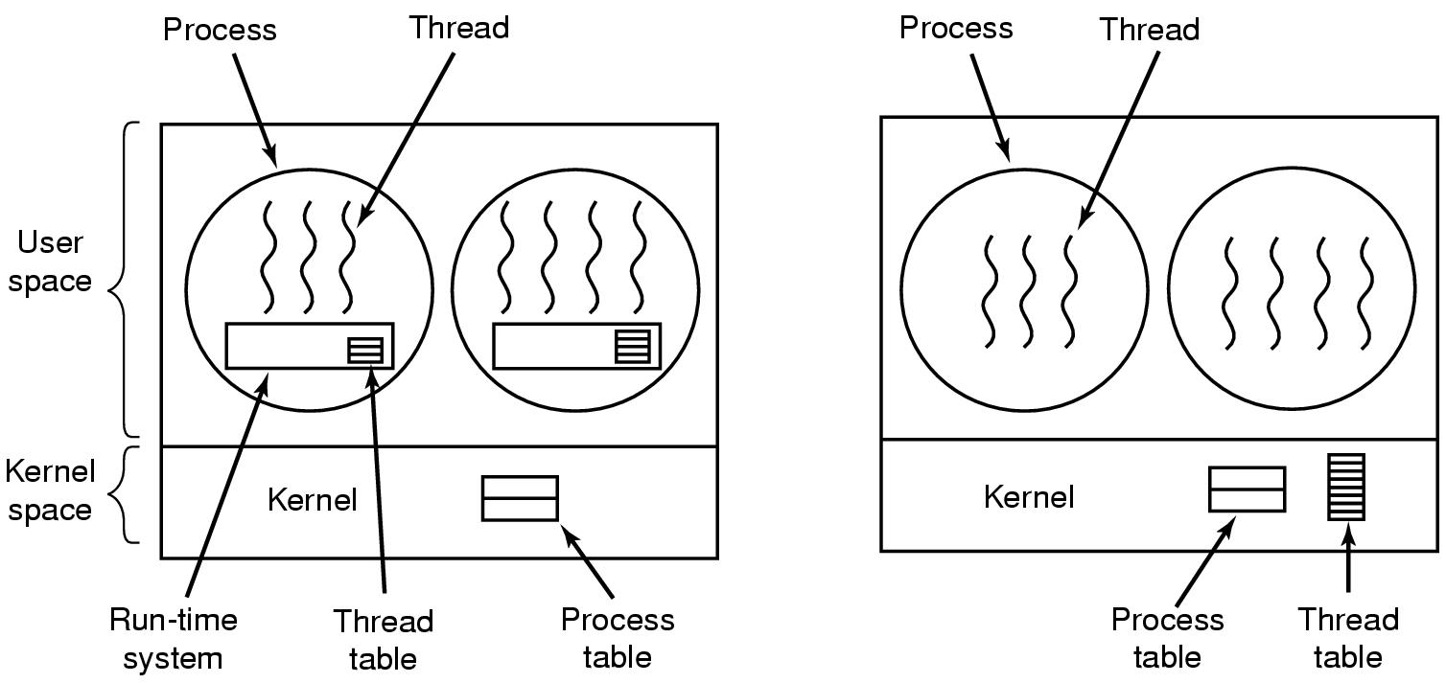
Implementing Threads in User Space
Figure 2-16. (a) A user-level threads package. (b) A threads package managed by the kernel.

Slide 14
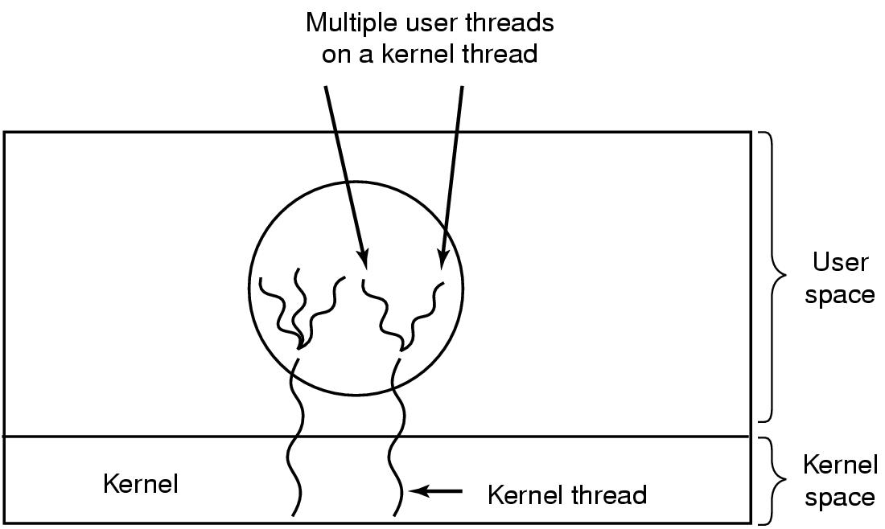
Hybrid Implementations
Figure 2-17. Multiplexing user-level threads onto kernel-level threads.

Slide 15
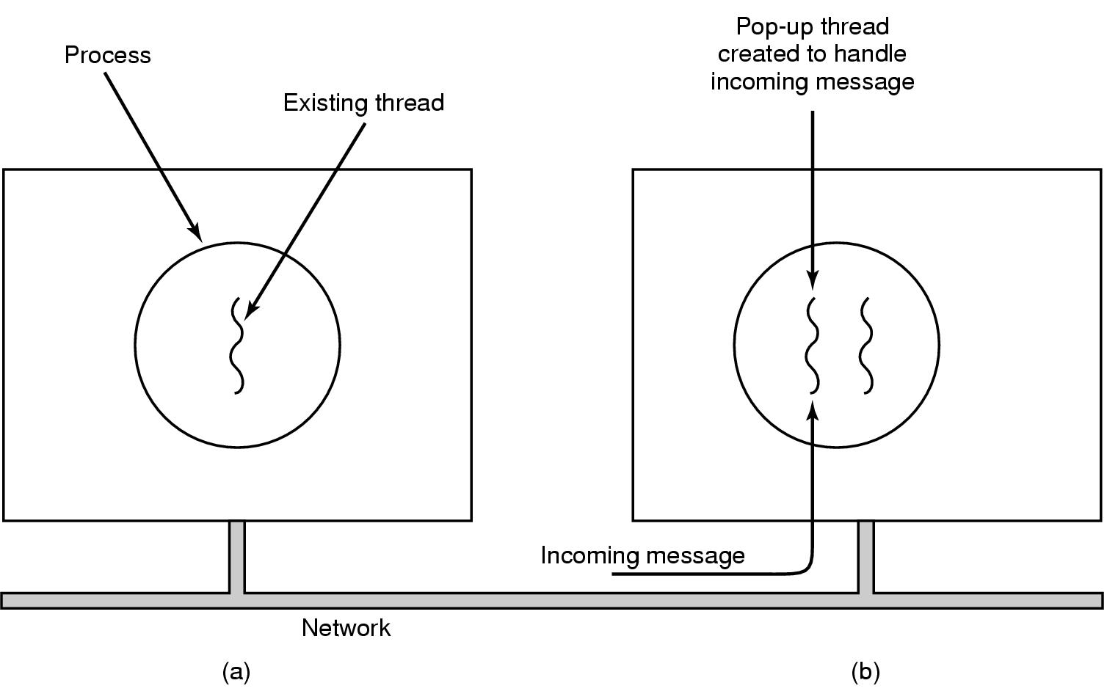
Pop-Up Threads
Figure 2-18. Creation of a new thread when a message arrives. (a) Before the message arrives. (b) After the message arrives.

Slide 16
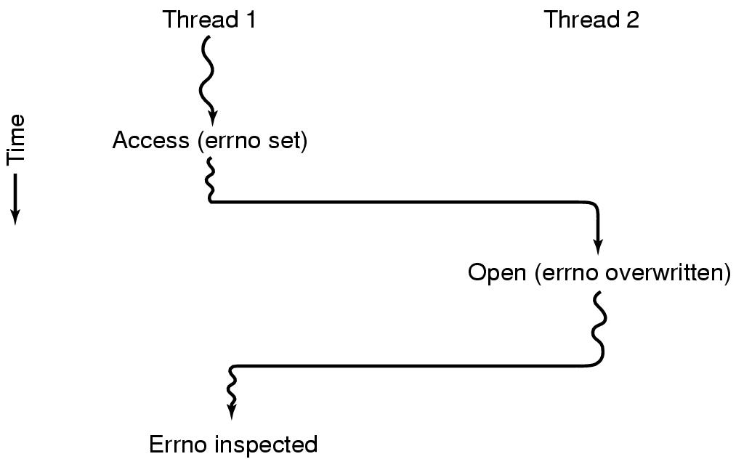
Making Single-Threaded Code Multithreaded (1)
Figure 2-19. Conflicts between threads over the use of a global variable.

Slide 17
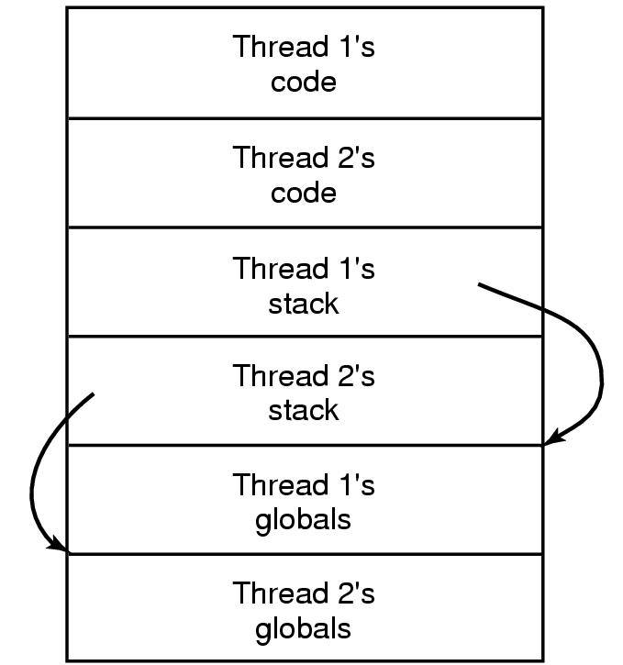
Making Single-Threaded Code Multithreaded (2)
Figure 2-20. Threads can have private global variables.

Slide 18
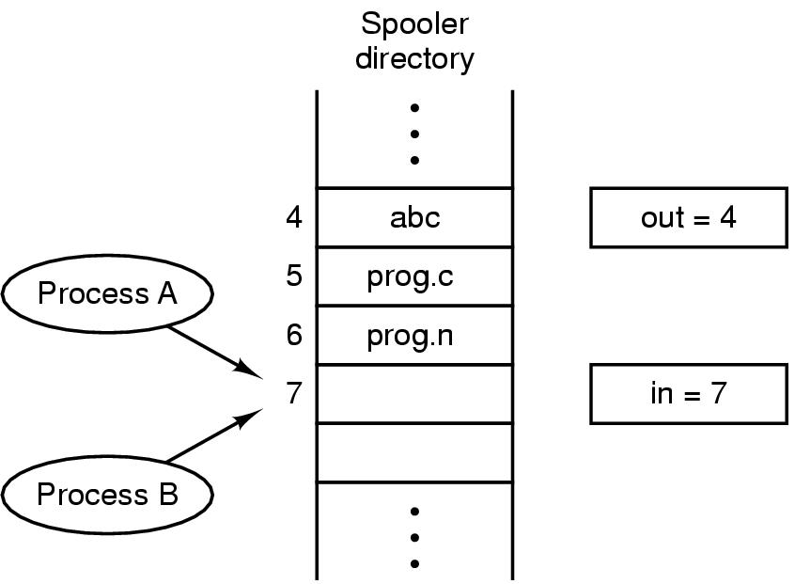
Race Conditions
Figure 2-21. Two processes want to access shared memory at the same time.

Slide 19
Critical Regions (1)
Conditions required to avoid race condition:
No two processes may be simultaneously inside their critical regions.
No assumptions may be made about speeds or the number of CPUs.
No process running outside its critical region may block other processes.
No process should have to wait forever to enter its critical region.

Slide 20
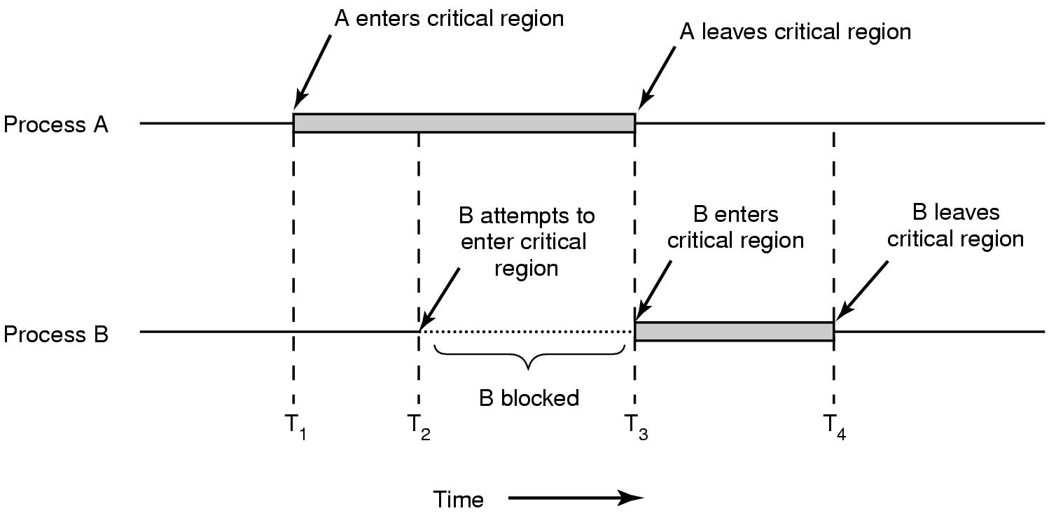
Critical Regions (2)
Figure 2-22. Mutual exclusion using critical regions.

Slide 21
Activity: It’s time to race!

Slide 22
Bank of Woe, Inc.
balance = 400;
Thread 0 | Thread 1 | Thread 2 | Thread 3
Paycheck | Buy fancy new TV | Roommate pays rent | Buying a video game
balance += 450; | balance -= 800; | balance += 300; | balance -= 50;

Slide 23
Bank of Woe, Inc.
balance = 400;
Thread 0 | Thread 1 | Thread 2 | Thread 3
Paycheck | Buy fancy new TV | Roommate pays rent | Buying a video game
retrieve balance add 450 to balance store balance | retrieve balance subtract 800 from balance store balance | retrieve balance add 300 to balance store balance | retrieve balance subtract 50 from balance store balance

Slide 24
Bank of Woe v2.0
balance = 400;
lock = 0;
Thread 0 | Thread 1 | Thread 2 | Thread 3
Paycheck | Buy fancy new TV | Roommate pays rent | Buying a video game
while (lock!=0); lock = 1; retrieve balance add 450 to balance store balance lock = 0; | while (lock!=0); lock = 1; retrieve balance subtract 450 from balance store balance lock = 0; | while (lock!=0); lock = 1; retrieve balance add 300 to balance store balance lock = 0; | while (lock!=0); lock = 1; retrieve balance subtract 50 from balance store balance lock = 0;

Slide 25
Mutual Exclusion with Busy Waiting
Proposals for achieving mutual exclusion:
Disabling interrupts
Lock variables
Strict alternation
Peterson's solution
The TSL instruction

Slide 26
Discussion Questions
Can we get race conditions between processes or is this just a thread problem?
Could a process and the OS agree to run certain code atomically? How would that work?
Does the size of a critical region matter? Should programmers try to keep them small or are large regions okay?

Slide 27

The End is Near

