Slide 1
Administration
Project 1:
Teammates (Confirm Checkpt. IA Reg Visible)
Final submission due Tonight at 11:59pm
Discussion Questions

Slide 2
Mutual Exclusion with Busy Waiting
Proposals for achieving mutual exclusion:
Disabling interrupts
Lock variables
Strict alternation
Peterson's solution
The TSL instruction

Slide 3
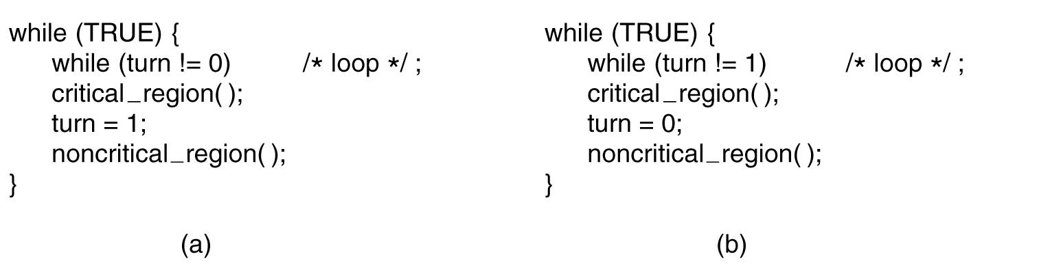
Strict Alternation
Figure 2-23. A proposed solution to the critical region problem. (a) Process 0. (b) Process 1. In both cases, be sure to note the semicolons terminating the while statements.

Slide 4
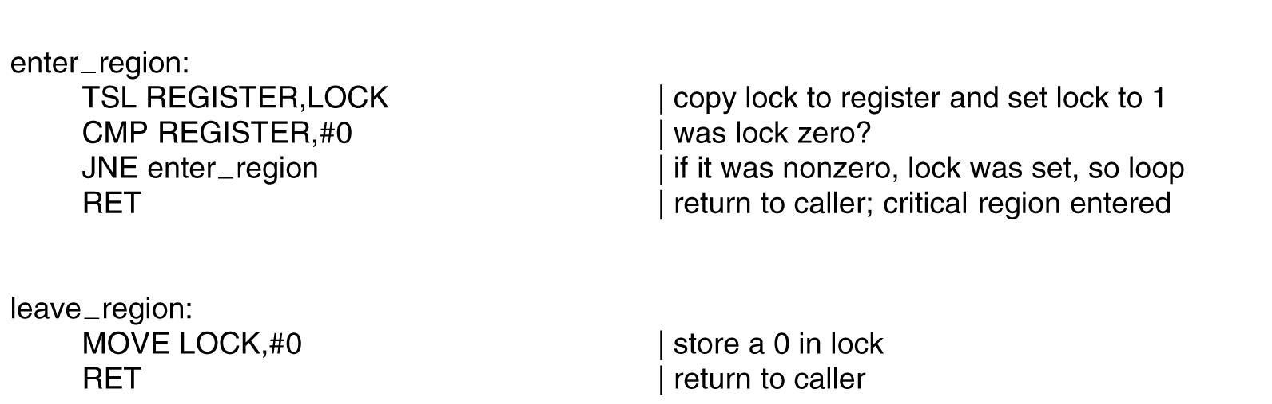
The TSL Instruction
Figure 2-25. Entering and leaving a critical region using the TSL instruction.

Slide 5
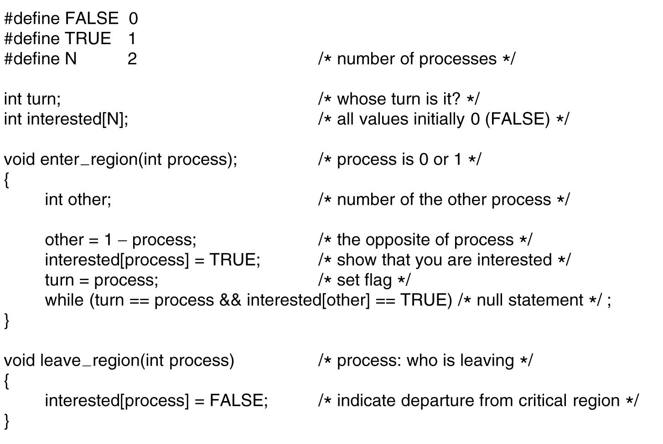
Peterson's Solution
Figure 2-24. Peterson’s solution for achieving mutual exclusion.

Slide 6
Peterson's Solution - Explained
Process 0
Process 1

Slide 7
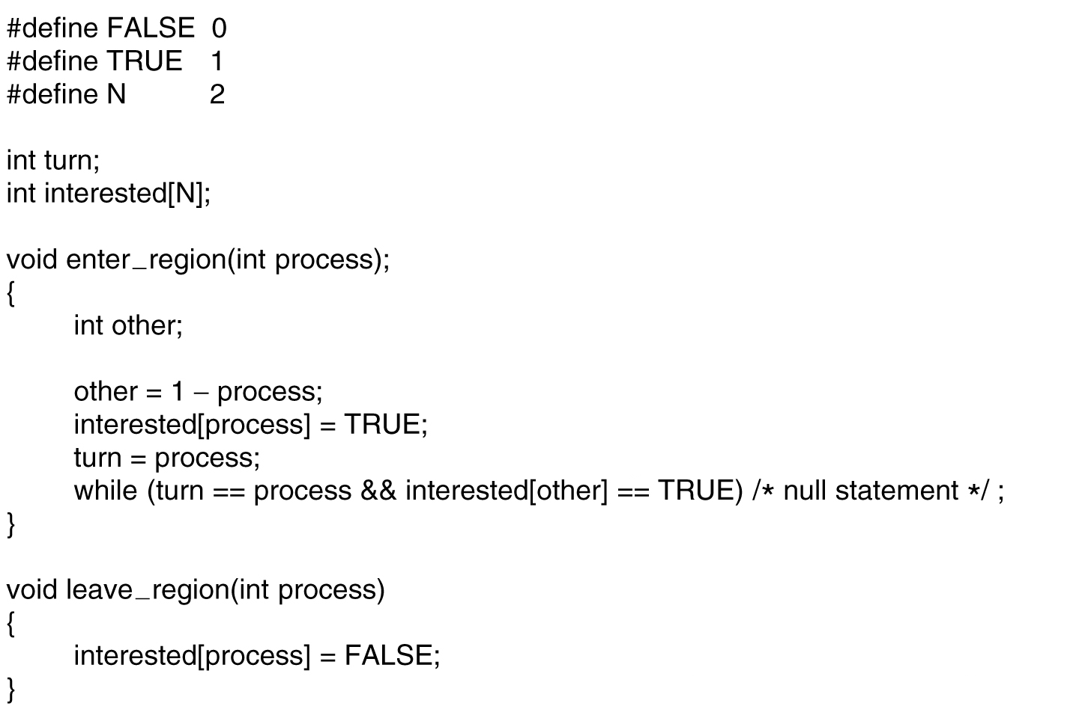
Peterson's Solution - Explained
Process 0
Process 1

Slide 8
Peterson's Solution - Explained
Process 0
Process 1
other = 1

Slide 9
Peterson's Solution - Explained
interested[0] = true
Process 0
Process 1
other = 1

Slide 10
Peterson's Solution - Explained
interested[0] = true
Process 0
turn = 0
Process 1
other = 1

Slide 11
Peterson's Solution - Explained
interested[0] = true
Process 0
turn = 0
Process 1
other = 1

Slide 12
Peterson's Solution - Explained
other = 1
interested[0] = true
Process 0
turn = 0
Process 1
other = 0

Slide 13
Peterson's Solution - Explained
interested[1] = true
other = 1
interested[0] = true
Process 0
turn = 0
Process 1
other = 0

Slide 14
Peterson's Solution - Explained
interested[1] = true
other = 1
interested[0] = true
Process 0
turn = 1
Process 1
other = 0

Slide 15
Peterson's Solution - Explained
interested[1] = true
other = 1
interested[0] = true
Process 0
turn = 1
Process 1
other = 0
Condition is true! Must keep
testing the while() loop

Slide 16
Peterson's Solution - Explained
interested[1] = true
other = 1
interested[0] = true
Process 0
turn = 1
Process 1
other = 0
Condition is false!
Function returns.

Slide 17
Peterson's Solution - Explained
interested[1] = true
interested[0] = true
Process 0
turn = 1
Process 1
other = 0
Condition is still true! Must keep
testing the while() loop

Slide 18
Peterson's Solution - Explained
interested[1] = true
interested[0] = false
Process 0
turn = 1
Process 1
other = 0

Slide 19
Peterson's Solution - Explained
interested[1] = true
interested[0] = false
Process 0
turn = 1
Process 1
other = 0
Condition is false!
Function returns

Slide 20
Application Design for Concurrency

Slide 21
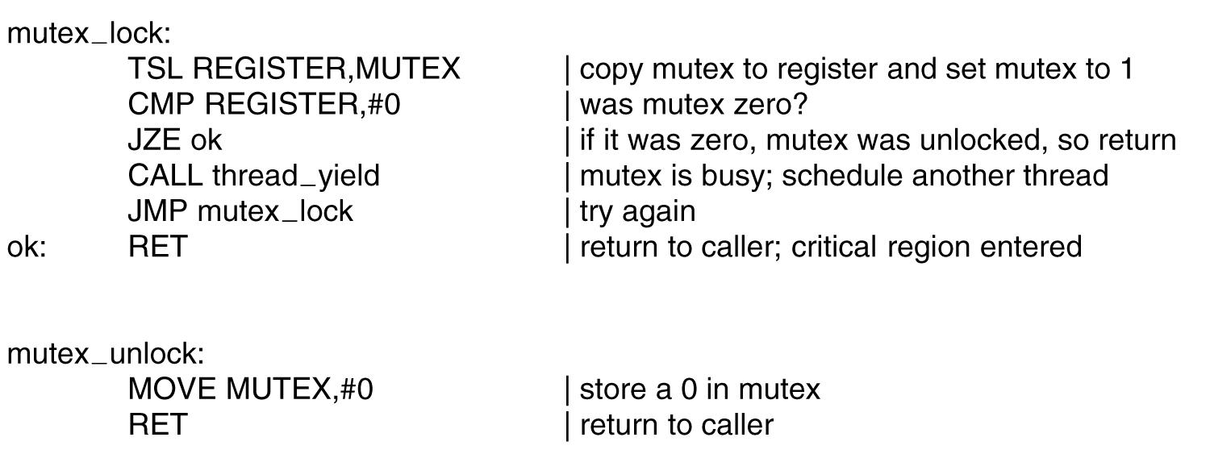
Mutexes

Slide 22
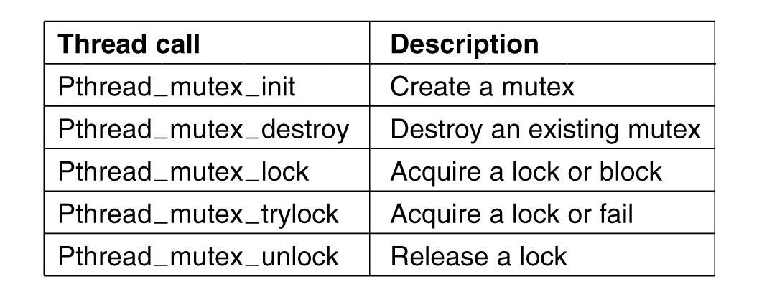
Mutexes in Pthreads

Slide 23
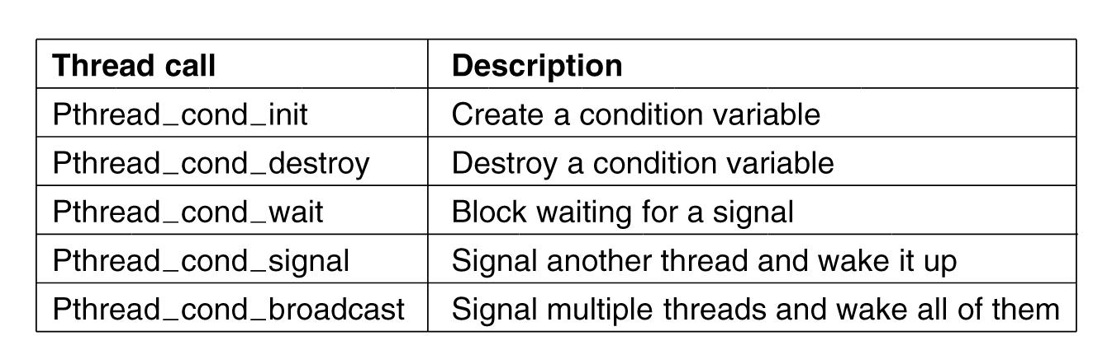
Condition Variables in Pthreads

Slide 24
The Producer-Consumer Problem
#define N 100
int count = 0;
void producer (void) {
int item;
while (TRUE) {
item = produce_item();
if (count == N) sleep();
count = count + 1;
if (count == 1)
wakeup(consumer);
}
}
void consumer (void) {
int item;
while (TRUE) {
if (count == 0) sleep();
item = remove_item();
count = count – 1;
if (count == (N – 1))
wakeup(producer);
consume_item(item);
}
}

Slide 25
Mutex: Producer/Consumer
#include <stdio.h>
#include <pthread.h>
#define MAX 100000000
pthread_mutex_t the_mutex;
pthread_cond_t condc, condp;
int value_to_pass = 0;
void *producer (void *ptr) {
int i;
for (i = 1; i <= MAX; i++) {
pthread_mutex_lock(&the_mutex);
while (value_to_pass != 0) {
pthread_cond_wait(&condp, &the_mutex);
}
value_to_pass = i;
pthread_cond_signal(&condc);
pthread_mutex_unlock(&the_mutex);
}
pthread_exit(0);
}

Slide 26
Mutex: Producer/Consumer
void *consumer (void *ptr) {
int i;
for (i = 1; i <= MAX; i++) {
pthread_mutex_lock(&the_mutex);
while (value_to_pass == 0) {
pthread_cond_wait(&condc, &the_mutex);
}
value_to_pass = 0; // remove item
pthread_cond_signal(&condp);
pthread_mutex_unlock(&the_mutex);
}
pthread_exit(0);
}

Slide 27
Mutex: Producer/Consumer
int main (int argc, char **argv) {
pthread_t pro, con;
pthread_mutex_init(&the_mutex, 0);
pthread_cond_init(&condc, 0);
pthread_cond_init(&condp, 0);
pthread_create(&con, 0, consumer, 0);
pthread_create(&pro, 0, producer, 0);
pthread_join(pro, 0);
pthread_join(con, 0);
pthread_cond_destroy(&condc);
pthread_cond_destroy(&condp);
pthread_mutex_destroy(&the_mutex);
}

Slide 28
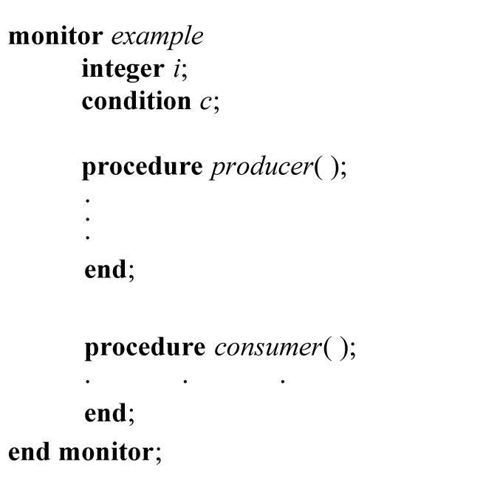
Monitors

Slide 29
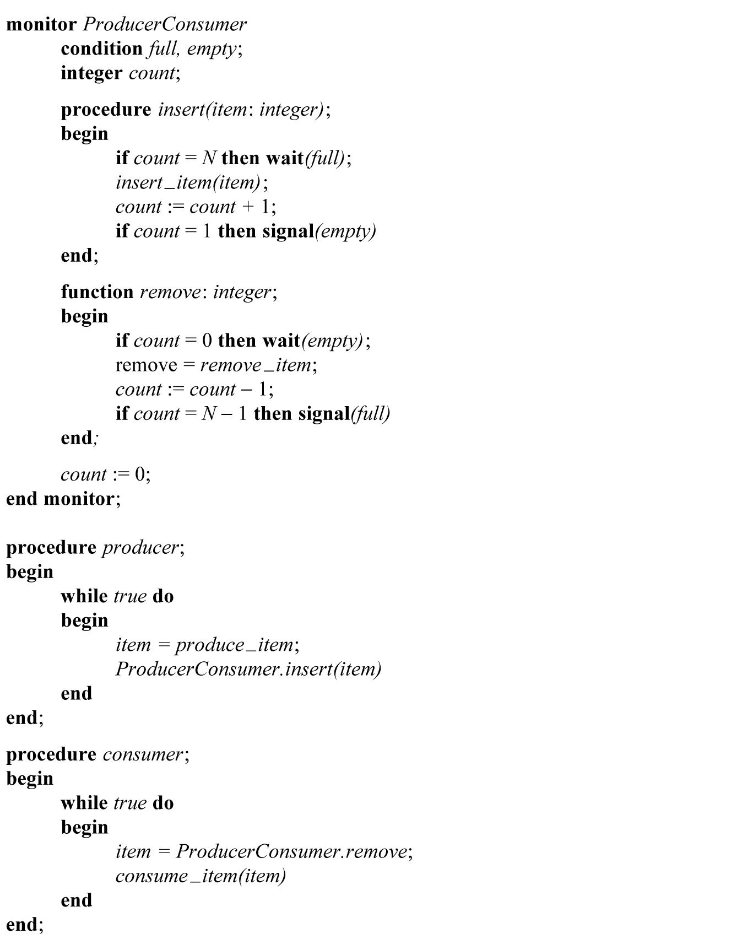
Monitors (2)

Slide 30
Producer-Consumer Problem with Message Passing (1)
. . .

Slide 31
Producer-Consumer Problem with Message Passing (2)
. . .

Slide 32
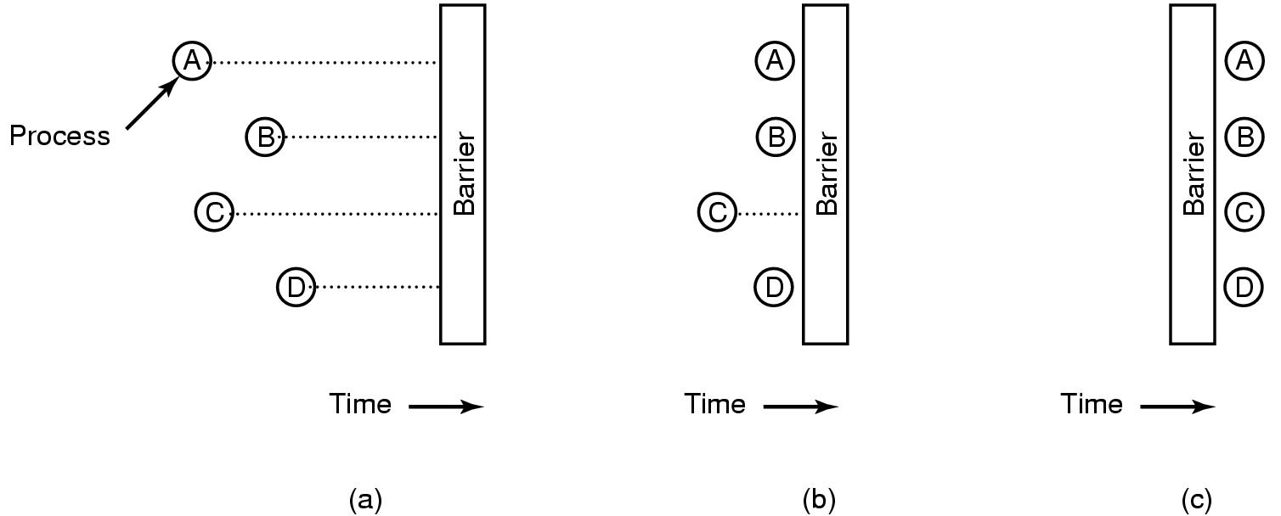
Barriers

Slide 33
Discussion Questions
Can we create a monitor using mutexes and condition variables? If so, how?
How would we implement a barrier with a condition variable and/or mutex?
What is priority inversion and how can we prevent it? Could it happen with processes and how would we handle that?

Slide 34

The End is Near

