Slide 1
Administration
Project 2:
Teammates Reminder
Final Submission: Tonight Sunday Night
Refactor/Redesign, Professionalize, Polish
Concurrency is Course Level & Systems Level Objective
See Announcement
Project 3:
Coming Up
Major Themes:
Concurrency: Lecture done, Project 2 soon
Memory Management: Today, Project 3

Slide 2
Example: FCFS Scheduling
Task Burst Time
P₁ 24
P₂ 3
P₃ 3
Suppose that tasks arrive in the order: P₁ , P₂ , P₃
The time line for the schedule is:–
Waiting time for P₁ = 0; P₂ = 24; P₃ = 27
Average waiting time: (0 + 24 + 27)/3 = 17
P₁
P₂
P₃
0
24
27
30

Slide 3
Example: FCFS
Suppose instead that the tasks arrive in the order
P₂ , P₃ , P₁
The time line for the schedule becomes:–
Waiting time for P₁ = 6; P₂ = 0; P₃ = 3
Average waiting time: (6 + 0 + 3)/3 = 3
Much better than previous case
Previous case exhibits the convoy effect
short tasks stuck behind long task
P₂
P₃
P₁
0
3
6
30

Slide 4
Shortest Job First

Slide 5
Non-Preemptive SJF
Task Arrival Time Burst Time
P₁ 0.0 7
P₂ 2.0 4
P₃ 4.0 1
P₄ 5.0 4
SJF (non-preemptive)
Average waiting time = (0 + 6 + 3 + 7)/4 = 4
P₁
P₃
P₂
P₄
0
3
7
8
12
16

Slide 6
Preemptive SJF
Task Arrival Time Burst Time
P₁ 0.0 7
P₂ 2.0 4
P₃ 4.0 1
P₄ 5.0 4
SJF (preemptive)
Average waiting time = (9 + 1 + 0 +2)/4 = 3
P₁
P₂
P₃
P₂
P₄
P₁
0
2
4
5
7
11
16

Slide 7
Scheduling in Interactive Systems
Round-robin scheduling
Priority scheduling
Multiple queues
Shortest process next
Guaranteed scheduling
Lottery scheduling
Fair-share scheduling

Slide 8
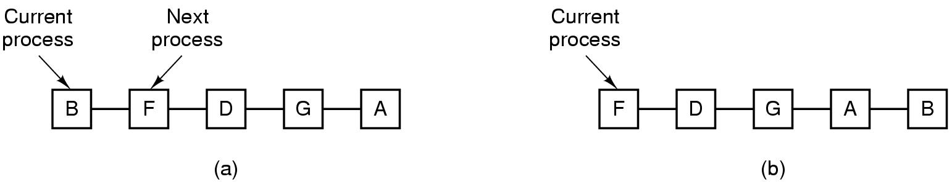
Round-Robin Scheduling

Slide 9
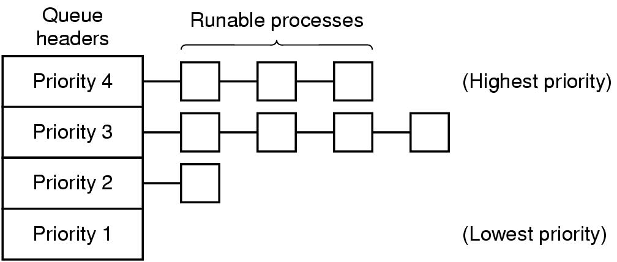
Priority Scheduling

Slide 10
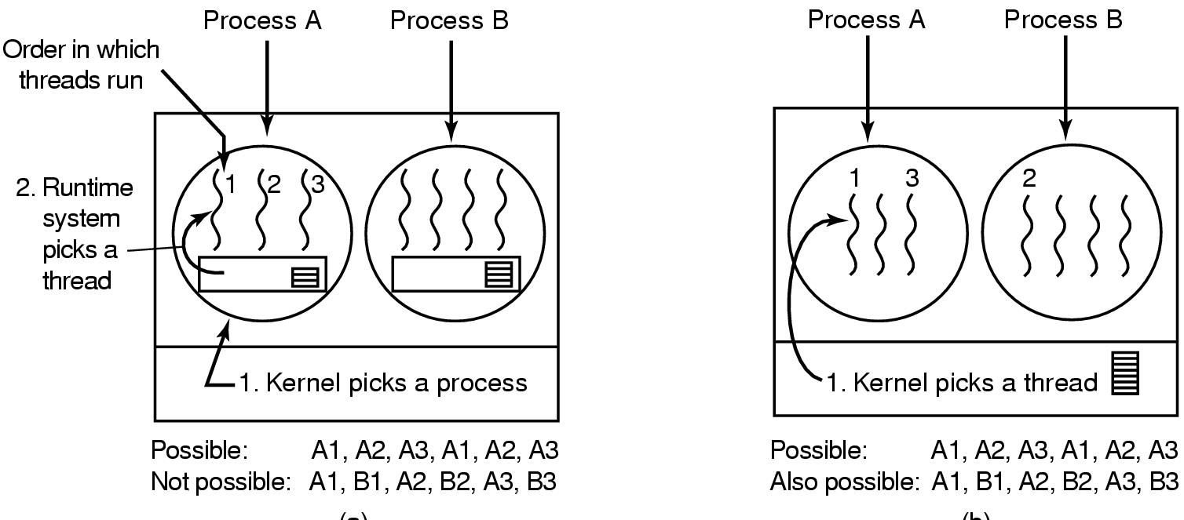
Thread Scheduling

Slide 11
Lottery Scheduling
Tickets in relationship to priority
Averages out to be higher priority scheduled more
Cooperative jobs can share tickets

Slide 12
Scheduling Metrics
Simplicity – easy to implement
Job latency – time from start to completion
Interactive latency – time from action start to expected system response
Throughput – number of jobs completed
Utilization – keep processor and/or subset of I/O devices busy
Determinism – ensure that jobs get done before some time or event
Fairness – every job makes progress

Slide 13
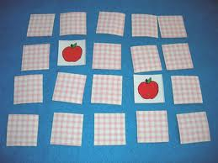
Memory Management
+ MBA?

Slide 14
In the Beginning, There was Batch
Batch systems
One program loaded in physical memory at a time
Runs to completion
Job > physical memory? Use overlays
Identify sections of program that
Can run to a result
Can fit into the available memory
Add commands after result to load a new section
Example: passes of a compiler

Slide 15
Still Early On
Multiple processes in physical memory at the same time
Fast switching to a ready process
Partition physical memory into multiple pieces
Some modern operating systems
Real-time systems
Embedded systems (mobile phone, automotive processors, etc.)
Partition requirements
Protection – keep processes from smashing each other
Fast execution – memory accesses not slowed by protection mechanisms
Fast context switch – can’t take forever to setup mapping of addresses

Slide 16
Physical Memory
0x0000FFFF
Empty
Process 3
Process 2
Physical
address space
Process 1
OS Kernel
E.g, OS360
0x00000000

Slide 17
Loading a Process
Relocate all addresses relative to start of partition
Memory protection assigned by OS
Block-by-block to physical memory
Base and limit registers
Once process starts
Partition cannot be moved in memory
Why?

Slide 18
Physical Memory – Process 2 terminates
0x0000FFFF
Empty
Process 3
Empty
Physical
address space
Process 1
OS Kernel
0x00000000

Slide 19
Problem
What happens when Process 4 comes along and requires space larger than the largest empty partition?
Wait
Complex resource allocation problem for OS
Potential starvation

Slide 20
Physical Memory
Empty
Process 3
Process 4
Empty
Process 1
OS Kernel

Slide 21
Solution
Virtual Address: an address used by the program that is translated by computer into a physical address each time it is used
Also called Logical Address
When the program utters 0x00105C, …
… the machine accesses 0x01605C

Slide 22
First Implementation
Base and Limit registers
Base is automatically added to all addresses
Limit is checked on all memory references
Introduced in minicomputers of early 1970s
Loaded by OS at each context switch
Physical Memory
Reloc Reg
Limit Reg
yes
CPU
+
<
logical
address
physical
address
no
error

Slide 23
Physical Memory
0x0000FFFF
Empty
Limit
Process 3
Base
Empty
Physical
address space
Process 1
OS Kernel
0x00000000

Slide 24
Advantages
No relocation of program addresses at load time
All addresses relative to zero!
Built-in protection provided by Limit
No physical protection per page or block
Fast execution
Addition and limit check at hardware speeds within each instruction
Fast context switch
Need only change base and limit registers
Partition can be suspended and moved at any time
Process is unaware of change
Potentially expensive for large processes due to copy costs!

Slide 25
Physical Memory
0x0000FFFF
Process 4
Limit
Process 3
Physical
address space
Base
Process 1
OS Kernel
0x00000000

Slide 26
Physical Memory
0x0000FFFF
Empty
Limit
Process 3
Base
Empty
Physical
address space
Process 1
OS Kernel
0x00000000

Slide 27
Physical Memory
0x0000FFFF
Process 4
Limit
Process 3
Physical
address space
Base
Process 1
OS Kernel
0x00000000

Slide 28
Definition
Virtual Address Space:
The address space in which a process or thread believes it is using
Address space with respect to which pointers, code and data addresses, etc., are interpreted
Separate and independent of physical address space where things are actually stored

Slide 29
New Problem:– How to Manage Memory
Fixed partitions
Easy
Variable partitions
Seems to make better use of space

Slide 30
Partitioning Strategies – Fixed
Fixed Partitions – divide memory into equal sized pieces (except for OS)
Degree of multiprogramming = number of partitions
Simple policy to implement
All processes must fit into partition space
Find any free partition and load the process
Problem – what is the “right” partition size?
Process size is limited
Internal Fragmentation – unused memory within a partition that is not available to other processes

Slide 31
Partitioning Strategies – Variable
Idea: remove “wasted” memory that is not needed in each partition
Eliminating internal fragmentation
Memory is dynamically divided into partitions based on process needs
Definition:
Hole: a block of free or available memory
Holes are scattered throughout physical memory
New process is allocated memory from hole large enough to fit it

Slide 32
Variable Partitions
More complex management problem
Must track free and used memory
Need data structures to do tracking
What holes are used for a process?
External fragmentation
memory that is outside any partition and is too small to be usable by any process
OS
OS
OS
process 1
process 1
process 1
Process 2
Terminates
Process 4
Starts
process 4
process 2
process 3
process 3
process 3

Slide 33
Definitions – Fragmentation
Unused space that cannot be allocated to fill a need
Internal fragmentation(FIXED Partitions)
Unused or unneeded space within an allocated part of memory.
Cannot be allocated to another task/job/process
External fragmentation(VARIABLE Partitions)
Unused space between allocations.
Too small to be used by other requests
SOLUTION: Compaction of memory (expensive in time)
Applies to all forms of spatial resource allocation
RAM, Disk, Virtual memory within process
File systems
…

Slide 34
Memory Allocation – Mechanism
MM system maintains data about free and allocated memory alternatives
Bit maps – 1 bit per “allocation unit”
Linked Lists – free list updated and coalesced when not allocated to a process
At swap-in or process create
Find free memory that is large enough to hold the process
Allocate part (or all) of memory to process and mark remainder as free
Compaction
Moving things around so that holes can be consolidated
Expensive in OS time

Slide 35
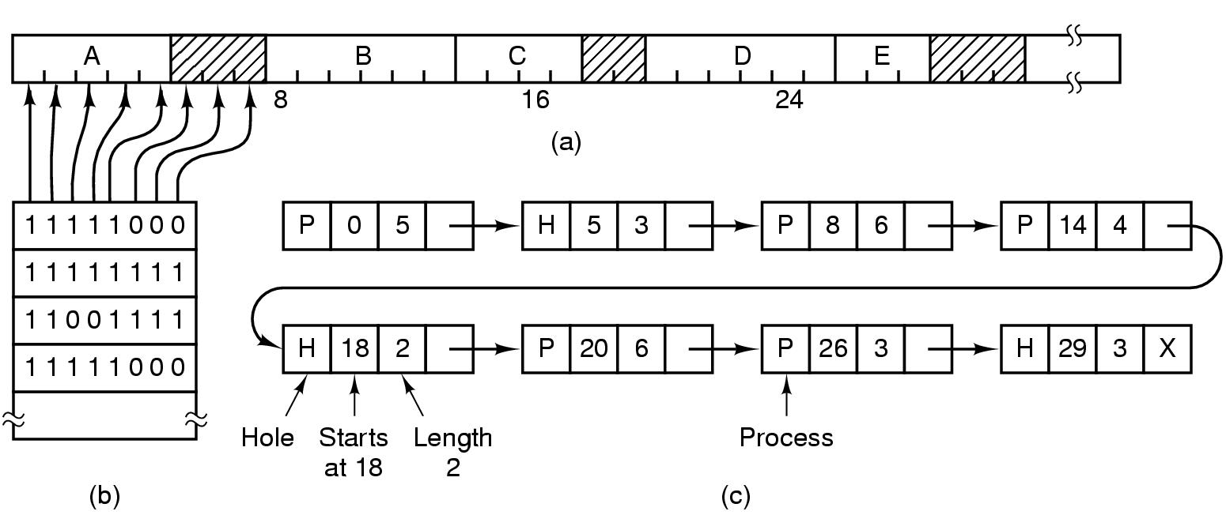
Memory Management – List vs. Map
Part of memory with 5 processes, 3 holes
tick marks show allocation units
shaded regions are free
Corresponding bit map
Same information as a list

Slide 36
Memory Management – Bit Map
Advantages:
Can see big picture
Easy to search using bit instructions in processor
Holes automatically coalesce
Disadvantage
No association between blocks and processes that own them

Slide 37
Memory Management – List
Advantages:
Direct association between block and process owning it
Disadvantages:
Cannot see big picture
Searching is expensive
Coalescing adjacent blocks requires extra effort (sorted order)

Slide 38
Discussion Questions
Imagine an OS in which the base and limit responsibilities are delegated to a process, rather than the OS doing it. What would the implications be?
Is there a middle option for fixed and variable allocations? Why can’t we “staple” two fixed partitions together?
What are the consequences of the memory management data structures? For example, if the OS wanted to associate memory with processes, which data structure is better?

Slide 39

The End is Near

