Slide 1
Eric M. Fink
Elon Law School
Notes:
Click to edit the notes format

Slide 2
Federal Trade Commission Act
15 U.S.C. § 45: Unfair or Deceptive Acts or Practices Prohibited
Unfair methods of competition in or affecting commerce, and unfair or deceptive acts or practices in or affecting commerce, are hereby declared unlawful.
Notes:
Click to edit the notes format

Slide 3
Federal Trade Commission Act
15 U.S.C. § 52(b): False Advertising Prohibited
The dissemination or the causing to be disseminated of any false advertisement … shall be an unfair or deceptive act or practice in or affecting commerce …
Notes:
Click to edit the notes format

Slide 4
Federal Trade Commission Act
15 U.S.C. § 55(a)(1): False Advertising Defined
The term “false advertisement” means an advertisement ... which is misleading in a material respect; and in determining whether any advertisement is misleading, there shall be taken into account (among other things) not only representations made or suggested by statement, word, design, device, sound, or any combination thereof, but also the extent to which the advertisement fails to reveal facts material in the light of such representations or material with respect to consequences which may result from the use of the commodity to which the advertisement relates under the conditions prescribed in said advertisement, or under such conditions as are customary or usual.
Notes:
Click to edit the notes format

Slide 5
Flight of Fancy
Pepsi Ad
Notes:
Click to edit the notes format

Slide 6
FTC Policy: Advertising Substantiation
Absent an express or implied reference to a certain level of support, and absent other evidence indicating what consumer expectations would be, the Commission assumes that consumers expect a “reasonable basis” for claims. The Commission’s determination of what constitutes a reasonable basis depends, as it does in an unfairness analysis, on a number of factors relevant to the benefits and costs of substantiating a particular claim. These factors include: the type of claim, the product, the consequences of a false claim, the benefits of a truthful claim, the cost of developing substantiation for the claim, and the amount of substantiation experts in the field believe is reasonable.
Notes:
Click to edit the notes format

Slide 7
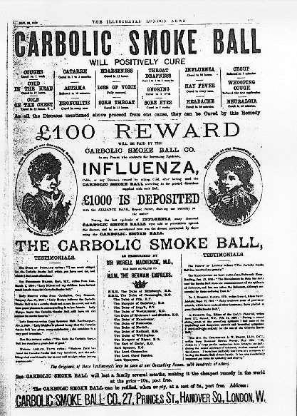
Blowing Smoke
Notes:
Click to edit the notes format

Slide 8
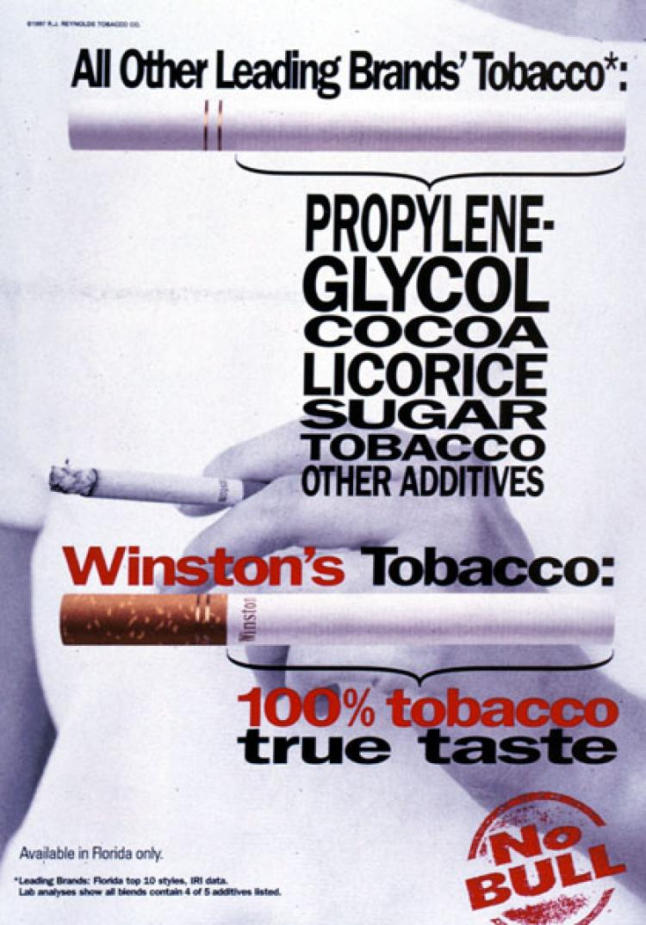
Blowing Smoke II
Notes:
Click to edit the notes format

Slide 9
FTC Policy: Endorsements & Testimonials
16 CFR §255.0(b): Endorsement Defined
For purposes of this part, an endorsement means any advertising message (including verbal statements, demonstrations, or depictions of the name, signature, likeness or other identifying personal characteristics of an individual or the name or seal of an organization) that consumers are likely to believe reflects the opinions, beliefs, findings, or experiences of a party other than the sponsoring advertiser, even if the views expressed by that party are identical to those of the sponsoring advertiser.
Notes:
Click to edit the notes format

Slide 10
FTC Policy: Endorsements & Testimonials
16 CFR §255.1: General Considerations
(a) Endorsements must reflect the honest opinions, findings, beliefs, or experience of the endorser. Furthermore, an endorsement may not convey any express or implied representation that would be deceptive if made directly by the advertiser.
Notes:
Click to edit the notes format

Slide 11
FTC Policy: Endorsements & Testimonials
16 CFR §255.1: General Considerations
(c) When the advertisement represents that the endorser uses the endorsed product, the endorser must have been a bona fide user of it at the time the endorsement was given. Additionally, the advertiser may continue to run the advertisement only so long as it has good reason to believe that the endorser remains a bona fide user of the product.
Notes:
Click to edit the notes format

Slide 12

Cover Girl Cover Up
Notes:
Click to edit the notes format

Slide 13

Cover Girl Cover Up
Notes:
Click to edit the notes format

