Slide 1
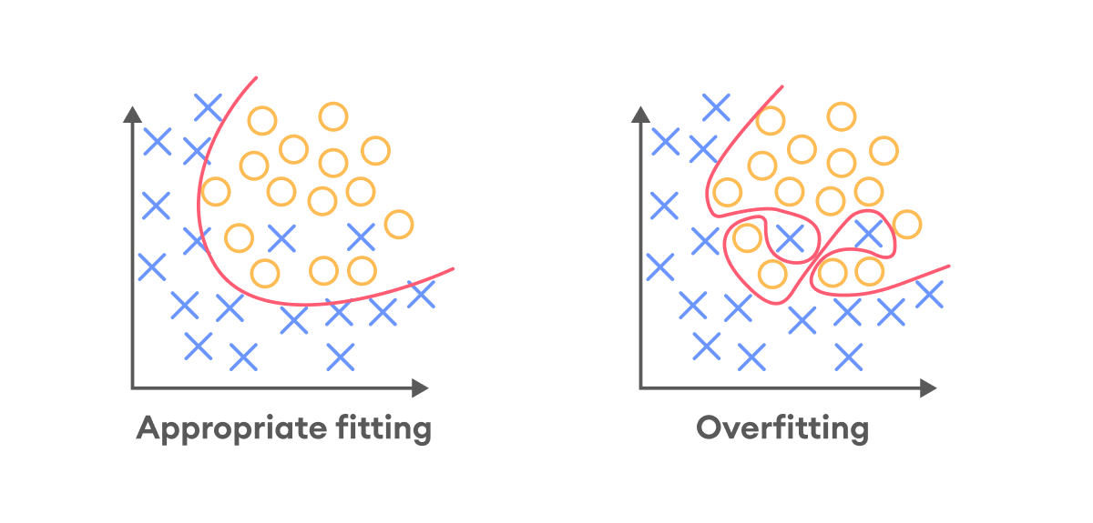
NN Architectures

Slide 2
References
http://cs231n.stanford.edu/index.html
http://www.cs.cornell.edu/courses/cs5670/2019sp/lectures/lectures.html
http://www.cs.cmu.edu/~16385/

Slide 3
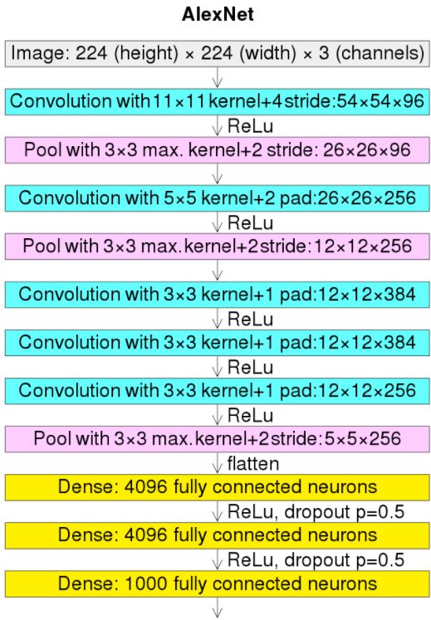
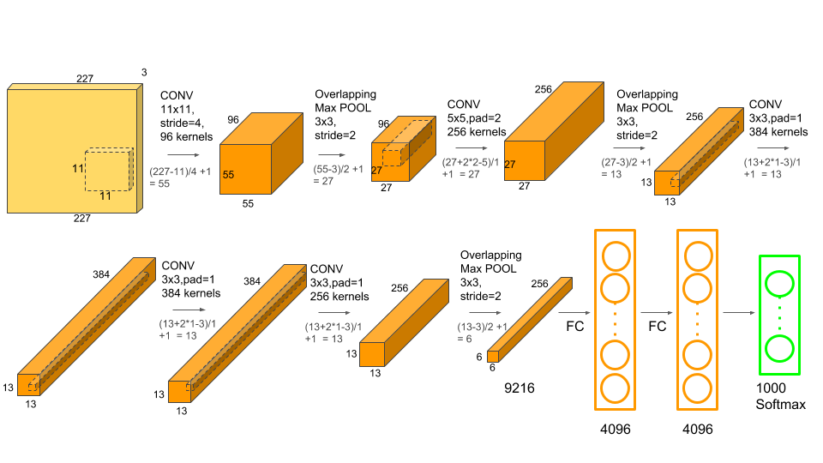
Alexnet
The winner of the 2012 IMAGENET competition (classification % of top 5 out of 1000 labels).
224X224X3 input.
8 learnable layers.
61M parameters.
Note the big kernel sizes.

Slide 4
Alexnet
Article: https://papers.nips.cc/paper_files/paper/2012/hash/c399862d3b9d6b76c8436e924a68c45b-Abstract.html
Publication Date: 2012
Authors:
Alex Krizhevsky
Ilya Sutskever – later OpenAI co-founder
Geoffrey E. Hinton- Received the 2018 Turing Award, often referred to as the "Nobel Prize of Computing", together with Yoshua Bengio and Yann LeCun, for their work on deep learning. They are sometimes referred to as the "Godfathers of Deep Learning“ (Wikipedia)

Slide 5
Alexnet
Key take aways:
Dropouts
L2 regularization
Better optimization: SGD + momentum + weight decay

Slide 6
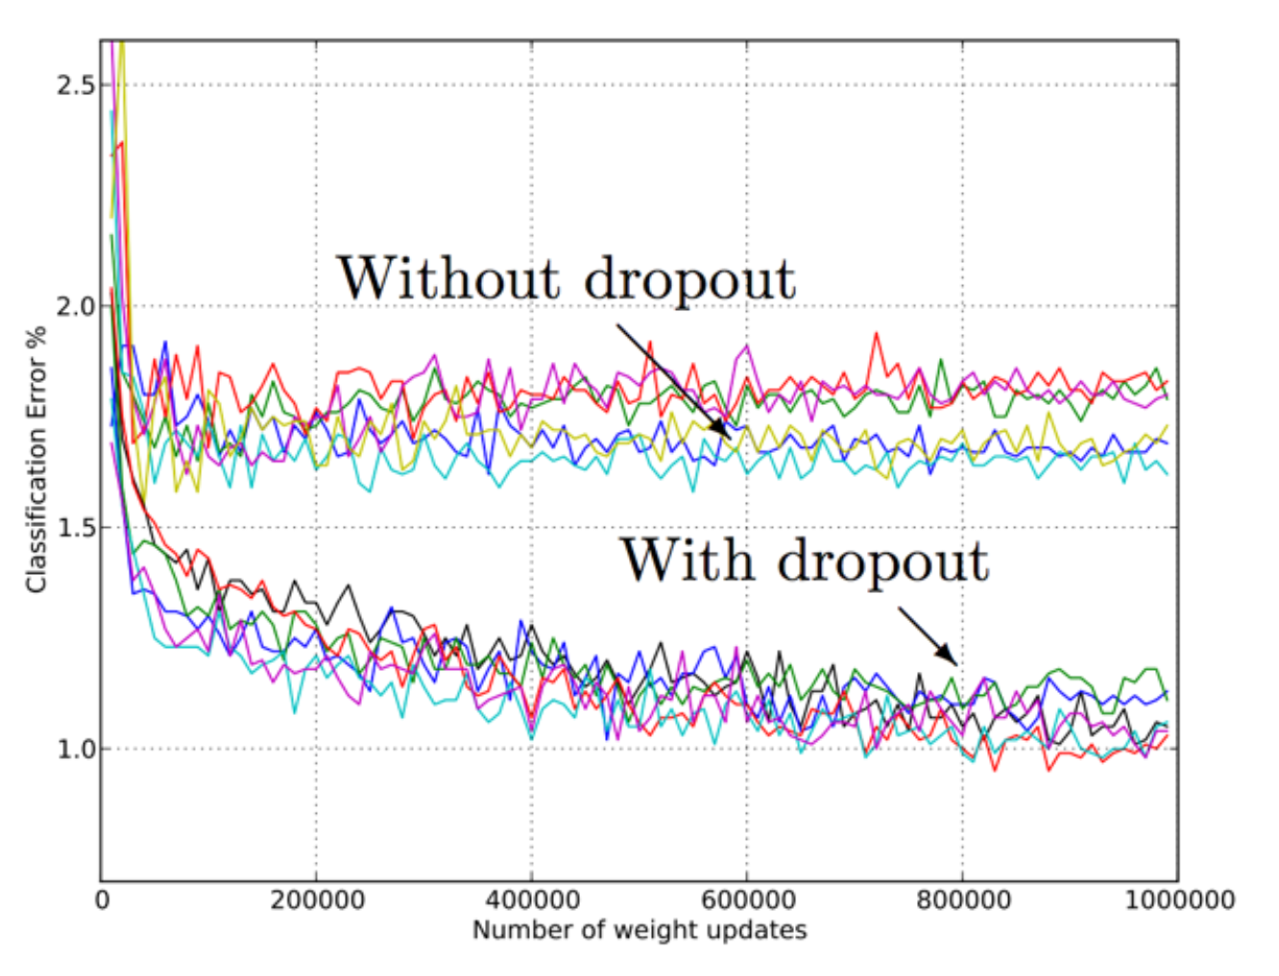
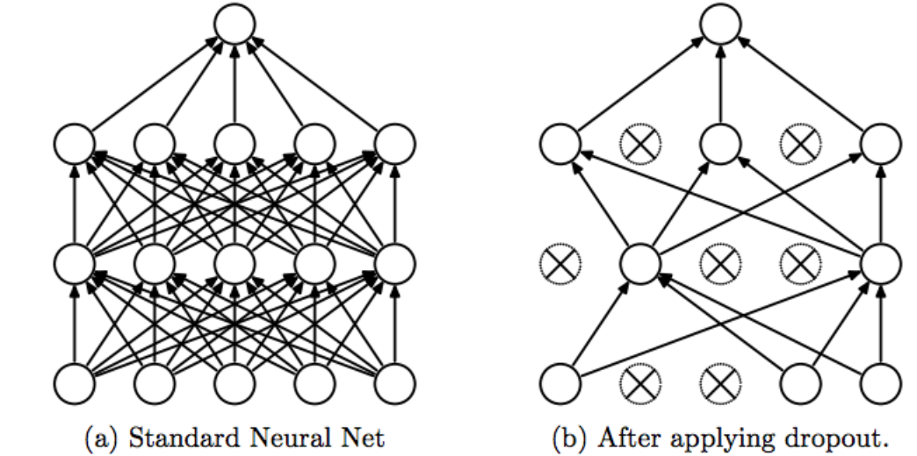
Dropout
Neuron is dropped from the network with a probability of X. When a neuron is dropped, it does not contribute to either forward or backward propagation.
Every input goes through a different network architecture, as a result, the learnt weight parameters are more robust.
During testing, there is no dropout and the whole network is used, but output is scaled by a factor of 1/X to account for the missed neurons while training.

Slide 7
Dropout
Advantage: with dropout, the remaining neurons must learn to handle a broader range of features on their own, rather than relying on a specific combination of other neurons (“co-adaptation”).
This leads to a more robust model that is better at representing the underlying data distribution (generalization), rather than overly specific features of the training set (overfitting).
Disadvantage: dropout can slow down the convergence of a training process. This is because, on each iteration, only a subset of neurons is active.

Slide 8
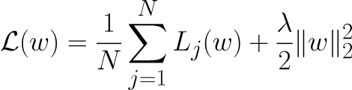
L2 regularization
Also known as ridge regression or Tikhonov regularization.
A technique used to reduce the complexity of a model and can give better generalization.
This is how we can change our loss function:
The bigger weights give bigger loss error and therefore the model will want to learn smaller weights.
L2 regularization

Slide 9
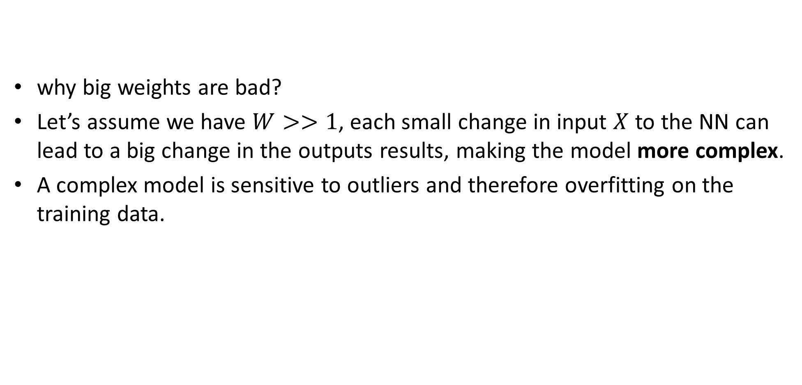
L2 regularization
why big weights are bad?
Let’s assume we have $W>>1$, each small change in input $X$ to the NN can lead to a big change in the outputs results, making the model more complex.
A complex model is sensitive to outliers and therefore overfitting on the training data.

Slide 10
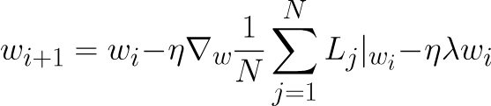
L2 regularization
Regularizing for small weights can lead to smoother model representation and better generalization.
Meaning our SGD step will look like:
This is also called weight decay because we are removing a bit of the old weights from the new weights every iteration
Notes:
\nabla_w\mathcal{L} = \nabla_w \frac{1}{N}\sum_{j=1}^NL_j(w) + \lambda w
w_{i+1} = w_i -\eta \nabla_w \frac{1}{N}\sum_{j=1}^NL_j|_{w_i} -\eta \lambda w_i

Slide 11
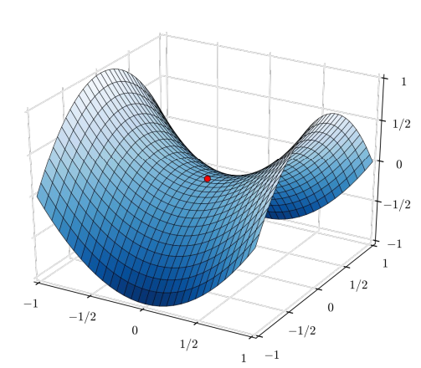
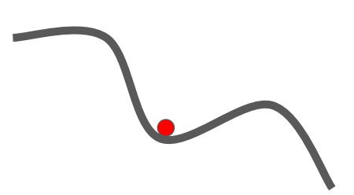
SGD + momentum
Main problem with SGD: can get “stuck” in zero gradient places: local minima & saddle points

Slide 12


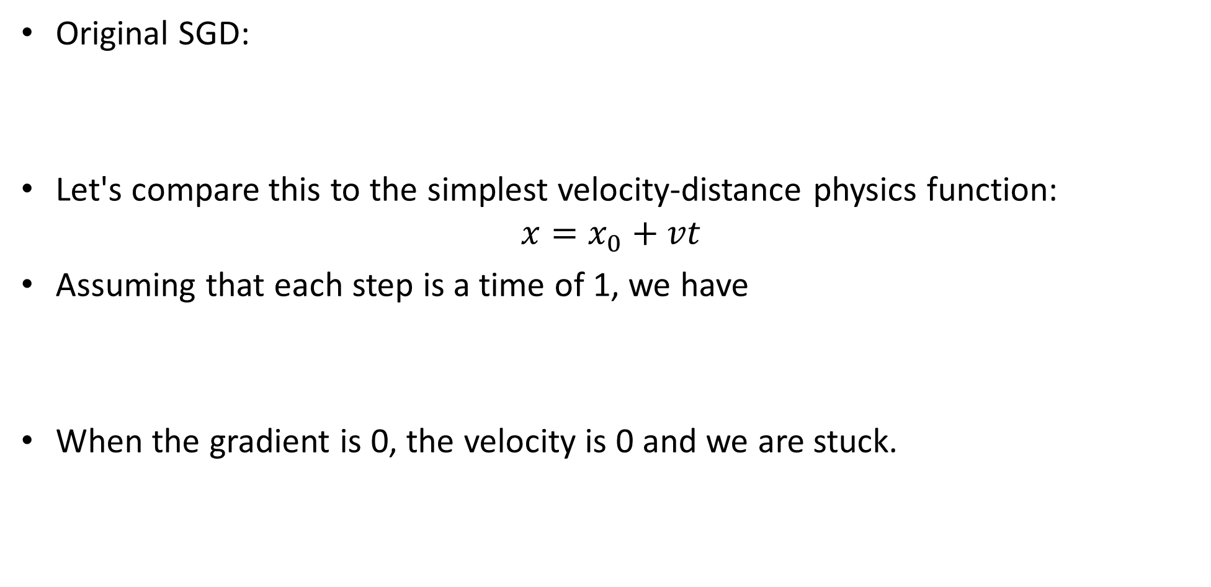
SGD + momentum
Original SGD:
Let's compare this to the simplest velocity-distance physics function:
$$x=x_{0}+vt$$
Assuming that each step is a time of 1, we have
When the gradient is 0, the velocity is 0 and we are stuck.
Notes:
v \leftrightarrow -\eta \nabla_w \mathcal{L}

Slide 13
SGD + momentum
If we “remember” the previous velocity and mean it with our current velocity, we can maintain “momentum”.

Slide 14
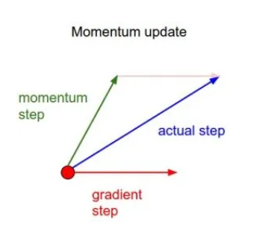


SGD + momentum
Original SGD:
SGD + momentum:
Where $α$is the momentum coefficient : A typical choice is between 0.5 and 0.9. Higher values give more weight to past gradients.
Notes:
\left\{\begin{matrix} v_i = \alpha v_{i-1}- \eta \nabla_w \sum_{j=0}^NL_j(w) \\ w_i = w_{i-1} + v_i \end{matrix}\right.

Slide 15
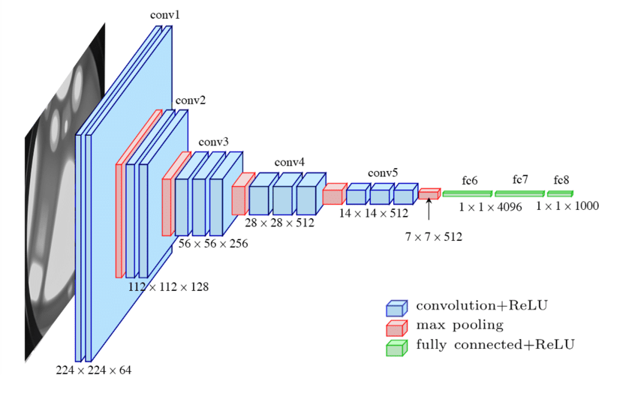
VGG16
Winner of IMAGENET 2014 classification challenge (Oxford research)
16 layers (there are also other variations with 11,13 and 19 layers)- meaning the NN can learn more abstract features.
138M parameters.
Used small receptive fields with stacked conv layers (shown before)- compared to 11X11 and 5X5 in AlexNet, her there is only 3X3 layers.
Still in use today!

Slide 16
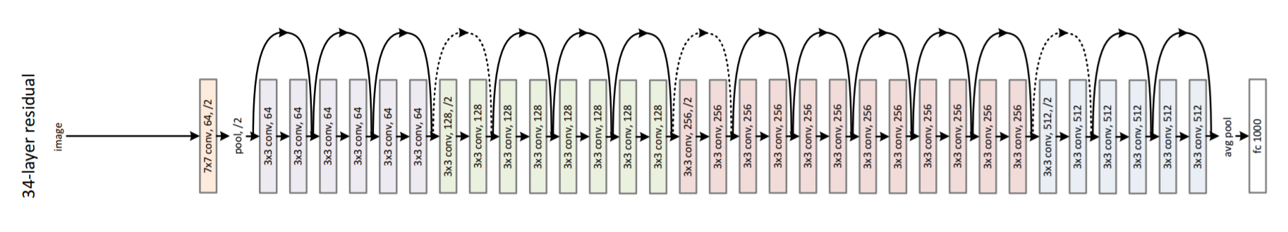
ResNet
Winner of IMAGENET 2015 classification challenge (Microsoft research).
152 layers (there are also other variations with 18, 34, 50 and 101 layers).
60M parameters (<0.5X VGG16!!!).
Still in use today!

Slide 17
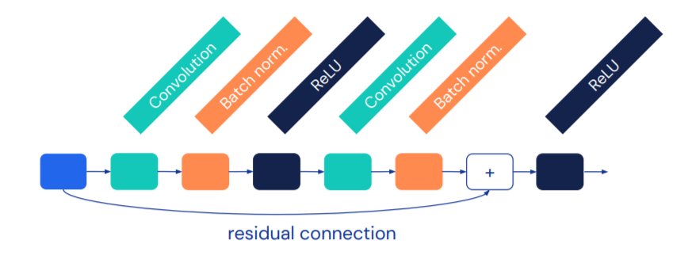
ResNet
Interesting blocks:
Batch normalization.
Residual block.

Slide 18
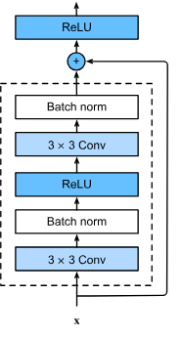
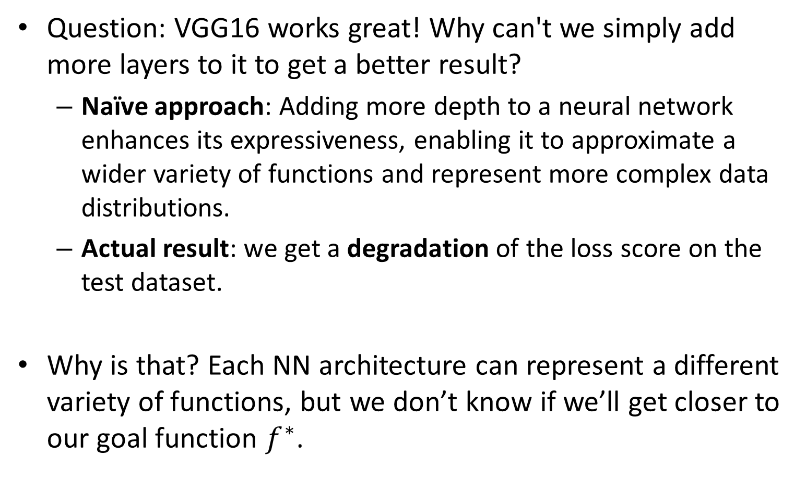
Residual Block
Question: VGG16 works great! Why can't we simply add more layers to it to get a better result?
Naïve approach: Adding more depth to a neural network enhances its expressiveness, enabling it to approximate a wider variety of functions and represent more complex data distributions.
Actual result: we get a degradation of the loss score on the test dataset.
Why is that? Each NN architecture can represent a different variety of functions, but we don’t know if we’ll get closer to our goal function $f^{∗}$.

Slide 19
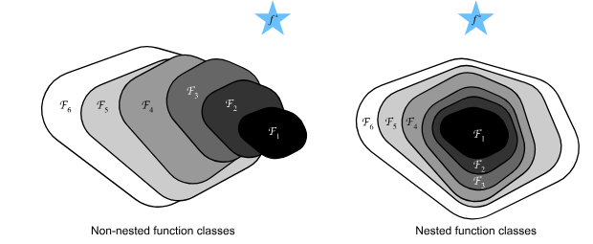
Function class representation
Illustration of a more complex NN architectures that degrade the loss score.
We want to make sure that each more complex NN contains all possible functions of the les complex architecture.

Slide 20
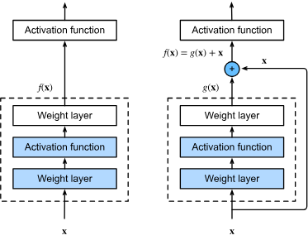

Skip connection
By adding to some NN architecture a residual block (NN block with “skip connection”/”residual connection”), we can always zero out all weights in that block ($g(x)$ in the example) and get the exact representation of the base architecture!
By doing this we know that we can’t get degradation of the results.

Slide 21
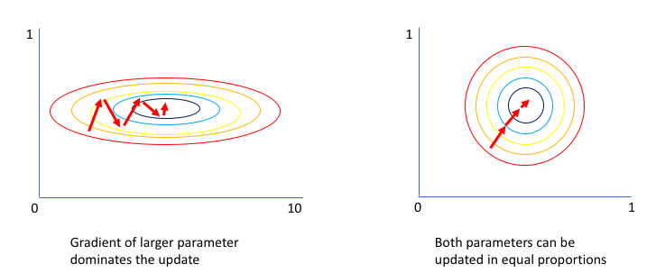
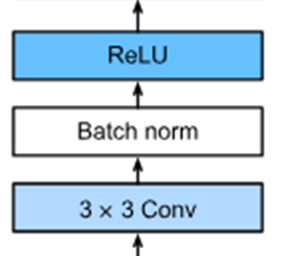
Batch normalization
Batch norm normalizes (and then scales) the inputs of each layer in a way similar to how inputs to the network are normalized. This can lead to better and faster convergence.
Although batch normalization has become popular due to its strong empirical performance, the working mechanism of the method is not yet well-understood. [Wikipedia].

Slide 22
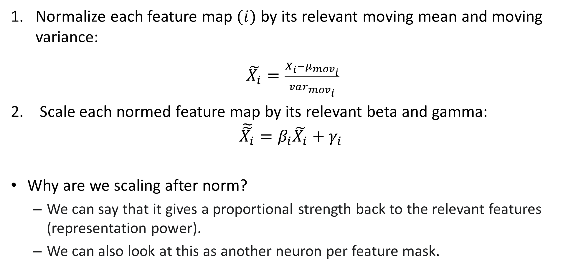
Batch norm - inference
Normalize each feature map $(i)$ by its relevant moving mean and moving variance:
$\tilde{X_{i}}=\frac{X_{i}−μ_{mov_{i}}^{}}{{var}_{mov_{i}}^{}}$
2. Scale each normed feature map by its relevant beta and gamma:
$$\tilde{\tilde{X_{i}}}=β_{i}\tilde{X_{i}}+γ_{i}$$
Why are we scaling after norm?
We can say that it gives a proportional strength back to the relevant features (representation power).
We can also look at this as another neuron per feature mask.

Slide 23
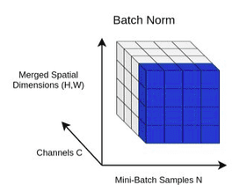
Batch norm- number of params
the number of params you have is determined by the dimensionality of the feature maps in your network layer.
For example, if a convolutional layer outputs a tensor of shape [batch_size, num_channels, height, width], there will be 4 vectors size num_channels for the mean, variance, beta and gamma.

Slide 24

Batch norm - train
We want to learn the bias $(β)$ and scale factor $(γ)$ of the normalization of each feature map.
We also want to calc the moving mean and variance.

Slide 25






Batch Norm Block (forward training mode)
Normalize each feature
$$\hat{X_{i}}=\frac{X_{i}−μ_{i}}{var_{i}}$$
Scale and shift
$$out_{i}=γ_{i}\hat{X_{i}}+β_{i}$$
Calc mean and var (sample variance) per feature($X_{i}$)
$$μ_{i}=\frac{1}{M}ΣX_{i}$$
$$var_{i}=\frac{{Σ{(X}_{i}−μ_{i})}^{2}}{M−1}$$
$i$: feature index (not iteration!)
$M$: batch_size*height*width
$$out$$
$$X$$
Update moving params
$${μ_{mov}}_{i}←α{μ_{mov}}_{i}+\left(1−α\right)μ_{i}$$
$${{var}_{mov}}_{i}←α{{var}_{mov}}_{i}+\left(1−α\right){var}_{i}$$
$α$: momentum of moving params

Slide 26
More basic building blocks
Schedulers
ADAM optimizer

Slide 27
Learning rate schedulers
Learning rate schedulers in neural networks are used to adjust the learning rate during training. This can help improve training speed and model performance by controlling the learning rate's fine-tuning throughout the training process.

Slide 28
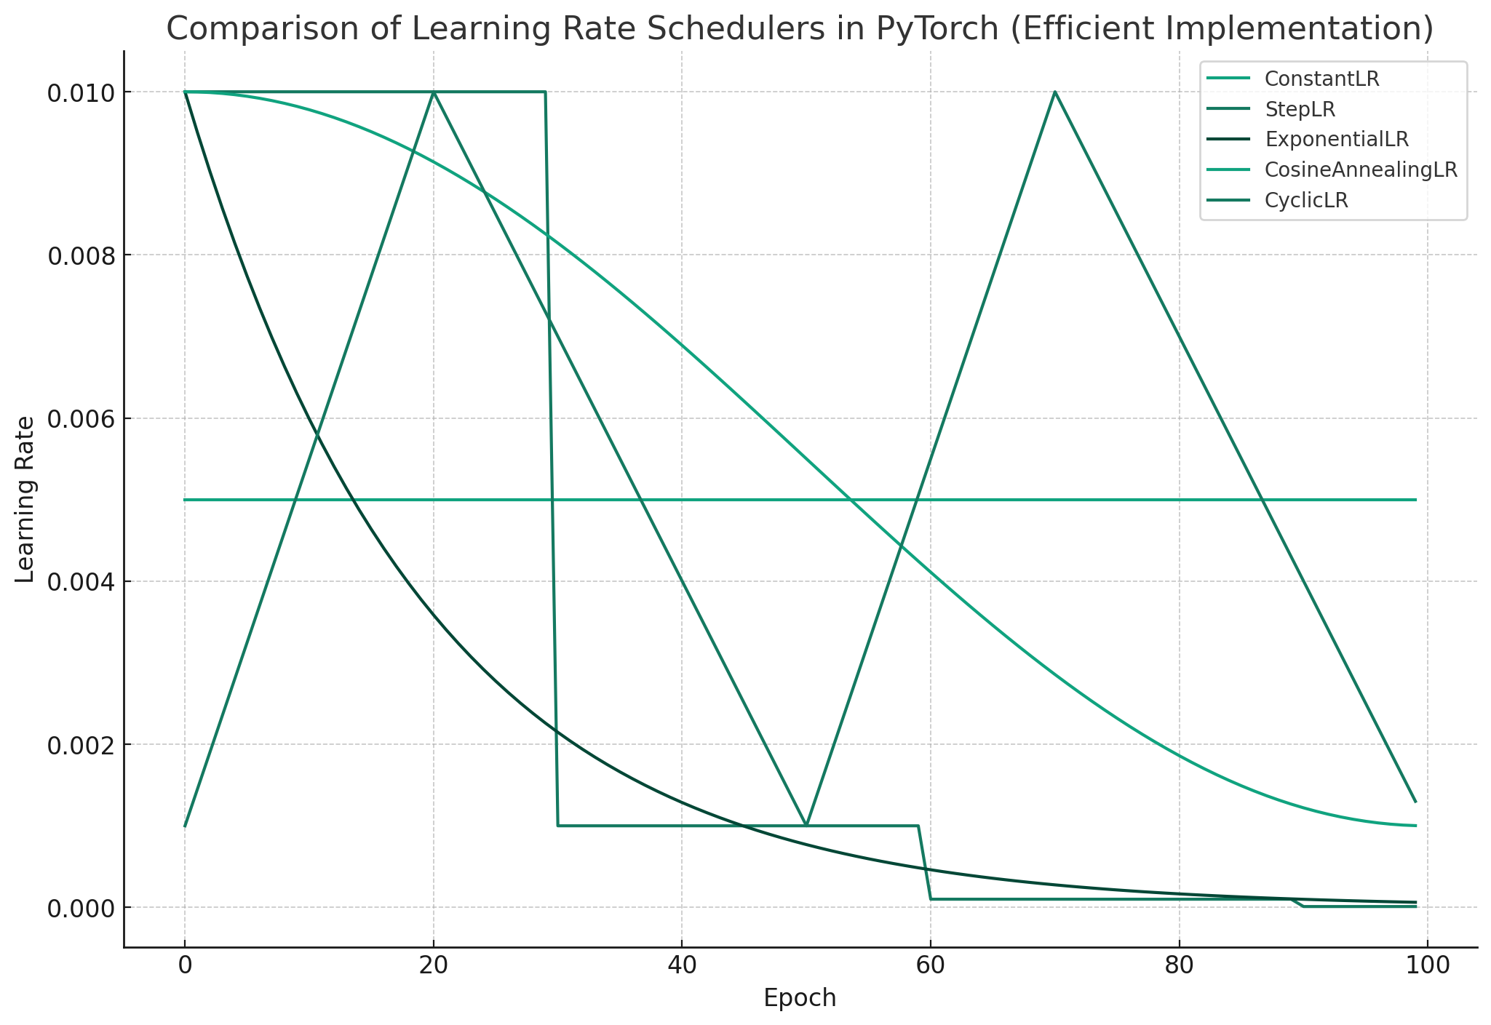
Notes:
# Adjusting the setup to have more cycles for CyclicLR, halving the initial learning rate for ConstantLR,
# and using for loops for more efficient implementation
# List of optimizers and corresponding schedulers
optimizers = []
schedulers = []
# Initial learning rates for different schedulers
initial_lrs = [0.005, 0.01, 0.01, 0.01, 0.01] # Halving the initial LR for ConstantLR
# Creating the optimizers and schedulers
for lr in initial_lrs:
optimizer = torch.optim.SGD([torch.zeros(1)], lr=lr, momentum=0.9)
optimizers.append(optimizer)
schedulers = [
torch.optim.lr_scheduler.LambdaLR(optimizers[0], lr_lambda=lambda epoch: 1),
StepLR(optimizers[1], step_size=30, gamma=0.1),
ExponentialLR(optimizers[2], gamma=0.95),
CosineAnnealingLR(optimizers[3], T_max=100, eta_min=0.001),
torch.optim.lr_scheduler.CyclicLR(optimizers[4], base_lr=0.001, max_lr=0.01, step_size_up=20, step_size_down=30)
]
# Number of epochs for demonstration
num_epochs = 100
# Storing learning rates
lr_lists = [[] for _ in range(len(schedulers))]
for epoch in range(num_epochs):
for i, scheduler in enumerate(schedulers):
lr_lists[i].append(scheduler.get_last_lr()[0])
scheduler.step()
# Plotting
plt.figure(figsize=(12, 8))
scheduler_names = ['ConstantLR', 'StepLR', 'ExponentialLR', 'CosineAnnealingLR', 'CyclicLR']
for i, lr_list in enumerate(lr_lists):
plt.plot(lr_list, label=scheduler_names[i])
plt.xlabel('Epoch')
plt.ylabel('Learning Rate')
plt.title('Comparison of Learning Rate Schedulers in PyTorch (Efficient Implementation)')
plt.legend()
plt.grid(True)
plt.show()

Slide 29
Basic schedulers
StepLR:
What it does: Decreases the learning rate by a certain factor every fixed number of epochs.
Theory: The step decay is based on the idea that as you get closer to the optimal weights, you want to make smaller updates. Large updates in the later stages of training can overshoot the optimal values. By reducing the learning rate at regular intervals, the model makes increasingly finer adjustments, leading to more stable convergence.
ExponentialLR:
What it does: Reduces the learning rate by a fixed multiplicative factor each epoch.
Theory: Similar to step decay, exponential decay ensures that the updates become progressively smaller. This approach is smoother compared to the abrupt changes in StepLR and can lead to more stable training, especially in the final stages of convergence.
CosineAnnealingLR:
What it does: Adjusts the learning rate following a cosine curve, decreasing it to a minimum value and then increasing it back, potentially multiple times during training.
Theory: This scheduler is inspired by the annealing process in metallurgy, a technique involving heating and controlled cooling of a material. In the context of optimization, this can be seen as a way to escape local minima – the increasing phases can provide enough "energy" to jump out of local minima, potentially finding better global minima.
CyclicLR:
What it does: Varies the learning rate between two boundaries in a cyclical manner with a certain step size.
Theory: Proposed by Leslie N. Smith, the cyclic learning rate scheduler is based on the observation that increasing the learning rate can help escape saddle points and local minima, while decreasing it helps in fine-tuning the convergence. By cycling the learning rate, it combines the benefits of exploring the weight space (at higher learning rates) and fine-tuning (at lower learning rates).

