Slide 1

NN Architectures

Slide 2
References
http://cs231n.stanford.edu/index.html
http://www.cs.cornell.edu/courses/cs5670/2019sp/lectures/lectures.html
http://www.cs.cmu.edu/~16385/

Slide 3
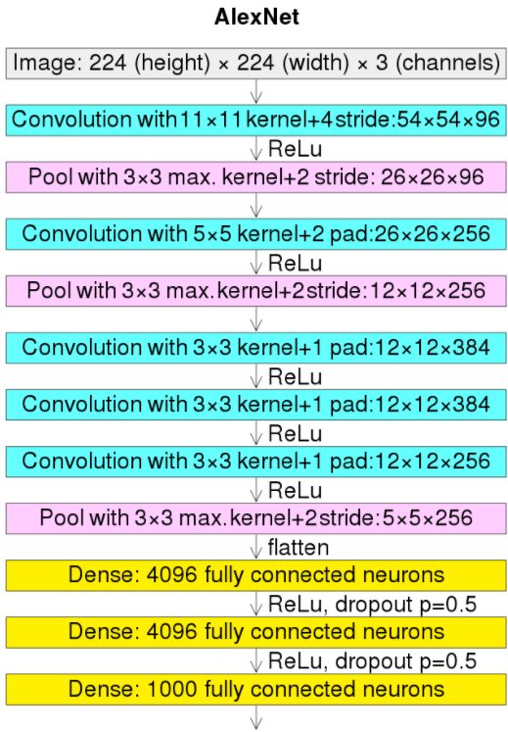
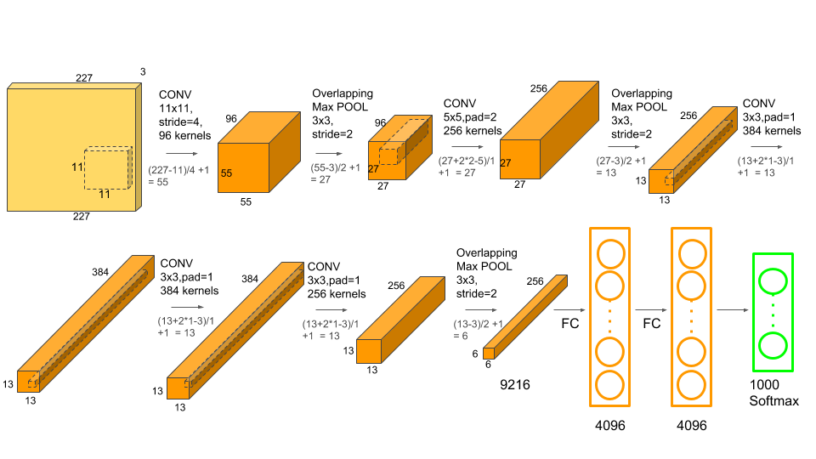
Alexnet
The winner of the 2012 IMAGENET competition (classification % of top 5 out of 1000 labels).
224X224X3 input.
8 learnable layers.
61M parameters.
Note the big kernel sizes.

Slide 4
Alexnet
Article: https://papers.nips.cc/paper_files/paper/2012/hash/c399862d3b9d6b76c8436e924a68c45b-Abstract.html
Publication Date: 2012
Authors:
Alex Krizhevsky
Ilya Sutskever – later OpenAI co-founder
Geoffrey E. Hinton- Received the 2018 Turing Award, often referred to as the "Nobel Prize of Computing", together with Yoshua Bengio and Yann LeCun, for their work on deep learning. They are sometimes referred to as the "Godfathers of Deep Learning“ (Wikipedia)

Slide 5
Alexnet
Key take aways:
Dropouts
L2 regularization
Better optimization: SGD + momentum + weight decay

Slide 6
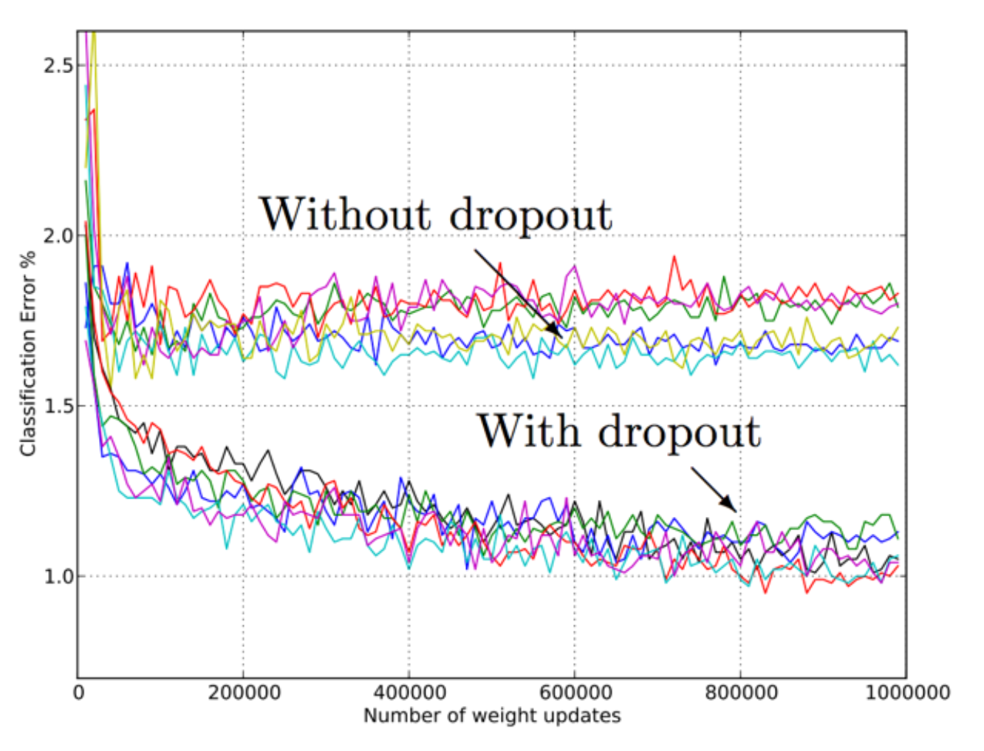
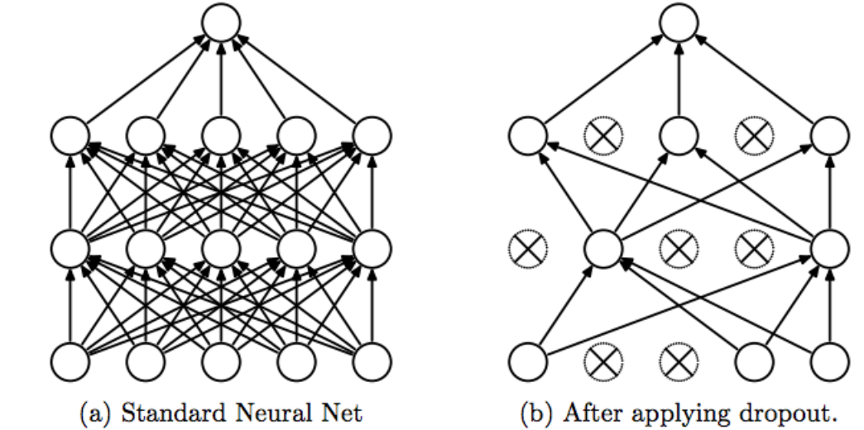
Dropout
Neuron is dropped from the network with a probability of X. When a neuron is dropped, it does not contribute to either forward or backward propagation.
Every input goes through a different network architecture, as a result, the learnt weight parameters are more robust.
During testing, there is no dropout and the whole network is used, but output is scaled by a factor of 1/X to account for the missed neurons while training.

Slide 7
Dropout
Advantage: with dropout, the remaining neurons must learn to handle a broader range of features on their own, rather than relying on a specific combination of other neurons (“co-adaptation”).
This leads to a more robust model that is better at representing the underlying data distribution (generalization), rather than overly specific features of the training set (overfitting).
Disadvantage: dropout can slow down the convergence of a training process. This is because, on each iteration, only a subset of neurons is active.

Slide 8
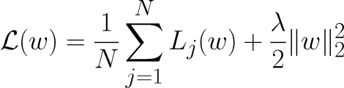
L2 regularization
Also known as ridge regression or Tikhonov regularization.
A technique used to reduce the complexity of a model and can give better generalization.
This is how we can change our loss function:
The bigger weights give bigger loss error and therefore the model will want to learn smaller weights.
L2 regularization

Slide 9
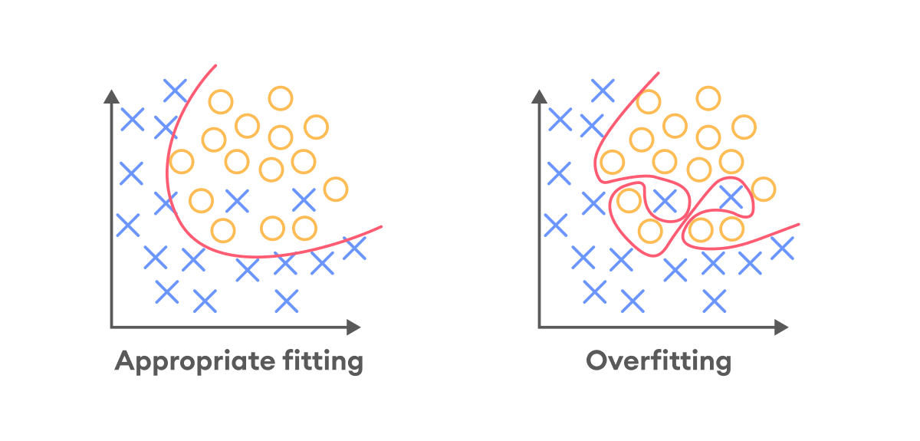
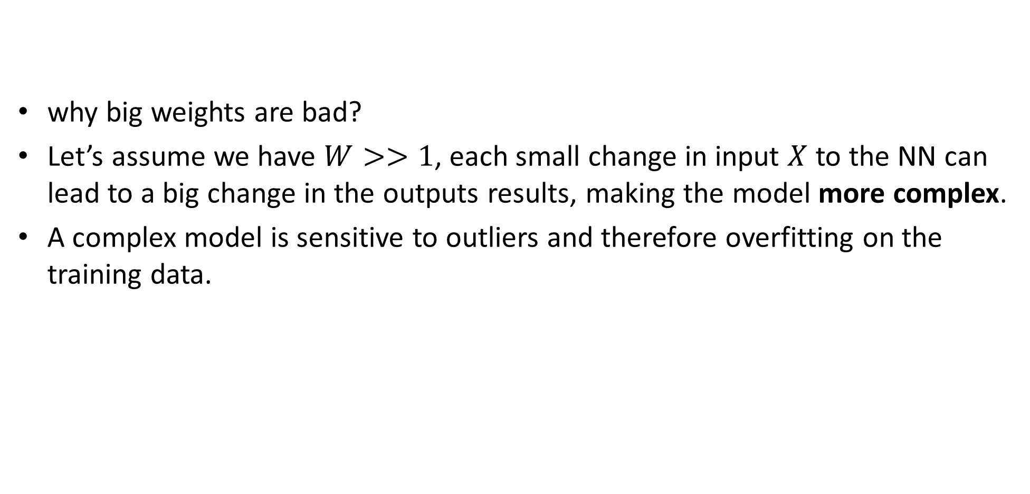
L2 regularization
why big weights are bad?
Let’s assume we have $W>>1$, each small change in input $X$ to the NN can lead to a big change in the outputs results, making the model more complex.
A complex model is sensitive to outliers and therefore overfitting on the training data.

Slide 10
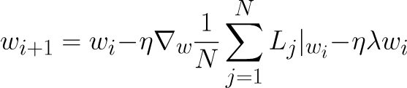
L2 regularization
Regularizing for small weights can lead to smoother model representation and better generalization.
Meaning our SGD step will look like:
This is also called weight decay because we are removing a bit of the old weights from the new weights every iteration
Notes:
\nabla_w\mathcal{L} = \nabla_w \frac{1}{N}\sum_{j=1}^NL_j(w) + \lambda w
w_{i+1} = w_i -\eta \nabla_w \frac{1}{N}\sum_{j=1}^NL_j|_{w_i} -\eta \lambda w_i

Slide 11
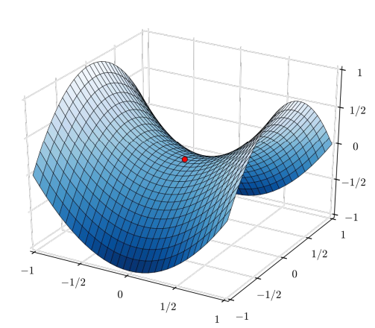
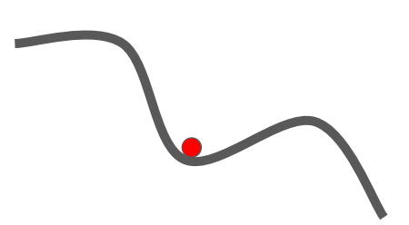
SGD + momentum
Main problem with SGD: can get “stuck” in zero gradient places: local minima & saddle points

Slide 12


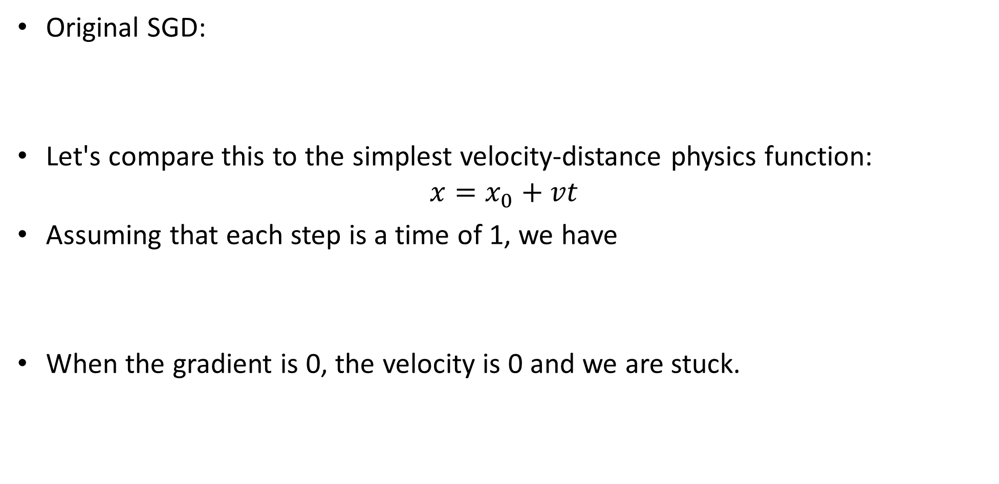
SGD + momentum
Original SGD:
Let's compare this to the simplest velocity-distance physics function:
$$x=x_{0}+vt$$
Assuming that each step is a time of 1, we have
When the gradient is 0, the velocity is 0 and we are stuck.
Notes:
v \leftrightarrow -\eta \nabla_w \mathcal{L}

Slide 13
SGD + momentum
If we “remember” the previous velocity and mean it with our current velocity, we can maintain “momentum”.

Slide 14
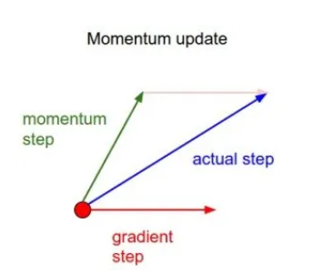


SGD + momentum
Original SGD:
SGD + momentum:
Where $α$is the momentum coefficient : A typical choice is between 0.5 and 0.9. Higher values give more weight to past gradients.
Notes:
\left\{\begin{matrix} v_i = \alpha v_{i-1}- \eta \nabla_w \sum_{j=0}^NL_j(w) \\ w_i = w_{i-1} + v_i \end{matrix}\right.

Slide 15
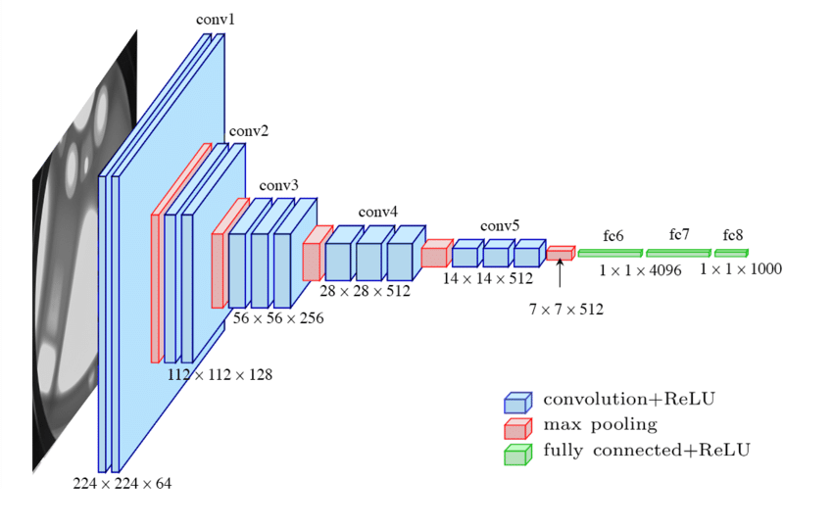
VGG16
Winner of IMAGENET 2014 classification challenge (Oxford research)
16 layers (there are also other variations with 11,13 and 19 layers)- meaning the NN can learn more abstract features.
138M parameters.
Used small receptive fields with stacked conv layers (shown before)- compared to 11X11 and 5X5 in AlexNet, her there is only 3X3 layers.
Still in use today!

Slide 16
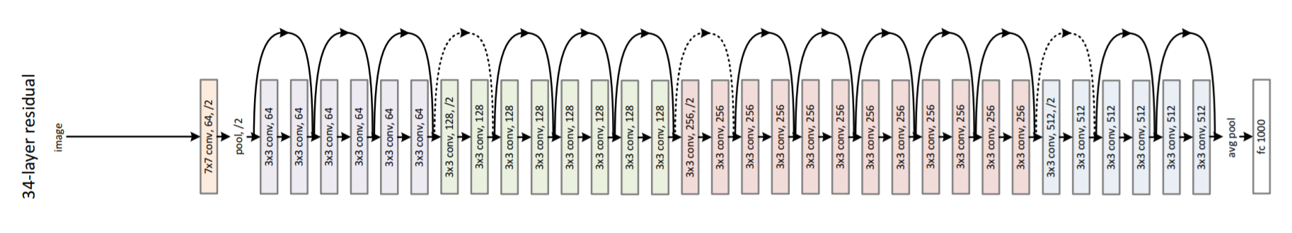
ResNet
Winner of IMAGENET 2015 classification challenge (Microsoft research).
152 layers (there are also other variations with 18,34,50 and 101 layers).
60M parameters (<0.5X VGG16!!!).
Still in use today!

Slide 17
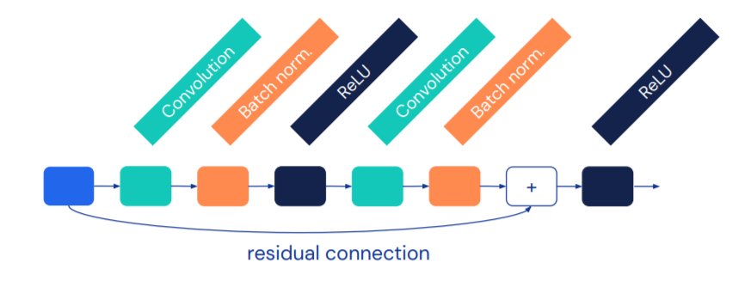
ResNet
Interesting blocks:
Batch norm (for vanishing gradient problem).
Residual block (for train accuracy degradation) – out of scope.

Slide 18
Vanishing gradient

