Slide 1
Weather Analysis
Akron, OH and Asheville, NC

Slide 2
Introduction

Slide 3
Purpose
Analyze historical weather data from Akron, OH and Asheville, NC
Determine whether the average temperature in Asheville, NC is warmer than Akron, OH

Slide 4

Asheville, NC overview
Located in north east North Carolina.
Population of 89,121
Known for vibrant art culture and historical architecture
Amazing Pubcycle

Slide 5
Comparison
Akron, OH
Asheville, NC
Latitude 40.9181
Elevation 369.7
Latitude 35.4319
Elevation 645.3

Slide 6
Data

Slide 7
Source
From National Oceanic and Atmospheric Administration Global Historical Climate Daily dataset
Daily records from 01/01/2014 to 12/31/2017
Field Name | Data Type | Description
STATION | String | Station ID
Date | Date | Date of the weather record
TAGV | Integer | Average temperature in Fahrenheit (average of hourly values)

Slide 8
Descriptive Statistics
Descriptive Statistics for Akron Data
 | TAVG
Observations | 1,461
Mean | 51.93
Median | 55
Standard Deviation | 19.178
Minimum | -6
Maximum | 83
Descriptive Statistics For Asheville Data
 | TAVG
Observations | 1,461
Mean | 56.99
Median | 59
Standard Deviation | 14.73
Minimum | 7
Maximum | 80

Slide 9
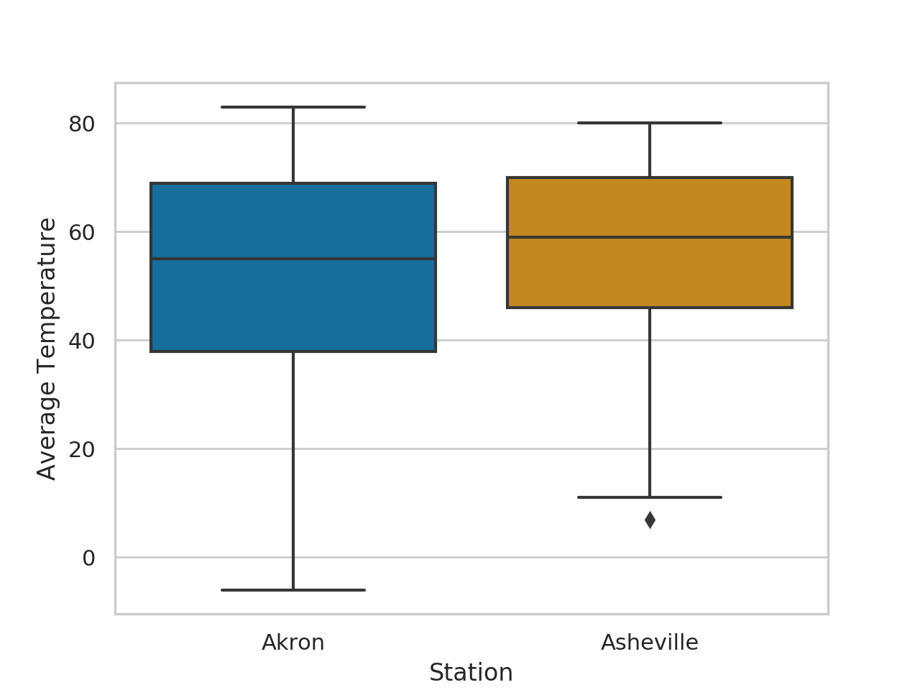
Box plot

Slide 10
Test

Slide 11
Test
Two sample Z test
Population distribution unknown, but because sample size is large can assume normal by central limit theorem
95% confidence

Slide 12
Test
H₀: Akron average temperature – Asheville average temperature = -5
Ha: Akron average temperature – Asheville average temperature < -5
Test statistic: z = -0.090892
-0.090892 > -1.645
Fail to reject null hypothesis, inconclusive

Slide 13
Looking deeper

Slide 14
Box plot

Slide 15
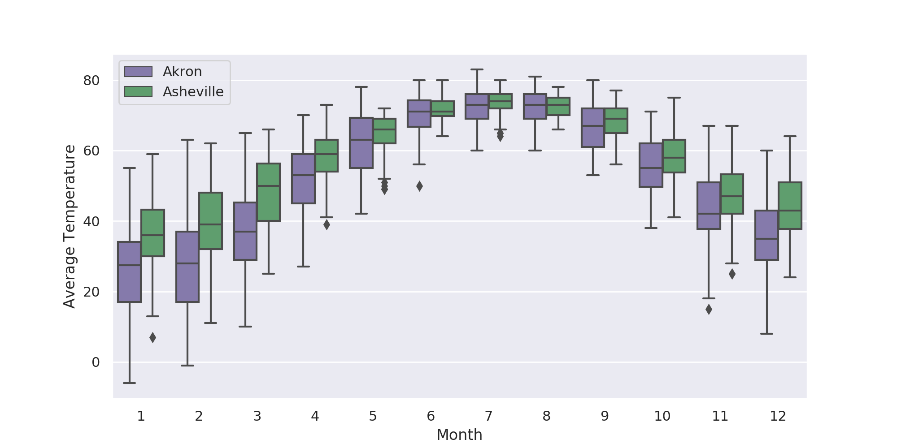
Data by month

Slide 16
Winter descriptive statistics
Descriptive Statistics for Akron Winter
 | TAVG
Observations | 361
Mean | 29.70
Median | 31
Standard Deviation | 13.16
Minimum | -6
Maximum | 63
Descriptive Statistics For Asheville Winter
 | TAVG
Observations | 361
Mean | 39.94
Median | 40
Standard Deviation | 10.42
Minimum | 7
Maximum | 64

Slide 17
Summer descriptive statistics
Descriptive Statistics for Akron Summer
 | TAVG
Observations | 368
Mean | 71.77
Median | 72
Standard Deviation | 5.22
Minimum | 50
Maximum | 83
Descriptive Statistics For Asheville Summer
 | TAVG
Observations | 368
Mean | 72.63
Median | 73
Standard Deviation | 3.28
Minimum | 64
Maximum | 80

Slide 18
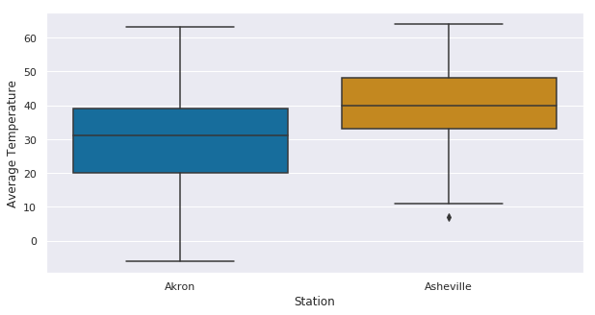
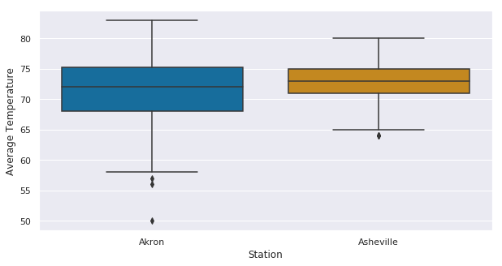
Box plot
Winter
Summer

Slide 19
Test again

Slide 20
Winter test
Two sample Z test
Population distribution unknown, but because sample size is large can assume normal by central limit theorem
95% confidence

Slide 21
Winter test
H₀: Akron winter average temperature – Asheville winter average temperature = -8
Ha: Akron winter average temperature – Asheville winter average temperature < -8
Test statistic: z = -2.530
-2.530 < -1.645
Reject null hypothesis, Asheville winter average temperature greater than 8 degrees warmer than Akron’s winter average temperature

Slide 22
Summer test
Two sample Z test
Population distribution unknown, but because sample size is large can assume normal by central limit theorem
95% confidence

Slide 23
Summer test
H₀: Akron winter average temperature – Asheville winter average temperature = -2
Ha: Akron winter average temperature – Asheville winter average temperature > -2
Test statistic: z = 3.551
3.551 > 1.645
Reject null hypothesis, Asheville summer average temperature less than 2 degrees warmer than Akron’s winter average temperature

Slide 24
Conclusion
When looking at the entire year temperature, then we are not able to make on conclusions about the temperature difference between Akron, OH and Asheville, NC
When looking at just the winter months, we are able to conclude that the average temperature in Asheville, NC is greater than 8 degrees warmer than Akron, OH.
When looking at just the summer months, we are able to conclude that the average temperature in Asheville, NC is less then 2 degrees warmer than Akron, OH.

Slide 25
Thank you
Access data, calculations, and full report at https://github.com/EricMaibach/AkronAshevilleWeatherAnalysis

