Slide 1





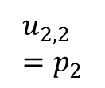






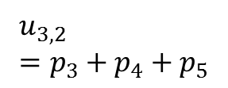





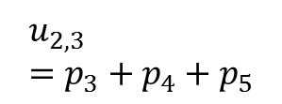





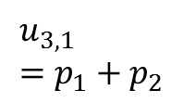
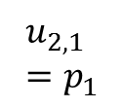

$$T_{3}$$
(a)
$$T_{2}$$
$k=$1
$$T_{1}$$
$${S=L}_{1}=5$$
$$p_{1}$$
$$p_{2}$$
$$p_{3}$$
$$p_{4}$$
$$p_{5}$$
$$\left(u_{1,s}=p_{s}\right)$$
(b)
$$k=2$$
(c)
$$k=K=3$$
$$T_{3}$$
$$L_{2}=3$$
$$L_{3}=2$$
$$T_{2}$$
$$U_{3,1}=2$$
$$U_{3,2}=3$$
$U_{2,1}=$1
$U_{2,2}=$1
$$U_{2,3}=3$$
$$u_{3,1}=p_{1}+p_{2}$$
$$u_{3,2}=p_{3}+p_{4}+p_{5}$$
$$u_{2,1}=p_{1}$$
$$u_{2,2}=p_{2}$$
$$u_{2,3}=p_{3}+p_{4}+p_{5}$$

