Slide 1
Professor Office Hour Scheduler
CIS 4301- Information Systems Design and Development
Dr. Granville
December 2, 2015
By: Trenique Barker, Joshua Diggs, Teayair Harrison, and Eric Mayberry

Slide 2
Table of Contents
Gantt Chart
Use Case Diagram
Activity Diagram
Class Diagram
Sequence Diagram
Wireframes
Request for Proposal
Response Proposal
Functional Requirements
Business Rules
ER Diagram
Database Table Design

Slide 3
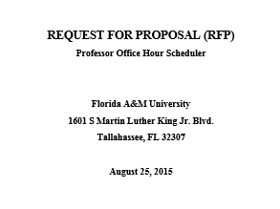
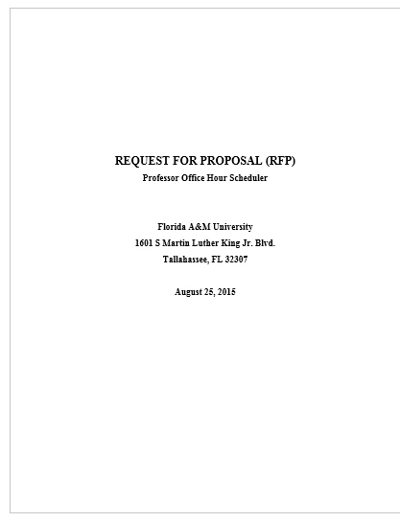
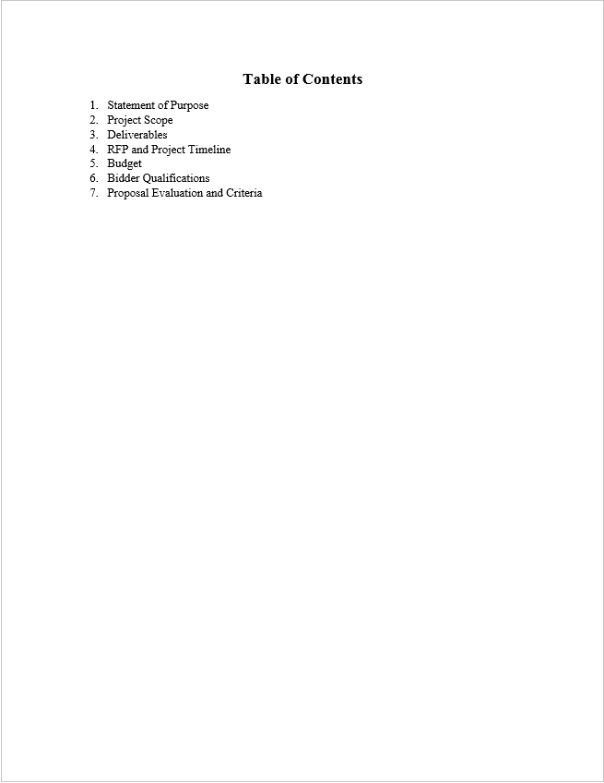
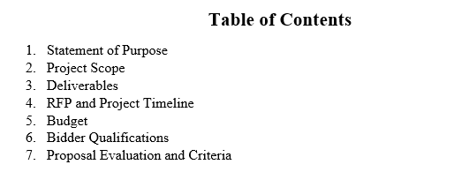
Request for Proposal

Slide 4

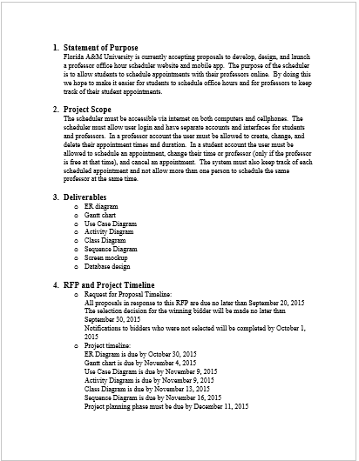
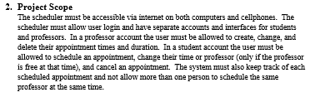
Request for Proposal cont…

Slide 5
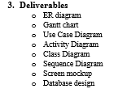
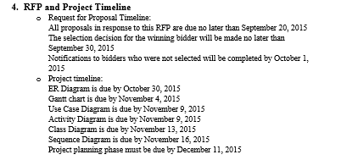
Request for Proposal cont…

Slide 6
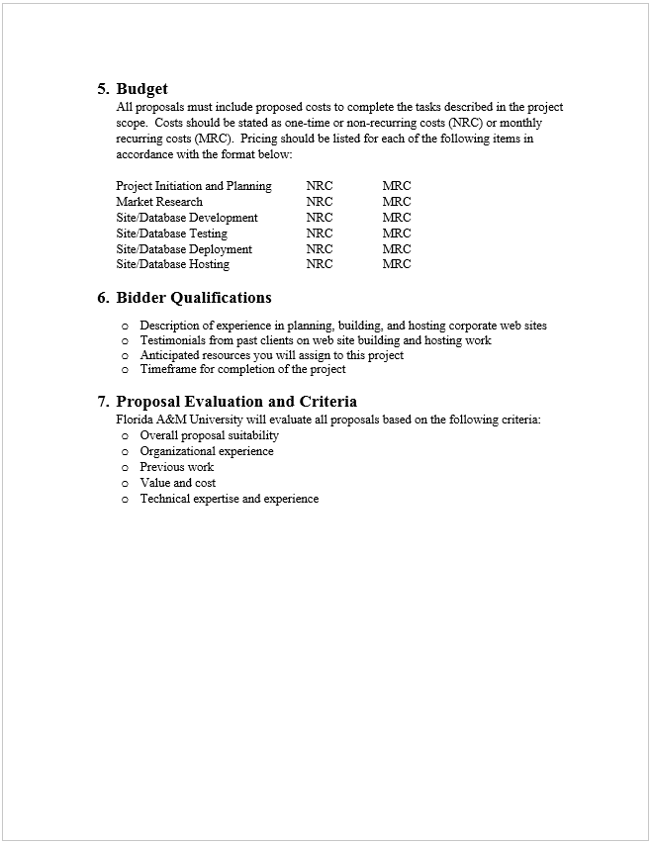
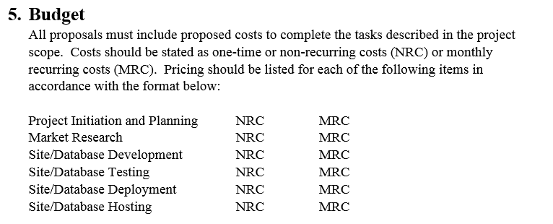
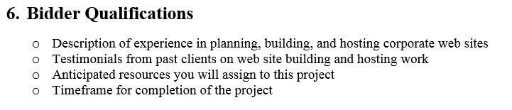
Request for Proposal cont…

Slide 7
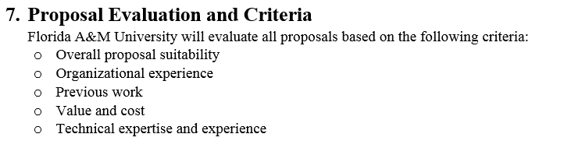
Request for Proposal cont…

Slide 8
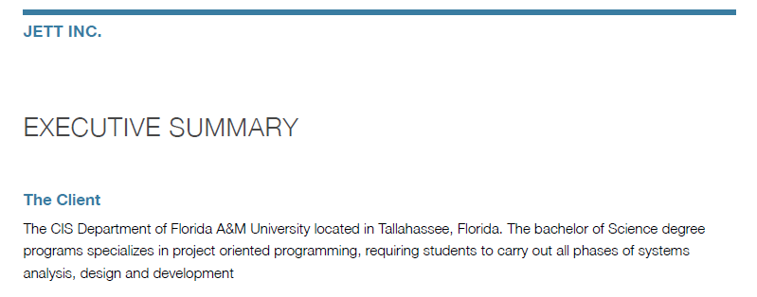
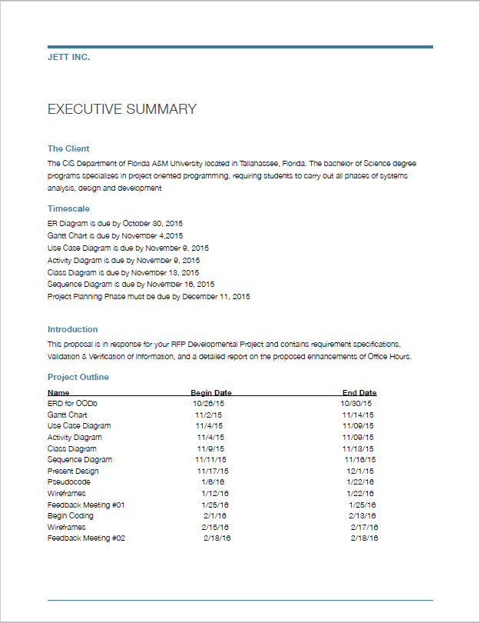
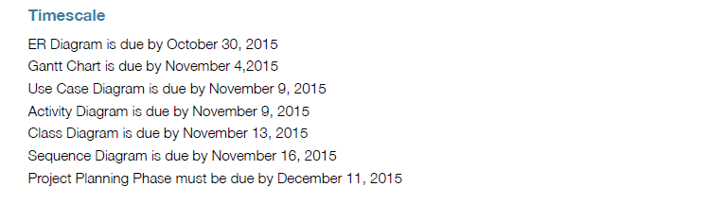
Response Proposal

Slide 9
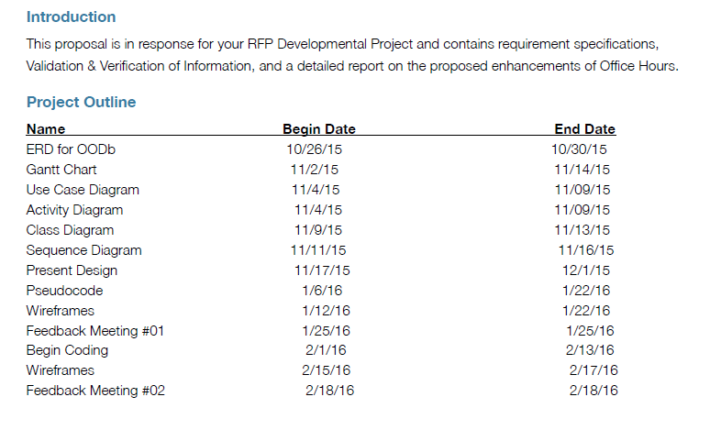
Response Proposal cont…

Slide 10
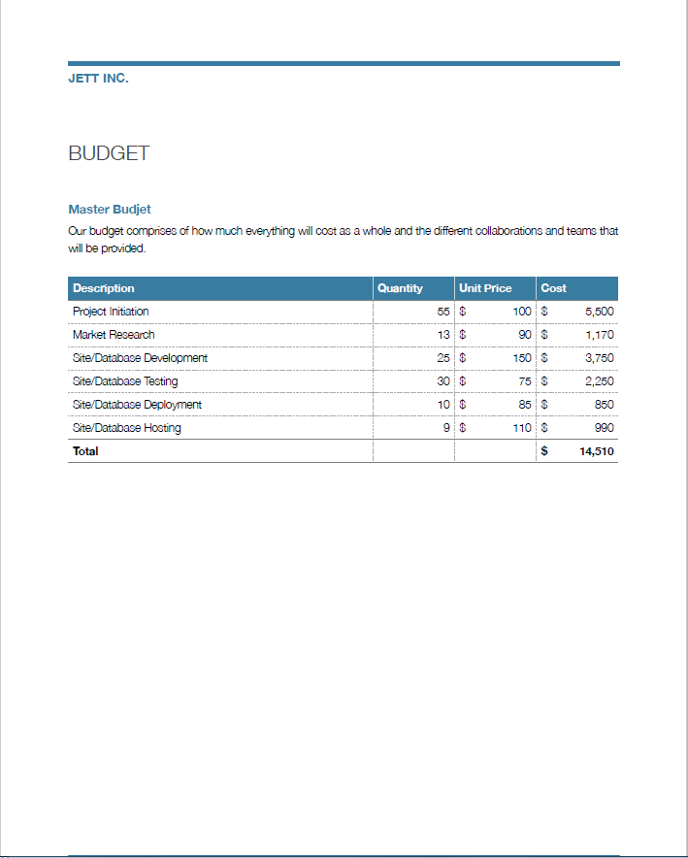
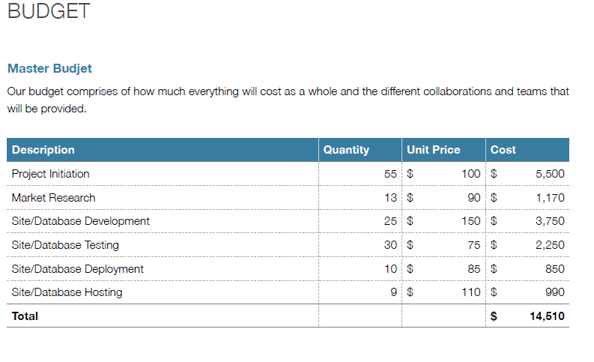
Response Proposal cont…

Slide 11
Functional Requirements
Student
Professor
User goes to website or mobile app
  User Sign-in
    Invalid login
  User Sign-up
    All fields are not filled
    User Sign-in
Login validated
Select appointment option
Select Professor
Select available time and date
Enter in information
Submit
Exit system
User goes to website or mobile app
User sign-in
  Login invalid
Login validated
Select Day and time
Select view, create, or delete appointment time
Submit
Exit system

Slide 12
Business Rules
Each STUDENT meets with zero or more INSTRUCTORS
Each INSTRUCTOR has a meeting with zero or more STUDENTS
Each STUDENT can set up zero or more MEETINGS
Each MEETING can be set up by zero or one STUDENTS
Each PROFESSOR can schedule zero or more MEETINGS
Each MEETING can be set up by only one PROFESSOR

Slide 13
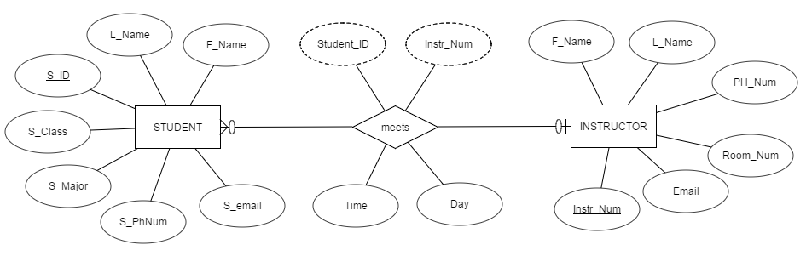
ER Diagram

Slide 14
Database Table Design

Slide 15
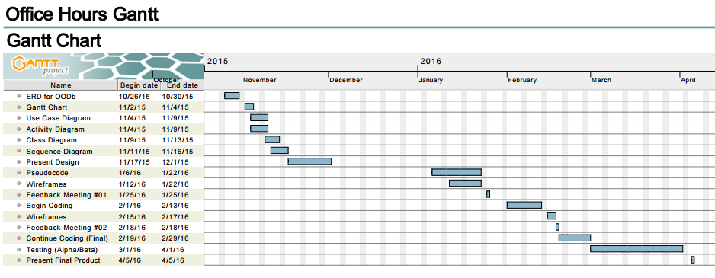
Gantt Chart

Slide 16
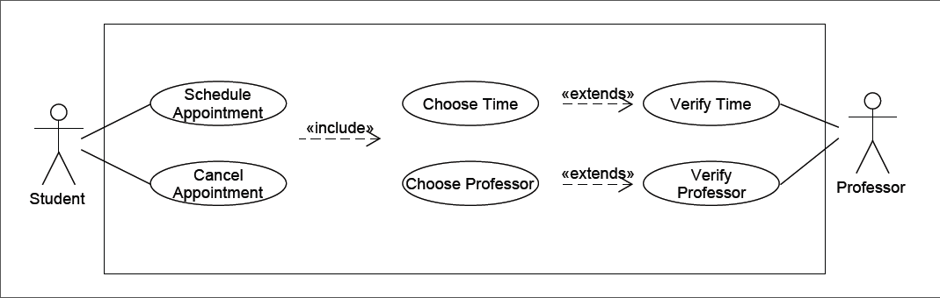
Use Case Diagram

Slide 17
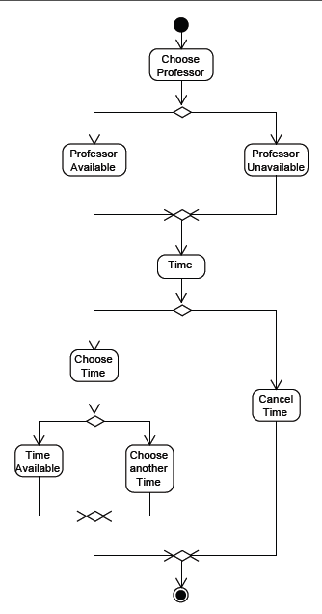
Activity Diagram

Slide 18
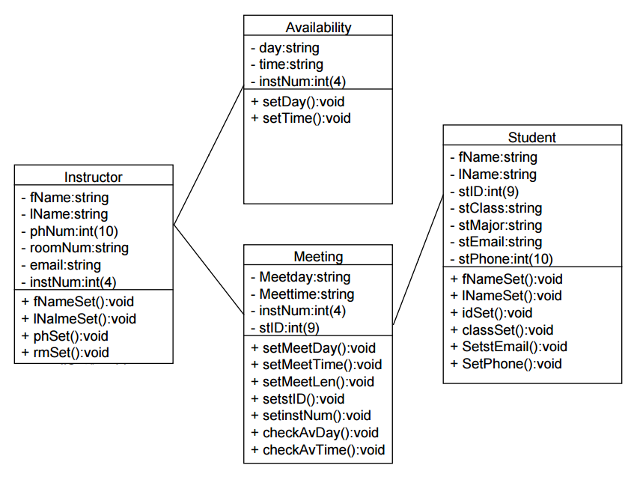
Class Diagram

Slide 19
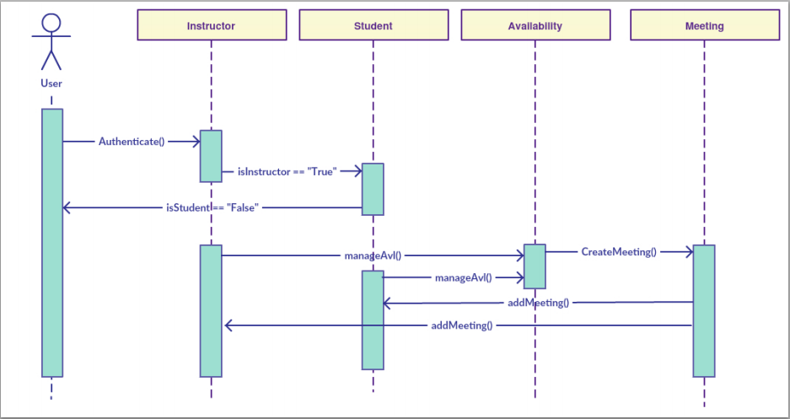
Sequence Diagram

Slide 20
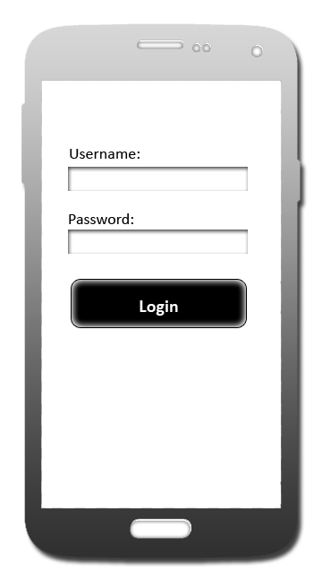

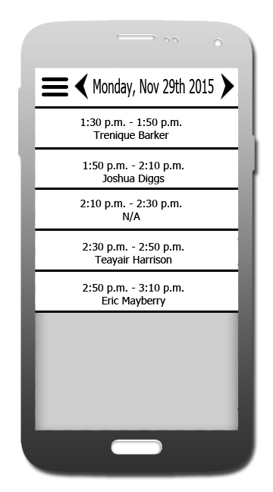
Wireframes
User Login
Student Schedule
Professor Schedule

Slide 21
THE END

