Slide 1



BU CS 611 |
05/08/2025
GRADING SYSTEM APP
CS 611: Object-oriented Software Principles and Design
FINAL PROJECT:
PRESENTED BY:
Grading System Application
Juling Fan, Kelvin Kuang, Eric Nohara-Leclair

Slide 2


03 | Overview
04 | Key Features
05 | Architecture and Design Patterns
06 | Database Schema
07 | User Interface
08 | Future Enhancements
09 | Live Demo
10 | Questions and Discussion
Agenda

Slide 3

01
Course Reusability Across Semesters:
Teachers typically teach the same course in different semesters
While content may change, assignment structure often remains consistent
Currently, every new semester requires rebuilding the entire class from scratch
03/10
Overview
02
Template-Based Course Creation:
Need for course templates that can be reused
Ability to copy structure from previous classes
Customize for new semester while preserving core components
A comprehensive academic grading system with:
User roles (Student, Grader, Teacher, Admin)
Course creation and management
Assignment creation and submission
Grading workflows
Templates for reuse across semesters
Statistics and reporting
03
Automated Grade Calculation:
Current tools (like Gradescope) lack automatic grade computation
Need for weighted average calculations across different assignment types
Statistical analysis for determining curves and adjustments

Slide 4


04/10
Key Features
Multiple User Roles
Course Management
Assignment Handling
Grading
Students: submit assignments, view grades
Graders: grade submissions
Teachers: create courses, assignments, templates
Admins: manage users, system settings
Create/edit/delete courses
Template-based course creation
Student enrollment management
Various assignment types (Homework, Quiz, Exam, Project)
File uploads with type validation
Deadline enforcement
Group submission support
Customizable rubrics
Grade calculations with different strategies
Statistics and reports
Grade export

Slide 5
Architecture and Design Patterns
05/10
MVC-like Architecture:
Model: User, Course, Assignment, Submission classes
View: Dashboard frames and panels
Controller: DAO classes and manager interfaces
Design Patterns
Singleton Pattern: Database connections, DAO instances
Strategy Pattern: Different grading strategies (Proportional, Pass/Fail)
Factory Pattern: Creating user instances based on role
DAO Pattern: Database access layers

Slide 6
Database Schema
06/10
Schema Design:
Normalized Design: Minimize redundancy through proper relationships
Templates: Separate templates from instances for easy reuse across semesters
Many-to-Many Relationships: Junction tables for enrollments and submissions
Status Tracking: Track submission, grading, and enrollment states
Referential Integrity: Foreign key constraints ensure data consistency

Slide 7
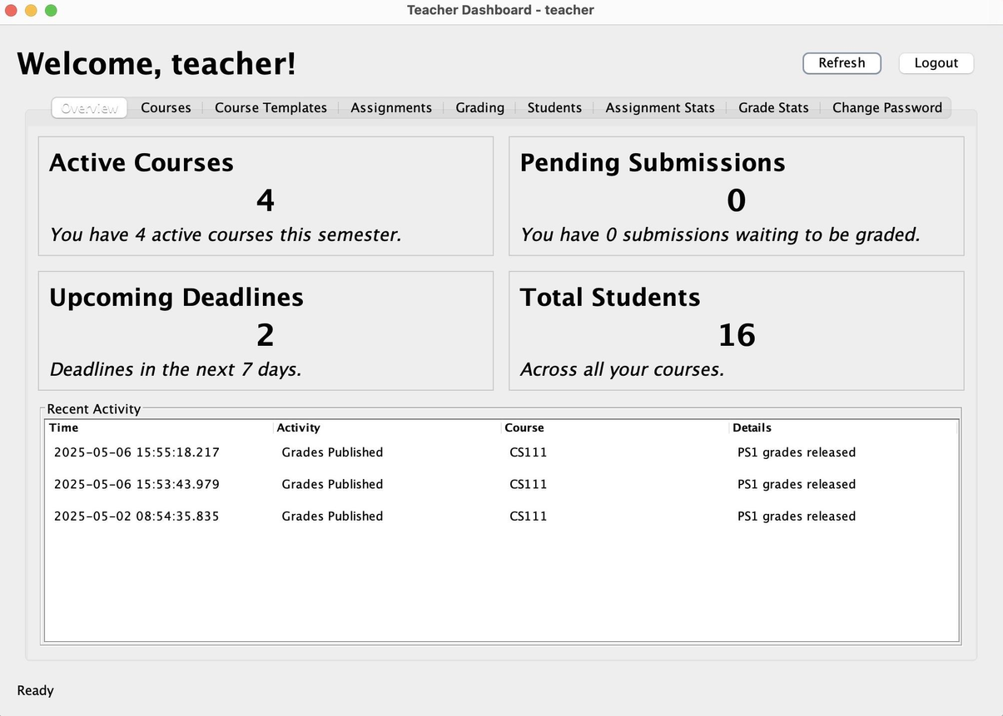
User Interface
07/10
Login and Authentication
Secure password hashing
Role-based access control
Role-Specific Dashboards
Different views for different user roles
Tabbed interfaces for functionality organization
Cards for summary statistics
Assignment Management
Create assignments from templates
Set deadlines and submission requirements
View and manage submissions

Slide 8
Future Enhancements
08/10
Extensibility:
New Assignment Types: Easy to add
Grading Strategies: Pluggable system
User Roles: Expandable as needed
Templates: Support for diverse course structures
Future Features:
Support for email notifications
Plagiarism detection
Peer review functionality
More advanced statistics
Web interface

Slide 9

09/10
Live Demo

Slide 10

09/10
Thank You
Questions?

