Slide 1
Automatic Attendance Metric Tracker
Kelvin, Eric, Howell

Slide 2
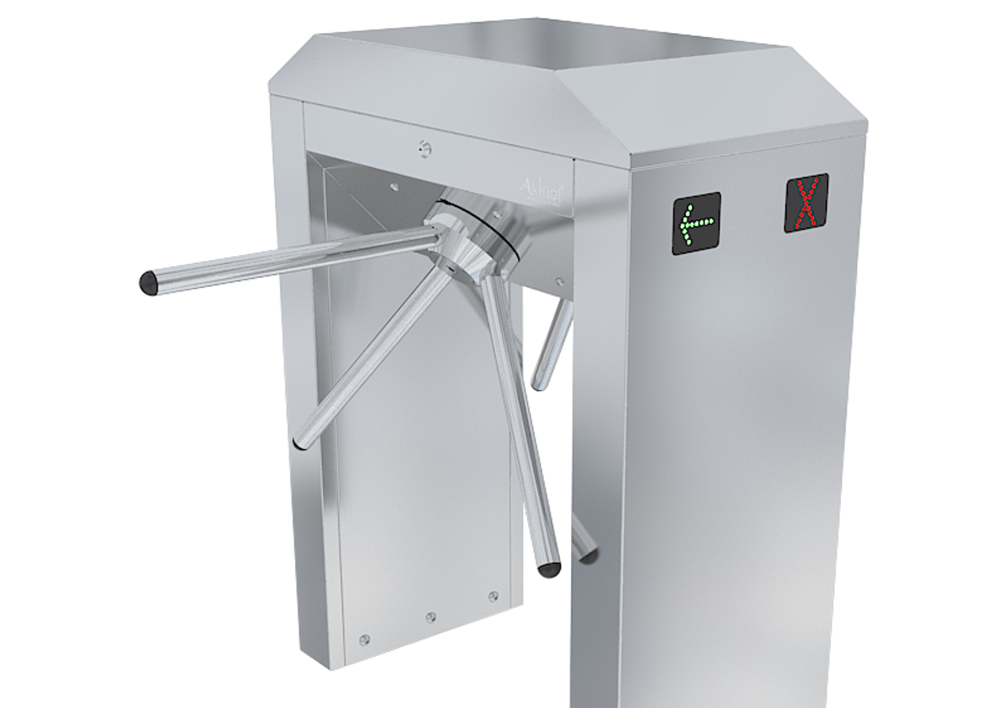
Our Project Idea
Automate attendance tracking in a non-blocking fashion
Keeps a running total of people in a given space
Ability to request real-time attendance data from client
HTML formatted response from web server
Different due to its crowd efficiency and real-time updates

Slide 3
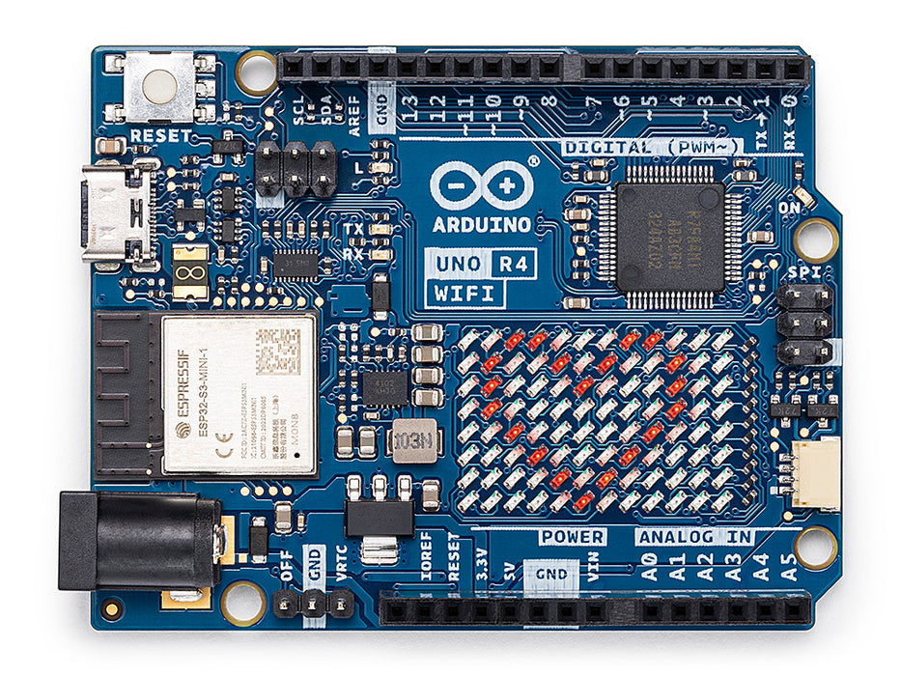
Hardware Decisions
Arduino® UNO R4 WiFi
Built in Wi-Fi and Bluetooth capabilities
Easy serial communication
Ultrasonic Sensors
Sensor range within scope of our project
Works well indoors/outdoors
Possible issue: may not work well in loud environments

Slide 4
Technical Details
2 IR sensors on each side of a door frame
Sensor 1 -> sensor 2 = person entered
Sensor 2 -> sensor 1 = person exited
Send running total to web server via serial communication
CGI script which gets data and formats it nicely
Client requests data from web server

Slide 5
Technical Challenges
Feeding data from Arduino to our web server via serial connection
Possibly sending the data to the user over email
Use ESMTP protocol to send formatted email to recipient specified by the client
Using Arduino for the first time

Slide 6
Timeline and Deliverables
Web Server
Initial Design
Implement initial concept for the project which sends response to the client
Cached Web Server
Implement sending attendance data to specified email
Additional Metrics
ESMTP Email Sending
Implement the web server to the required functionality
Implement the cached web server as specified
Implement visual attendance trends over time
1
2
3
4
5

Slide 7
Thank You!

