Slide 1

Modularizing React Applications
With Established UI patterns
How layering the architecture.
Notes:
UI patterns : data fetch, state management, etc …
This focused on refactoring the code to make a fit for an large applications. How layering architecture

Slide 2
React Application
Not a framework but just a library for views
Everything-in-component
View
No-View
Notes:
Less – organized structure
Can increase reusability and scalable readable, easy to debug

Slide 3
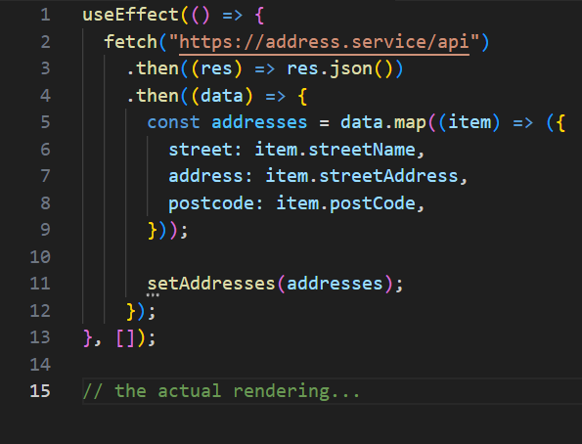
Example of Everything-in-component

Slide 4
Real world react applications
User interface is a pure function to map data into the DOM.
LESS-PURE FUNCTION
Send a network request.
?
Side effects like page navigation.

Slide 5
Front-end stuff
User interfaces
Router
Local storage, cache
Network requests
3rd-party integrations
3rd-party login
Security etc.
View-Model-Data
Architecture
(focus on the three topics
(i.e., view, model, data)
relatively independently)
Notes:
(focus on the three topics (i.e., view, model, data)
Relatively independently)

Slide 6

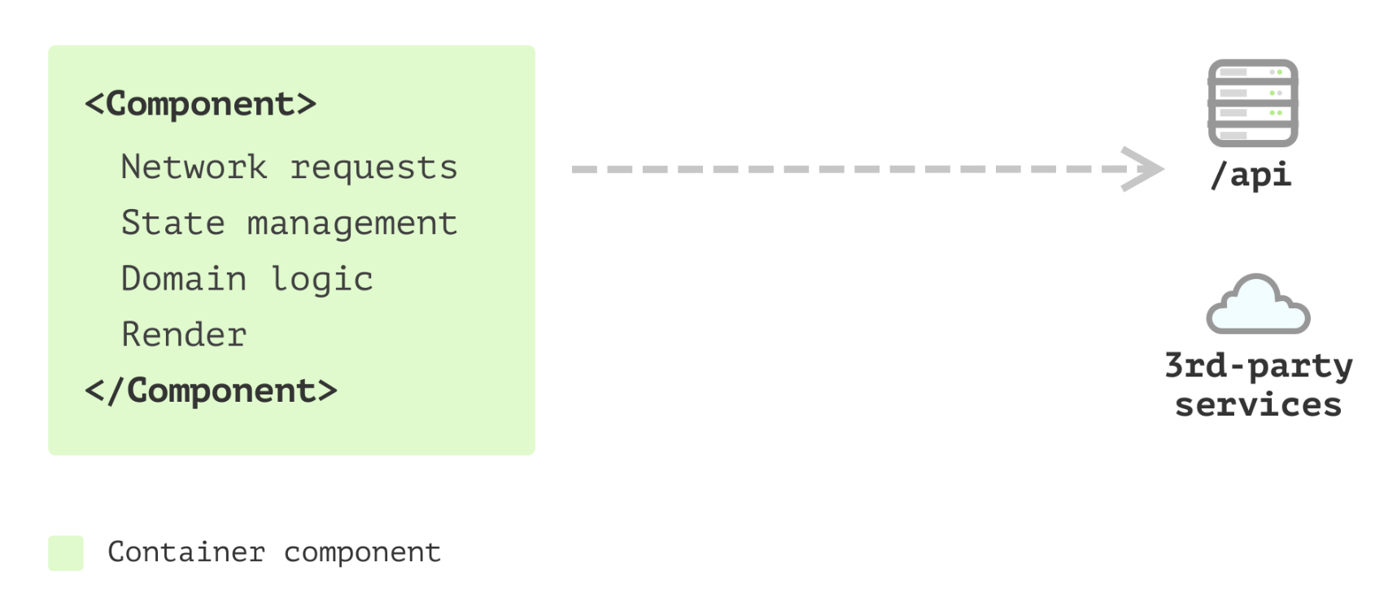
Single Component Application

Slide 7
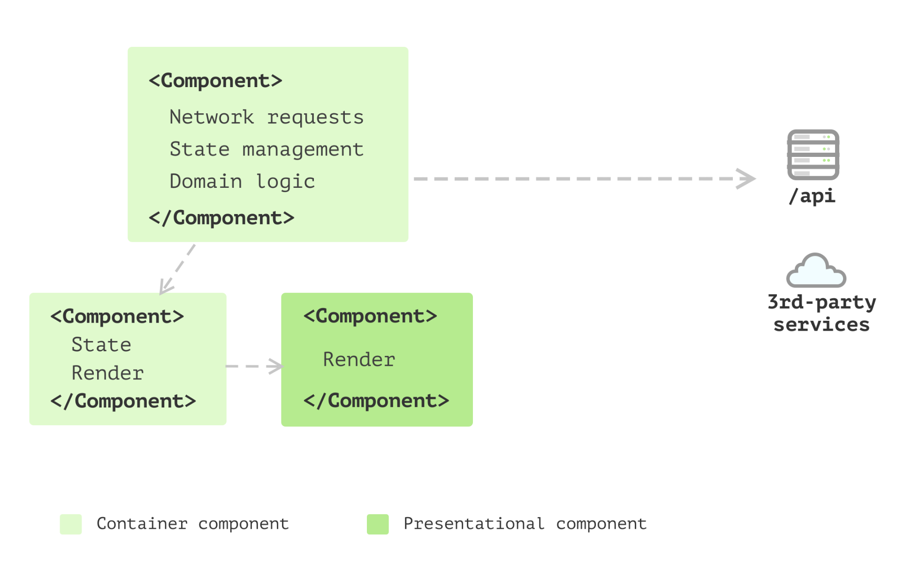
Multiple Component Application

Slide 8
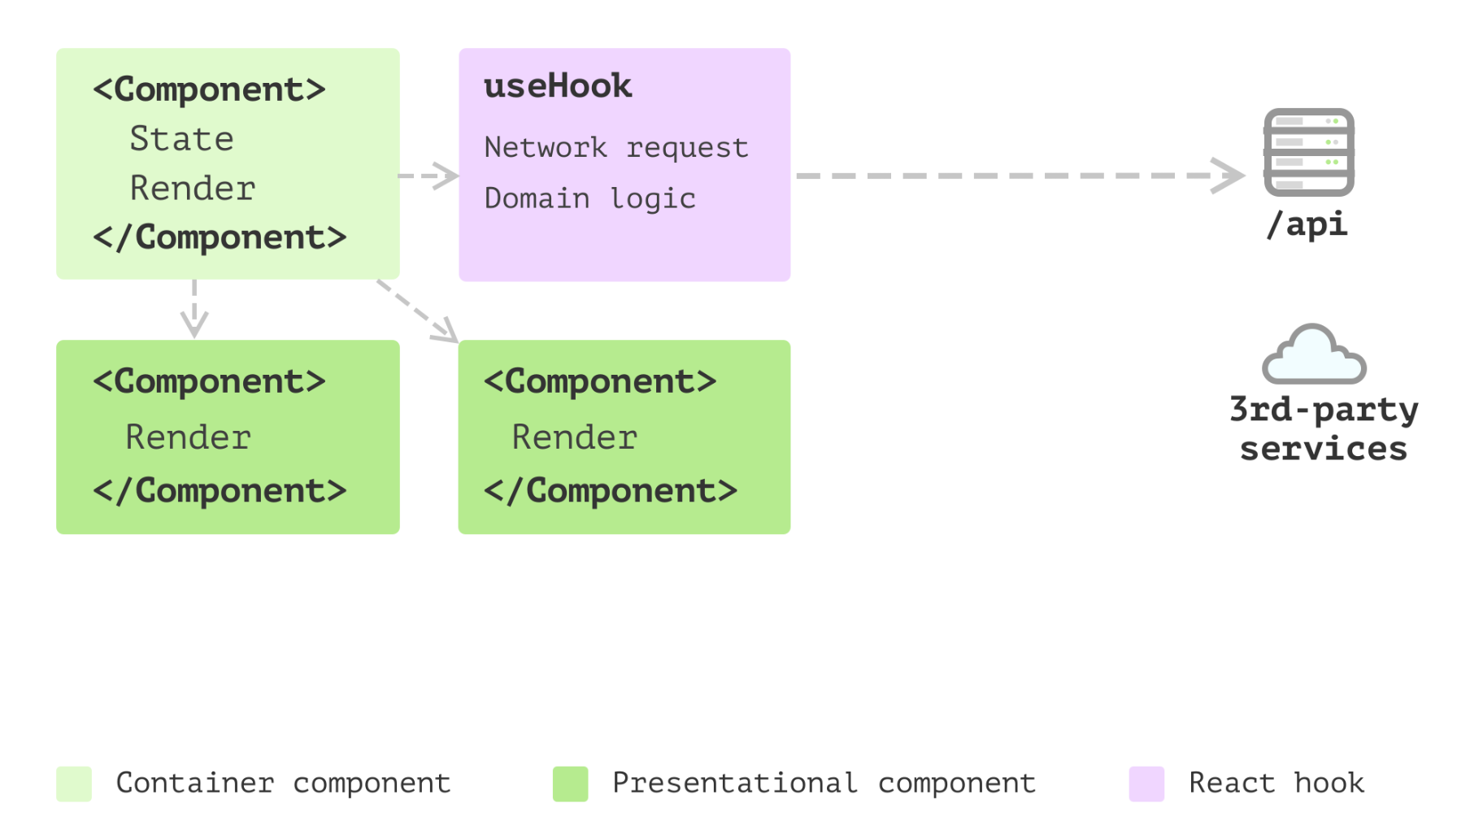
State management with Hooks

Slide 9
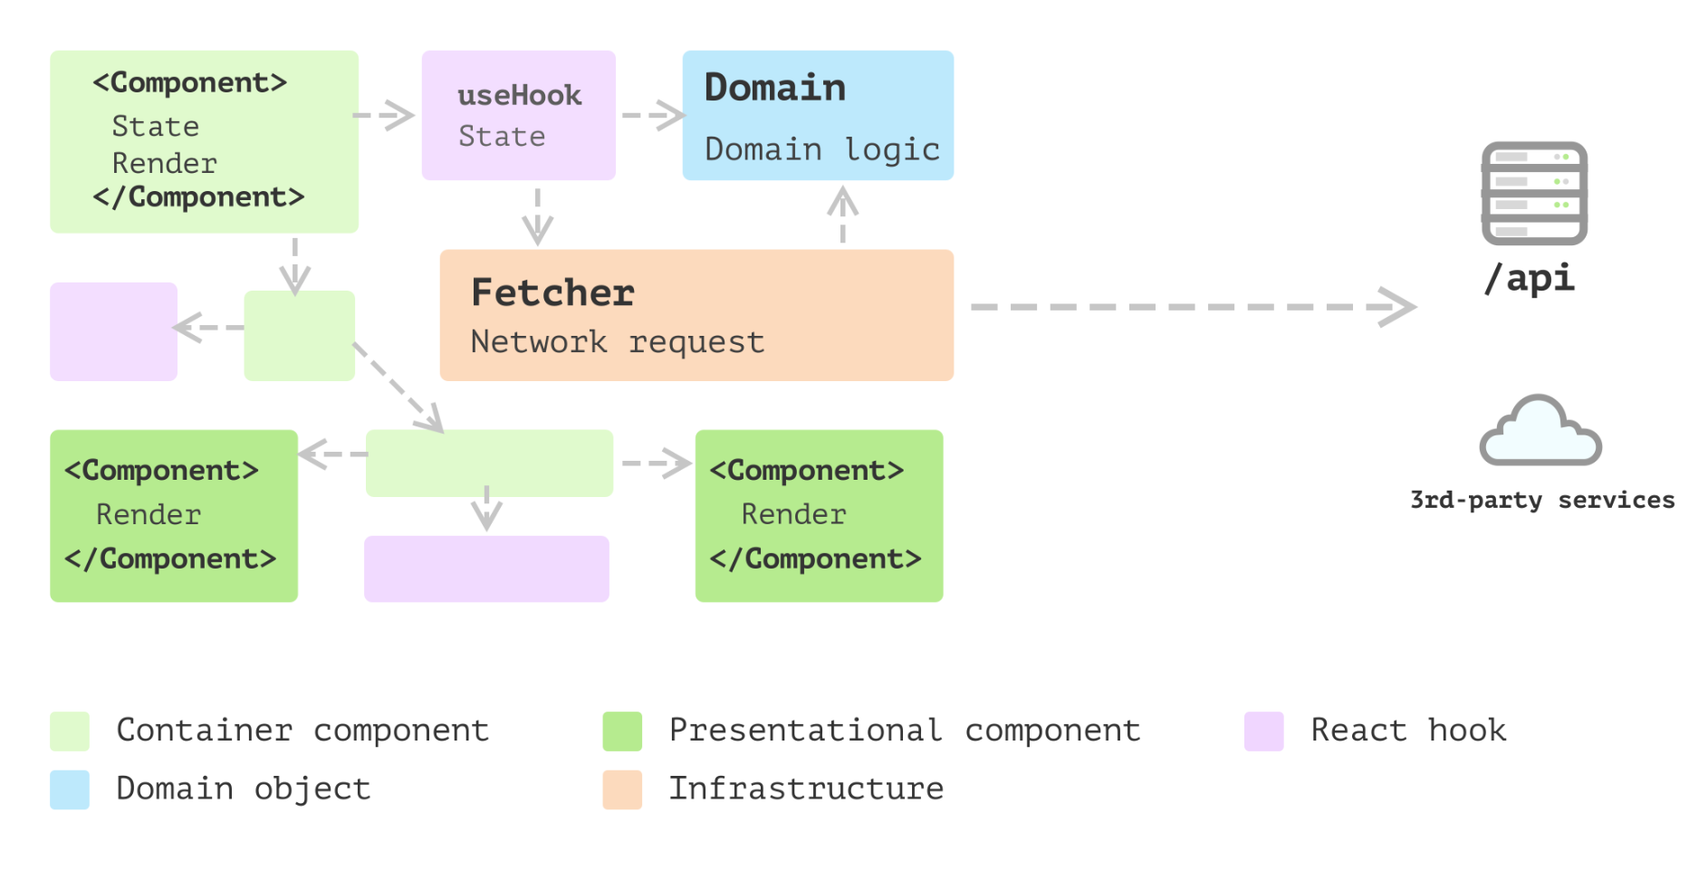
Business models

Slide 10
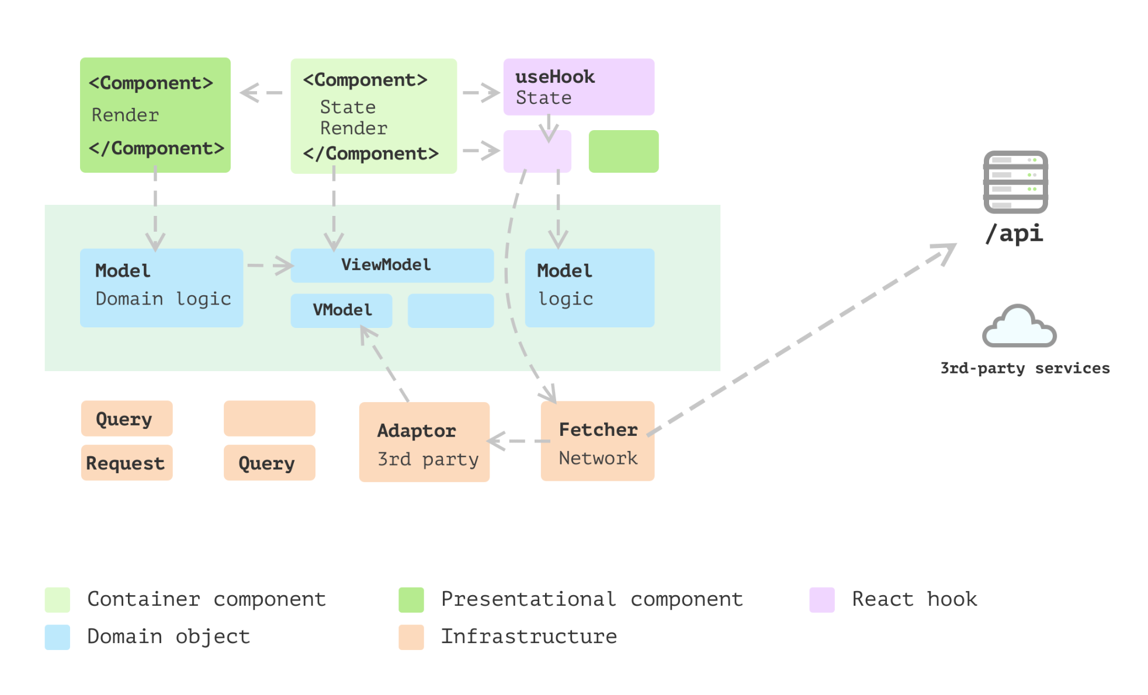
Layered Frontend application

Slide 11
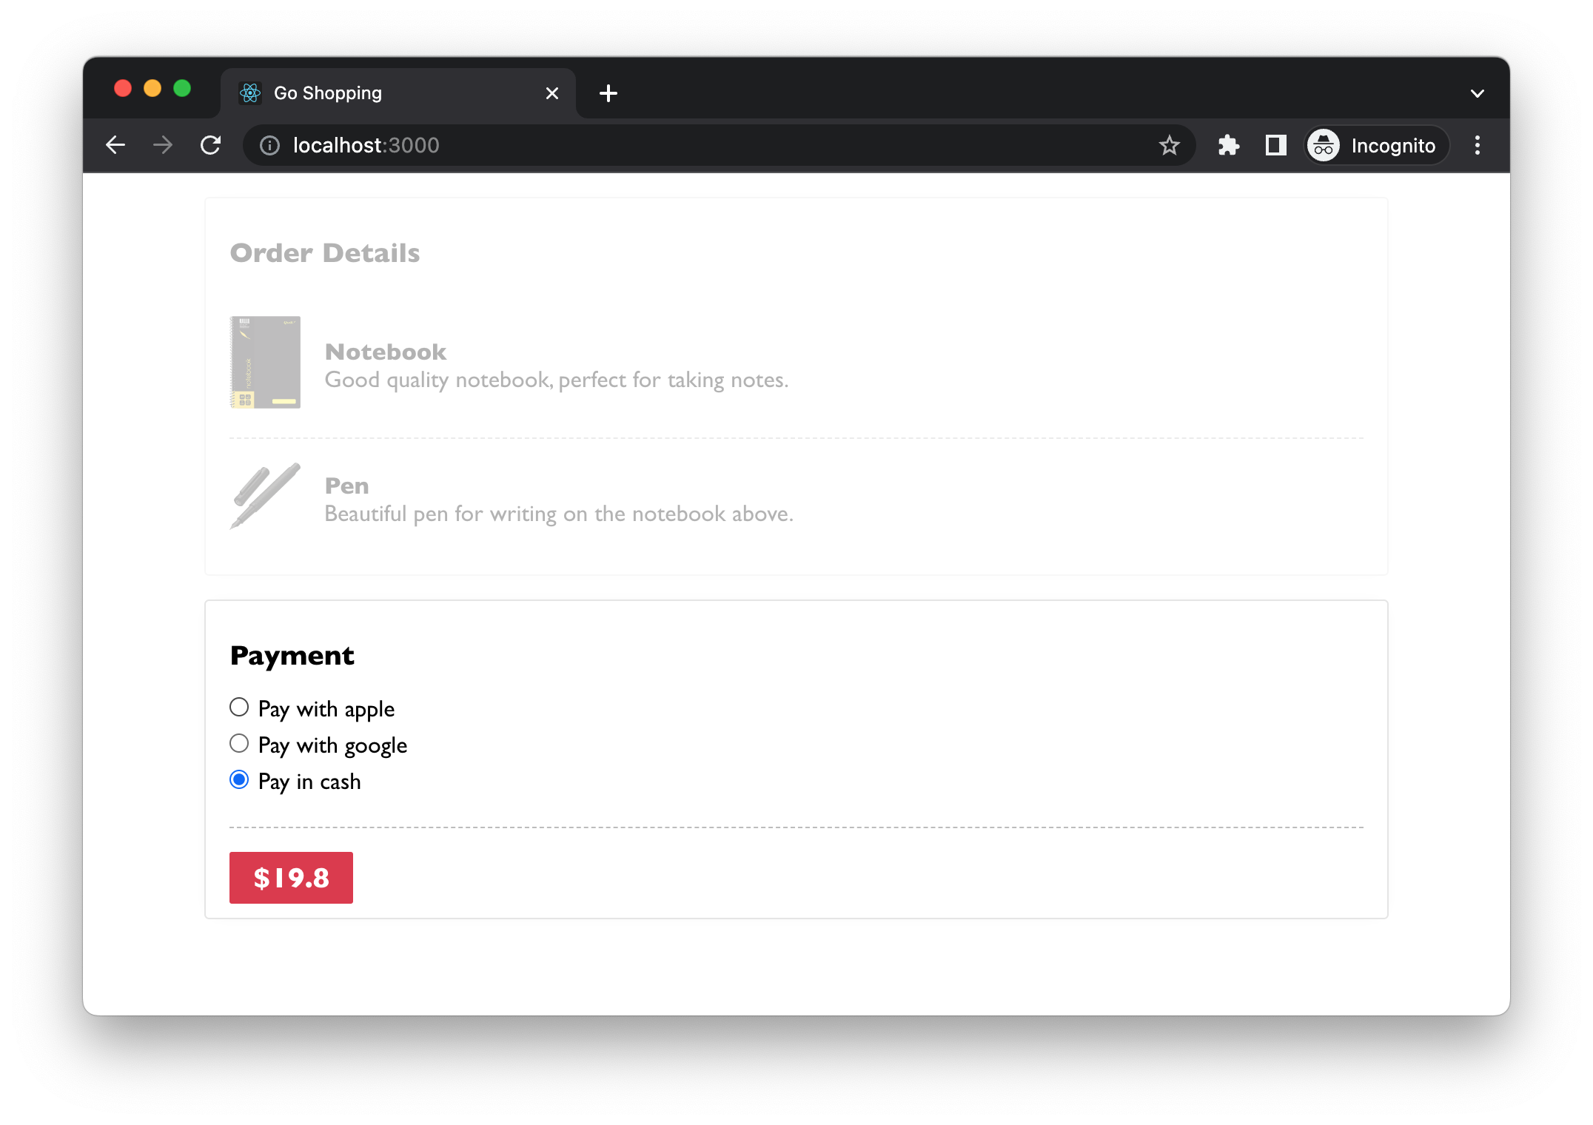
Payment
feature
Let’s try!

Slide 12
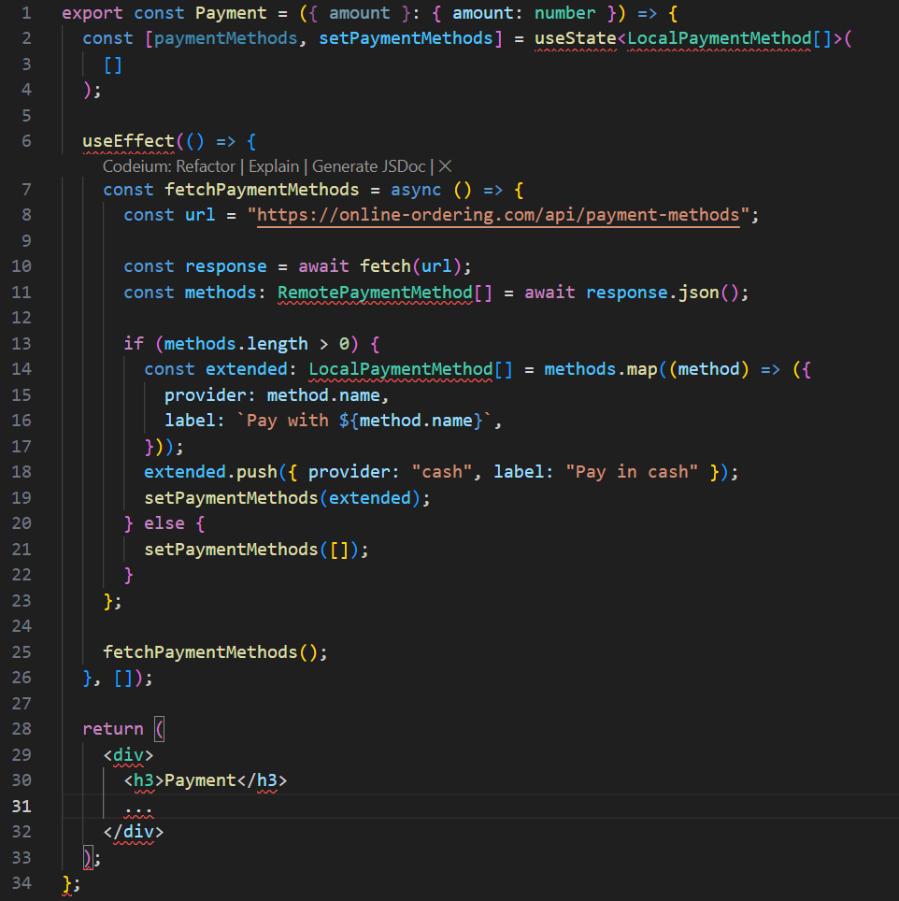
State Management
How to initialize network request
How to map the data to a local format that the component can understand
How to render each payment method
The rendering logic for payment itself
Data Fetching
Rendering

Slide 13
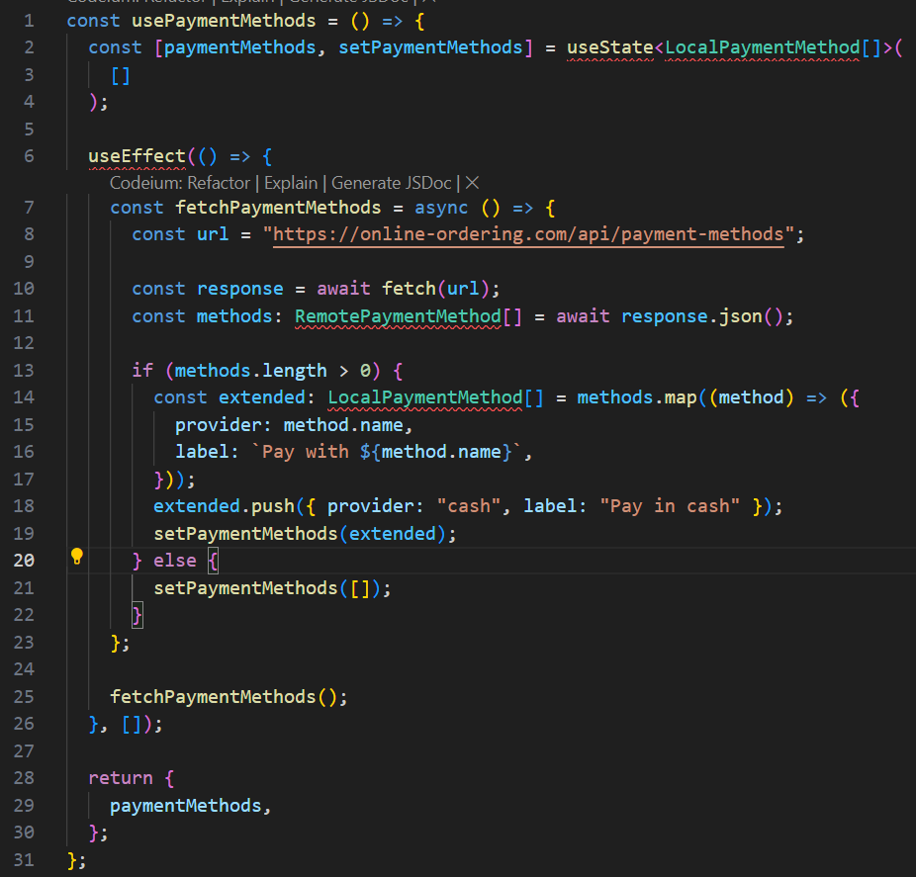
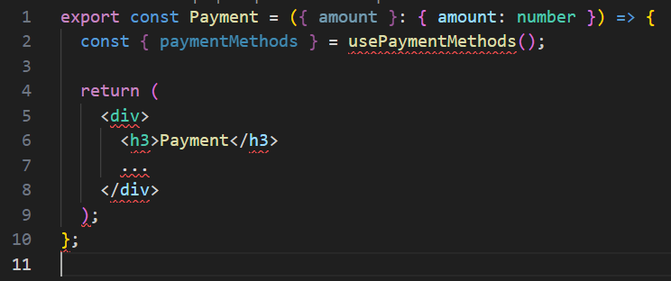
The split of view and non-view code

Slide 14
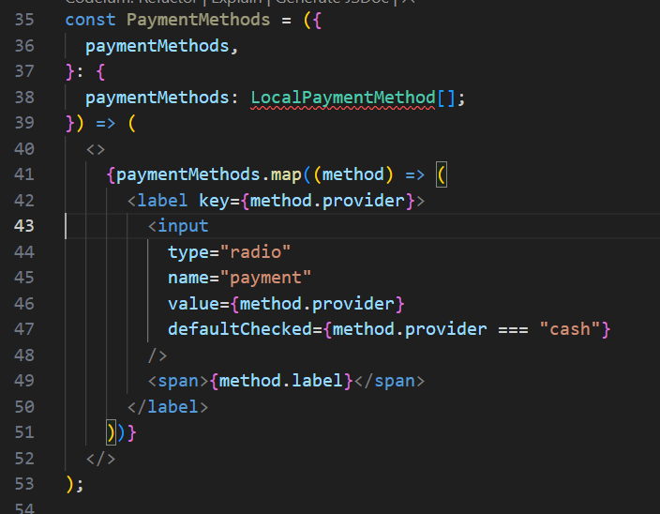
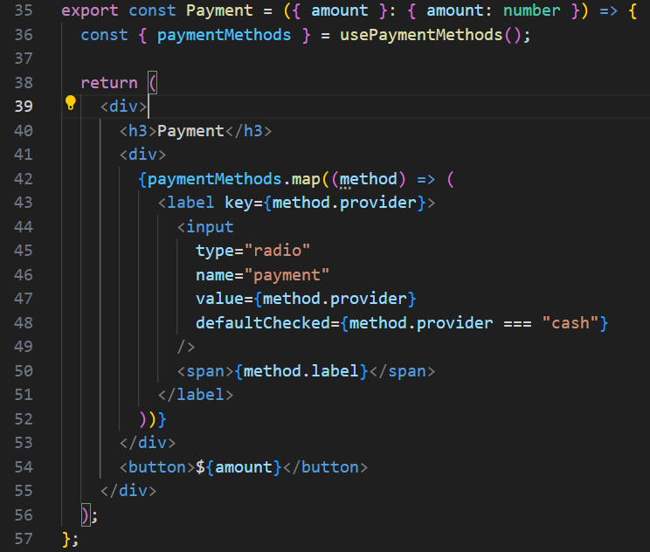
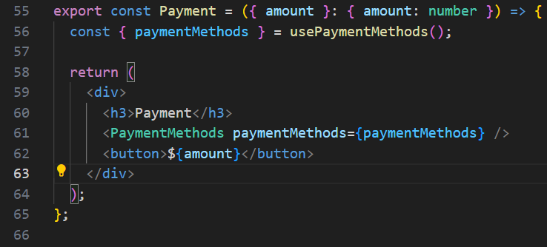
Split the view by extracting sub component

Slide 15
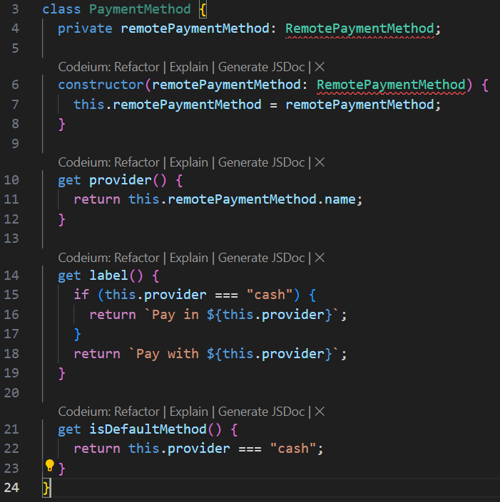
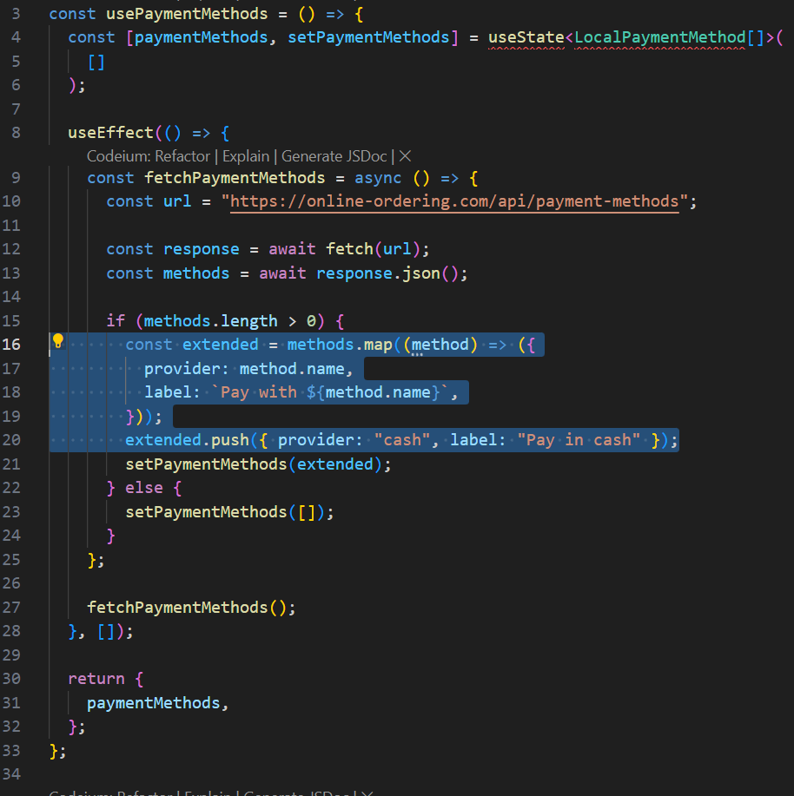
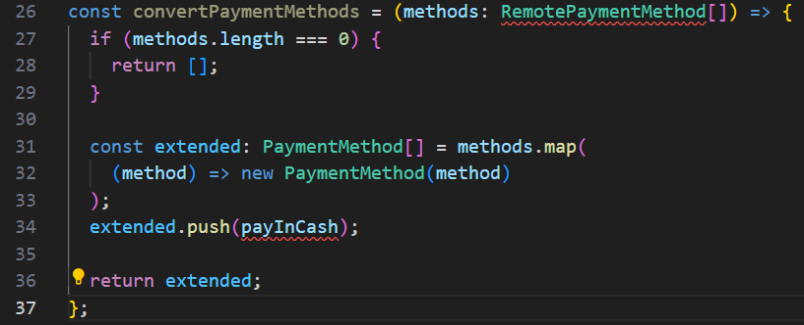
Data modelling to encapsulate logic
const payInCash = new PaymentMethod({ name: "cash" });

Slide 16
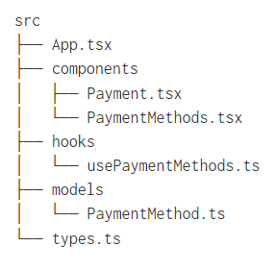
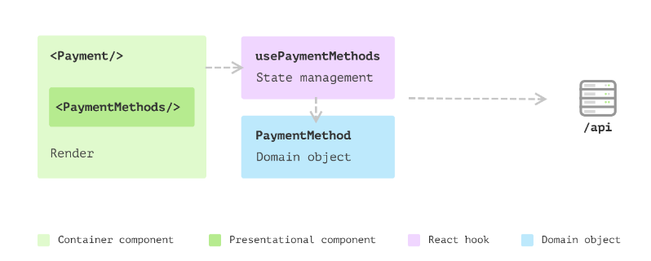
The benefits of the new structure
Domain object
Extracted component
Each clear part of the feature

Slide 17
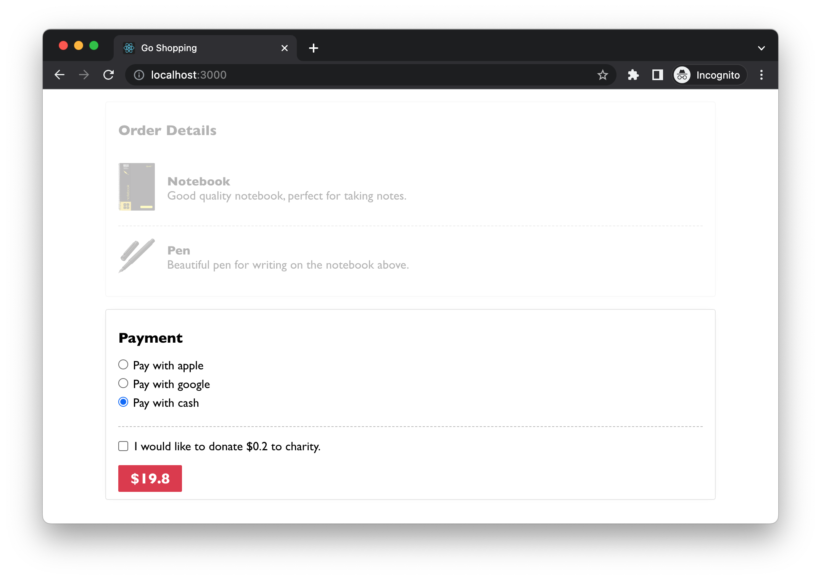
New requirement: Donate to a charity

Slide 18
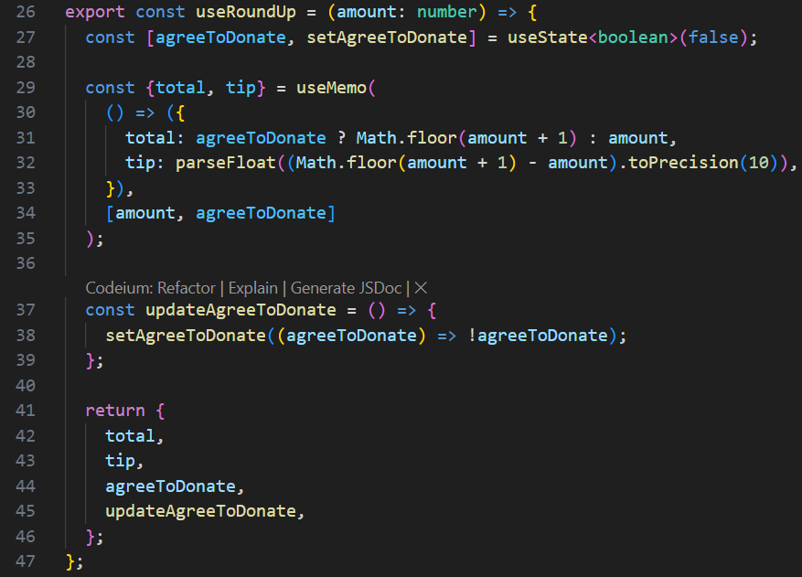
Extract the hook

Slide 19
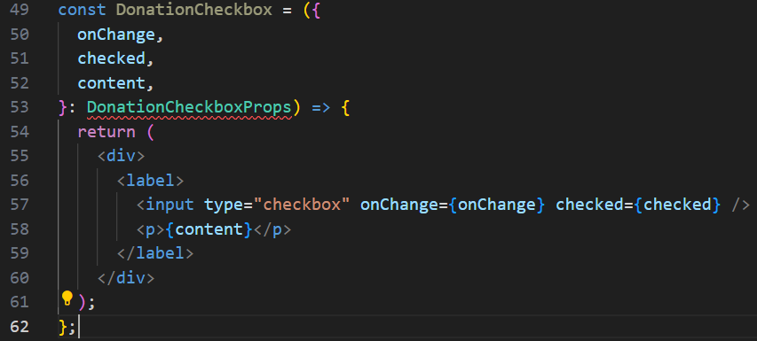
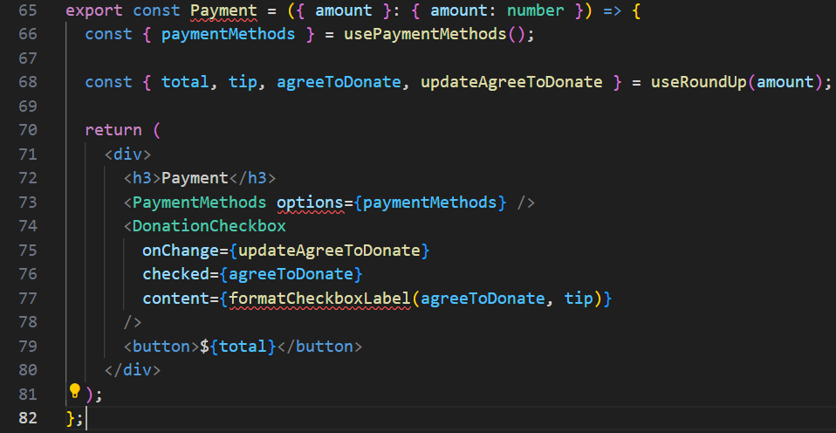
Extract the Pure component

Slide 20
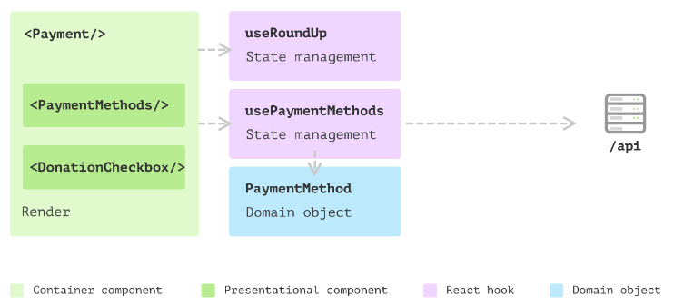
Overall architecture

Slide 21
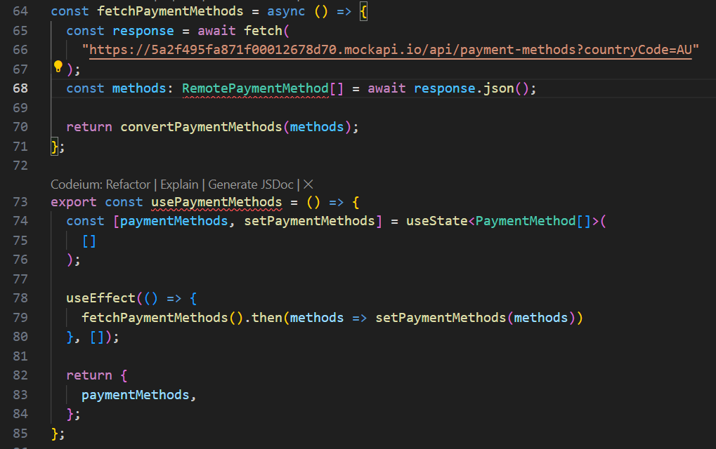
Extract network request

Slide 22
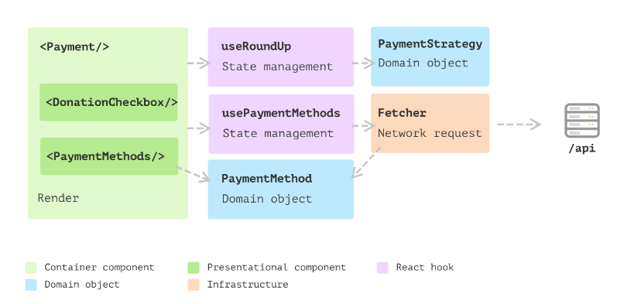
Maintainability
Modularity
Readability
Scalability
Easy to migrate to another tech stack

