Slide 1
Podstawy Programowania Computer Programming 1
PRG-BASICS
Course Introduction

Slide 2
Communication with Teacher
Course forum on Microsoft Teams
Microsoft Teams chat
Email (details on teacher’s e-card)
Office Hours (details on teacher’s e-card)
Teacher’s e-card
https://e-uczelnia.uek.krakow.pl/course/view.php?id=218

Slide 3
Course Details

Slide 4
Course Content
Main Class Topics
Part 1: PROGRAMING BASICS (variable, control structure, function)
Part 2: DATA STRUCTURES (array, file, dictionary, set)
Part 3: PROGRAMMING PARADIGMS (class, object, method)

Slide 5
Checking Knowledge
TESTS | POINTS
Test 1 | 0-10
Test 2 | 0-10
Test 3 | 0-10
TOTAL | 0-30
Bonus point for high attendance | 0-3

Slide 6
Test Score Improvement
Not possible

Slide 7
Test For Absent Students
At the end of the semester (~January)
Absence has to be confirmed by a sick leave (within 7 days)

Slide 8
Final Grade
Total Points | Final Grade
>= 27 | 5.0
>= 24 | 4.5
>= 21 | 4.0
>= 18 | 3.5
>= 15 | 3.0
< 15 | 2.0

Slide 9
Services Necessary for Course
Log in to Teams, Moodle, and Github

Slide 10
Sign up for Course on Teams
Run Microsoft Teams
Log in to your account
Display team list
Select „join a team”
Use a team code 76wfate

Slide 11
Sign up for Course on Moodle
Log in to Moodle https://moodle.uek.krakow.pl
Find the course Podstawy Programowania / Computer Programming 1
Sign up for the course As the access key, use your full group number (from University Schedule)

Slide 12
Create Account on Github
Go to the Github service https://github.com
Create an account or use the one you have
Important!! In Github Settings, enter your real full name (first and last name)

Slide 13
Make Copy of Class Materials
Log in to Github
Find the course materials (github repository) stalj/prg-basics
Fork (copy) the repository
Make sure you have your own private copy of the course materials on your account on Github

Slide 14
Homework
Tools Installation

Slide 15
Watch the video
Python Tutorial for Beginners with VS Code by Dave Gray
https://youtu.be/6i3e-j3wSf0

Slide 16
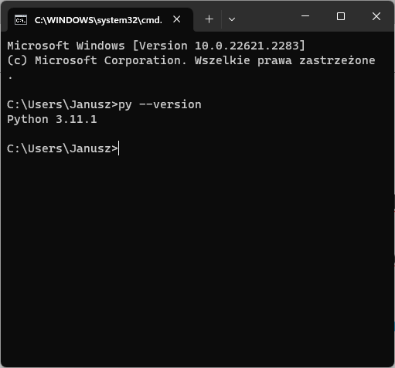
Install Python
Install Python https://www.python.org
Check Python on your computer
Open command prompt window
Enter command python --version or py --version

Slide 17
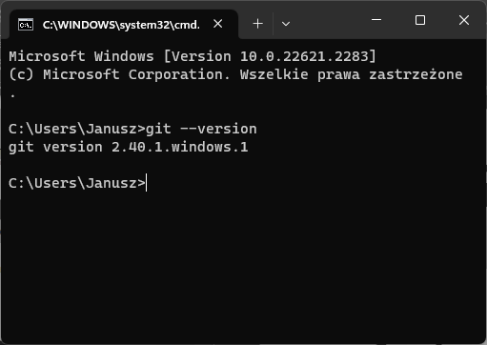

Install Git
Install Git Control Version System https://git-scm.com
Check Git on your computer
Open command prompt window
Enter command git --version

Slide 18

Install Visual Studio Code
Install Microsoft Visual Studio Code (VSCode) https://code.visualstudio.com
Install VSCode extensions for Python (Microsoft)
Check Python working in VSCode
On your computer desktop, create a folder TestPython
Run VSCode
Open the created folder
In the folder, create a file hello.py
Enter Python statements as it was in the video
Run the program

Slide 19
Clone Your Course Repository
Find out on how to use Git command git clone
Open command prompt window
Clone (copy) your own copy of the course repository (materials) from github to your personal computer

Slide 20
Read the Course Syllabus
In your local repository, open a folder 01-CourseIntroduction
Familiarise yourself with the course syllabus Syllabus.docx
Find course textbooks "Python for Everybody" (Polish and English versions). Open those pdf documents. Read the table of contents.

Slide 21
Python Tutorials
Python for Everybody (book)
https://www.py4e.com/book
Python Tutorial
https://docs.python.org/3/tutorial/index.html
W3Schools Python Tutorial
https://www.w3schools.com/python/default.asp
SoloLearn Python Course (for mobile devices)
https://play.google.com/store/apps/details?id=com.sololearn&hl=en

