Slide 1
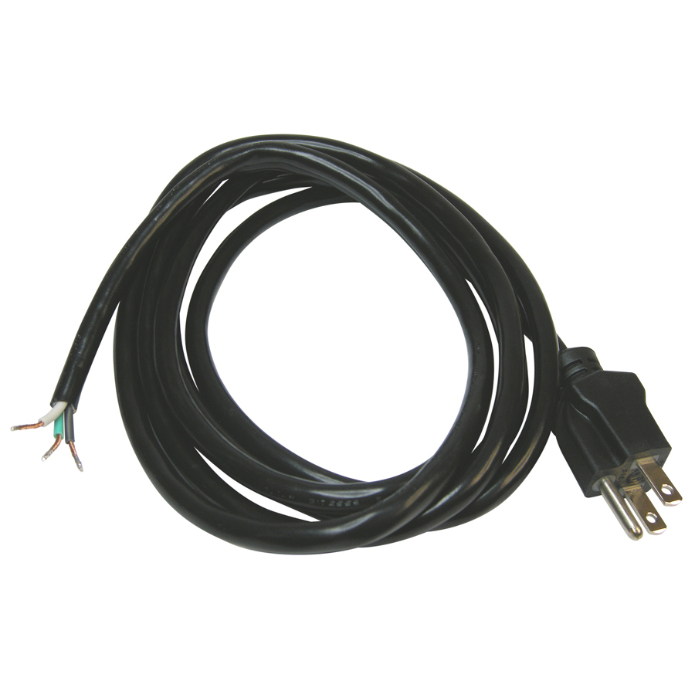
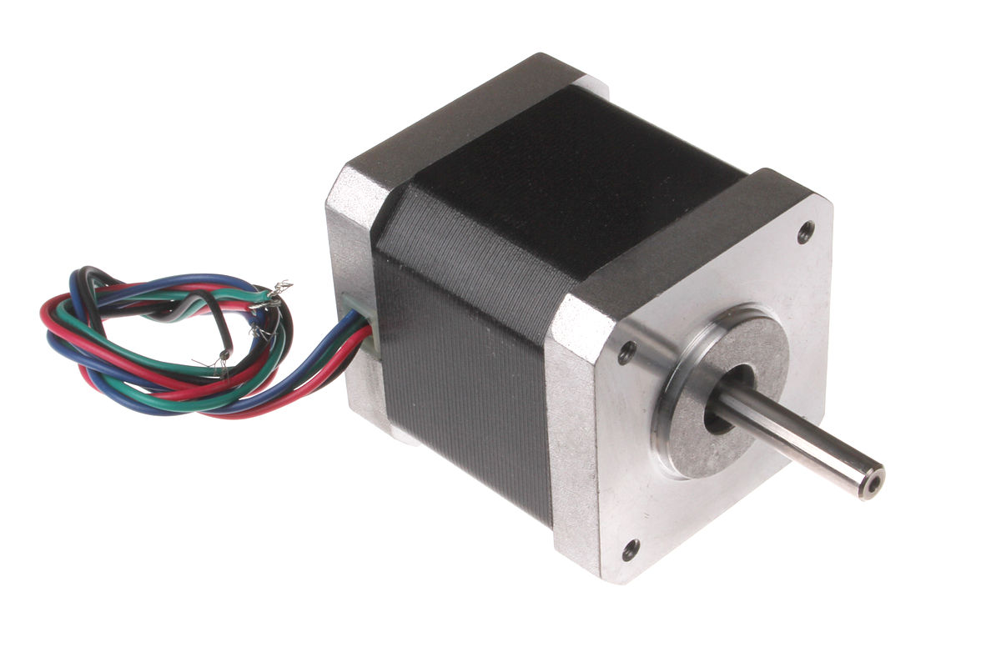
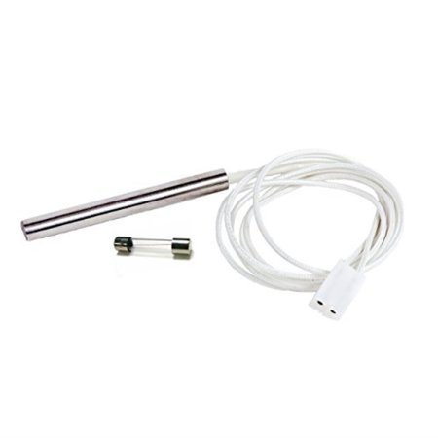

Molex
Female
5V DC Power Supply
NO
COM
NC
N
NO
L
COM
NC
NO
COM
NC
NO
Molex
Male
COM
NC
4-Channel Relay
Traeger Controller

Slide 2
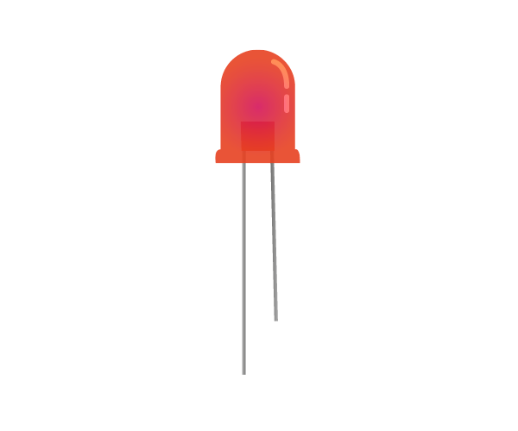
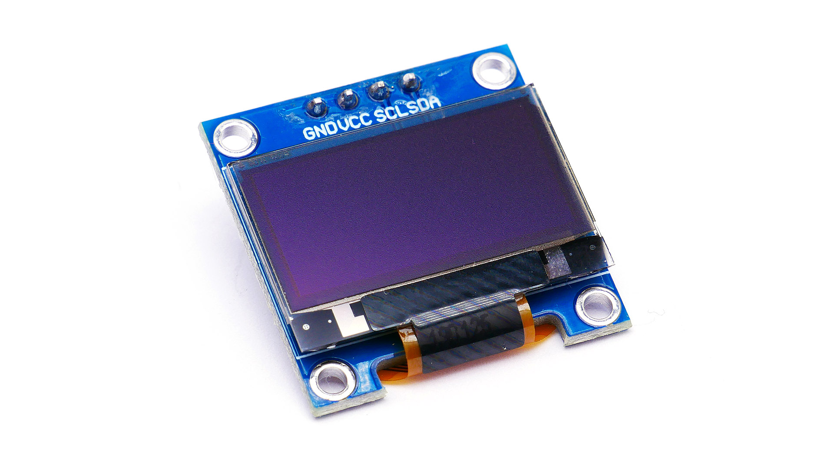

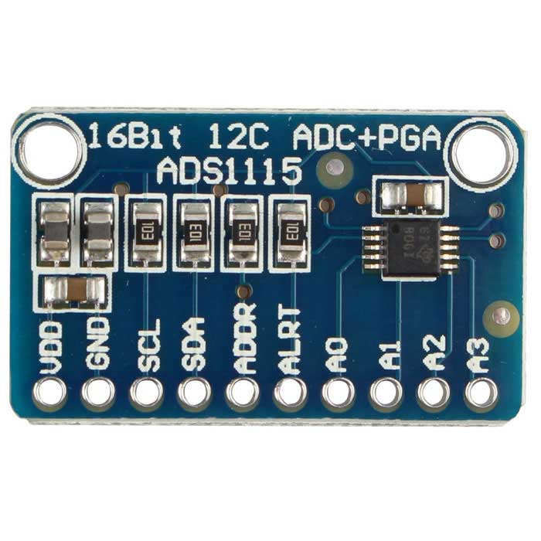
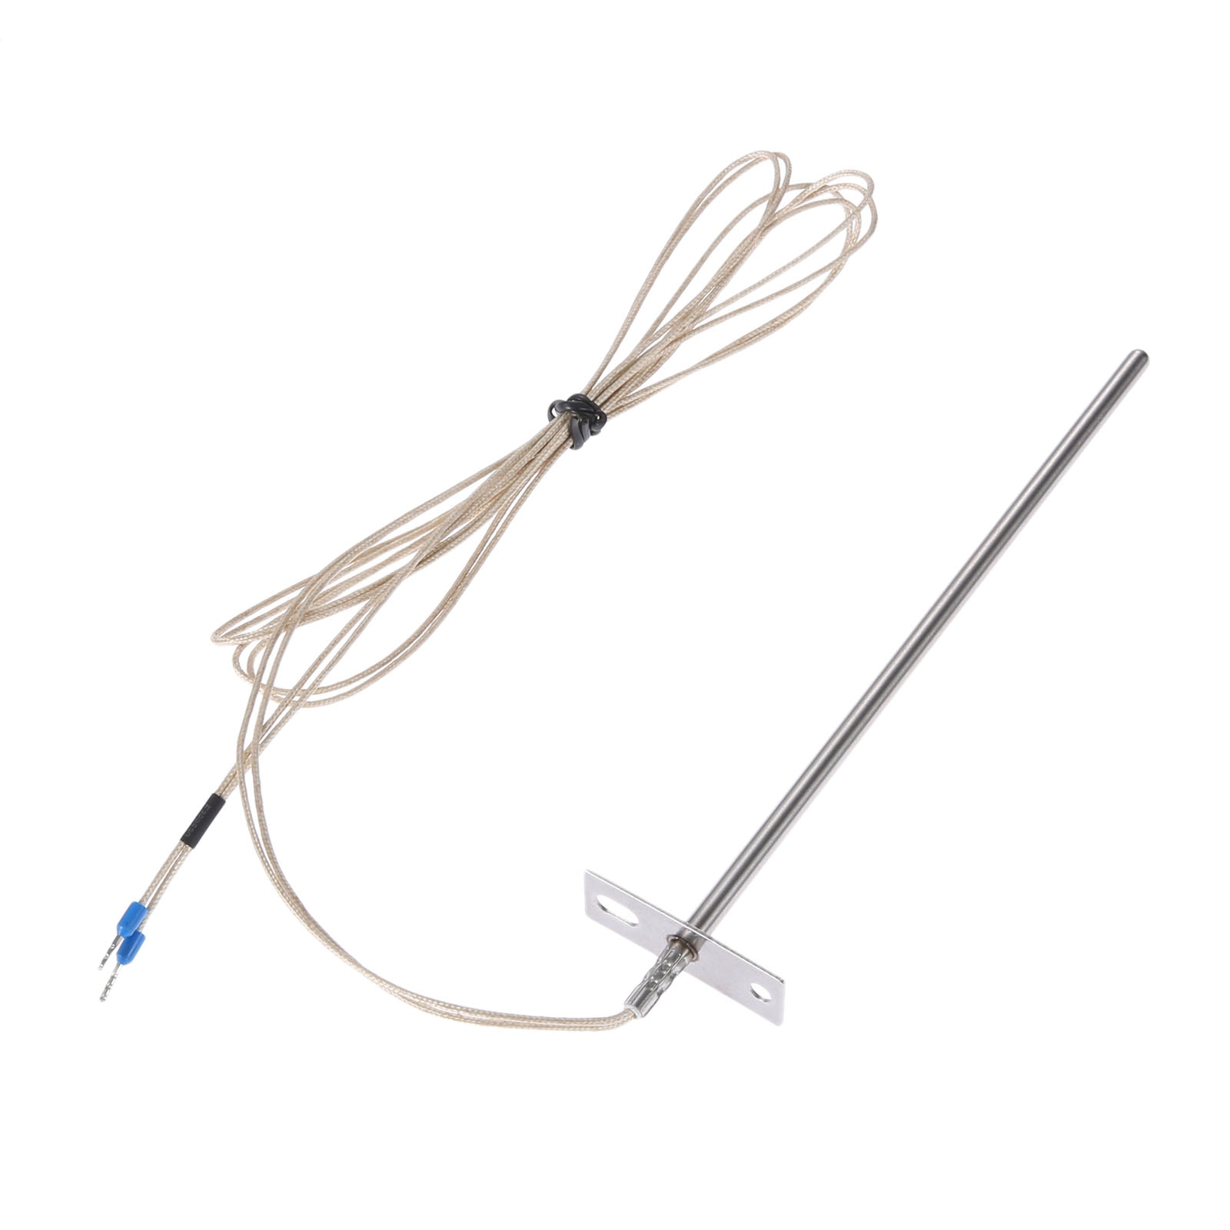
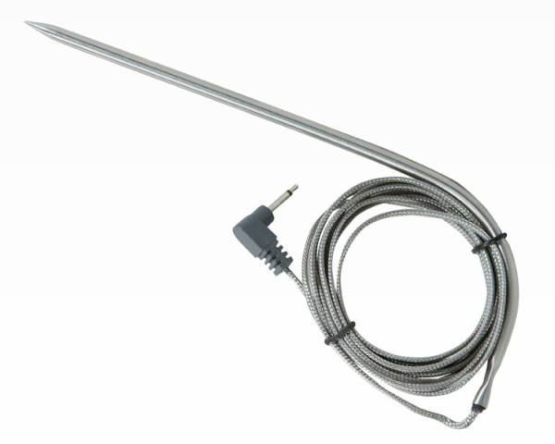
14
15
18
23
24
25
8
7
12
16
20
21
SSD 1306 OLED
2
3
4
17
27
22
10
9
11
5
6
13
19
26
330Ω
GND | VCC | SCL | SDA
ADS 1115 (ADC)
5V DC Power Supply
V+
10kΩ
10kΩ
10kΩ
V-
+
+
Screw Terminal
2.5mm Mono
Headphone Jack
2.5mm Mono
Headphone Jack
GPIO
Ground
3.3V
5V
Other
GND | VCC | JD-VCC
GND | IN1 | IN2 | IN3 | IN4 | VCC
14
4-Channel Relay
Probe 1
Probe 2
PT100 RTD Probe

Slide 3
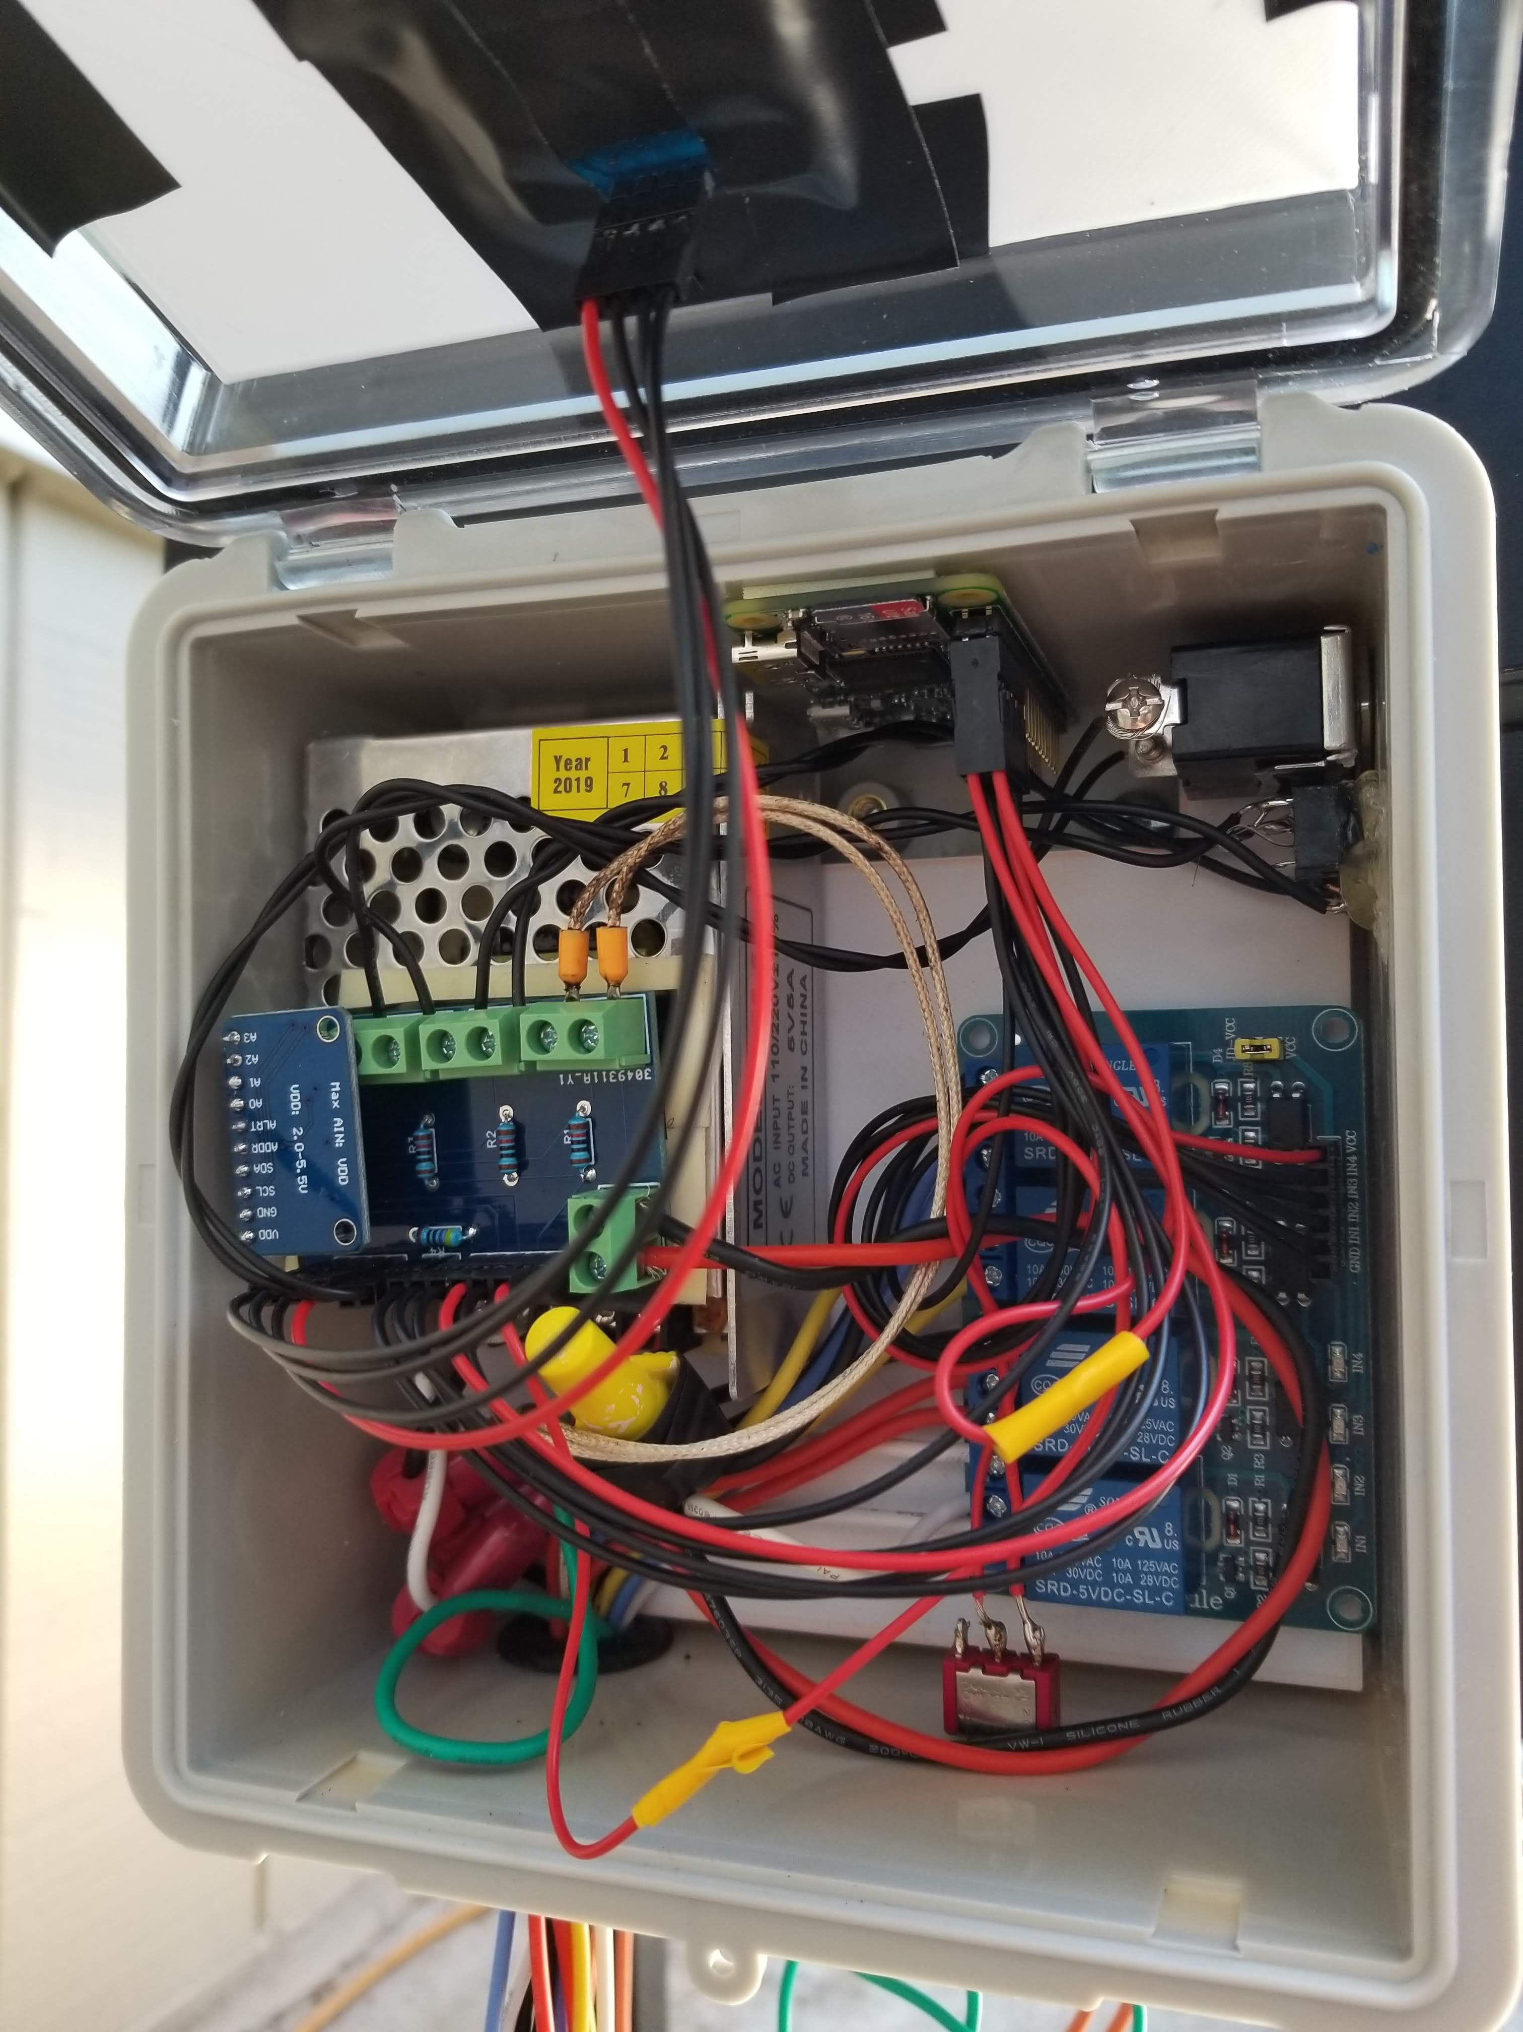
Raspberry Pi Zero W
SSD 1306 OLED Display
5V 5A Power Supply
On-Off Switch
2x 2.5mm Mono Jacks
Interface PCB
ADS 1115 ADC
4-Channel Relay
Wiring Harness to Molex
Optional Power Switch

Slide 4
Backup

Slide 5
OLD IMPLEMENTATION – Doesn’t Work
Molex
Female
5V DC Power Supply
NO
COM
NC
N
NO
L
COM
NC
NO
COM
NC
NO
Molex
Male
COM
NC
4-Channel Relay
Traeger Controller

