Slide 1
Machine Learning
Final Project
Home Credit Default Risk
Yuchen Peng

Slide 2
Contents
1. Project Introduction
2. Dataset Analysis
3. Feature Engineering
4. Model Construction
5. Making Progress
6. Result
7. Conclusion

Slide 3
Project Introduction
Many people struggle to get loans due to insufficient or non-existent credit histories. And, unfortunately, this population is often taken advantage of by untrustworthy lenders.
Home Credit strives to broaden financial inclusion for the unbanked population by providing a positive and safe borrowing experience. In order to make sure this underserved population has a positive loan experience, Home Credit makes use of a variety of alternative data--including telco and transactional information--to predict their clients' repayment abilities.
While Home Credit is currently using various statistical and machine learning methods to make these predictions, they're challenging Kagglers to help them unlock the full potential of their data. Doing so will ensure that clients capable of repayment are not rejected and that loans are given with a principal, maturity, and repayment calendar that will empower their clients to be successful.

Slide 4
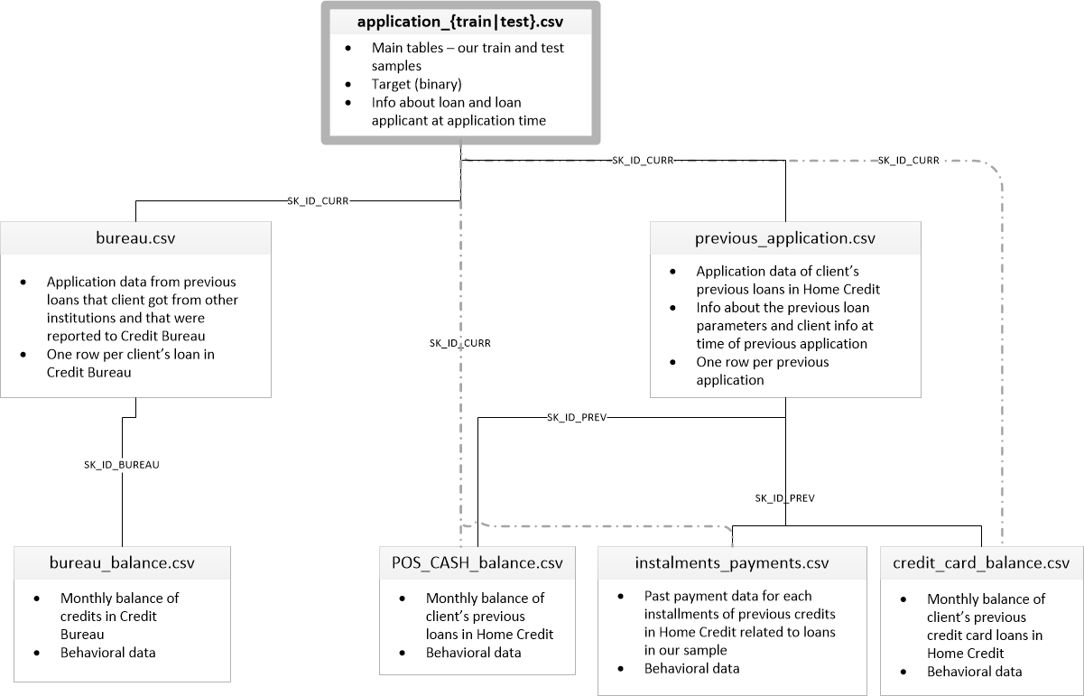
Dataset Analysis
7 different tables
Hundreds of variables
TARGET in application table for prediction
Common column SK_ID_CURR, SK_ID_PREV for joining tables

Slide 5
Dataset Analysis
application_{train|test}.csv
  This is the main table, broken into two files for Train (with TARGET) and Test (without TARGET).
  Static data for all applications. One row represents one loan in our data sample.
bureau.csv
  All client's previous credits provided by other financial institutions that were reported to Credit Bureau (for clients who have a loan in our sample).
  For every loan in our sample, there are as many rows as number of credits the client had in Credit Bureau before the application date.
bureau_balance.csv
  Monthly balances of previous credits in Credit Bureau.
  This table has one row for each month of history of every previous credit reported to Credit Bureau – i.e the table has (#loans in sample * # of relative previous credits * # of months where we have some history observable for the previous credits) rows.
POS_CASH_balance.csv
  Monthly balance snapshots of previous POS (point of sales) and cash loans that the applicant had with Home Credit.
  This table has one row for each month of history of every previous credit in Home Credit (consumer credit and cash loans) related to loans in our sample – i.e. the table has (#loans in sample * # of relative previous credits * # of months in which we have some history observable for the previous credits) rows.
credit_card_balance.csv
  Monthly balance snapshots of previous credit cards that the applicant has with Home Credit.
  This table has one row for each month of history of every previous credit in Home Credit (consumer credit and cash loans) related to loans in our sample – i.e. the table has (#loans in sample * # of relative previous credit cards * # of months where we have some history observable for the previous credit card) rows.
previous_application.csv
  All previous applications for Home Credit loans of clients who have loans in our sample.
  There is one row for each previous application related to loans in our data sample.
installments_payments.csv
  Repayment history for the previously disbursed credits in Home Credit related to the loans in our sample.
  There is a) one row for every payment that was made plus b) one row each for missed payment.
  One row is equivalent to one payment of one installment OR one installment corresponding to one payment of one previous Home Credit credit related to loans in our sample.

Slide 6
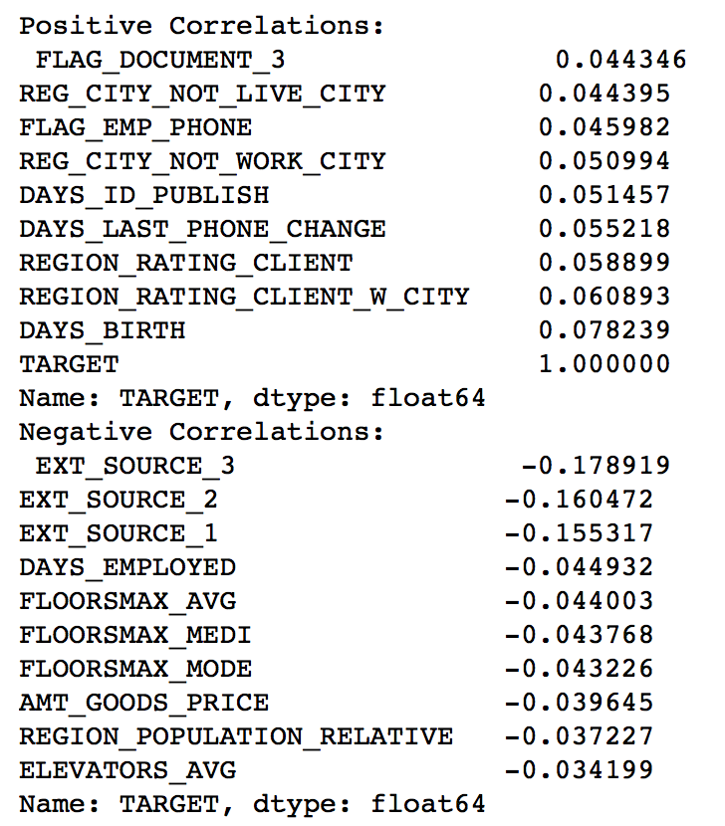
Feature Engineering
Huge amount of features
Hard to decide features useful to the prediction
Intuition: Target oriented
Calculate the correlation between the feature and the target
Features with most positive correlation & negative correlation

Slide 7
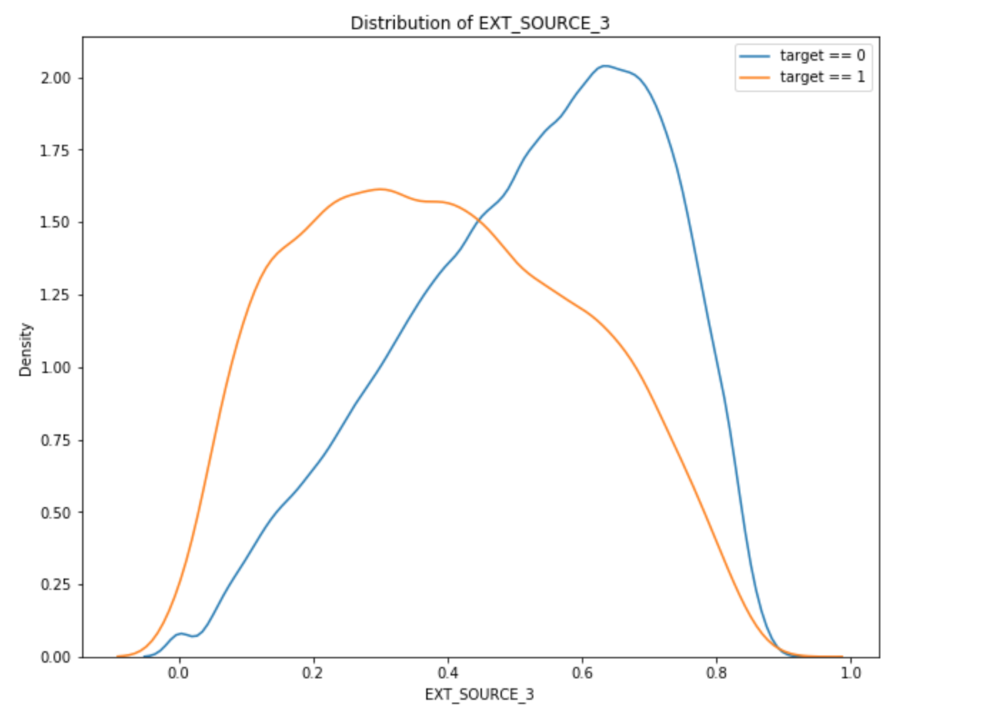
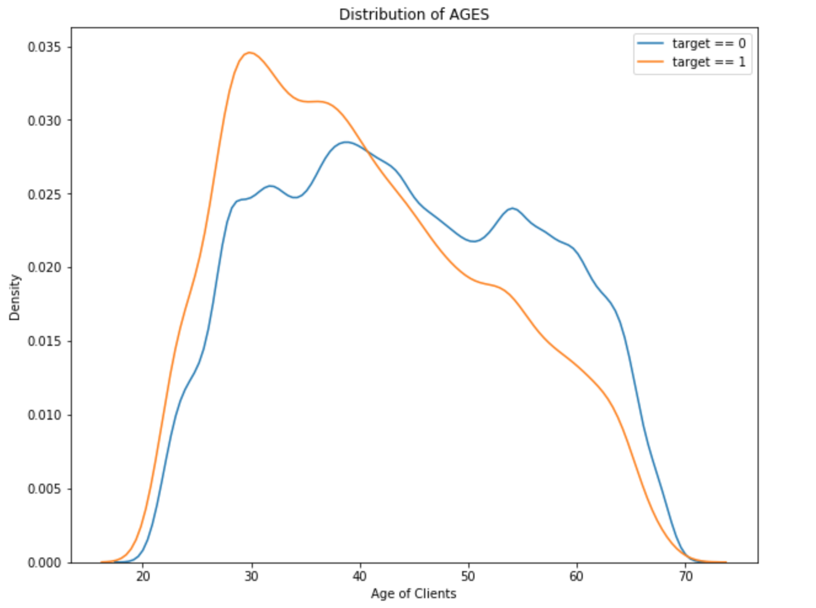
Feature Engineering
Distribution graph reflect the correlation value

Slide 8
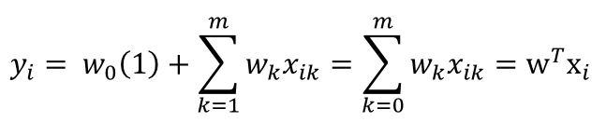
Model Construction
Linear Regression
When applied in this project
X represents the features
Y represent the prediction whether the client will pay the loan, when y is 0, the client will pay it, otherwise won’t
w₀ & w_{k} are intercept and weights respectively

Slide 9
Model Construction
Features selected
FLAG_DOCUMENT_3
Operations about missing values
Set the missing values to -1

Slide 10
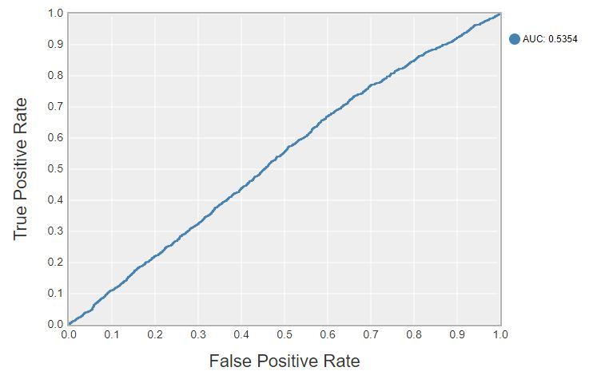
Model Construction

Slide 11
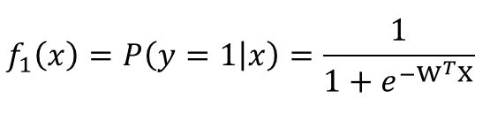
Model Construction
Logistic Regression
When applied in this project
X represents the features
Y represents the prediction whether the client will pay the loan, when y is 0, the client will pay it, otherwise won’t
W represents the weight vector

Slide 12
Model Construction
Features selected
EXT_SOURCE_3
Operations about missing values
Set the missing values to -1

Slide 13
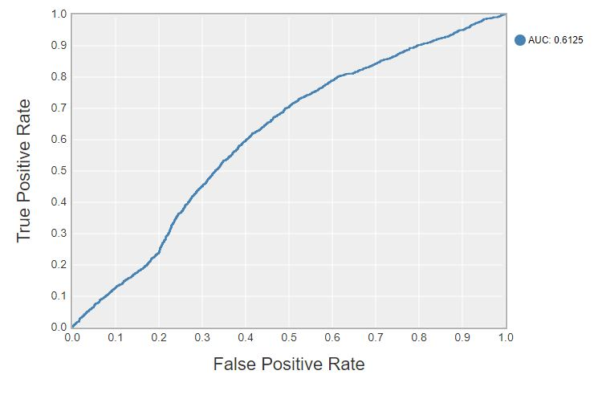
Model Construction

Slide 14
Making Progress
Normalization
We use z-normalize to pre-process the dataset
Missing Value Operations
We set the missing values to the mean value of the rest of the data instead of -1
Construct more features
ext_source_1, ext_source_2, ext_source_3, (AMT_ANNUITY/AMT_CREDIT), DAYS_BIRTH, REGION_RATING_CLIENT, DAYS_LAST_PHONE_CHANGE, FLAG_DOCUMENT_3, REG_REGION_NOT_LIVE_REGION, REG_CITY_NOT_WORK_CITY, REG_CITY_NOT_LIVE_CITY

Slide 15
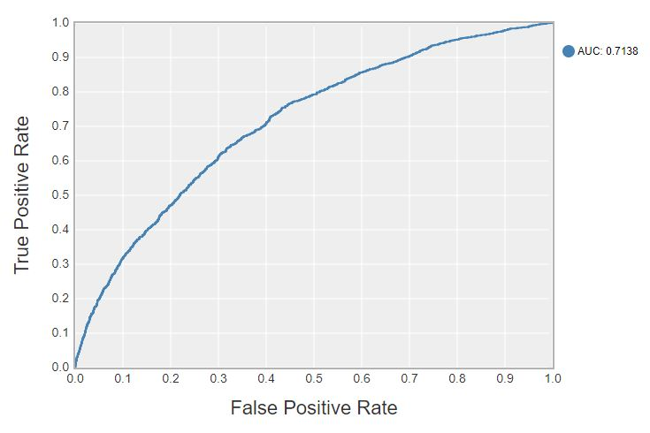
Result

Slide 16
Conclusion
As a Kaggle competition project, it has witnessed numerous fantastic models and learning algorithms. Now it serves as our final project, I can only use what I’ve learned to give it a try.
I didn’t have a clue when starting seeking for features. There are hundreds of variables, how would I choose features so that they work for our model. I calculate their correlation to the target to analyze their feasibilities, and plot their distribution to see their impact on the target. Finally I extract some useful features.
When it comes to model selection, what I’ve learned is restricted to some basic models. Intuitively, I start with Linear Regression. Of course, there can’t be a good result with that. Then I switch to Logistic Regression, the AUC gets a lot better
Finally, I try to improve my project by normalizing data, adjusting missing values and constructing more useful features. The results

Slide 17
Conclusion
get better and better.
Although this is just a course project, it gives me lots of knowledge about how to complete a whole machine learning

Slide 18
Thank You !
Yuchen Peng
www.themegallery.com

