Slide 1
EDPS 7950
Intro to Data Analytics and Visualizations
Eric Poitras, Ph.D.
eric.poitras@utah.edu
Fall 2019
Aug 26th

Slide 2
Class Schedule
Course objectives
Today’s objectives
Overview of course github/canvas and workflow
Intro to common terminology
How to get started

Slide 3
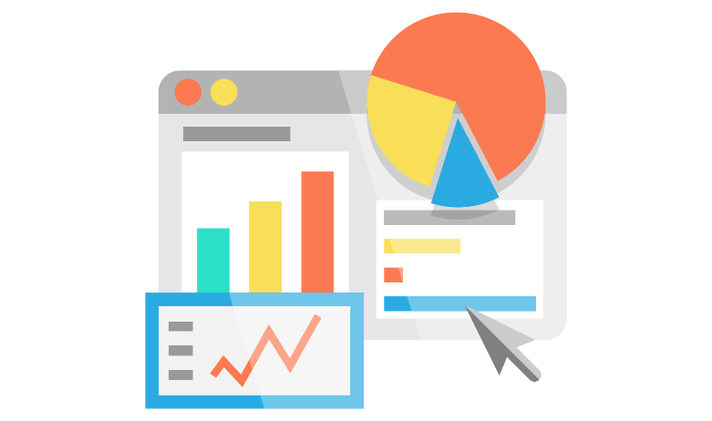

Class Objectives
Develop your own analytics dashboard
Apply data mining methods – how to import and prepare data as well as build, validate, and apply models for predictive analytics
Develop web-based interface for analytical requirements that is responsive to different devices (mobile, tablet, desktop) and interactive
Gain technical skills associated to coding dashboards – how to program the graphs and connect to the data
Visualizations
Analytics

Slide 4
Today’s Objectives
Common terms that you will hear about a lot
Explain the course workflow in creating and managing re-usable data pipelines and its relevance to the job market
Getting ready for next week
  How do I prepare for next class?
  What will I need in class to do the work?
  What if I get stuck?!?

Slide 5
Data Analyst / Quantitative Analyst
Use statistical methods to analyze data and generate useful reports
Work with management team to create prioritized list of needs & data needs for each project
Identify and recommend new ways to serve stakeholders by streamlining processes
Use data to create models that depict trends in the client/customer base and population as a whole

Slide 6
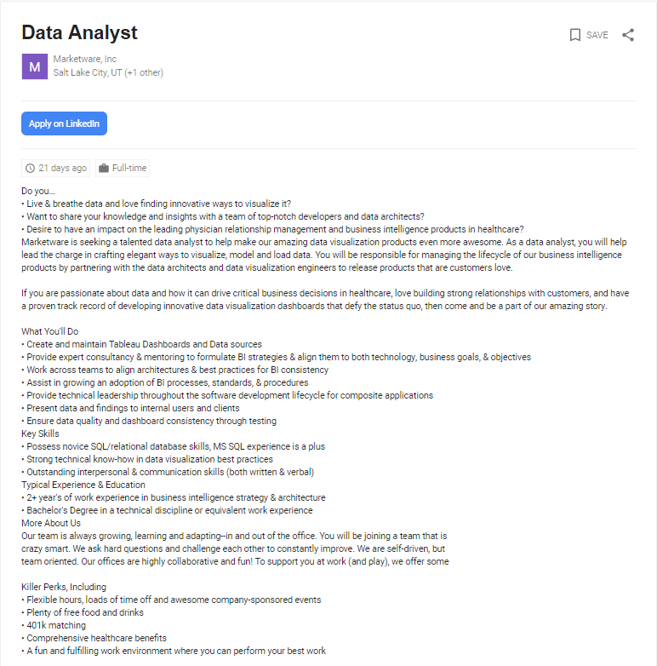
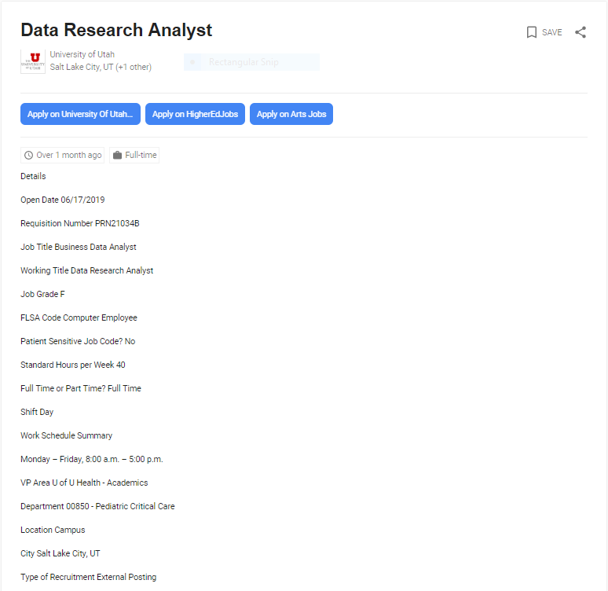
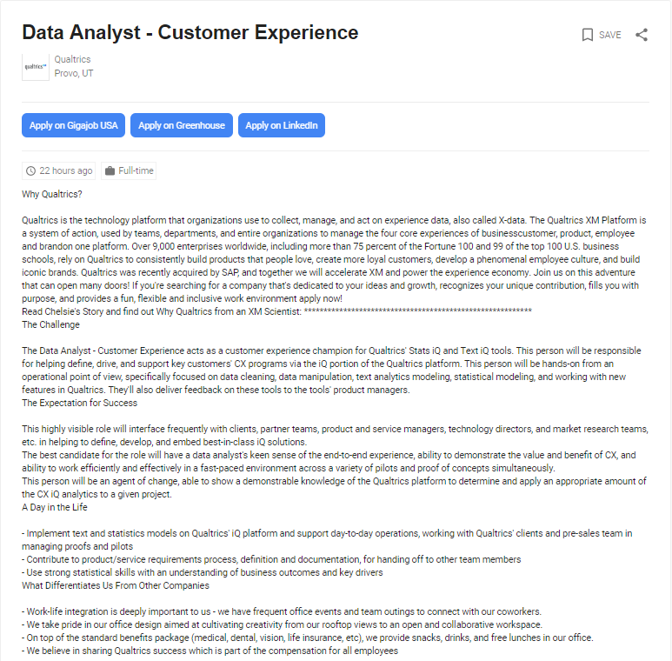
Data Analyst / Quantitative Analyst
Different from data engineer or scientist
Backend development with SQL/R/Python
BA/MA in Business with Information Systems
BA/MA in CS with emphasis on Data Sciences
Often the roles / expectations in companies are confused…

Slide 7
Business Intelligence (BI) Skills
Easy
Microsoft PowerBI Desktop/Server
Tableau Prep/Desktop/Online
Salesforce Analytics/Discovery/Insights
Qlik Data Catalyst/View/Sense
Ease of Use for complex analyses
EDPS7950
ApexCharts.js
Chart.js
Low
Google Charts.js
Difficult
Price
High
D3.js
On-premises
Cloud
Infrastructure

Slide 8
Machine Learning (ML) Skills
Easy
EDPS7950
RapidMiner Studio/Server/Cloud
IBM SPSS Modeler/Stat/Watson Studio
KNIME Desktop/Server
SAS EM, VDMML
Ease of Use for complex analyses
Amazon AWS Analytics, SageMaker,
Google ML Engine, AutoML, BigQuery, TensorFlow, Data Prep, Datalab, Data Flow, Data proc, …
Low
Price
Microsoft Azure ML, Data Factory, Databricks
Difficult
High
On-premises (Scoring Code Export/Engine)
Cloud (REST API)
Infrastructure

Slide 9
Being Competitive on the Job Market
Programming a dashboard/custom graphs will help you standout with a skillset that is unique from your competition in BI
Download free trial of Tableau and PowerBI – do a quick dashboard, take a screenshot/video and add it to your portfolio site
As a beginner in ML, RapidMiner is a great starting point and can serve as a platform for an entire business to implement models
RapidMiner allows you to use and learn R, Python, and SQL scripts – the building blocks for cloud based solutions like Google, Microsoft, and Amazon web services – while facilitating other steps in your data pipeline
To learn more, read the Gardner reports on BI and ML in Canvas

Slide 10







Course Workflow
WRITE
Reports
READ
External Data Source
RapidMiner
Studio
Web
RapidMiner
AutoML Cloud
API

Slide 11
Course Workflow
In-Class
  Demos (Download materials from course github) – 1h30min.
    ½ HTML, CSS, JS – How to build a dashboard/visualizations
    ½ RapidMiner – How to prepare and analyze data for predictive analytics / Lectures on algorithm training and hyperparameter opt
  Practice -1h30min.
    Replicate/Expand on steps for Titanic Survival competition demo; Apply skills to analyze Utah.gov open dataset (or your own)
  Feedback
    Activities & Projects with revise/resubmit
Out-of-Class – TO BE COMPLETED BEFORE CLASS
  RapidMiner tutorial videos/documentation & Codecademy modules (Links available from syllabus/canvas assignment)

Slide 12
Let’s Review the Course Syllabus
Office hours and my contact info
No textbook required – all readings/videos/exercises in Canvas
Course assignments (see description & schedule – 1 week revise/resubmit option)
Assignment | Weight | Deadline(s)
Activities #1-5: Front-End Web Development | 30% | Weeks 1, 3, 7, 10, 12
Project #1: Data Preprocessing | 20% | Week 5
Project #2: Data Processing | 20% | Week 9
Project #3: Data Analytics Dashboard | 20% | Week 14
Training Videos, Readings, and Exercises | 10% | Week 14

Slide 13
Break (10 Min.)

Slide 14
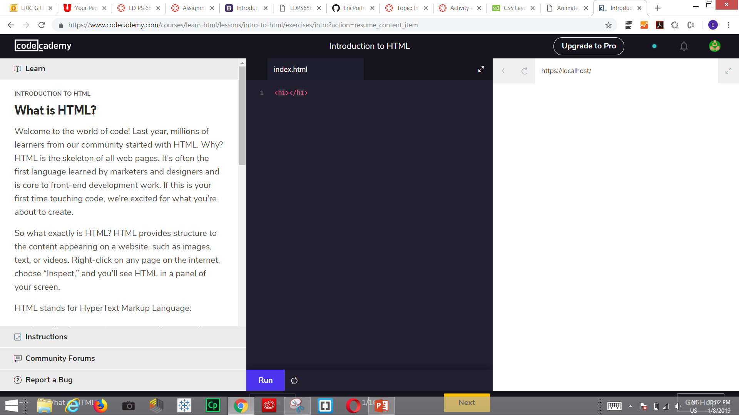
In Preparation for Next Class
Codecademy
Online and interactive tutorials for learning how to code
Provides feedback on each attempt for multi-step problem

Slide 15
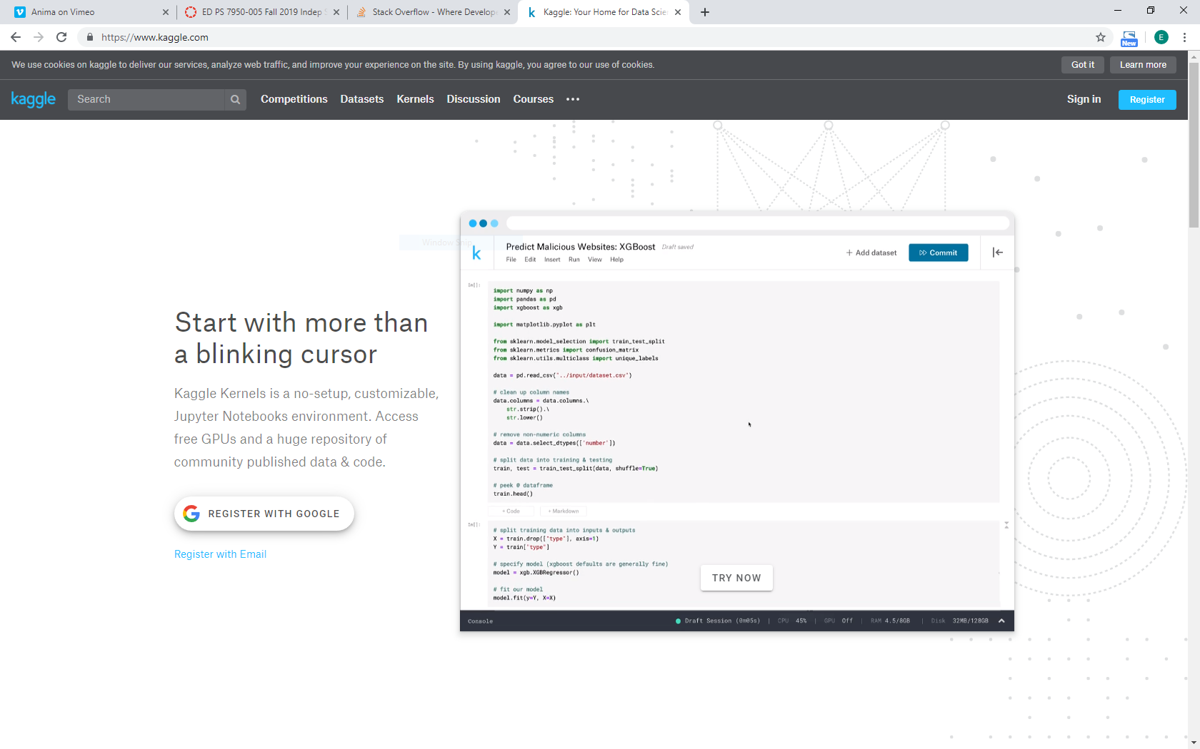
In Preparation for Next Class
Kaggle
Crowdsourcing platform for data mining competition
Sign up for an account
Visit the Titanic Survival Competition

Slide 16
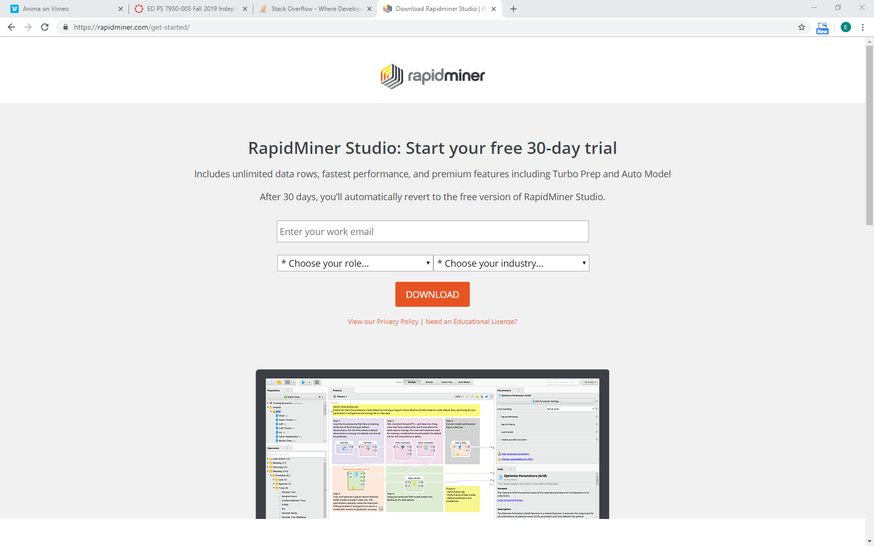
In Preparation for Next Class
RapidMiner
Data mining platform
Sign up for an account and download the software
Apply for the educational program

Slide 17
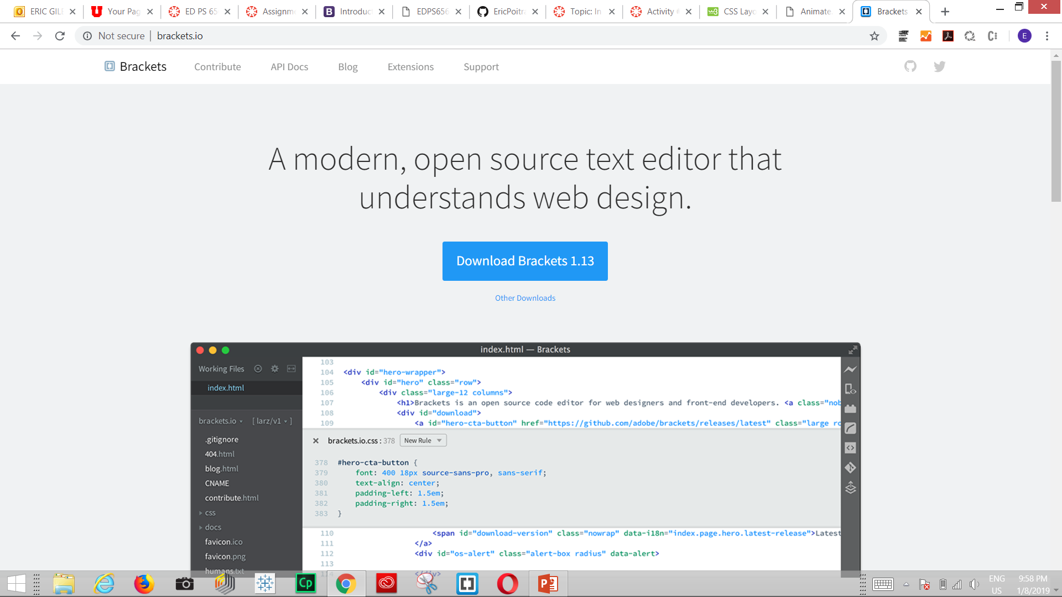
In Preparation for Next Class
Adobe Brackets
Free and simple text editor to write HTML, CSS, and JS code
Get the starter template from the BS4 website to create your Hello World!

Slide 18
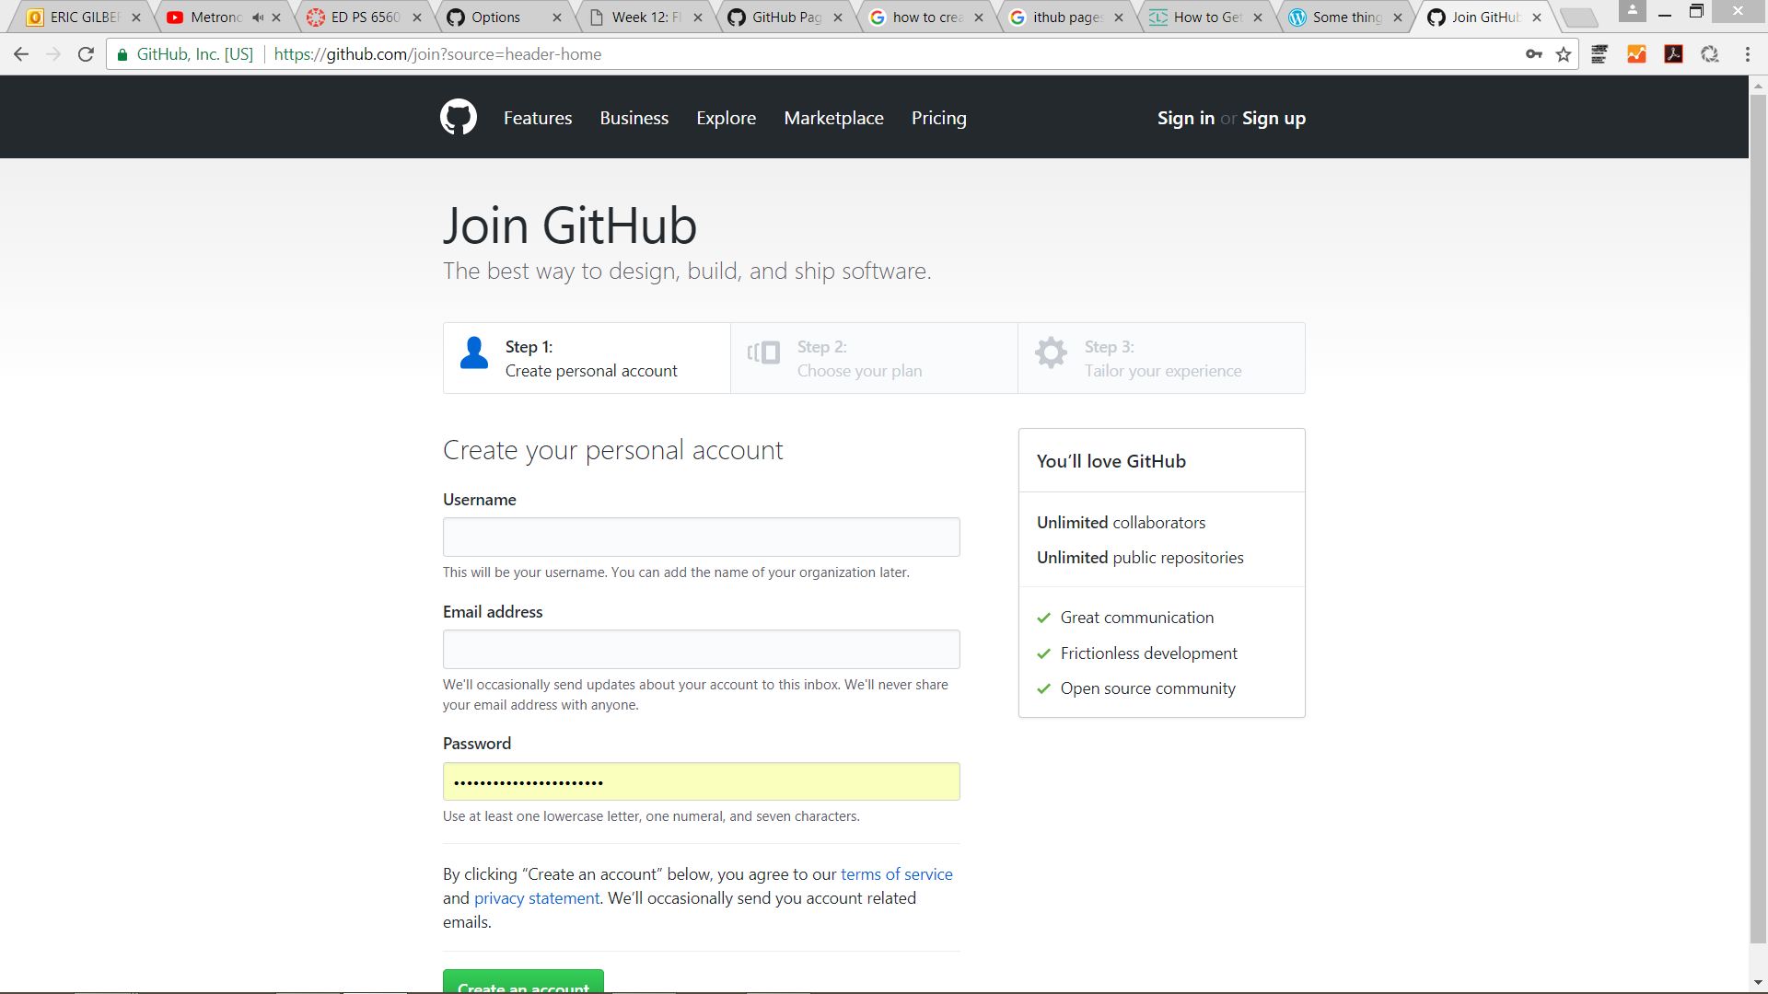
Activity #1: Hello World!
Sign up for an account
Navigate to this website: https://github.com/join?source=header-home
Choose a username, email, and password. Create an account.

Slide 19
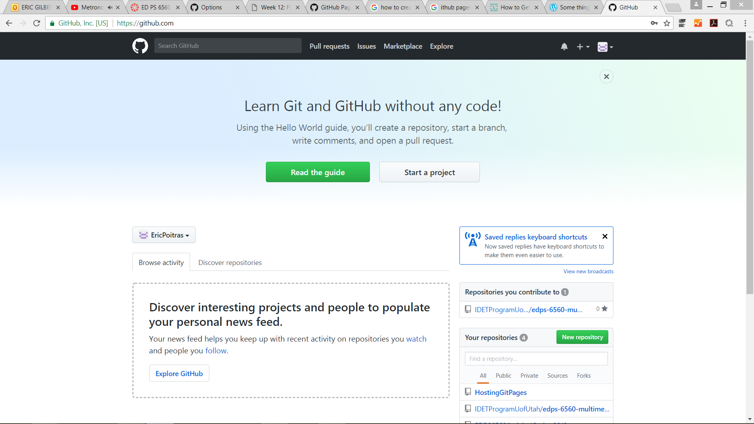
Activity #1: Hello World!
Creating a repository
Navigate to your profile page once you’ve signed in to the platform.
Select New Repository.

Slide 20
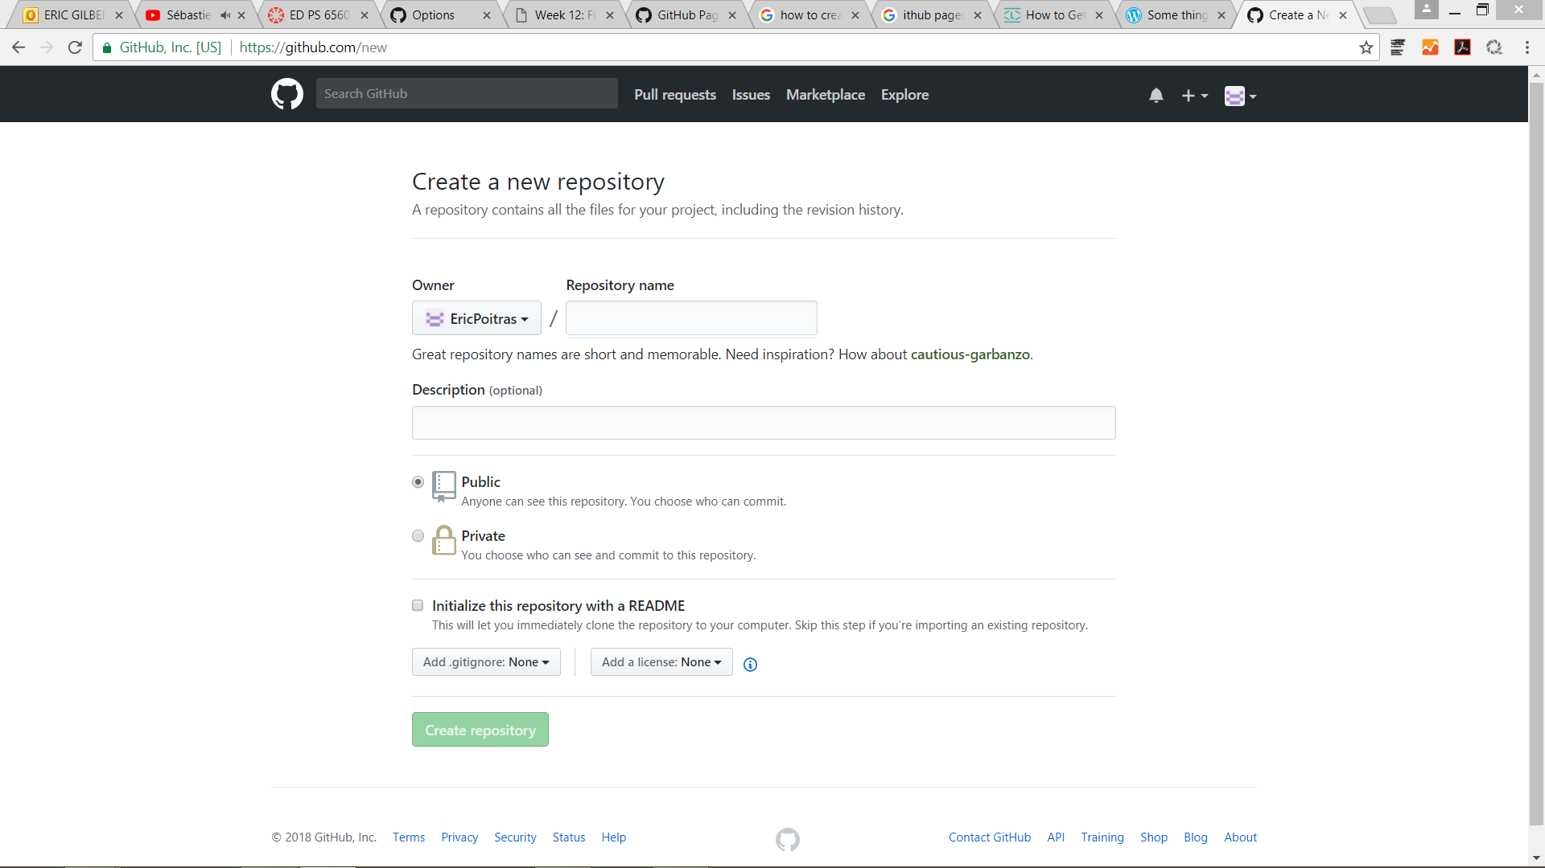
Activity #1: Hello World!
Creating a repository
Write a name for the repository. Write also a short description.
Choose Public. Then, specify that the repository should be created with a Readme file.
Create the repository.

Slide 21
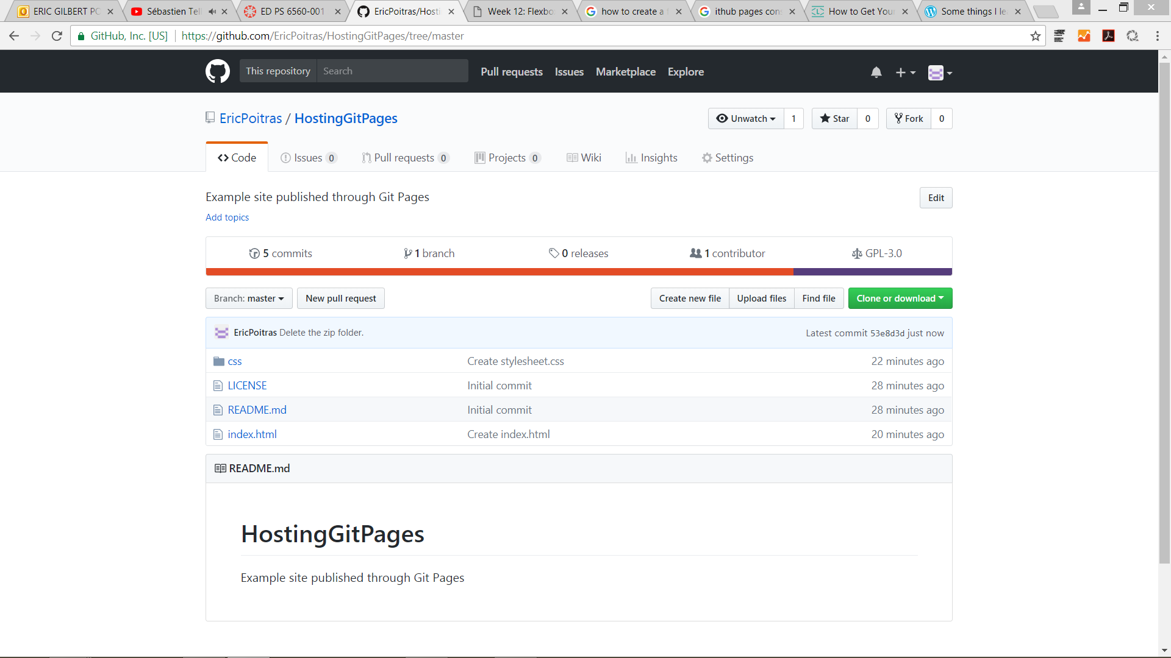
Activity #1: Hello World!
Creating the folder structure for your website
GitHub pages requires the use of an index.html file.
Create a new file. Call it index.html. Commit the change to the repository.

Slide 22
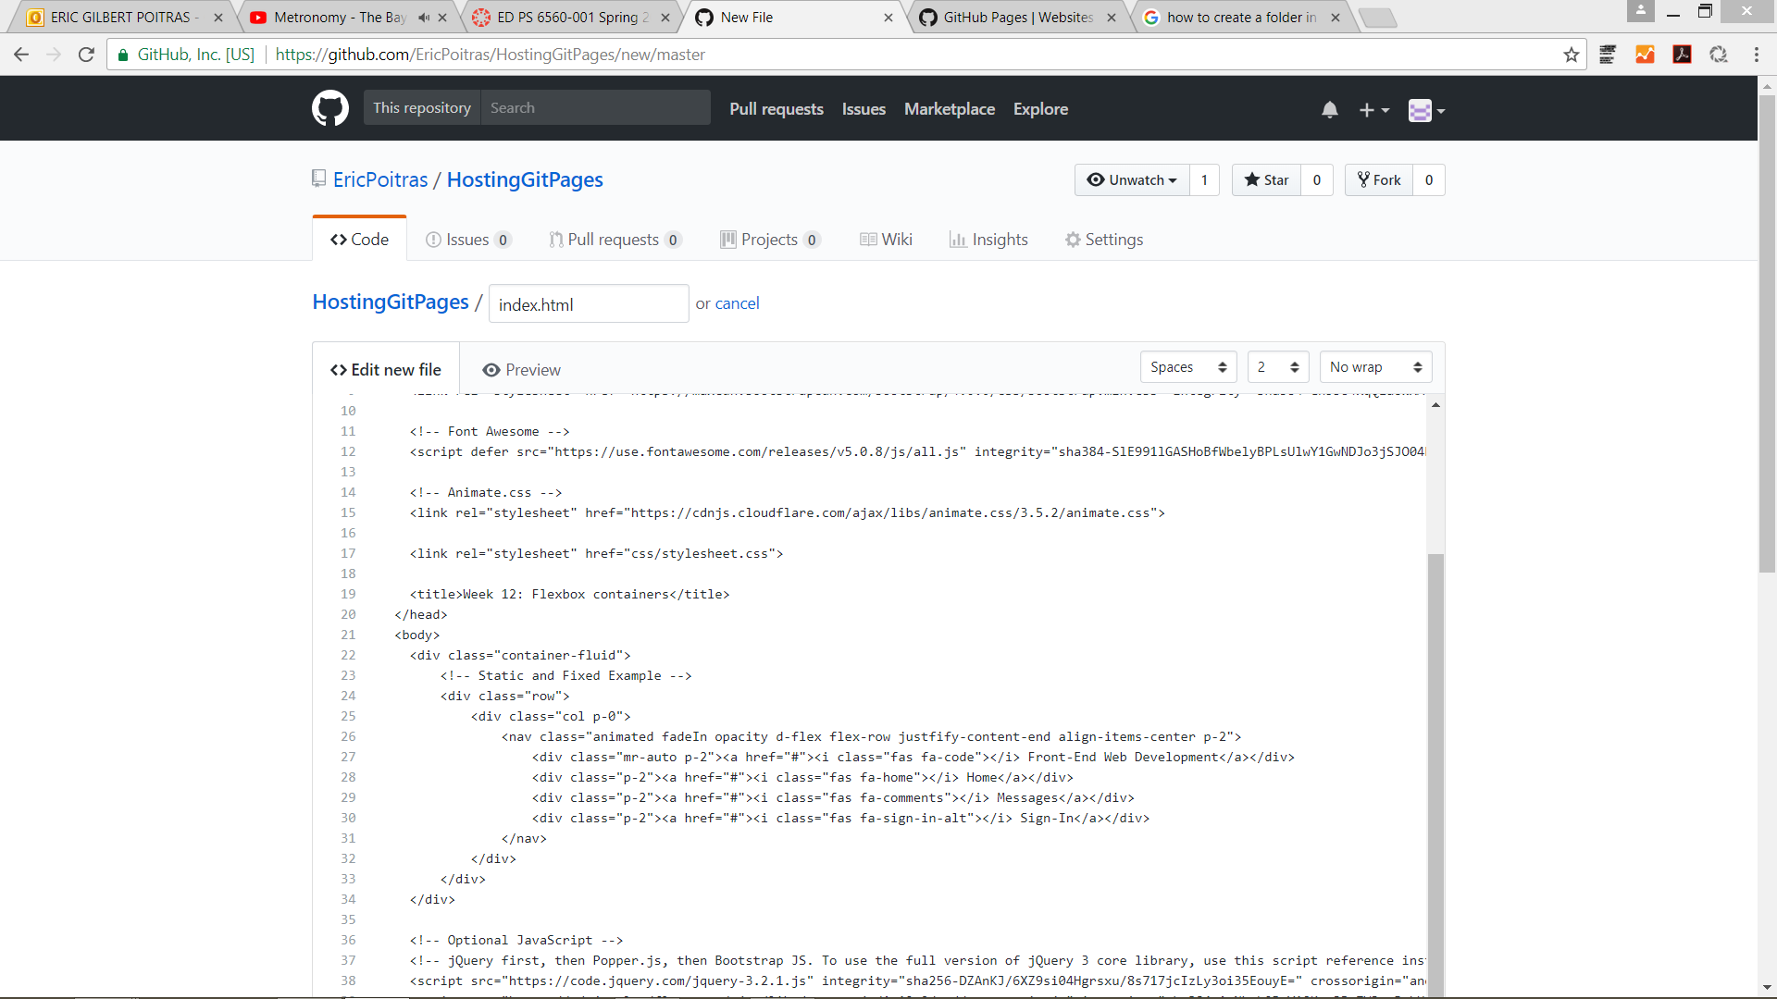
Activity #1: Hello World!
Creating the folder structure for your website
Select the index.html. Using the pen icon, edit the contents of the file.
Navigate to the BS4 website to the starter template section: https://getbootstrap.com/docs/4.1/getting-started/introduction/#starter-template.
Copy paste the code from the starter template into the index.html.

Slide 23
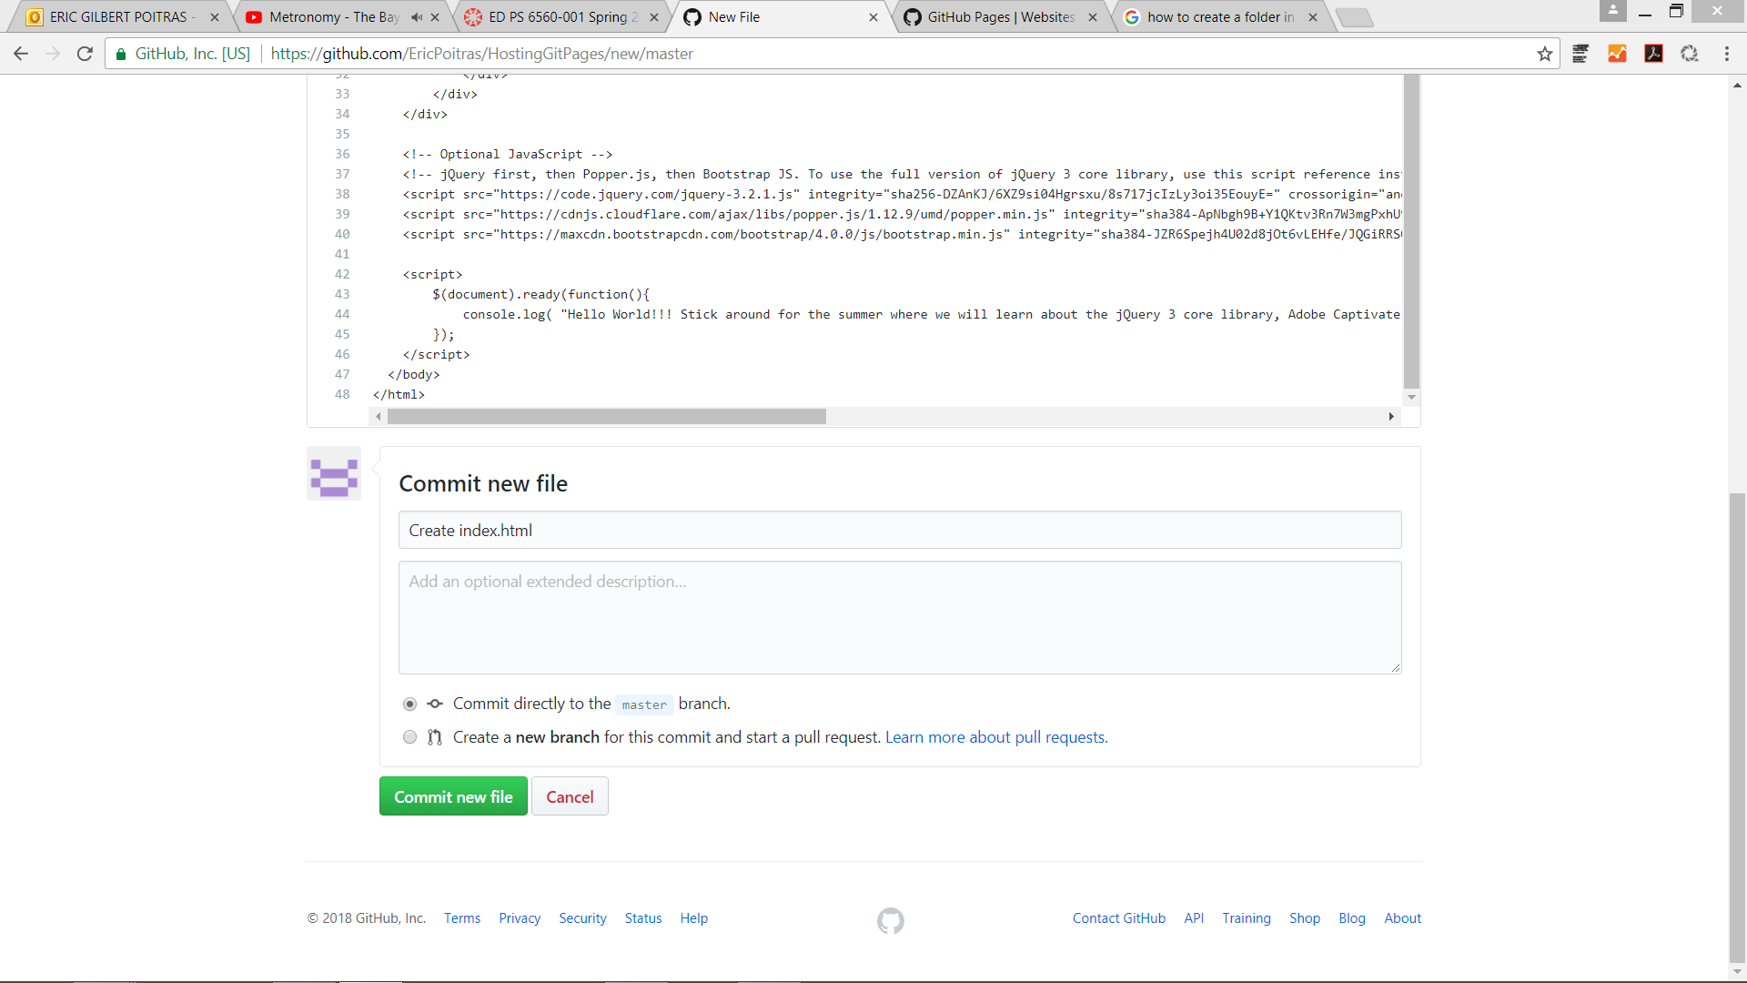
Activity #1: Hello World!
Creating the folder structure for your website
Customize the hello world! Message.
Commit the changes to the master branch.

Slide 24
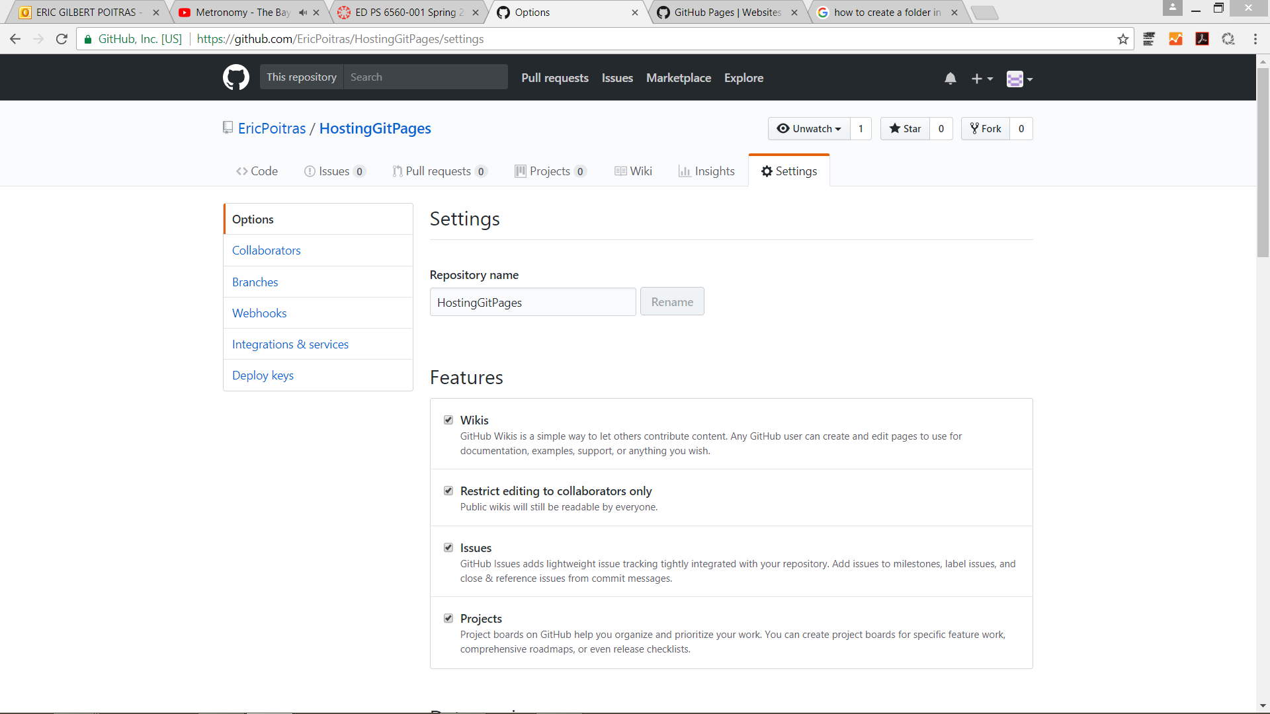
Activity #1: Hello World!
Creating the folder structure for your website
Navigate to the Settings of your account.
Scroll down until you reach the section “GitHub Pages”.

Slide 25
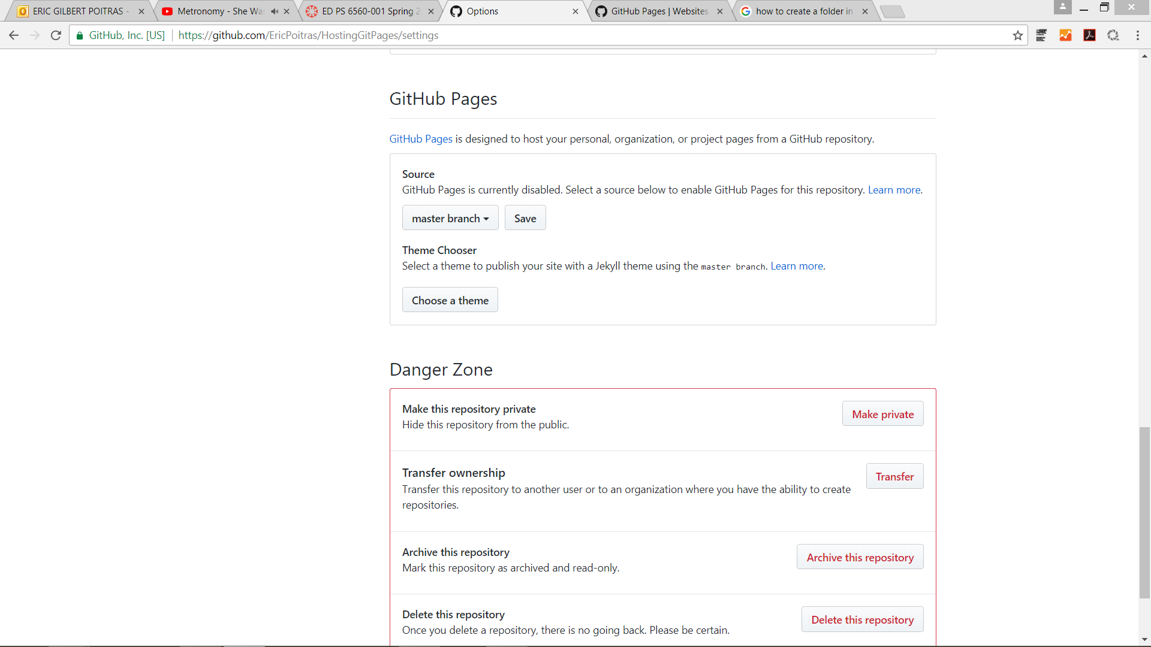
Activity #1: Hello World!
Creating the folder structure for your website
In the GitHub pages section, specify that you want to host the website from the master branch.
Select Save.

Slide 26
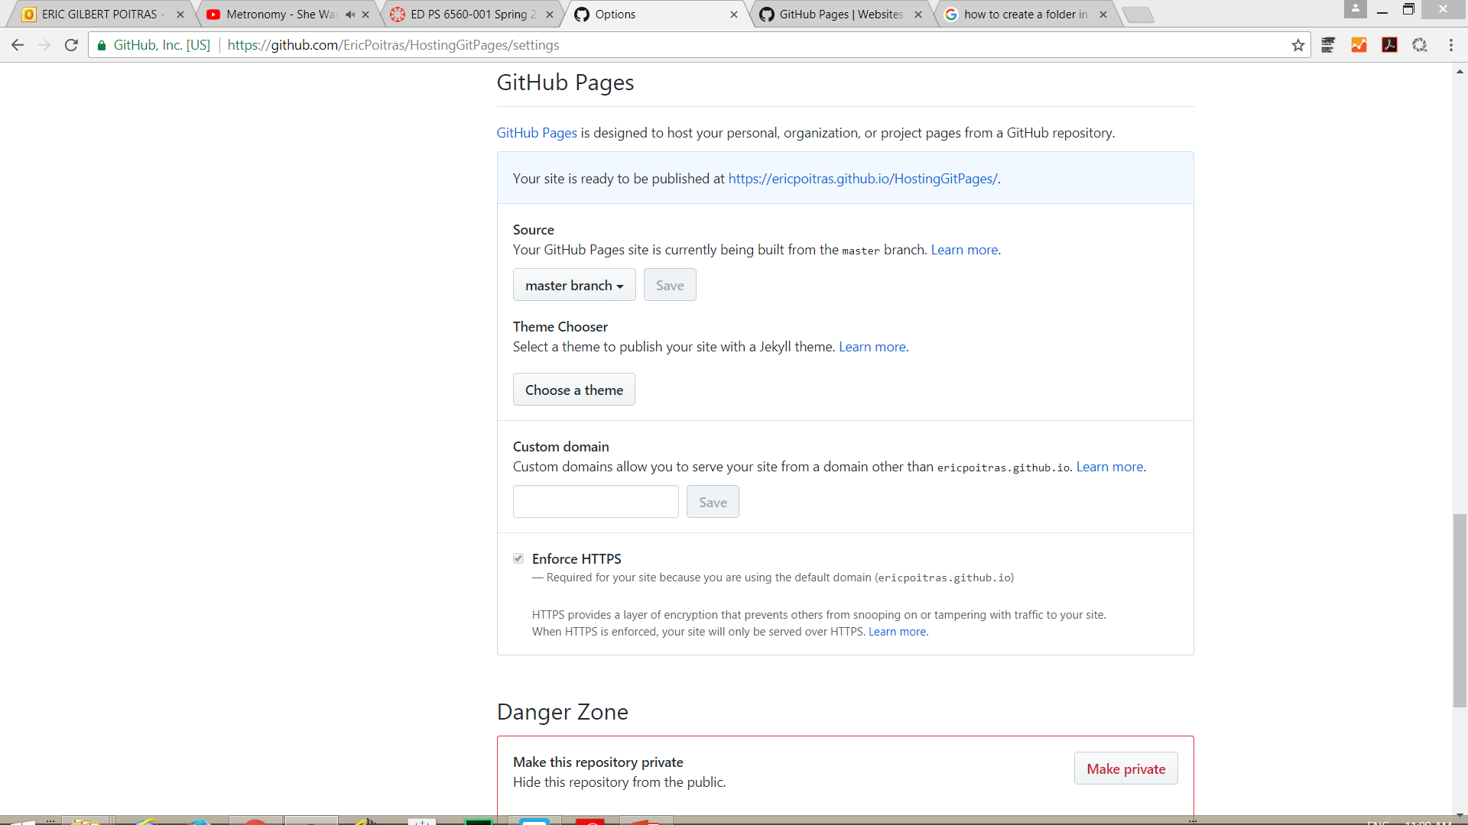
Activity #1: Hello World!
Creating the folder structure for your website
A confirmation message should appear with the url address of your site.
Navigate to the url address. Submit the url address via the Canvas course section to complete your first Activity #1 assignment.

Slide 27
In Preparation for Next Week
Watch tutorial videos on RapidMiner
Skim the North textbook chapter 1 and 2 on data mining
Solve the Codecademy module Make a Website – Site Structure

