Slide 1
Becoming A Better Data Communicator: Stata Data Visualization
Billy Buchanan - Data Scientist
Office of Research, Evaluation, Assessment, & Accountability
Minneapolis Public Schools

Slide 2
Why Data Visualization?
The best single device for suggesting,
and at times answering, questions
beyond those originally posed is the
graphical display. - John Wilder Tukey
Notes:
What is the overarching purpose for the talk?
As quoted in
Brillinger, D. R. (2002). John Wilder Tukey (1915-2000). Notices of the American Mathematical Society, 49(2), pp. 193-201. Retrieved on 06may2016; Retrieved from: http://www.ams.org/notices/200202/fea-tukey.pdf.
Quote from p. 198.
In short, Tukey = awesome stats/visualization ninjitsu.

Slide 3
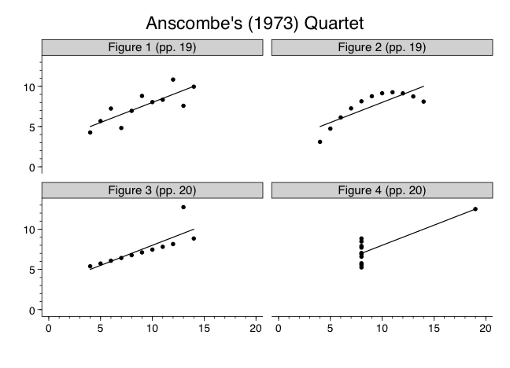
IS visualization Needed
to communicate data?
 | µ | σ
x | 9.0 | 3.317
y | 7.5 | 2.03
Graphs Are Essential to
Good Statistical Analysis.
Done Well, Visualization IS Infinitely More Effective Than Prose or Tables At Communicating Data.
Yes…The same Anscombe from the previous example
Y = α + β1X + ε
y = 3 + 0.5x + ε
r² = 0.67
Notes:
Tables and prose don’t necessarily imply closed systems or unique solutions to values. In this case, the distribution of X and Y are fixed, as are the relations between the two variables.
X = 9.0 (3.317)
Y = 7.5 (2.03)
Y = 3 + 0.5X + e
r^2 = 0.67
Graphs adopted from:
Anscombe, F. J. (1973). Graphs in Statistical Analysis. The American Statistician, 27(1), pp. 17-21. Retrieved on 06may2016, Retrieved from: http://www.sjsu.edu/faculty/gerstman/StatPrimer/anscombe1973.pdf.
If you're following along the code examples, there is a file called anscombesQuartet.do that contains all of the code used to generate the graph (including the data from the original study).
I say this not only out of personal conviction, but also because there is an overwhelming body of literature suggesting that our ability to perceive some of these complex relationships is orders of magnitude better when we use our visual system (e.g., data visualization) vs semantic systems (e.g., reading tables, prose, etc...). We evolved to be awesome pattern processing/recognizing ninjas, so we should leverage that ability to our advantage whenever possible.

Slide 4
But sometimes, data visualizations break bad
Go To: https://www.pollev.com/surveys/c95vsw2iy to submit your answers
Notes:
Now I’m going to show a fairly well known example and ask everyone to participate in a quick/simple poll. Once everyone’s ranked the pie segments for the pie graph on the left let me know.
What about the pie graph on the right?
Lastly, rank the bar segments
If the pie chart on the left doesn't immediately look familiar to you, it is the same pie chart used by Steve Jobs at one of Apple's major conferences several years ago and was the subject of some harsh criticism due to the inherent perceptual problems that are present. Some folks even speculate that it was done purposefully to take advantage of the perceptual problem.

Slide 5
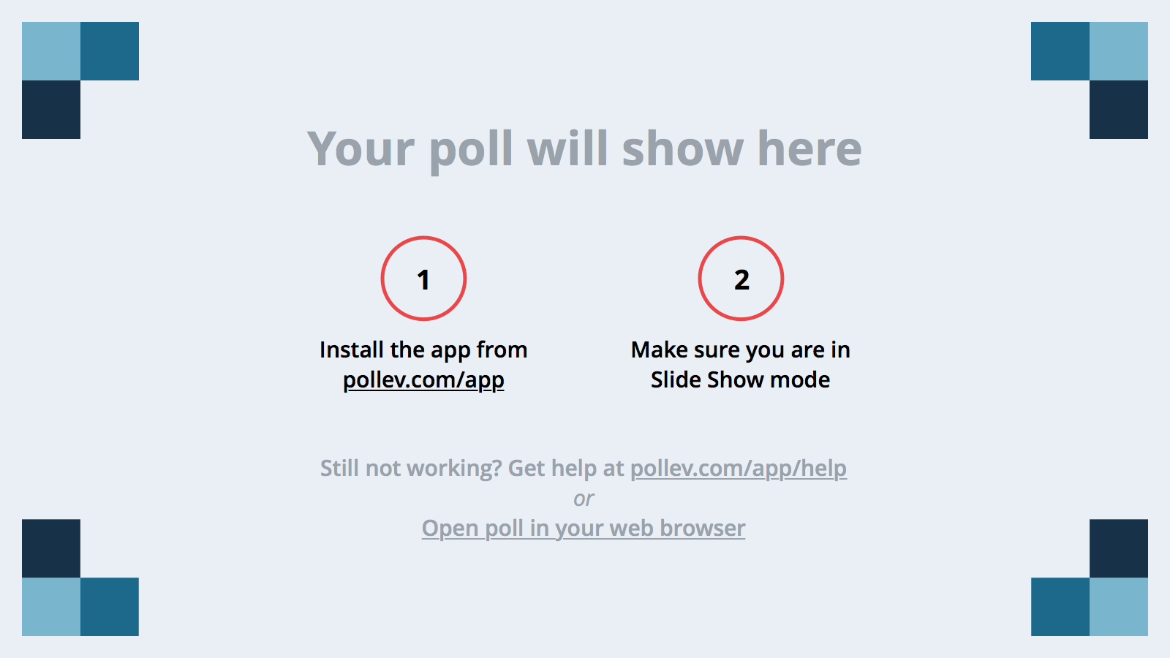
Notes:
Rank the Pie Slices on the Left by Size from Largest to Smallest
https://www.polleverywhere.com/ranking_polls/EXfEHeUM7fIXrPQ
Are these results what you expected? Why/Why Not?

Slide 6
Notes:
Rank the Pie Slices on the Right by Size from Largest to Smallest
https://www.polleverywhere.com/ranking_polls/KFWzbMpVmzixkWX

Slide 7
Notes:
Rank the Size of Bars on the Right by Size from Largest to Smallest
https://www.polleverywhere.com/ranking_polls/6SvWUNG6IFQ5PXW

Slide 8
1. Learn Foundational concepts in data visualization.
2. Learn How to Avoid Common Problems in Data Visualization.
3. Learn How to apply these concepts when creating visualizations in Stata.
Notes:
1. Learn foundational concepts in data visualization.
2. Learn how to avoid common problems in data visualization.
3. Learn how to apply these concepts when creating visualizations in Stata.
A good first step might be to put some of this in the context of existing frameworks...

Slide 9
what is communication?
Purpose
Information
1. Explore
2. Expose
3. Explicate
Destination
What are Some purposes for Visualization?
Noise Source
A
D
Transmitter
Receiver
?
B
C
Notes:
This diagram is based on a fairly old model of communications developed by Shannon, C. E. (1948). A mathematical theory of communication. The Bell System Technical Journal, 27, pp. 379-423. In Shannon’s case, this was a very literal translation of telecommunications, but still provides a useful framework for thinking about the process of communication (at least enough to the point where the paper has been cited > 80k times based on Google’s count).
Path A is the message as we (the transmitter) perceive/understand it.
Path B shows our effort to send this message to some recipients.
Path C is the message that the target of our communications receives.
Path D is the message as the target of the communications understands/perceives it.
In our particular case, purpose (e.g., communicating with stakeholders, communicating with C-Suite, communicating w/other data geeks, etc…) will mediate the process. However, we can use this framework to help us think through decisions along the way.
We can think about the purpose of data visualization a few different ways:
Explore - This is what exploratory data analysis is all about. Learning from and gaining an understanding of the data.
Expose - I’m using this specifically in the context of artistic uses of data (e.g., data sculpting, etc…), but could also be used to expose otherwise unknown/overlooked information and knowledge
Explicate - This is where the communication really happens. How do we make the graph a self-contained story that anyone can understand?
In each case there is a fairly distinct set of requirements/use cases that needs to be considered. For example, we don’t necessarily need to create a highly interactive scatterplot if we are only using it to screen for any egregious data entry errors. However, if we’re trying to show information about the opt-out movement, a visualization that allows users to interact with geographical features of the data could prove useful in highlighting demographic differences within the movement.
Another important factor to keep in mind when considering how the context of purpose affects communications is the noise that will be introduced along the way.
Here's an example of how information that a transmitter wanted to send to a receiver was muddied both by the transmitter and also by some outside noise:
https://public.tableau.com/profile/emily.le.coz#!/vizhome/MCT2DataAnalysis/Dashboard2
One of the more difficult tasks we face is trying to create visualizations that have unambiguous interpretations, or at least that are fairly robust to a lot of the interference beyond our control.

Slide 10
Task
questions, goals,
assumptions
Data Processing
Munging, Algorithms, Business Rules
data
Data type,
Measurement Scale
IMAGE
Marks,
UI/UX
DOMAIN
metadata,
sociocultural,
Semantics
Mapping
Dimensionality, Visual Encodings
Notes:
The process above is an adaptation of the process described in:
Heer, J. (2015). Effective Data Visualization. Retrieved on 06may2016; Retrieved from: http://homes.cs.washington.edu/~jheer/talks/Heer-EffectiveDataVisualization.pdf.
Won’t be able to focus on everything, but we’ll try to address some of the bigger issues that affect the efficacy of data visualizations. By starting with measurement scales, we can actually address quite a bit of information related to creating effective visualizations. It will not only give us constraints that we can use to guide decisions related to visualizations, but will also provide a foundation we can use to think about issues related to dimensionality, how we map the data to visual representations, and ultimately how this translates to a data visualization.
Although this framework places data and mapping in different parts of the process they are to some degree inseparable. So, if it seems like I'm bouncing back and forth between the two it is a combination of trying to address the relationships between the topics and a reflection of the iterative nature of creating data visualizations.

Slide 11
Scaling is then mapping observations into data. (McDonald, 1999; p 408)
 | Frequency | Min/Max | %iles | Mean / Dispersion | Coef of Variation
Nominal | YES | NO | NO | NO | NO
Ordinal | YES | YES | YES* | NO | NO
Intervallic | YES | YES | YES | YES | NO
Ratio | YES | YES | YES | YES | YES
What are measurement scales?
axioms defining numeric/mathematical properties of the datum
Measurement scales Constrain the math we can use with the data.
Notes:
McDonald's main points related to scaling are:
(a) Measurement is the assignment of numbers to quantifiable attributes according to a rule
(b) The rule can be arbitrary, allowing more than one assignment
(c) Distinct assignments can be non-linearly related
This can be distilled further to say that measurement scales are the rules we use to map measurement onto numeric values that have defined mathematical properties. Given a known measurement scale, we can define whether or not certain mathematic/algebraic algorithms are valid/appropriate.
For example, in Likert-type response sets the measure is ordinal. In other words, each response choice indicates a greater degree of agreement with a statement, but there are no constraints on the difference between the level of agreement. Typically, the distance between agreement and strong agreement would be smaller than the distance between disagreement and agreement. If the distance between the integers is not constant, decimal values (e.g., a property of a ratio of the proportional distance between integers) don't have an actual meaning. While this occurs constantly, it would be more appropriate to use the modal value to identify central tendencies in nominal and ordinal scale measures.
Although it is "technically" possible to estimate percentiles with an ordinal scale, there typically won't be sufficient variance in the values to have meaning. If there are sufficient enough values (e.g., 100 ordinal values in the scale) the variance in the distance between the integers becomes less problematic and we could treat it as intervallic.
Table adopted from:
Rosier, M. (2015). A practical introduction to Item Response Theory (IRT) using Stata 14. Retrieved on 06may2016, Retrieved from: http://www.stata.com/meeting/australia15/abstracts/materials/oceania15_rosier.pdf

Slide 12
why do we need to know about them?
To make better choices about visual mapping of data
Notes:
The data may be made up, but we've all witnessed these types of graphs that use nominal scale glyphs/marks to display data that are better displayed with glyphs/marks that are derived from the same measurement scale.
What are some of the issues that you notice with this graph? Anyone notice anything about the x-axis? If the letter grades are purely rankings the x-axis would reinforce a store about rankings from best to worst, but if they are ordinal values along a scale (e.g., F < D < C < B < A) then the scaling choice is telling a story about failure (e.g., as the values increase along the x-axis we are talking about higher levels of failure, not success).
The first step would probably be to encode things with some type of line graph to more clearly convey the message that we are viewing trends over time. This means the dimension encoded in color would no longer be the year, but the letter grade.
Now the colors follow the standard practice advocated by Heer and others, but on a dark background increasing the intensity of the color for the greatest quantities. For example, the letter grades are ordinal and indicate some increasing amount of quality/performance) ends up making the lowest quantity values contrast with the background the most (e.g., because the line for grade A is < luminescent than the line for grade F it ends up getting subdued a bit. Although the variance of the colors would certainly be appropriate with a lighter background, I would suggest reversing the encoding when working with darker backgrounds. Now, the greatest contrasting line encodes the highest level of quality/performance.
In short this, like the pie graphs is related to maximizing the efficiency of the visual encoding of dimensionality.
There are certainly socio-cultural meanings attached to colors/palettes that can be used as well, but I would suggest using visual encodings/mappings that match the underlying measurement scale of the data. In addition to preventing potential confusion, reinforcing the measurement scale of the data with visual mappings/encodings can also make it a bit easier to communicate some of the nuance to broader audiences.

Slide 13

Mapping dimensional spaceS from data to Viz
 | Nominal | Ordinal | Continuous
Position | NO | YES | YES
Shape | YES | NO¹ | NO
Size | NO | YES² | YES²
Color | YES³ | YES³ | YES³
Trellis | YES | YES | NO
NEVER 3-D*
you never need to encode data in 3-dimensional VISUAL space*
NEVER 3-D*
NEVER 3-D*
NEVER 3-D*
NEVER 3-D*
NEVER 3-D*
NEVER 3-D*
Z
Y
X
Notes:
Traditional 3D model is sufficient for concrete/tangible objects in many cases, but our data live in N-dimensional space and the combination of distortion of higher dimensional spaces projected on two dimensional surfaces (e.g., 3-D images on a computer screen/piece of paper) and the ubiquitous nature and familiarity that we have with the Cartesian plane makes this dimensional model useless for nearly all our visualization needs/purposes. In other words, we need to think about ways that we can map/encode higher dimensions in a two dimensional visual/image space to communicate most effectively with the users of the visualizations.
Technically you could encode ordinal values with geometries that have the same number of sides as the ordinal value (e.g., with a Likert type response set you could use a dot, line, triangle, square, and pentagon to show values of 1 - 5). However, it usually isn't a good idea to do this since it is fairly subtle and can easily be overlooked.
Size - like area/volume in general - will be difficult to perceive with high levels of accuracy and can also create other issues in the visual space (e.g., marks that overlap/obscure data from view). If you're able to control alpha transparency it isn't too bad, but is still best reserved for cases where the user isn't expected to perceive small differences accurately.
Encoding additional dimensions with color is entirely possible and common practice. The difficulty occurs when the measurement scale of the data and the scale of the visual encoding are conflicting.
If you view any of the existing literature, such as MacKinlay (1986), you'll notice some differences. For example, MacKinlay (1986) suggests that Position is the best encoding/mapping method for all measurement scales. However, this conflicts with the axioms that define a nominal scale as specifically unordered. Additionally, this work includes texture as one of the better ranked encoding/mapping techniques. While this is true in sets with few members (e.g., sex, race, etc...), it generalizes poorly when the set contains many members or when the ink to page ratio is high (e.g., if there are lots of marks on the page texture becomes more difficult to discern).
With regards to color, Nowell, Schulman, & Hix (2002) stated :
Some designers are reluctant to use color codes, because of variability in computer displays and concern about color impaired users. However, the power of color codes to improve both accuracy and speed of performance leads us to suggest that color codes should be used (p. 7)
Nowell, L., Schulman, R., & His, D. (2002). Graphical Encoding for Information Visualization: An Empirical Study. In The Proceedings of the IEEE Symposium on Information Visualization 2002 (InfoVis’02).
If you're wondering what the Trellis concept is at the bottom, this is derived from the work of Cleveland while he was working for Bell Laboratories. Basically, we can create subplots for the individual values along these nominal/ordinal scales and apply the same plot to values in that particular subset. The term trellis was used based on how the plots would/could be arranged (e.g., like a 2 x 2 cross tabulation, but with graphs instead of cell frequencies).
In other words, if there are more than two dimensional axes in your graph there is inefficient mapping of the data dimensionality to the visual space. The only possible exception is a rare enough use case to not be practical for us. For example, if you were communicating with statisticians/mathematicians you could use a tour to present your data in 3-4 dimensional visual space, but for 99.99% of our audiences this will not be the case and will make it more difficult to communicate the information clearly and consistently.

Slide 14
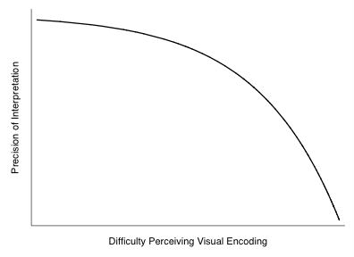
How about another quick perception test?
Encoding Choices are Economic Choices
Notes:
What in the world is the economics stuff doing in the data visualization talk?
Consider the degree of accuracy required when Using size to encode data. As long as high accuracy isn't required, the size trade off isn't quite so bad, but if you need the user to be able to perceive the information with a high level of precision/accuracy it would be better to use a different encoding (e.g., position/location).
Mapping Intervallic/Ratio Scales to color is also difficult to perceive
What you just experienced in the color/size encoding is an example of a "lossy" mapping between the data and the visual encoding. In other words, because of the choice to encode these data with these mappings there is a loss of information (to varying degrees). The "lossy" property of the mapping is exactly what the production frontier curve was illustrating. As the difficulty perceiving the information from the encoding increases, the degree of precision users will interpret the information with decreases.

Slide 15
What are common accessibility issues?
Congenital / Injury Based Issues
13%
13%
issues we create
Insufficient Color Contrast
Insufficient Color Contrast
 | Rarity | Primary Effect
Achromatopsia | 1:33000ª | All Colors
Protanopia | ~ 8% Men² 0.5% Women² | Red
Deuteranopia | ~ 8% Men² 0.5% Women² | Green
Tritanopia | < 8%^{b} | Blue
Notes:
Color contrast is an easy thing to fix, but probably not at the front of our thoughts when creating visualizations. It isn't available in brewscheme yet, but the next minor release will include a function to check color contrast from two RGB values and let you know which of the W3C standards it satisfies.
The next example is what I would label chart vomit. Tufte calls lots of things chart junk, but those things are usually put in the graph by someone. I like to think of chart vomit as all of those default things that the tool vomits into the graph in a way that makes it more difficult to interpret/perceive.
Quote from Stata user in response to version 1 of brewscheme:
“[Bill,] what a wonderful idea! I personally have tritanopia, and in my largest research collaborative there are two other people with protanopia. So we are always howling at meetings when our colleagues put up color-coded graphs that don't work for us. Personally, I had given up on ever using color, and I do all my graphical work in black and white unless specifically instructed to do otherwise by my collaborators. But it is very restricting, given that even those of us with limited color perception can still make some use of suitably chosen color information. I think this will prove liberating for me!”
American Association for Pediatric Ophthalmology and Strabismus. Retrieved from: http://www.aapos.org/terms/conditions/10, Retrieved on 11may2016
NIH Facts About Color Blindness. Retrieved from: https://nei.nih.gov/health/color_blindness/facts_about, Retrieved on 11may2016.
Achromatopes see everything as shades of grey.
Protanopes have issues with:
1. Black with many shades of red
2. Dark brown with dark green, dark orange and dark red
2. Some blues with some reds, purples and dark pinks
3. Mid-greens with some oranges
Deuteranopes have issues with:
1. Mid-reds with mid-greens
2. Blue-greens with grey and mid-pinks
3. Bright greens with yellows
4. Pale pinks with light grey
5. Mid-reds with mid-brown
6. Light blues with lilac
Tritanopes have issues with:
light blues with greys, dark purples with black, mid-greens with blues and oranges with reds

Slide 16
// Comments
code format
Applications in Stata
brewscheme intro (Stata >= 13 only)
Stata graph/visualization process
Participant identified challenges
Inferential results
IRT/Assessment data
Notes:
Just to break the flow and give everyone a heads up on the change in the slide formatting/visual theme shift. This should look familiar if you use the "Classic theme" in Stata.
Disclaimer: most of the code examples should work fine in Stata 13 or later, with some exceptions:
1. There is one program that was designed specifically to work for Stata 12 or later (distgraph).
2. The IRT examples will only work with Stata 14, but fitting the Rasch model to the data is possible in Stata 13.

Slide 17
What is brewscheme?
A Toolkit for Data Visualization in Stata
Utilities for working with color
Create reusable graph schemes/themes
Tools for checking accessibility issues
Reduces code needed for dataviz aesthetics
Notes:
Primarily uses research based color palettes (e.g., ColorBrewer, D3js, Tableau, other research, etc…). In addition to color palettes, also includes utilities for common tasks (e.g., hex to RGB conversion, color interpolation, checking color contrast, etc…)

Slide 18
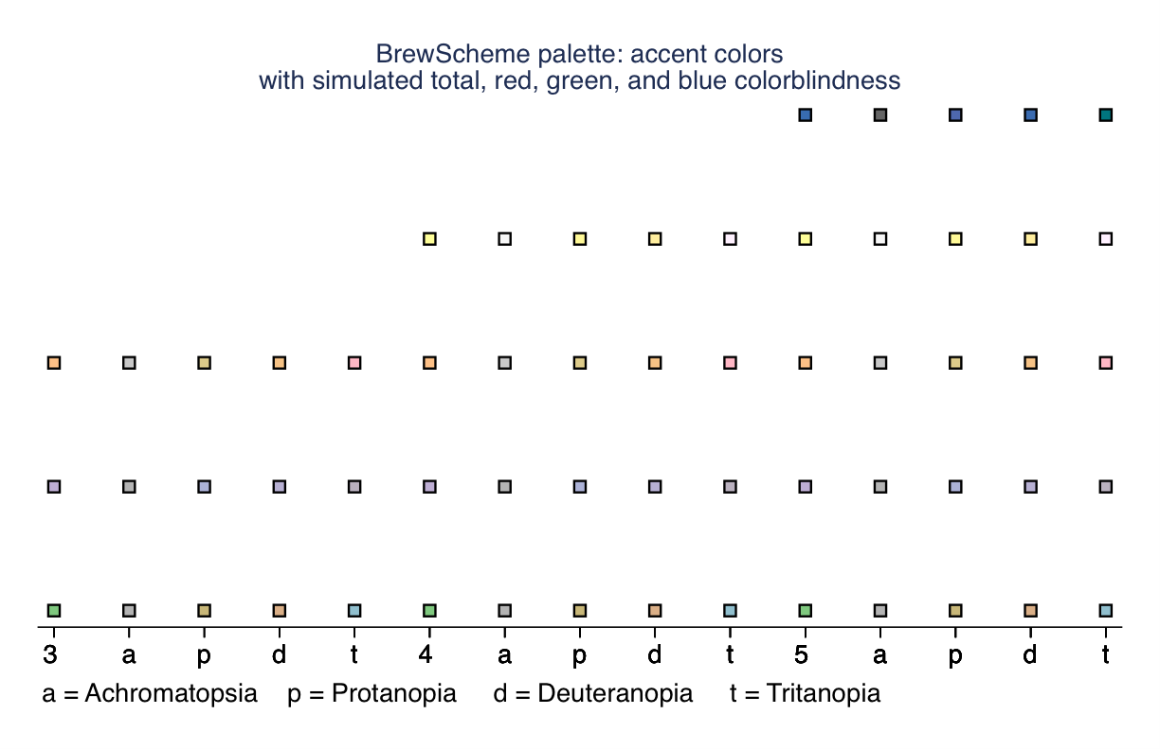
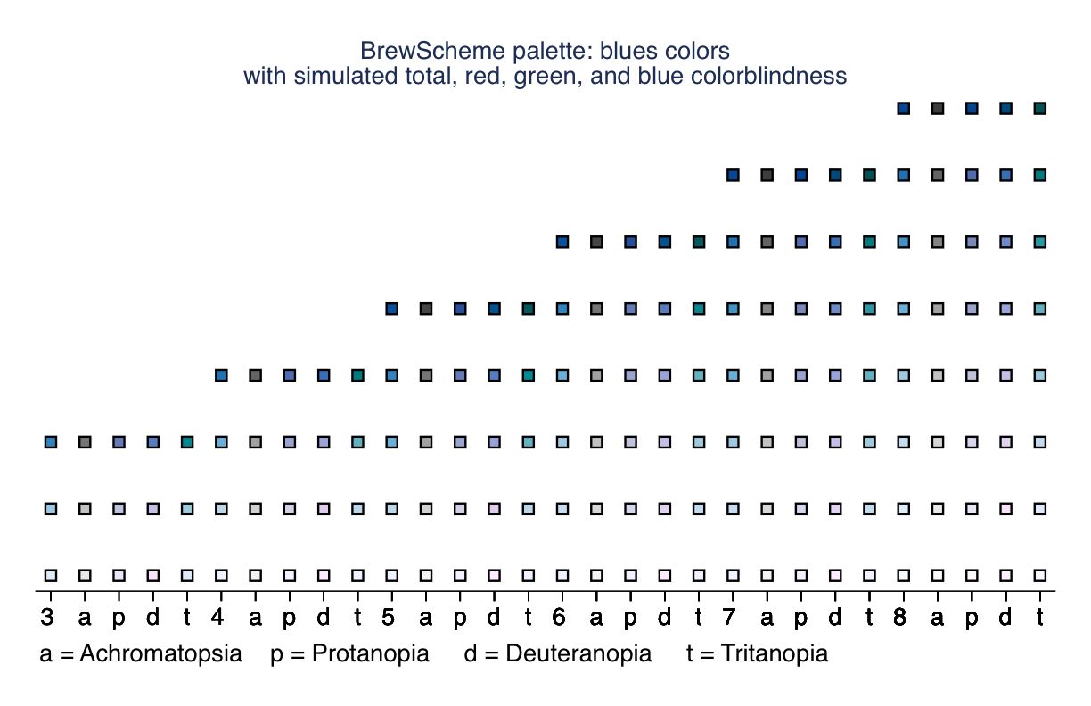
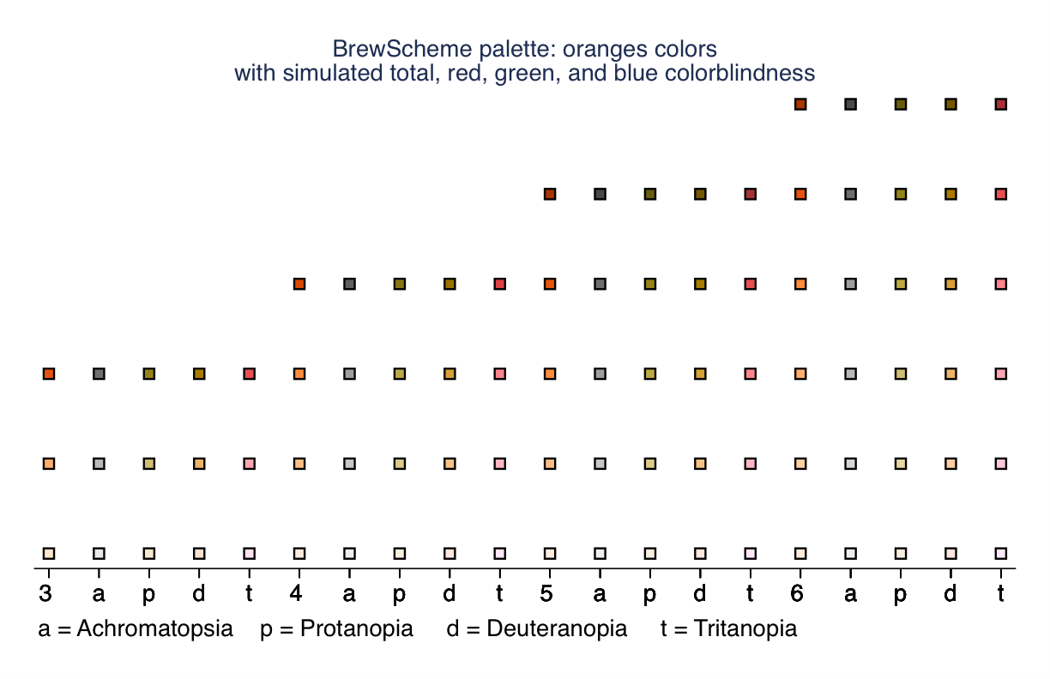
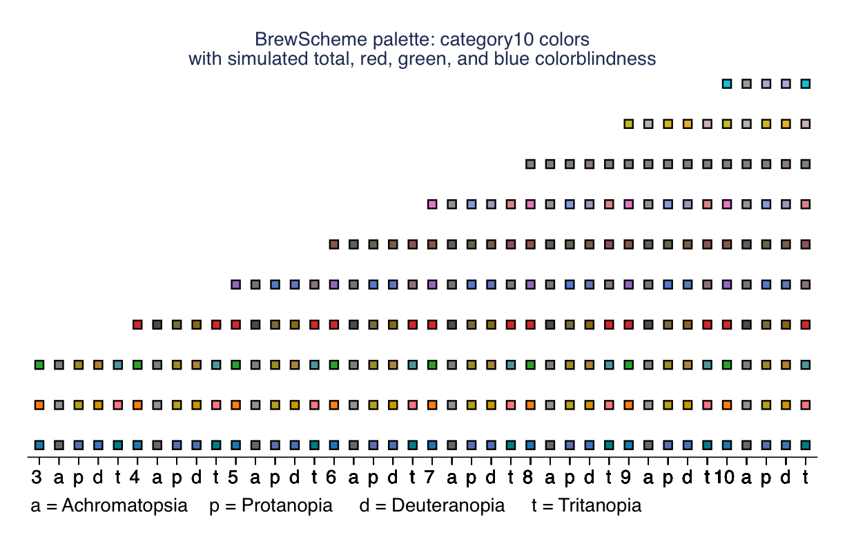
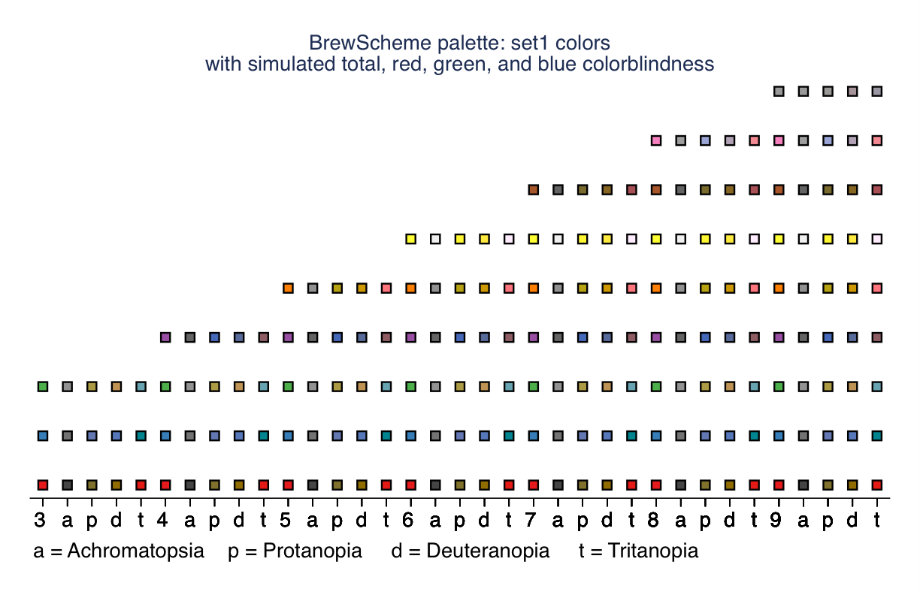
// Learning about palette properties
brewmeta "accent", colorid(5) colors(8)
brewmeta "blues", colorid(8) colors(9)
brewmeta "oranges", colorid(6) colors(8)
brewmeta "category10", colorid(10) colors(10)
brewmeta "set1", colorid(9) colors(9)
// Preview the different color palettes
brewviewer accent, c(5) seq imp
brewviewer blues, c(8) seq imp
brewviewer oranges, c(6) seq imp
brewviewer category10, c(10) seq imp
brewviewer set1, c(9) seq imp
Notes:
We can see some examples of lossy color mapping in these schemes. While it may not be possible to satisfy the needs of all audiences all the time, using tools like this can help us to understand how some of our aesthetic choices affect the ability of the audience to perceive the information.

Slide 19
/* Creating simple Stata graph schemes */
/* When the default theme is not enough */
// Create a scheme using the D3js Category 10 palette for
// all graph types with modified color intensities
brewscheme, scheme(sdp2016a) allsty(category10) ///
allc(10) allsat(60)
// Create a customized theme file:
brewtheme sdp2016theme, clockdir("legend_position 3") /// numsty("legend_cols 1" "legend_rows 0" "zyx2rows 0" /// "zyx2cols 1") barlabelsty("bar none") ///graphsi("x 5.5" "y 4")
// Then you can use the theme file when creating new schemes
brewscheme, scheme(sdp2016a2) allsty(category10) ///
allc(10) allsat(60) themef(sdp2016theme)
// Create a scheme with different color palettes for bar, // line, and pie graphs (and set a default for other types)
brewscheme, scheme(sdp2016b) piesty(accent) piec(5) ///
barsty(blues) barc(8) linesty(category10) linec(10) ///
somesty(oranges) somec(6) scatsty(set1) scatc(9) /// symbols(circle diamond plus square triangle)
brewscheme, scheme(sdp2016b2) piesty(spectral) piec(5) ///
barsty(blues) barc(8) linesty(category10) linec(10) ///
somesty(oranges) somec(6) symbols(circle diamond plus ///
square triangle) themef(sdp2016theme)
Notes:
You can see the online documentation for other examples, but these should give you some ideas of what you can do to create different types of schemes using the default themes.
The first example uses the Category 10 palette from D3 with a color intensity of 60 for all graph types. If you only need to graph nominal data, or only need to encode nominal scale data with color this is a completely acceptable solution. But if you find yourself needing to use color to encode data from other measurement scales, this might not be the most useful (e.g., encoding ordinal scale data with color).
If you primarily create bar, pie, and line graphs, you can specify palettes for only those types of graphs. We'll assume that bar graphs are used for ordinal scale data, pie graphs for nominal scale data, and individual lines would be used for different dimensions of a single measure/fact. You can also make sure that markers are able to encode nominal scale data using shapes at the same time.
The theme files also can help you to set things like the overall size of the graphs (the default is 9in x 6.5in - a landscape oriented page with 1 inch margins all around the image). You'll see some examples in a bit that use the graph schemes so you can see how they affect graphs. In short, once you get used to brewscheme a bit, you'll probably never want to bother entering aesthetics for graphs manually ever again or will at least reserve it for rare occasions/fine tuning the look of graphs. In either case, you'll see how using brewscheme can save you a significant amount of time and help you to create production/near-production quality visualizations with significantly less effort and time.

Slide 20
Stata Graph Structure
code examples Are in the session repository
Text/Titles
Graph/Plot Regions
By-graphs (Trellis)
Notes:
At first I just want to show some of the basic properties (e.g., the different parts of Stata graphs, different text elements, etc...) and then will show a bit more detail. A lot of the code examples here are fairly verbose, so rather than projecting them I suggest just following along with the various .do files.

Slide 21
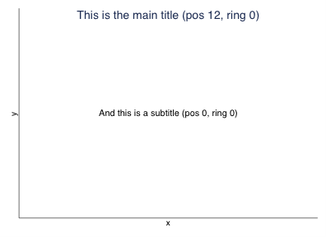
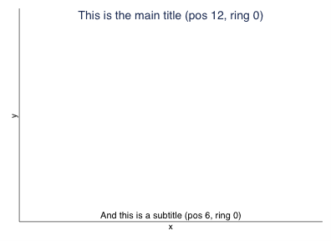
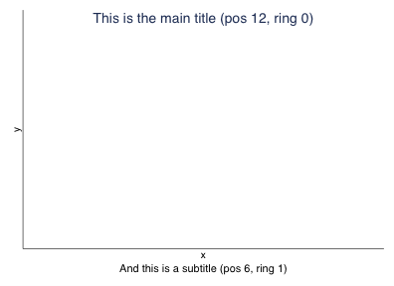
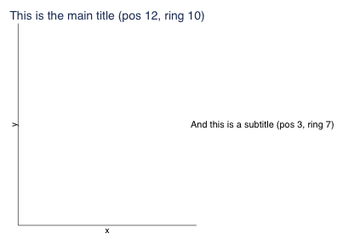
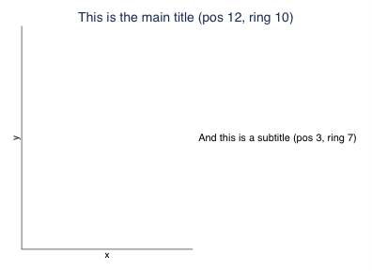
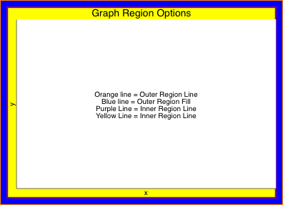
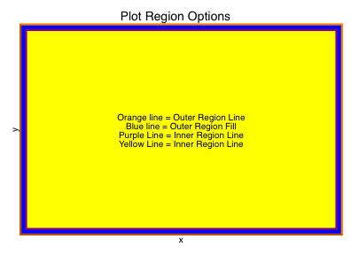
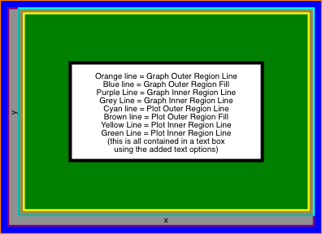
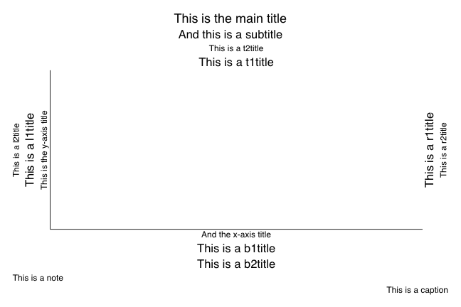
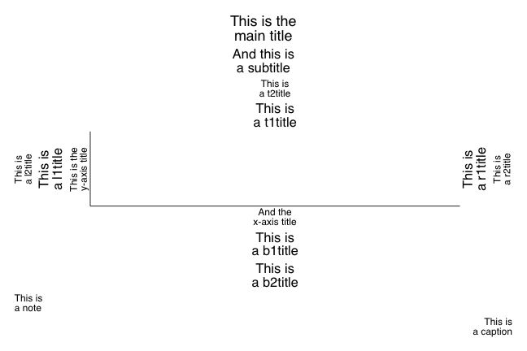
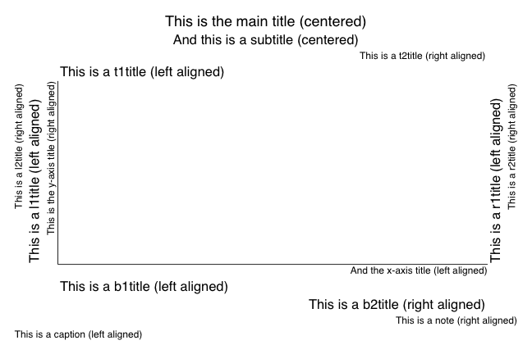
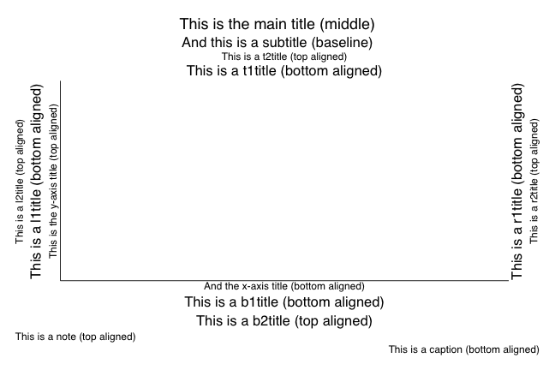
Notes:
1. Different text elements. Beware the b1title
2. Although creating multi-line titles/added text isn't difficult, multi-line axis labels can be extremely frustrating to handle/manage. A good way to work around it is to store the labels you would want to use in characteristics (e.g., can store the space separated lines of text and then use extended macro functions to grab the already prepared text)
3. Shows some of the alignment operations. Two different centering options. Can center aligned with the plot by passing the value center to the justification parameter or can center across the entire image using the span option.
4. Vertical alignment is a bit more subtle with all of the options show, but you can fine tune those options as well.
5. Elements are placed using position and ring parameters. The ring parameter defines how far from the plot the element should be placed. A value of 0 will place the element inside of the plot area. The position parameter defines the clock location of the element (e.g., 12 = top 6 = bottom), but a position value of 0 will place the element exactly centered on the point.
6. As long as position is not 0, everything with a ring value of 0 will be in the area where the data will be graphed.
7. Elements can be positioned inside and outside of the graph area simultaneously.
8. Adding elements to the right/left of the graph will reduce the amount of space you have for the plot itself.
9. In case you were wondering, this is what using the span option looks like (used on the title element)
10. There are also elements that define different parts of the image. Stata uses the term 'graph' to represent everything outside of the area where data is displayed and 'plot' to represent the area where data is displayed.
11. This should help to clarify the difference between graph and plot regions a bit more.
12. And to make it a bit easier to identify how everything works together

Slide 22
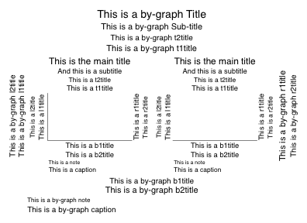
Notes:
This shows the graph anatomy when the by option is used with graphs. In short, all of the options that were used previously are no longer used to adjust the text elements for the graph over all, but for the individual subplots, while the same named options used inside of the by option will cause them to be rendered for the graph as a whole. The by option is the way to implement "trellis" style plots in Stata.

Slide 23
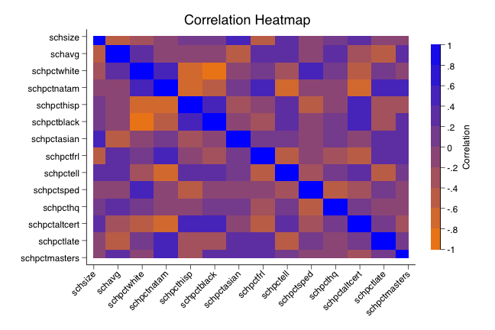
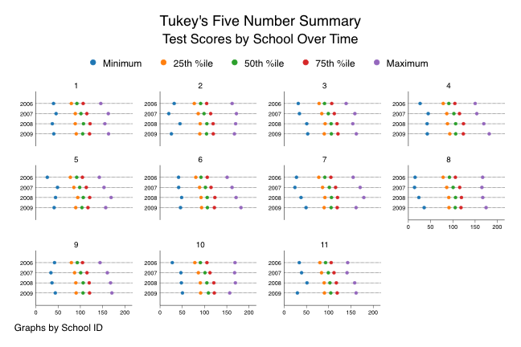
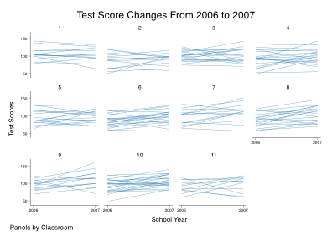
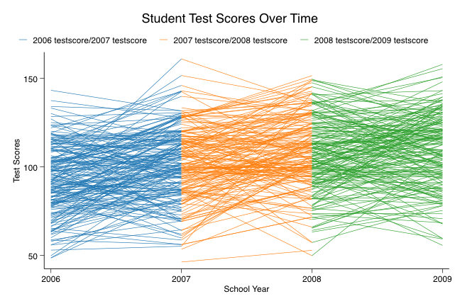
// Simulate Data for graph
schsim, avgsc(100 15) dist(3) disteff(0 .15) ///asi(0.065 7) bl(0.375 -7.5) hisp(0.2 -5.25) ///natam(0.03 -9.5) white(0.33 4.75) sex(0.51 3.75) ///sp(0.11 -14.5) el(0.175 -8.5) mast(0.8 0.0125) ///lateh(0.225 -2.5) altc(0.075 -1.5) hq(0.95 0.001) ///frl(0.65 -4.5) chart(0.085 0.75) ch(1 15) educ(10 35) /// stud(18 34) yea(4) attr(0.2285) time(0 1) scheff(0 1) /// edeff(0 5) steff(0 10) seed(7779311)
// Create year indicators
forv i = 2006/2009 {
qui: g int x`i' = `i'
}
// Store longer varname in local macro
loc ts testscore200
// Use more Dot Plots
gr dot (min) min = testscore (p25) pct25 = testscore ///(p50) median = testscore (p75) pct75 = testscore ///(max) max = testscore if distid == 1, over(schyr) ///asyvars scheme(sdp2016a) blabel(none) legend( ///label(1 "Minimum") label(2 "25th %ile") ///label(3 "50th %ile") label(4 "75th %ile") ///label(5 "Maximum")) by(schid, ///ti("Tukey's Five Number Summary") ///subti("Test Scores by School Over Time"))
// Heatmap code is lines 75-148 in otherGraphExamples.do
// Create parallel coordinate plot over longer span of time
tw pcspike `ts'6 x2006 `ts'7 x2007 if `ifc' || ///
pcspike `ts'7 x2007 `ts'8 x2008 if `ifc' || ///
pcspike `ts'8 x2008 `ts'9 x2009 if `ifc', ///
scheme(sdp2016a) xti("School Year") yti("Test Scores") ///
ti("Student Test Scores Over Time")
// Store condition in local macro
loc ifc distid == 1 & schid == 1
// Create class level parallel coordinate plots for year
tw pcspike testscore2006 x2006 testscore2007 x2007 ///if `ifc', by(tchid, note("Panels by Classroom") ///ti("Test Score Changes From 2006 to 2007")) xlab(#2) /// xsca(range(2006(1)2007)) xti("School Year") /// scheme(sdp2016b2) yti("Test Scores")
// Preserve and keep a subset of the data
preserve
keep stdid schyr tchid schid distid testscore proflevel ///race sex sped ell frl nce
// Restructure the data for a parallel coordinates plot
reshape wide testscore proflevel nce, i(distid schid ///tchid stdid) j(schyr)
Notes:
bygraph options:
colfirst - count subplots by columns then rows
total - includes a subplot for the overall as well
holes() - specifies subplot areas to be left empty
rows() - number of rows of subplots
cols() - number of columns of subplots
iscale() - alters the scaling of subplot elements (e.g., to shrink/enlarge the marks in the subplots)
compact - no margins between subplots (e.g., all touching)

Slide 24
visualization Process
Identify the simplest visualization that communicates your story
Don't reinvent the wheel ... unless you have to.
Create the visualization with the use case and medium in mind
Notes:
Visualization is labor intensive. Visualization is also an iterative endeavor. If you know a scatterplot tells your story, start with the simplest scatterplot that tells that story. Then your iterations are less about how/what to visualize and more about cleaning up the aesthetics.
If someone has already written a program/command there's no reason not to use their work. Just be kind and cite their work in what you do. In those cases where you do need to "reinvent the wheel" use the same approach (e.g., what is the smallest modification you can make in order to get the desired result).
Creating a visualization that looks good on a screen is different from one that looks good on a computer is different from one that looks good on paper. If you're aware of this from the onset, you can avoid issues that make a graph look awesome in one setting but awful in another. Understanding the use case will also help you to determine when you need to use certain tools/techniques to create the visualization. For example, if you need web-based visualizations you would probably reach for D3, using tools that are already available you could generate these visualizations in Stata with a combination of the jsonio, libhtml, and libd3 packages. There's also a huge difference between a graph created for exploratory purposes and one created for expository purposes.

Slide 25
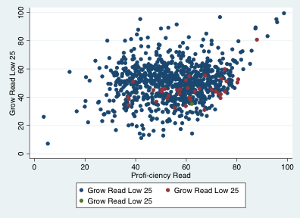

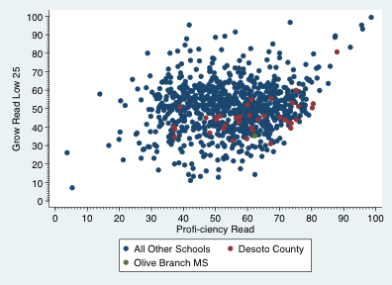
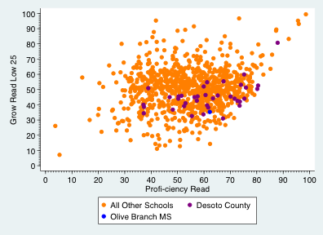
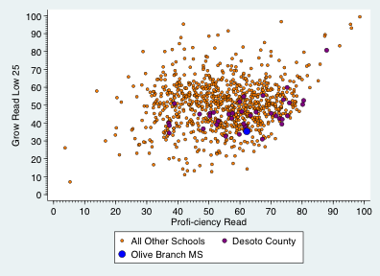
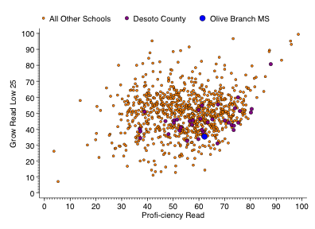
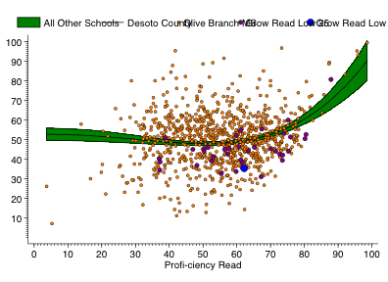
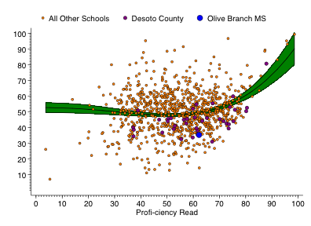
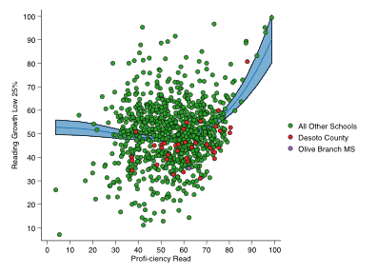
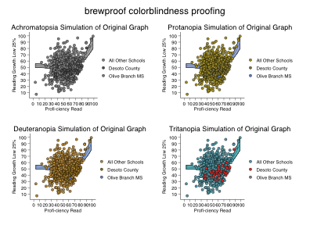
// Load some data
msas using msas.xlsx, perf
// Create a moderately complex graph
tw (scatter rlagrol rlapro if schnm != "District Level" ///& distnm != "Desoto Co") (scatter rlagrol rlapro if /// !inlist(schnm, "District Level", "Olive Branch MS") ///
& distnm == "Desoto Co")(scatter rlagrol rlapro if ///schnm == "Olive Branch MS")
// So we fix the labels in the legend
tw (scatter rlagrol rlapro if schnm != "District Level" ///& distnm != "Desoto Co") (scatter rlagrol rlapro if /// !inlist(schnm, "District Level", "Olive Branch MS") ///
& distnm == "Desoto Co")(scatter rlagrol rlapro if ///schnm == "Olive Branch MS", legend( ///label(1 "All Other Schools") label(2 "Desoto County") /// label(3 "Olive Branch MS"))
// Now we try to fix the axis labels/tick marks
tw (scatter rlagrol rlapro if schnm != "District Level" ///& distnm != "Desoto Co") (scatter rlagrol rlapro if /// !inlist(schnm, "District Level", "Olive Branch MS") ///
& distnm == "Desoto Co")(scatter rlagrol rlapro if ///schnm == "Olive Branch MS", legend( ///label(1 "All Other Schools") label(2 "Desoto County") /// label(3 "Olive Branch MS")) ylab(#11, angle(0) nogrid) ///xlab(#10) ymti(0(1)100) xmti(0(1)100))
// Now we try to make the points contrast a bit more
tw (scatter rlagrol rlapro if schnm != "District Level" ///& distnm != "Desoto Co", mc(orange))(scatter rlagrol ///rlapro if !inlist(schnm, "District Level", /// "Olive Branch MS") & distnm == "Desoto Co", mc(purple)) ///(scatter rlagrol rlapro if schnm == "Olive Branch MS", ///legend(label(1 "All Other Schools") ///label(2 "Desoto County") label(3 "Olive Branch MS")) ///ylab(#11, angle(0) nogrid) xlab(#10) ymti(0(1)100) ///xmti(0(1)100) mc(blue))
// Still a bit challenging, so we try to sharpen the points
tw (scatter rlagrol rlapro if schnm != "District Level" ///& distnm != "Desoto Co", mc(orange) msize(small) ///mlc(black) mlw(vthin))(scatter rlagrol rlapro if /// !inlist(schnm, "District Level", "Olive Branch MS") & ///distnm == "Desoto Co", mc(purple) msize(medium) ///mlc(black) mlw(vthin)) (scatter rlagrol rlapro if ///schnm == "Olive Branch MS", legend( ///label(1 "All Other Schools") label(2 "Desoto County") /// label(3 "Olive Branch MS")) ylab(#11, angle(0) nogrid) ///xlab(#10) ymti(0(1)100) xmti(0(1)100) mc(blue) ///msize(large) mlc(black) mlw(vthin))
// Then we fix the background and clean up the legend
tw (scatter rlagrol rlapro if schnm != "District Level" ///& distnm != "Desoto Co", mc(orange) msize(small) ///mlc(black) mlw(vthin))(scatter rlagrol rlapro if /// !inlist(schnm, "District Level", "Olive Branch MS") & ///distnm == "Desoto Co", mc(purple) msize(medium) ///mlc(black) mlw(vthin)) (scatter rlagrol rlapro if ///schnm == "Olive Branch MS", legend( ///label(1 "All Other Schools") label(2 "Desoto County") /// label(3 "Olive Branch MS") pos(12) region(lc(white)) /// rows(1) size(medsmall) span) ylab(#11, angle(0) nogrid) /// xlab(#10) ymti(0(1)100) xmti(0(1)100) mc(blue) ///msize(large) mlc(black) mlw(vthin) graphr(ic(white) /// fc(white) lc(white)) plotr(ic(white) fc(white) lc(white)))
// Then we realize how nice a smoother would be...
tw (fpfitci rlagrol rlapro if schnm != "District Level", /// lc(black) lw(medthin) fc(green))(scatter rlagrol rlapro if ///schnm != "District Level" & distnm != "Desoto Co", mc(orange) /// msize(small) mlc(black) mlw(vthin))(scatter rlagrol rlapro if /// !inlist(schnm, "District Level", "Olive Branch MS") & ///distnm == "Desoto Co", mc(purple) msize(medium) mlc(black) /// mlw(vthin)) (scatter rlagrol rlapro if ///schnm == "Olive Branch MS", legend(label(1 "All Other Schools")/// label(2 "Desoto County") label(3 "Olive Branch MS") pos(12) ///region(lc(white)) rows(1) size(medsmall) span) ///ylab(#11, angle(0) nogrid) xlab(#10) ymti(0(1)100) ///xmti(0(1)100) mc(blue) msize(large) mlc(black) mlw(vthin) /// graphr(ic(white) fc(white) lc(white)) plotr(ic(white) ///fc(white) lc(white)))
// Then you fix the legend...again...
tw (fpfitci rlagrol rlapro if schnm != "District Level", /// lc(black) lw(medthin) fc(green))(scatter rlagrol rlapro if ///schnm != "District Level" & distnm != "Desoto Co", mc(orange) /// msize(small) mlc(black) mlw(vthin))(scatter rlagrol rlapro if /// !inlist(schnm, "District Level", "Olive Branch MS") & ///distnm == "Desoto Co", mc(purple) msize(medium) mlc(black) /// mlw(vthin)) (scatter rlagrol rlapro if ///schnm == "Olive Branch MS", legend(label(1 "All Other Schools")/// label(2 "Desoto County") label(3 "Olive Branch MS") pos(12) ///region(lc(white) order(3 4 5)) rows(1) size(medsmall) span) ///ylab(#11, angle(0) nogrid) xlab(#10) ymti(0(1)100) ///xmti(0(1)100) mc(blue) msize(large) mlc(black) mlw(vthin) /// graphr(ic(white) fc(white) lc(white)) plotr(ic(white) ///fc(white) lc(white)))
// Less code for comparable result w/brewscheme
tw fpfitci rlagrol rlapro if ///schnm != "District Level" || scatter rlagrol ///rlapro if schnm != "District Level" & ///distnm != "Desoto Co" || scatter rlagrol rlapro ///if !inlist(schnm, "District Level", /// "Olive Branch MS") & distnm == "Desoto Co" || ///scatter rlagrol rlapro if ///schnm == "Olive Branch MS", ///yti("Reading Growth Low 25%") ylab(#11) xlab(#11) /// legend(order(3 4 5) label(3 "All Other Schools") /// label(4 "Desoto County") ///label(5 "Olive Branch MS")) scheme(sdp2016a2)
// We can check some accessibility issues too
brewproof, scheme(sdp2016a2): /// tw fpfitci rlagrol rlapro if ///schnm != "District Level" || scatter rlagrol ///rlapro if schnm != "District Level" & ///distnm != "Desoto Co" || scatter rlagrol rlapro ///if !inlist(schnm, "District Level", /// "Olive Branch MS") & distnm == "Desoto Co" || ///scatter rlagrol rlapro if ///schnm == "Olive Branch MS", ///yti("Reading Growth Low 25%") ylab(#11) xlab(#11) /// legend(order(3 4 5) label(3 "All Other Schools") /// label(4 "Desoto County") ///label(5 "Olive Branch MS"))
How do we normally generate Data visualizations?
what if the process didn't need to be this way?
But wait...
There's More...
Notes:
If you hadn't noticed, I had to make the font size smaller as the graph increased in complexity in order to fit everything on the screen. I also kept the time of the input animations constant. So it wasn't speeding up, but providing a visual/temporal representation of how much more information needs to be added for the modifications in order to generate the desired end result. Conversely, I increased the time each of the code blocks burned to help reinforce the amount of time that we all probably spend when building visualizations.
Unfortunately, this doesn't help users working with Stata 12 directly, but since scheme files are independent of the Stata version they can always be shared (so someone with Stata 13 could generate a scheme file - or files - for you and you could still get the benefit that way).
Although it might look like there is a lot of code on the screen, I actually enlarged the font to make it a bit easier to read. In reality, there is a significant amount less code being used to generate the graphs. And this is one of the biggest reasons I'd suggest using brewscheme. You may not have known it at the time, but each time you ran the brewscheme command earlier your computer was writing somewhere around 10-12 thousand lines of code. Since the schemes are created fairly quickly/easily, you can create schemes as often as you want to customize things, and in doing so can avoid some of the issues created by hardcoding all of the graph options into your commands.
Also, if you're a fan of ggplot2 in R, there is an example theme file used to recreate the ggplot2 aesthetics on the brewscheme project page. Unfortunately, the aesthetics used as defaults by ggplot2 (prior to the version 2 release at least) are almost indiscernible to individuals with color sight impairments.

Slide 26
Challenges You Identified
Graph Options
Distributions w/reference lines
Nested & Overlaid Distributions
(semi-)Dynamic Displays
Notes:
These are my best guesses at solving some of the issues that you all identified. It's very likely that I may not have understood things correctly, and feel free to use the collaboration/group time at the end of the session to connect with me if that is the case or to connect with me over the next few days.
Wasn't sure exactly which options/graphs people had challenges with so I cant address them here directly, but feel free to let me know what issues you were having in a bit and I can try to help address it on the spot or will try to add some examples to the project repository to address the issue so you can still get some help/support.

Slide 27
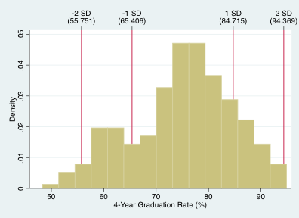
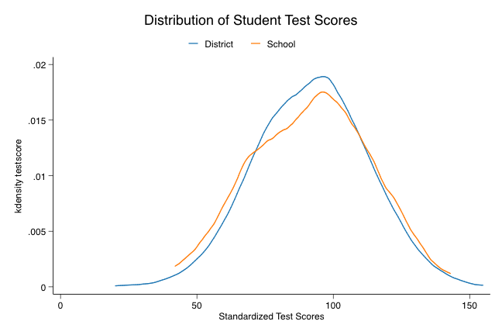
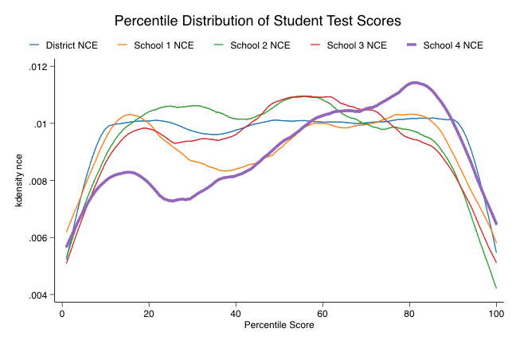
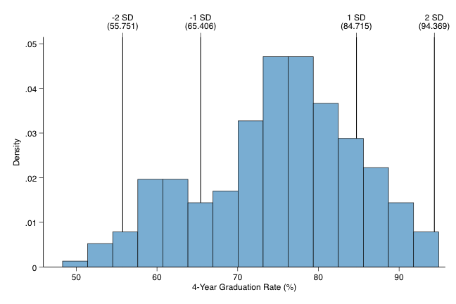
// Load the performance data
msas using msas.xlsx, perf
School Name --- School District School Year 2014-2015: A School Year 2015-2016 w/o Waiver: D School Year 2015-2016 w/Waiver: A Differentiated Accountability Performance: Not a Title I School
Grade: D Total Points: 396 | Reading | Mathematics | Science
Proficiency | 62.2 | 70.0 | 82.7
Growth All Students | 59.6 | 53.8 | Participation Rate
Growth Low 25% | 35.3 | 32.7 | 99.8
The colors above indicate in which quintile the individual component is in compared to other schools in the MS Statewide Accountability System.
// Can also pass a scheme file to the command as well
distrograph gradrate if schnm != "District Level", ///reflin(-2 -1 1 2) scheme(sdp2016a)
// Store most syntax in local to reduce repeating code
loc dif kdensity nce if distid == 1 & centyear == 0
// Create graph with multiple school distributions overlaid
tw `dif' || `dif' & schid == 1 || `dif' & schid == 2 || ///`dif' & schid == 3 || `dif' & schid == 4, lw(thick) ///scheme(sdp2016a) legend(label(1 "District NCE") ///label(2 "School 1 NCE") label(3 "School 2 NCE") ///label(4 "School 3 NCE") label(5 "School 4 NCE")) ///
xti("Percentile Score") ///ti("Percentile Distribution of Student Test Scores")
// Simulate data for graph example
schsim, avgsc(100 15) dist(3) disteff(0 .15) ///asi(0.065 7) bl(0.375 -7.5) hisp(0.2 -5.25) ///natam(0.03 -9.5) white(0.33 4.75) sex(0.51 3.75) ///
sp(0.11 -14.5) el(0.175 -8.5) mast(0.8 0.0125) ///lateh(0.225 -2.5) altc(0.075 -1.5) hq(0.95 0.001) ///frl(0.65 -4.5) chart(0.085 0.75) sch(1 15) educ(10 35) /// stud(18 34) yea(4) attr(0.2285) time(0 1) scheff(0 1) /// edeff(0 5) steff(0 10) seed(7779311)
// Open the file semiDynamic.do from the project repository
Need to spin up an HTTP Server, but this will show the
result of the .do file
/* Create a distribution plot of graduation rates with the references mentioned in the request above: */
distrograph gradrate if schnm != "District Level", /// reflin(-2 -1 1 2)
// Show nested distributions
tw kdensity testscore if distid == 1 & centyear == 0 || /// kdensity testscore if distid == 1 & schid == 1 & /// centyear == 0, scheme(sdp2016b) ///legend(label(1 "District") label(2 "School")) /// xti("Standardized Test Scores") ///ti("Distribution of Student Test Scores")
0-20%ile
21-40%ile
41-60%ile
61-80%ile
81-100%ile
Notes:
If there are small modifications you make to graphs regularly, it can be extremely helpful to create wrappers that implement the standard modifications that you make. This is the approach I used to create the histograms that include reference lines for various units of standard deviations from the mean. As long as not too much is changed, you can also allow all the same options to be passed back and forth between the wrapper and underlying graph commands.
The schsim command is something I threw together to simulate data that looks like the data we normally deal with. If you needed/wanted to show the relationship(s) between distributions of scores (e.g., district vs school distributions) the kernel density plot is extremely helpful/useful. These are essentially non-parametric smoothers of the distribution, so they won't be the exact observed distribution, but give you a good approximation. One way to explain smoothers is that they function the same way sandpaper and saw dust function in carpentry. Any jagged peaks get rounded out/flattened a bit and any deep grooves get filled in a bit to make the surface a bit smoother. Sometimes these can be good for illustrating how one - or more - schools perform differently from the rest. In the second example with more schools overlaid, school 4 has students that tend to perform at a higher level on the standardized tests.
If the purpose of showing percentile information is more about context, you could take a slightly different approach as well. First apologies for the difficulties reading some of the text, but the reports weren't only intended for print and/or self-contained reports and not to be projected with a background with any color (e.g., remember the purpose/use case for the visualization). In this example, schools and districts were provided not only with the scores they earned in the accountability system, but we also color coded the cells of the report to indicate which quintile the score fell in. In cases like this, some of the values that may not seem very positive are actually pretty good in a normative sense (e.g., a 62 might not be the greatest, but it is in the 4th quintile) and could also highlight values that may not seem too bad as low performing (e.g., while 59.6 is in the middle of the distribution for reading growth, a few points lower than that is in the lowest quintile for math growth).
The semiDynamic.do file and dynamicPage1.mata contain the code used to create a simple web-based browser if you have multiple graphs created. If dynamic visualizations are of interest to you, I highly suggest checking out the D3js session tomorrow. I've written a Mata-based wrapper of the D3 library that mirrors the semantics extremely closely (there are a couple small nuances, but generally you can take working D3 code make a few small modifications and get a working product that is completely reusable).

Slide 28
Visualizing Inferential Results
Interaction effects
Polynomial effects
Multilevel Model (MLM) / Hierarchical Linear Model (HLM)
Notes:
This next section is - in a way - an overview of the margins and marginsplot commands. These are incredibly powerful tools for getting a deeper understanding of the inferences the data support and to generate visualizations that can help you to communicate what are often results that are difficult to understand/interpret by many audiences.
Additionally, I'll try to help explain one of the ways nearly everyone miscommunicates results from inferential models. For details about the correct interpretation of regression coefficients, I highly recommend everyone check out:
Hoaglin, D. C. (2016). Regressions are commonly misinterpreted. Stata Journal, 16(1), pp. 5-22.
Hardin, J. W. (2016). Regressions are commonly misinterpreted: Comments on the article. Stata Journal, 16(1), pp. 23-24.
Long, J. S., & Drukker, D. M. (2016). Regressions are commonly misinterpreted. Stata Journal, 16(1), pp. 25-29.
Hoaglin, D. C. (2016). Regressions are commonly misinterpreted: A rejoinder. Stata Journal, 16(1), pp. 30-36.
The long and short of it is that short of an experimental design where some random variable is truly held constant (e.g., sampling from the population of males only), suggesting that a coefficient is the expected change in Y for a 1 unit change in X holding all else constant is fundamentally incorrect. Rather, the more appropriate interpretation is that the coefficient represents the expected change in Y for a 1 unit change in X adjusted for the simultaneous change in other covariates. In other words, the value of the coefficient on X is in part dependent on the other variables in the model. For an example of where the "held constant" approach breaks down, we only need to look to a simple polynomial. If we model Y = a + B1x + B2x^2 + e, there is no possible way to interpret the polynomial term using this language (e.g., we can't simultaneously hold the value of x constantly while allowing the squared term to vary independently).

Slide 29
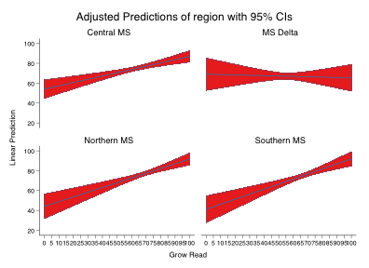
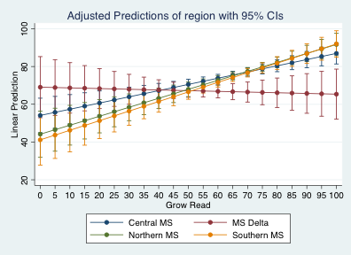
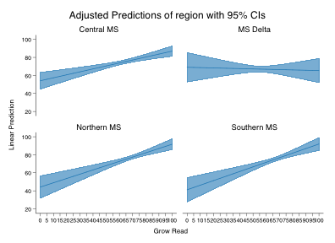
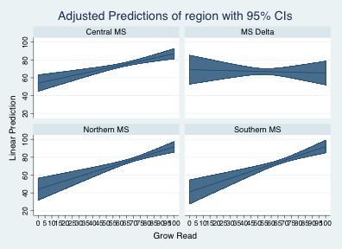
// In some places in the Toolkit you may notice code like:
// Step 5: Create dummy variables for each year of teaching experience.
tab t_experience, gen(exp)
rename exp1 first_year_teacher
rename exp2 second_year_teacher
rename exp3 third_year_teacher
rename exp4 fourth_year_teacher
rename exp5 fifth_year_teacher
// Step 6: Create interaction terms between the experience dummy
// variables and the ever hired late indicator.
foreach year in first second third fourth fifth {
g late_hire_`year'_year_teacher = ever_late_hire*`year'_year_teacher
}
// 1. Run the regression with interaction terms in the model.
areg std_scaled_score_`subject' second_year_teacher ///third_year_teacher fourth_year_teacher ///fifth_year_teacher late_hire_second_year_teacher /// late_hire_third_year_teacher ///late_hire_fourth_year_teacher ///late_hire_fifth_year_teacher ///std_scaled_score_`subject'_tm1, cluster(cid_`subject') /// absorb(grade_by_year)
// Replace that code with:
areg std_scaled_score_`subject' /// i.t_experience##i.ever_late_hire ///std_scaled_score_`subject'_tm1, cluster(cid_`subject') /// absorb(grade_by_year)
// Make slight improvement
marginsplot, by(region) recastci(rarea) recast(line)
// Load the performance data
msas using msas.xlsx, perf
// Create a graph with default settings
marginsplot
// Custom schemes can make even more improvements
marginsplot, by(region) recastci(rarea) /// recast(line) scheme(sdp2016a2)
// And what it looks like with the other scheme
marginsplot, by(region) recastci(rarea) /// recast(line) scheme(sdp2016b2)
// Fit regression model to data w/interaction term
reg gradrate i.region##c.rlagro if ///schnm != "District Level"
// Get marginal effects of Reading growth on
// graduate rates in 5 point intervals
margins region, at(rlagro=(0(5)100))
Notes:
(Example in slide from Analyze_1_Recruitment.do of Human Capital Toolkit)
There are a few places in the toolkits where the code creates individual indicator variables and/or interaction or polynomials. You can save yourself a significant number of keystrokes using "factor variable notation" in Stata and get the added bonus of nice visualization tools after fitting your models.
Using margins and marginsplot is a useful way to see how the estimated effect of a given variable varies across its range of values. The margins plot command is especially useful for communicating the results of inferential models since you can estimate the effect of one variable while manipulating the values of any of the other variables and show how these manipulations affect the estimated effect.
So, what's the story the graph can help us to tell?
Unlike the other regions, the relationship between reading growth and graduation rates is negative in the delta, the amount of variance is greater, and the place where the effect is estimated with the greatest precision is also in a slightly different location.

Slide 30
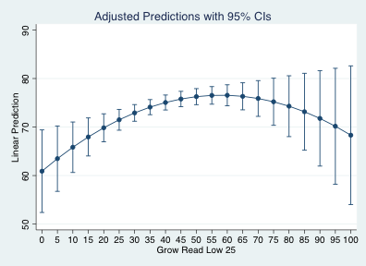
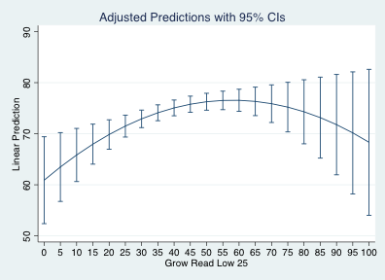
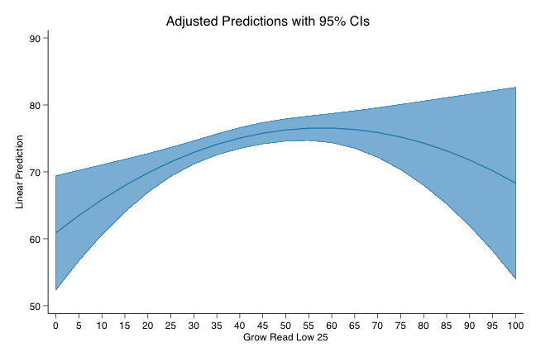
// Same method applies to polynomials relationships too
reg gradrate c.rlagrol##c.rlagrol if /// schnm != "District Level"
// The rendering of the graph is still possible
marginsplot, recast(line)
// Can still apply schemes as well
marginsplot, recast(line) recastci(rarea) scheme(sdp2016a)
// Estimate the marginal effects
margins, at(rlagrol=(0(5)100))
// Simple plot of the marginal effects
marginsplot
Notes:
If you have polynomial terms, margins plot can also be useful for visualizing those effects too. Although the model fitted to the data is fairly naive, if this relationship held while adjusting for other covariates it might indicate that there is a negative impact on graduation rates if schools raise the growth of the low 25% students too much. Again, this is a naive model so that isn't actually the case, but illustrates a way that these types of terms can be visualized/explained graphically.

Slide 31
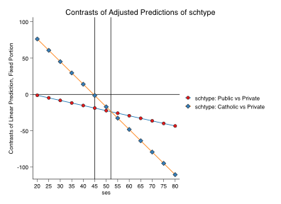
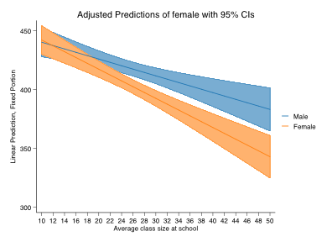
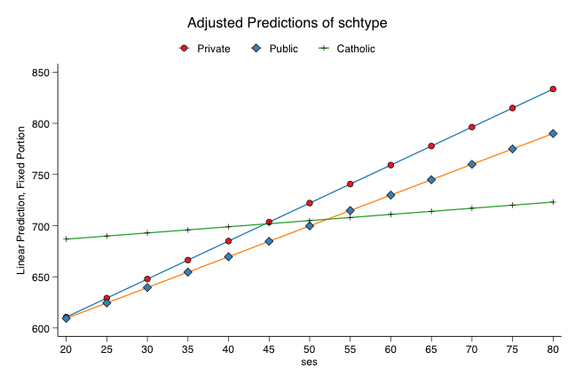
// Set the location for example data
webuse set http://www.stata-press.com/data/ivrm/
// Replay the estimates to avoid errors with margins
est replay m1
// Load other example data set
webuse school_math.dta, clear
// Estimate marginal effects of school type
margins r.schtype, at(ses=(20(5)80)) contrast(effects)
// Defines value labels
la def female 0 "Male" 1 "Female"
// Load example dataset for multilevel marginal effects
webuse school_read.dta, clear
// Create a graph illustrating the effects
marginsplot, noci scheme(sdp2016b2) yline(0) xline(45) ///xline(52)
// Fit multilevel model with categorical level 2 variable
_eststo m1: mixed read i.schtype##c.ses || ///schoolid: schtype, cov(uns)
// Applies value labels
la val female female
// Fit multilevel model with a continuous Level 2 covariate
mixed math i.female##c.clsize || schoolid: clsize, cov(uns)
// Estimate marginal effects of school type
margins schtype, at(ses=(20(5)80))
// Estimate marginal effect of class size by sex
margins female, at(clsize=(10(2)50))
// Create a graph illustrating the effects
marginsplot, noci scheme(sdp2016b)
// Graph the marginal effects
marginsplot, recast(line) recastci(rarea) scheme(sdp2016a2)
Notes:
In the first of these graphs, we are illustrating how school level SES affects student performance on standardized tests differently by school type. Catholic schools, for example, seem to be relatively invariant to the concentration of low SES students in the school, and private schools seem to do better as the concentration increases.
As an alternative to graphing these effects separately, we could also graph comparative relationships by estimating different contrasts. The contrast command, like the margins command, is a post-estimation command that you can use to estimate specific post-hoc effects/comparisons. For example, with contrasts you can test whether one group is significantly different from the grand mean (e.g., test if test results in one school differ significantly from test results across the district). You can also test fairly specific constrained relationships that can be helpful for program evaluations (e.g., contrasts that test whether or not the return on an increased dosage is monotonically increasing over the range of doses or if there is a point where additional dosage does not provide an increase in the return). In this case, the contrast shows the different in the means between the three different types of schools, in particular the difference compared to private schools. I added reference lines to the graph to show where there is no difference (e.g., horizontal line) and the point at which the different school lines intersect.
In the last example, we use a categorical variable as a random slope for school level effects and visualize how test scores of males and females vary based on class size. After about a class size of 23, there is a non-zero difference in the scores, but we can also see how class sizes smaller than that aren't necessarily systemically different from one another. Including the confidence intervals around the estimates also helps to show how much variance there is in the scores when class sizes are very large (e.g., 44 - 50 students).

Slide 32
IRT/Assessment Data Visualization
Requires Stata >= 14
Item Characteristic Curves
Item Information Functions
Test Characteristic Curve
Test Information Function
Notes:
We won't be discussing any of these issues in the context of polytomous responses, but some of the facilities available in Stata 14 can also be useful for us to better understand locally developed assessments and to help us explain some of the technical details of assessments when questions arise. There are essentially two different types of graphs used in IRT modeling -> Characteristic Curves and Information Functions.
Characteristic curves provide information about the way items/tests relate to ability. For example, item characteristic curves show how difficult an item is (e.g., the point at which there is an equal probability of a correct/incorrect response) based on ability/the difference between examinee ability and chance. The discrimination - or slope - of the curve provides an indication of how well the item does at identifying high and low ability examinees. Curves with steep slopes indicate that there is a small range of ability where students might answer correctly/incorrectly by chance, but typically a correct/incorrect response would be indicative of some amount lower or higher of ability. Lastly, the asymptotes (e.g., the start/end of the graph) show potential guessing effects (e.g., if the left side doesn't go to zero it is an adjustment for the probability of guessing correctly regardless of ability) and/or fatigue/suppression effects (e.g., if students are too tired the probability of a correct response for the highest ability students would not necessarily be 1, this also applies to survey settings where the questions may be a bit more sensitive like asking about drug/alcohol abuse, food insecurity, etc...).
The examples here are only going to illustrate the 1 parameter model, but the irtsim command from the session repository allows you to generate data that follows the 1PL, 2PL, and 3PL models that you could further explore at your leisure.

Slide 33
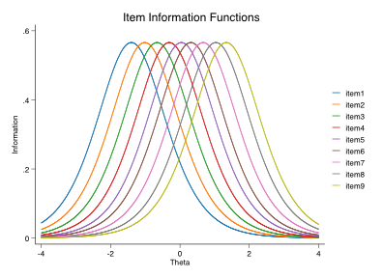
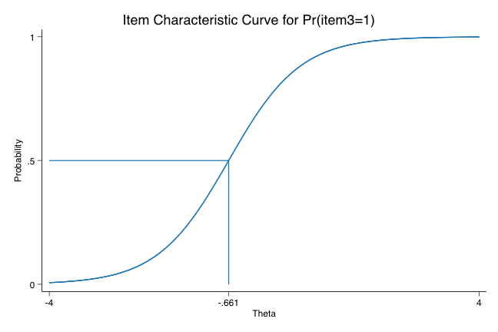



// Simulate item responses from the Rasch model
irtsim, th(0 1) nob(5000) discrim(1) ///pseudog(0) diff(-2(0.5)2) scalef(1)
// Graph the item characteristic curves
irtgraph icc item1-item9, scheme(sdp2016b) n(1500)
// Test characteristics curve
irtgraph tcc, scheme(sdp2016a) n(1500) /// th(-2(1)2) ra(-5 5)
// Test information function
irtgraph tif, scheme(sdp2016a) n(1500) se ///ra(-5 5)
// Look at item information functions
irtgraph iif item1-item13, scheme(sdp2016b2) /// n(1000)
// Individual ICC are even more useful/helpful
irtgraph icc item4, bloc ploc n(1000) /// scheme(sdp2016b)
// Fit a 1PL IRT model to the data
irt 1pl item1-item9
Notes:
For the 1PL model (and the Rasch model in particular) we assume that each item does just as good a job of discriminating between students with low/high ability (alpha), does not involve random guessing (c/pseudoguessing), is not subject to test fatigue effects (d), and that items can have varying degrees of difficulty. In this case, the slope of each of the item characteristic curves (ICC) are all equal - and for the Rasch model they are all constrained to equal 1 - and the thing that varies is the "location" parameter. The location in this case is the point at which someone with a given level of ability (e.g., theta) has equal probability of answering correctly/incorrectly. The next graph will help to illustrate this a bit more.
One of the nice features with the IRT graphs in Stata are the options to add useful reference lines. In this case, a student with an ability of -0.661 has the same chance of answering correctly as they have of answering incorrectly.
The item information functions provide different information and information that is especially useful when trying to discuss validity concerns. Each curve shows the distribution of information that each item provides relative to ability. So item 1 seems to provide the most information about a test participant that has an ability level of -2 or so, while item 5 provides the most information about test participants with average ability (e.g., theta = 0). If these curves are bunched up on either side of the distribution of theta, it is an indicator that the tool may not be the most useful for the widest audience. This is a good thing if the tool is a screener for advanced learning and/or special education needs, but not as good if the assessment is being used by the entire population.
While we may be the most interested in the item-level analyses to support test development/construction at the local level, it might be more useful to discuss the test-level equivalents. Like the ICC, Stata provides nice functionality for test-level analytics and in particular it provides an optional argument that can be used to show how the values of theta map onto the raw sum scores. So of a total possible score of 9, we'd expect students with a theta of -1 to score about 2 points.
For accountability purposes, the Test Information Function (TIF) is especially good to know about. Like the item information functions, it shows the amount of information the test provides about test takers with different levels of ability (blue line). There is also an option in Stata to show the standard errors around those values. At the best, this example shows that the place where the test provides the most information about test takers has a standard error of about 0.5 and once we move beyond the [-2, 2] range of theta the amount of error grows significantly. Outside of that range, the probability for misclassification (e.g., different proficiency levels, etc...) is much higher than it is in the middle of the distribution).
While there is a lot more that goes into test construction, even rudimentary item/test analyses can lead to productive work with locally developed assessments (e.g., removing items that provide little information, assembling test forms that include items that provide the best coverage over a specific range of ability, etc...). This in turn leads to greater efficiency/effectiveness of these assessment implementations (e.g., classroom educators get better quality information about student performance on the lower stakes tests they create to inform their instructional practices).

Slide 34
Time for Group work/Questions
End

Slide 35
Extra Materials for those interested

Slide 36
Nominal Scales
1. Either a = b or a ≠ b
2. If a = b then b = a
3. If a = b and b = c then a = c
Ordinal Scales
4. If a > b then b ≱ a
5. If a > b & b > c then a > c
Intervallic Scales
6. a + b = b + a
7. If a = c & b = d then a + b = c + d
8. (a + b) + c = a + (b + c)
Ratio Scales
9. a + 0 = a
10. If a = c and b > 0
then a + b > c
Notes:
Material adopted from:
McDonald, R. P. (1999). Test theory: A unified treatment. Malwah, NJ: Lawrence Erlbaum Associates. p. 409
Nominal Scales - Can test equality/inequality only. Can use any one to one transformation (e.g., doesn’t matter what the numeric values are so long as each value is mapped to any other distinct value)
1. Defines the property that allows us to test equality (e.g., male = male or male != female)
2. Defines set equivalence (e.g., no way to order males/females, race, etc…)
3. Generalizes to more than two values
Ordinal Scales - Can also compare magnitude - no subtraction. Can use any monotonic transformation because the integer distance is not constrained to be equal (e.g., as long as the magnitudes convey the same order it is equivalent)
4. If a value is greater than the comparator, the comparator cannot be greater than or equal to the value
5. Establishes magnitude comparatively;
Intervallic Scales - Can use subtraction and addition; Can use any linear transformation
6. Commutative property
7. Property of equality
8. Associative property
Ratio Scales - All arithmetic operations; Can use any ratio transformation.
9. Defines the property of a true zero (e.g., a value meaning complete absence)
10. Constrains summation to always be greater than the original element if it is a positive value

Slide 37
 | Nominal | Ordinal | Intervallic / Ratio
Nominal | Tetrachoric | Rank Biserial | Point Biserial
Ordinal | Rank Biserial | Polychoric | Polyserial
Intervallic / Ratio | Point Biserial | Polyserial | Pearson’s r
Notes:
Understanding a bit more about correlations. I’ve highlighted the correlation that most of us are familiar with in yellow. It has a relatively limited application in the context of education. I highlighted the other cells based on applications in education.
The cells with purple text are typically used in the development of measurement tools (e.g., tests, surveys, etc…) where we want to describe the relationship between the item and the total score. For example, with dichotomously keyed items the point biserial correlation describes the relationship between the keyed (correct) response and the total score. The polyserial correlation functions similarly, but is used for polytomous items.
What could be more useful, particularly for locally developed assessments, would be to look at the relationships between the items. The types of correlations that would be used in these applications are highlighted in orange.
One way of making use of this information is to create a correlation heatmap since you can quickly/easily identify items that might form testlets (e.g., groups of structurally related items) and/or identify items that may be more likely to measure the same construct (e.g., all the items that are highly correlated with each other).

