Slide 1
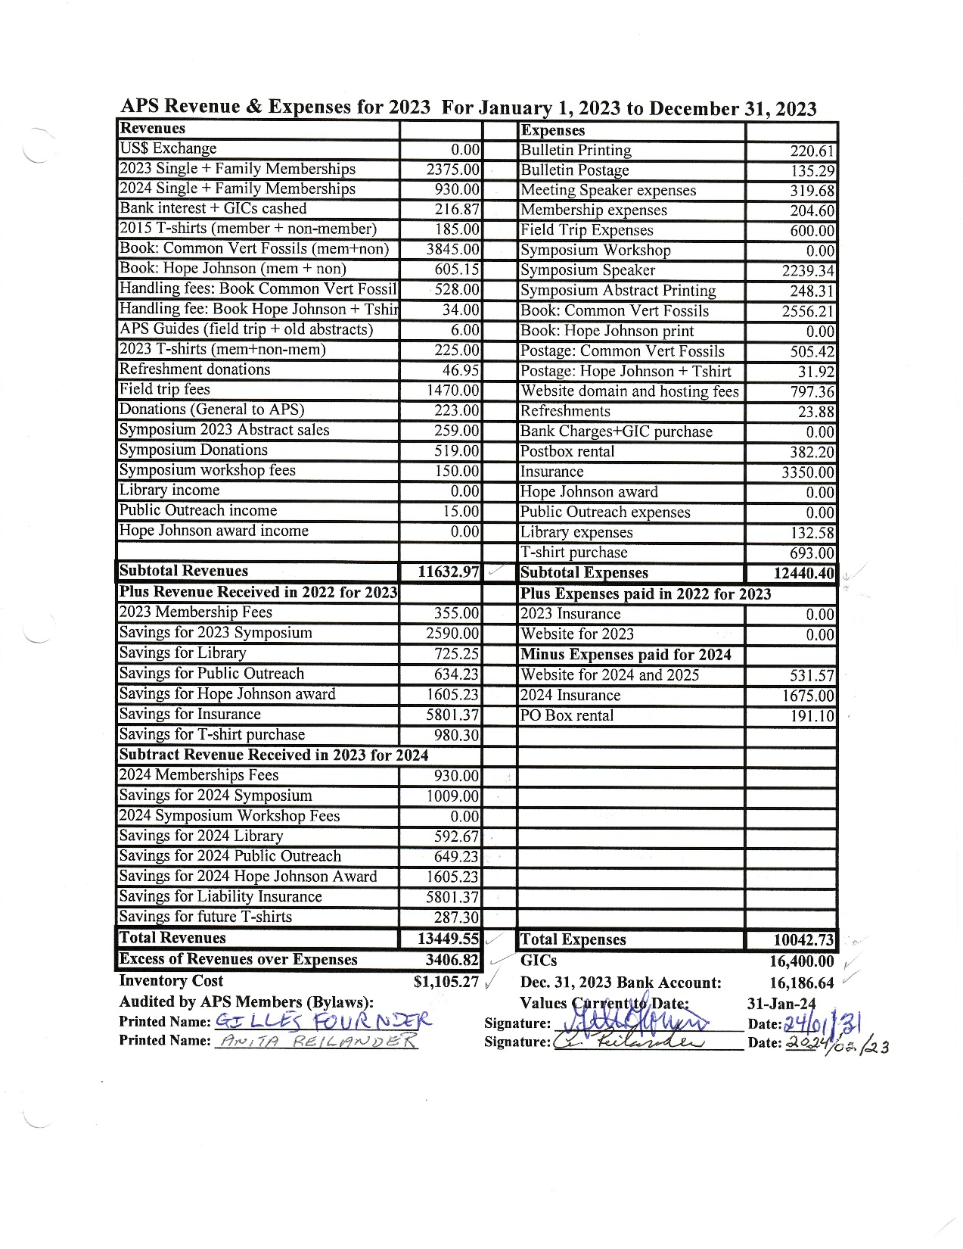
Audited 2023 Revenues and Expenses.
See APS Bulletin March 2024

Slide 2
Statement of Society’s Financial Position
In accordance with Article 6.7 of the APS Bylaws, the Treasurer shall prepare for submission a statement of the Society’s financial position detailing the Revenues, Expenses, and Inventory of the Society.

Slide 3
APS 2023 Revenues & Expenses
Revenues: 13,429.55 Expenses: 10,042.73
------------------------------------
Net: 3,386.82
Thank you Gilles Fournier and Anita Reilander for auditing the 2023 Treasurer Books + Minutes!

Slide 4
APS Status on Dec. 31, 2023
Money in Chequing: 16,186.64
GICs: 16,400.00
Inventory Cost: 1,105.27
Reserved Funds ($9,944.80) include:
2024 Symposium: 1,009.00
Hope Johnson Award: 1,605.23
Public Outreach: 649.23
Library: 592.67
Future T-shirt purchase: 287.30
Future Liability Insurance: 5,801.37

Slide 5
Guide To Common Vertebrate Fossils from the Cretaceous of Alberta Summary to Dec. 31, 2023
Sold: 1392 (126 in 2023)
Donated: 146
Printed: 1554
Net Revenue: $7,719.71

Slide 6
Now There Was A Lady! Hope Johnson LL.D. 1916-2010 Summary to Dec. 31, 2023
Sold: 98 (21 in 2023)
Donated: 27
Printed: 130
Net Loss: $ 102.12
(Loss due to purchase of extra inventory. Once all inventory sold, the net profit will be at least $48.00)

Slide 7
APS Status on April 30, 2024
Money in Chequing: TBA
(after deducting cheques and expenses not yet reimbursed)
GICs: 16,400.00
Inventory Cost: TBA
Reserved Funds (TBA) include:
2025 Symposium TBA
Hope Johnson Award: TBA
Public Outreach: TBA
Library: TBA
Future T-shirt purchase: TBA
Future Liability Insurance: TBA

Slide 8
Statement of Society’s Financial Position
In accordance with Article 6.7 of the APS Bylaws, the Treasurer shall prepare for submission a statement of the Society’s financial position detailing the Revenues, Expenses, and Inventory of the Society.
Motion: to approve the audited Revenue and Expenses Sheet for 2023, and Statement of the Society’s Financial Position detailing the Revenues, Expenses and Inventory of the Society at December 31, 2023 as presented.

Slide 9
Statement of Society’s Financial Position
Books and Records of the Society
In accordance with Article 8.8 of the APS Bylaws, the Books and Records of the Society are being made available for inspection by any Member of the Society.

Slide 10
Appointment of Auditors for 2024
Motion to appoint the following APS members as auditors for the 2024 APS Treasurer Books and Minutes:
Matthew Rhodes
Lorraine Stratkotter
If for some unforeseen reason, either person cannot perform this function, the APS Executive will appoint another APS member to audit the 2024 APS Treasurer Books and Minutes.

