Slide 1
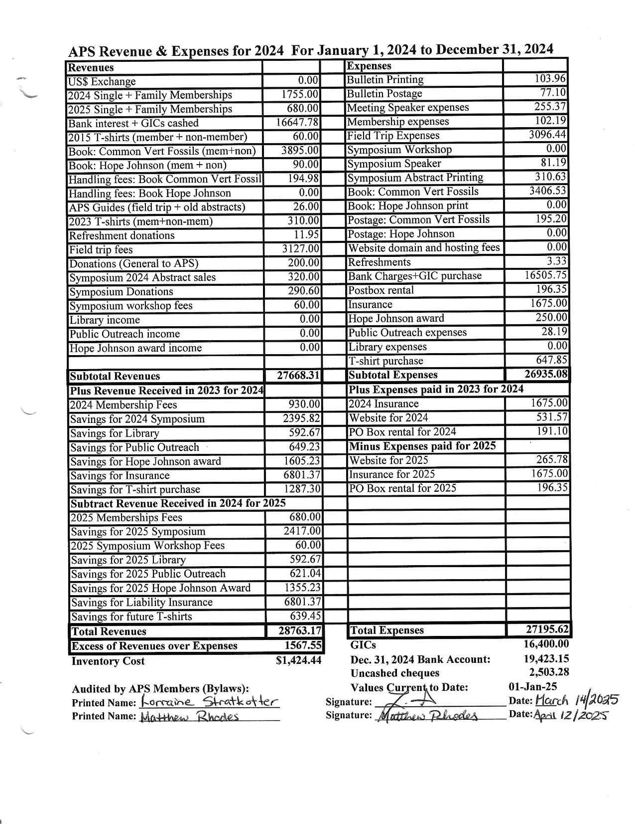
Audited 2024 Revenues and Expenses.
See APS Bulletin June 2025

Slide 2
Statement of Society’s Financial Position
In accordance with Article 6.7 of the APS Bylaws, the Treasurer shall prepare for submission a statement of the Society’s financial position detailing the Revenues, Expenses, and Inventory of the Society.

Slide 3
APS 2024 Revenues & Expenses
Revenues: 28,763.17 Expenses: 27,195.62
------------------------------------
Net: 1,567.55
Thank you Matthew Rhodes and Lorraine Stratkotter for auditing the 2024 Treasurer Books + Minutes!

Slide 4
APS Status on Dec. 31, 2024
Money in Chequing: 19,423.15
GICs: 16,400.00
Inventory Cost: 1,424.44
Reserved Funds ($12,426.76) include:
2025 Symposium: 2,417.00
Hope Johnson Award: 1,355.23
Public Outreach: 621.04
Library: 592.67
Future T-shirt purchase: 639.45
Future Liability Insurance: 6,801.37

Slide 5
Guide To Common Vertebrate Fossils from the Cretaceous of Alberta Summary to Dec. 31, 2024
Sold: 1520 (128 in 2024)
Donated: 153
Printed: 1698
Net Revenue: $8,207.96

Slide 6
Now There Was A Lady! Hope Johnson LL.D. 1916-2010 Summary to Dec. 31, 2024
Sold: 101 (3 in 2024)
Donated: 29
Printed: 130
Net Loss: $12.12
Currently this book is out of print until there is demand to print more copies

Slide 7
APS Status on April 30, 2025
Money in Chequing: 14,893.69
(after deducting cheques and expenses not yet reimbursed)
GICs: 16,400.00
Inventory Cost: 2,974.64
Reserved Funds ($12,183.76) include:
2026 Symposium 1,974.00
Hope Johnson Award: 1,355.23
Public Outreach: 621.04
Library: 592.67
Future T-shirt purchase: 839.45
Future Liability Insurance: 6,801.37

Slide 8
Statement of Society’s Financial Position
In accordance with Article 6.7 of the APS Bylaws, the Treasurer shall prepare for submission a statement of the Society’s financial position detailing the Revenues, Expenses, and Inventory of the Society.
Motion: to approve the audited Revenue and Expenses Sheet for 2024, and Statement of the Society’s Financial Position detailing the Revenues, Expenses and Inventory of the Society at December 31, 2024 as presented.

Slide 9
Statement of Society’s Financial Position
Books and Records of the Society
In accordance with Article 8.8 of the APS Bylaws, the Books and Records of the Society are being made available for inspection by any Member of the Society.

Slide 10
Appointment of Auditors for 2025
Motion to appoint the following APS members as auditors for the 2025 APS Treasurer Books and Minutes:
Jennifer Hibbard
Lorraine Stratkotter
If for some unforeseen reason, either person cannot perform this function, the APS Executive will appoint another APS member to audit the 2025 APS Treasurer Books and Minutes.

