Slide 1
Robust models for detecting bridge defects under natural distribution shifts
Team 4: Eric Rodriguez, Nicholas Miller, Kanitta Srichan, Daniel Anthony

Slide 2


Motivation
Aspect | Traditional Methods | Our ML Approach
Efficiency | Labor-intensive, time-consuming | Automated, faster image analysis
Accuracy | Prone to human error | Improved defect detection accuracy
Scalability | Limited by manual effort | Easily scalable with additional data
Defect Detection | Subjective, based on inspector’s experience | Consistent, data-driven analysis
Challenges | High cost, inconsistent outcomes | Addressed dataset quality and generalization
Real-World Deployment | Difficult to standardize | Robust to distribution shifts with diverse data
Traditional vs. Machine Learning Approach

Slide 3
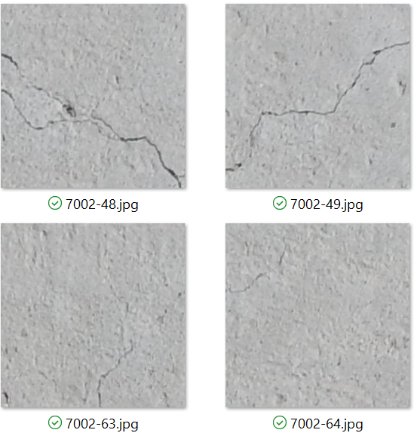
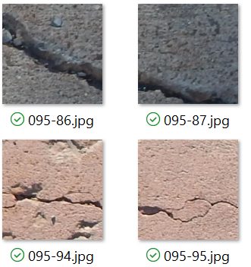
Defining Distribution Shift & robustness
Components of Natural Distribution Shift present our data:​
Background color​ and Shading​
Focus​
Size/shape of crack
Relative Robustness = Measure of Robustness to Natural Distribution Shift
Difference between Accuracy of Model with Intervention and Accuracy of Model without Intervention
Interventions used: Size, Diversity, Arch
Robustness to Adversarial Attacks
Gradient Sign Attack aka Fast Gradient Sign Method (FGSM)
Implemented with Foolbox
Adds perturbations to the image by evaluating how each pixel contributes to the loss
Uses the gradients of the loss with respect to the input image to create a new image that maximizes the loss
Standard Data (D)
Shifted Data (P)

Slide 4
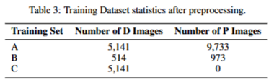
Experiment
D: Standard Images
(3) Training Sets
A = Large & Diverse (D & P)
B = Small & Diverse (D & P)
C = Small & Standard (D only)
(2) Test Sets
D = Standard
P = Shifted
(3) Interventions
Size: Compare A to B
Diversity: Compare B to C
Architecture: Compare A' to A
(2) Architectures: Baseline (A) & Experimental (A')
For each architecture, a model is trained on each training set and evaluated on the two test sets
P: Shifted Images

Slide 5
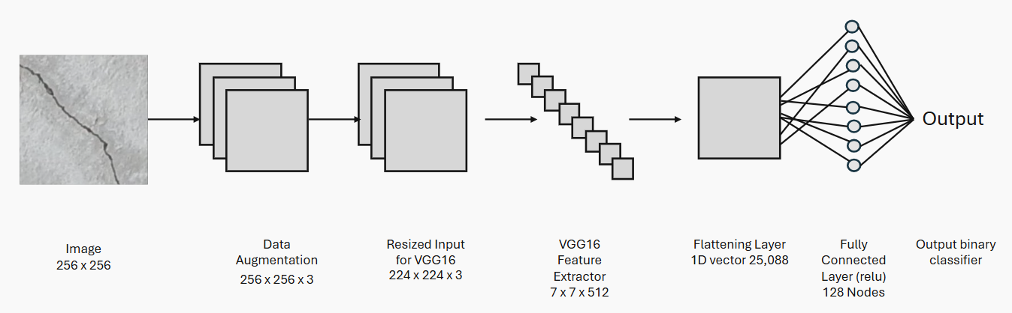
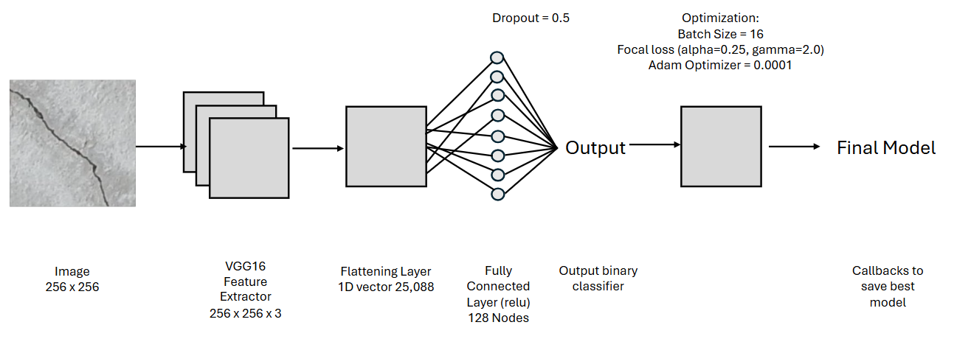
Model Architecture & Methods
Regularization Techniques:
Data Augmentation
Early Stopping
Dropout
Fig.1 Base model
Model Improvements:
Additional Fine-tuning of final 10 layers
Threshold optimization
Fig.2 Experimental model

Slide 6
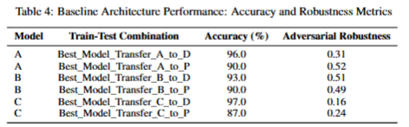
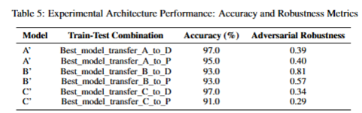
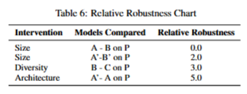
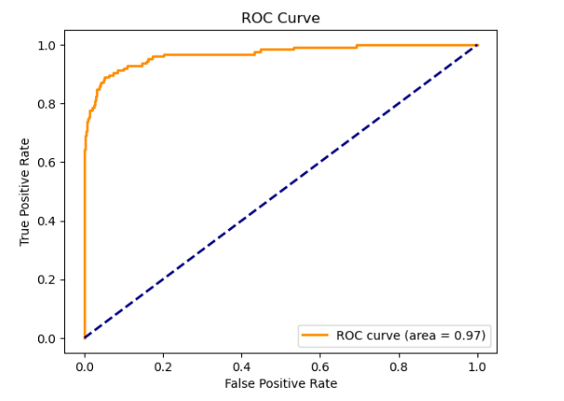
Results/Conclusion
Training on Larger Datasets improves model performance (on experimental arch only) but decreases robustness to adversarial attacks
Training on Diverse Datasets improves robustness to distribution shifts but decreases traditional performance metrics (accuracy)
Additional fine-tuning improves model performance
Transfer learning is a viable approach for binary image classification with structural health monitoring (SHM) tasks
Best model could achieve up to 97% accuracy

Slide 7
Future Work
Cost Analysis: Is the increase from 87% to 91% on the shifted dataset via fine-tuning more cost-effective than procuring a training dataset with diversity or size and achieving accuracies of 93-95%
Include an evaluation of effective robustness (Taori et al., 2020)
Include a comparison of adversarial attacks
Include additional techniques for improving the baseline model
Additional classes of structural defects such as spalling and corrosion
Prepare for distribution shifts caused by weather or lighting
Notes:
Generate synthetic variations in the training data to mimic real-world conditions. This could include:
Simulating changes in lighting intensity (e.g., day, night, overcast).
Adding weather effects such as rain, fog, snow, or shadows.
Using libraries like Albumentations or Photoshop scripting to apply these effects.

