Slide 1

Predicting Mortality Of Sepsis-III Patients Using a Voting Classifier
Presented By:
Eric Rodriguez, Isidro Romille Pride, and Rachel Daniel

Slide 2
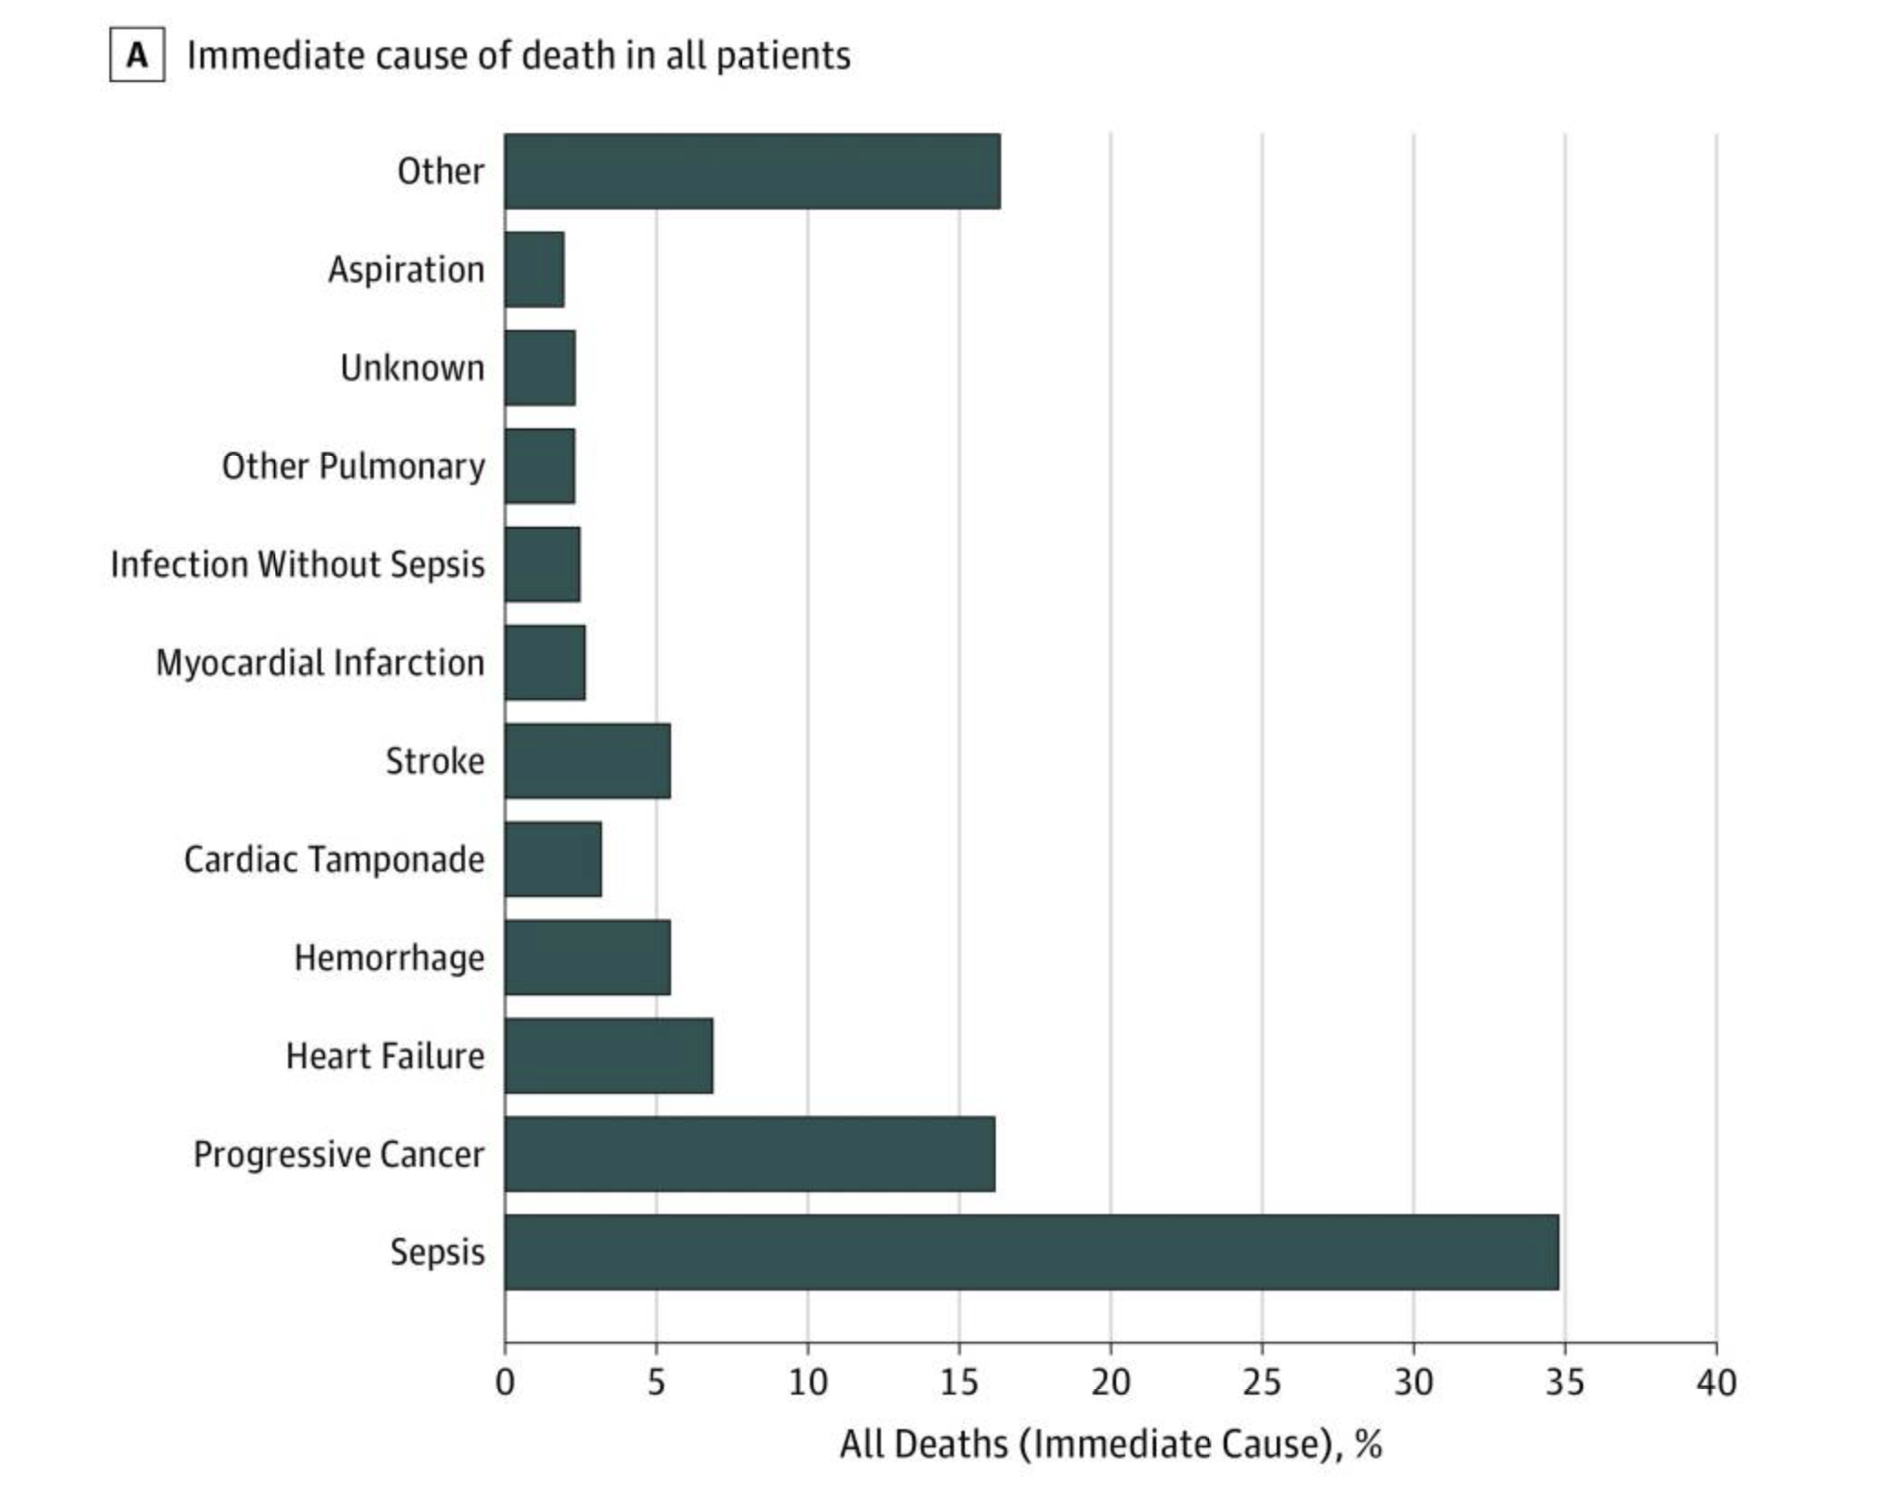
Sepsis is a Leading Cause Of Death Within Hospitals
The Goal
Develop a model that can predict mortality within 30 days of diagnosis
Implement to allow for additional intervention
JAMA Netw Open. 2019;2(2):e187571. doi:10.1001/jamanetworkopen.2018.7571
Notes:
Presenting the problem
Sepsis occurs when the body’s immune system responds aggressively to infection (commonly hospital-acquired) and attacks its own organs
Image: Cohort study in which a retrospective medical record review was conducted of 568 randomly selected adults admitted to 6 US academic and community hospitals from January 1, 2014, to December 31, 2015, who died in the hospital or were discharged to hospice and not readmitted.
Goal: Develop a machine learning model that can predict mortality within 30-days post-diagnosis
Allows for additional intervention before condition becomes more severe
Costly and no specific protocol for treatment
More info: https://www.nigms.nih.gov/education/fact-sheets/Pages/sepsis.aspx#:~:text=Sepsis%20is%20a%20serious%20condition,350%2C000%20die%20as%20a%20result.

Slide 3
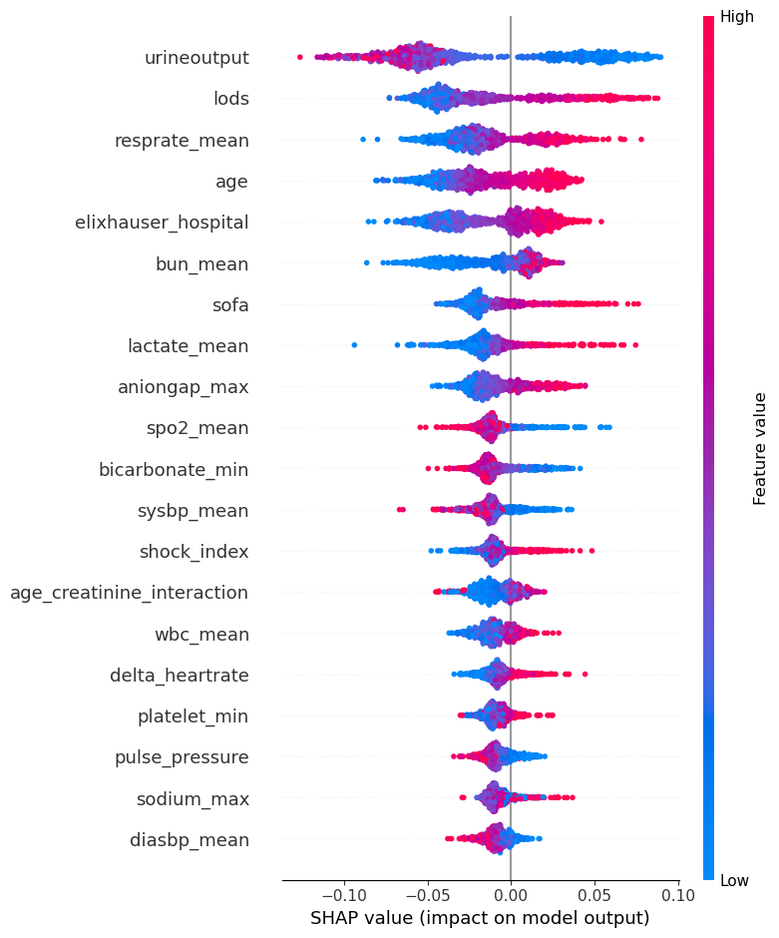
Voting Classifier Model Displayed Best Performance
SHAP values Random Forest
Ensemble of Logistic Regression, Random Forest and XGBoost
Overall accuracy of 76%
For Non-Surviving Class:
F1-Score of 0.54
Recall of 0.73
Precision of 0.43
Confusion Matrix
560 | 171
48 | 130
TN
FP
FN
TP
Notes:
Results
Voting classifer model was ensemble of logistic regression, random forest, and xgboost
F1-score of 0.54 for the target class
Our threshold chosen was 0.45.
Model favors correctly choosing the positive class over correctly choosing the negative class.
While we experimented with using a threshold that optimizes the overall F1 score, we found that our recall for the positive class using this approach was compromised versus using the threshold of 0.45.
Our main goal in this task was to improve the recall of the positive class (while maintaining a relatively high precision) as it is more important to accurately predict if a patient will die at the expense of having more false positives.
Most important features:
Urine output, lods(Logistic Organ Dysfunction System, which is a scoring system used to predict mortality and morbidity in intensive care unit (ICU) patients)
Sofa, age, elixhauser hospital (a tool that measures the severity of a patient's comorbidities and is used to predict hospital resource use and in-hospital mortality)

Slide 4
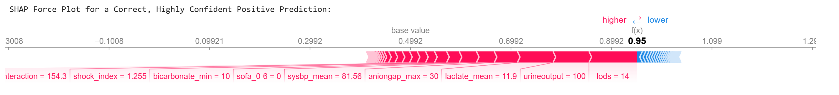
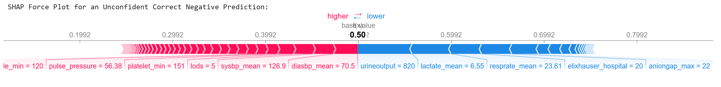
Examining Sample Correct Predictions

Slide 5
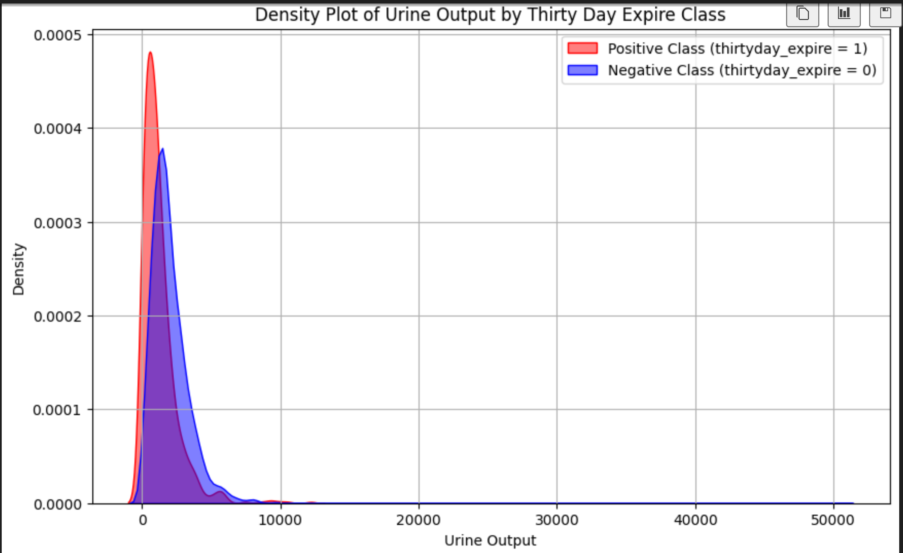
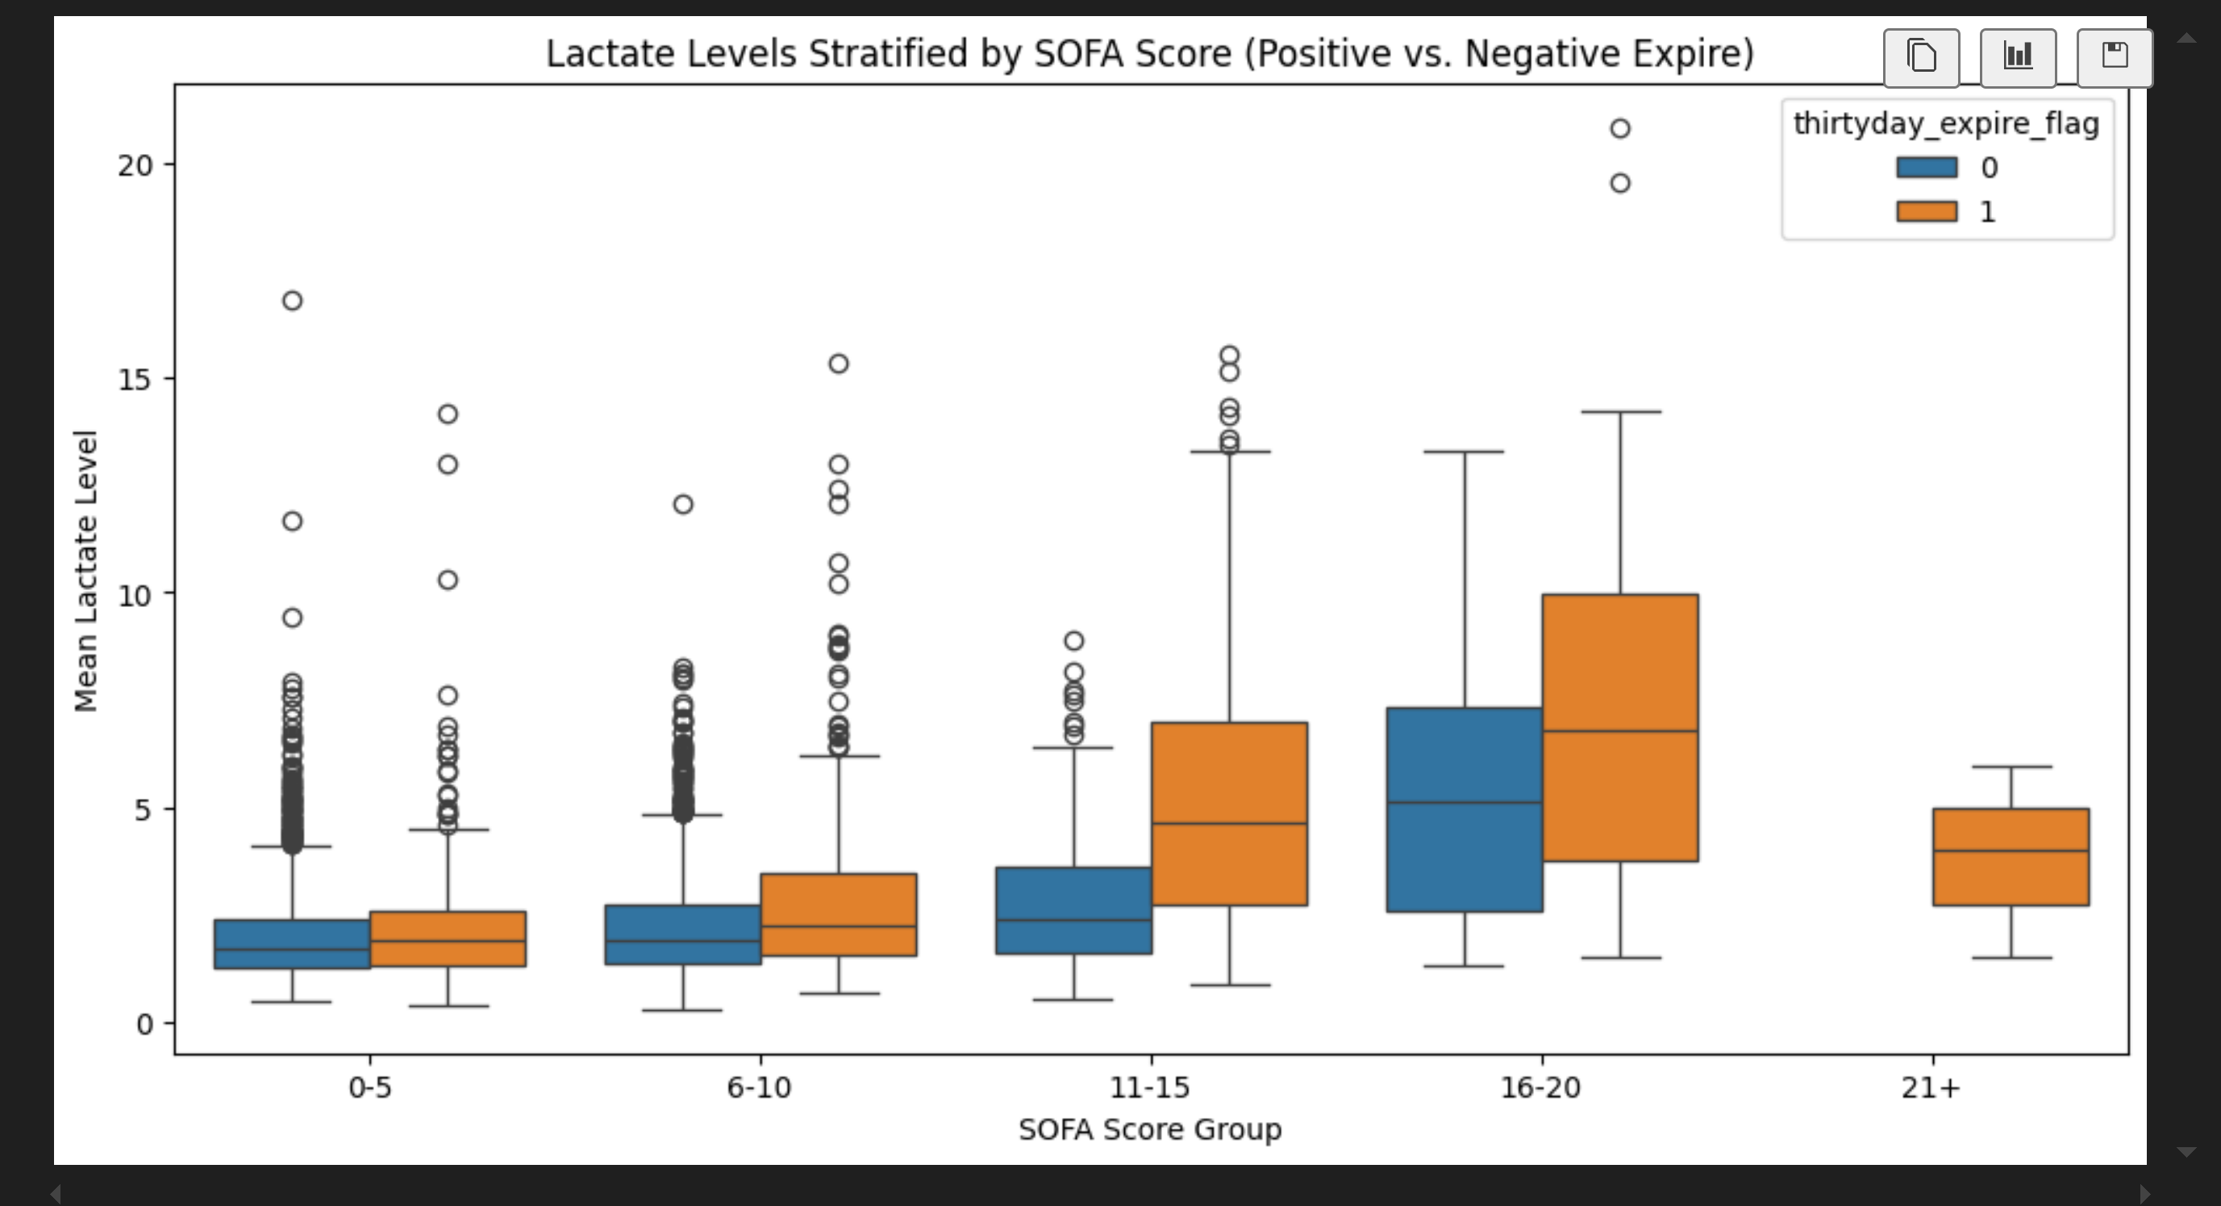
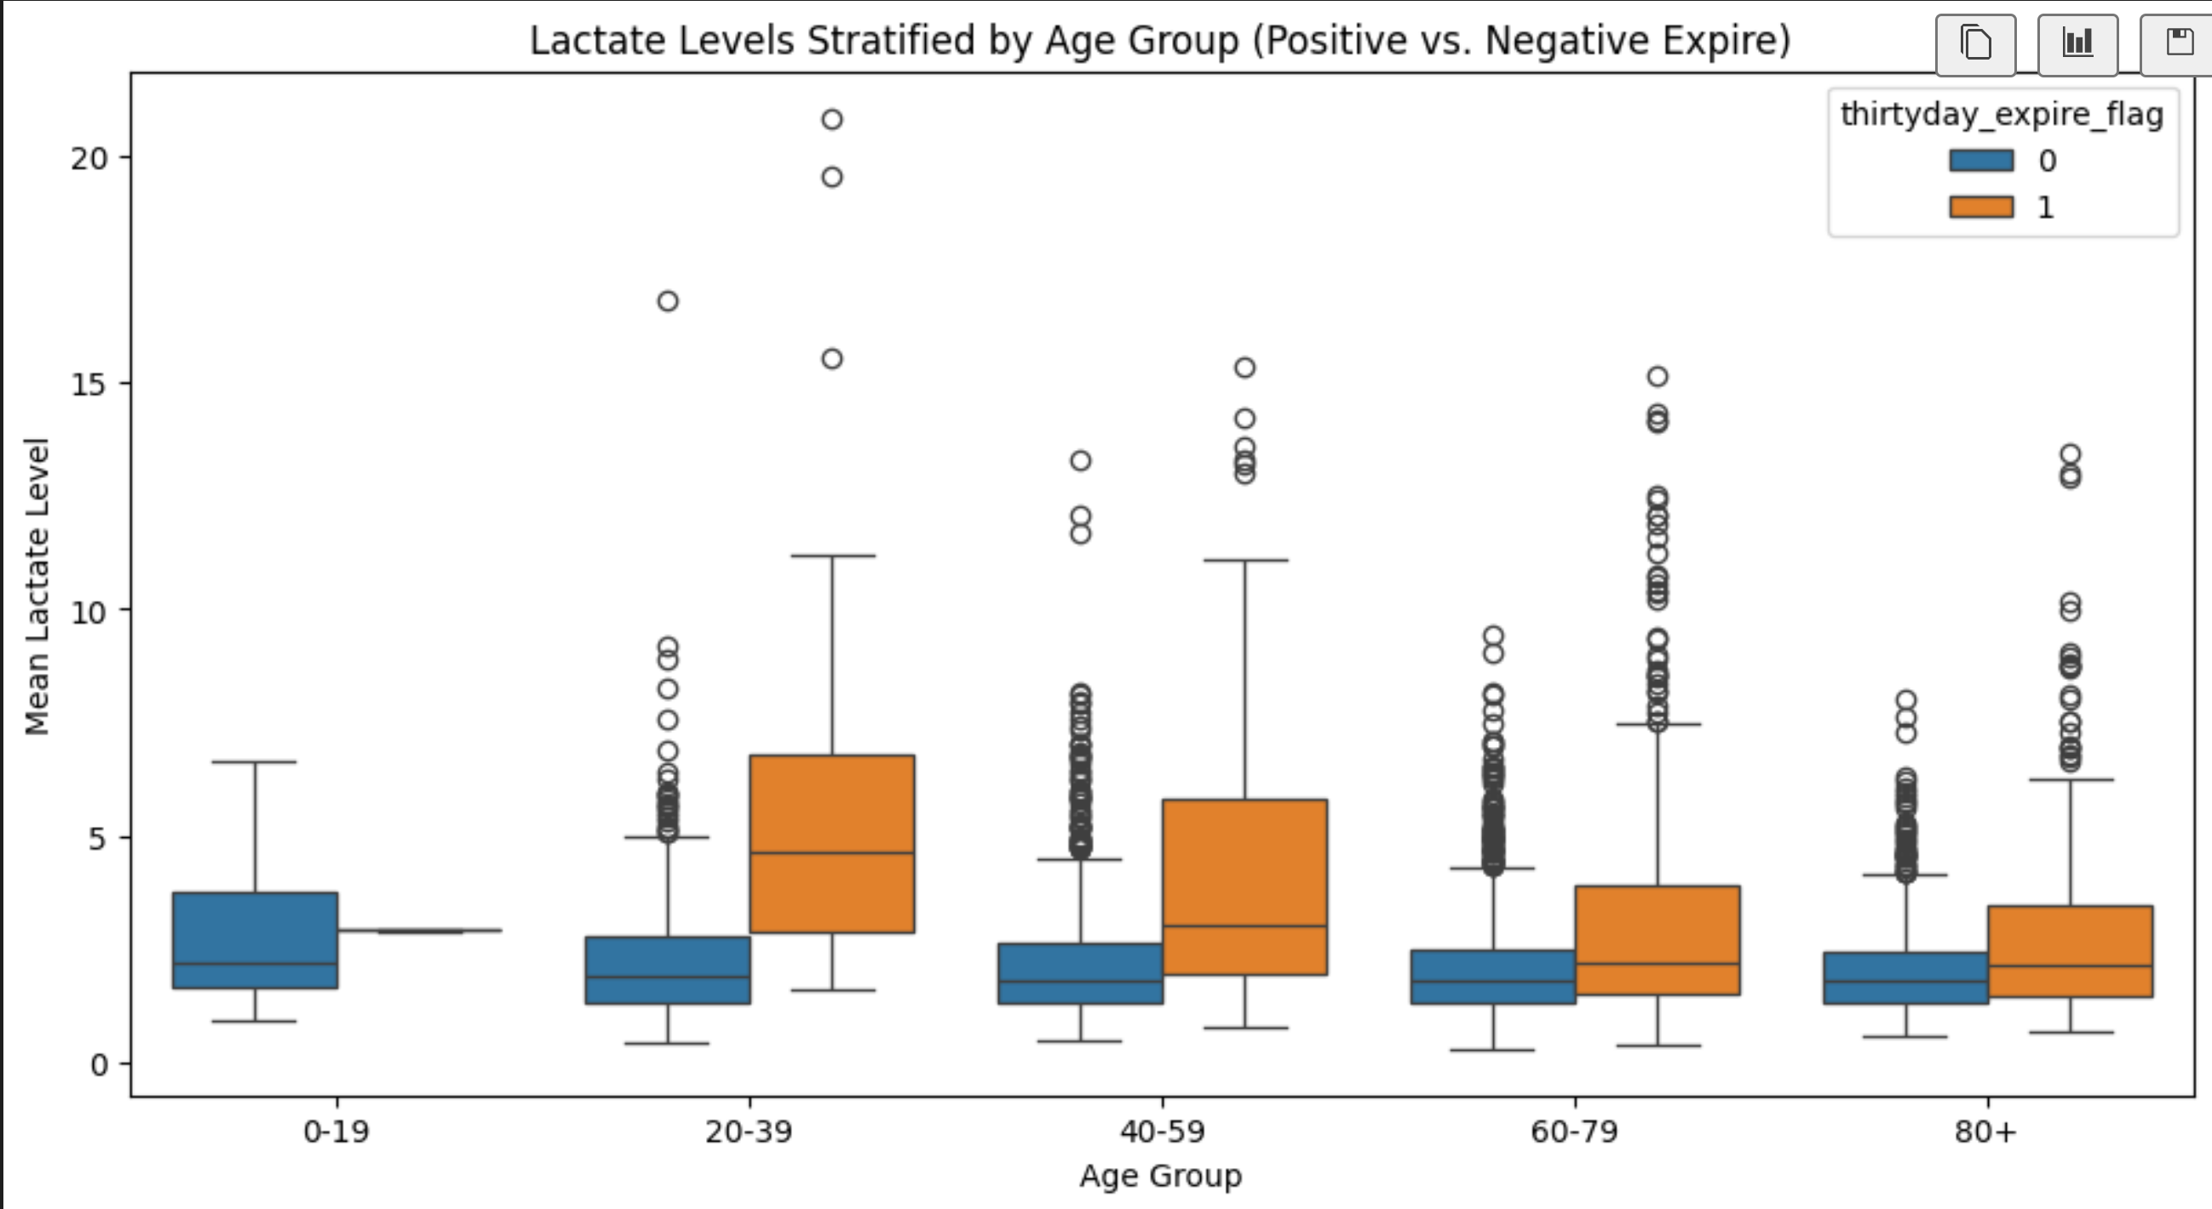
Method, Approach, and Clinical Findings
Identified features strongly clustered to classes
Excluded length of stay
Strong predictors of sepsis based on domain knowledge:
Heartrate (min and max), urine output, creatinine, SOFA scores, BUN and WBC
ANOVA tests

Slide 6
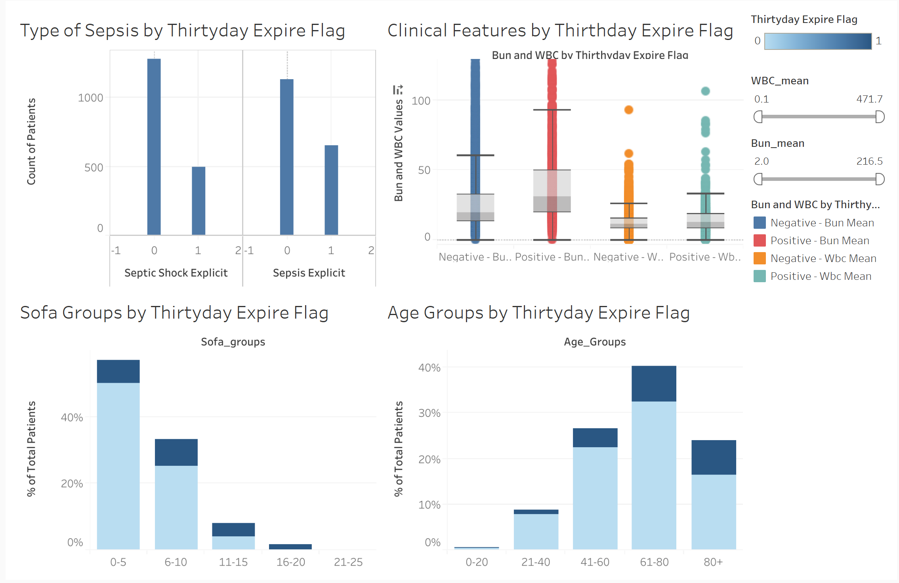
Feature Selection/Engineering- Showing Which Patients Have The Greatest Risk And Why

Slide 7
Recommendations for Future Research
Different models
Test different combinations of models
Additional Metrics
Utilize additional metrics and clinical markers (e.g. demographic information, comorbidity indices)
Diversity in Data
Collect data from diverse populations with similar distributions
Notes:
Stacking classifier could be tested
Improved feature selection that can improve model performance (demographic info such as socioeconomic status, admission type – elective vs emergency, primary diagnosis codes to provide context about the patients condition, comorbidity indices such as the charlson index or number of comorbidities, previous hospitalizations such as number of prior admissions,

Slide 8
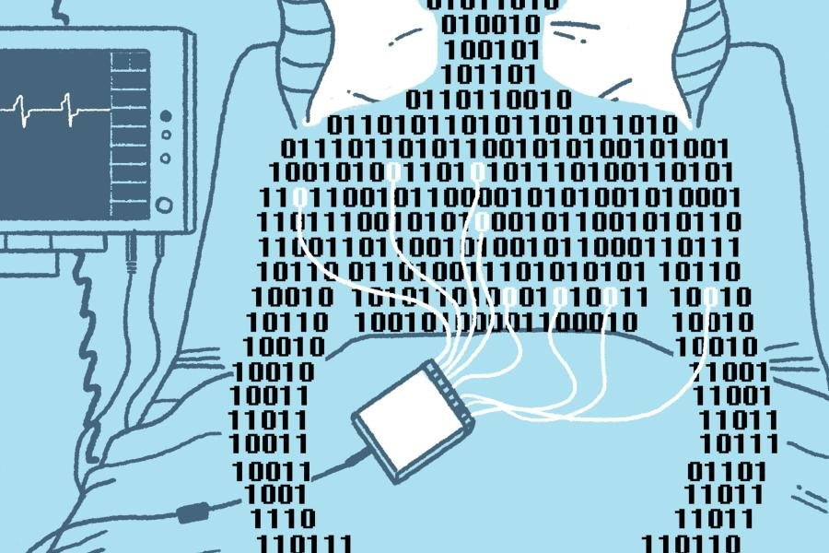
Summary And Future Steps
A Voting Classifier made up of Logistic Regression, Random Forest and XGBoost models can achieve decent performance
Our findings reveal important features to utilize for these models, but more are necessary
Sepsis detection would be another important avenue to explore so patients receive fast and accurate treatment
We uncovered key clinical insights about our patient population
https://hub.jhu.edu/magazine/2022/winter/ai-technology-to-detect-sepsis/

