Slide 1
Figures
A Little R Survival Kit

Slide 2
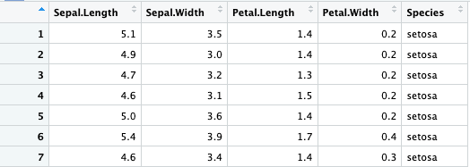
Column Index
Row Index
1
2
3
4
5
iris[3,]
iris[5,3] or
iris[5,’Petal.Length’]
iris[,5] or iris$Species
Notes:
Figure 1.1

Slide 3
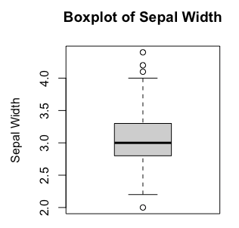
Outliers
Upper Whisker
Q3
Median
Q1
Lower Whisker
Notes:
Figure 3.3 Anatomy of a Boxplot.

Slide 4
Group | Daily Tobacco Consumption | Controls | Cases
A | 0-9g/day | 90 | 14
B | 10-19 | 44 | 13
C | 20-29 | 25 | 8
D | 30+ | 8 | 11
Notes:
Chapter 4. Figure 4.1
This one can’t illustrate the purpose of a table, e.g., for chi-square test.

Slide 5
A
Heart Disease | Smoking Status
 | Formerly | Never | Smoke | Unknown
0 | 808 | 1802 | 728 | 1496
1 | 77 | 90 | 61 | 48
B
Group | Daily Tobacco Consumption | Controls | Cases
A | 0-9g/day | 90 | 14
B | 10-19 | 44 | 13
C | 20-29 | 25 | 8
D | 30+ | 8 | 11
Notes:
Chapter 4. Figure 4.1

Slide 6
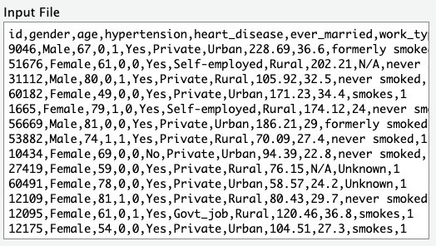
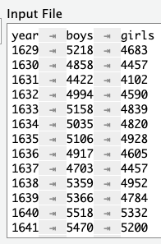
A
B
Notes:
Figure 4-2

