Slide 1
CS5660: Signal and Image Processing
Lecture 2: Wavelets and Transforms
Ramin Zabih

Slide 2
Administrivia
https://github.com/cornelltech/signal-and-image-processing
Wednesday guest lecture by Brian McFee, Columbia
Homework #1 coming today or tomorrow
TA is Alex Fix, CS PhD student working with RDZ
Surveymonkey coming shortly
Your math & programming comfort levels
Breadth vs. depth, and applications lecturers

Slide 3
Topics (tentative!) from web page
4-Sep | Introduction: model fitting, smoothing and prediction
9-Sep | Wavelet and Fourier transforms
11-Sep | Guest lecture: Brian McFee
16-Sep | Convolution and time-invariant systems
23-Sep | Model fitting with outliers
25-Sep | Guest lecture: Noah Snavely
30-Sep | Time series analysis
2-Oct | Feature extraction from 1D data
7-Oct | Statistical signal processing: ML and MAP estimation
9-Oct | Statistical signal processing: density estimation, sampling
14-Oct | Statistical signal processing: causality
16-Oct | Edge detection
21-Oct | Image denoising and deblurring
23-Oct | Image denoising via graph cuts
28-Oct | Image registration and transforms
30-Oct | Image registration via mutual information
4-Nov | Segmentation: active contour models
6-Nov | Segmentation: graph cuts
11-Nov | Image enhancement and morphing
13-Nov | Texture analysis and segmentation
18-Nov | Feature extraction from images and video
20-Nov | Recognition with features and bag-of-words
25-Nov | Image compression

Slide 4
Outline for today
Problem transforms
Wavelets
Linear shift-invariant systems
Fourier transform, spectrograms
We will try to take a short break mid-lecture

Slide 5
Changing representations
In any problem, the choice of representation is key
Examples: PageRank, TSP, sorting, etc
In signal processing we usually look at transforms
Map the input problem into a different representation that makes it easy to compute what you want
Optionally, map the solution back to the original representation

Slide 6
Motivation: accelerometry data

Slide 7
How to represent this data?
It sure likes like the sum of a roughly constant value plus a small rapidly changing function
But the standard representation doesn’t make this explicit!

Slide 8
Unit impulse response
Unit impulse: [… 0 1 0 …]
Any input is the sum of scaled and shifted unit impulses
Example: to get [1 6 -10] we:
Take the unit impulse shifted once left: [1 0 0]
Add 6 times the unit impulse, no shift: [1 6 0]
Subtract 10 times the unit impulse, shifted right

Slide 9
Why use frequency domain?
Many things become clear
Measurement process removes high-frequency components
Consider a checkerboard where a pixel contains 100 squares?
Or ECG noise at 1 Gigaherz?
Natural view of operations on various frequency components
Local averaging removes high-frequency components

Slide 10
Choice of basis
The usual way to describe frequency is Fourier transform
Today: Wavelet representation called the Haar basis
Same basic idea, but easier and more intuitive
For example, our basis vectors will be mostly 0
By contrast, the Fourier basis is sine waves

Slide 11
Signal representations
Consider a 1-D image (signal) with four elements: I = [9 7 3 5]
Spatial representation:
I = 9*[1 0 0 0]+7*[0 1 0 0]+3*[0 0 1 0]+5*[0 0 0 1]
The basis elements are 1-D (in this case) vectors, each with a single 1

Slide 12
Wavelets and DC components
Our basis vectors will have a scale, intuitively how many non-zero elements
To begin with, we subtract the average value of I, i.e. 6 for [9 7 3 5]
I - 6 = [3 1 -3 -1] I = 6*[1 1 1 1] + [3 1 -3 -1]
[1 1 1 1] is our first (dull) new basis
No zeros, so coarsest possible scale
The average value of a signal is referred to as its DC component, others are AC components

Slide 13
Haar basis AC components
Wavelet basis functions are shifted and scaled versions of a single function
Like Fourier basis, with sine/cosine
Haar “generating function” is [1 -1]
Everywhere else it’s 0
Pretty simple way to describe a signal!

Slide 14
Computing detail coefficients
The average of two numbers is halfway between them
Therefore, a pair [a b] can be represented as:
avg*[1 1] + diff*[1 -1], where
avg = (a + b)/2 and diff = a - avg = avg - b
For the Haar basis, we will use this trick
For a pair of numbers, compute the average and difference

Slide 15
Multi-resolution averaging
Given a signal of size 2^{n}, we can average the pixels together at various scales
Compute a pairwise average, to get size 2^{n-1}
Compute a pairwise average on that, too
Eventually you get a single number
Example (n = 2):
scale
average
4
2
1
[9 7 3 5]
[8 4]
[6]

Slide 16
Generating detail coefficients
Each time we compute the average, we can write down the difference too
[9 7] -> [8 1], [3 5] -> [4 -1]
We can reconstruct [8 4] from [6] and [2]
Reconstruct [9 7 5 3] from [8 4] and [1 -1]
scale
average
detail
4
2
1
[9 7 3 5]
[8 4]
[6]
[1 -1]
[2]

Slide 17
Example
Goal: represent the input (left) in terms of a DC term, plus
scaled and shifted versions of the basis function (right)

Slide 18
One step of average and difference
Add these to get our original input [9 7 3 5]

Slide 19
Last step of average and difference
Add these to get the previous average [8 8 4 4]

Slide 20
Wavelet representation
Several ways to do the representation
For the Haar basis, we use a single DC component, and everything else is details
6*[1 1 1 1]+2*[1 1 -1 -1]+1*[1 -1 0 0] +-1*[0 0 1 -1]
Note that you can build the averages at one level from the averages and differences on the next level down
We can reconstruct [8 4] from [6] and [2]
[8 4] = 6*[1 1] + 2*[1 -1]

Slide 21
Computing the transform
Given an input signal, we can create the transformed signal by repeated averaging and differencing
Algorithm:
Turn each adjacent pair into an (avg,diff) pair
Store all the avg’s in the left half of output
Store all the diff’s in the right half
Recurse on the left half of the output
Stop when there is a single number left
[9 7 3 5]
[8 4 1 -1]
Inverting is a simple homework exercise
[6 2 1 -1]

Slide 22
Scaling the Haar basis vectors
The basis vectors for the Haar basis are shifted and scaled versions of [1 -1]
We’d like the basis to be orthonormal
For any two elements u,v we want the inner product u^{t}v to be 1 if u = v, otherwise 0
What is [1 -1]^{t}[1 -1] ?
Solution: multiple basis vectors by the appropriate constant

Slide 23
Wavelet summary
We can represent our input signal in a way that makes it easy to see its frequency components
Determine that the signal is basically constant with a small amount of “high frequency” changes, probably due to noise
Remove the noise, then detect (e.g.) major changes
This is quite a bit of homework #1

Slide 24
Two slides about Fourier transforms

Slide 25
Stationarity, STFT
A signal whose statistics are fixed over time is called stationary
Often the frequency composition of our 1D signal is not fixed over time
Example: playing a violin
Non-stationary signals are common, but harder to analyze
Short Time Fourier Transform (STFT)
DFT within a fixed time window

Slide 26
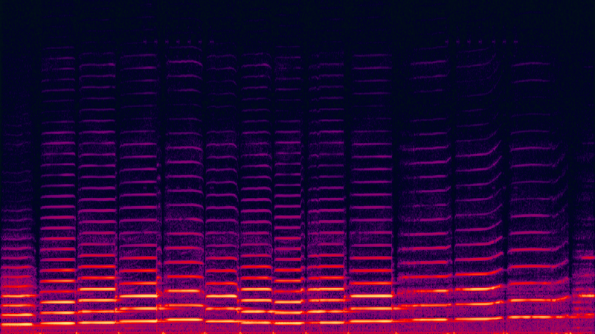
Spectrogram
Time (x axis) and frequency (y)
Value is magnitude of STFT

