Slide 1
CS 598 Deep Learning for Healthcare
Project Presentation
Eric Schrock (ejs9)
Spring, 2025

Slide 2
Project Goal
Reproduce the following research paper
Multi-Label Generalized Zero Shot Learning for the Classification of Disease in Chest Radiographs (https://arxiv.org/abs/2107.06563)
Extend the findings

Slide 3
Problem Statement
When reviewing an X-ray, radiologists can identify diseases that they have never seen, based on things they have read
Multi-label generalized zero shot learning models can identify classes absent from their training data
Based on semantic relationships between class labels
By mapping images and class labels into a shared semantic space
Limitations of prior works
Pre-trained visual encoder (don’t allow end-to-end training)
Mapping images onto the semantic embedding space loses information

Slide 4
Approach
Use a trainable visual encoder to allow end-to-end training
DenseNet-121 (but remove classification layer)
Map the visual and semantic embedding spaces onto a shared latent embedding space
Larger than the semantic embedding space
Use BioBERT to map class labels to the semantic space
Fine-tuned for medical applications

Slide 5
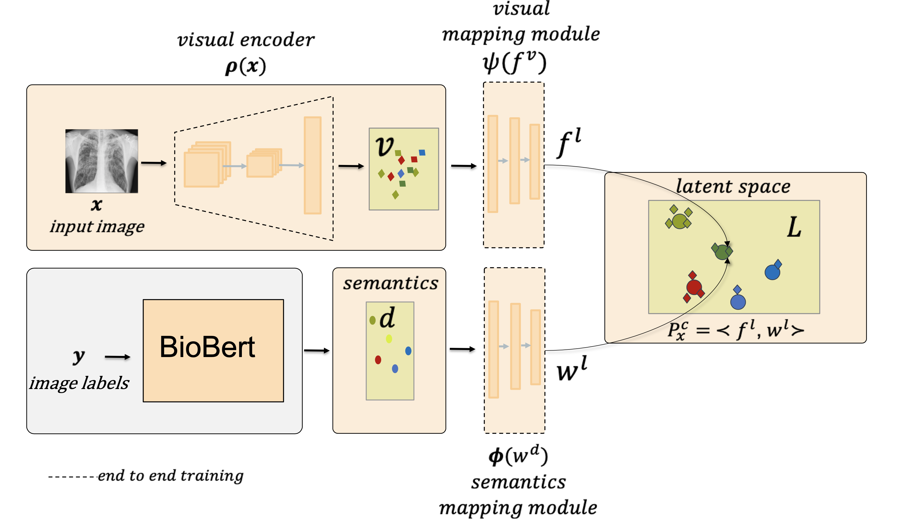
Approach: Model
Source: https://github.com/nyuad-cai/CXR-ML-GZSL/blob/master/images/figure.png

Slide 6

Approach: Loss Function
Loss component goals
Ranking: All positive class scores (ground truth) should be larger than all negative class scores by some value “delta”
Alignment: Images and their labels should map near each other in the latent embedding space
Consistency: Class labels should have similar relationships to each other in both the semantic and latent embedding spaces

Slide 7
Reproduction
One goal
Reproduce the AUROC scores from the original paper
Three attempts
Used the provided code and pre-trained weights
Caveat: Minor changes to support newer versions of PyTorch and scikit-learn
Used the provided code but re-trained
Caveat: Fixed three bugs
Alignment loss hardcoded to 0.0
Training loop epoch count off-by-one error
ReduceLROnPlateau patience and factor values don’t match the paper
Rewrote the code from scratch with the help of an LLM
LLM: ChatGPT (GPT-4-turbo)
Dev time: 1.5 days

Slide 8
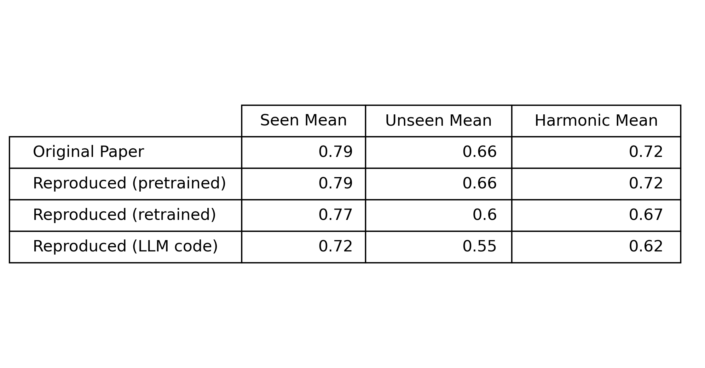
Results (AUROC)

Slide 9
Attempt #1: Provided Code (pre-trained)
Result
Same AUROC scores as the original paper
Why same?
Provided model code matches the paper
Provided weights are same ones used to report the paper’s results

Slide 10
Attempt #2: Provided Code (re-trained)
Result
Worse AUROC scores than the original paper
Why worse? Wrong code or hyperparameters.
Training code has bugs (present in paper results or not?)
Training code has wrong defaults (do no match the paper)
Epochs (100 vs 40)
Delta (0.5 vs 0.2 vs 0.03) (ranking loss parameter)
Paper does not state all hyperparameter values (used code defaults)
Learning rate
Gamma 1 and gamma 2
Batch sizes

Slide 11
Attempt #3: Code from Scratch with LLM
Result
Much worse AUROC scores than the original paper
Why worse?
Code written rapidly from scratch tends to have bugs
No chance to iterate
Project deadline
Google Colab PRO+ limits (used almost 500 compute units)
Training times of ~9 hours
Compounded by the same problems listed for attempt #2

Slide 12
Extension
Replace the visual encoder (DenseNet-121) with EfficientNet-B0
Faster training time?
Comparable AUROC scores?
Shorter training due to project deadline and Google Colab limits
50 epochs instead of 100
Half of the dataset

Slide 13
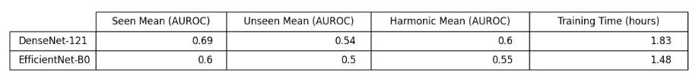
Results
Faster training time
But worse AUROC

