Slide 1
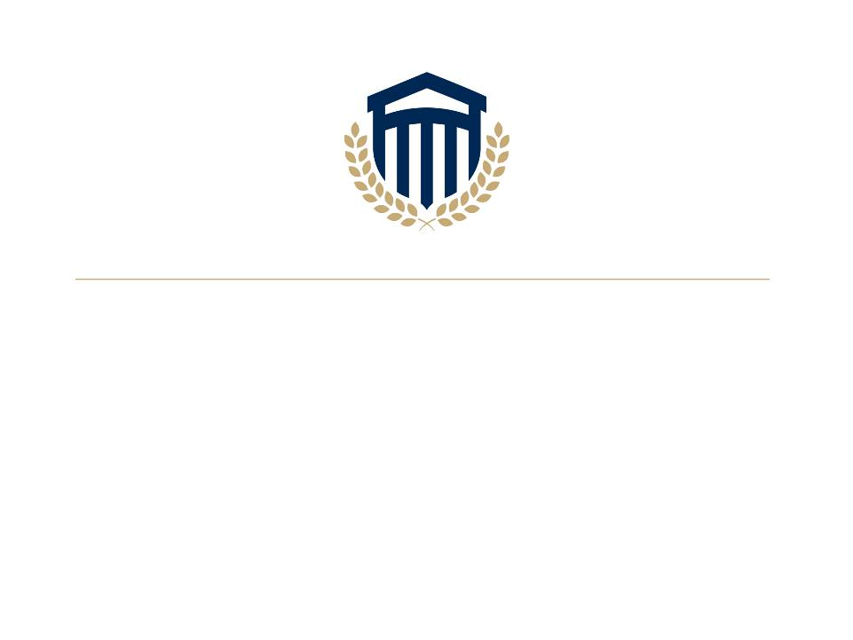
Maritime Safety Concentration
Academic Program Director: Travis L. Smith

Slide 2
Concentration Description
Maritime Safety Concentration
Occupational Safety and Health – Maritime Safety Concentration
Concentration Learning Outcomes
Upon completion of the program, students should be able to do the following:
Propose research-based solutions that promote a safe maritime work environment.
Analyze maritime workplaces to identify occupational hazards.
Course Number and name Credit Hours
OSH 2306, Maritime Safety Standards 3
OSH 3313, Introduction to Maritime Workers
Compensation (Longshore and Jones Act) 3
OSH 3314, Special Topics in the Maritime Industry 3
OSH 4314 Materials Handling in the Maritime Industry 3
Offered in the following programs:
BS, Homeland Security
BS, Occupational Safety and Health

Slide 3
Course Descriptions
OSH 2306, Maritime Safety Standards
  Provides a comprehensive overview of the international and domestic regulations, standards, and best practices governing maritime safety. Students will explore the key elements of maritime safety management, including risk assessment, emergency response, accident investigation, and the human element in maritime safety.
OSH 3313, Introduction to Maritime Workers Compensation (Longshore and Jones Act)
  Provides a comprehensive overview of the unique legal framework governing workers' compensation for maritime employees. It explores the complexities of maritime law as it intersects with workers' compensation principles, focusing on the various statutes and doctrines that determine liability and benefits for injured maritime workers. Students will examine the Jones Act, the Longshore and Harbor Workers' Compensation Act (LHWCA), and other relevant legislation

Slide 4
Course Descriptions (cont’d)
OSH 3314, Special Topics in the Maritime Industry
Provides a comprehensive overview of accident prevention, risk minimization, and protection of life and property at sea.
OSH 4314 Materials Handling in the Maritime Industry
Provides a comprehensive overview of the principles, equipment, and best practices involved in material handling within the maritime industry. Students will learn about the unique challenges and considerations associated with moving cargo in port environments, onboard vessels, and during intermodal transportation.

Slide 5
Who are our potential students?
Dock Worker
Ship workers
Cruise Employees
Active Military
Ship Construction Workers

Slide 6
Program Benefits
Targeted Career options
Trendsetting Expertise curriculum
Different Student Population
Maritime Work is trending upwards
Recognition and expansion of safety knowledge within the industry

Slide 7
Faculty Information
Bobby Oberlechner
Maritime Safety
Wrote two Courses
Dr. John Penton
Masters of Law in Ocean and Coastal Law
PhD Oceanography & Coastal Sciences
Dr. Dennis Whitson
Navy Experience

Slide 8


