Slide 1
ai4fm.cs.luc.edu
ChatTLA+ - Can LLMs Write Correct TLA+ Specifications?
Eric Spencer

Slide 2
The issue:
Software should be mathematically correct
Cruise control, elevator doors, bank software, etc.

Slide 3
The solution:
Model checking programming languages
verify a system’s edge cases by ensuring a bad action can never be true

Slide 4
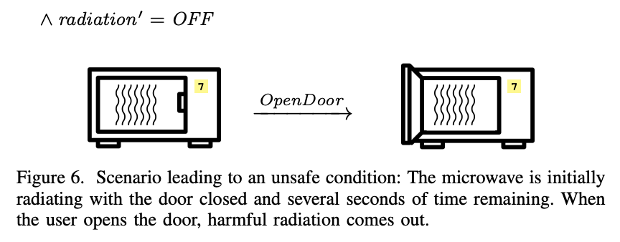
TLA+: Temporal Language of Actions
Invariants must never happen
Läufer, Konstantin; Mertin, Gunda; Thiruvathukal, George K. (2024). WIP: An Engaging Undergraduate Intro to Model Checking in Software Engineering Using TLA+IEEE Frointiers in Education, 2024. https://doi.org/ 10.6084/m9.figshare.27226500.v1
https://arxiv.org/abs/2407.21152

Slide 5



Large Language Models
ai4fm.cs.luc.edu

Slide 6
The language problem
Only ~200 verified examples of natural language -> model checking in TLA+
Existing LLMs only output correct syntax 26.6% of the time and output a verifiable model 8.6% of the time (B. Ortiz et. al, 2026).
https://ai4fm.cs.luc.edu/papers/llm-tla-evaluation/

Slide 7
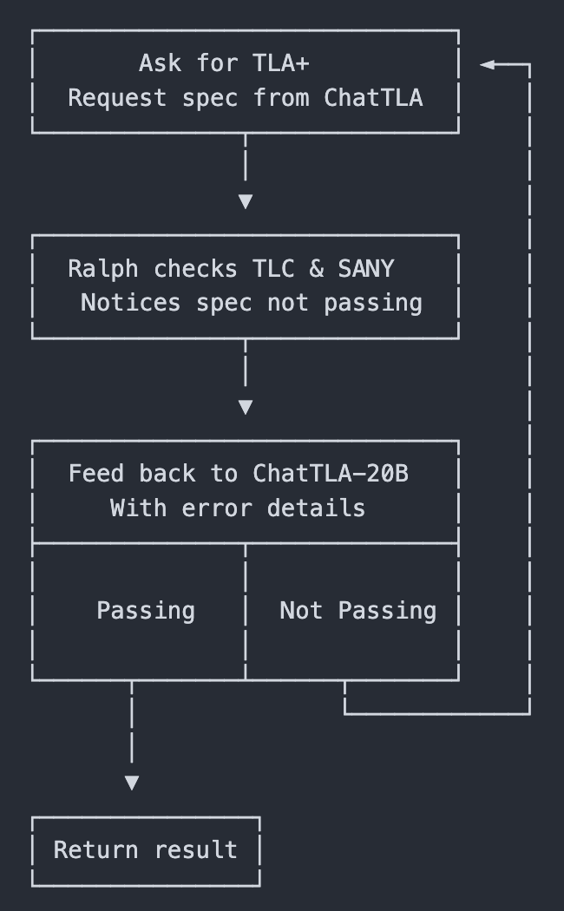
The context-repair solution
Let the model try once
It might fail, give it the error output
Let it try again
This results in a much higher verified result
Applicable to other languages
(E. First et. al, 2023).
https://github.com/LUC-AI4FM/ralph-tla
https://people.cs.umass.edu/~brun/pubs/pubs/First23fse.pdf

Slide 8
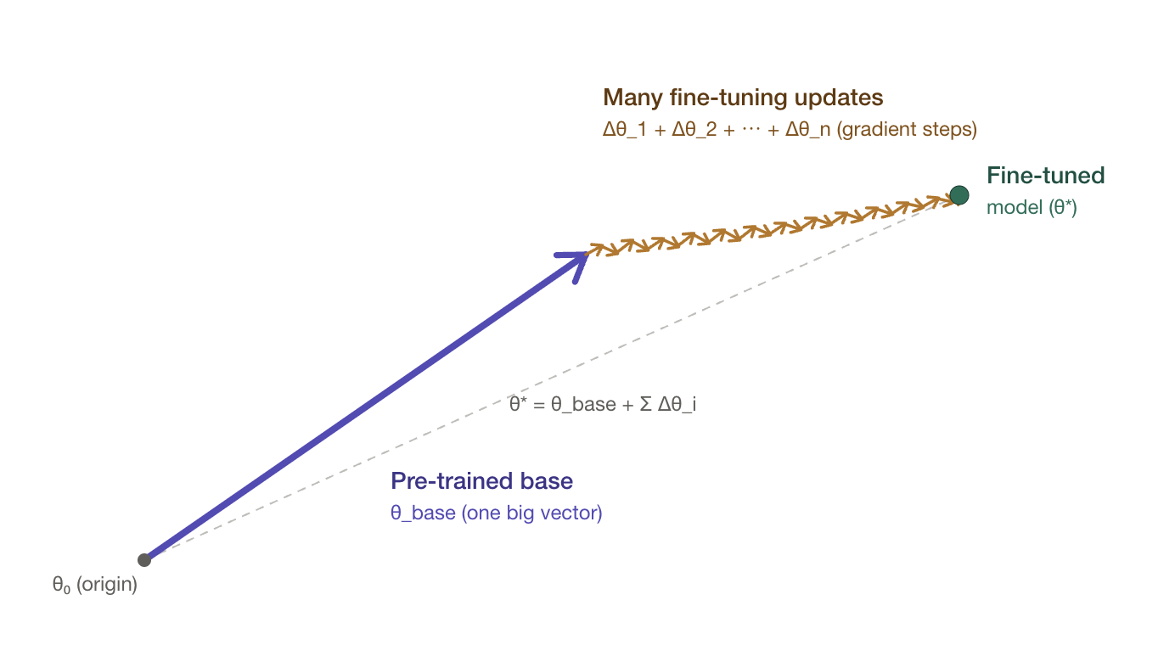
Reinforcement learning
ai4fm.cs.luc.edu

Slide 9
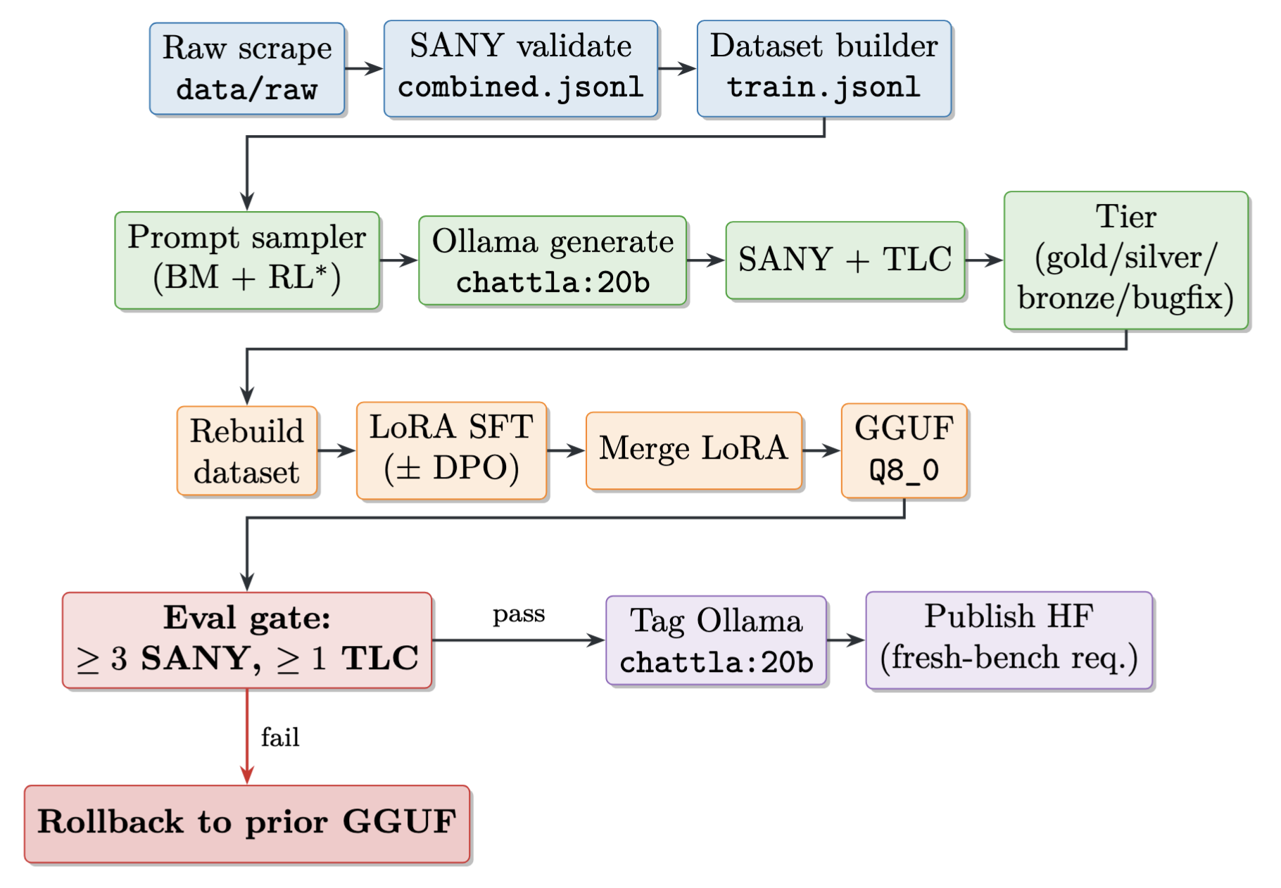
ai4fm.cs.luc.edu

Slide 10
Results
The fine-tuned model achieved better results than base models
At it’s best: 80% syntax, 25% semantic performance on 30 results
Metric | gpt-oss:20b | ChatTLA v9 | Gain
SANY | 69.2% | 80% | +10.8 pp (1.16×)
TLC | 23.1% | 25% | +1.9 pp (1.08×)
Strategy | SANY | TLC
Few-Shot | 18/26 (69.2%) | 0/26 (0%)
Half-Completion | 3/26 (11.5%) | 0/26 (0%)
Progressive | 9/26 (34.6%) | 6/26 (23.1%)
FIM | 5/26 (19.2%) | 0/26 (0%)
ai4fm.cs.luc.edu

Slide 11
ai4fm.cs.luc.edu
Thank you!
Eric Spencer - AI for Formal Methods in Software Engineering

