Slide 1

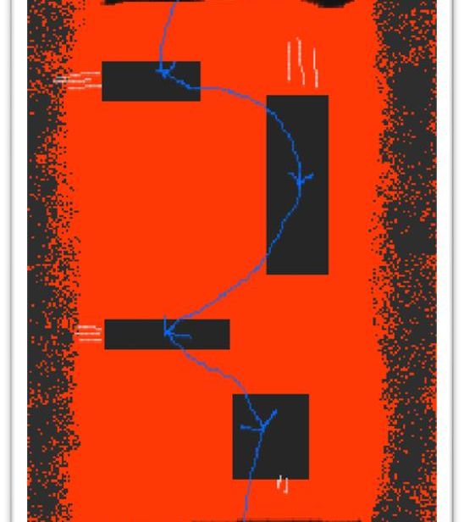
The floor is lava
By Eric Spiteri

Slide 2
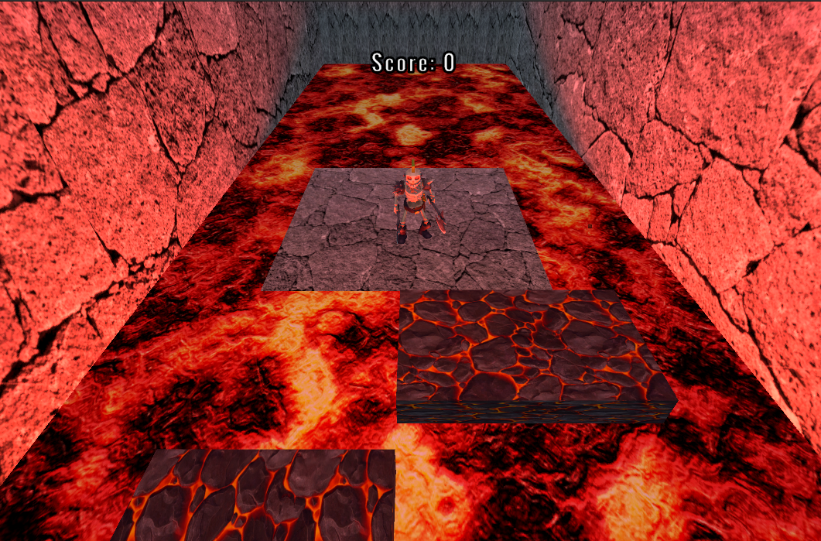
Introduction

Slide 3
Introduction
-The Floor is Lava is a 3D, isometric hypercasual platformer
-It is played with a keyboard using WASD and Space
- It is infinite with random levels

Slide 4
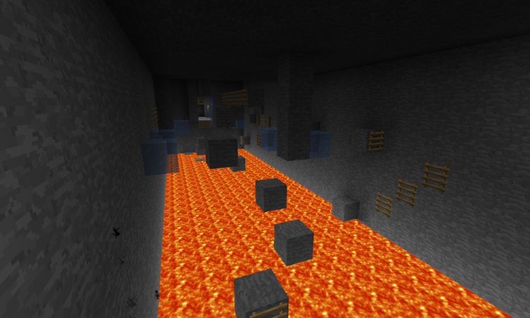

Ideas
-I was inspired by Minecraft parkour
-I was also inspired by Max Payne’s bullet time

Slide 5
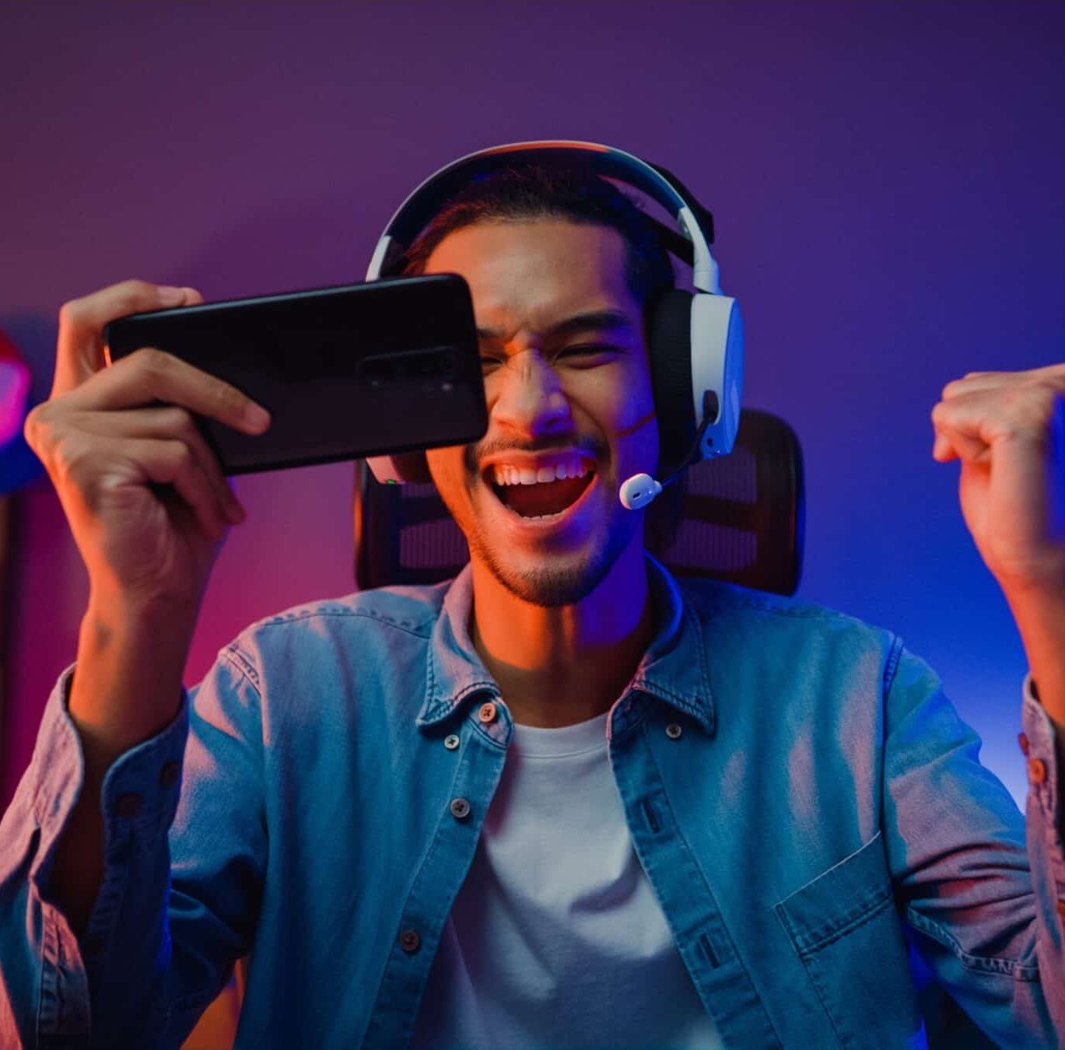
Intentions
-This was meant as a hypercasual game you play when you’re bored on a smartphone.
-Unfortunately, I do not know hot to develop for mobile

Slide 6
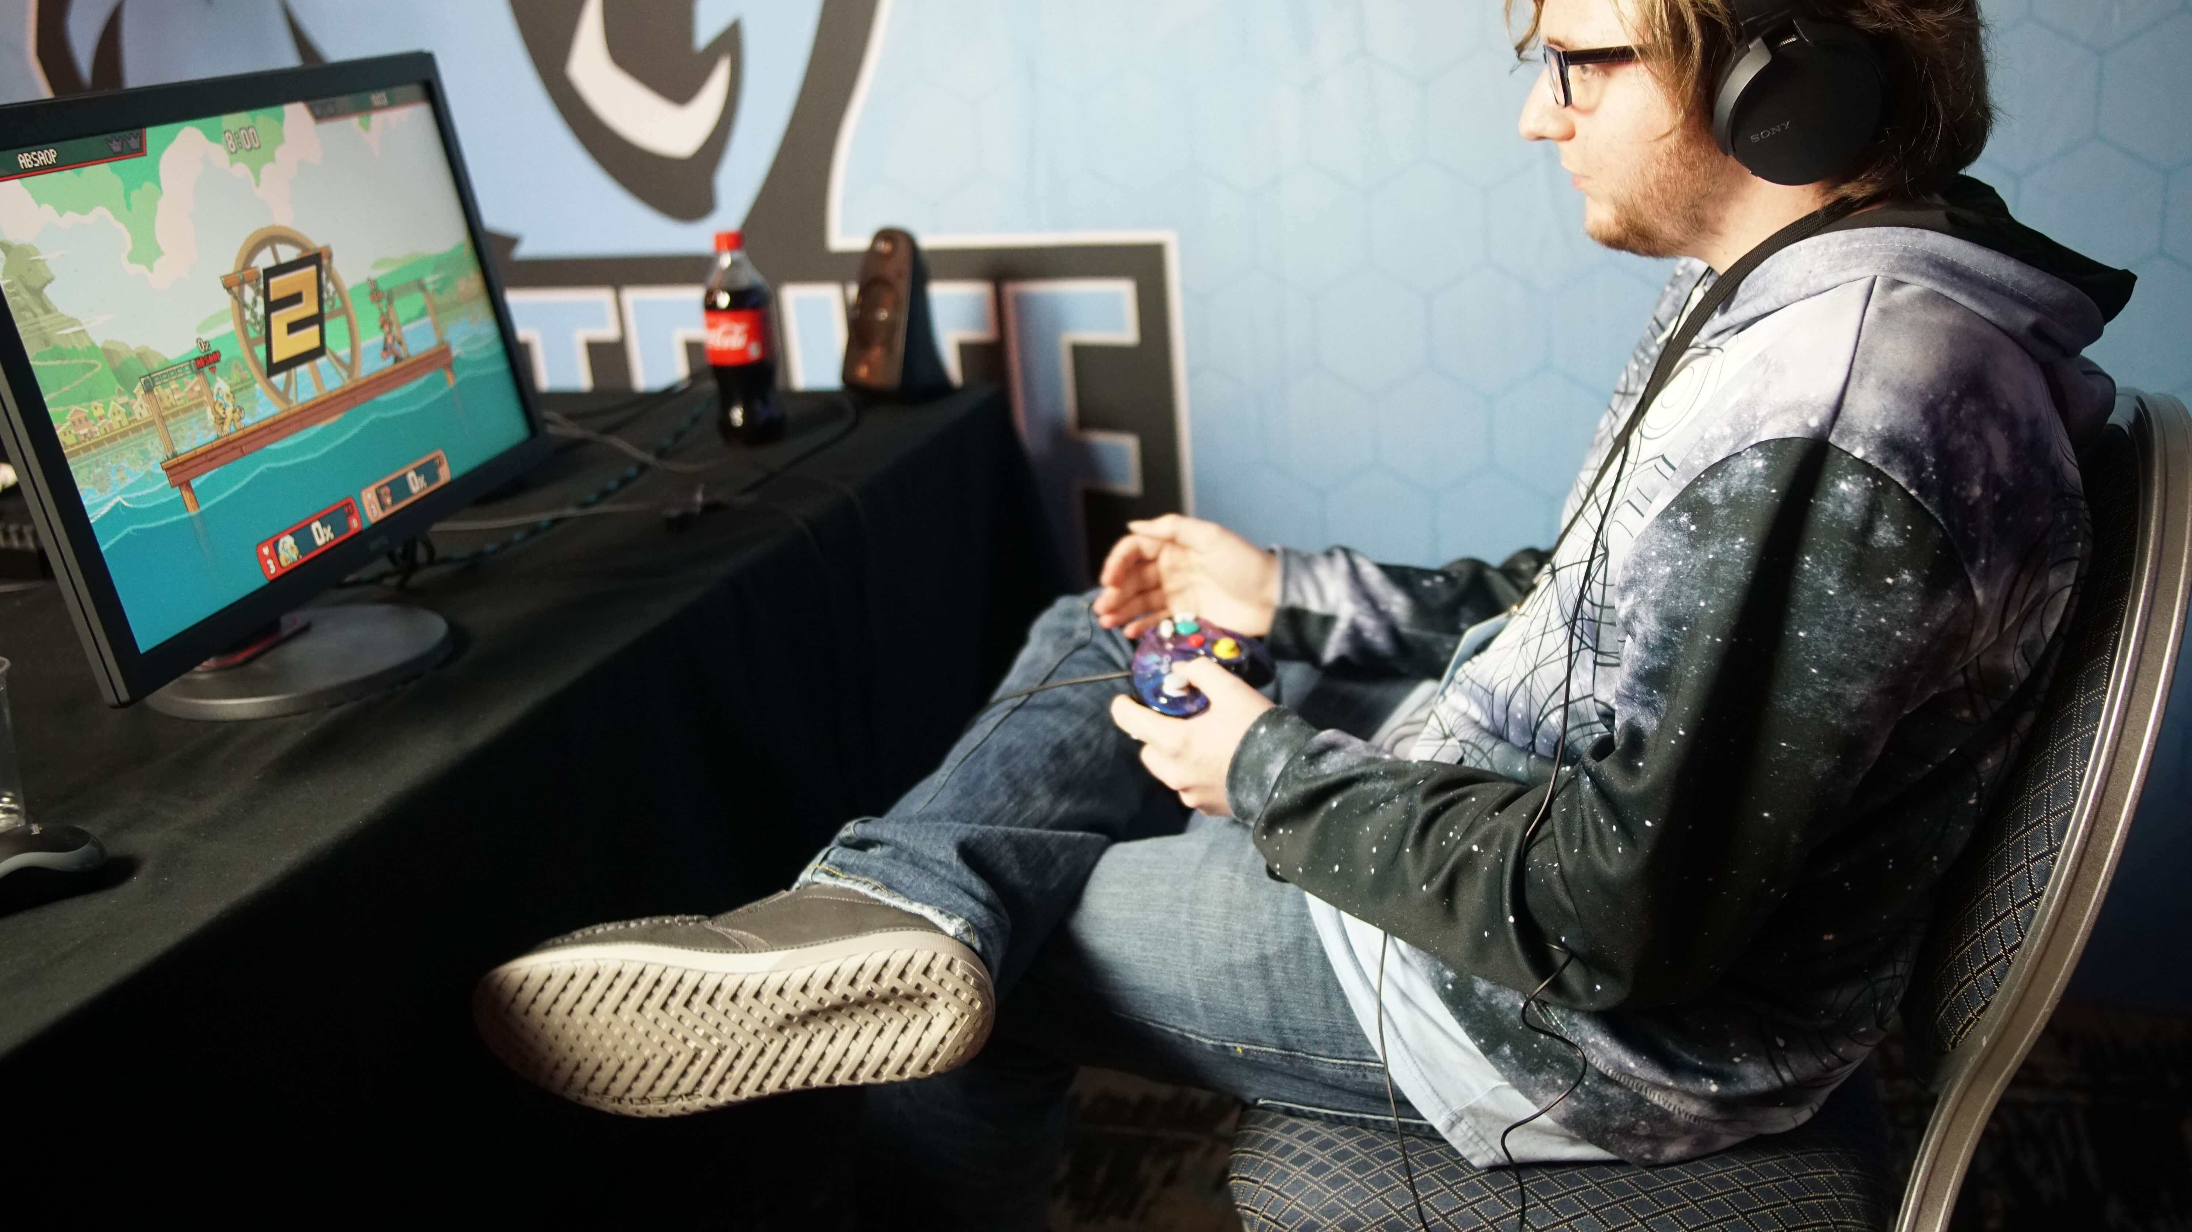
Playtesting
Each playtesting session was done remotely via a teams call and recorded.
From the recording, notes were taken down regarding their feedback.
From these notes, changes were added.

Slide 7
Playtesting (continued)
-Dramatic Elements feedback was mostly good, the playtester wanted a bit of variety in the platforms.
Collision bugs which were spotted were patched.
Animation was added as per feedback
Positive loop was amplified for a more obvious effect

Slide 8

Roles
-I am the sole game designer and developer of this game :(
- Note assets were not mine

Slide 9


