Slide 1

Project Lasik
Executive Review
A Collaboration Between Schneider Electric Indirect Procurement & Harvard Analytics
Dec. 9th, 2020

Slide 2
1
Project Background & Overview
Table of Contents
2
Deliverable Update
3
Next Steps
4
Appendix: More About Project Lasik
Notes:
Agenda slide

Slide 3
Project Background & Overview
Gather insights into Schneider IP spend, to enable predictive analytics for future spend, and introduce potential data integrity improvement design to the purchase request (PR) process.
Problem Statement(s):
1. Indirect Procurement (IP) spend analytics thus far has been back-forward looking, as descriptive analytics; IP teams struggled when pressed for spend projection taking consideration macro/microeconomics associated with the industry, competitive landscape, and Schneider Electric current and projected financial results.
2. IP spends significant time “cleansing” spend data before data are “validated” for use; in many cases, spend data are “mis-categorized” from the start (Purchase Requisition, or PR creation by Schneider users). No tangible mechanism is place today to improve spend data integrity at point of entry (PR creation).
Desired Outcome for 2 months of Harvard Analytics collaboration:
1. A “predictive analytics” design foundation that can be implemented to enable “predictive” spend analytics going forward
2. A design foundation that can be implemented in scalable manner to enhance data integrity at point of entry/creation (PR)

Slide 4
Project Execution Approach
“Agile” scope definition and bi-weekly check-ins/milestone reviews enables close alignment in exploration and design execution
Bi-weekly Check-ins/Milestone Reviews
1. Define Preliminary Scope for Collaboration
2. Align on Pre-dictive IP Spend Deliverable
3. Align on IP Spend Data Integrity Improvement Deliverable
4. Review
Deliverables
5. Close Out Project; Transition Knowledge
Part 1 – Predictive Analytics to Forecast Schneider IP Spend
Leverage public financial data (Schneider + Schneider Peer Group + Industry Verticals)
Utilize outside company markers to reveal trends and predictions for Schneider IP spend
Linear regression to identify correlation between various “financial” markers and IP spend based on historical spend data, based on which IP spend predictions can be continuously tweaked and improved
Part 2 - Purchase Requisition (PR) Data Integrity Improvement at Entry Point
Simplify manual sanity checks for verifying purchase requisitions; establish foundation to enable automated validation process via bots going forward
Highlight errors in typical material group classification by requestors – identified as area for future RPA + manual combination solution
Identify key words & frequency to enable near-term gain of e-Catalog establishment effort

Slide 5
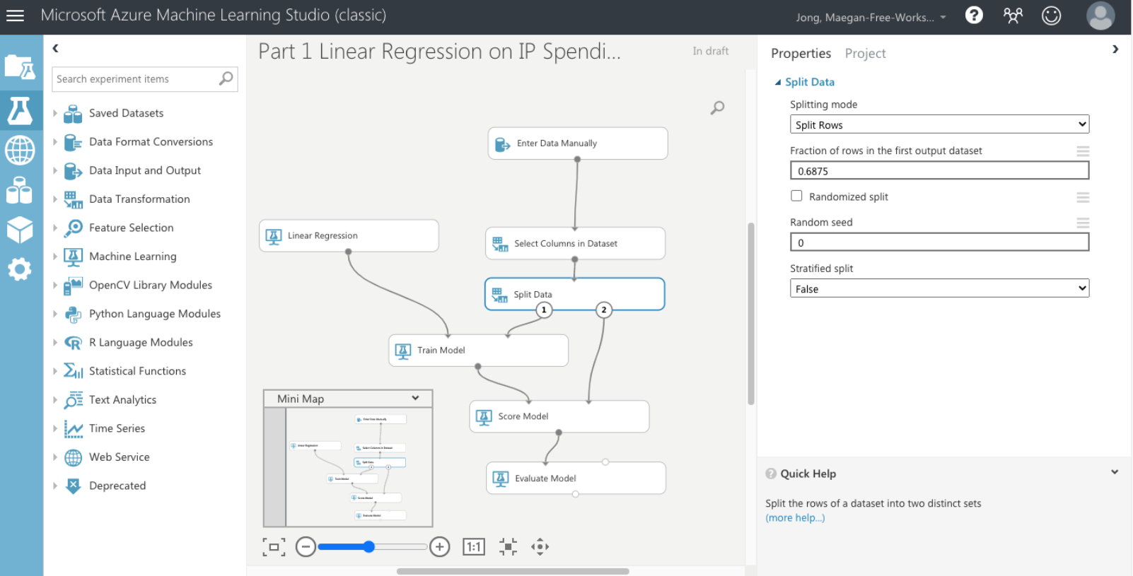
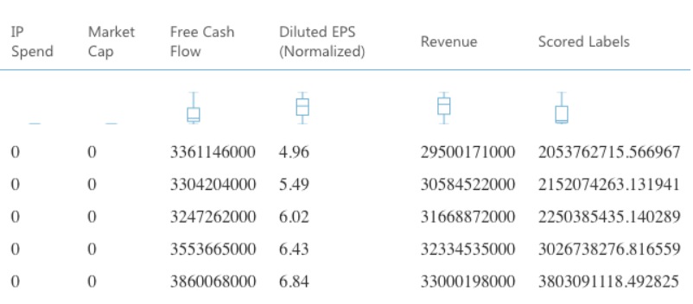
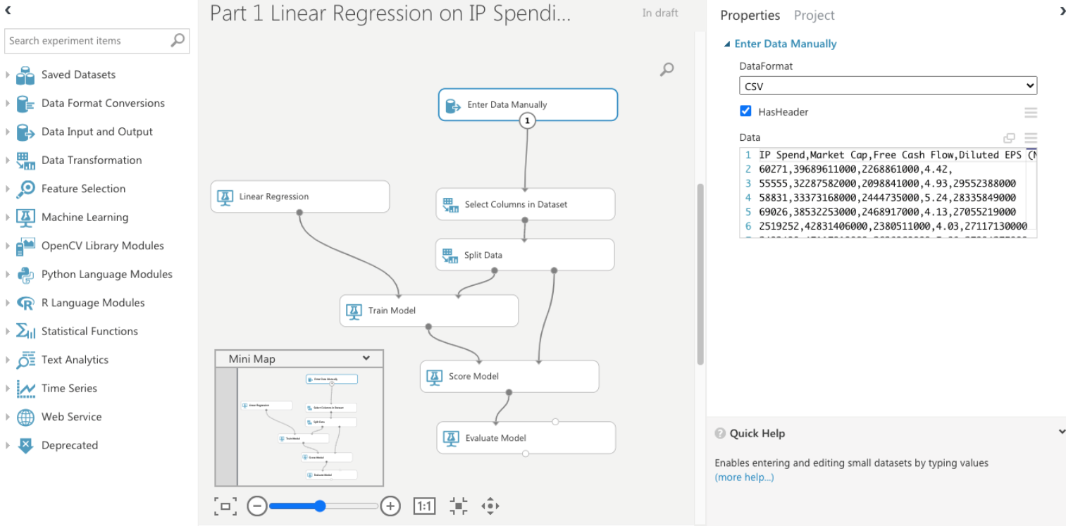
The Outcome
Part 1 – Predictive Analytics to Forecast Schneider IP Spend
Linear Regression to Identify IP Spend Projection Algorithm

Slide 6
The Next Steps
Part 1 – Predictive Analytics to Forecast Schneider IP Spend
Currently IP spend data from 2018 – 2020 have been incorporated; team will incorporate 2015-2017 data after “cleansing”
Further define relevant financial data “marker” to improve validity of projection algorithm
Refine peer group (Legrand, Siemens, Rockwell Automation, Vertiv) to improve validity of project algorithm
Transition project learning and current model to GSC Analytics to carry the effort forward

Slide 7
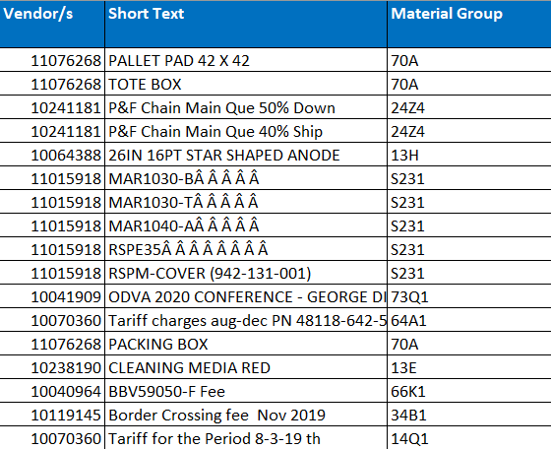
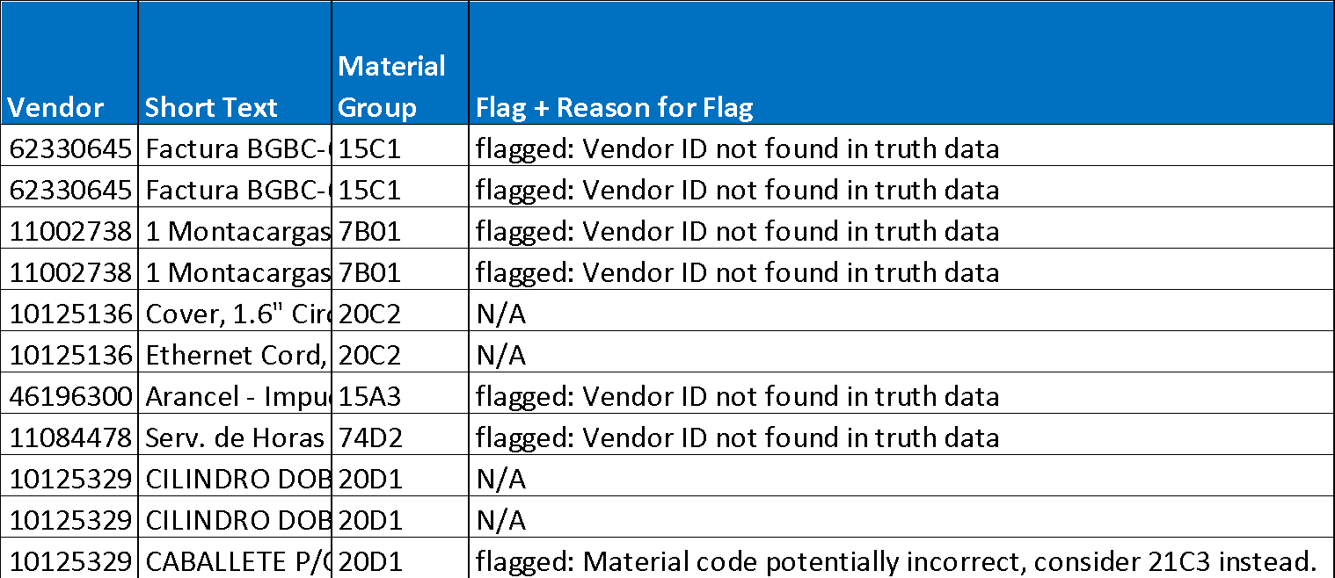
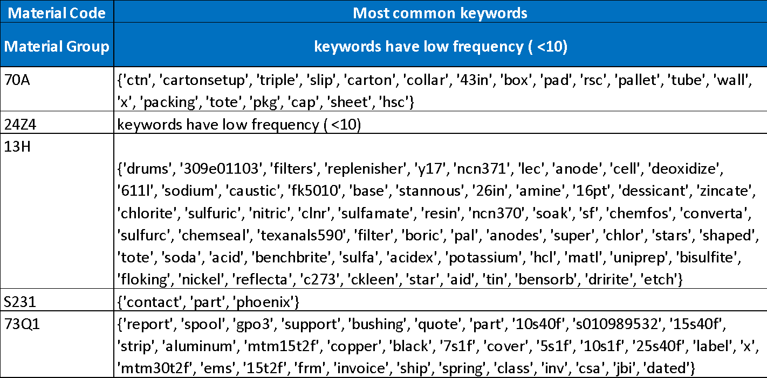
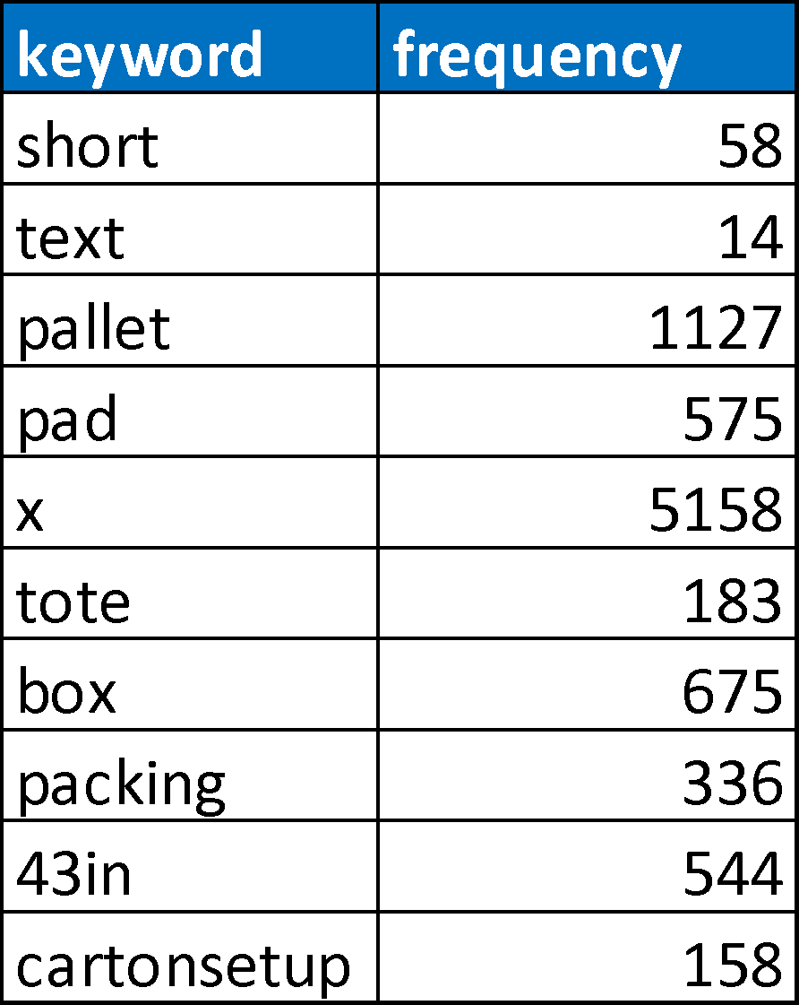
The Outcome
Part 2 - Purchase Requisition (PR) Data Integrity Improvement at Entry Point

Slide 8
The Next Steps
Part 2 - Purchase Requisition (PR) Data Integrity Improvement at Entry Point
Refine the “truth” “flagged” and “dirty” findings and rules; build bot(s) to “crawl” across PRs created in Coupa, to self-correct or flag for “human intervention”, so spend data integrity can be “controlled” or at least “enhanced” at point of entry
Transition project learning and current model to GSC Analytics to carry the effort forwar
Build key words and frequency findings into e-Catalog deployment ongoing to achieve quick win

Slide 9
Appendix
More About Project Lasik
Part 1: Methodology, Outcome, and Benefits
Part 2: Methodology, Outcome, and Benefits
Moving Forward

Slide 10
Part 1 Methodology
Aimed at forecasting spend amounts based on various variables.
Gathered public semesterly IP spend data from 2015-2020
Company markers (datasets are projections, e.g. projected revenue for 2022):
Market Cap
Free Cash Flow
Diluted EPS
Revenue
Trained a linear regression model to predict IP spend in 2021-2022
Required complete datasets for other variables to 2022 to predict IP spend
Filled cells are inputted into the model (ignore time data)
Green indicates historical values
Yellow indicates forecasts

Slide 11
Part 1 Methodology
Time (MYY) - ignore for forecast | IP Spend | Market Cap | Free Cash Flow | Diluted EPS (Normalized) | Revenue
615 | 60271 | 39689611000 | 2268861000 | 4.42 | 29581000000
1215 | 55555 | 32287582000 | 2098841000 | 4.93 | 29552388000
616 | 58831 | 33373168000 | 2444735000 | 5.24 | 28335849000
1216 | 69026 | 38532253000 | 2468917000 | 4.13 | 27055219000
617 | 2519252 | 42831406000 | 2380511000 | 4.03 | 27117130000
1217 | 2493490 | 47117019000 | 2638969000 | 5.08 | 27904275000
618 | 2569947443 | 45983263000 | 3055821000 | 5.4 | 29683922000
1218 | 2563709727 | 37534872000 | 3143697000 | 5.5 | 30351306000
619 | 2553300099 | 49738575000 | 3183674000 | 5.69 | 30348140000
1219 | 2596345388 | 56468117000 | 3483712000 | 6.16 | 30401881000
620 | 2300843225 | 59537221000 | 3019682000 | 5.57 | 28229766000
1220 | 0 | 73820000000 | 3361146000 | 4.96 | 29500171000
621 | 0 | 81313825000 | 3304204000 | 5.49 | 30584522000
1221 | 0 | 84471055000 | 3247262000 | 6.02 | 31668872000
622 | 0 | 88746815000 | 3553665000 | 6.43 | 32334535000
1222 | 0 | 91989450000 | 3860068000 | 6.84 | 33000198000

Slide 12
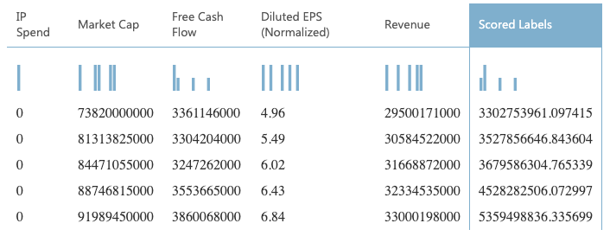
Part 1 Outcomes
Linear Regression model to return IP spend forecasts for the years 2021-2022
Output: IP Spend predictions for semester periods 12/20, 6/21, 12/21, 6/22, 12/22
Input: Public financial data forecasts for future semester periods from financial institutions & (not pictured) historical IP spend and public financial data

Slide 13
Part 1 Benefits
Easily accessible and customizable model to create IP spend predictions
Forecasted data can be used to influence company decisions to reduce future IP spend
Could add more financial data as necessary to improve accuracy
Model is publicly available on Microsoft Azure

Slide 14
Part 2 Methodology
Aimed at flagging errors in the purchase requests using verified purchase requests.
Draw associations of vendors, keywords (item description), and material group in the validated purchase requests
Apply determined associations in un-validated purchase requests
Utilize keyword frequencies as well as each supplier’s set of material groups to highlight potentially wrong material group classifications by requestor

Slide 15
Part 2 Outcomes
Script to filter out unknown vendors and flag potentially wrong material group classifications.
Un-validated purchase requests are indicated with “unknown vendor” or “flagged”
Marks potential errors in the un-validated purchase requests
Threshold of 10 times for frequency of keywords
Script allows specification of “validated” and “un-validated” purchase requests csv files
Output of “un-validated” purchase requests can simplify validation process

Slide 16
Part 2 Benefits
Streamline purchase request validation process.
Lightweight Python script to append an indicator column to the un-validated purchase requests
Easy to update with new set of validated purchase requestors
Output of “common_keywords” which shows high frequency keywords for all the material codes & “all_keywords” which shows all the keywords for each material code

Slide 17
Moving Forward
Potential improvements.
Part 1:
Gather more fine-tuned data, either quarterly or monthly
Improve accuracy of prediction with dataset increase
Incorporate time series data to enhance prediction
Spend data should be updated to reflect accurate amounts in earlier years
Part 2:
Look for more trained and testing data with more diverse vendors
Current model flags a large number of vendors as unknown
Build upon the logic for improved flagging for relative frequency
Improve on the model so it returns lower percentage of false negatives
Change the model to include relative frequency

Slide 18
Moving Forward Continued
Guidelines of hand-off.
Part 1:
Access Microsoft Azure environment via https://gallery.cortanaintelligence.com/Experiment/Part-1-Linear-Regression-on-IP-Spending
Input csv of previous IP spend and financial data as well as financial forecasts to run model
Elements to personalize:
Load data: historical IP spend and financial data & financial forecasts
Split data: decimal percentage of the historical data
Part 2:
Specify xls files for the un-validated and validated purchase requests
Run “parse_spend.py” then “flag_unknowns.py” to received “flagged.csv” reports
Elements to personalize:
Set of un-validated purchase requests to check
Set of validated purchase requests to establish the “truth”

