Slide 1

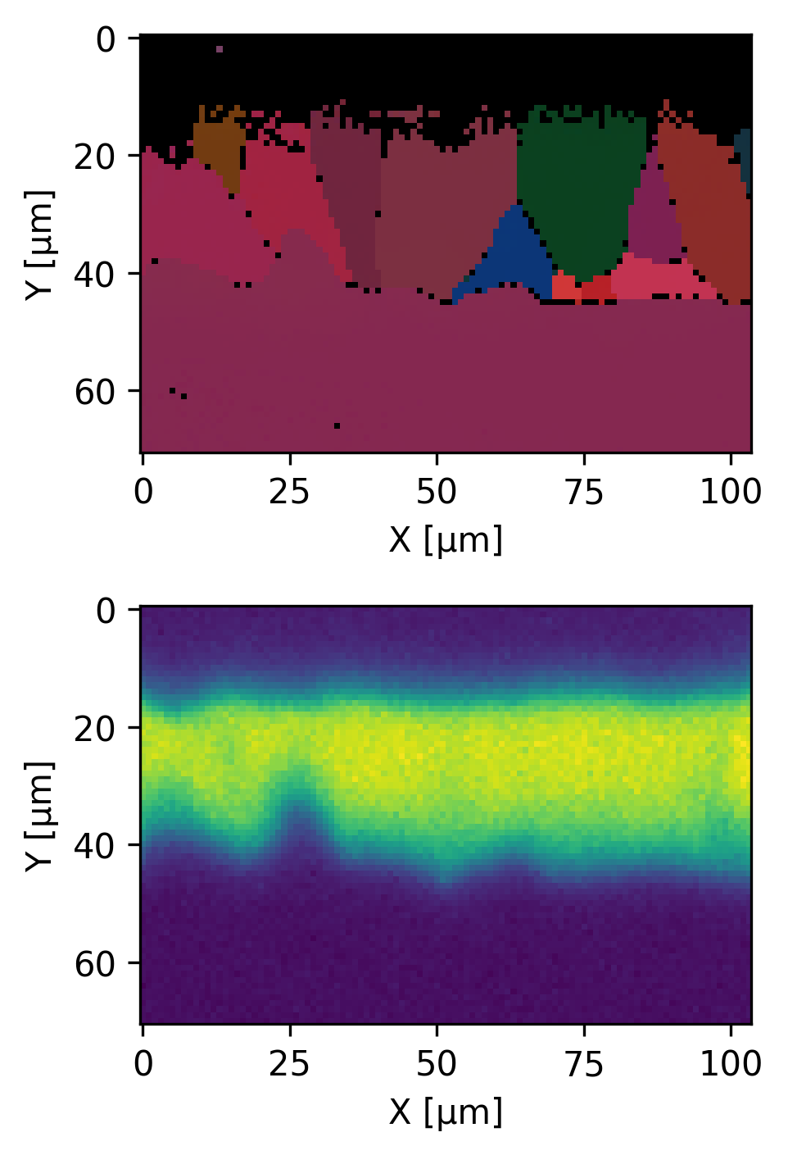
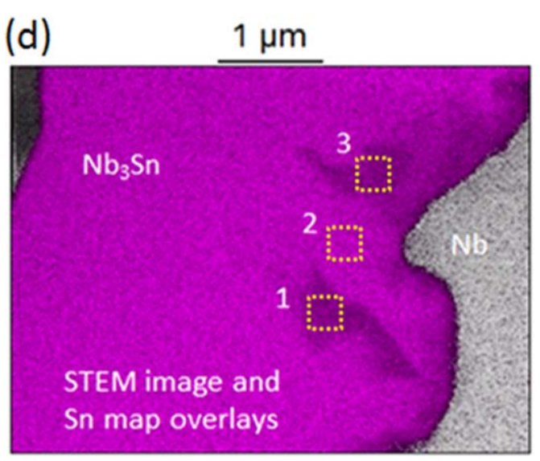
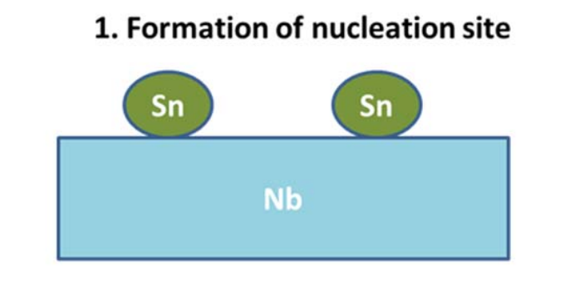
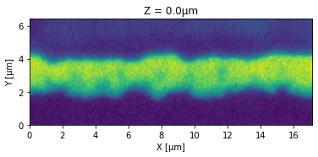
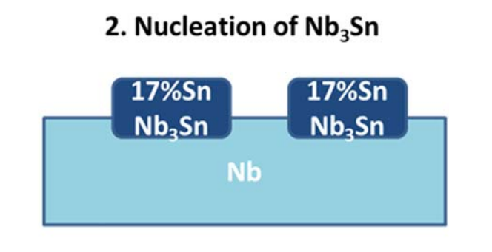
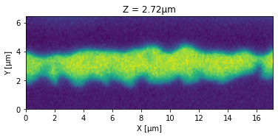
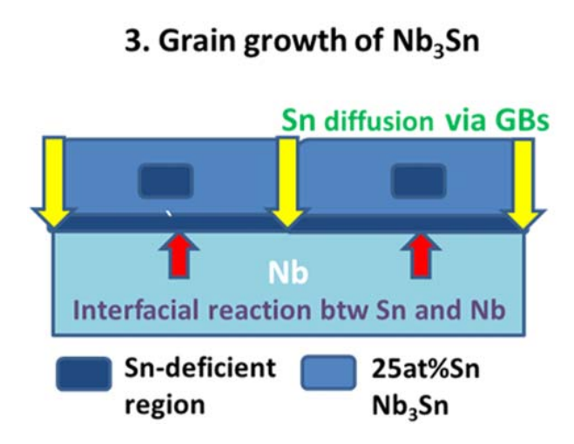
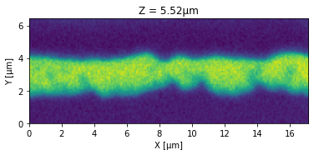
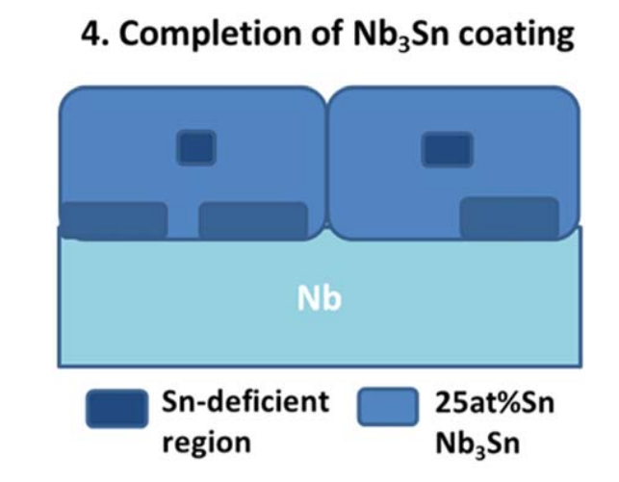
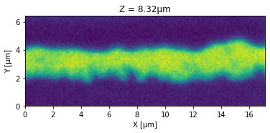
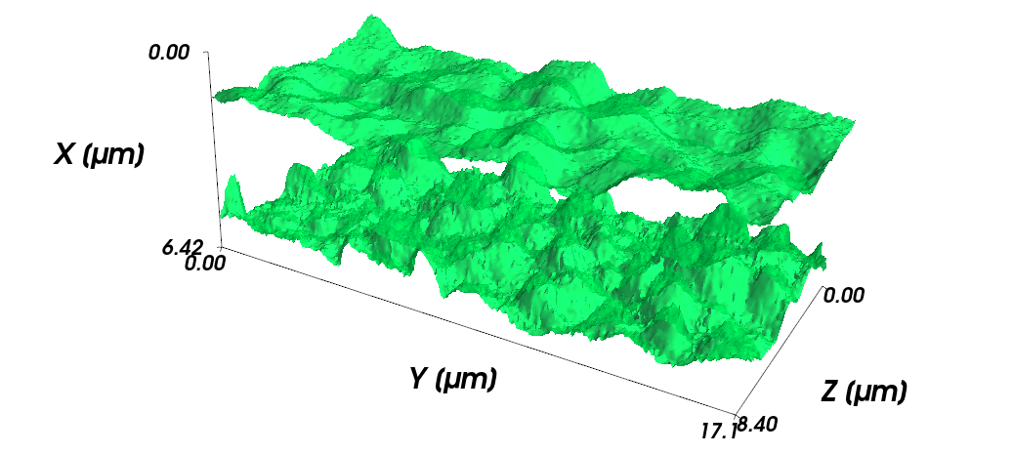
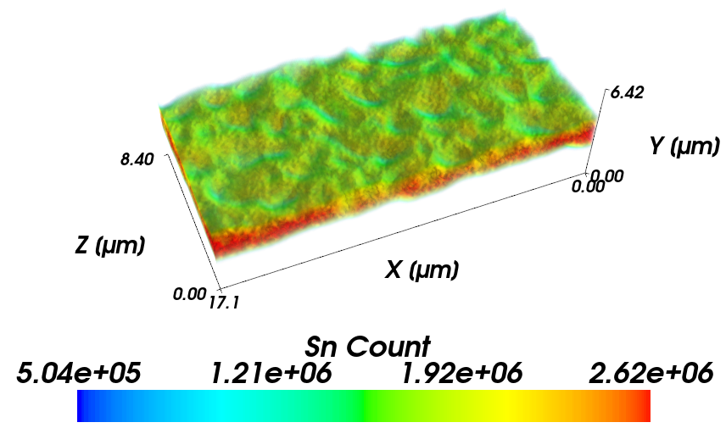
Three-Dimensional Reconstruction of Nb3Sn Thin Films
Eric Viklund^{1,2}, David Seidman¹, Jae-yel Lee², Sam Posen²
¹Northwestern University, ²Fermi National Accelerator Laboratory
Introduction
Focused Ion-Beam Tomography
Combined EDS and EBSD Measurements
Nb₃Sn SRF cavities manufactured using Sn-vapor deposition are a promising candidate for future accelerator applications to achieve higher Q and higher accelerating gradients.
Combined focused ion beam and electron beam instrument at FNAL allows for 3D characterization of Nb₃Sn films.
e-
Combining EDS measurements with EBSD gives a clearer picture.
Thin regions form between grain boundaries.
Sn deficient regions form within the grains.
This suggests that our model of Sn deficient region formation is correct.
Ga+
Figure 4: The orientation of the sample, ion-beam, and electron-beam during a FIB tomography measurement.
Figure 1: TEM-EDS image showing Sn-deficient regions near the Nb-Nb₃Sn interface.¹
Sn deficient regions found throughout the film.
Film fails to grow in some regions leading to thin areas.
Sn-deficient regions are formed during the growth of the Nb₃Sn film.
Sn deficient regions theorized to form during nucleation.
Sn predominantly diffuses through Nb₃Sn grain boundaries (GBs).
Sn cannot reach the center of grains due to slow intra-granular diffusion.
Figure 7: Simultaneous measurement of grain orientation and Sn content of a Nb₃Sn film.
Conclusion
In this study we use 3D EDS and EBSD methods to image the distribution of Sn-depleted regions in Nb₃Sn films and correlate their position with grains and grain boundaries.
We find several areas where the film is thin or Sn deficient, which could contribute to poor cavity performance.
EBSD measurements indicate that the Sn deficient regions are located within the Nb₃Sn grains as is predicted by our Nb₃Sn nucleation model.
Figure 2: The mechanism which generates Sn-deficient regions during the vapor-diffusion coating process.¹
Figure 5: The orientation of the sample, ion-beam, and electron-beam during a FIB tomography measurement. A thin region of the film and a Sn-deficient region have been indicated by a red circle.
Acknowledgement
This manuscript has been authored by Fermi Research Alliance, LLC under Contract No. DE-AC02-07CH11359 with the U.S. Department of Energy, Office of Science, Office of High Energy Physics.
Sources
Jaeyel Lee et al 2019 Supercond. Sci. Technol. 32 024001
Figure 3: The boundaries of the Nb₃Sn film calculated from the 3-D Sn X-ray count distribution. The threshold value for the iso-surface was chosen as 1.5x10⁶.
Figure 6: Volume rendering of the 3-dimensional Sn X-ray count data.

