Slide 1
PARRHI
1
0
Real World Model
Input Module
Parametrised Program
Robot
2
Core Routine
Real World
Output Module
3
4
AR - Space

Slide 2



PARRHI
1
0
Real World Model
Input Module
Developer
Real World
Validation
2
Parametrised Program
8
Robot
User
Core Routine
Output Module
6
7
3
4
AR - World
5

Slide 3
Core Routine
Parametrised Program
Resolve Parameters
Update inner State
Evaluate
Triggers
Execute Actions
Output Module
0
1
2
3

Slide 4
Core Routine
Unity
PARRHI library
Robot Library

Slide 5




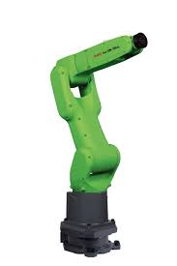
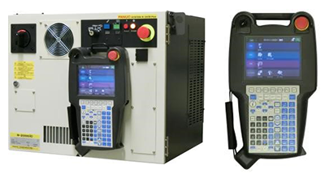
Local Wireless Network – „FanucRobot“
Commands via custom protocol (wireless)
PC Code via ftp (wireless)
OR
Ethernet Cable
Network Socket
Client
C#
(application logic)
Perl
(dev automation)
1. Changes Version numbers
2. Compiles Karel to pcode
3. Changes Wlan & IP Settings to „FanucRobot“
4. Uploads compiled code via ftp to controller
5. Changes WLan settings back to Eduroam
FTP Server
Network Socket
Host
Commands via Network Socket (Bi-Directional)
KAREL Commands (Movement, Read Robot values, Network Rec. & Send Cmd)
Future: AR Hologram projection onto robot
Karel
Command interpreter
FTP: Code upload to controller

Slide 6
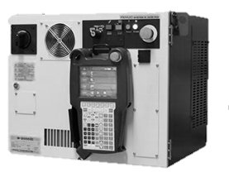
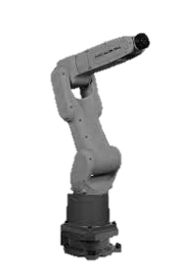
Augmented Reality
.NET Framework Host
Robot Controller
Application Logic (C#)
R-30iB Controller
CR-i7L
1
WLAN
Router
Karel Host
WLAN
Ethernet
6
9
Robot Library
Network- Socket Client
5
8
Network Socket Server
Register
TP Loop
2
3
7
4

Slide 7
Initialise
Handle RelAbs Change
Reset Gripper
Set rel mode
Reset Pos Register
Launch ARobot Server
[relAbs != oldRelAbs]
Store current pos (JPos, LPos) to Data Register
[exit == 0]
[relAbs == oldRelAbs]
Write new Pos to Robot
Handle Gripper State Change
Calculate new Pos
Store current Pos to PR
Finalise Edge Detection
[exit == 1]

Slide 8
Command User to Start Position
[UserPos == StartPos]
Command: Robot Tip to Target Point
[RobTip == TarPoint]
[60 Sec. passed]
Success Msg, Command User to Finish Pos
disable
Fail Msg, Command User to Finish Pos
[UserPos == FinishPos]
Success Message

Slide 9


PARRHI
1
0
Real World Model
Input Module
Developer
Real World
Validation
2
Parametrised Program
Target 1
Target 2
Target 3
8
Core Routine
Output Module
3
4
Target n
AR - World
5

