Slide 1

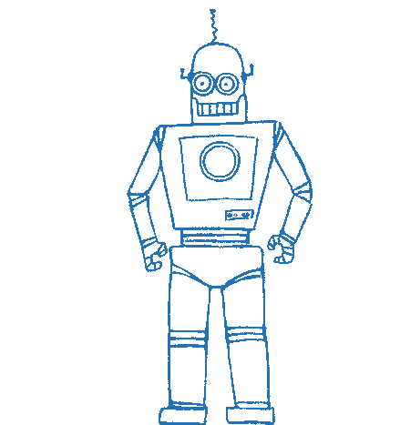
Bachelor’s thesis presentation Parametrised Augmented Reality Robot Human Interface (PARRHI)
Eric Vollenweider
Technische Universität München
Fakultät für Maschinenwesen
Lehrstuhl für Automatisierung und Informationssysteme
Garching, 10. Juli 2019

Slide 2
Table of Contents
Introduction
State of the Art
Requirements
Concept
Implementation
Evaluation
Conclusion

Slide 3
Table of Contents
Introduction
State of the Art
Requirements
Concept
Implementation
Evaluation
Conclusion

Slide 4

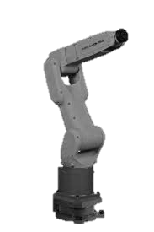

Why is Augmented Reality helpful?
Goal: Describe Why AR is important
Modern production plants should be:
Agile
Safe
Efficient
This requires:
Mind + Machine Collaboration

Slide 5


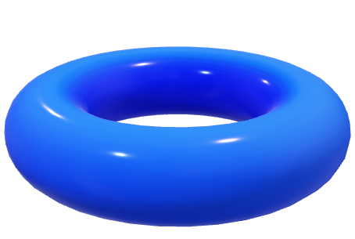
Why is Augmented Reality helpful?
Goal: Describe Why AR is important
Modern production plants should be:
Agile
Safe
Efficient
This requires:
Mind + Machine Collaboration
Move!
2 m
1,2 m

Slide 6



AR Development
Goal: Development of AR not easy / simple / Person responsible might not know how
Responsible person has domain specific knowledge but no AR-Development skills
Time consuming
Expensive

Slide 7
Table of Contents
Introduction
State of the Art
Requirements
Concept
Implementation
Evaluation
Conclusion

Slide 8
What has been done?
Goal: Quickly describe what has been done
No existing standards for AR-HR Interfaces [1]
AR in use for Robotics during development, testing and operation [2]
AR helps for Robot Human Communication [3]
Parametric Design in other disciplines [4]

Slide 9
Table of Contents
Introduction
State of the Art
Requirements
Concept
Implementation
Evaluation
Conclusion

Slide 10
Table of Contents
Introduction
State of the Art
Requirements
Concept
Implementation
Evaluation
Conclusion

Slide 11
Table of Contents
Introduction
State of the Art
Requirements
Concept
Implementation
Evaluation
Conclusion

Slide 12
Table of Contents
Introduction
State of the Art
Requirements
Concept
Implementation
Evaluation
Conclusion

Slide 13
Table of Contents
Introduction
State of the Art
Requirements
Concept
Implementation
Evaluation
Conclusion

Slide 14
Farben
Als erstes soll mit schwarz und weiß gearbeitet werden. Für Aufwändigere Darstellungen sind Farben mit Bedacht und in möglichst geringem Umfang einzusetzen.
In diesem Folienmaster ist die Farbpalette festgelegt.
Zuerst mit den Primärfarben arbeiten.
Für z.B. komplexe Diagramme stehen nochSekundärfarben zur Verfügung.
Gering im Einsatz sind die Akzentfarben.

Slide 15
Sources
C. Perey, T. Engelke, and C. Reed, “Current status of standards for augmented reality”, in Recent Trends of Mobile Collaborative Augmented Reality Systems, Springer, 2011, pp. 21–38
W. Hoenig, C. Milanes, L. Scaria, T. Phan, M. Bolas, and N. Ayanian, “Mixed reality for robotics”, in 2015 IEEE/RSJ International Conference on Intelligent Robots and Systems (IROS), IEEE, 2015, pp. 5382–5387.
P. Milgram, S. Zhai, D. Drascic, and J. Grodski, “Applications of augmented reality for human-robot communication”, in Proceedings of 1993 IEEE/RSJ International Conference on Intelligent Robots and Systems (IROS’93), IEEE, vol. 3, 1993, pp. 1467– 1472.
M. Stavric and O. Marina, “Parametric modeling for advanced architecture”, International journal of applied mathematics and informatics, vol. 5, no. 1, pp. 9–16, 2011

