Slide 1
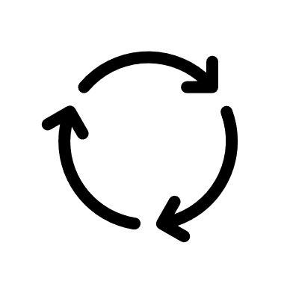
User‘s Input Data
</>
PARRHI
3D Space
Interpreter
Robot
Cycle
Holograms

Slide 2
Input Data
Variables
Points
Holograms
Events

Slide 3
Points

