Slide 1

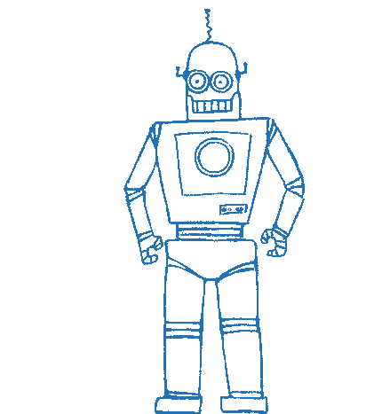
Bachelor’s thesis presentation Parametrised Augmented Reality Robot Human Interface (PARRHI)
Eric Vollenweider
Technische Universität München
Fakultät für Maschinenwesen
Lehrstuhl für Automatisierung und Informationssysteme
Garching, 10. Juli 2019

Slide 2
Table of Contents
Introduction
State of the Art
Requirements
Concept
Implementation
Evaluation
Conclusion
Notes:
This how I proceed

Slide 3
Table of Contents
Introduction
State of the Art
Requirements
Concept
Implementation
Evaluation
Conclusion

Slide 4
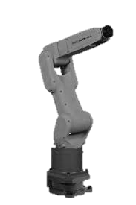

Why is Augmented Reality helpful?
Modern factories:
Industry 4.0
Agile
Flexible
Notes:
Thing is: Not good at communicating

Slide 5

Why is Augmented Reality helpful?
Notes:
Thing is: Not good at communicating

Slide 6


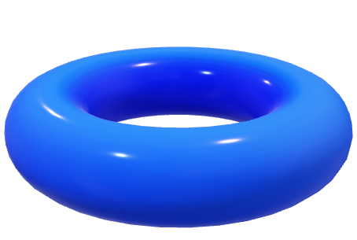
Why is Augmented Reality helpful?
Move!
2 m
1,2 m
Notes:
AR can help here
What if: The robot comm. his intent to the human
And likewise, the human tells the robot what he wants to do,
The other can react

Slide 7




AR Development is challenging
Responsible person: domain specific knowledge but no AR-Development skills
Time consuming
Expensive
Notes:
Thing is: Not easy!
Responsible Person not AR specialist
Time consuming
Expensive
Both are not things that companies can typically afford
This is the topic of my thesis: Mitigate the challenges in industrial AR development

Slide 8
Table of Contents
Introduction
State of the Art
Requirements
Concept
Implementation
Evaluation
Conclusion
Notes:
No what has been done?

Slide 9


What has been done?
PARRHI (this thesis)
Parametrised Thinking
No existing standards for AR-HR Interfaces [Perey, Engelke, and C. Reed.,1]
AR in use for Robotics during development, testing and operation [Hoenig et al., 2]
AR helps for Robot Human Communication [Milgram et al., 3]
Parametric Design in other disciplines [Stavric and Marina, 4]
Notes:
Four core technologies
AR – old. But no existing standards for robot communication
Robot + Machine: Topic of the last 5-10 years, proven to benefit during development, testing % operation of r
Proven that AR helps H&R communication through intent and context
Separate, sth called parametrized thinking -> recent years popular in architecture e.g.
Enables expression of param. & rules, that together define encode and clarify . relationship betw. Intent and response

Slide 10
Table of Contents
Introduction
State of the Art
Requirements
Concept
Implementation
Evaluation
Conclusion

Slide 11

Who is the User of the PARRHI Framework?
Employees in roles like:
Application engineers
Plant operators
…
Technical background
No AR development experience
Little to no software engineering experience
Notes:
Who would is responsible?
In roles like: Application engineer or plant operators
Most strong Tech backgr.
No AR dev exp, or
Even no SE skills
Guy that would develop with the PARRHI framework

Slide 12



Example Use Case
Agile factory with many production lines
Increase safety and efficiency of collaborative processes of human and machines
Application engineer develops an AR application:
Visualize danger zones around machines
Communicate the machine’s intent to the human
Stop the machine if the human is in danger
Notes:
For the bigger picture:
In introduction mentioned: agile factory, many production lines
Better collab of Mind+Machine
App engineer tasked to develop ar application

Slide 13

PARRHI framework requirements:
Handle all AR components and challenges without dev input
Allow simple and intuitive development
Allow the definition of 2D/3D objects and logic operators using parameters
Sensing and commanding of the robot’s position
Notes:
PARRHI requ
Since dev no AR exp, the framework handles everything from imagetracking to gestures
Intuitive dev
Allow variety of workflows: define 2d/3d objects/holograms, and logic operators for workflows
Communicate with robots
Combine Real and Augmented World data. Danger perimeter arbitrary area – should be included in the workflow

Slide 14
Table of Contents
Introduction
State of the Art
Requirements
Concept
Implementation
Evaluation
Conclusion

Slide 15


PARRHI concept:
1
Real-World
0
Real World Model
Input Module
Robot
User
Developer
2
Parametrised Program
6
7
Validation
8
Core Routine
AR - World
Output Module
3
4
5
Notes:
Left hand side: Developer that produces a document, which encodes the workflow, feel and look of the application. Domain specific knowledge
Produced doc is validated, bevore access to parrhi
-> Called “Parametrised program” since written w/ placeholders (parameters).
Two types of parameters
Provided by framework
Other object
framework param? -> Input module, Model
Core Routing, Output Module, AR-RealWorld changes reflechted in the next cycle, PP updated

Slide 16


PARRHI concept:
1
Real-World
0
Real World Model
Input Module
Robot
User
Developer
2
Parametrised Program
6
7
Validation
8
Core Routine
AR - World
Output Module
3
4
5
Notes:
Focus on PP bc core component,
Everything else also topic of thesis and also very workintensive. Conceptually not that important

Slide 17
Parametrised Program:
2
Parametrised Program
Points
Holograms
Define
Include
Manipulate
Triggers
DinstanceTr.
…
Actions
- AR World
- Real World
Invoke
Command Robot
Notes:
Points: Different kind of points: Important: Disclose 3D data to the public.
Some are parametrized with the robot’s data, some by fix values

Slide 18
Table of Contents
Introduction
State of the Art
Requirements
Concept
Implementation
Evaluation
Conclusion

Slide 19
Implementation Software:
Unity
PARRHI library
Robot Library
Implements the PARRHI framework
C#, .NET framework v4.6.1
Robot Communication
C#, .NET framework v4.6.1
2D/3D Game Engine
Hosts the other libraries

Slide 20
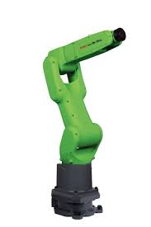
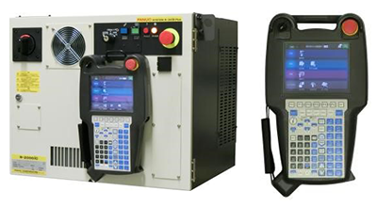
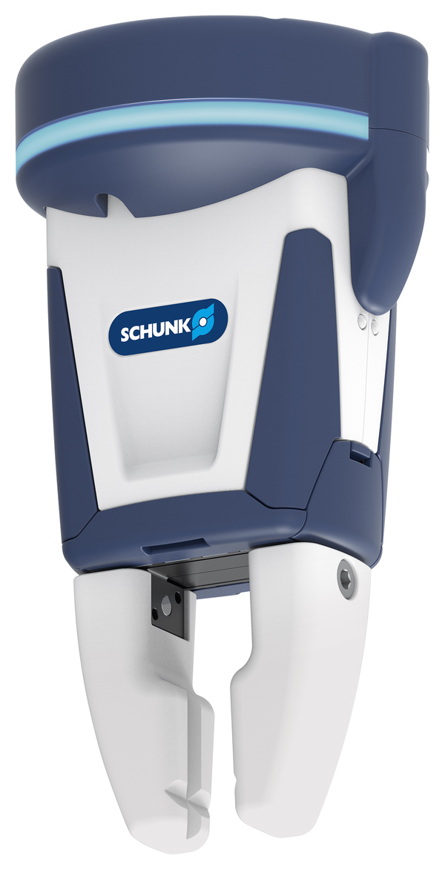
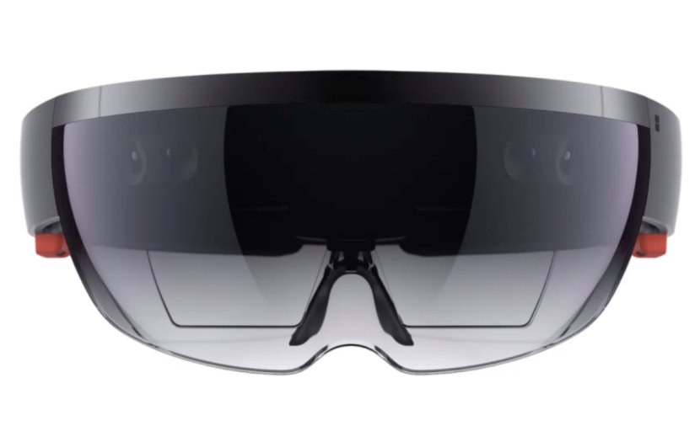
Implementation Hardware:
CR-7iA/L – 6 DOF Robot
R-30iB Controller
Microsoft HoloLens
Schunk Co-act EGP-C
Notes:
State of the Art technology

Slide 21
Parametrised Program Implementation
01. <PProgram xmlns="PARRHI">
02. <Points>
03. <PointFix name="ConstPoint" X="200" Y="-300" Z="300" />
04. <PointRobot name="RobotTip" J1=“5" J2=“6" Scale=“1" />
05. </Points>
06. <Holograms>
07. <Sphere name="Sphere" point="RobotTip" radius="25"/>
08. </Holograms>
09. <Events>
10. <Trigger>
11. <DistanceTrigger name="DTrigger" point1="ConstPoint" point2="RobotTip" distance="15.5" actions=“Action1 Action2 Action3"/>
12. </Trigger>
13. <Actions>
14. <SetHologramStateAction name=“Action1" offHolograms="Zyl1"/>
15. <ChangeUITextAction name=“Action2" text="Tutorial step nr. 4"/>
16. <MoveRobotAction name=“Action3" target="100 100 100 45 15 0/>
17. </Actions>
18. </Events>
19. </PProgram>

Slide 22
Table of Contents
Introduction
State of the Art
Requirements
Concept
Implementation
Evaluation
Conclusion
Notes:
Two evaluations

Slide 23
Evaluation 1
Manual
PARRHI
Work:
450 lines of C# source code
+ Unity configuration and preparation
Work:
38 lines parametrized program
Pro:
Flexible
Software engineering
Manual work
Pro:
Simpler
Focus on workflow
Con:
Limite
Notes:
First: Use Case defined and programmed it once manually in Unity, and once in the PARRHI system At the start some metrics:
Manual approach Pros, Cons PARRHI Pros, Cons
Großer Teil von einfachen Visualierungen

Slide 24
Evaluation 2
Command User to Start Position
6 participants
5 mechanical engineering students
1 software engineering student
Summary:
20 min introduction
Provided a cheat sheet
Only minor questions answered
42 minutes on average to achieve the task
5 succeeded, 1 failed
[UserPos == StartPos]
Command: Robot Tip to Target Point
[RobTip == TarPoint]
[60 Sec. passed]
Success Msg, Command User to Finish Pos
disable
Fail Msg, Command User to Finish Pos
[UserPos == FinishPos]
Key Feedback:
Overview hard to keep
Custom extensions not possible
Success Message
Notes:
Other people tried the PARRHI system
6 participants
Their task: Write a PP that follows the workflow
Disclaimer: I next them, answer general questions but none concerning params
Avg 42 min, 5/6 succeeded
Not like classical programming -> different styles
Feedback: Overview, Extendability

Slide 25
Table of Contents
Introduction
State of the Art
Requirements
Concept
Implementation
Evaluation
Conclusion

Slide 26
Conclusion
Parametrized Augmented Reality Robot Human Interface (PARRHI): Development framework using a parameterized approach, to create AR Human-Robot collaboration applications.
Future Work:
Thorough evaluation with statistical significance
Re-collect requirements with industry partners
Transfer to other machines for a wider variety of use cases

Slide 27
Sources
C. Perey, T. Engelke, and C. Reed, “Current status of standards for augmented reality”, in Recent Trends of Mobile Collaborative Augmented Reality Systems, Springer, 2011, pp. 21–38
W. Hoenig, C. Milanes, L. Scaria, T. Phan, M. Bolas, and N. Ayanian, “Mixed reality for robotics”, in 2015 IEEE/RSJ International Conference on Intelligent Robots and Systems (IROS), IEEE, 2015, pp. 5382–5387.
P. Milgram, S. Zhai, D. Drascic, and J. Grodski, “Applications of augmented reality for human-robot communication”, in Proceedings of 1993 IEEE/RSJ International Conference on Intelligent Robots and Systems (IROS’93), IEEE, vol. 3, 1993, pp. 1467– 1472.
M. Stavric and O. Marina, “Parametric modeling for advanced architecture”, International journal of applied mathematics and informatics, vol. 5, no. 1, pp. 9–16, 2011
M. Walker, H. Hedayati, J. Lee, and D. Szafir, “Communicating robot motion intent with augmented reality”, in Proceedings of the 2018 ACM/IEEE International Conference on Human-Robot Interaction, ACM, 2018, pp. 316–324
R. S. Magazine. (2018). The grand challenges of science robotics, [Online]. Available: https : / / robotics . sciencemag . org / content / 3 / 14 / eaar7650 (visited on 04/25/2019).
H. J. Baker. (2017). 2018’s software engineering talent shortage — it’s quality, not just quantity, [Online]. Available: https : / / hackernoon . com / 2018s - software - engineering-talent-shortage-its-quality-not-just-quantity-6bdfa366b899 (visited on 04/25/2019).
P. Figueroa, R. Dachselt, and I. Lindt, “A conceptual model and specification language for mixed reality interface components”, in VR 2006, In Proc. of the Workshop “Specification of Mixed Reality User Interfaces: Approaches, Languages, Standardization, 2006, pp. 4–11.

