Slide 1
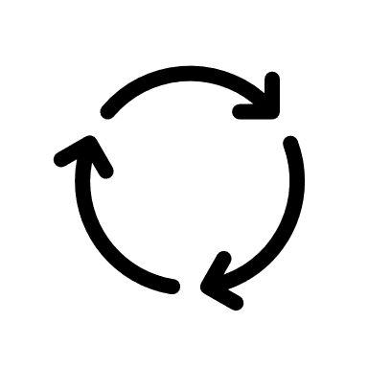
User‘s Input Data
</>
PARRHI
3D Space
Interpreter
Robot
Cycle
Holograms

Slide 2
Input Data
Variables
Points
Holograms
Events

Slide 3
PARRHI
1
0
Real World Model
Input Module
Parametrised Program
Robot
2
Core Routine
Real World
Output Module
3
4
AR - Space

Slide 4



PARRHI
1
0
Real World Model
Input Module
Developer
Real World
Validation
2
Parametrised Program
8
Robot
User
Core Routine
Output Module
6
7
3
4
AR - World
5

