Slide 1

COMP3059 Presentation Ⅱ
Team: T03 Dec.7th 2021

Slide 2




Team T03
Project description Xiaolin Wang
Project demo of Mockup Yoo Kyung Baek, Sunny Arun
Technology Requirements Tan loi Ngo, Ke Wang

Slide 3



Project description
The system we are going to do is not unique. There are already many social networking sites or software widely used in today’s internet. Our team focuses on making our products unique. We will make our own social recruitment website by referring to and absorbing the PROS and CONS of surrounding software.

Slide 4
Project description
Front end: Our system will use JavaScript to implement the specific functions and design of the website, and with CSS to make the website beautiful, the server will be implemented with Node.js and NPM.
Database: System database storage we use SQL to achieve, because SQL is more convenient and more suitable for small and medium-sized website data storage and operation.
Communication: Depending on the requirements of the team, we will also be using the form of GitHub to publish our own system if necessary

Slide 5

Project demo of Mockup
Figma:
https://www.figma.com/proto/PUDeMHzY2vCZiJlRM8iX3a/Untitled?page-id=0%3A1&node-id=2%3A3&viewport=241%2C48%2C0.2&scaling=min-zoom&starting-point-node-id=2%3A3

Slide 6
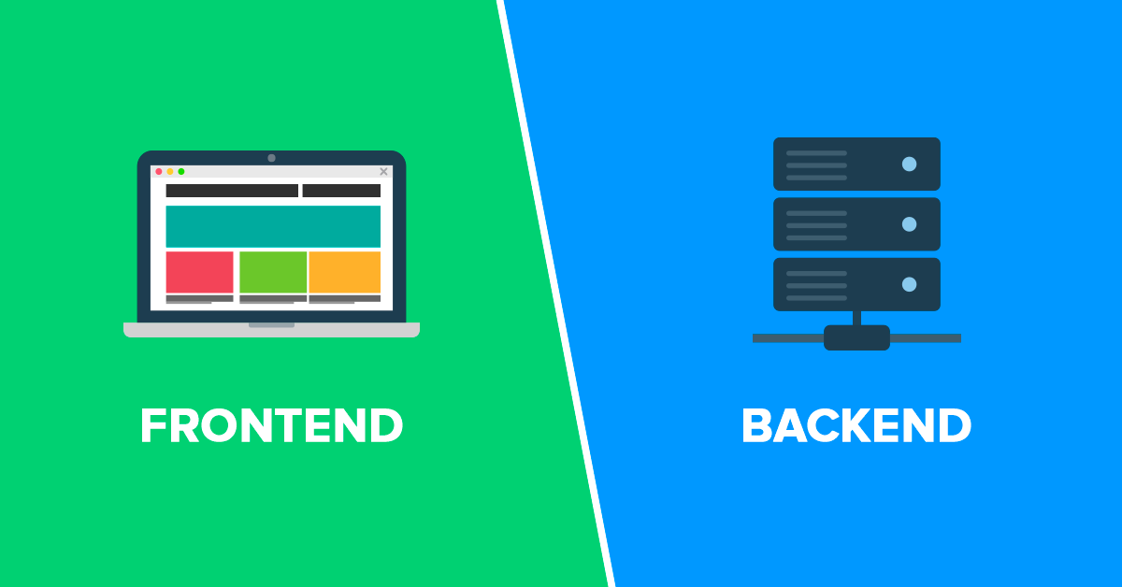
Technology Requirements

Slide 7
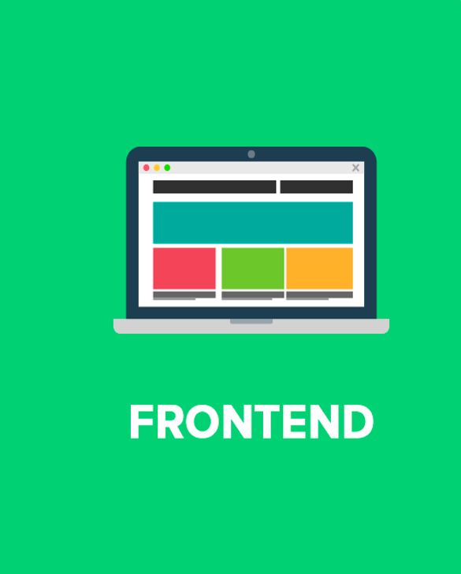
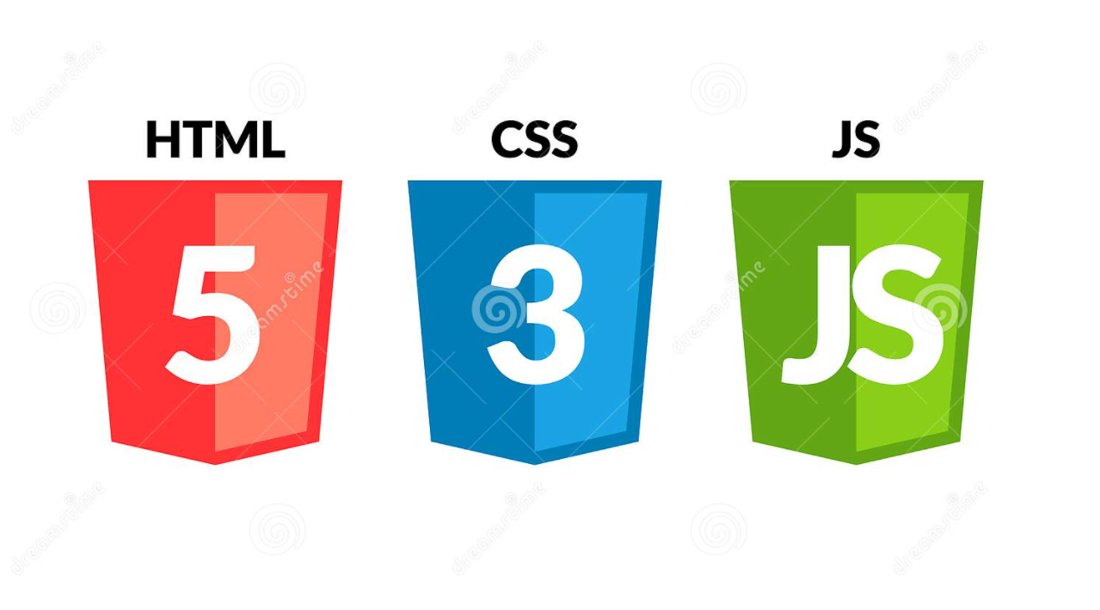

Slide 8
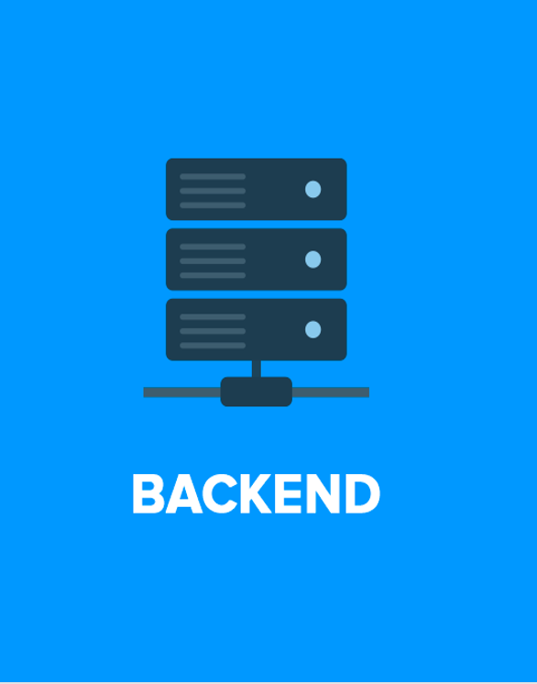


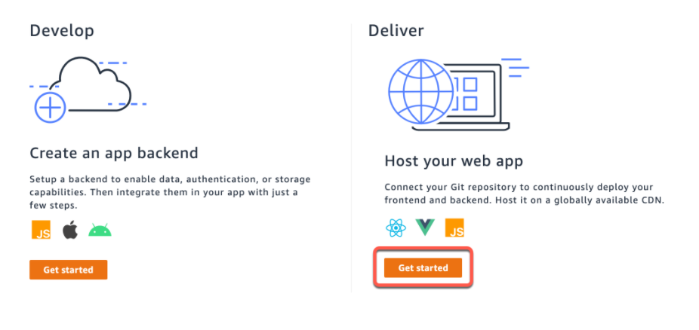

Slide 9
Technology Requirements
 | Pros | Cons
BACK-END: JAVA | Learned in classes Java's security is very high and platform-independent. Java security is very high and platform-independent It supports multi-threading. | Uses a lot of memory Poor performance
Database: MySQL | Easy to install and free, nice tool to write SQL queries. Compatible to run on multiple operating systems. High-security privileges. | Error messages are not well explanatory. Limited in capacity.

Slide 10
Technology Requirements
Framework | Pros | Cons
Spring | Easily access databases Reduce code development time, increase the overall development performance of the whole project. Easily integrate related modules | More complex. Lots of XML.
Bootstrap | Quick and Time-Saving Framework. Cross browser compatible. Good interaction with smartphones and optimal platforms. | Too much redundant code and "kills" the creativity of designers. Can be heavy.

Slide 11


Technology Requirements

Slide 12

Thank you!
Team T03

