Slide 1
Deep Learning for High-Throughput MXene Property
Prediction
Dr. Eric Warnemunde Vertina, PhD Data Science (2025)
9 September, 2025

Slide 2
Why do we need ML/DL methods?

Slide 3
Why do we need ML/DL methods?
MXenes have possibly largest 2D chemical space¹
¹ J. Park et al. Active learning framework for expediting the search of thermodynamically stable MXenes in the extensive chemical space. ACS Nano, 18(43):29678–29688, 2024. PMID: 39401454.

Slide 4
Why do we need ML/DL methods?
MXenes have possibly largest 2D chemical space¹
MXene synthesis remains costly and time-consuming²
¹ J. Park et al. Active learning framework for expediting the search of thermodynamically stable MXenes in the extensive chemical space. ACS Nano, 18(43):29678–29688, 2024. PMID: 39401454.
² B. Anasori and Y. Gogotsi. 2D Metal Carbides and Nitrides (MXenes) Structure, Properties and Applications. Springer, 06 2019.

Slide 5
Why do we need ML/DL methods?
MXenes have possibly largest 2D chemical space¹
MXene synthesis remains costly and time-consuming²
DFT: accurate but too slow for high-throughput predictions³
¹ J. Park et al. Active learning framework for expediting the search of thermodynamically stable MXenes in the extensive chemical space. ACS Nano, 18(43):29678–29688, 2024. PMID: 39401454.
² B. Anasori and Y. Gogotsi. 2D Metal Carbides and Nitrides (MXenes) Structure, Properties and Applications. Springer, 06 2019.
³ H. Bing, O. A. von Lillenfeld, and D. Bakowies. personal communication. 2017.

Slide 6
Why do we need ML/DL methods?
MXenes have possibly largest 2D chemical space¹
MXene synthesis remains costly and time-consuming²
DFT: accurate but too slow for high-throughput predictions³
ML/DL models are great for making very large numbers of predictions quickly
¹ J. Park et al. Active learning framework for expediting the search of thermodynamically stable MXenes in the extensive chemical space. ACS Nano, 18(43):29678–29688, 2024. PMID: 39401454.
² B. Anasori and Y. Gogotsi. 2D Metal Carbides and Nitrides (MXenes) Structure, Properties and Applications. Springer, 06 2019.
³ H. Bing, O. A. von Lillenfeld, and D. Bakowies. personal communication. 2017.

Slide 7
Our contributions

Slide 8
Our contributions
A pipeline to perform high-throughput MXene property predictions with greater accuracy and computationally cheaper inputs than current ML methods

Slide 9
Our contributions
A pipeline to perform high-throughput MXene property predictions with greater accuracy and computationally cheaper inputs than current ML methods
Takes ~1 second to calculate a target property for one MXene
~50,000x faster than DFT

Slide 10
Our contributions
A pipeline to perform high-throughput MXene property predictions with greater accuracy and computationally cheaper inputs than current ML methods
Takes ~1 second to calculate a target property for one MXene
~50,000x faster than DFT
We predict MXene target properties for 13 million unique MXenes

Slide 11
Our contributions
A pipeline to perform high-throughput MXene property predictions with greater accuracy and computationally cheaper inputs than current ML methods
Takes ~1 second to calculate a target property for one MXene
~50,000x faster than DFT
We predict MXene target properties for 13 million unique MXenes
To our knowledge, this is the largest publicly-available dataset of MXenes properties to date

Slide 12
Our contributions
A pipeline to perform high-throughput MXene property predictions with greater accuracy and computationally cheaper inputs than current ML methods
Takes ~1 second to calculate a target property for one MXene
~50,000x faster than DFT
We predict MXene target properties for 13 million unique MXenes
To our knowledge, this is the largest publicly-available dataset of MXenes properties to date
Most extreme predictions found here: https://github.com/EricWarnemundeVertina/Deep-Learning-Methods-for-High-Throughput-MXene-Property-Predictions

Slide 13
High-throughput MXene prediction pipeline
Our pipeline consists of two algorithms:

Slide 14
High-throughput MXene prediction pipeline
Our pipeline consists of two algorithms:
(1) a novel rules-based generative model to generate a large set of unique MXene crystal graph structures (.cif files)

Slide 15
High-throughput MXene prediction pipeline
Our pipeline consists of two algorithms:
(1) a novel rules-based generative model to generate a large set of unique MXene crystal graph structures (.cif files)
(2) a Deep Learning model that takes as input the generated molecular graph structure and outputs predicted properties for the given MXene

Slide 16
“Desired” MXene Properties to predict
Property Name | Property Name (continued)
Band Gap | Magnetic (T/F)
Carrier Density | Metallic (T/F)
Carrier Effective Mass | Optical Absorption Coefficient
Carrier Lifetime | Permeability
Carrier Mobility | Permittivity
Charge Recombination | Poisson’s Ratio
d-Band Center | Reflectivity
Density of States at Fermi Level | Resistivity
Dynamically Stable | Seebeck Coefficient
Elastic Moduli (Bulk, Shear, Young’s) | Sensitivity to Disorder
Elastic Coefficients, c₁₁ and c₁₂ | (Termination) Binding Energy
Energy above Convex Hull | Thermal Conductivity
Electrical Conductivity | THz Range (Transmission)
Heat of Formation | Transmittance
Hole Effective Mass | Work Function
Lattice Constant
Notes:
Here is a list of material properties that I came up with after extensive discussions with project team members

Slide 17
“Desired” MXene Properties to predict
Property Name | Property Name (continued)
Band Gap* | Magnetic (T/F)*
Carrier Density | Metallic (T/F)
Carrier Effective Mass | Optical Absorption Coefficient
Carrier Lifetime | Permeability
Carrier Mobility | Permittivity
Charge Recombination | Poisson’s Ratio*
d-Band Center* | Reflectivity
Density of States at Fermi Level* | Resistivity
Dynamically Stable* | Seebeck Coefficient
Elastic Moduli (Bulk, Shear, Young’s)* | Sensitivity to Disorder
Elastic Coefficients, c₁₁ and c₁₂* | (Termination) Binding Energy*
Electrical Conductivity | Thermal Conductivity
Energy above Convex Hull* | THz Range (Transmission)
Heat of Formation* | Transmittance
Hole Effective Mass | Work Function*
Lattice Constant*
* Indicates sufficient training data found
Notes:
Here is a list of material properties that I came up with after extensive discussions with project team members

Slide 18
“Desired” MXene Properties to predict
Property Name | Property Name (continued)
Band Gap* | Magnetic (T/F)*
Carrier Density | Metallic (T/F)
Carrier Effective Mass | Optical Absorption Coefficient
Carrier Lifetime | Permeability
Carrier Mobility | Permittivity
Charge Recombination | Poisson’s Ratio
d-Band Center* | Reflectivity
Density of States at Fermi Level* | Resistivity
Dynamically Stable* | Seebeck Coefficient
Elastic Moduli (Bulk*, Shear, Young’s) | Sensitivity to Disorder
Elastic Coefficients, c₁₁ and c₁₂ | (Termination) Binding Energy*
Electrical Conductivity | Thermal Conductivity
Energy above Convex Hull | THz Range (Transmission)
Heat of Formation* | Transmittance
Hole Effective Mass | Work Function*
Lattice Constant
* Indicates sufficient training data found and sufficiently accurate GNN models
Notes:
Here is a list of material properties that I came up with after extensive discussions with project team members

Slide 19
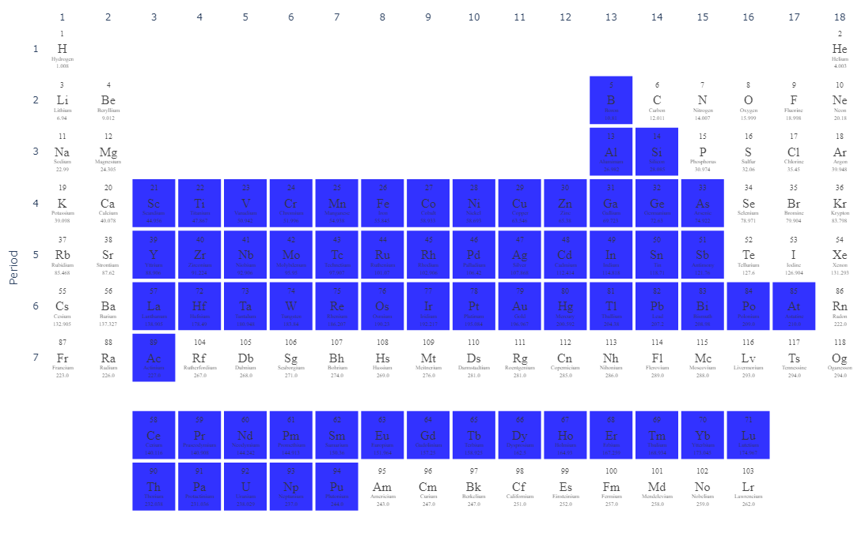
M atoms

Slide 20
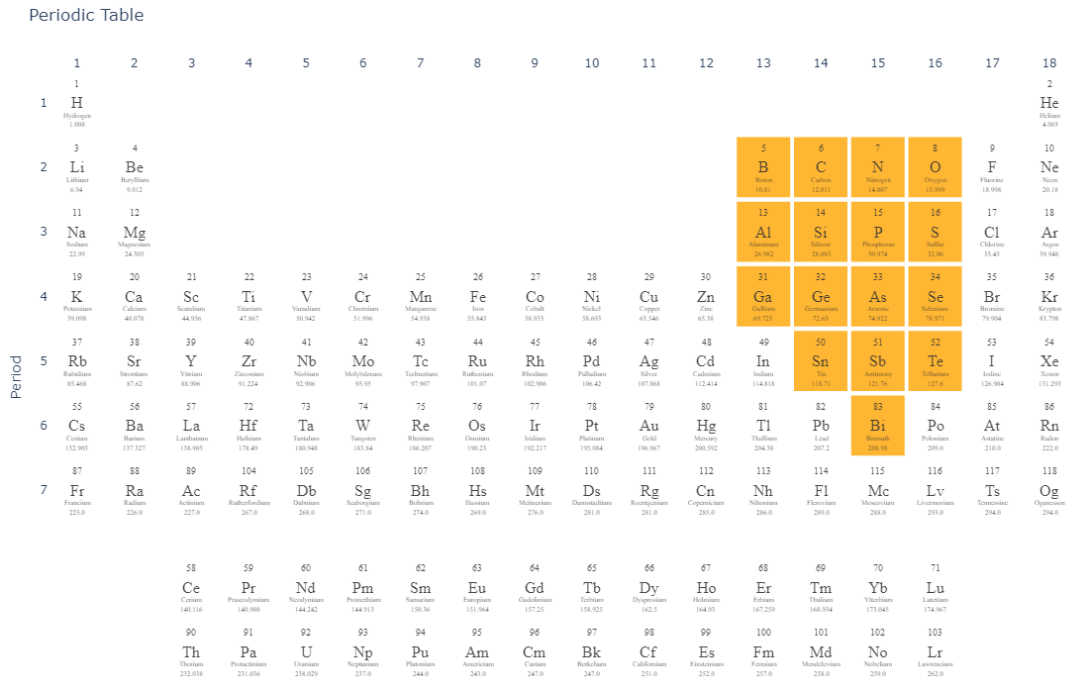
X atoms

Slide 21
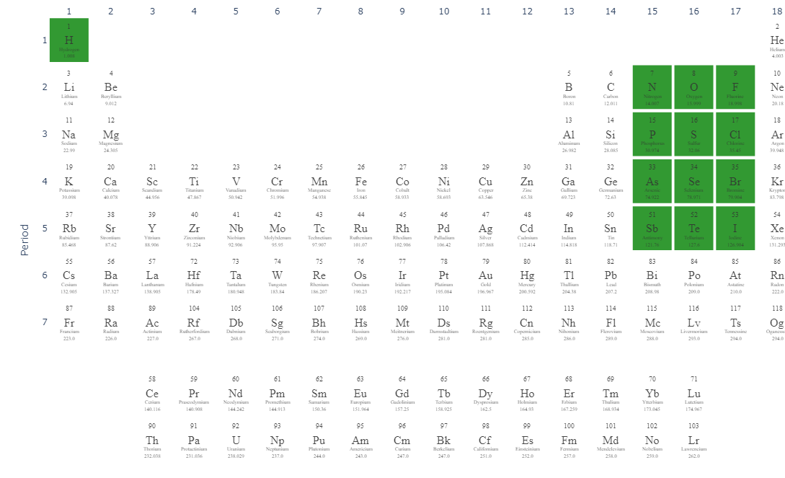
T_{x}

Slide 22
MXene Sample Space Enumeration
n = 9
M = 64
X = 16
T_{x} = 39
# Structure types = 10
A simplified sample space with these possibilities consists of:
90 BILLION MXenes!!!!
And this is vastly simplified!

Slide 23
Reducing this sample space
We sample a subset of these 90 billion MXenes

Slide 24
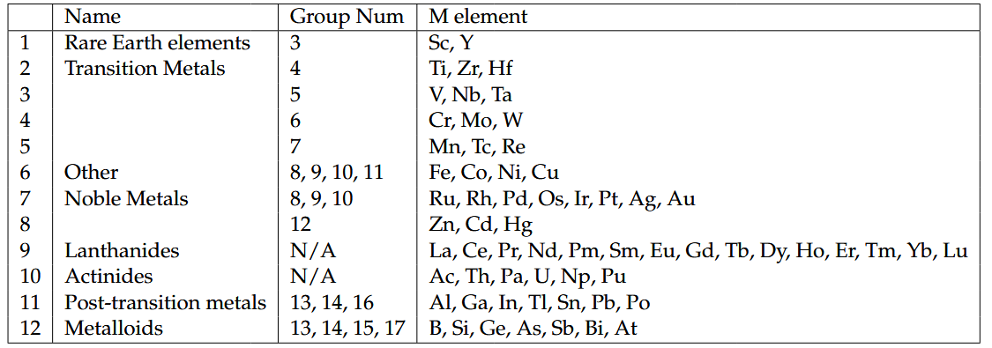
Possible M Elements

Slide 25
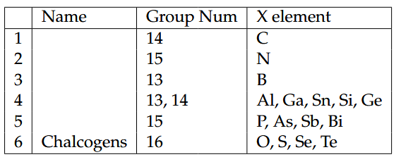
Possible X Elements

Slide 26
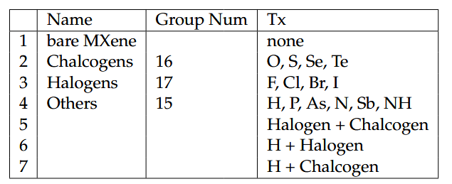
Possible T_{x}

Slide 27
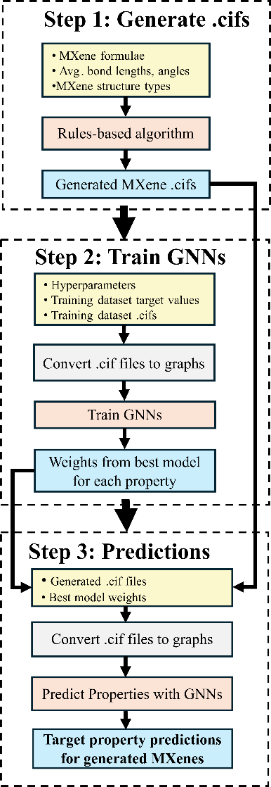
Workflow

Slide 28
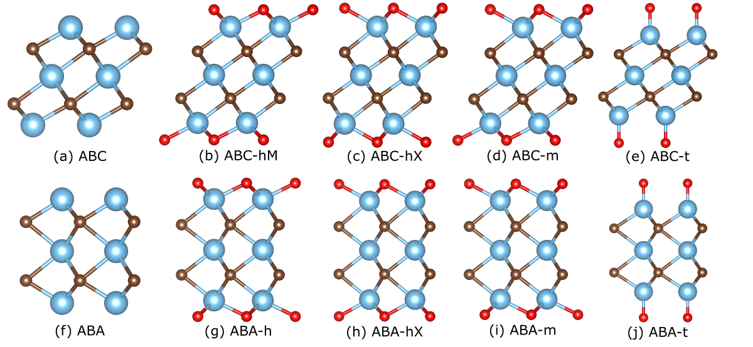
Workflow
10 MXene Structure types

Slide 29
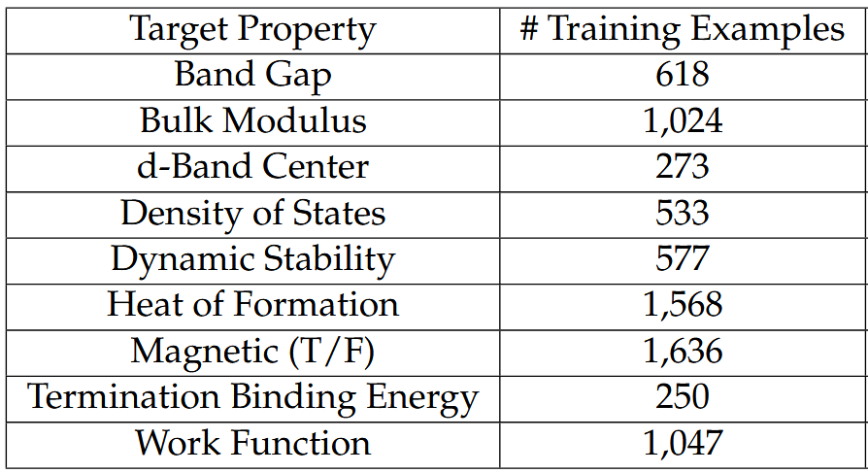
Workflow

Slide 30
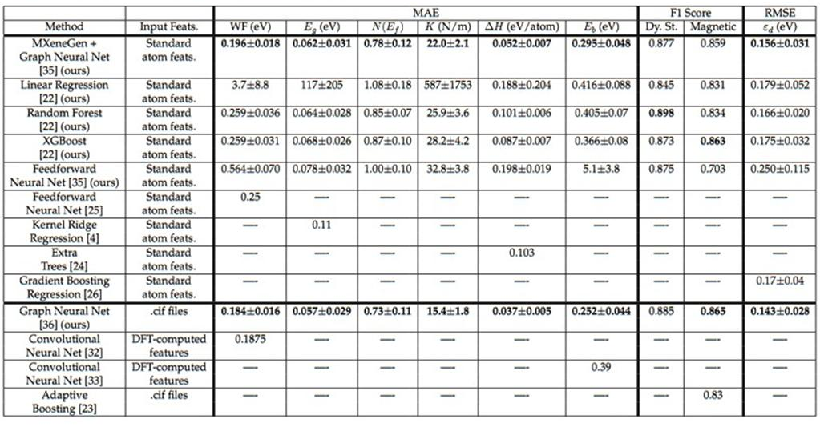
Accuracy of different machine learning models when predicting various MXene properties. The value after the ± symbol denotes the standard deviation, when available. WF denotes Work Function, E_{g} Band Gap, E_{b} Binding Energy, K Bulk Modulus, ε_{d} d-Band Center, N(E_{f}) Density of States at Fermi Level, Dy. St. Dynamically Stable, and ΔH is Heat of Formation.

Slide 31
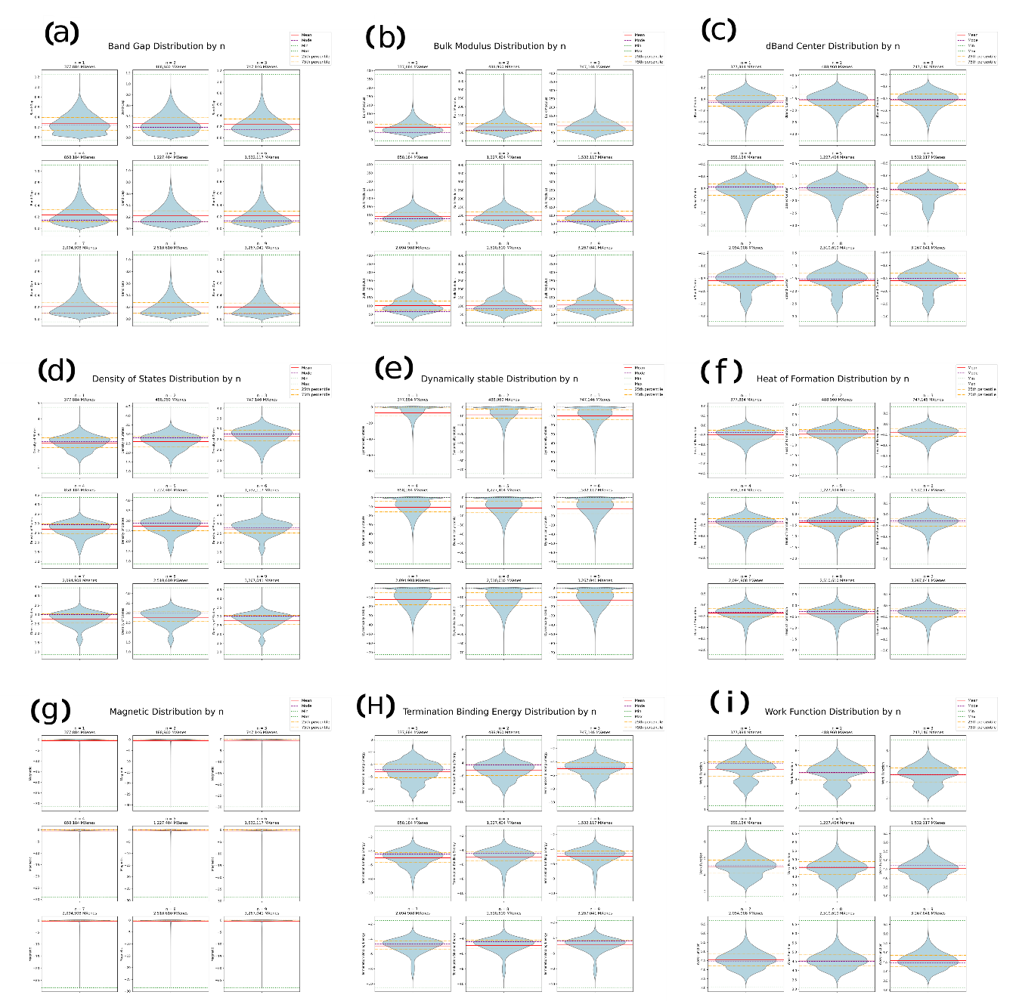

Slide 32
Stability of Generated MXenes

Slide 33
Stability of Generated MXenes
91.2% of generated MXenes (11,954,811) predicted to be dynamically stable¹
¹ Dynamic stability: predicted T/F

Slide 34
Stability of Generated MXenes
91.2% of generated MXenes (11,954,811) predicted to be dynamically stable¹
98.8% of MXenes (12,943,783) predicted to be highly stable by binding energy²
¹ Dynamic stability: predicted T/F
² Thresholds for Binding Energy:
≤ -3.0 eV - highly stable
-3.0 to 0 eV - stable
0 eV - unstable
H. Guo and S. Lee. J. Mater. Chem. A, 13:22730–22744, 2025.
R. Jones and J. Coutinho. In Cor Claeys and Eddy Simoen, editors, Germanium-Based Technologies, pages 187–210. Elsevier, Oxford, 2007.

Slide 35
Stability of Generated MXenes
91.2% of generated MXenes (11,954,811) predicted to be dynamically stable¹
98.8% of MXenes (12,943,783) predicted to be highly stable by binding energy²
92.2% of MXenes (12,091,811) predicted to be stable or highly stable by HoF³
¹ Dynamic stability: predicted T/F
² Thresholds for Binding Energy:
≤ -3.0 eV - highly stable
-3.0 to 0 eV - stable
0 eV - unstable
H. Guo and S. Lee. J. Mater. Chem. A, 13:22730–22744, 2025.
R. Jones and J. Coutinho. In Cor Claeys and Eddy Simoen, editors, Germanium-Based Technologies, pages 187–210. Elsevier, Oxford, 2007.
³ Thresholds for Heat of Formation:
≤ -1.0 eV/atom - highly stable
-1.0 to 0 eV/atom - stable
> 0 eV/atom - unstable
J. Park et al. Phys. Chem. Chem. Phys., 26:10769–10783, 2024.

Slide 36
Stability of Generated MXenes
91.2% of generated MXenes (11,954,811) predicted to be dynamically stable¹
98.8% of MXenes (12,943,783) predicted to be highly stable by binding energy²
92.2% of MXenes (12,091,811) predicted to be stable or highly stable by HoF³
Out of our 13,104,254 generated MXenes, 84.3% of these (11,050359) are predicted to be stable across all 3
¹ Dynamic stability: predicted T/F
² Thresholds for Binding Energy:
≤ -3.0 eV - highly stable
-3.0 to 0 eV - stable
0 eV - unstable
H. Guo and S. Lee. J. Mater. Chem. A, 13:22730–22744, 2025.
R. Jones and J. Coutinho. In Cor Claeys and Eddy Simoen, editors, Germanium-Based Technologies, pages 187–210. Elsevier, Oxford, 2007.
³ Thresholds for Heat of Formation:
≤ -1.0 eV/atom - highly stable
-1.0 to 0 eV/atom - stable
> 0 eV/atom - unstable
J. Park et al. Phys. Chem. Chem. Phys., 26:10769–10783, 2024.

Slide 37
Our contributions
A pipeline to perform high-throughput MXene property predictions with greater accuracy and computationally cheaper inputs than current ML methods
Takes ~1 second to calculate a target property for one MXene
~50,000x faster than DFT
We predict MXene target properties for 13.6 million unique MXenes
To our knowledge, this is the largest publicly-available dataset of MXenes properties to date
Most extreme predictions found here: https://github.com/EricWarnemundeVertina/Deep-Learning-Methods-for-High-Throughput-MXene-Property-Predictions

Slide 38
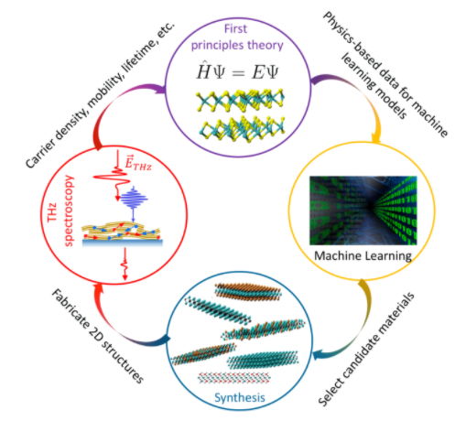
MXene discovery workflow
(1)
This work
(4)
(2)
(3)
Notes:
Go to: https://wp.wpi.edu/cedar/project-accelerating-discovery-and-characterization-of-functional-2d-materials-for-catalysis-and-solar-energy-conversion-using-data-science-methods/

Slide 39


Acknowledgment
I would like to thank:
Professor Oren Mangoubi, my advisor
Dr. Emily Sutherland, former WPI Physics PhD student
Dr. Sajal Chakroborty, WPI Post-Doctoral Scholar
Professor N. Aaron Deskins, WPI Chemical Engineering
Professor Elke Rundensteiner, WPI Data Science and CEDAR project director
Professor Randy Paffenroth, WPI Data Science
Professor Lyubov Titova, WPI Physics
This research was supported in part by the NSF under grant NRT-HDR-2021871
Notes:
Say that Emily and Prof. Deskins were coauthors for the conference paper

Slide 41
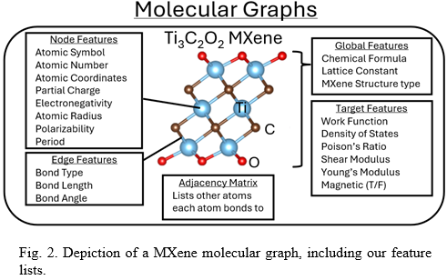
MXene Molecular Graph

Slide 42
Graphs vs Tabular Data
Existing ML methods for MXene property prediction require tabular data – not molecular graph data
Graphs allow more efficient information representation than tabular data
Encode important structural information not captured by tabular data
Graph Neural Networks (GNNs)
Type of neural network which takes graph data as input
Offer a flexible, tunable architecture for material property prediction
P. Reiser et al. Commun Mater 3, 93 (2022).
Y. Zhu, Y. Xu, Q. Liu, and S. Wu. arXiv:2109.01116, 2021.

Slide 43
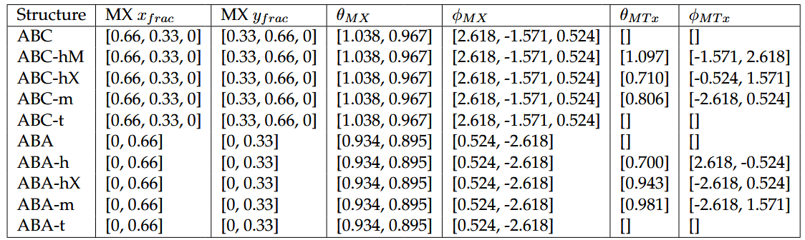
Building a MXene

