Slide 1
PROGRESS UPDATE
Real-world data collection for ASAP on the Unitree G1
Capture pipeline built, first clean dataset collected, calibrated and validated. Eric Xie · 30 July 2026

Slide 2
Why we need this
• ASAP closes the sim-to-real gap by learning a delta-action model from REAL rollouts
• Training that model needs, at every control step:
– joint state and the action the policy actually commanded
– the floating base (pelvis) pose — which the robot cannot measure itself
• The onboard IMU gives orientation but NOT position, so an external reference is required
• Chosen source: Vicon motion capture of a 4-marker cluster on the pelvis
The hard part is not measuring either stream — it is putting them on one trustworthy timeline.

Slide 3
01
What was built

Slide 4
Capture pipeline
• Vicon Nexus streams LABELLED pelvis markers over OSC at 100 Hz
• The robot's Jetson receives them and timestamps on arrival
• rl_sar records state + action at each policy step (~50 Hz) on the SAME machine
• Pelvis pose computed from the markers by a least-squares Umeyama/Kabsch rigid fit
• Streams merged offline by timestamp; pose interpolated to each step's exact instant
Tooling: scripts/vicon/ — osc_listener.py, merge_rollout_vicon.py, clean_dataset.py

Slide 5
The key design decision: one clock
• Both streams are timestamped by the same machine, so only ONE clock exists
• This removes an entire class of problem:
– no NTP / PTP clock synchronisation
– no clock-offset or drift estimation
– no sync event (clap, stomp, shove) to cross-correlate
• Alignment is plain timestamp matching — pose interpolated to the step's own instant
• Unlike a latest-value buffer, dropouts stay visible rather than being silently filled
– with a stale pose, so occluded spans can be excluded instead of trusted

Slide 6
02
Problems found and fixed

Slide 7
1 — Right ankle wind-up destroyed early runs
• Symptom: robot cut power mid-dab, repeatedly (firmware overload protection)
• Traced in the logs to R_ankle_roll being commanded to ~100° against a ~15° joint limit
• Root cause: ankle_roll is an under-constrained action dimension
– planted feet mean it barely affects the tracking reward, so training let it drift
– simulation hides it — joint limits, contact and the force cap absorb the command
– the reference motion asks for 0° ankle roll on both feet, for all 179 frames
• Fixed by a targeted fine-tune penalising commanded targets outside joint limits
A deployment-side action clamp kept collection going until the fine-tune landed.

Slide 8
1 — Result of the ankle fine-tune
 | Before | After
R_ankle_roll commanded | ~100° | 1.7–2.9°
R_ankle_roll torque | ~30 Nm | 0.6–3.5 Nm
Power cuts per session | every run | none
Consecutive dab reps | 0–2, then dead | 30+
Diagnosed from the captured logs and handed to the training side, which produced the fix.

Slide 9
2 — Motion capture kept mislabelling the markers
• Symptom: the pelvis rigid body flipped ~180°, corrupting orientation
• The G1's silver shell throws IR reflections, spawning phantom markers
• The arm occludes pelvis markers during the dab, leaving the solve under-constrained
• Left/right markers sit only ~75 mm apart (vs ~170 mm front/back) — easy to confuse
• Fixed by moving to Nexus and redefining the subject
– Nexus streams LABELLED markers, so identity is fixed and cannot be swapped
– axes defined from the robot's perspective: origin right-back, X forward, Y left
An automatic geometry-based repair was tried first and failed — a 180°-rotated labelling fits a near-symmetric cluster equally well.

Slide 10
3 — Robot kept losing communication
• Symptom: rt/lowstate stopped intermittently; robot needed repeated power cycles
• Network and DDS discovery both looked healthy, which made it hard to see
• Root cause: a second IP subnet had been added to the robot's network interface
– the Jetson then advertised TWO DDS locators
– the robot intermittently sent data to the unreachable one
• Fixed by keeping one address on the interface and giving the Vicon PC an address
– on the robot subnet via a DHCP reservation — 6/6 stability windows afterwards

Slide 11
03
Result

Slide 12
Dataset quality — before vs after the fixes
 | Before | After
Orientation flips | 655 | 0
Mislabelled frames | 17.8% | 0.00%
Markers tracked per frame | dropouts | 4 / 4 always
Rigid-body fit residual | — | 0.40 mm median
Vicon coverage of policy steps | partial | 100%
Same cameras, same robot — the difference is the subject definition and the network fix.

Slide 13
The dataset
• 69 complete dab repetitions — 20,556 transitions, 411 s of dab motion
• Every step carries: action, joint position / velocity / torque, IMU, and pelvis pose
• 100% mocap coverage — no step is missing a base pose
• Nothing dropped: none too short, none after a power cut, no coverage gaps
• Published as a release asset with a dataset card describing schema, quality and caveats
github.com/EricXieQ/rl_sar_g1_deployment — release capture-20260730

Slide 14
Calibration to the robot's own frame
• The Vicon marker frame and the URDF pelvis frame differ by a fixed rotation
• Solved by least squares against the IMU, which is in the URDF frame by definition
• Result: roll +4.51°, pitch +5.99°, yaw −3.71°
• Applying it brings Vicon and IMU orientation into agreement:
– 8.23° median disagreement → 2.63°
• The small offset confirms the marker axes are correctly oriented; it also matches an
– independent hand measurement taken days earlier — a genuine constant, not noise

Slide 15
04
Validation

Slide 16
How we know the data is right
• Vicon and the onboard IMU measure the same motion through completely separate
– physical paths — neither can influence the other, so agreement is real evidence
• Angular velocity: Vicon-derived vs IMU gyroscope → correlation 0.92 (pitch), 0.94 (yaw)
• Gravity, measured two independent ways: +9.727 vs +9.719 m/s² — agree to 0.08%
• Time alignment: cross-correlation peaks at exactly 0 ms — no residual offset
• Repeatability: 69 reps of the same motion overlay to 1.4 mm median spread
Reproduce with reports/validate.py

Slide 17
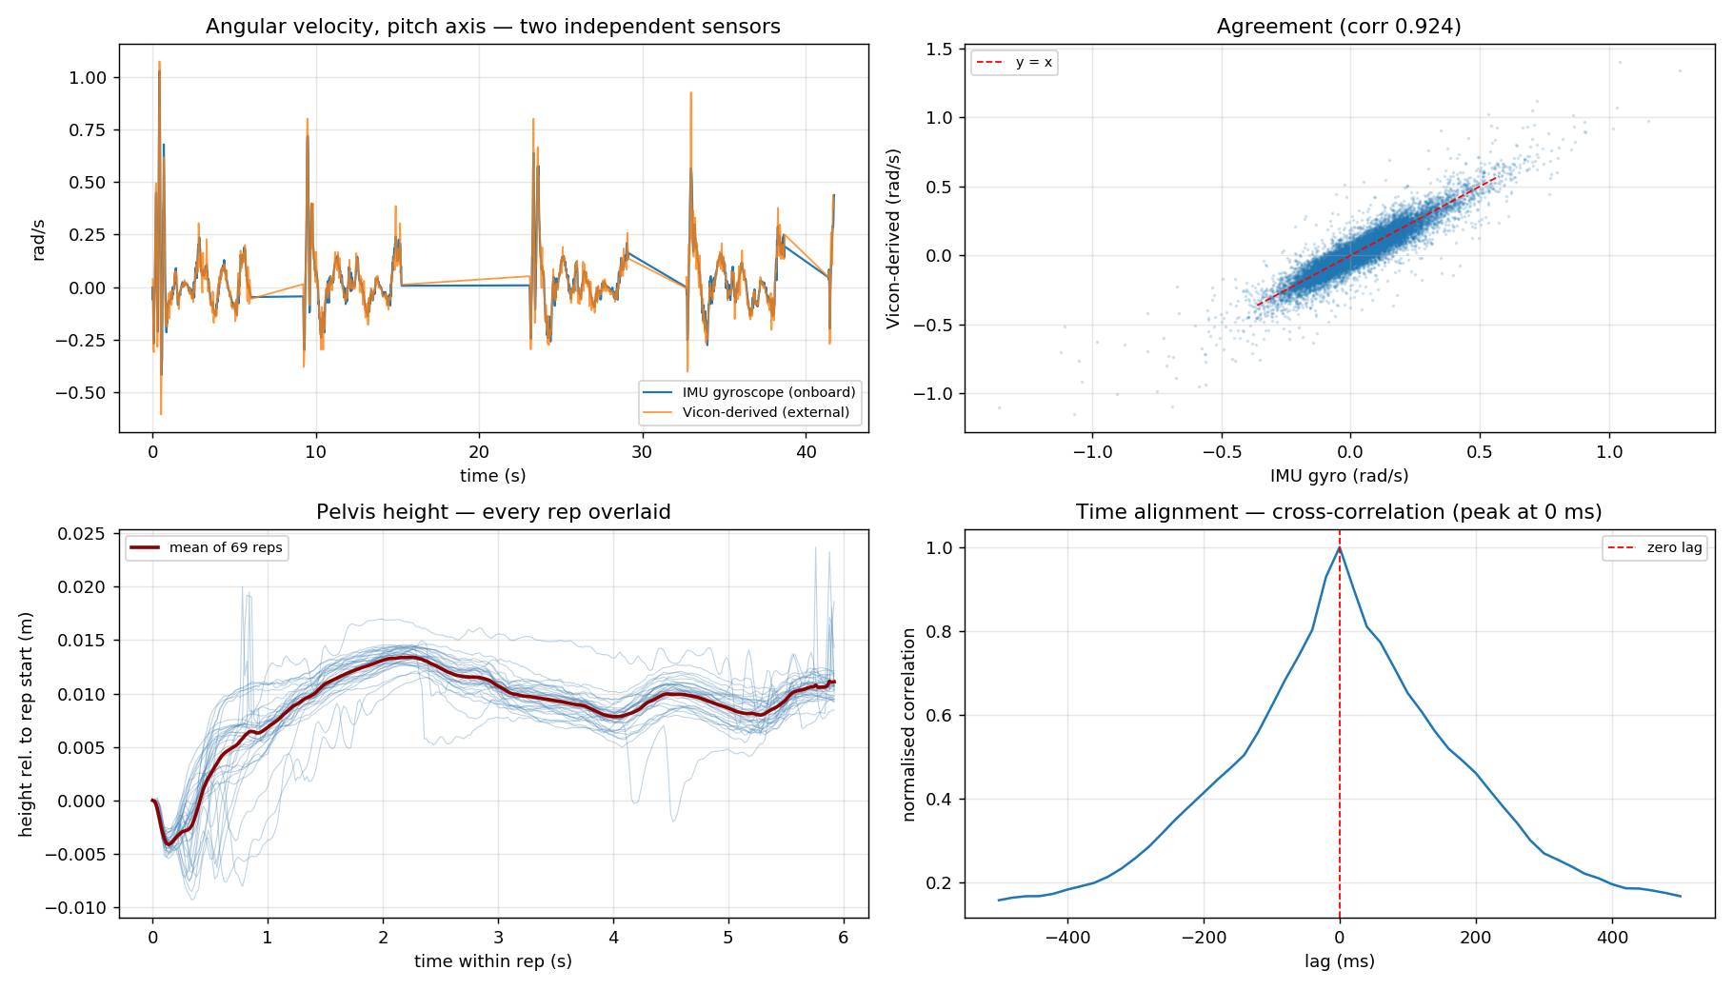
Validation — independent sensor agreement
Top: Vicon-derived angular velocity tracks the IMU gyroscope through fast transients. Bottom left: all 69 reps overlaid. Bottom right: time alignment peaks at zero lag.

Slide 18
What this validation does NOT prove
• Dynamic linear acceleration could not be validated directly
– differentiating position twice at 50 Hz amplifies noise enormously —
– 0.4 mm of position noise becomes ~1 m/s² of spurious acceleration
– so that comparison is noise-dominated (raw correlation 0.11–0.24)
• Position is therefore validated indirectly — via gravity and via repeatability
• The roll axis correlates less well (0.60) simply because the pelvis barely rolls in a dab
– little signal to correlate, not a defect in the measurement
Stated explicitly so the delta-model results are read with the right error bars.

Slide 19
05
Next

Slide 20
Next steps
• Fit the delta-action model on the 69 repetitions and evaluate the corrected simulator
• Fine-tune the policy in the corrected sim and re-deploy
• Collect a second session with deliberate variety rather than more identical reps:
– different positions and headings in the capture volume
– a few repetitions at reduced action scale
– small perturbations, so the model sees off-nominal states
• Open question for the training side: should the reference dab end heading-neutral?
– the robot yaws slightly per repetition — worth a symmetry or yaw-drift term

Slide 21
Known limitations
• Vicon orientation needs the calibration applied; the IMU is already in the URDF frame
• IMU yaw drifts slowly over a long session — roll and pitch are gravity-referenced and do not
• Base velocities are finite-differenced from interpolated pose, so noisier than position
• All 69 repetitions are the same motion from broadly the same place — coverage, not count,
– is what the next session should add
• Only 9 of 20 mocap cameras are currently working, limiting the usable capture volume

