Slide 1
Transaction prediction
CS433.7
Hang Zhu
Changcheng Yuan

Slide 2
CONTENT
01
02
03
04
05
Problem & Data Set
SVM
NN
Result
Code

Slide 3
Problem
Binary classification / prediction
Will a customer buy this product? The data provided are related to the problem. We would use the data provided to predict if a customer would make the transaction or not.
Data Set
The data is about the personal information of the customer and they are all stored as float numbers.
- large dimension
- low connection
Notes:
Simple but rather hard
Important -> better decision allocate resource
Classification -> SVM

Slide 4
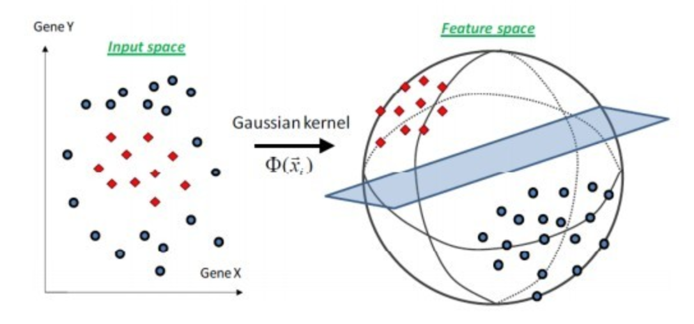
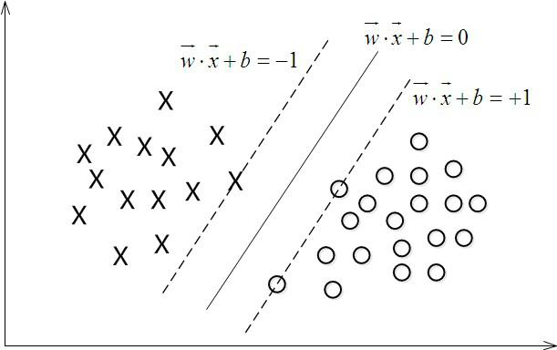
SVM
Basic Idea:
- Separating Hyperplane
- Linear
Non-Linear:
- Apply Kernel
Notes:
Strictly separate
Plot data in higher dimension
Overfit good for easy seperatable data

Slide 5
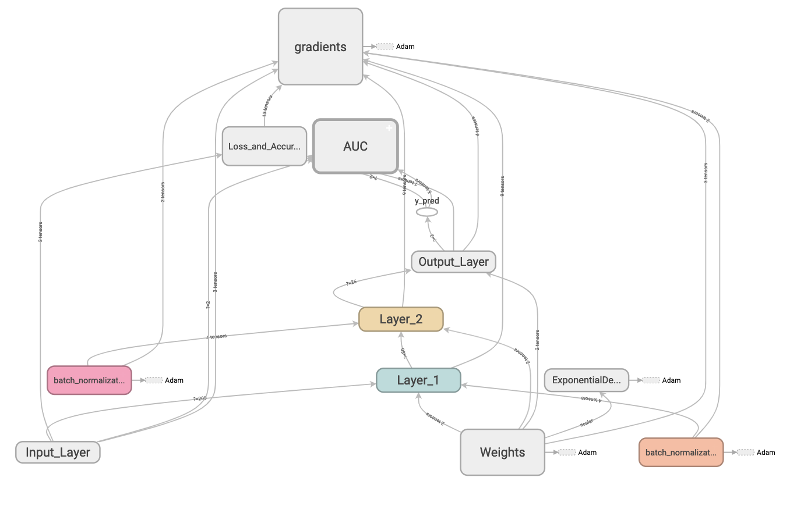
Neural Network

Slide 6
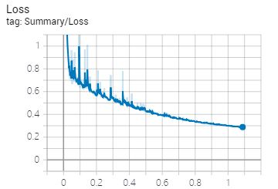
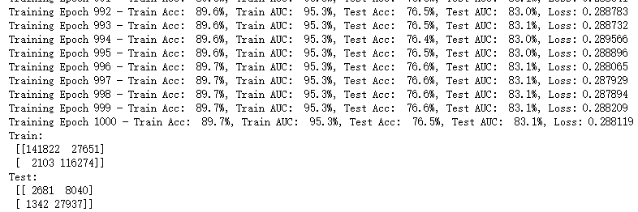
Result
Loss decay
Training AUC: 95.3%
Testing AUC: 83.1.3%

Slide 7
Code

