Slide 1

AOC NewCo | Investment Committee discussion materials
Decision requested: a capped preparation period, released gate by gate on evidence
2026-11-02 | Ruochen Zhang, M.D. | Confidential - internal use only

Slide 2
We ask the IC to approve a capped preparation period that buys three decisions, not a company
/ EXECUTIVE SUMMARY
Conjugates have made muscle reachable for RNA drugs and the market has paid platform prices for that, but the step that decides whether a programme works is still unproven in public. We propose to buy three read-outs before committing to a company.
The opportunity
Antibody-oligonucleotide conjugates turned muscle into a reachable tissue. Novartis paid about USD 12.0 bn for Avidity in February 2026; a second sponsor carries a PDUFA date of 21 January 2027. The modality is proven at tissue entry, not at durable clinical benefit.
The gap we would enter
Public work concentrates on one receptor and a handful of muscle targets. What no one has shown is receptor-dependent productive delivery under free uptake: payload reaching the cytosol of the target cell, measured as such rather than inferred from whole-tissue concentration.
Why WuXi
The group runs the full oligo discovery chain and has delivered 150+ conjugates at five to six weeks' turnaround. What a new company adds is product judgement, patient material, and ownership of rights and primary data.
What we would buy: a written freedom-to-operate opinion on the receptor antibody and backbone chemistry; a productive-delivery judgement under free uptake with a paired patient-cell arm; and an interpretable conjugate with full payload-distribution characterization.
What we are not deciding today: amounts, valuation, ownership, and the choice between the three company configurations. Thresholds can only be set once the target product profile is fixed, so every figure is marked TBD.
Decision requested: approve the preparation period and its five deliverables; release further investment gate by gate on evidence, not on calendar or business milestones.
Source: IC Memo v2; Novartis, Avidity, BMS and Dyne disclosures (2025-2026); team analysis
Notes:
The one page to read if you read nothing else. Lead with the fact that others have de-risked the modality at the tissue-entry level: that is what makes the window real and also what makes it crowded. Our wedge is one layer down. Stress that this is a request for a decision framework, not a cheque.

Slide 3
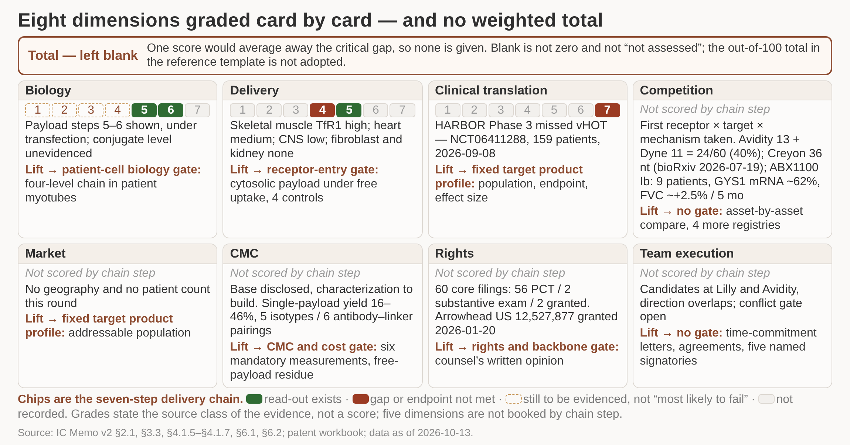
Eight dimensions graded separately on the evidence behind them, with no weighted total
/ EXECUTIVE SUMMARY
Each dimension is graded by the kind of evidence supporting it - measured, disclosed by a third party, or inferred - and carries its own upgrade read-out and owner. No weighted total is given, because a single score would average away the two dimensions that can stop this investment on their own.
1 Rights and delivery are read first
2 Biology is proven at payload level only
3 No positive conjugate clinical record yet
4 Market and team wait on the product profile
DETAIL IN THE MEMO
Per-dimension upgrade read-outs, owners and prerequisite facts are listed in full in the memo
Evidence status by dimension, with the facts that must be settled before any valuation. Total deliberately left blank
Scoring logic: dimensions are graded by evidence type, not by attractiveness. Rights and delivery come first because either can end the case on its own.
If the IC wants an indicative number, the honest version is a pair: high confidence on biology and CMC, low on delivery and rights.
Source: IC Memo v2 (§6.1, §6.2, §4.1.7, §2.1); patent workbook; data as of 2026-10-13
Notes:
The reference template reports a single out-of-100 figure. Here that would hide the fact that two of the eight dimensions rest on inference rather than measurement, so the total stays blank by design - the memo takes the same position. Walk the cards in reading order: rights and delivery, then biology and CMC, then translation, competition, market and team.

Slide 4
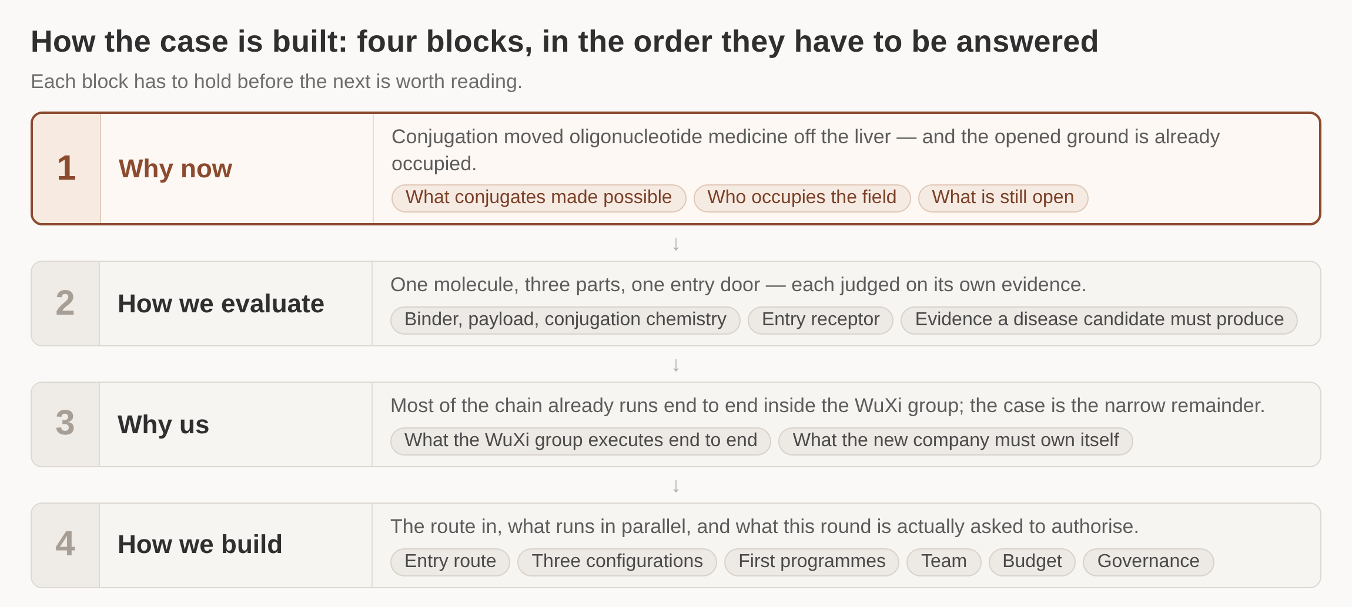
Four questions this material answers, in the order an investment decision needs them
/ EXECUTIVE SUMMARY
Each block is worth discussing only if the one above it held. The material stops at the preparation period: the sections on configuration and funding set out options, not a commitment of capital.
1 Why now: the window and the field
2 How we evaluate: binder, payload, chemistry
3 Why us: what we already execute
4 How we build: route, team, money, gates
The four blocks of this material and what each one settles
Source: IC Memo v2
Notes:
Walk the four blocks top to bottom in about a minute. The order is deliberate. Note that the deck deliberately stops at the preparation period.

Slide 5
1
Why now
What conjugates made possible, who already occupies the field, and which part of the problem is still open

Slide 6
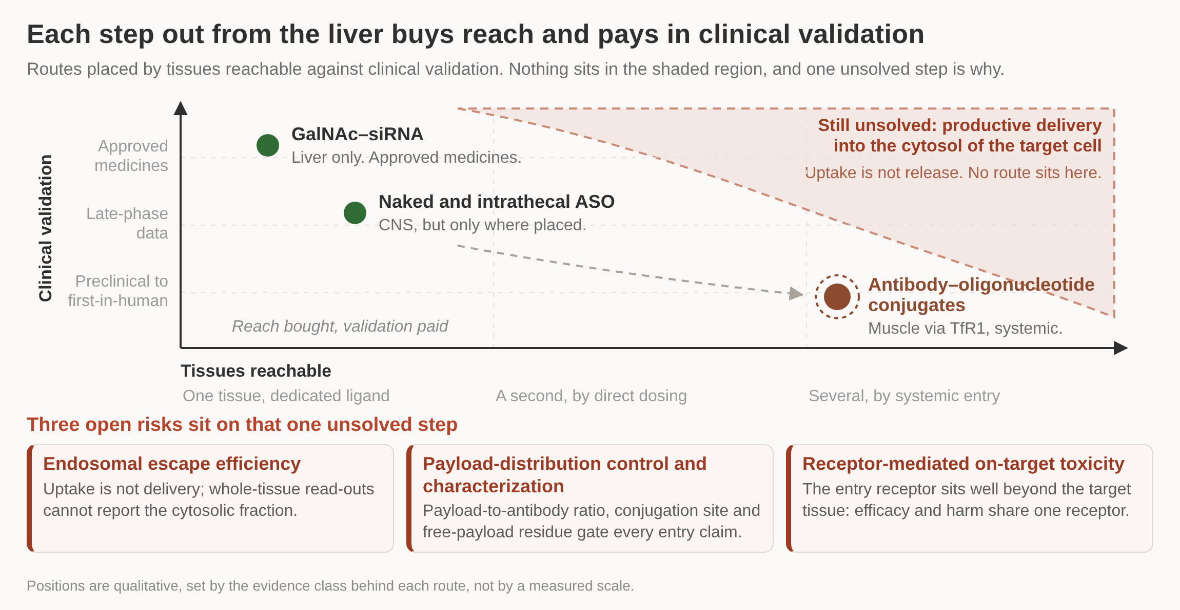
Conjugates moved RNA drugs out of the liver, and the money followed before the biology was finished
/ WHY NOW
Naked and GalNAc oligonucleotides work in the liver and, intrathecally, in the central nervous system. An antibody against a surface receptor extends that reach to muscle, and buyers have paid platform prices for it - while the step that decides efficacy remains unsolved and, in most published work, unmeasured.
1 USD 12.0bn: Novartis for Avidity, Feb 2026
2 USD 2.3bn: BMS deal, up to five targets
3 PDUFA 21 Jan 2027 for the first filing
4 Approved conjugates to date: none
DETAIL IN THE MEMO
Deal terms, trial identifiers and filing dates are listed in the memo's competitive annex
Reachable tissues against clinical validation by delivery approach, with the three risks that remain open
Unresolved across the field: endosomal escape efficiency, control and characterization of payload distribution, and on-target toxicity from receptor-mediated uptake.
These three are exactly where conjugation chemistry and delivery measurement decide the outcome, which is where the group's capability sits.
Source: Novartis, Avidity, BMS and Dyne disclosures (2025-2026); IC Memo v2
Notes:
The point of this page is the mismatch between validation and valuation. Buyers have paid platform prices for assets whose central technical problem is still unsolved. That mismatch is the opportunity: the expensive part of the field is the receptor antibody and the clinical asset; the unsolved part is chemistry and measurement.

Slide 7
Two companies hold most of the clinical field, and both are now past the readout that defines the ceiling
/ WHY NOW
The crowding is specific: one receptor, one tissue. Of 60 conjugate programmes in our search set, 24 belong to these two sponsors, and the Phase 3 miss in myotonic dystrophy says the hard part is no longer getting in - it is choosing a target and an endpoint where getting in produces benefit.
Programme | Target and payload | Stage as of Nov 2026 | What it tells us
Del-desiran | TfR1 antibody, DMPK siRNA | Phase 3, 159 patients, primary endpoint missed Sep 2026 | Tissue entry is not clinical benefit; endpoint choice decides the trial
Del-zota | TfR1 antibody, exon-44 PMO | Filed Jun 2026 under accelerated approval; confirmatory Phase 3 running | Splice correction on a surrogate endpoint is the shortest regulatory route
Z-rostudirsen | TfR1 antibody, exon-51 PMO | Accepted with priority review; action date 21 Jan 2027 | A second sponsor reaching filing on the same receptor and tissue
Z-basivarsen | TfR1 antibody, DMPK ASO | Confirmatory Phase 3 dosing since Jul 2026; cohort reads out Q1 2027 | The myotonic dystrophy question stays open despite the competitor's miss
Early entrants | Backbone-modified and non-TfR1 conjugates | Preprint and preclinical only; no registered trials found | Differentiation is being attempted at the chemistry layer, not the receptor
Our search covers the US registry and a preprint sweep to 2026-11-01; European, Japanese and Chinese registries have not been searched, so this table may understate the field.
Source: company disclosures and ClinicalTrials.gov to 2026-11-01; IC Memo v2 (competition)
Notes:
Three things to draw out. The Phase 3 miss is the most important datum in this deck. Both filings in hand are splice-correction programmes on surrogate endpoints, which is why our first programme is a splice-correction benchmark. And the crowding is specific to one receptor and one tissue, so entry elsewhere is open - but there is no public precedent to lean on either.

Slide 8
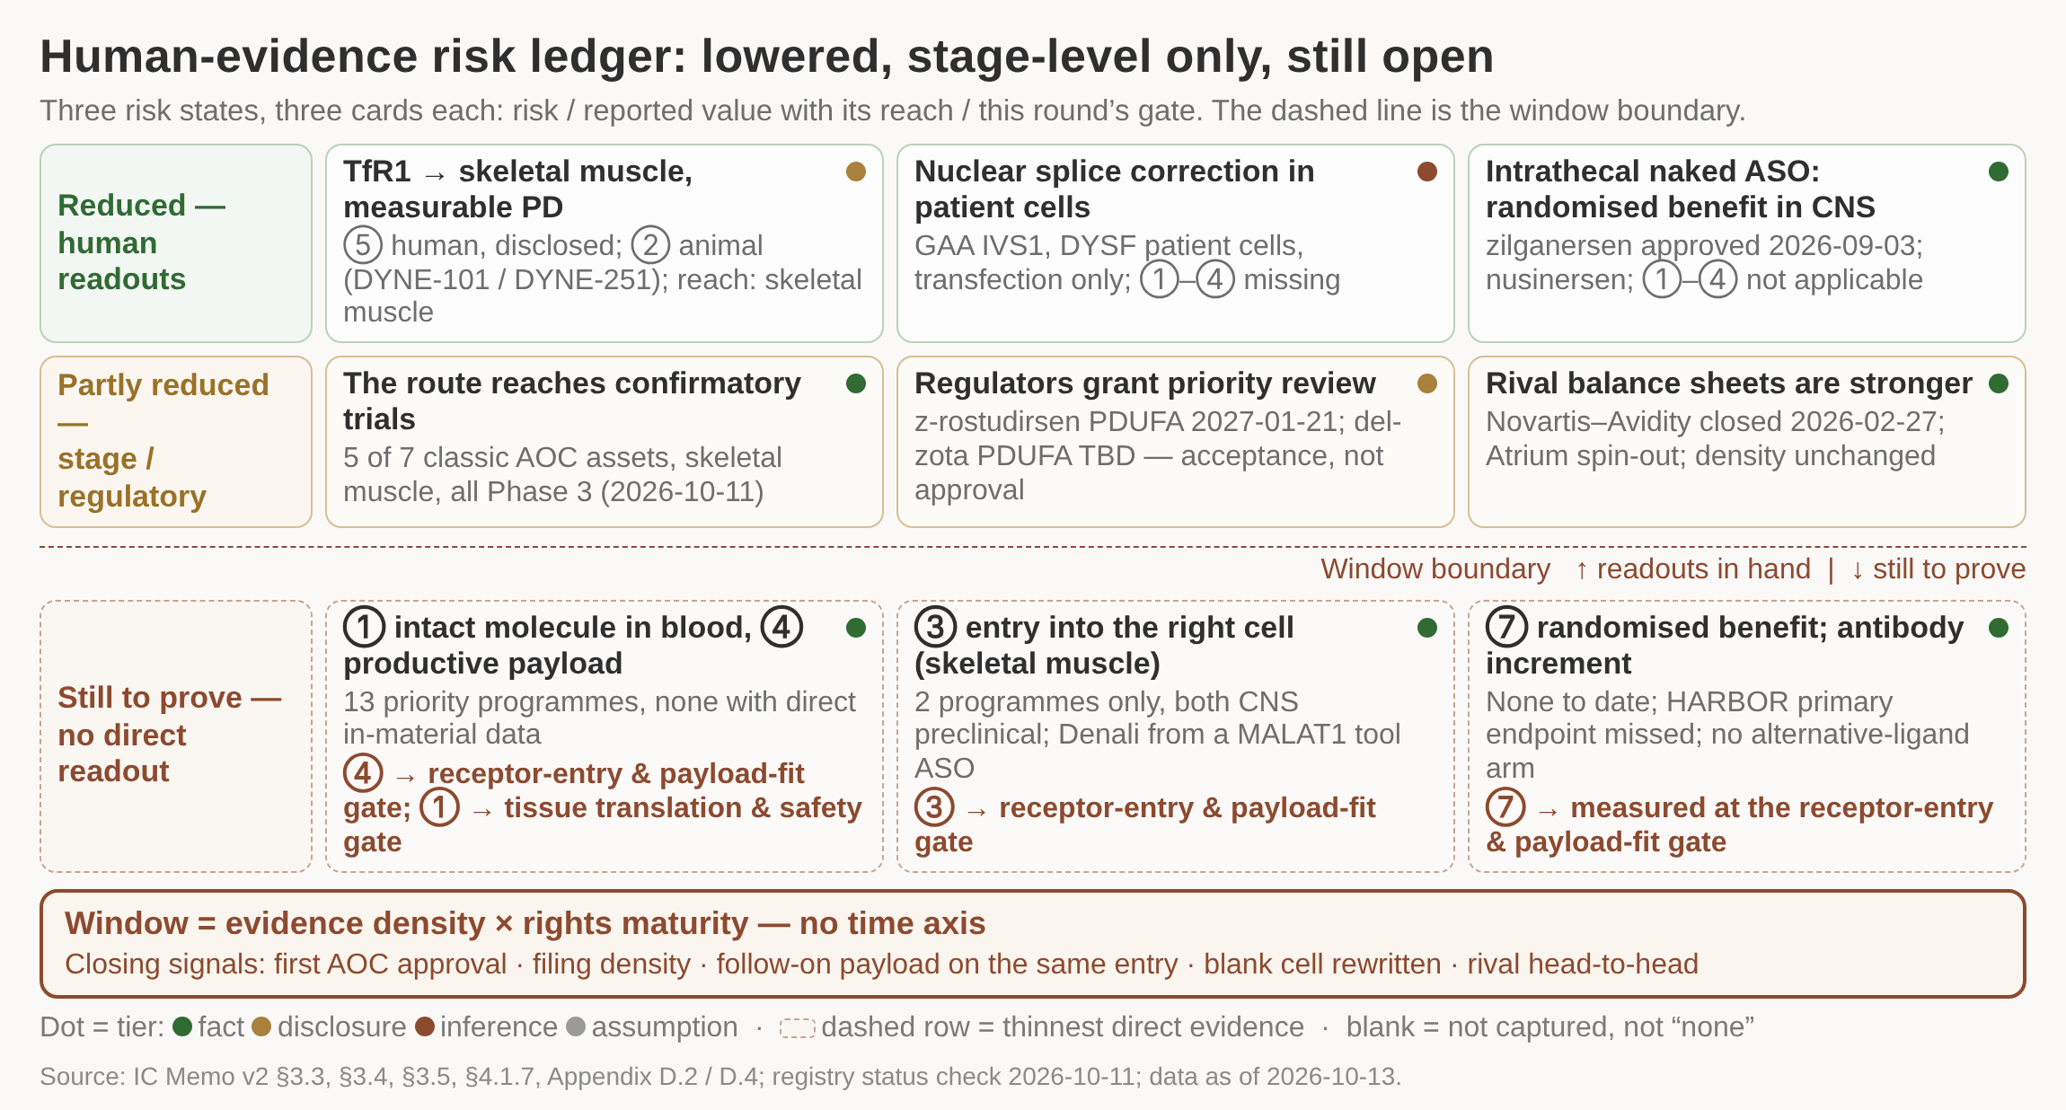
Human evidence de-risks the skeletal-muscle entry; the window is measured by evidence density and rights
/ WHY NOW
The length of the window cannot be predicted but its closing conditions can be monitored: this round secures rights at the payload-sequence and disease-use layers and turns transfection-free functional data on the first two payloads into our own first readouts.
1 Nine cards in three bands: lowered by human readouts, lowered only at stage level, and still to be proven.
2 All three green cards carry human or patient-cell data, but each one's reach is narrow and stated on the card.
3 The amber band is stage and regulatory fact only; none of it is evidence for any single step of the chain.
4 Every card below the dashed boundary carries a named gate, so each open risk has an owner this round.
5 The window has no date: it closes when evidence density or rights maturity moves on five monitored signals.
DETAIL IN THE MEMO
Risks lowered by human evidence: reported value with its reach first, judgement after
Closing signals are reviewed quarterly and reported as order of magnitude, never as a rate
Nine cards in three bands: risks lowered by human readouts, lowered only at stage or regulatory level, and still to be proven.
Registry reads carry status only and no trial results; the check date is 2026-10-11 and no record was re-verified for this deck.
Human PD for TfR1 into skeletal muscle is company-disclosed with details absent from the material; the reach is skeletal muscle, TfR1 and the classic AOC format only.
Two BLA priority reviews are acceptances, not approvals, and no classic AOC has been approved anywhere in this search set.
Source: IC Memo v2 §3.3, §3.4, §3.5, §4.1.7, Appendix D.2/D.4; registry status check 2026-10-11; data as of 2026-10-13
Notes:
Human readouts have lowered three risks, each with a stated reach: TfR1 delivery into skeletal muscle with measurable PD, nuclear splice correction in patient cells, and randomised benefit for the intrathecal naked ASO route in CNS. Phase 3 status, priority review and the Novartis-Avidity deal lower feasibility and regulatory risk but supply no step-level delivery data, so they sit in the middle column and cannot stand as evidence for any one step of the chain. The right-hand column is what this round pays for: intact molecule in blood, entry into the right cell and productive intracellular payload, each with a named gate. The window itself is defined by evidence density times rights maturity, with no time axis and no weighted score. Cut for space: the full five-signal review cadence and the asset-by-asset gap read.

Slide 9
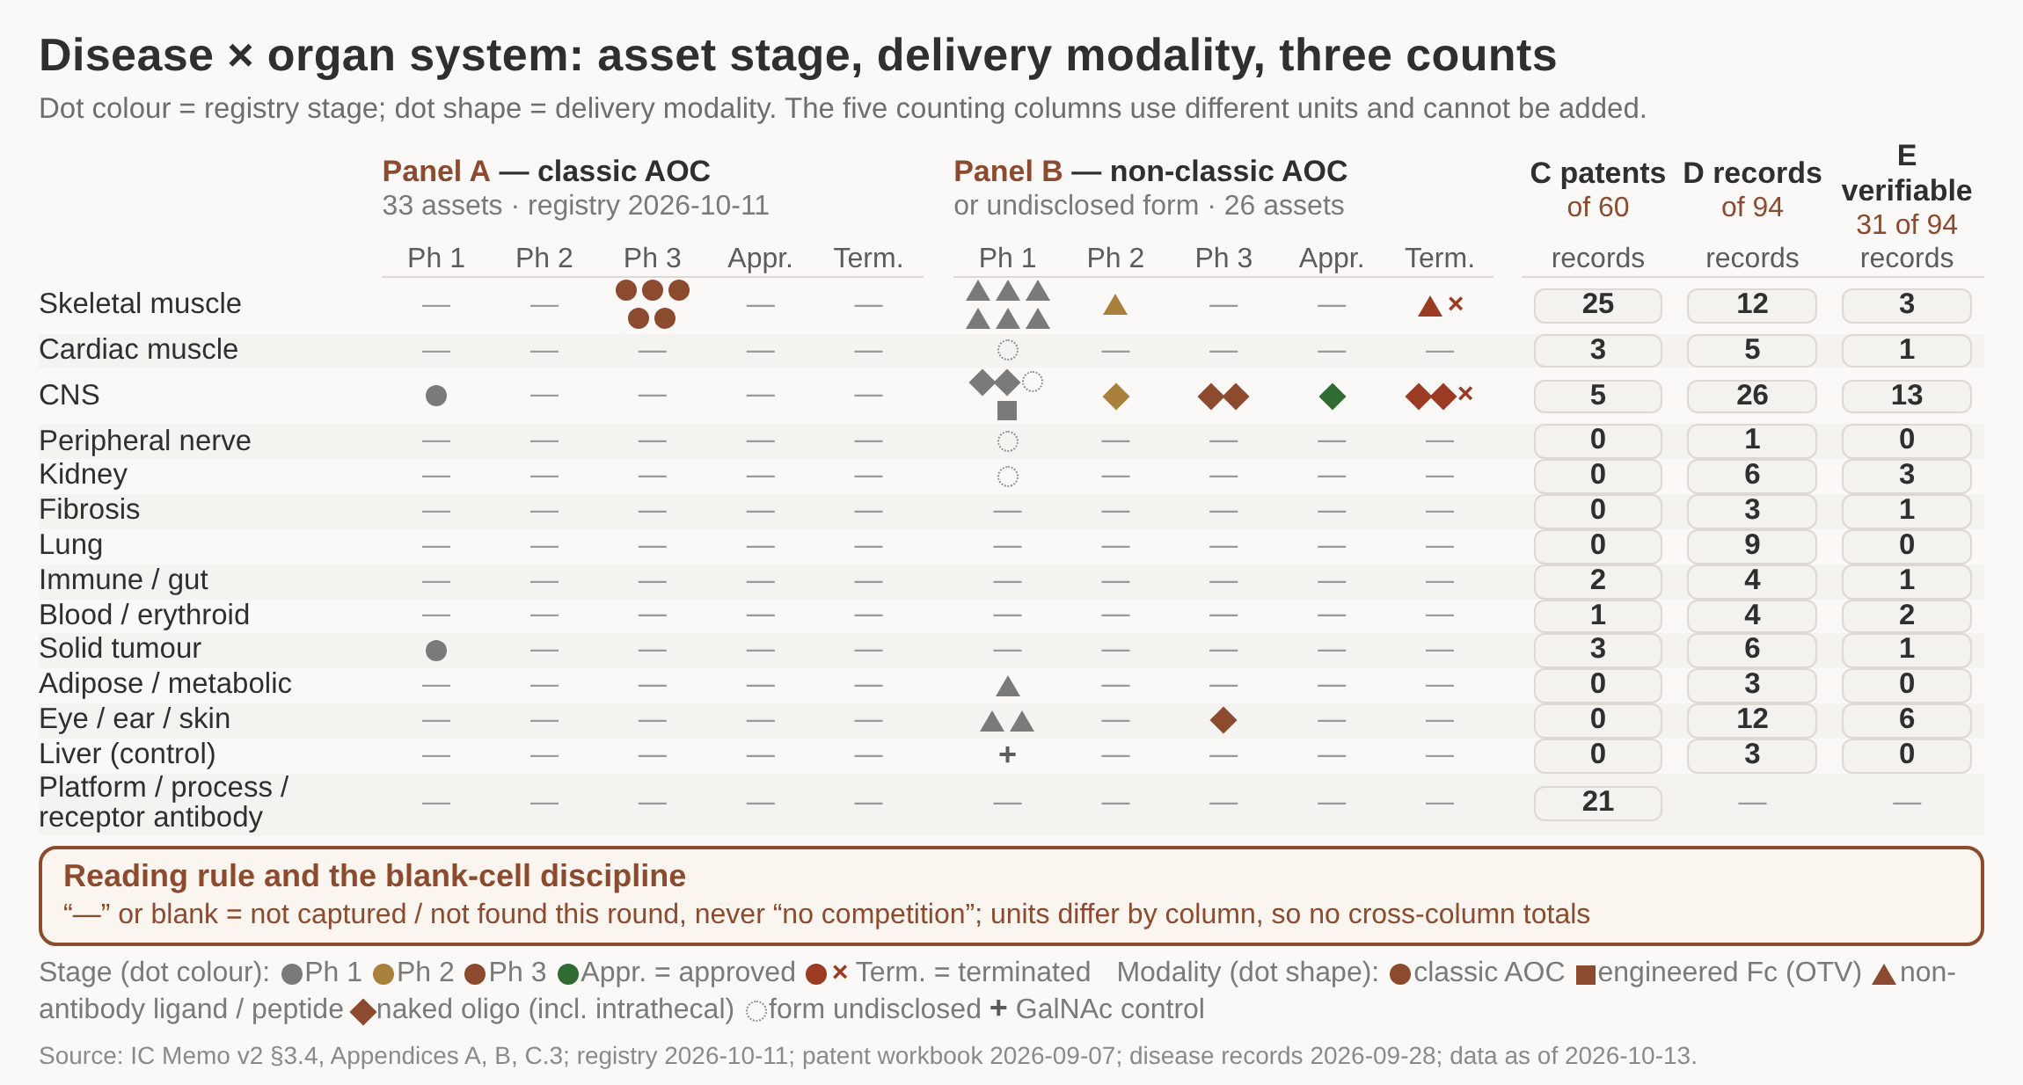
Crowding sits at the delivery entry; the disease layer is read by system and stage against its own denominator
/ WHY NOW
Crowding in AOC is measured in delivery entries and development stages rather than company or disease counts: 7 assets spread across 3 systems while 6 share TfR1, so positioning and the follow-up search list are both generated on the entry and stage axes.
1 Fourteen organ systems against two asset panels and three counts; dot colour is stage, dot shape is modality.
2 All five Phase 3 classic AOC assets sit on one row, skeletal muscle; everything else is Phase 1 or absent.
3 CNS carries the most records and the second-largest patent count but only one classic AOC asset, in Phase 1.
4 The five counting columns use different units and denominators, so no two of them may be added.
5 A dash means not captured or not found this round, never 'no competition here'.
DETAIL IN THE MEMO
Assets 33, patent publications 60, disease records 94, mechanism-verifiable 31 of 94
A '0' means the search set returns zero by definition; a blank means nothing was looked up
Disease x organ system: asset stage shown by dot colour, delivery modality by dot shape, and three counts that cannot be added.
A dash or a blank means not captured or not found this round, which is not the same as 'no competition here'; coverage is representative, not a global picture.
Publication numbers are neither patent families nor granted rights, and column E is broken out for four systems only, covering 25 of 31 records.
'Phase 1' includes Phase 1/2 and 'approved' requires a company announcement corroborated in the registry; CGB1001 is excluded from the figure.
Source: IC Memo v2 §3.4, Appendix A, Appendix B, Appendix C.3; ClinicalTrials.gov check 2026-10-11; patent workbook 2026-09-07; data as of 2026-10-13
Notes:
Every column has its own unit and denominator, so the figure deliberately drops all cross-column totals and any weighted density score. Late-stage activity is concentrated in a single system, skeletal muscle, where all five classic AOC assets sit in Phase 3, while the largest record counts sit in CNS: where the literature is densest is not where assets are most advanced. Blank cells are triaged three ways, as not captured, not found this round, or entry conditions not yet met, and the same entry-by-stage grid generates the follow-up search list. Cut for space: the full five-column statistical-unit table and the per-system record breakdown.

Slide 10
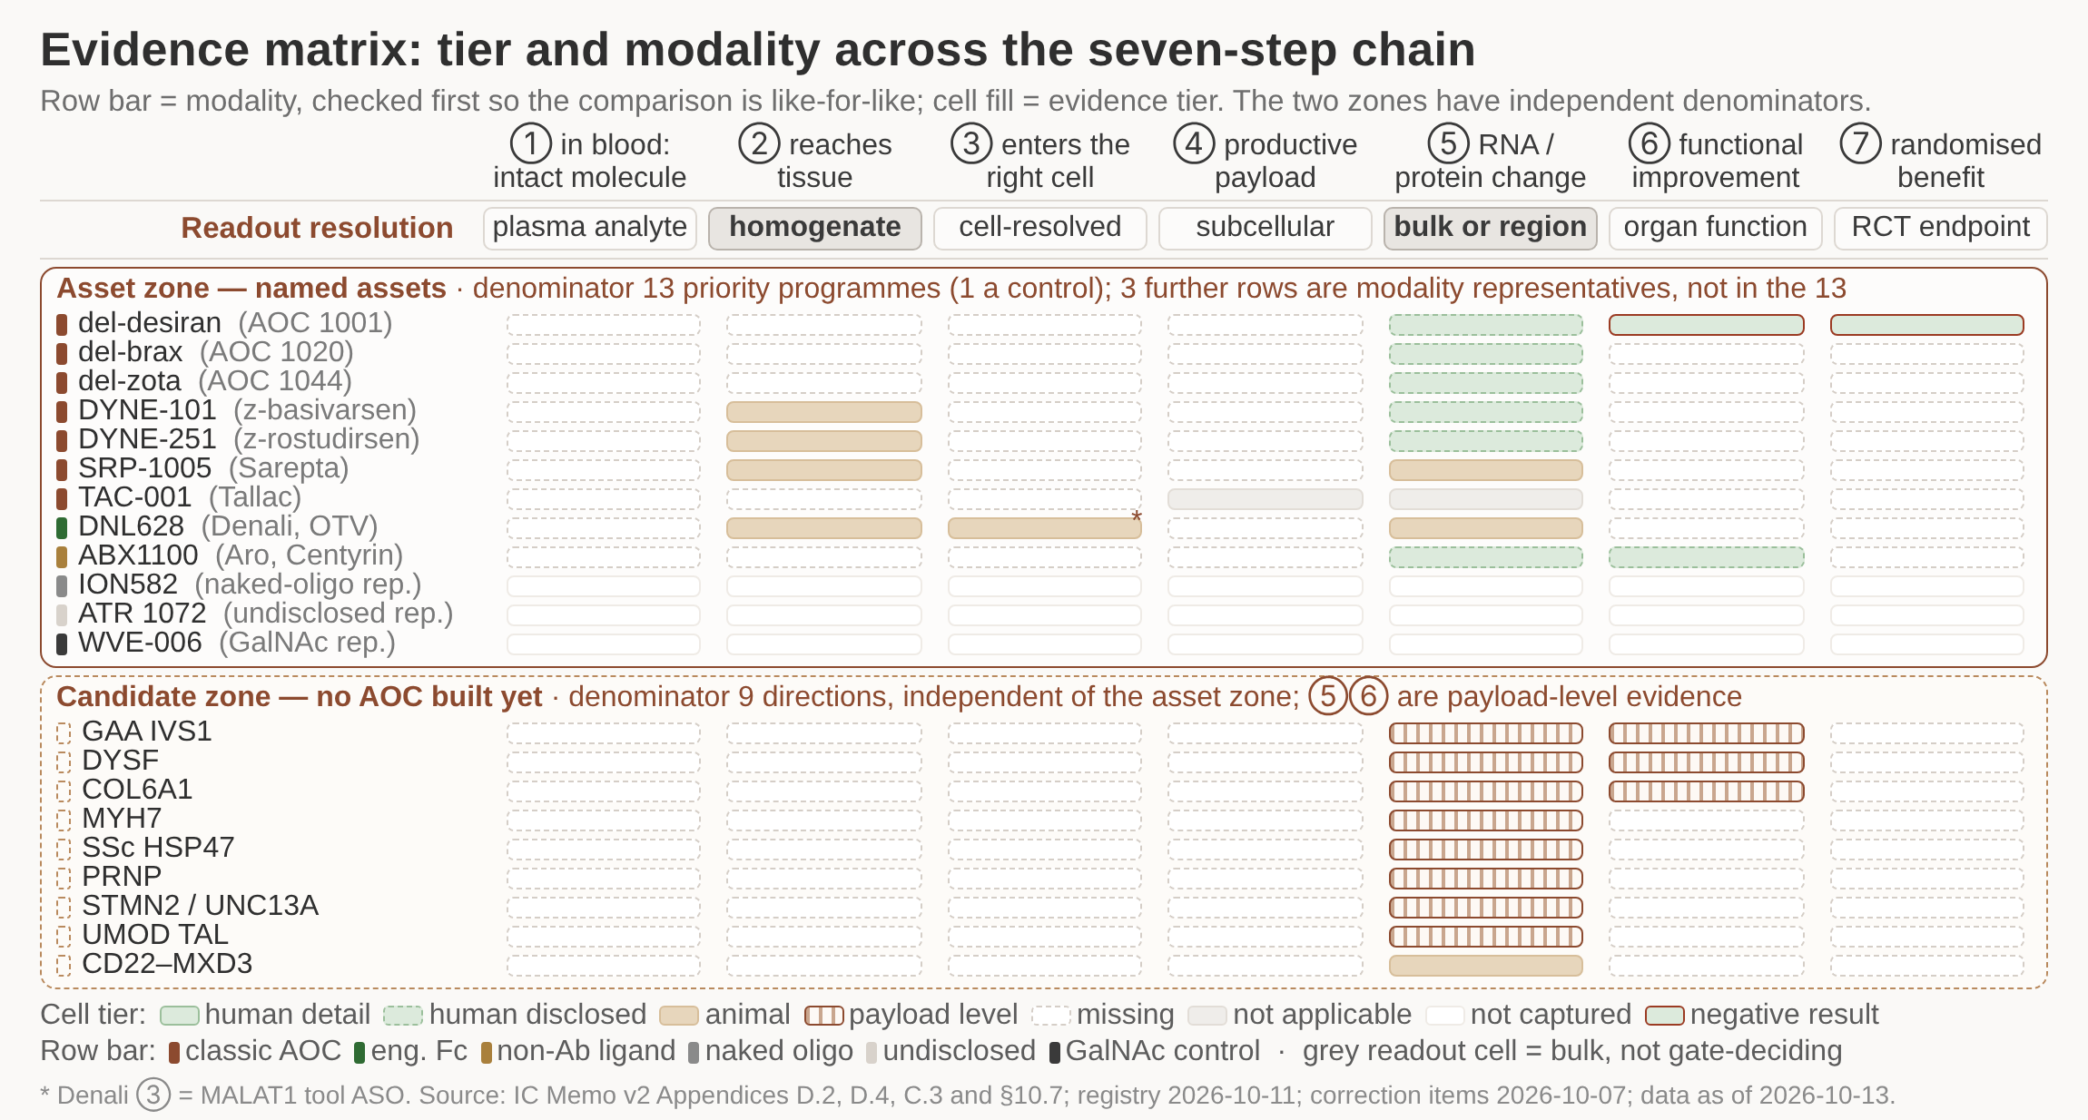
Representative companies split into six modality classes; the antibody's increment is answered asset by asset
/ WHY NOW
Competition sits inside the same target and modality and also across alternative ligands and naked-oligonucleotide routes serving the same patients, so the first proposition moves from 'why AOC over naked oligo' to 'why an antibody over an aptamer', measured at the receptor-entry gate.
1 Twenty-one rows by seven steps: twelve named assets above, nine candidate directions below, separate denominators.
2 Steps 1 and 4 are empty for every asset: no direct in-material data on blood stability or productive payload.
3 What evidence exists clusters in step 5, and most of it is company disclosure rather than published detail.
4 The red frames on del-desiran mark negative results, which is a different state from a missing cell.
5 Candidate rows carry payload-level evidence only; no AOC has been built for any of the nine directions.
DETAIL IN THE MEMO
26 same-disease assets in six delivery classes (check: 26 = 33 - 7)
Three modality representatives are shown but are not counted in the 13 programmes
Evidence tier and modality for 12 named assets and 9 candidate directions across the seven-step chain, under two independent denominators.
Check dates are batched: registry 2026-10-11 and correction items 2026-10-07; the two batches are not merged and no record was re-verified on 2026-11-02.
No classic AOC approval exists in this search set; the two BLA priority reviews, del-zota PDUFA TBD and z-rostudirsen PDUFA 2027-01-21, are acceptances only.
Bulk readouts (tissue homogenate, bulk RNA) do not count toward a gate decision; steps 3 and 4 need cell-level and subcellular resolution before they can be judged.
Source: IC Memo v2 §3.3, §3.5, §4.1.5, §10.7, Appendix C.3, Appendix D.2/D.4; data as of 2026-10-13
Notes:
The competitor table is split into six delivery classes and each asset's configuration is confirmed from three sources, because the comparison is only meaningful inside a class. Not one of the 13 priority programmes has in-material data for intact molecule in blood or for productive intracellular payload, which is the evidential backdrop for treating the step after cell entry as the likeliest failure point. The Denali cell-entry data comes from a MALAT1 tool molecule and is listed apart from the candidate, and HARBOR's failure is not inferred from other programmes on the same platform. Non-antibody ligands set the external benchmark for the antibody increment, and intrathecal naked oligonucleotide is the CNS comparator. Cut for space: the per-asset three-source confirmation log.

Slide 11
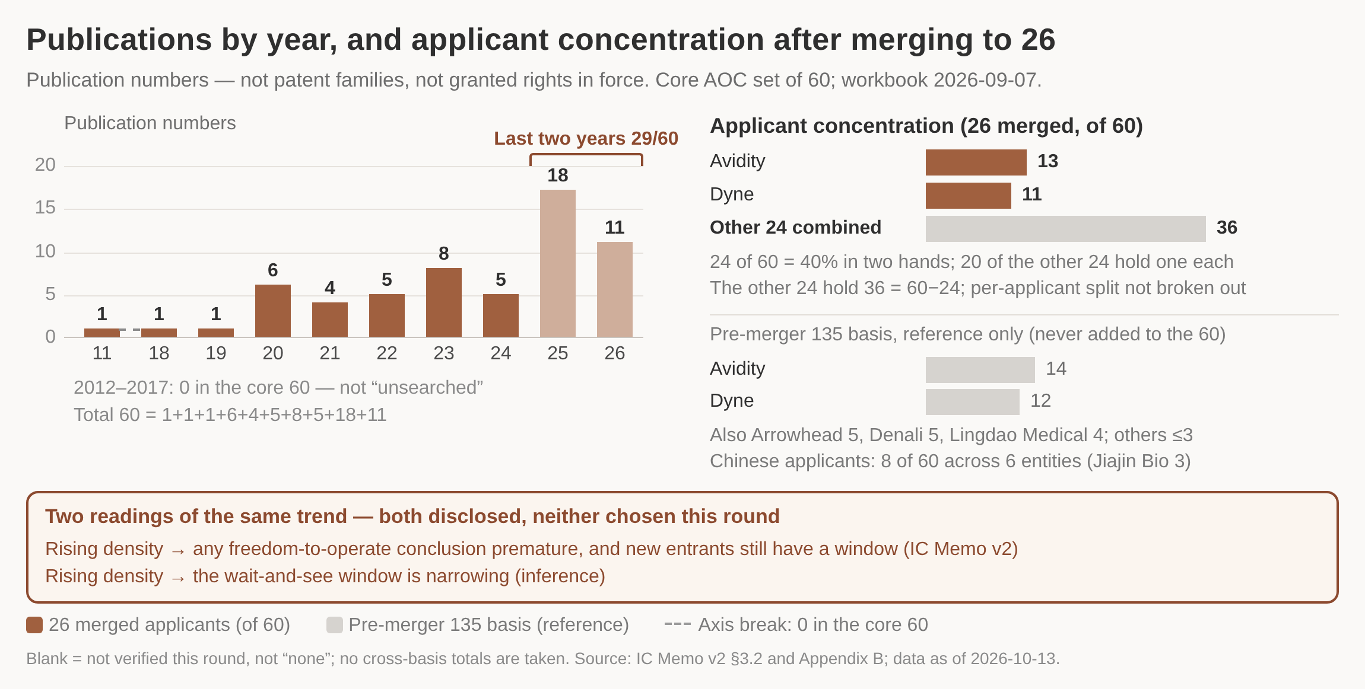
Rights dependency sits in the receptor-antibody layer; the backbone-chemistry path waits on a supplementary search
/ WHY NOW
The layer NewCo can differentiate on is payload sequence and disease use, while the backbone-chemistry layer needs a supplementary search before a path is chosen. Across the four entry paths the decisive costs are commercial terms, data rebuild, receptor-access rebuild and scarce models.
1 29 of the 60 core publications land in 2025-26; nothing in this set before 2018, and the trend is still rising.
2 Avidity 13 and Dyne 11 hold 40% of the 60; 20 of the other 24 applicants hold a single publication each.
3 The two leaders concentrate on TfR1 conjugates, linker chemistry and muscle indications - our own entry layer.
4 Both time-window readings are disclosed side by side: the window is still open, and it is closing.
5 Dependency sits in the receptor-antibody layer; payload sequence and disease use stay differentiable.
DETAIL IN THE MEMO
Three counts kept apart: 135/60 publications, no family counts yet, 2 granted-in-force
Pre-merger 135 basis is reference only and is never added to the 60
Core-60 publication numbers by year, plus the two-leaders-and-long-tail split of the 26 merged applicants; grey = pre-merger basis.
Not a freedom-to-operate opinion: changing epitope or sequence is not automatic design-around, process innovation may not solve FTO, and publication does not imply freedom to operate.
A 'Ceased' status on one WO page says nothing about the whole family, and the counts reflect the search set only, not global filing.
2026 is a partial year and publication lags about 18 months, so the last two years are necessarily understated.
Source: IC Memo v2 §3.1, §3.2, §4.5, Appendix B; core AOC patent workbook 2026-09-07; data as of 2026-10-13
Notes:
Filing density is still rising, and the deck discloses both readings of that fact side by side: it makes any FTO conclusion premature, and it also narrows the wait-and-see window. This round does not choose between them. The pre-merger 135-publication basis (Avidity 14, Dyne 12, Arrowhead 5, Denali 5) is shown for reference only and is never added to the 60. Chinese applicants hold 8 of the core 60 across six entities. The first two entry paths fall inside gate work; the last two stay exploratory.

Slide 12
2
How we evaluate
Taking a conjugate apart into binder, payload and chemistry, and the evidence a disease candidate must produce

Slide 13
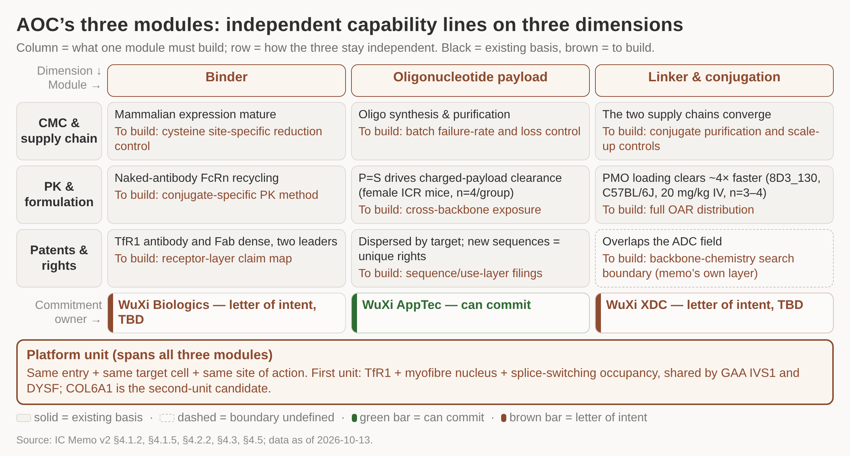
AOC splits into binder, payload and conjugation chemistry: three capability lines built separately
/ HOW WE EVALUATE
Build and commit along three capability lines, not one: this round buys only the configuration-neutral freedom-to-operate & backbone study and the shared productive-delivery study, and reuse is claimed one platform unit at a time, first tested at the platform-transfer gate.
1 Three columns, three dimensions: nine cells, each with an existing basis and a capability still to build.
2 Everything on the brown line is new work this round; none of it transfers from one module to another.
3 The commitment bar is green only under the payload line; binder and linker sit at letter of intent, amounts TBD.
4 Reuse is claimed per platform unit, not per programme: GAA IVS1 and DYSF share one, COL6A1 is the second.
5 The dashed rights cell is the memo's own layer: thinnest direct evidence, search boundary undefined.
DETAIL IN THE MEMO
Classic AOC scope only: direct covalent antibody-oligonucleotide conjugates
Three listed partners; rights boundary and commitment authority stay in the memo
Three modules x three dimensions; each cell gives the existing basis and what must be built, with the commitment owner under each column.
Classic AOC scope only, a direct covalent antibody-oligonucleotide conjugate; antibody-protamine-siRNA complexes, targeted LNP, Centyrin, aptamers, peptides and GalNAc are out of scope.
P=S clearance and the DAR1 versus DAR2 and backbone conclusions hold only inside the published system: female ICR mice, n=4/group, IV dosing, one siRNA chemistry, two loading levels.
Blank cells mean not captured or not found; the figure carries no amounts and no count rankings, and the commitment bars mark ownership only.
Source: IC Memo v2 §4.1.2, §4.1.5, §4.2.2, §4.3, §4.5; data as of 2026-10-13
Notes:
We buy and commit along three lines, and each line is owned by a different partner: WuXi AppTec can commit on the payload, while WuXi Biologics and WuXi XDC are at letter-of-intent stage with amounts still TBD. ADC experience runs in reverse on three points: conjugate PK is not predicted by the naked antibody, OAR distribution must be reported in full rather than as a mean, and the backbone-chemistry layer has the thinnest direct evidence and no defined search boundary. Reuse is claimed per platform unit, not per programme, so GAA IVS1 and DYSF share one unit and COL6A1 is held as the second-unit candidate. Cut for space: the three-company rights-boundary table and the detail of commitment authority.

Slide 14
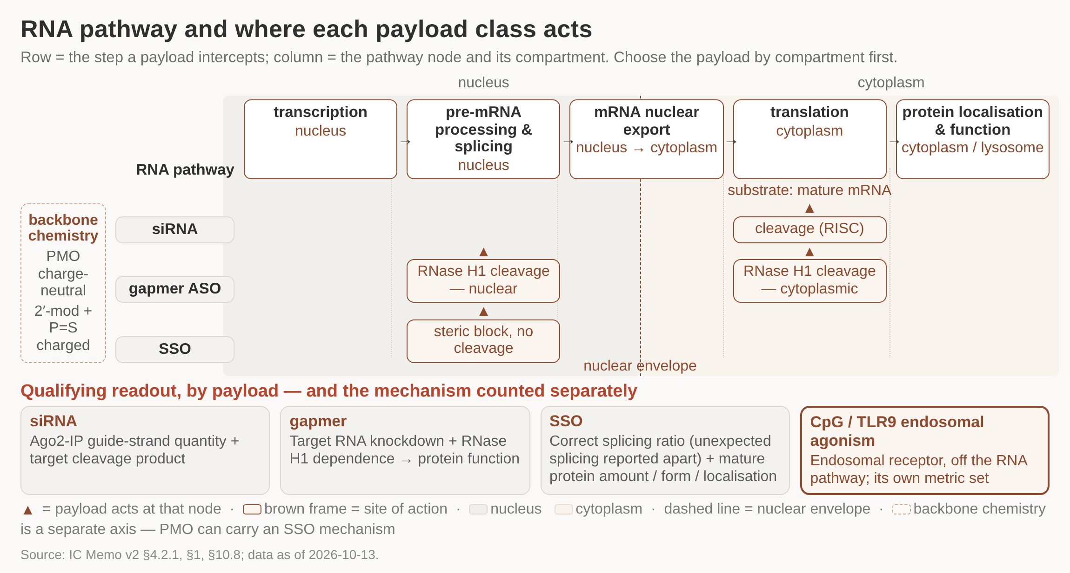
Each payload class acts in its own compartment; for SSO the bar is correct splicing plus functional protein
/ HOW WE EVALUATE
Choose the payload by target cell and compartment first, then fix mechanism, backbone chemistry and readout: both first payloads are splice-switching oligonucleotides, so the gate threshold reads correct splicing ratio plus mature protein, scored on two axes that are never merged.
1 Five pathway nodes across two compartments; the dashed line is the nuclear envelope, crossed at export.
2 Each payload class acts at its own node: siRNA on mature mRNA, gapmer on either side, SSO on nuclear pre-mRNA.
3 Only the gapmer works in two compartments, which is why its readout needs RNase H1 dependence evidence.
4 No transport probability or percentage is drawn: the pathway is a framework, not a measured efficiency chain.
5 CpG/TLR9 sits off the pathway at an endosomal receptor and is scored on a separate set of metrics.
DETAIL IN THE MEMO
Backbone chemistry is a third axis: PMO charge-neutral, 2'-modified plus P=S charged
A total-RNA readout is a methodological error for an SSO; occupancy does not cleave
The five-step RNA pathway, the point at which each payload class acts, the compartments involved, and the qualifying readout per class.
A total-RNA readout is a methodological error for an SSO: occupancy does not cleave the transcript, so any change in total level arises indirectly through splicing and NMD.
CpG/TLR9 endosomal agonism acts at an endosomal receptor, off the RNA pathway, and needs its own metric set; it is never scored together with RNA silencing.
Conjugate PK must be measured on the conjugate: the same antibody clears about four times faster once PMO is loaded.
Source: IC Memo v2 §4.2.1, §1, §10.8; data as of 2026-10-13
Notes:
Payload choice starts from the target cell and the compartment where the drug has to act, and only then fixes mechanism, backbone chemistry and readout. siRNA acts on mature mRNA in the cytoplasm, a gapmer cleaves through RNase H1 in either compartment depending on where the target RNA sits, and an SSO occupies nuclear pre-mRNA without cleaving it. Because both first payloads are SSOs, the receptor-entry & payload-fit gate and the patient-cell biology gate record correct splicing ratio and mature protein on two separate axes and never collapse them into one score. Cut for space: the full mechanism comparison table and the three separate sources behind the DAR and backbone conclusions.

Slide 15
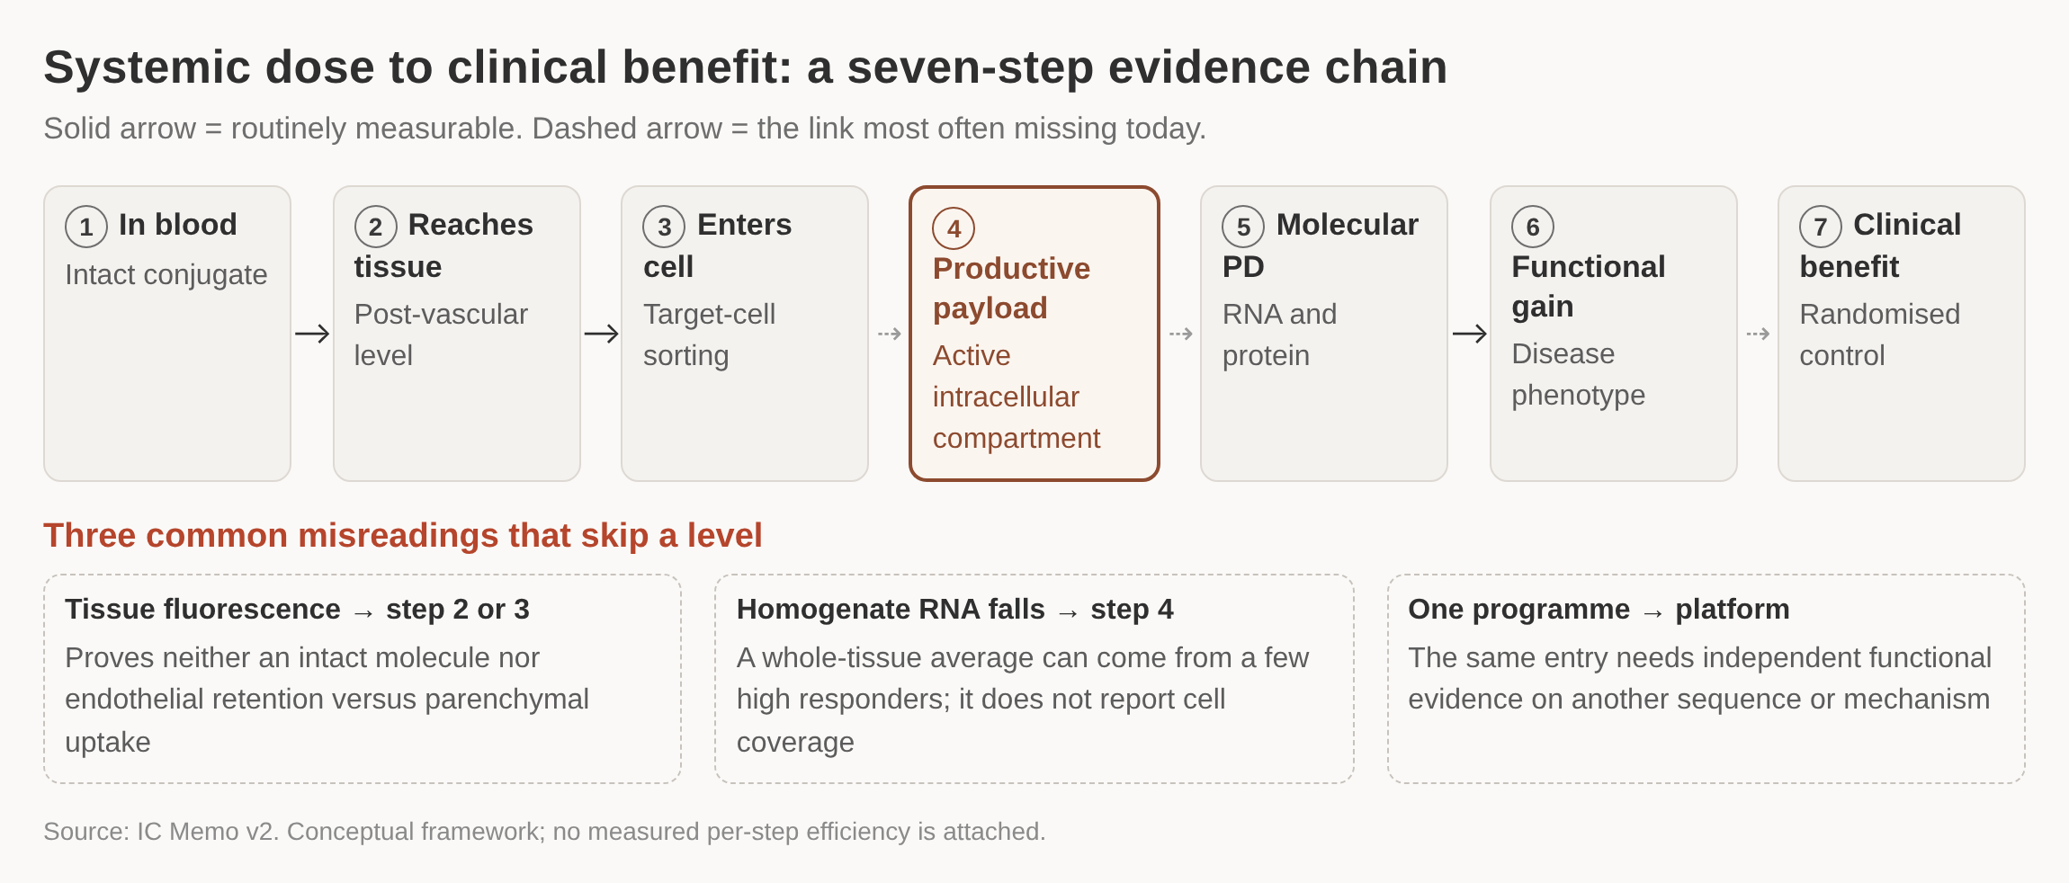
Seven steps from systemic dose to clinical benefit; the step still to be proven is productive payload
/ HOW WE EVALUATE
Each step in the chain needs evidence of its own, and the step no public conjugate programme has shown directly is the fourth: payload arriving in the active intracellular compartment of the target cell. That is what the first study is designed to answer.
1 Every step carries its own evidence
2 Step four is the open question
3 Three misreadings skip a level
4 Tissue signal is not cell entry
DETAIL IN THE MEMO
Per-step read-outs and the controls each requires are set out in the memo
Seven-step evidence chain. Solid arrow: routinely measurable. Dashed arrow: the link most often missing today
The chain is a conceptual framework; no measured per-step efficiency is attached to it in the source material.
Of the thirteen priority programmes reviewed, none reports a direct measurement at the productive-payload step.
Source: IC Memo v2 (§2.1, Appendix D); data as of 2026-10-13
Notes:
This is the spine of the whole evaluation. Everything later in the deck — which entry receptor, which payload, which gate releases money — hangs off the claim that step four is the open one. The three misreadings at the bottom are the ones to watch for when a competitor or a partner presents delivery data: tissue fluorescence, homogenate RNA knockdown, and generalising from a single programme to a platform.

Slide 16
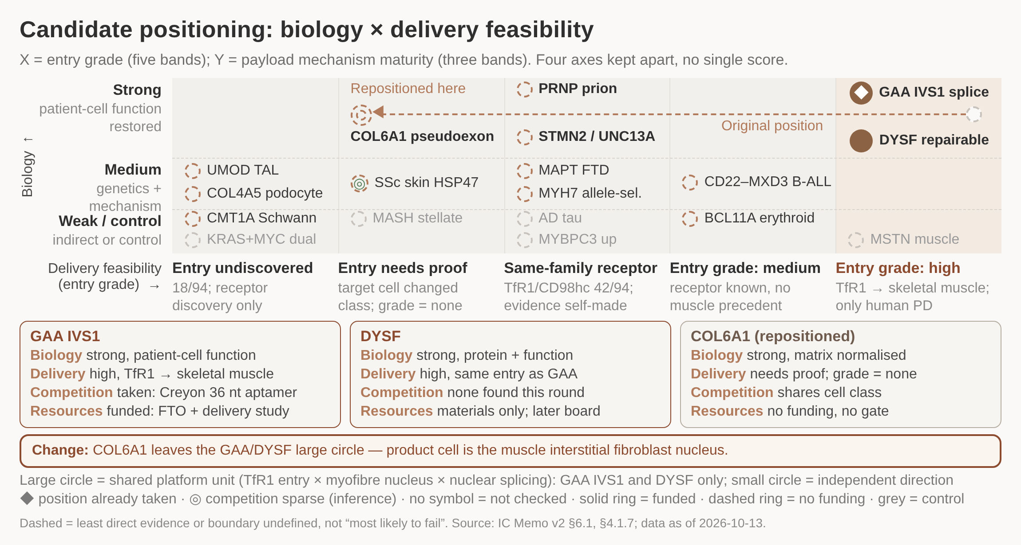
Crowding sits at the entry and rights layers, not the disease layer
/ HOW WE EVALUATE
Of 94 disease records, 45% share one receptor family, so the first wave backs the single entry with human PD, TfR1 into skeletal muscle. Differentiation stays in payload sequence and disease use, and the 18 records whose entry is still undiscovered run as a separate receptor-discovery route.
1 45% of the 94 disease records sit in one receptor family, so crowding is at the entry layer, not the disease layer.
2 Only GAA IVS1 and DYSF share the platform unit - same TfR1 entry, myofibre nucleus and nuclear splicing.
3 COL6A1 moves off that circle: its product cell is the interstitial fibroblast nucleus, so its entry needs separate proof.
4 GAA's slot is already taken at same receptor, target and mechanism by a Creyon 36 nt aptamer; ABX1100 is the comparator.
5 Four axes are marked on four channels - y, x, symbol, border - and never collapsed into one score.
DETAIL IN THE MEMO
Entry families of 94: TfR1/CD98hc 42, local dosing 12, other receptors 10, immune/blood 8
18 records still need their entry receptor discovered - the moat candidate set
Candidates placed by biological confidence against entry grade; COL6A1 is repositioned, and the four axes are kept apart.
The map answers where work is already under way, not where work is worth doing; that second question is answered by the four-axis grading.
The five counting columns use different units and no two may be added; the 26 adjacent-technology records are likewise not additive.
Of the 31 records ready for mechanism validation, 13 are CNS, 6 eye, ear and skin, 3 skeletal muscle and 3 kidney.
Source: IC Memo v2 §3.3, §3.4, §4.1.7, §6.1; registry status check 2026-10-11; data as of 2026-10-13
Notes:
The figure repositions COL6A1 away from GAA IVS1 and DYSF: its product cell is the muscle interstitial fibroblast nucleus, which is not the myofibre nucleus under the platform-unit definition, so it no longer shares a platform unit with the other two. Only GAA IVS1 and DYSF share the large circle. Biology, delivery, competition and resource dependency are marked on four separate channels and are never combined into a single score. GAA IVS1 is already occupied at same receptor, same target site and same mechanism by a Creyon 36 nt aptamer; DYSF shows no same-configuration occupancy this round.

Slide 17
Five evidence labels say what each candidate still lacks; three axes set the order of work
/ HOW WE EVALUATE
The three axes are entry feasibility, payload-mechanism maturity, and availability of rights and resources; each is scored separately.
Five fit labels: meaning, next step, where evidence lands
Label (records) | What it means | Next step | Where the evidence lands
Ready for mechanism validation (31) | Biology and payload mechanism supported in humans or patient cells; delivery unproven | Go straight into the productive-delivery study; no further biology needed | Productive intracellular payload is unmeasured; receptor-entry & payload-fit gate
Delivery increment unproven (25) | Target and payload route validated by others; AOC must show gain over current dosing | Define what it has to beat, then design the control | Three-arm comparison against naked payload and the best alternative route
Exploratory hypothesis (18) | Mechanism plausible, but the key experimental step was not verified this round | Add patient-cell evidence before discussing delivery | Patient-cell biology gate; rebuilt with free uptake, no transfection reagent
High-risk exploration (11) | Known precedent of failure, or major uncertainty in the mechanism itself | Explain why others failed, otherwise do not start the project | Veto item: unexplained same-mechanism failure
Non-AOC preferred (5; 8 after standardisation) | A simpler or more mature modality already solves the same problem | Keep as a control, not as a candidate | Retained as a control; this is not a veto
Priority comes from three axes, scored once each
On those axes the first cluster is only two candidates, both on TfR1 into the myofibre nucleus: GAA IVS1 and DYSF.
A label reads one axis only, how far disease biology and payload mechanism have come; it carries no entry-feasibility information.
Entry feasibility must therefore be scored on its own; ranking labels high to low as an investment score sets entry risk to zero.
The labels are not summed and are not turned into a score card; eight original labels were standardised into five, with the denominator recomputed to 100%.
Remaining candidates go into three different queues: receptor discovery, failure explanation, or retained control arm.
Source: IC Memo v2 §2.5, §6.1, §7.6, §7.8, Appendix A; data as of 2026-10-13
Notes:
The labels tell us which link each candidate is still missing and what the next experiment should be; they do not rank investments. 'Delivery proof missing' means specifically that productive intracellular payload has never been measured, which is what the receptor-entry & payload-fit gate buys. For the delivery-increment group, the comparator is a three-arm design: same payload, naked payload, and the best alternative route. Cut for space: the mapping from eight original labels to five and the cross-tabulation of the 31 mechanism-validation records by entry grade.

Slide 18
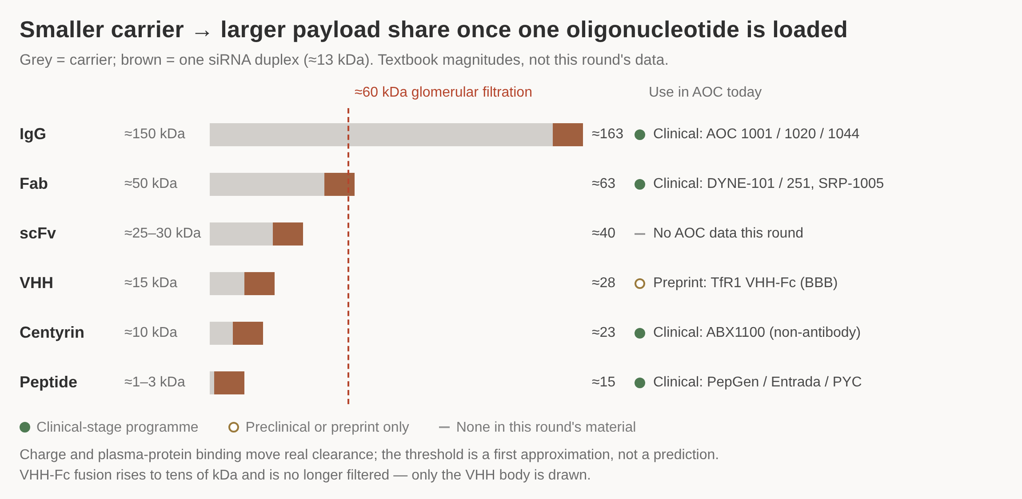
Antibody format is derived from target cell and compartment, then fixed by our own same-payload comparison
/ HOW WE EVALUATE
Format follows from the mature myofibre and the nucleus rather than from a literature ranking, and is settled by a same-payload, same-model comparison we run ourselves. Antibody gain is measured on functional delivery, safety window and durability, and antibody supply gates the start.
1 The smaller the carrier, the larger the share of mass one 13 kDa oligonucleotide duplex takes.
2 About 60 kDa is a first-approximation filtration level, so Fab and everything below sit near or under it.
3 Clinical precedent exists at IgG, Fab, Centyrin and peptide mass; scFv has no AOC data this round.
4 Format follows from the mature myofibre and the nucleus, then from our own same-payload comparison.
5 Antibody gain is read on functional delivery, safety window and durability - never summed into a score.
DETAIL IN THE MEMO
VHH-Fc fusion rises to tens of kDa and is no longer glomerularly filtered
Charge and plasma-protein binding move real clearance off the mass threshold
Carrier mass plus one loaded siRNA duplex across six binder formats, against the glomerular-filtration magnitude and current AOC use.
No same-payload, same-model head-to-head between formats exists in this round's material, so formats are not interchangeable parts.
No sub-rating is merged into an overall delivery score and there is no score card; the three antibody-gain dimensions are also shown separately.
The one read-out to buy sits with WuXi Biologics, so closing antibody supply is a hard precondition for starting the receptor-entry & payload-fit gate.
Source: IC Memo v2 §4.1, §4.1.2, §10.8; data as of 2026-10-13
Notes:
The smaller the carrier, the larger the share of mass one oligonucleotide takes, and about 60 kDa is a first-approximation glomerular-filtration level rather than a prediction: charge and plasma-protein binding move real clearance, and a VHH-Fc fusion rises to tens of kDa and is no longer filtered. Clinical precedent exists at IgG, Fab, Centyrin and peptide-ligand mass; scFv has no AOC data in this round's material and VHH appears only in a preprint. The influence of antibody format on AOC delivery is graded as system-dependent, supported only by valency, affinity and epitope having been compared systematically inside a single study.

Slide 19
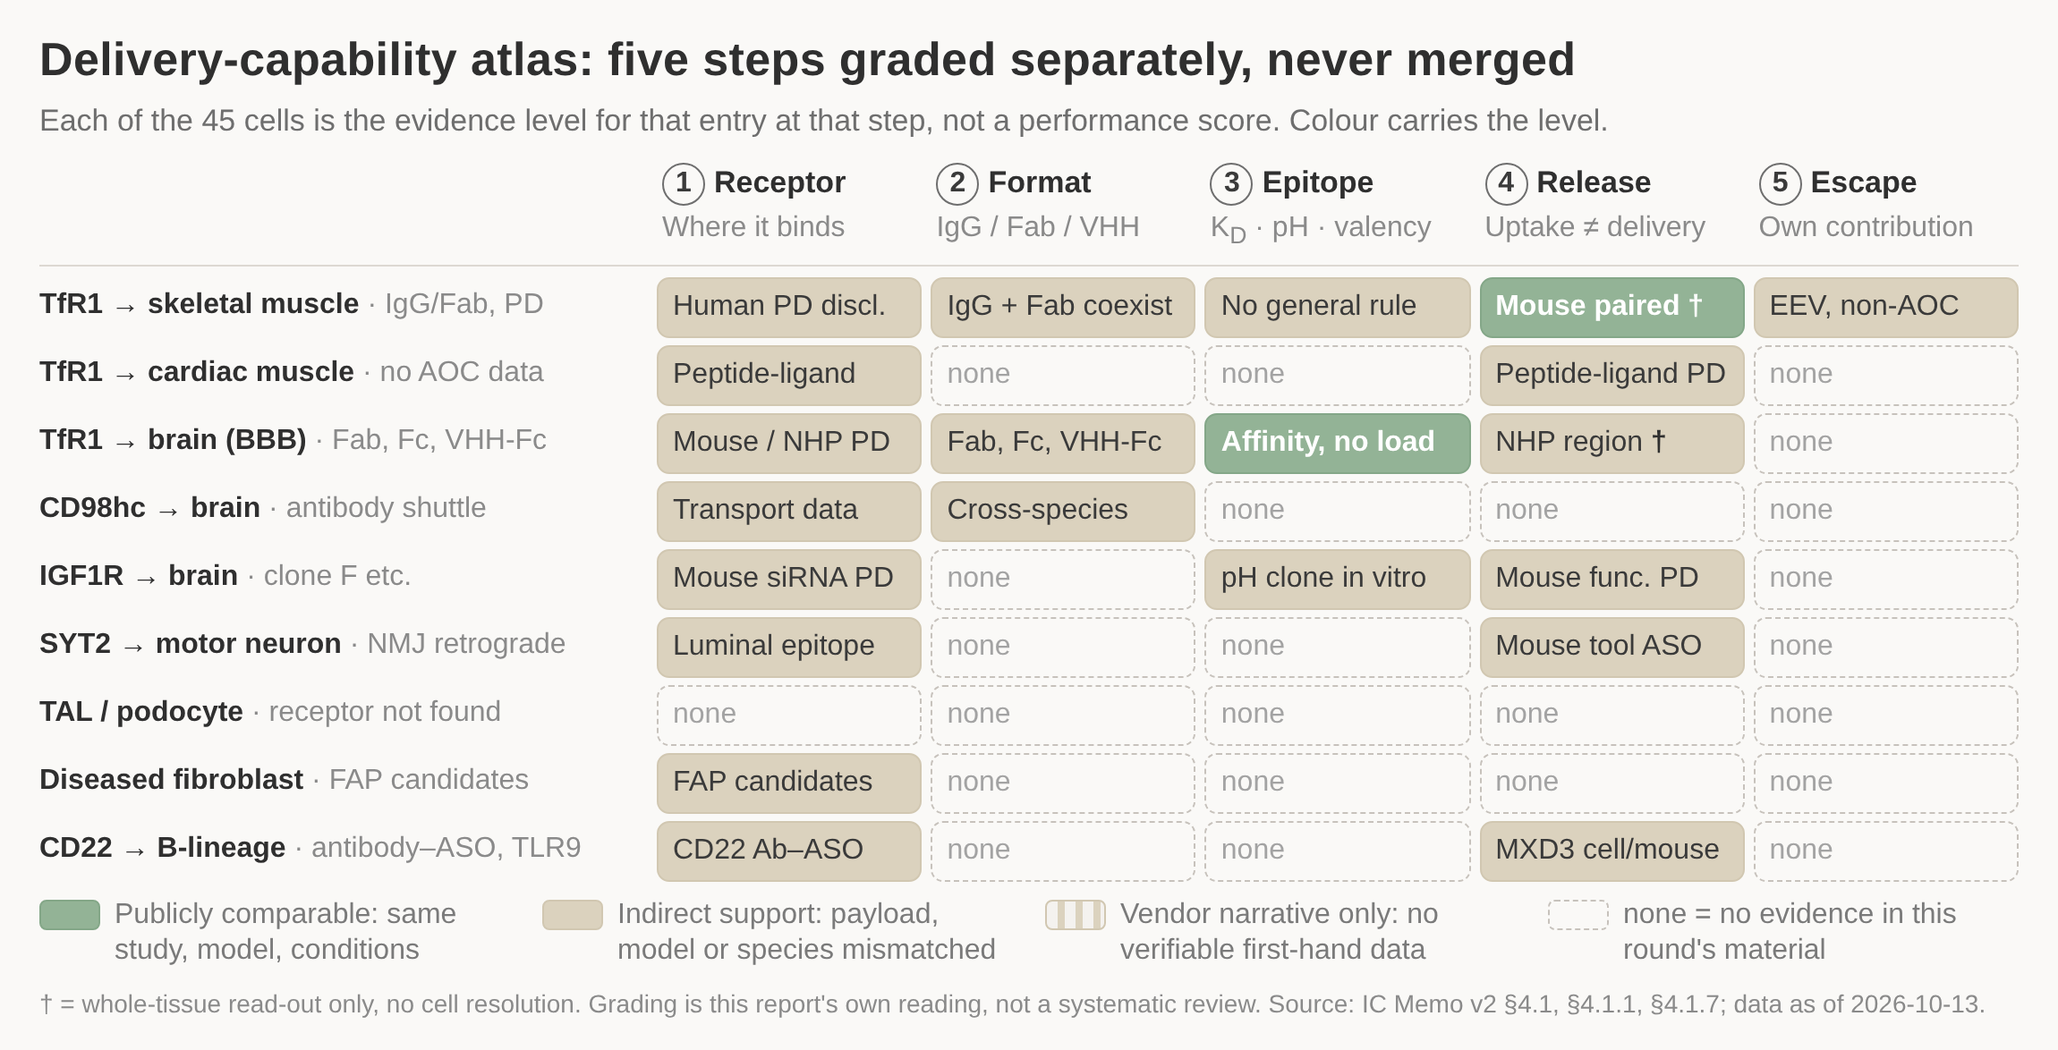
Nine entries graded on five steps: the atlas screens entries and sets the first read-out to buy
/ HOW WE EVALUATE
Across the 45 cells the evidence stands at 2 publicly comparable, 19 indirect support, 0 vendor narrative and 24 none. The first-wave skeletal-muscle TfR1 row is the only one with human PD yet still carries four indirect cells, so the first money buys two read-outs on that row.
1 Only 2 of the 45 cells rest on a published head-to-head; 19 are indirect and 24 have no evidence at all.
2 The skeletal-muscle TfR1 row is the only one with human PD, yet four of its five cells are indirect.
3 Both comparable cells are whole-tissue read-outs, so neither resolves what reaches the target cell.
4 First money buys two read-outs on that row: cell-resolved payload, then a same-payload format comparison.
5 Not more dose and not a second entry - the kidney-cell row is blank across all five steps.
DETAIL IN THE MEMO
Three company configurations held in parallel: none ranked, none eliminated this round
Evidence level and clinical maturity are separate scales and are never multiplied
Nine entries by five delivery steps; cell colour is the evidence level for that step, and the steps are never merged into a total.
Evidence level and clinical maturity are two different scales: they are not multiplied and not combined into a delivery total.
The grading is this report's own reading of the material (research inference), not a systematic review.
Comparable human receptor copy numbers at the blood-brain barrier are unavailable, and anti-CD98 antibodies do not transit the LAT1 substrate channel.
Source: IC Memo v2 §4.1, §4.1.1, §4.1.7; registry status check 2026-10-11; data as of 2026-10-13
Notes:
Each cell records the evidence level for that entry at that step, not a performance score, and the four counts must always be quoted together. The first money buys cell-resolved productive payload, then a same-payload format comparison on the skeletal-muscle TfR1 row - not more dose and not a second entry. The diseased-fibroblast configuration is stuck at receptor selection, and the kidney configuration has no accessible endocytic receptor on the blood side. Transport fate across the five steps is coupled, so moving one step moves the others.

Slide 20
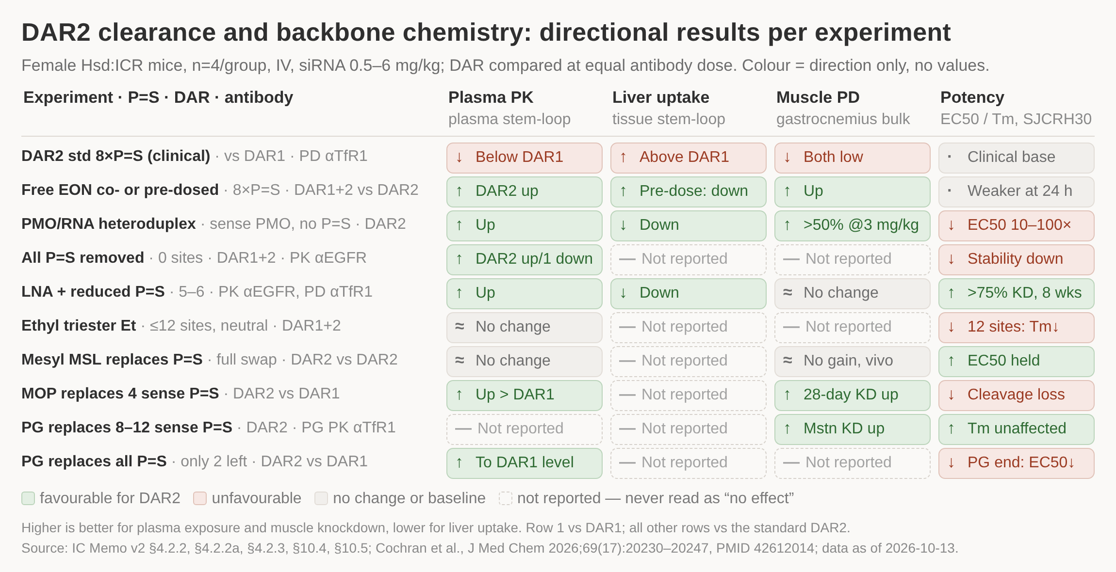
Loading is optimised jointly on payload charge, P=S content, site and format, one system at a time
/ HOW WE EVALUATE
Loading is set by payload charge, P=S content, site and format together, with the read-out basis labelled on every experiment. The rights & backbone-chemistry gate judges only two items: counsel's written directional opinion, and the exposure gain seen on a non-targeting backbone.
1 DAR2 loses plasma exposure and gains liver uptake against DAR1, and muscle knockdown falls with it.
2 Charge-neutral backbone changes reverse it: the PMO heteroduplex gives >50% knockdown at 3 mg/kg.
3 Better plasma exposure does not buy muscle PD - the LNA row improves exposure but not knockdown.
4 Every gain costs something: removing all P=S wrecks stability, MOP loses material in deprotection.
5 Three antibodies are used across the study, so PK and PD rows are never chained into one mechanism.
DETAIL IN THE MEMO
Usable premise: within this chemistry the DAR ceiling is set by payload charge and P=S
No evidence for a best DAR across payload classes, receptors or species
Ten backbone experiments across plasma PK, liver uptake, muscle PD and potency; colour shows direction only and carries no values.
Female Hsd:ICR mice, about 24 g, n=4 per group, intravenous 5 mL/kg, siRNA equivalent 0.5-6 mg/kg; DAR1 and DAR2 compared at equal antibody dose.
Only two loading levels were tested, so nothing extends to all DAR>=2, and a blank cell reads as 'not reported', never as 'no effect'.
Single institution, single siRNA chemistry, no third-party replication; the PMO gain needs an antisense 5'-vinylphosphonate, and 2'-O-MOE only partly rescues the stability loss.
Source: IC Memo v2 §4.2.2, §4.2.2a, §4.2.3, §10.4, §10.5; Cochran et al., J Med Chem 2026;69(17):20230-20247 (PMID 42612014); data as of 2026-10-13
Notes:
The DAR2 problem sits mainly in plasma-side non-specific hepatic clearance and is dominated by P=S content, though the authors state the mechanism is not fully defined. Better plasma exposure does not guarantee better muscle knockdown, as the LNA row shows, and several effective modifications carry a synthesis or potency cost. Three antibodies are used across the study - a targeting anti-TfR1 for efficacy, an anti-TfR1 for PG plasma exposure and a non-binding anti-EGFR for the reduced-P=S arm - so PK and PD from different antibodies are read separately and never strung into one causal chain. The backbone-chemistry patent-family search boundary is scoped by counsel first.

Slide 21
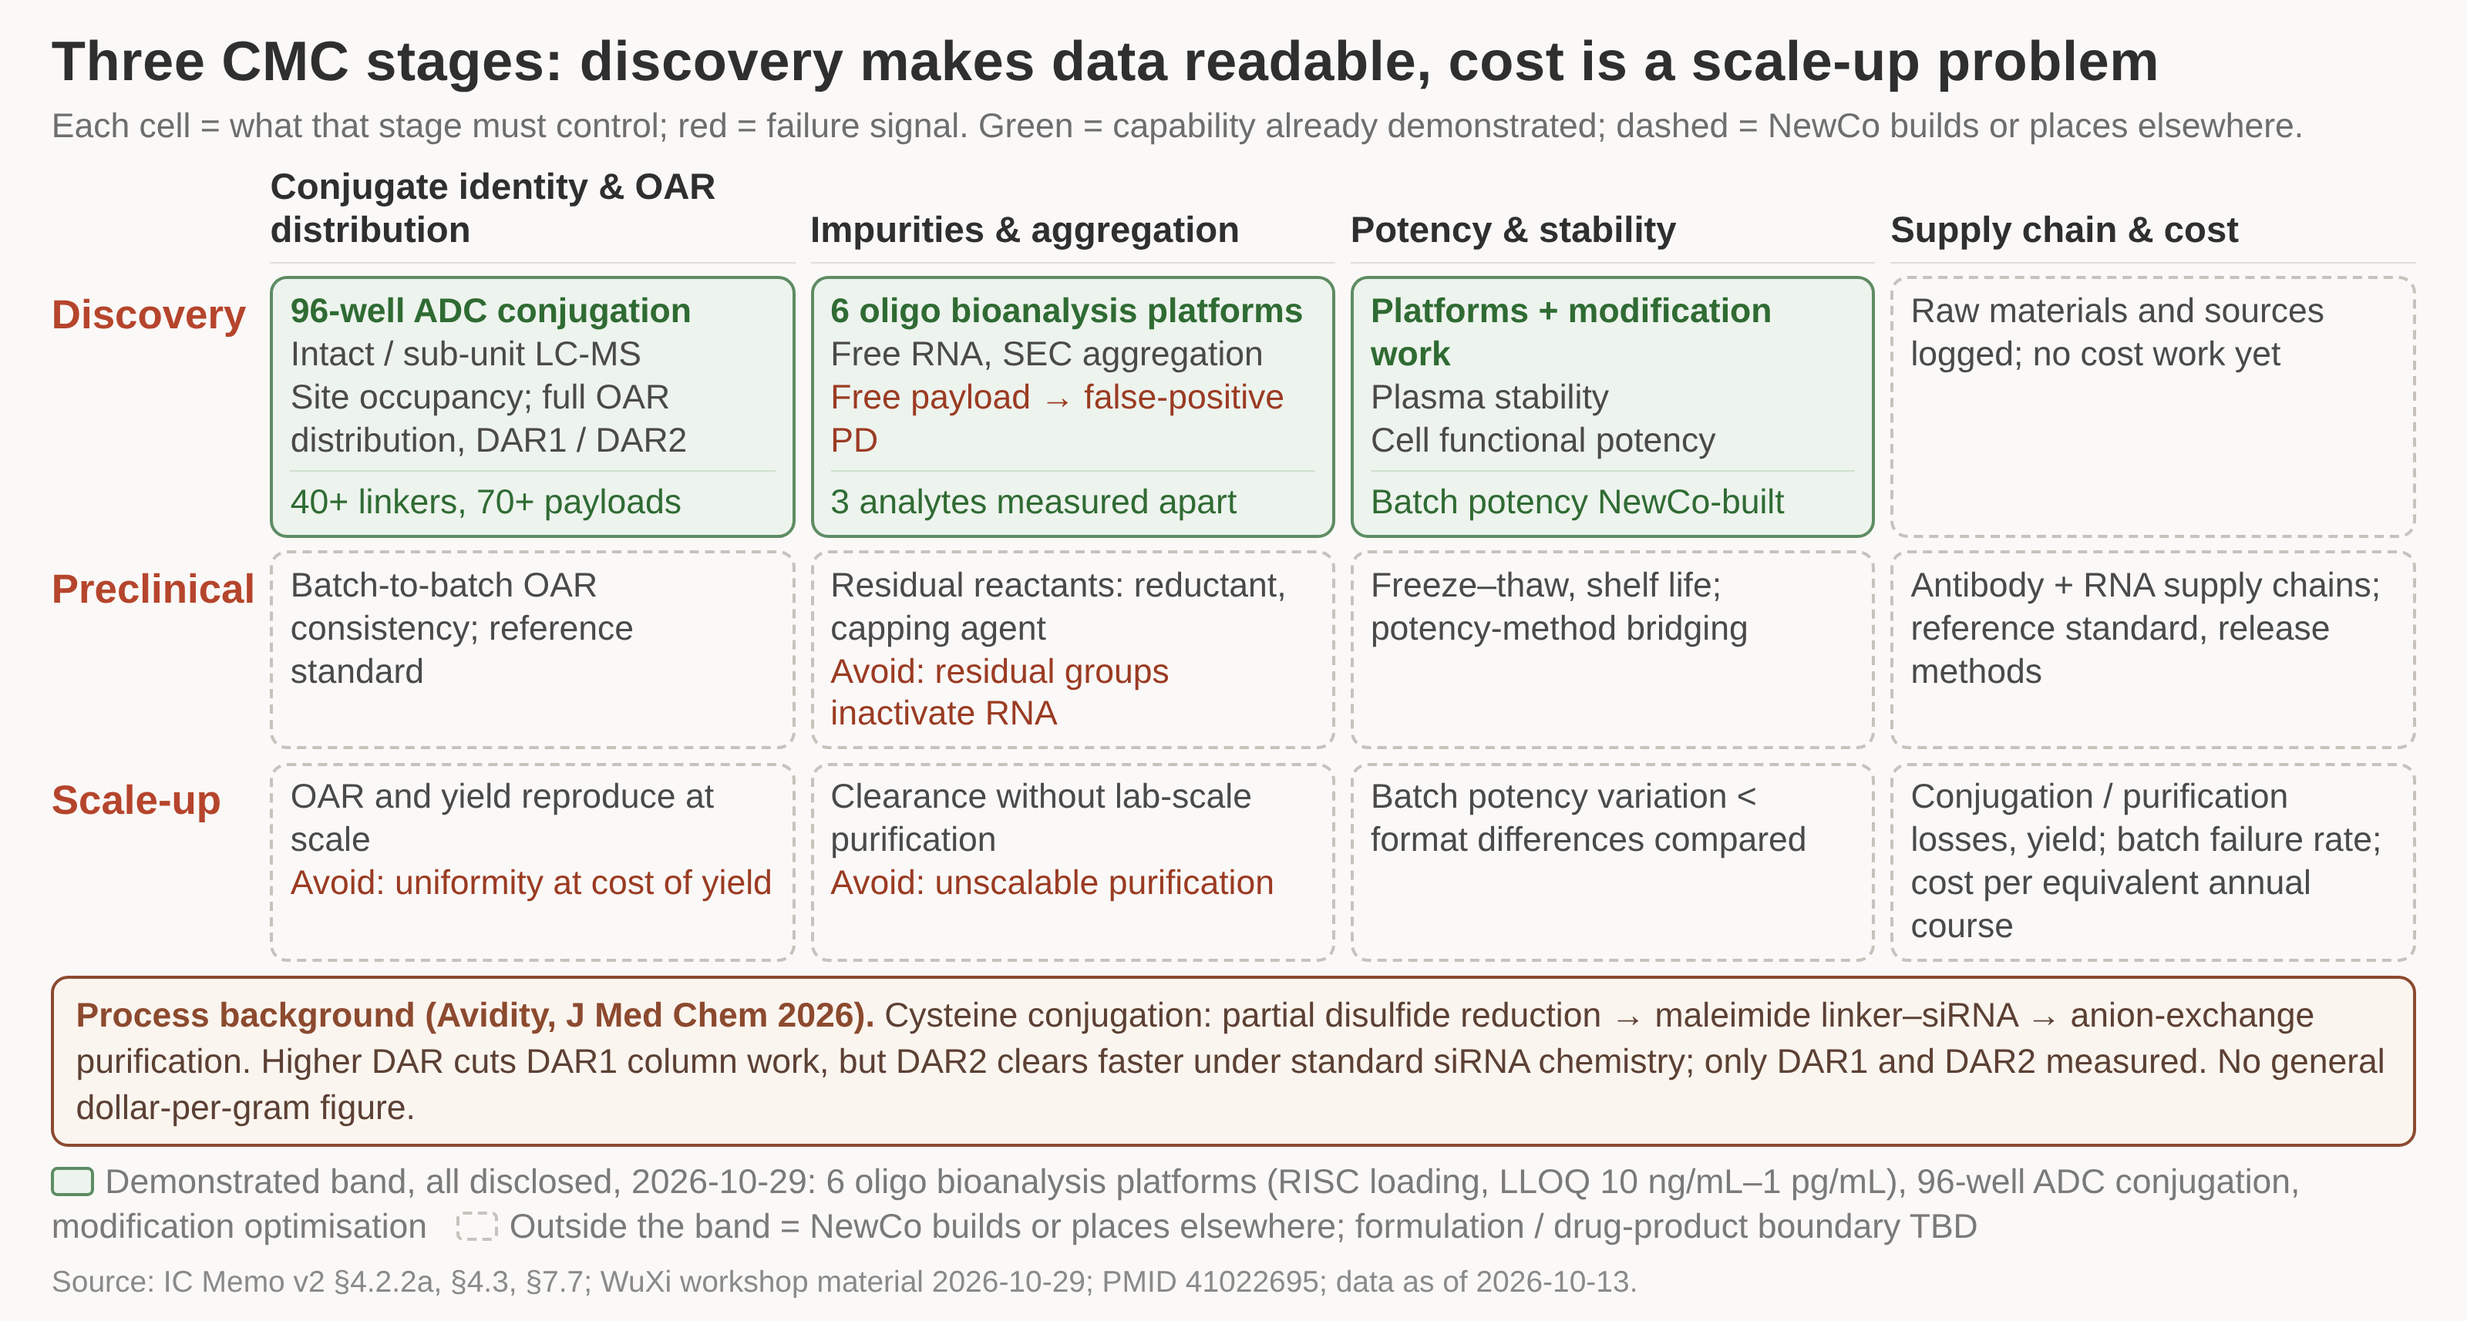
Model AOC colloidal stability runs opposite to the parent antibody; the candidate needs its own formulation DoE
/ HOW WE EVALUATE
Formulation and colloidal-stability DoE is the first work front to start, with direction confirmed on our own candidate rather than assumed from the model molecule, while discovery builds the OAR distribution, free-payload and three-analyte methods that make later format comparisons readable.
1 Twelve cells: four things to control, read across the three stages from discovery to scale-up.
2 Green marks the three cells WuXi has already demonstrated; the other nine are NewCo's to build or place.
3 Discovery controls full OAR distribution and three separate analytes, so later format comparisons stay readable.
4 Red lines are the failure signals: uniformity bought with yield, purification that cannot be scaled.
5 Cost becomes a question only at scale-up, counted per equivalent annual course of qualified conjugate.
DETAIL IN THE MEMO
Model AOC colloidal stability inverts the parent antibody's low-pH, low-salt starting point
Handles are pH, ionic strength and antibody surface positive patches; no animals needed
Three CMC stages by four control areas; the green band is capability already demonstrated, dashed cells fall to NewCo
The direction rests on one model AOC, one format, one institution and one condition set (pH x ionic strength DoE, phase separation, DLS, viscosity), with no DAR gradient and no DAR value
No long-term stability or aggregation kinetics were reported, and a category-level claim that AOC and antibody formulation rules are generally opposite is not made here
Demonstrated capability covers the discovery column only; the preclinical and scale-up columns are built by NewCo or placed elsewhere, and the formulation interface is still undefined
Source: IC Memo v2 §4.3, §10.6; WuXi workshop material 2026-10-29; PMID 41022695; data as of 2026-10-13
Notes:
This front starts first because it is cheap, needs no animals, no targeting antibody and no first payload, so nothing holds it up. Its direction has to be confirmed on our own candidate rather than inherited from a model molecule whose behaviour inverted the antibody rule. Building the full OAR distribution, free-payload and three-analyte methods during discovery is what makes every later format comparison interpretable; free payload otherwise contaminates the productive-delivery read-out directly. Batch potency variation must stay smaller than the differences between the formats we intend to compare, or the comparison carries no information. Cut for space: the stage-by-stage failure-signal table and the Avidity process background.

Slide 22
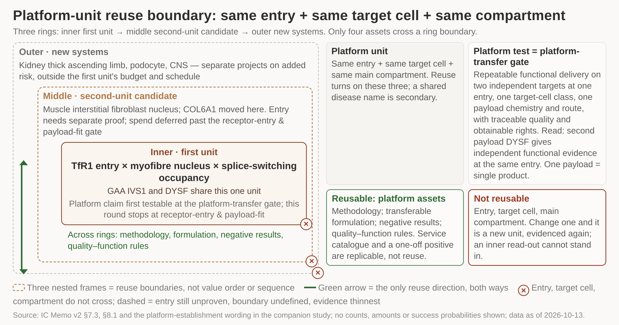
Platform value is built one unit at a time; acquisition is judged module by module across four routes
/ HOW WE EVALUATE
Build the platform unit by unit and put the verification point for the platform claim at the platform-transfer gate; list acquisition module by module and trade off build, module licence, partnership and equity item by item, closing the licensable-platform premise first.
1 Three nested rings: the first unit inside, the second-unit candidate around it, new systems outside.
2 A unit is one entry, one target cell, one compartment; change any one and the evidence starts again.
3 GAA IVS1 and DYSF share the inner unit; COL6A1 sits in the middle ring and needs its own entry proof.
4 Only four things cross a ring: methodology, formulation, negative results, quality-function rules.
5 The platform claim is first testable at the platform-transfer gate, well past anything funded this round.
DETAIL IN THE MEMO
The three capability lines share almost nothing across the CMC, PK and rights dimensions
Four acquisition routes costed per module: build, module licence, partnership, equity
Three nested reuse rings: inner first unit, middle second-unit candidate, outer new systems; only four assets cross
No wholly licensable mature AOC delivery platform was found this round; the search covered three inquiry rows, all 'not contacted, TBD' at 2026-11-02, and five ClinicalTrials.gov sponsors
A sponsor search returning no records leaves the premise unclosed rather than disproven, so the inquiry table closes it before any acquisition route is fixed
'Module-level licence plus build where rights are open' is this round's planning assumption only, not the single feasible path, and the evidence may change it
Source: IC Memo v2 §4.1, §4.1.2, §4.1.5, §4.1.7, §7.3, §8.1; inquiry table and ClinicalTrials.gov sponsor search as of 2026-11-02; data as of 2026-10-13
Notes:
A reusable unit is same entry, same target cell, same main compartment; change any one and it is a new unit needing fresh evidence, so a shared disease name proves nothing. GAA IVS1 and DYSF share the first unit, COL6A1 moves out to a second-unit candidate whose entry must be proven separately, and kidney, podocyte and CNS work is re-scoped as separate projects on their own risk. Only methodology, transferable formulation, negative results and quality-to-function rules cross ring boundaries; an open service catalogue and a one-off positive experiment are replicable, not platform. The platform claim is first testable at the platform-transfer gate, when the second payload gives independent functional evidence at the same entry; this round authorises only as far as the receptor-entry and payload-fit gate. Cut for space: the capability build order and the four commitment types.

Slide 23
3
Why us
What the group can already execute end to end, and what a new company must own itself

Slide 24
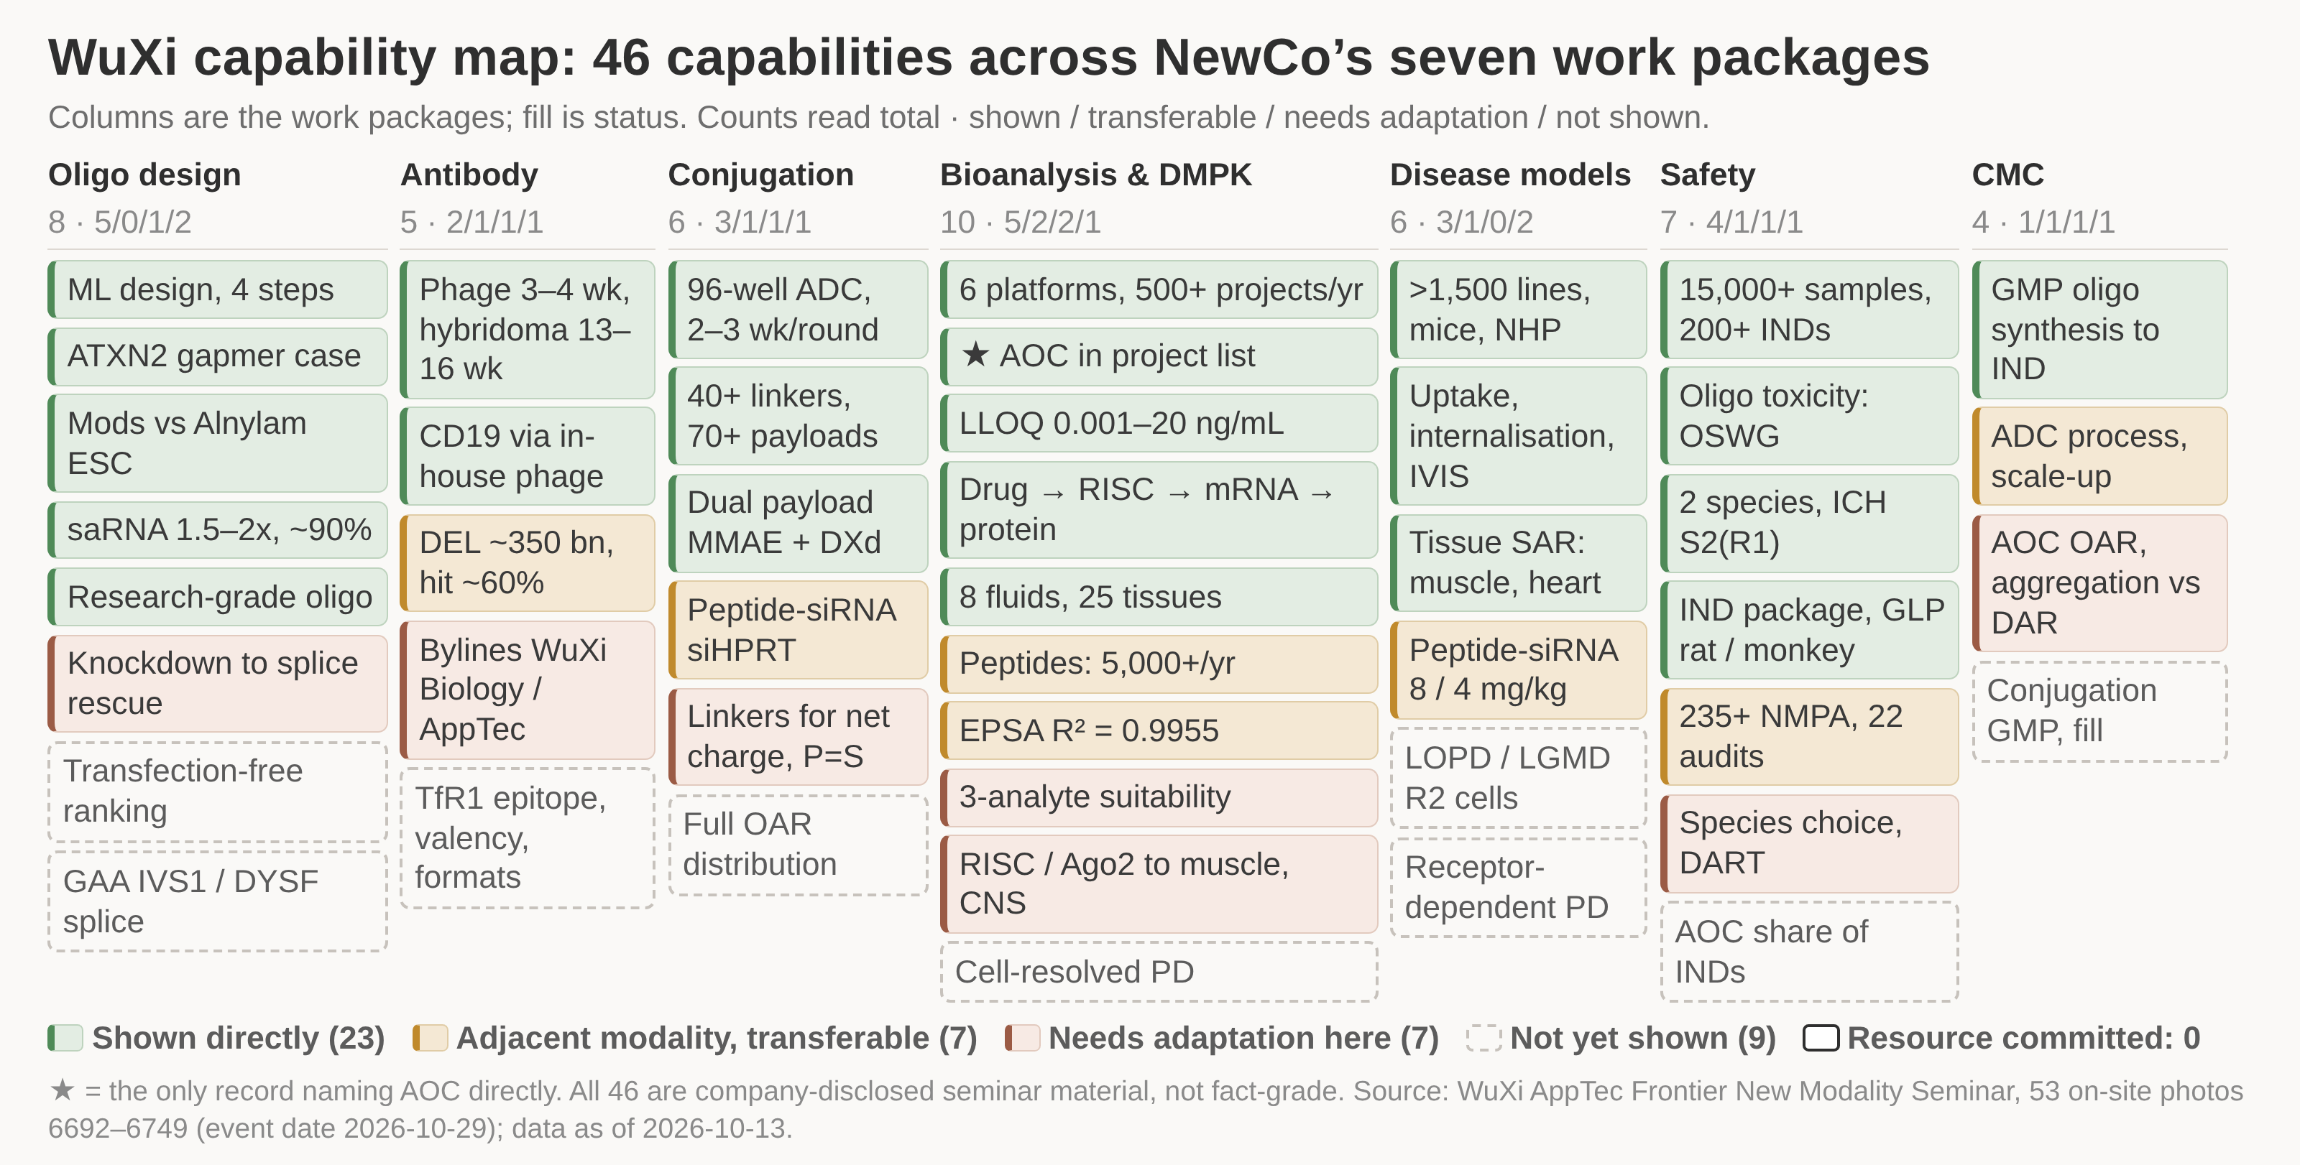
Of 46 WuXi capabilities across NewCo's seven work packages, 23 are shown directly and none is yet committed
/ WHY US
Of WuXi's 46 capabilities, 23 can be ordered directly, 14 are usable after transfer or adaptation and 9 must be built or evidenced separately, so the case rests on execution cost and pace; product judgement, format choice, key rights and transferable raw data stay with NewCo.
1 Forty-six capabilities sorted into NewCo's seven work packages, each one coloured by its status.
2 Twenty-three are shown directly, seven transfer from an adjacent modality, seven need adaptation here.
3 Nine dashed cards are absent from the 53 photographs, mostly patient cells and conjugate CMC.
4 The committed-resource count is zero: no written intent, quote, slot or capacity exists yet.
5 One card names AOC directly, in the DMPK project list; it proves the category, not the depth.
DETAIL IN THE MEMO
Capabilities per work package: 8, 5, 6, 10, 6, 7 and 4 across the seven columns
Forty-six capabilities in seven columns; the fill gives one of five statuses and each card's foot gives its source photo
All 46 are seminar slides and posters, registered as company-disclosed and kept apart from fact-grade patents and papers; the material's own caution is that 'can do' is not 'does well'
Material and a live demonstration are not an exclusive resource or a contract: resource commitments stand at 0, and quotes, slots, capacity and the two letters of intent are all TBD
Status marks coverage within these 53 photographs, not a capability score; 'not seen' means nothing was found in that photo range and can be re-graded when more material arrives
Source: WuXi AppTec Frontier New Modality Seminar, 53 on-site photos (event date 2026-10-29); IC Memo v2 §4.3; data as of 2026-10-13
Notes:
Changing the axis from WuXi's own service catalogue to NewCo's seven work packages is what makes the map decision-grade: it shows what can be ordered tomorrow, what needs transfer or adaptation first, and what nobody has yet shown. The 23 directly shown items concentrate in oligonucleotide design, conjugation and bioanalysis; the 9 absent ones concentrate exactly where this programme is hardest, in patient-cell functional delivery and conjugate CMC. Status is a record of what the material covers, not a judgement on quality, and every item re-grades when more is supplied. The single most important number on the page is the zero: no written intent, quote, slot or capacity commitment exists yet.

Slide 25
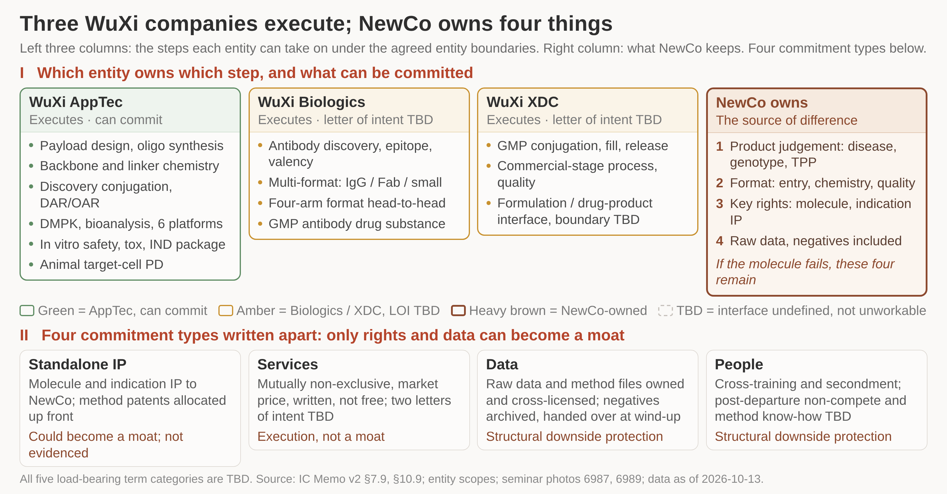
Three WuXi companies execute; NewCo owns product judgement, format choice, key rights and raw data
/ WHY US
Execution splits across three separately listed WuXi companies, while four owned assets - product judgement, format choice, key rights and transferable raw data - are the source of difference; five term categories decide whether they hold, and this round seeks two letters of intent and a mandate.
1 Three columns of steps, one per listed WuXi company; the brown column is what NewCo never outsources.
2 AppTec is the sponsor side and can commit; Biologics and XDC each still need a letter of intent.
3 The four owned assets - judgement, format, rights, raw data - are what survives a failed molecule.
4 Of the four commitment types, only rights and data can become a moat; services are execution.
5 Every load-bearing term is still TBD, so the four owned assets are intent, not secured position.
DETAIL IN THE MEMO
Five load-bearing term categories decide whether the four owned assets are realised
Left three columns list the steps each WuXi entity can take on; the brown column is what NewCo keeps for itself
Which entity owns which step, and who may commit for another, is the memo's own judgement from entity scope; neither research report describes the three WuXi companies' own capabilities
Branding and contracting entity are two different things: antibody discovery and ADC conjugation were shown under WuXi Biology and WuXi AppTec bylines; the service entity is set by contract
The formulation and drug-product boundary between WuXi AppTec and WuXi XDC is undefined this round, and nothing on that interface can be promised before it is fixed
Source: IC Memo v2 §7.9, §10.9; entity-scope definitions for the three listed WuXi companies; WuXi seminar photos 6987 and 6989; data as of 2026-10-13
Notes:
Execution capacity is available from three separately listed companies, which is an advantage on cost and pace but not on its own a moat. What differentiates NewCo is the four it keeps: the product judgement, the format choice, the key rights, and raw data including negative results. The five load-bearing term categories - IP allocation, service terms, data ownership and cross-licensing, people and non-compete, and the wind-up interface - are all TBD, so the four owned assets are stated intent rather than secured position. The asks are two letters of intent, confirmation of the ownership interface, and a mandate to negotiate those five categories. Versus a purely financial investor the increment sits on the capability side, in methods and retained people, and is classed as structural downside protection rather than upside.

Slide 26
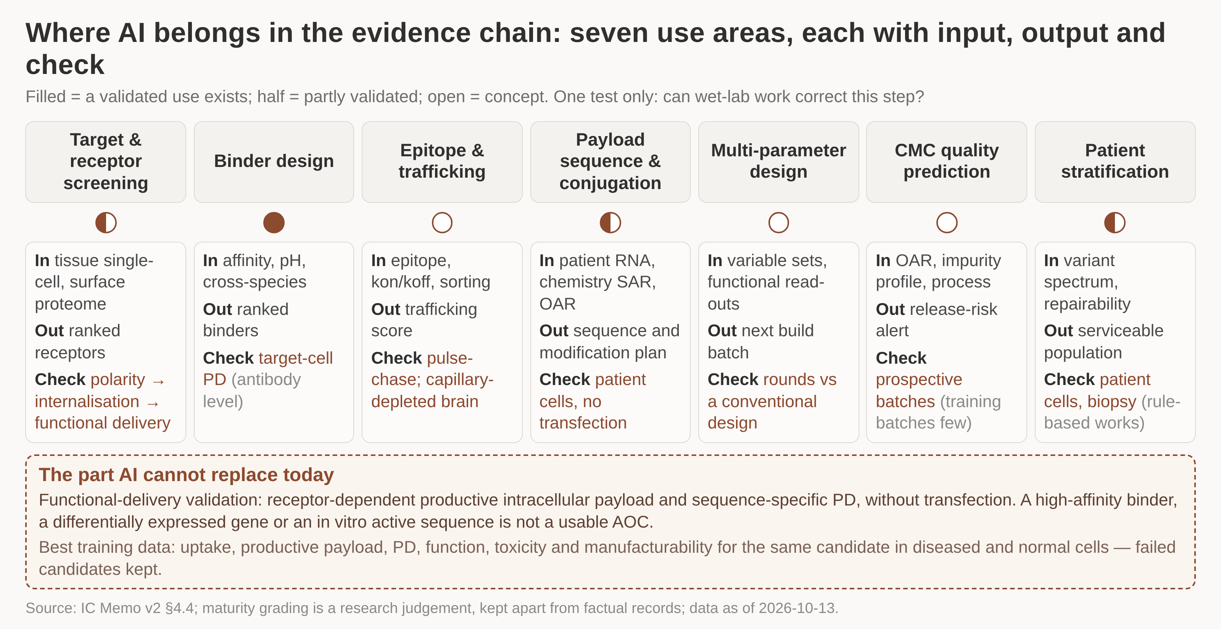
AI is applied only where wet-lab work can correct it, each task with its own validation loop
/ WHY US
AI is pointed first at four task classes that wet-lab work can correct, each with one loop and one pass criterion - functional-delivery ranking; gain is measured against a non-AI baseline at the same budget on the same task, and the blind set and retraining rights stay with NewCo.
1 Seven AI use areas, each written out as input, output and the wet-lab check that corrects it.
2 One filled circle only, binder design; three areas are partly validated and three remain concepts.
3 The pass criterion is the same everywhere: functional-delivery ranking without transfection.
4 The brown box is the gap AI cannot close, receptor-dependent payload and sequence-specific PD.
5 Best training data pair diseased and normal cells for one candidate, failures kept, not discarded.
DETAIL IN THE MEMO
Seven use areas fold into four task classes, each with its own validation loop
Seven use areas with input, output and validation; filled, half-filled and open circles grade how far each is proven
The maturity grading is a research judgement, stated as such in the source, and is kept apart from that source's factual records
The four statuses are counted by step rather than by application, so the status totals and the seven use areas belong to two different countings; the figure keeps the original seven
A high-affinity binder, a differentially expressed gene or an in vitro active sequence is not a usable AOC, and no AI result substitutes for functional-delivery validation
Source: IC Memo v2 §4.4; data as of 2026-10-13
Notes:
There is one test for any AI step: can a wet-lab experiment close the loop and correct it. Binder design is the only area with a validated use today, target and receptor screening, payload sequence work and patient stratification are partly validated, and trafficking, multi-parameter design and CMC quality prediction remain concepts. What AI cannot yet replace is functional-delivery validation - receptor-dependent productive intracellular payload and sequence-specific PD without transfection. The most valuable training data are uptake, productive payload, PD, function, toxicity and manufacturability for the same candidate in diseased and in normal cells, with failed candidates kept rather than discarded. Cut for space: the seven acceptance criteria and the four label-discipline rules.

Slide 27
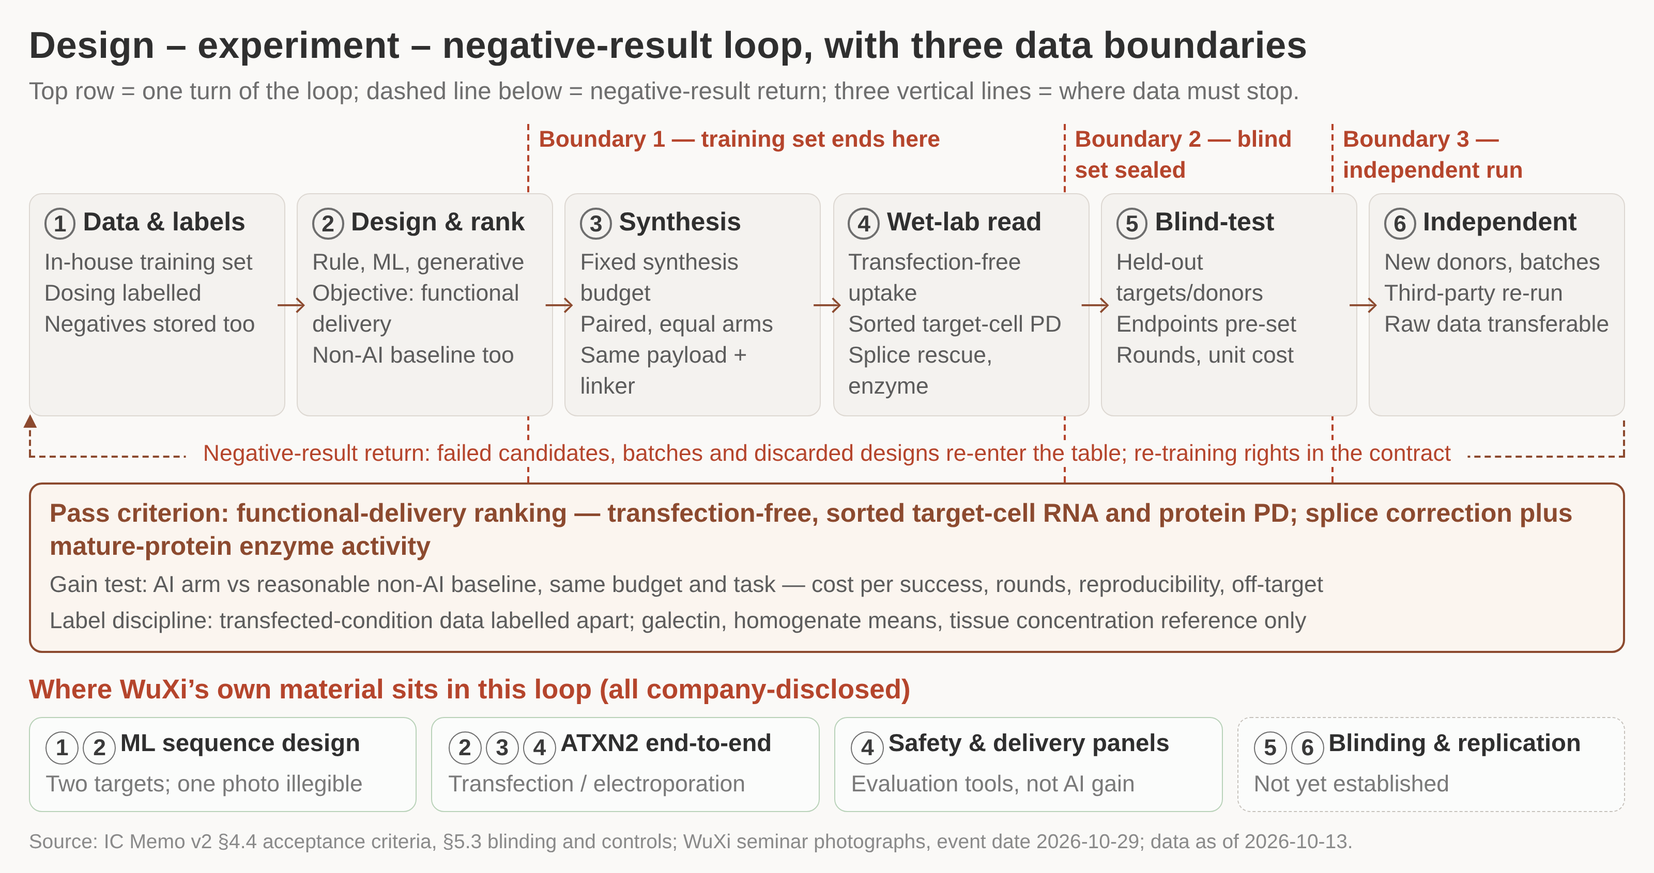
WuXi's internal AI evidence shows tools and a discovery workflow; the gain number needs a prospective control
/ WHY US
Internal AI material supports tools and a payload-discovery workflow, not a measured gain. The gain number should come from one prospective controlled run on a defined target, and this round approves the twelve answers and a prospective-collaboration SOW.
1 The top row is the loop we want to buy; WuXi's own material covers only its first four steps.
2 Boundary one closes the training set, boundary two seals the blind set, boundary three changes donor, batch and executing party.
3 Blinding, held-out targets and independent replication are the steps nobody has run yet.
4 Negative results loop back into the same table, with re-training rights and ownership written into the contract.
5 The pass criterion is a functional-delivery ranking read on sorted cells, not a hit rate under transfection.
DETAIL IN THE MEMO
Twelve questions for Andy Ng and the oligonucleotide discovery team sit in the memo.
Every internal figure shown is company-disclosed; none was re-verified this round.
Six-step design loop with negative-result return and three data boundaries; the four cards show where WuXi's own material sits
Material event date 2026-10-29; checks anchored to the 2026-10-13 report and 2026-10-11 project stage, with no re-verification this round, so the figures stay company-disclosed.
Slides and posters are marketing material: 'can do' versus 'does it well', and 'done once' versus 'repeatable', are judged separately.
Source: IC Memo v2 (§4.4, §4.6, §5.3); WuXi capability map, investor view; seminar photographs, event date 2026-10-29; data as of 2026-10-13
Notes:
The loop is the test the collaboration has to pass, not a description of what already exists. WuXi's own material covers the first four steps - data and labels, design and ranking, paired synthesis, wet-lab readout - while blinding, held-out targets and independent replication are not yet established and would be built in a prospective collaboration. The gain test is the AI arm against a reasonable non-AI baseline at the same experimental budget and task, recording cost per success, rounds needed, reproducibility and off-target effects. Labels from transfected conditions are tagged separately, and galectin signal, homogenate means and tissue concentration stay reference-only, with positive labels taken from cell-resolved readouts. Cut for space: the ATXN2 hit rate is recorded as disclosed and under transfection or electroporation, not as a validated AI gain, and one of the two targets in the pipeline photo is illegible.

Slide 28
The group already runs the full oligonucleotide discovery chain, at a scale that makes screening a schedule rather than a risk
/ WHY US
Sequence design, screening and the safety package are routine work here, not a build. The assays our first read-outs depend on - including cytosolic arrival measured directly - are already running.
1,000+
oligo discovery projects delivered
250+
targets, across 300+ clients
60+
programmes taken to IND
7,000+
oligos screened in one 8-week campaign
The assays our first read-outs need
Exon skipping measured in differentiated human skeletal muscle cells with sequence-confirmed bands - the same read-out our splice-correction benchmark requires.
Antibody-mediated free uptake in iPSC-derived cardiomyocytes, run side by side with transfection, which is how a delivery claim is separated from a payload claim.
Endosomal escape measured three ways: endo-lysosomal colocalization, galectin foci, and split-luciferase quantification of cytosolic arrival.
Machine-learning sequence design with cross-species and genome-wide off-target screens, plus patent risk tagging; off-target and immunogenicity confirmed by RNA-seq, cytokine, complement and platelet assays.
Split-luciferase quantification of cytosolic arrival is the measurement most often missing from published conjugate work, and it is the one our first gate turns on.
Figures are from WuXi materials marked confidential; this page is for internal IC use and should not be circulated externally without written permission.
Source: WuXi Biology oligonucleotide platform overview, Oct 2026. Internal use only
Notes:
The purpose of this page is to show that the screening and assay work our gates require is routine here. Call out the third bullet specifically: it distinguishes productive delivery from tissue accumulation.

Slide 29
Conjugation and characterization are in place, which is where our first gate is decided
/ WHY US
The conjugate gate turns on two questions: can we make material whose payload distribution we can actually report, and can we tell free payload from conjugated payload in a tissue sample. Both are answered by capability already running in the group.
Conjugation and analytics
Pharmacokinetics and bioanalysis
Random conjugation via interchain disulfides, and site-specific routes by cysteine mutagenesis or enzymatic tagging, giving defined payload-to-antibody ratios of one or two.
Linker library spanning alkyl, PEG, cleavable disulfide and peptide chemistries; over 1,000 maleimide-oligos delivered in 2025 at greater than 95% purity.
Representative conjugate: ratio 1.0 with no unconjugated antibody detected, 90% purity by anion exchange and 95% by size exclusion, endotoxin below 0.1 EU/mg.
Characterization by anion exchange, size exclusion, mass spectrometry and peptide mapping - the basis for reporting a full payload distribution rather than an average.
Conjugate-specific bioanalysis separating total antibody, conjugated antibody, free payload and each oligo strand - the only way to read a tissue result correctly.
Ligand binding, mass spectrometry and stem-loop PCR platforms, including a payload ratio read directly from high-resolution mass spectrometry.
200+ rodent and 10+ large-animal conjugate pharmacokinetic studies completed, with metabolite identification at both the oligo and the protein level.
Dosing and sampling routes relevant to our programmes, including intramuscular, intrathecal and intracerebroventricular administration.
Five to six weeks' turnaround at 1-50 mg scale, 150+ conjugates delivered across 20+ programmes - fast enough to compare configurations in parallel rather than in sequence.
Figures are from WuXi materials marked confidential; this page is for internal IC use and should not be circulated externally without written permission.
Source: WuXi AppTec integrated antibody-oligonucleotide conjugate platform, Oct 2026. Internal use only
Notes:
The turnaround figure is what makes parallel evaluation of the three configurations affordable in time, which is the practical argument for not choosing a configuration today.

Slide 30
4
How we build
Entry route, the three configurations, first programmes, team, budget and the governance we ask the IC to approve

Slide 31
Licensing a proven entry and building on it is the base case; equity co-incubation stays the alternative
/ HOW WE BUILD
Run diligence on all three in parallel, with licence-then-build as the base case; if rights are not obtainable within 6 months, compare alternative entries or co-incubation.
Three ways into the field
Entry mode | What it buys | What it costs | Pick it when
Build fully in-house | Full decision autonomy; background technology accumulates inside the company | New receptor, new payload and new model stack up: longer, riskier early cycle | No licensable entry covers the target product and the rights we need
License the entry, then build | Concentrates risk on nuclear delivery and disease function, not on entry discovery | Depends on a licensor able to grant, with scope coverage and affordable economics | Rights are obtainable — the base case for the validation period
Minority stake / co-incubation | Fastest access to an existing team and an existing construct | Less control; service synergies and ownership of new IP must be agreed up front | Rights are not obtainable, or an existing asset is already ahead of us
Source: IC Memo v2 (§6.3, §7.9); team analysis, cut-off 2026-10-12
Notes:
The case for building in-house has to come from the target product and the rights package we can assemble, not from the fact that few assets are available to buy. The three options differ mainly in how much technology evidence we can obtain at the moment of entry: the more mature that evidence, the lower the new-technology R&D burden we carry. Licence-then-build is the base case because it moves our risk off entry discovery and onto nuclear delivery and disease function, which is where our own work adds value. Project evidence and control rights under a minority stake still need diligence, and the ownership of newly created IP and any service synergies must be written into the agreement. The positioning here is a strategy judgement, not a scored ranking or a valuation.

Slide 32
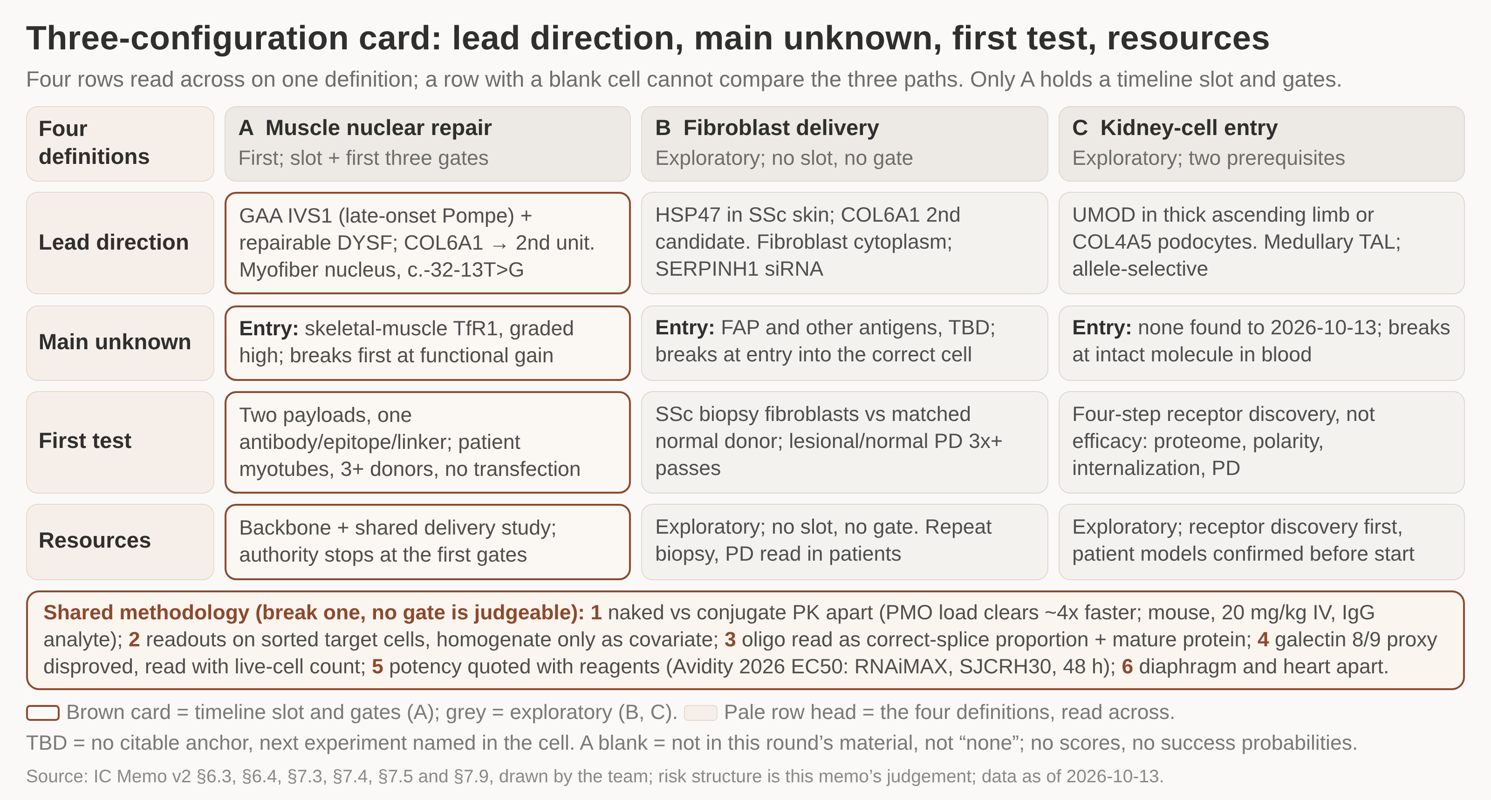
Three configurations evaluated in parallel: lead direction, first experiment and pass test matched row by row
/ HOW WE BUILD
This round buys the evidence that can change the configuration choice - the construct-neutral backbone study and the shared productive-delivery study - rather than writing three platforms into one first budget. Only configuration A holds a timeline slot and gates.
1 Four rows read across on one definition; a row with a blank cell cannot compare the three paths.
2 Only the brown card holds a timeline slot and gates; the two grey cards stay exploratory this round.
3 Each path breaks first at a different step, which is why one shared experiment cannot settle all three.
4 The first budget buys the construct-neutral backbone study and the shared productive-delivery study.
5 The band underneath is the methodology all three share; break one line and no gate can be judged.
DETAIL IN THE MEMO
Cells give the memo's reported value first, then this memo's judgement.
Amounts, valuation, shareholding and the approval outcome stay TBD.
Three-configuration card: lead direction, main unknown, first validation and resources, four rows read across the three columns
The owner asked for all three configurations to be analysed in parallel; no three-way choice is made this round, and the page does not record one as pending arbitration either.
'Lower risk' refers only to the entry step, where skeletal-muscle TfR1 has human PD in the same target-cell type; competition, freedom-to-operate and clinical risk are judged separately.
Amounts, valuation, shareholding and the approval outcome are TBD; diaphragm samples are the main bottleneck, and cardiac and CNS stay outside this round as collaboration extensions.
Source: IC Memo v2 (§6.1, §6.3, §6.4, §7.2, §7.3, §7.4, §7.5, §7.9); team analysis; data as of 2026-10-13
Notes:
A card counts as comparable only when all four rows are filled; a blank reads 'to be completed' and names the next experiment, which is why the three cards are read across rather than scored. Configuration A breaks first at functional improvement, B at entry into the correct cell, and C at intact molecule in blood and entry - three different points in the same delivery sequence, so one shared experiment cannot settle all three. A carries the construct-neutral backbone study and the shared productive-delivery study with its patient-cell arm; B and C stay exploratory, with C additionally requiring receptor discovery first and confirmed patient-derived models before any start. Cut for space: the six shared methodological constraints, of which the most consequential are that naked-antibody and conjugate PK are measured separately and that every decision readout is taken on sorted target cells.

Slide 33
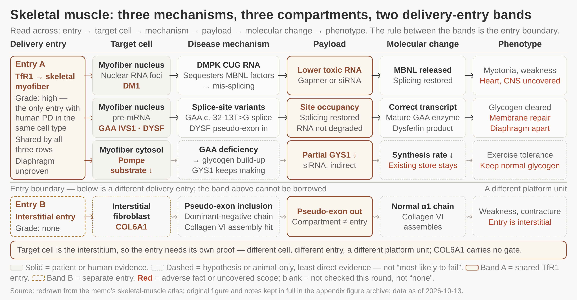
GAA IVS1 sets the mechanism and delivery benchmark: a four-level chain from splice correction to glycogen
/ HOW WE BUILD
GAA IVS1 matters because it runs splice correction to mature enzyme to enzyme activity to glycogen once under free uptake, becoming the reference point for nuclear oligonucleotide delivery into myofibers; other cells, proteins and payloads each need their own evidence.
1 Three mechanisms share one delivery entry, TfR1 into the skeletal myofiber, read left to right.
2 The GAA and DYSF row is the four-level chain: correct transcript, mature enzyme, activity, glycogen.
3 Dashed boxes mark the substrate-reduction row, where the evidence is animal-only or assumed.
4 Red text flags what each row does not cover, including heart, CNS and the diaphragm.
5 Below the rule is a second entry: COL6A1 sits in interstitial fibroblasts and cannot borrow the band above.
DETAIL IN THE MEMO
Delivery reads high because a same-type target cell already has human PD.
The eight-column grid for GAA IVS1 in late-onset Pompe stays in the memo.
Skeletal muscle read across: delivery entry, target cell, mechanism, payload, molecular change, phenotype, in two entry bands
Figures, registry numbers, species and n carry the memo's original qualifiers; check-dates are project stage 2026-10-11, literature 2026-10-07, working-paper report 2026-10-13.
Patient-cell evidence for the two first-cluster payloads and COL6A1 is disclosed at payload level only; the conjugate-level steps from blood to productive intracellular payload are missing.
A change in transcript ratio alone is not a claim of disease modification, and diaphragm coverage still has to be shown separately from limb muscle.
Source: IC Memo v2 (§6.1, §6.2, §6.4, §7.7, §8.1); team analysis; data as of 2026-10-13
Notes:
The same skeletal-muscle entry carries three different mechanisms in the source material: toxic-RNA reduction in DM1, splice correction for GAA and DYSF, and partial GYS1 knockdown as an indirect substrate-reduction route that slows new glycogen synthesis but does not clear what has already accumulated. The four-level chain is what makes GAA IVS1 a benchmark rather than one more splice-correction result, because each level is read on its own terms - correct-transcript proportion, mature GAA protein, enzyme activity, cell glycogen - with no transfection reagent in the system. Chemistry is mature here, so the conjugate characterization study, not the biology, sets oligonucleotide-to-antibody ratio distribution, site occupancy and free-payload residue. The COL6A1 row sits below the entry boundary because its product cell is the muscle interstitial fibroblast nucleus: same compartment does not mean same entry, and the band above cannot be borrowed.

Slide 34
DYSF advances as a conditional product: two routes on one entry, each proving its own claim
/ HOW WE BUILD
Product status requires all four at once: an identifiable patient population, functional change, rights and clinical increment. If they do not hold, DYSF reverts to a platform-validation payload.
The two routes differ in product, frame and population
Route | Splicing event | Expected product | What must be proven
Pseudoexon removal | The oligonucleotide blocks a pseudoexon that a deep-intronic variant causes to be included | Full-length transcript in normal reading frame; full-length dysferlin | Localization and laser-injury membrane repair, against normal donor cells
Tolerated coding-exon skipping | The oligonucleotide skips an exon that belongs to the coding sequence | Internally deleted transcript, frame still readable; shorter dysferlin isoform | That isoform's own function; deletion effects differ from exon to exon
Shared and divergent | Both use nuclear splice occupancy, the same entry and the same functional readout | They differ in expected product, frame consequence and variant population covered | Success of DMD exon skipping is adjacent evidence for the second route only
Source: IC Memo v2 (§6.2, §6.4, §7.9); team analysis, data cut-off 2026-10-13
Notes:
DYSF is the second payload of the first wave, and its job this round is to deliver the platform-transfer evidence: a second payload producing an independent functional readout on the same entry, which is the single criterion of the platform-transfer gate. The two routes are mechanistically different and are kept apart in the readout tables, in the use claims and in patient stratification — the first restores full-length dysferlin, the second yields a shorter internally deleted isoform whose function cannot be assumed. If the four product conditions are not met, the programme is demoted to a platform-validation payload rather than kept alive to maintain pipeline count. Cut for space: the per-variant grid for repairable DYSF variants and the continue/demote/stop decision table.

Slide 35
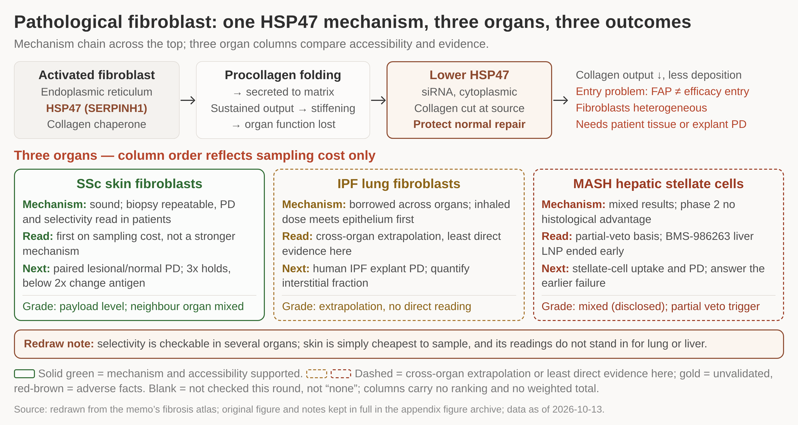
COL6A1 and HSP47 are two entry tasks: interstitial delivery and the selectivity window prove themselves apart
/ HOW WE BUILD
The fibroblast side runs as two independent entry tasks that only share a cell class. COL6A1 keeps one gated option, taken when models and materials are separately available; HSP47's value this round is measuring the lesional-versus-normal selectivity window.
1 One mechanism chain across the top: HSP47 chaperone, siRNA knockdown, less collagen deposited.
2 The fourth box is the entry problem: FAP expression is not the same thing as a drug-efficacy entry.
3 The three organ cards compare evidence, not mechanism: solid green for skin, dashed for lung and liver.
4 Skin leads the column order on sampling cost alone; its readings do not stand in for lung or liver.
5 The liver card already carries adverse facts, with a phase 2 showing no histological advantage.
DETAIL IN THE MEMO
COL6A1 and HSP47 are two entry tasks that happen to share a cell class.
The selectivity window holds at 3x; below 2x we change the antigen, not the payload.
One HSP47 mechanism chain across the top, then SSc skin, IPF lung and MASH liver compared for accessibility and evidence
COL6A1's product cell is the muscle interstitial fibroblast nucleus, a separate entry task from the myofiber; no reuse claim here puts COL6A1 inside the myofiber entry's scope.
If the myofiber entry cannot be secured this configuration serves as a comparison, but a failure budget does not automatically convert into a second platform.
Skin ranks first on sampling cost, not on a stronger mechanism; a skin readout does not stand in for the lung-side or liver-side reading.
Source: IC Memo v2 (§6.1, §6.2, §6.4, §7.4, §7.5); team analysis; data as of 2026-10-13
Notes:
The HSP47 test is a paired one: activated fibroblasts from an SSc patient biopsy against normal donor cells from the same site, with lesional and normal PD read inside the same experiment. A ratio of 3x or more with normal fibroblast proliferation, migration and wound closure intact means the selectivity window holds; a ratio below 2x means we change the antigen, not the payload. The three organs separate on evidence rather than on mechanism - skin is samplable and repeatable, lung rests on cross-organ extrapolation with the inhaled route meeting epithelium first, and the liver already carries adverse facts, with a phase 2 showing no histological advantage and hepatic uptake landing on hepatocytes and Kupffer cells. The earlier BMS-986263 liver programme ended early, and that status is still to be verified. Cut for space: the original figure's wording implied skin was the only measurable organ, which this version corrects.

Slide 36
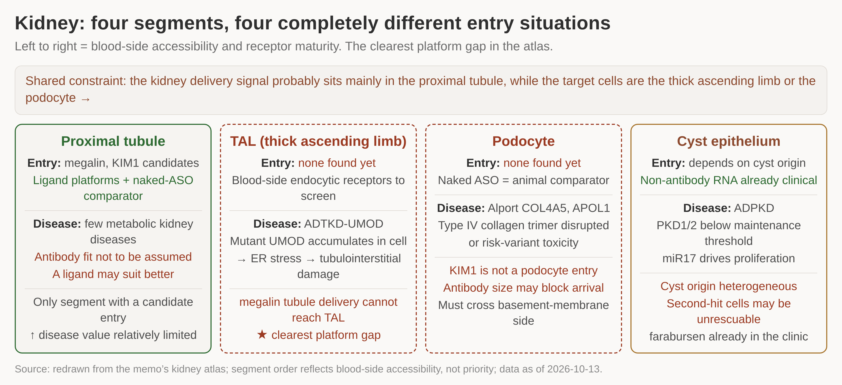
Kidney runs as two separate entry tasks: receptor discovery for TAL and podocytes before any platform claim
/ HOW WE BUILD
The kidney stays a high-risk research option. This round buys only the first two receptor-discovery steps - single-cell plus surface proteome, and polarity sections - which eliminate candidates cheaply, and confirms that patient-derived models are obtainable before any start.
1 Four segments ordered by blood-side accessibility: only the proximal tubule has a candidate entry.
2 The two dashed columns, TAL and podocyte, are the target cells and have no entry found yet.
3 The delivery signal sits where we do not need it, which is the clearest platform gap in the atlas.
4 Green text marks comparators that already exist: ligand platforms, naked ASO, non-antibody RNA.
5 Red text is what rules an option out: megalin cannot reach TAL, antibody size may block the podocyte.
DETAIL IN THE MEMO
This round buys only the first two of the four receptor-discovery steps.
Cyst epithelium is listed for completeness; farabursen is already in the clinic.
Four kidney segments ordered by blood-side accessibility and receptor maturity; the TAL and podocyte columns are the platform gap
UMOD in the thick ascending limb and COL4A5 in podocytes differ in target cell, access, mechanism and payload design, so they are funded apart, not as one generic kidney platform.
Sparse entries mean high discovery risk, and existing non-antibody nucleic-acid pharmacology in the kidney raises the bar an antibody increment has to clear.
Entry status is stated only to this round's search limit of 2026-10-13; a blank means not found in the material, not that no receptor exists.
Source: IC Memo v2 (§6.1, §6.2, §6.4, §7.5, §7.9); team analysis; data as of 2026-10-13
Notes:
The common constraint across the organ is that the strongest delivery signal sits in the proximal tubule while the target cells are elsewhere, which is what makes the thick ascending limb the clearest platform gap in the atlas. Receptor discovery is an elimination exercise, not an efficacy study: candidates broadly expressed on liver, marrow or vascular endothelium are discarded, as are lumen-only expression and binding without internalization or routing entirely to lysosome, and no specific PD at the patient-model step retires the receptor and returns the search to step one. The proximal tubule is the only segment with a candidate entry, through megalin and KIM1, but its disease value is relatively limited and a ligand may suit better than an antibody. If the kidney does work it has the strongest barrier and the longest timescale of the three configurations, which is why it is preferably advanced as a technology collaboration.

Slide 37
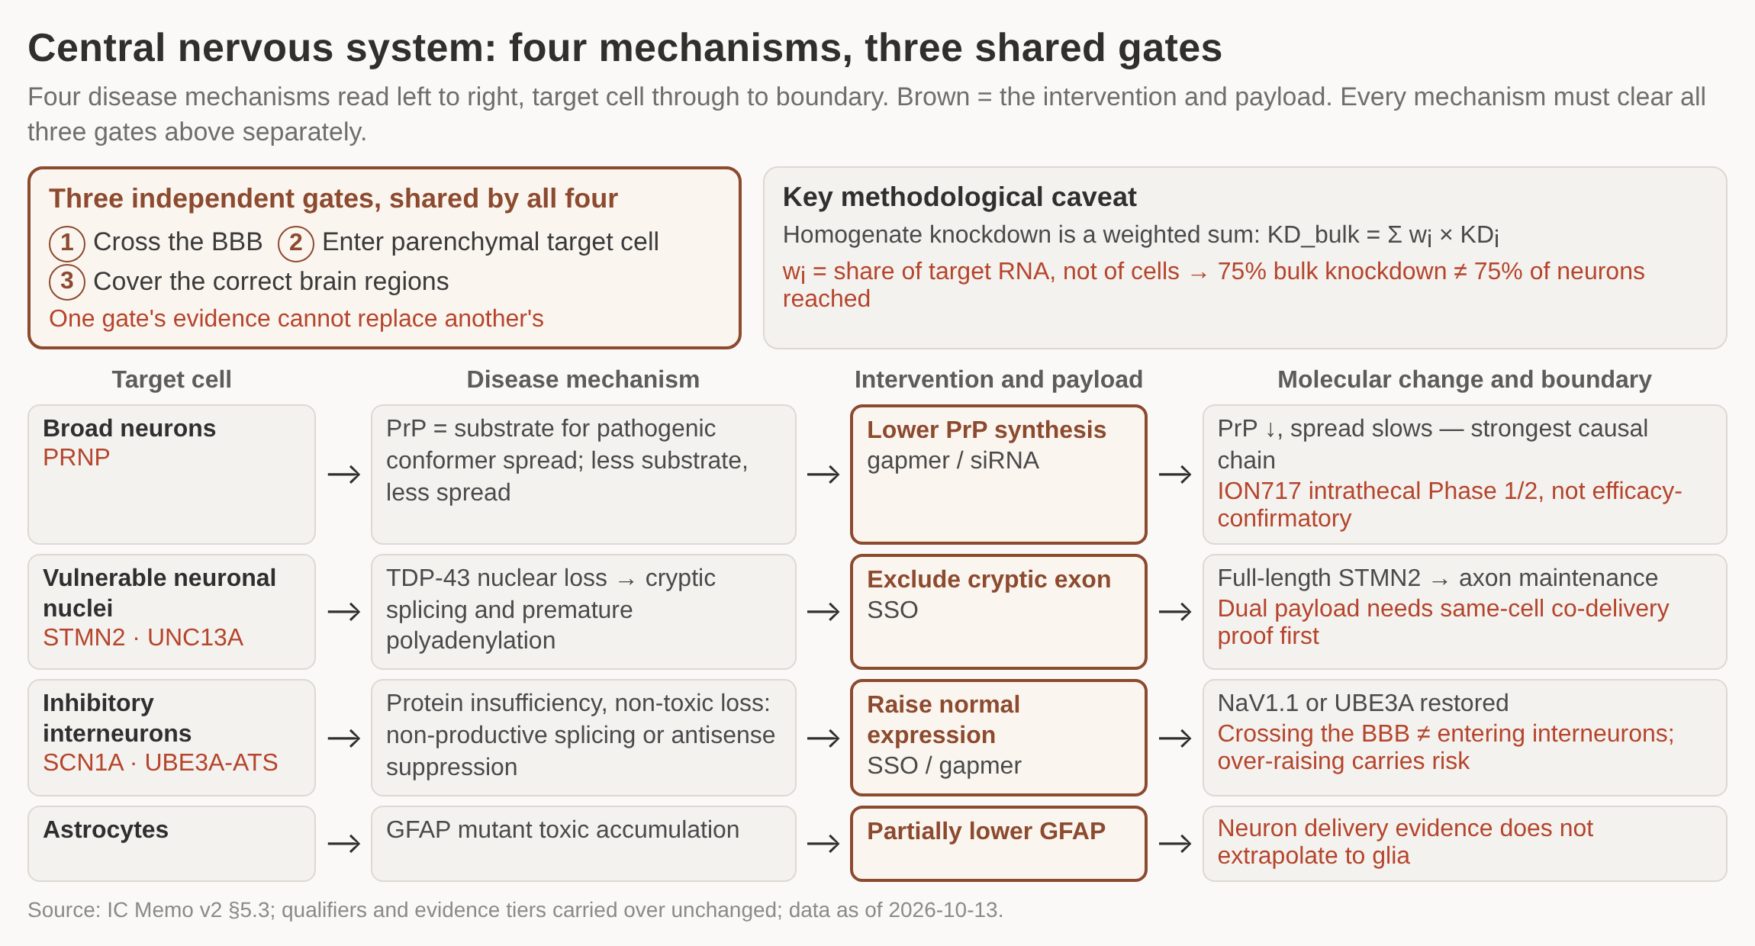
CNS and cardiac stay collaboration extensions: disease evidence is deep, delivery evidence is filled in gate by gate
/ HOW WE BUILD
CNS and cardiac are held as collaboration extensions entered only through a verifiable technology or product partnership: the partner delivers final conjugate evidence for this payload in this cell, with raw material, models, a manufacturing definition and commercially usable rights.
1 Four mechanism rows, each read target cell to mechanism to payload to boundary; the brown column is the intervention.
2 The three gates at the top are independent: crossing the barrier proves neither cell entry nor regional coverage.
3 Each row ends in a brown boundary line - what the evidence does not yet support, not what the mechanism promises.
4 Only the PRNP row has a clinical asset behind it, and the astrocyte row has no neuron evidence that carries over.
DETAIL IN THE MEMO
CNS asset and benchmark rows sit in the memo, with material and verification dates apart.
Six preconditions are checked item by item before any collaboration spend is committed.
Four CNS mechanisms read left to right from target cell to boundary; above them the three delivery gates every mechanism must clear separately
Registry status for the benchmark assets was read on 2026-10-11 against materials dated 2026-09-30, and nothing in this section has been re-verified here.
Crossing the blood-brain barrier is not entry into the parenchymal target cell, and neither is coverage of the correct brain regions: evidence for one gate cannot stand in for another.
Homogenate knockdown is weighted by each cell population's share of target RNA, not by cell count, so 75% bulk knockdown does not mean 75% of neurons were reached.
Source: IC Memo v2 (§1, §5.3, §6.3); data as of 2026-10-13; registry read 2026-10-11
Notes:
CNS is a disease direction and cardiac is a separate one, and both are kept out of the build plan. The disease-side evidence in CNS is deep across four mechanism groups - lowering PrP synthesis in prion disease, excluding the cryptic exon to restore full-length STMN2 where TDP-43 nuclear function is lost, raising expression at SCN1A and UBE3A-ATS in inhibitory interneurons, and partially lowering mutant GFAP in astrocytes - but each still has to clear all three delivery gates on its own. Neuronal delivery evidence does not extrapolate to glia, and skeletal-muscle human delivery evidence does not carry over to cardiac. Cut for space: the per-asset benchmark table, the full six-precondition list and the quality-balance detail, all of which stay in the memo.

Slide 38
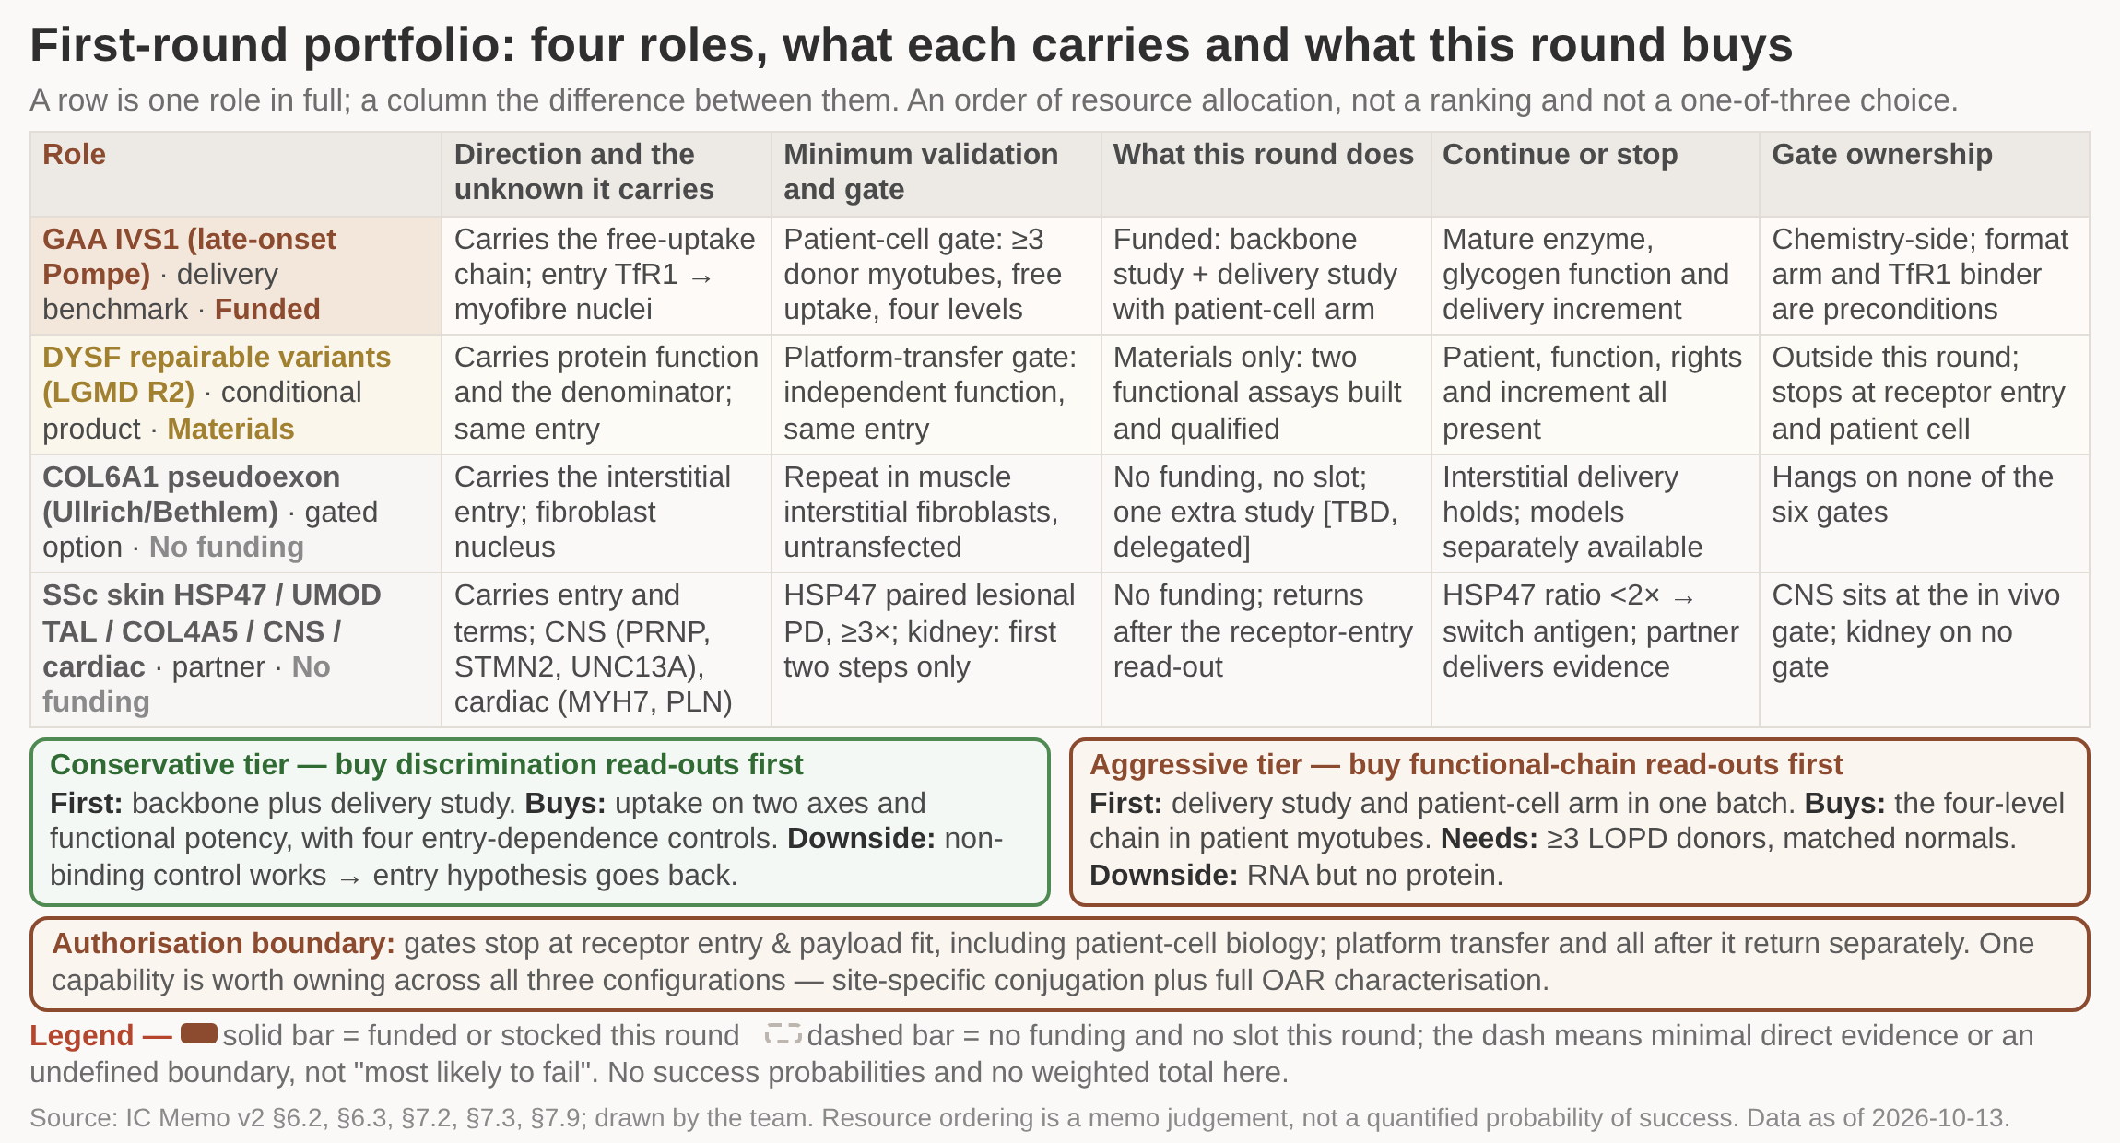
First round carries three named unknowns: one mechanism benchmark, one conditional product, one gated option
/ HOW WE BUILD
The first round takes on three unknowns that can be named - a mechanism benchmark in GAA IVS1, a conditional product in DYSF, a gated option in COL6A1 - with the rest held for partnering; if entry rights, the product population or function fails, not forming NewCo stays acceptable.
1 Each row is one role read end to end: direction, gate, what this round funds, and the stop condition.
2 Only the top two rows carry money this round - one benchmark funded, one product stocked with assays.
3 The two dashed rows take no slot in the sequence, so nothing downstream waits on them.
4 The two tiers below differ in one thing: whether the first study buys discrimination or function.
DETAIL IN THE MEMO
First-round roles, minimum validation and continue-or-stop conditions sit in the memo.
The portfolio is an allocation order, not a ranking of the three configurations.
Four roles as columns, read down from direction to gate ownership; solid columns are funded or stocked this round, dashed columns are not
The portfolio is not a one-of-three choice made this round: the three configurations stay listed in parallel, and no decision between them is taken here.
Authorisation reaches only receptor entry and payload fit, including patient-cell biology; the platform-transfer gate and everything after it come back to committee separately.
Every number and status in this section is carried over from the memo with its original qualifier and evidence tier; nothing has been re-verified. Data as of 2026-10-13.
Source: IC Memo v2 §6.2, §6.3, §7.2, §7.3, §7.9; data as of 2026-10-13
Notes:
GAA IVS1 carries the functional chain under free uptake and is the only entry where AOC already has human PD in the same class of target cell. DYSF carries the function of the expected protein product and the patient denominator, and it is the only test of platform transfer: a second payload producing independent function at the same entry. COL6A1 gets no money and no slot - it is one independent gated judgement, made only if interstitial functional delivery holds and models and materials are separately obtainable. The first study can be bought two ways: the conservative tier buys discrimination read-outs first, with uptake and functional potency on separate axes and all four entry-dependence controls; the aggressive tier starts the patient-cell arm in the same batch and goes straight at the four-level functional chain. One capability is worth owning across all three configurations - site-specific conjugation and full OAR distribution characterisation - because it decides whether discovery-stage data can be interpreted at all.

Slide 39
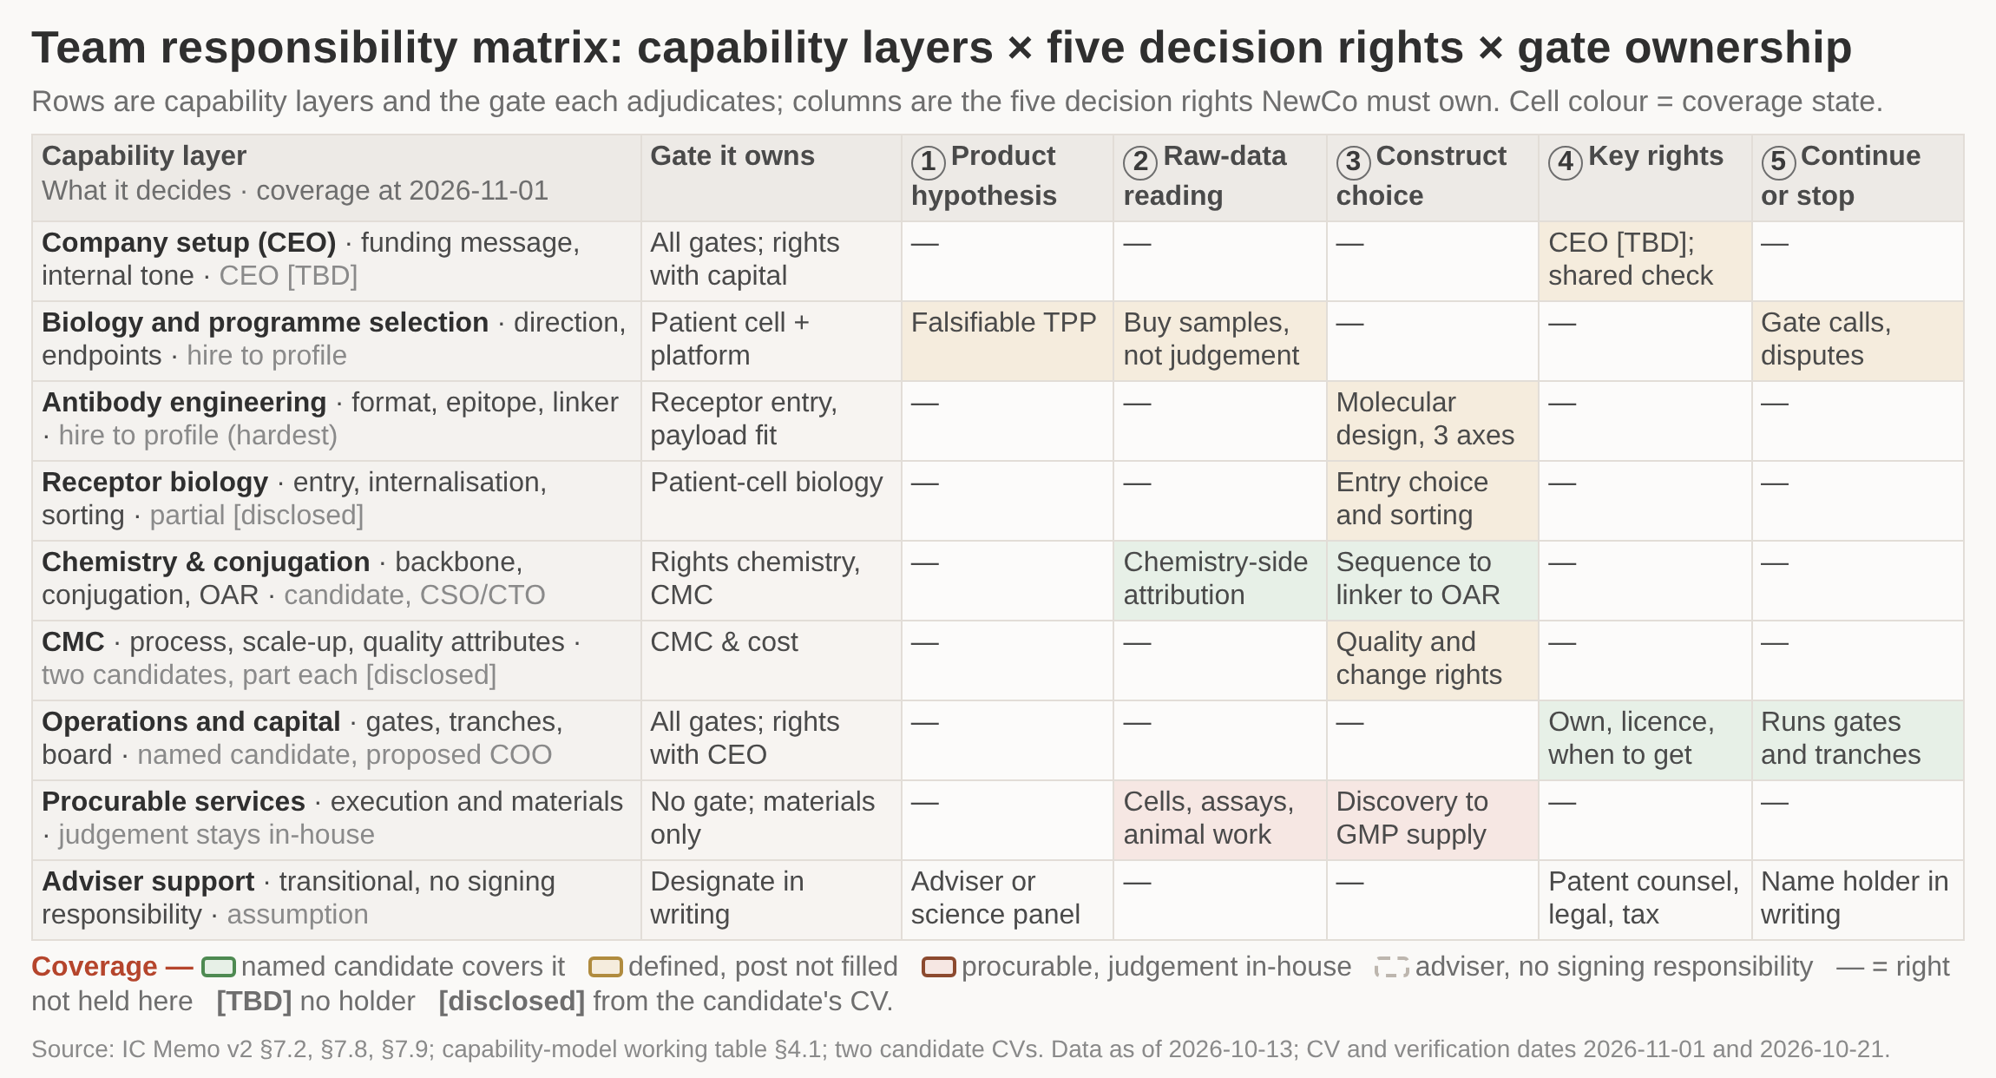
Two of the six capability layers have named candidates; the science and product lead unblocks the rest
/ HOW WE BUILD
What this round approves is a profile and a set of signing responsibilities, not a headcount table: two layers have named candidates, the biology lead comes in first as an adviser with gate adjudication designated in writing, and no term negotiation starts before conflict-of-interest closes.
1 Nine rows against five decision rights: green cells have a named candidate, tan cells are still only a profile.
2 Just two rows are green, and both sit low on the ladder - chemistry and conjugation, operations and capital.
3 Every tan cell in the biology row blocks a gate, which is why that one hire unblocks the rest.
4 Pink cells can be bought in, but the read-out and the failure attribution stay inside the company.
5 Dashed cells are adviser cover only; an opinion there does not substitute for signing responsibility.
DETAIL IN THE MEMO
The six-layer model with gate ownership and coverage status sits in the memo.
Four conflict-of-interest documents must close before any term negotiation starts.
Capability layers as rows, five decision rights as columns; cell colour marks candidate identified, fill to profile, procurable or adviser support
A CV does not carry in a former employer's IP: authorship and inventorship prove participation only, not that a person is recruitable or that the technology or patents are freely available.
Proposed CSO/CTO and COO are proposals only: appointment, time commitment, equity, current status and employment restrictions are confirmed in writing before any work package starts.
Both named candidates work for organisations whose direction overlaps heavily with this project; until the conflict-of-interest documents close, neither may judge a gate read-out alone.
Source: IC Memo v2 §7.2, §7.8, §7.9; capability-model working table §4.1; two candidate CVs. Data as of 2026-10-13; CV and verification dates 2026-11-01 and 2026-10-21
Notes:
The unit of judgement is the adjudication right, not the job title. Chemistry and conjugation is covered by a named candidate proposed as CSO/CTO, and operations and capital by a named candidate proposed as COO. The biology and programme-selection layer is the hire that unblocks everything else, because it adjudicates the patient-cell biology and platform-transfer gates directly and rules on whether read-outs qualify at the other four. Patient-derived cells, functional assays, animal work and toxicology can be procured, but interpretation and failure attribution stay in-house; diaphragm samples need an animal substitute plan agreed in advance. Cut for space: the adviser-support arrangements that bridge the period before formal appointment, and the full four-document conflict-of-interest list.

Slide 40
External technology is taken module by module; outreach and rights checks are prerequisites, not gate criteria
/ HOW WE BUILD
The premise that no licensable mature AOC delivery platform exists is still unproven: every enquiry row reads 'not contacted'. Acquisition stays conditional, not 'must build in-house'.
Questions put to every delivery platform
Delivery-platform enquiries and what we do next
Whether skeletal-muscle rights have already been granted exclusively, and what scope remains.
Whether a mature, licensable AOC delivery package exists at all.
Plus one tailored question each: separated single-DAR species; GAA use-rights scope; non-competing split within the same disease; aptamer as a control arm.
Outreach runs in three steps: non-confidential materials first, rights verified under a confidentiality arrangement, terms last.
Counterparty | Status (2026-10-29) | Action this round
Vect-Horus, Manifold Bio, Nosis Bio | Not yet contacted; no contact record | Run the three outreach steps; nothing here is tied to a gate criterion
ABL Bio | Not yet contacted | Same three steps; sits outside the five-name wording list, so reconcile at source
Creyon Bio | Not yet contacted; no registry record and no IND verified (checked 2026-10-07) | Treat as a direct competitor; discuss only if residual field or territory rights are clear
Gensaic | No verifiable registry record found (checked 2026-10-07) | Add to the enquiry list and correct the name mismatch at the same time
Source: IC Memo v2 §4.5, §10.7 (verified 2026-10-07); enquiry-table status as of 2026-10-29
Notes:
Three things are being approved: a set of outreach conversations, two academic technology-transfer ownership checks, and closing one of three supply routes for the binder in the productive-delivery study. None of them is a gate criterion, and none of them delays a gate read-out. Zero hits on a sponsor search of CT.gov means not verified, not global whitespace: all five have publicly disclosed oligonucleotide delivery programmes that have simply not reached a registrable stage, and the search coverage itself has gaps. Cut for space: the seven-row table of identified technology sources and the seven-row table separating what can be acquired from what must be owned.

Slide 41
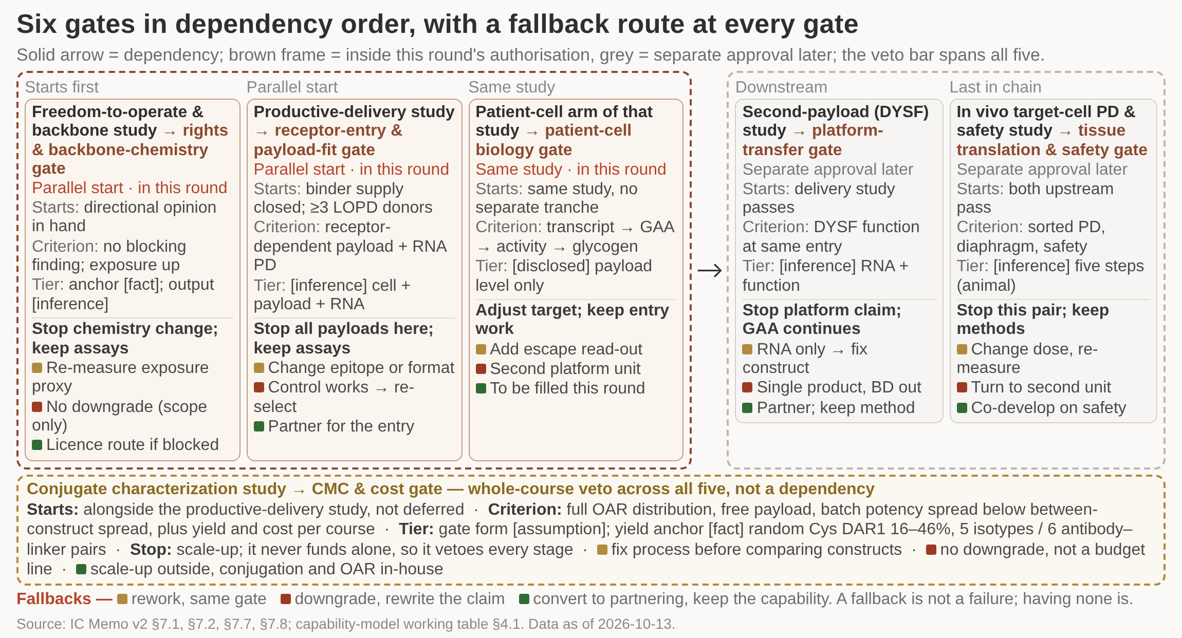
Six gates advance in dependency order, and every tranche hangs on a read-out that can be judged objectively
/ HOW WE BUILD
This round approves two tranches and one dependency graph - the freedom-to-operate and backbone study, and the productive-delivery study including its patient-cell arm - with no scale-up before the gate read-outs are in hand and three preset fallback routes, each with a cash boundary, at every gate.
1 Three studies start together inside the brown frame; two more run in series only once the first passes.
2 The veto bar spans all five: the CMC and cost gate is never funded alone but can stop any stage.
3 Each card ends in three preset fallbacks - rework, downgrade, convert to partnering - coded by colour.
4 Approval stops at the brown frame; the two grey cards return to committee with their own budget.
5 One fallback reads to be filled: this round's material specifies no partnering route at that gate.
DETAIL IN THE MEMO
Five studies and six gates with start preconditions and criteria sit in the memo.
A miss is decided by the IC among four options; no tranche releases automatically.
Studies and their gates as cards; solid arrows are dependencies, the brown dashed frame is this round's authorisation boundary
Approval stops at receptor entry and payload fit plus patient-cell biology: of the two gaps left open, only effective intracellular payload falls inside this round.
Across thirteen reference programmes including one control, none has direct in-material data on effective intracellular payload - that is a gap, not a proven rate-limiting step.
The one first-hand paper running a competition-inhibition experiment puts the main DAR2 limit at non-specific hepatic clearance in plasma, and concedes no direct evidence for the cell step.
Source: IC Memo v2 §7, §7.1, §7.2, §7.7, §7.8; capability-model working table §4.1; data as of 2026-10-13
Notes:
There is no calendar in this plan: order is set by dependency. The freedom-to-operate and backbone study and the conjugate characterization study start in parallel with the productive-delivery study, and the second-payload and in vivo studies are strictly downstream. The CMC and cost gate is never separately funded but holds a veto over every later stage, which is why it is drawn off the series chain. Each gate carries three fallbacks - rework inside the same gate, downgrade the claim, or convert to partnering - and a fallback is not a failure; having no fallback is. Pass thresholds at three gates are still TBD and are set back from the TPP rather than from a general figure. Cut for space: the per-gate cash boundaries and the full procedural list that has to close before the graph can run.

Slide 42
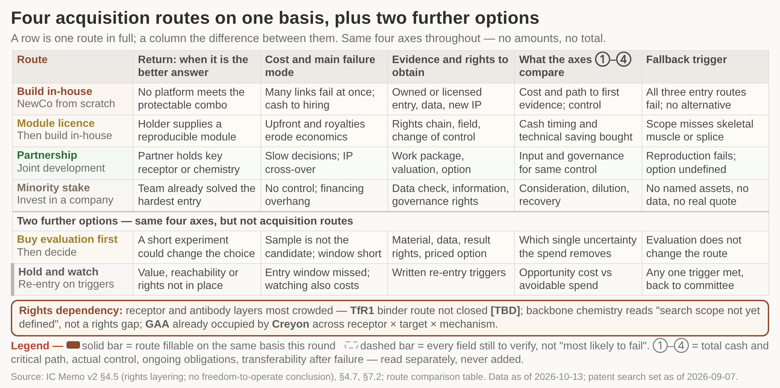
Build, licence, partnership and minority stake compared on one evidence and rights basis, each with a fallback trigger
/ HOW WE BUILD
Design-arounds belong at the antibody and backbone layers, not in switching tissue: this round verifies in parallel, as conditionals, one suppliable entry and one alternative-tissue option, and confirms a negotiable commercial path before any irreversible spend is enlarged.
1 Each row is one route written on the same four axes, so the rows can be compared line by line.
2 The dashed row is the minority stake: every field is still to verify, which is not the same as weak.
3 The two rows under the divider sit on the same axes but are not acquisition routes.
4 Every route carries a written fallback trigger, so stopping is a condition rather than a judgement call.
5 No cell holds an amount and nothing is summed - the figure deliberately produces no score.
DETAIL IN THE MEMO
Alternative designs, their costs and when a licence becomes mandatory sit in the memo.
Rights layering and the patent search set as of 2026-09-07 are recorded in the appendix.
Four routes as columns on the same four axes, read down for one route and across for the difference; dashed column is still entirely to verify
This round reaches no freedom-to-operate conclusion: a scanning-stage search supports no non-infringement view, and changing epitope or sequence is not by itself a completed design-around.
The backbone-chemistry layer returned no patent family numbers: its status is "search scope not yet defined", not "buildable" or "rights-free". Counsel's directional opinion comes first.
If two separately named backbone chemistries prove to be the same chemistry, that layer becomes named and licence-only immediately, and the comparison on this page is re-run.
Source: IC Memo v2 §4.5 (patent snapshot, no freedom-to-operate conclusion), §4.7, §7.2, Appendix B; route comparison table; data as of 2026-10-13; patent search set as of 2026-09-07
Notes:
The comparison basis is fixed first, and all four routes are written on the same four axes - total cash and critical path, actual control, ongoing obligations, transferability after failure - with no amounts and no weighted score. Rights dependency is most crowded at the receptor and antibody layers, where the acquisition route for the lead TfR1 binder is still open; the payload-sequence and disease-use layers are relatively open, while GAA is already occupied across the receptor, target and mechanism triple. Each route carries its own fallback trigger, so a route that stops does so against a written condition rather than a judgement call. Cut for space: the item-by-item alternative-design table and the detail of when a licence becomes mandatory at each layer.

Slide 43
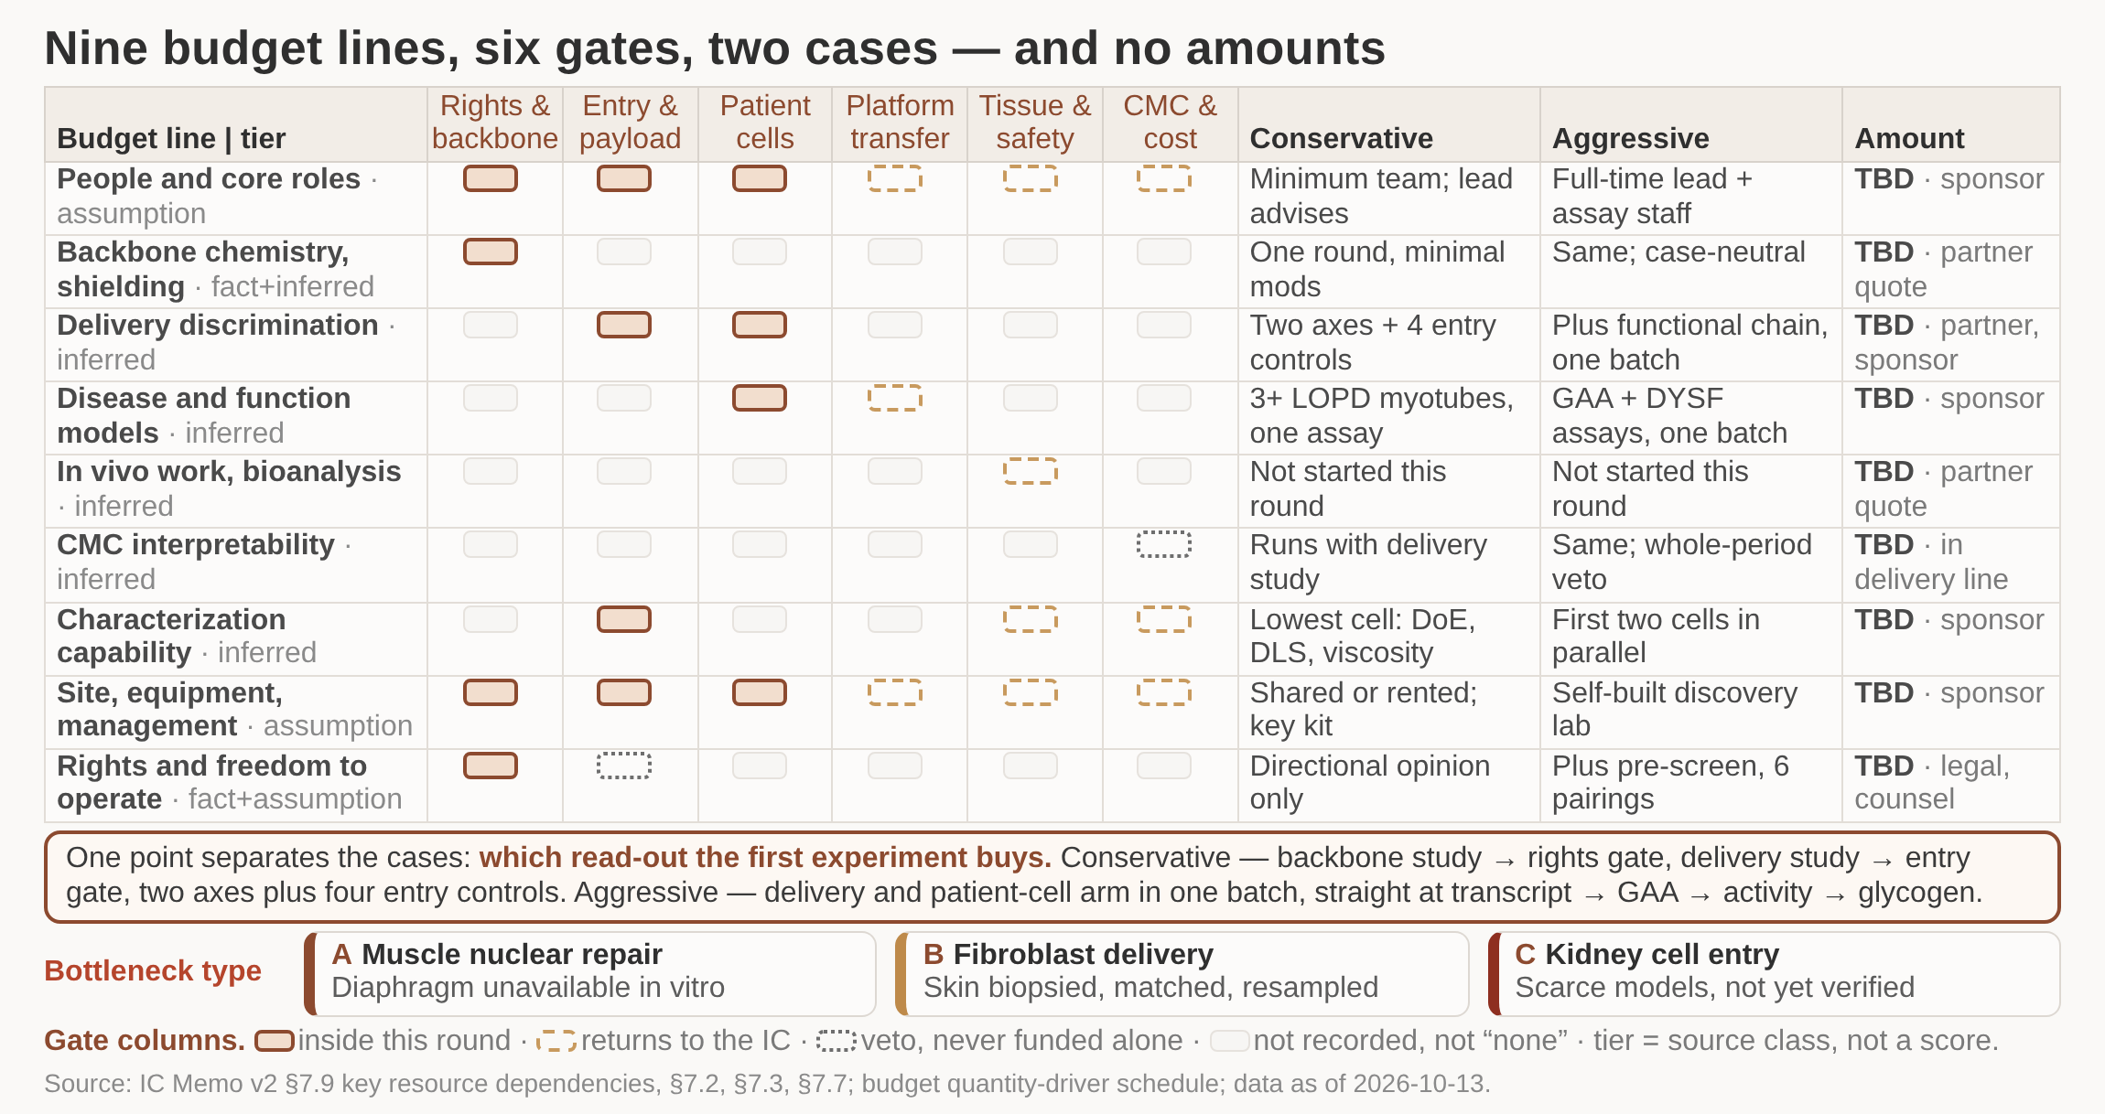
Budget rebuilt as line items and quantity drivers, each tied to a gate and split into two cases
/ HOW WE BUILD
What goes to the IC is a line-item schedule tied to gates plus two resource cases, not a total: amounts go in once the four prerequisites are settled and like-for-like quotes are in, and RMB 47m stands only as a recomputable muscle-configuration scenario, never a platform budget.
1 Why only line items and drivers this round
2 What actually drives the budget
3 The cases differ on the first read-out
4 Three configurations, three bottlenecks
DETAIL IN THE MEMO
Conservative: freedom-to-operate and backbone study plus the productive-delivery discrimination
Aggressive: delivery study and its patient-cell arm in one batch, straight at the functional end
Most valuable conservative result: similar uptake with more than fivefold difference in potency
Nine budget lines against six gates, the conservative and aggressive cases side by side, and every amount left as TBD
No amounts are given: a budget can only be built after company positioning, the case for conjugates, the patient and product profile, and the availability of rights are settled.
Public data do not support generic unit costs; cost per effective course is an output of the CMC and cost gate, not an input, and filling it now assumes that gate has passed.
The conservative case exposes failure fastest because the delivery study is the only one that can start without a fixed disease direction; the aggressive case is one notch slower.
Source: IC Memo v2 §4.3, §7.2, §7.3, §7.7, §7.9; budget quantity-driver schedule; data as of 2026-10-13
Notes:
Setting a raise first and back-filling the pipeline turns gate criteria into reporting decoration, so this round delivers the structure and leaves every figure blank against a named owner. The two cases are not big and small versions of the same plan: they differ on which read-out the first experiment buys. The conservative case buys discrimination - two axes recorded separately plus four entry-dependency controls - and its most useful outcome is similar uptake with a more than fivefold difference in functional potency. The aggressive case goes straight at the four-level chain in patient myotubes and is slower to expose a failure, because a negative functional endpoint still has to be attributed to delivery or to sequence. The three configurations bottleneck on different resources: muscle nuclear repair on donor myotubes and two functional assays, with diaphragm unobtainable in vitro and needing planning early; fibroblast delivery on clinical sampling, which is feasible; kidney entry on scarce models, where not verified is not the same as non-existent.

Slide 44
Addressable population is set by repairable-variant frequency and treatable disease stage, not by total disease counts
/ HOW WE BUILD
GAA IVS1: repairable-variant frequency differs by ancestry and cannot be carried across populations.
Addressable population to net sales - each factor used once
Step | Input | Where the number comes from | Owner
Prevalent and diagnosed | Prevalence in the study region; share already diagnosed | Regional epidemiology and registries | Science and product lead, with external epidemiology
Repairable-variant frequency | Share of the target variant in that disease population; not carried across ancestries | Genotype registries and sequencing centres | Science and product lead
Treatable disease stage | Share with residual reversible tissue function | Natural-history studies | Science and product lead, with clinical centres
Access to care and treatment | Centre coverage, diagnostic routes, payment pathway | Centre survey and payer research | Sponsor decision and market access
Adoption | Share of addressable patients who actually start treatment | Adoption curves of analogue therapies, with the analogue named | Finance and market access
Persistence | Share retained after starting treatment | Adoption curves of analogue therapies | Finance and market access
What bounds each direction, and what we will not do
DYSF: until the target-variant list is fixed, limb-girdle muscular dystrophy patients as a whole are not the denominator.
MYH7: the addressable population is limited by phasing and by SNP coverage.
No patient numbers, incidence, market size or price this round - every missing input is marked for verification with a named owner, never filled with an estimate.
Source: IC Memo v2 §6.1, §6.2; team analysis
Notes:
What we deliver is a market input table that can be voted down item by item, not a market size. Four things bound the addressable population: repairable-variant frequency, treatable disease stage, diagnostic route and net price. Each factor enters the derivation exactly once, so the same optimism cannot be counted twice. Addressable population and genotype coverage can only be built once the patient definition and target product profile are agreed. Cut for space: the per-direction patient subgroup and differentiation table.

Slide 45
Financing, dilution and exit on one basis; three cash-flow types modelled separately with parameters still to fill
/ HOW WE BUILD
The two empty tables and their rules are this round's deliverable; any arithmetic scenario reads as a sensitivity, not an expected return.
Three cash flows, modelled separately and never netted
Equity return
Paid at exit by holding and preference order. Exit value is set by the whole company, which licence income influences but does not equal; 'stake x equity value' holds only with single-class common. Amount TBD.
Company licence income
Upfront, milestones and royalties accrue to the company, with the development obligations. It raises company value and so equity return indirectly, but counting it as shareholder recovery double-counts. Terms TBD.
Related-party service income
Group-side revenue from NewCo buying services from the group: a NewCo cost, opposite to equity return and not an investment return. Turning capital into related-party purchasing does not remove risk. Pricing TBD.
Rules that hold the basis together
No back-solving a first-round post-money valuation from a platform purchase price or a BD upfront.
40/30/30 - WuXi AppTec 40%, co-investor 30%, founding team including option pool 30% - is illustrative, not a commitment.
Domestic limited company, converting to a joint-stock company if financing requires; no Cayman-HK-WFOE layering.
One co-investor's status is still TBD: if it is not purely financial, the claim that the increment sits only on the capability side must be re-judged.
Source: Governance and terms basis 04 §1.2, §2.1-§2.3 (shareholders, roles and protective provisions TBD); IC Memo v2; team analysis
Notes:
We are submitting two empty tables with their rules and a list of parameters to fill, not numbers. The three cash flows must stay separate because merging them either double-counts or hides an obligation. We do not reuse comparable-transaction return figures: different entry risk, different rights position and different capital structure make those multiples uninformative here. Governance terms already agreed in principle: no controlling stake, no board majority, a customer-data firewall accepted by both quality organisations, and no exclusive-sourcing requirement. Tranche structure is already determined by the gates, so financing instalments follow gate read-outs rather than a calendar.

Slide 46
Funding switches hang on gate read-outs only; the full rights opinion is a standalone diligence deliverable
/ HOW WE BUILD
Only counsel's written directional opinion is a release condition; the full rights opinion and targeted freedom-to-operate work are standalone diligence deliverables, not funding switches.
Stop conditions by gate - and what must not be done instead
Gate | What stops | What does not stop | What must not be done
Rights and backbone chemistry | Chemical modification work, where rights are constrained | Formulation, assays and characterisation build continue | No chemistry work to design around; no exposure-boosting modification that cuts potency
Receptor entry and payload fit | All payloads on that construct | Both functional assays and the characterisation already built remain in use | No rescue by raising affinity; if the non-binding control also works, the hypothesis fails
Patient-cell biology | Target choice or patient stratification is adjusted | Entry-side work continues | No rescue by stronger delivery; an RNA-ratio change alone is not disease repair
Platform transfer | The platform claim; fall back to a single product and revalue | GAA work may continue, but valuation and narrative must be rewritten | No passing off several sequences against one target as platform evidence
Tissue translation and safety | That entry and payload combination | Methods and analytical capability building continue | High total tissue concentration does not explain failure; homogenate data do not count
CMC and cost | Process scale-up | No separate tranche, so no 'stop this tranche' step; it holds a veto over every tranche | If batch spread exceeds between-construct spread, fix the process before comparing
Source: IC Memo v2 §7.2, §7.3, §7.7, §7.8; stop-condition annex to the investment agreement; data as of 2026-10-13
Notes:
A rights conclusion is a switch on scope of work, not a switch on money. Three downside cases are pre-scripted with immediate actions and an inventory list: the asset reduces to a single product, rights are not obtained, or a key person does not take up post. Five consideration groups are kept separate, share no parameters, and are all TBD. One sequencing conflict must be resolved before the terms are finalised: the targeted freedom-to-operate work is placed before the receptor-entry gate in one source and after the construct is fixed in another, and under our own definition the construct is fixed only after that gate reads out, so the two cannot both stand. The criteria behind each stop are two-sided where the source is two-sided: at the patient-cell gate, the target must change and function must recover in patient cells while normal cells are not over-affected.

Slide 47
Candidate questions ranked by discriminating power; nine resolutions and six open slots go to an item-by-item vote
/ HOW WE BUILD
Nine resolutions voted item by item and six open slots filled; authorisation stops at a defined preparation and verification period, after which the IC decides again.
Technical questions, ranked by what they settle
Question | Decision it settles | Answer that changes the plan
Yield from random-cysteine conjugation when isolating DAR1? | Whether conjugation chemistry is built in-house, borrowed internally or hired | A neat point value or a vague answer means conjugation chemistry needs its own hire
How do you report DAR? | Whether their team can define and sign off full OAR distribution characterisation | Reporting a mean, or no answer on thiol capping, means a separate analytical hire
How would you formulate a high-concentration subcutaneous AOC? | Whether colloidal-stability work starts this round or goes outside | Copying monoclonal-antibody practice means that workstream is outsourced
Is endosomal escape the rate-limiting step for AOC? | Whether a separate escape workstream and gate is budgeted; our answer is no | A flat 'yes', or review consensus presented as measurement, fails evidence discipline
Can Gal8/Gal9 reporters evidence productive delivery? | How the membrane-damage read-out at the patient-cell gate is defined | Treating galectin signal as delivery evidence means an external adviser defines it
What does a rise in tissue concentration show? | Whether homogenate discipline holds internally at the tissue translation gate | Explaining success or failure by total tissue concentration means independent review
What the IC is asked to settle
Conversations run in two stages, and the first stage can stand even if the second lapses.
Two candidates, conflicts of interest not yet cleared: no in-depth discussion, no terms, no equity and no title until that gate closes.
No question asks for a former employer's confidential material; any question touching undisclosed current-employer content is stopped on the spot.
Source: Candidate discussion outline 2026-10-20 §0, §2, §4-§5; IC Memo v2 §4.2.2; Cochran et al., J Med Chem 2026;69(17):20230-20247
Notes:
Questions are ordered by discriminating power, and each one is written to land on a single decision rather than on an impression. Avoid open questions about what the candidate finds exciting: they produce agreement, not information. For each question we also fix what source material we want to see - published methods, publicly discussable cases, the candidate's own reasoning - so that nothing asked requires a former employer's confidential information. Cut for space: the governance questions, the single most important question of the session, and the detail of the six open slots.

Slide 48
5
Recommendation
What we ask the investment committee to approve today

Slide 49
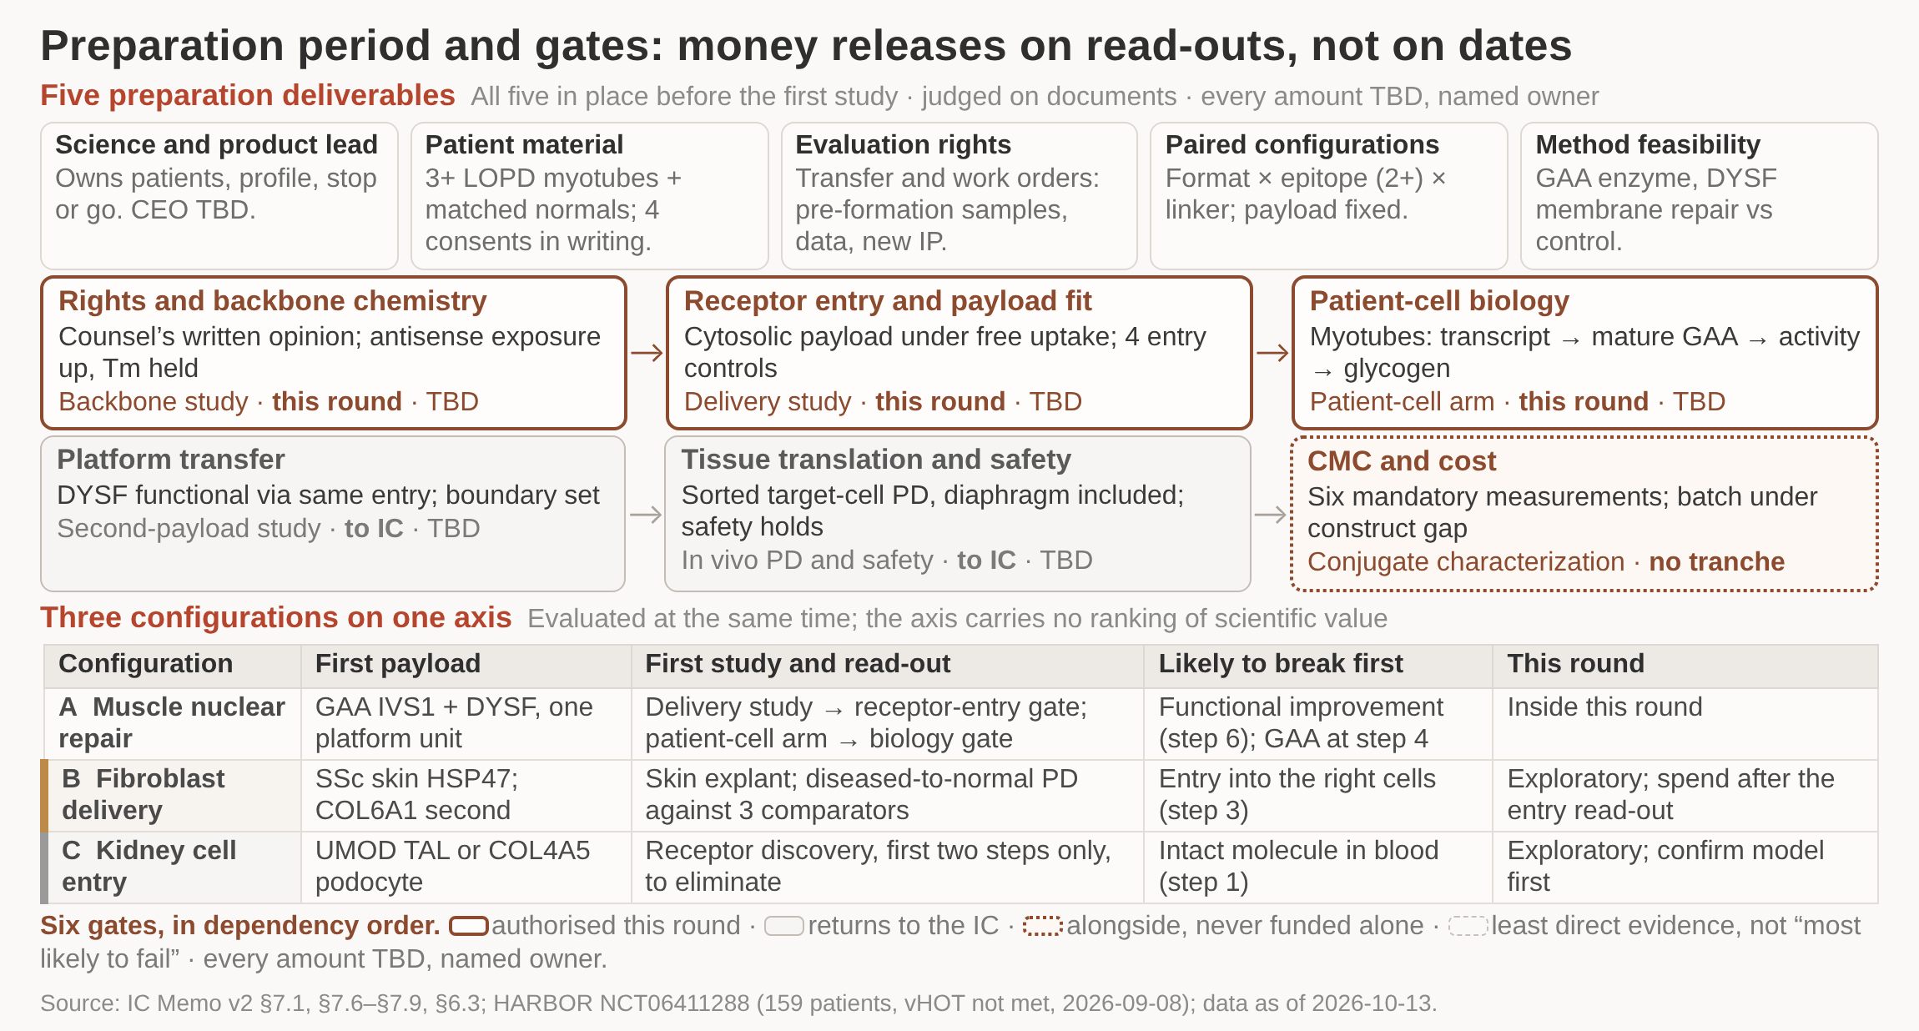
Five deliverables define the preparation period, each with a stated test and a named owner
/ RECOMMENDATION
The five are deliberately unglamorous: they are the things that cannot be bought later - a person who owns product judgement, patient material with clean provenance, the right to use what gets generated, a defined set of configurations to compare, and a written rights opinion.
1 Science and product lead in post
2 Patient material and compliance cleared
3 Limited evaluation rights executed
4 Paired configurations and rights opinion
DETAIL IN THE MEMO
Judging criteria and owners for each deliverable are set out in full in the memo
The five deliverables of the preparation period and how further investment is released against gate read-outs
Amounts stay TBD: the memo is explicit that no universal threshold exists - not 90% knockdown, not a fixed payload ratio, not quarterly dosing. Thresholds follow the target product profile.
Authority sought today stops after the receptor-entry and payload-fit gate, plus the conjugate gate that runs alongside; platform transfer and in vivo translation return to the IC.
Source: IC Memo v2 (preparation period, gate structure)
Notes:
Close on this page. The first thing the science lead delivers is the target product profile, and that is what unlocks every threshold left blank in this deck.

Slide 50
Executive summary
China’s RNAi market expects exponential growth in upcoming years:
  RNAi therapy is reaching maturity with several drugs approved recently; however, China’ RNAi industry is still at early innings where licensed GalNAc candidates from overseas are still at preclinical stage
  Nevertheless, many RNAi startups were founded or incubated by other funds recently, suggesting potential explosive growth in coming years
WuXi is the perfect platform to incubate a RNAi technology company:
  WuXi will see significant synergy upside from newco to help our vision to build an end-to-end service platform; our BU is building testing platforms for target selection. Through our newco we would also be able to accelerate such platform capabilities
Newco creation strategy consists of the following key areas:
  [RNAi types]: Due to better clinical evidence and industry feedbacks of siRNA, we believe that siRNA holds better chance for clinical and thus select it to be our priority RNAi
  [Delivery]: Delivery is the key knowhow in RNAi therapy; currently GalNAc is the most mature type of delivery with most approved drugs using GalNAc. We would license GalNAc from Kylonova (甘宝利) while developing our own GalNAc in-house
  [Targets]: For our first & second wave, CVD targets, such as AGT, ANGPTL3, ApoA and ApoC3, and compliment targets such as C3 and C5 proved to be the most attractive due to significant market potential and ability for RNAi therapy to win
  [Team]: We have identified a CEO candidate Zhang Fang, who has extensive experience in newco leadership, big pharma and CVD-drug development
We propose to invest in $20M, with $3M invested in 2021; 125.4% XIRR in 5 years is expected

Slide 51
The team expects newco to score 91 out of 100 on scorecard, ranking it xxx position in our pipeline
Dimensions |  | Weight | Newco team score | Rationale | Team
Strategic synergy
 | Investment area decided early this year? | 5 | 5 | Oligo is part of the new modality focus
 | Portfolio company, or significant value creation after strategic partnership with WuXi | 5 | 5 | Oligo is an important growth engine of STA, LTD & RSD
 | Enhance CRO capabilities? | 5 | 5 | BUs are building oligo end-to-end capabilities
 | Enhance CRO revenue/ cost cutting? | 5 | 5 | R&D carried out by WuXi BU team
Expected IRR
 | >50% 10; 40%-50% 8; 30-40% 6; 20-30% 4; 10-20% 2; <10% 0 | 10 | 10 | XIRR ~125%
 | Likelihood of reaching the IRR: (>80% 5; 60-80% 4; 40-60% 3;20-40% 2;<20% 0) | 5 | 4 | Less risky due to timely market positioning and likelihood to achieve successful licensing
Business model/ technology
 | Business, revenue, operational and profit model | 10 | 10 | Licensing + in-house development model
 | Strong competitive advantage e.g. advanced technology, industry leader positions etc. | 10 | 10 | RNAi is an advanced field and we license IP from industry leaders
 | Strong IP protection | 5 | 4 | Licensing + in-house development
Team
 | CEO has successful entrepreneurial experience or industry leader | 5 | 5 | Startup leadership, big pharma and R&D experience
 | Personal capability of CEO (strategic mindset, strong team building, execution) | 5 | 5 | Great professional experience and positive feedbacks from co-workers
 | Mgmt. team has the required experience of growth | 5 | 3 | Part of the mgmt. team is still underway
 | Mgmt. team completed previous milestones | 5 | 3 | Part of the mgmt. team is still underway
Risks
 | Legal/ policy risks | 5 | 5 | No risks involved
 | Compliancy risk | 5 | 5 | No risks involved
 | R&D risks/ investment risks | 5 | 4 | In-house R&D; less risky due to licensing
 | Exit risks | 5 | 3 | Seed round – multiple years till IPO
Total |  | 100 | 91

Slide 52
This investment memo consists of the following key discussion points
Why now?
Why us?
Collaboration model, budget plan and financials
How to build?
Types of RNAi
Delivery technology
Indication & target selection
Team

Slide 53
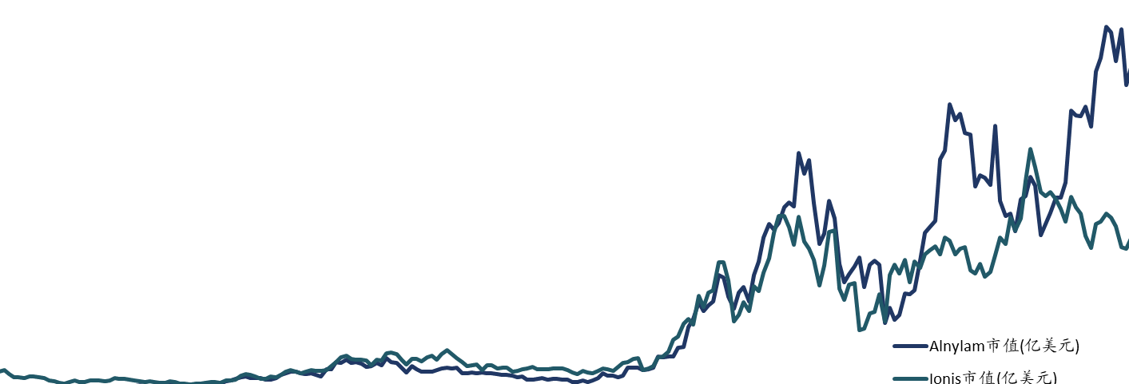
Global: Various new modalities have emerged; RNAi sits towards the mature side of the spectrum with leader’s market cap rapidly growing
Why now
Overcoming tech hurdles
Extend indications & launch blockbusters
Expanding to more TAs by further improvement
POC undergoing
18
Market cap (B USD)
Alnylam
12
6
Ionis
0
2005
2010
2015
2020
Clinical trial phase
# of approved drugs
Technology maturity
Note: *M&A price; **Incl ASO drugs
Source: BCG report; Public information

Slide 54
China: New modalities generally lie on the competition vs. maturity band; yet RNAi is the most mature New Modality but much less competition
Why now
.6
Less competition in RNAi space vs. other new modalities
Clinical trial phase
# of approved drugs
Technology maturity
Source: BCG; Public information

Slide 55

Within the limited established RNAi players in China, few are worthy of investing
Why now
Description
Delivery
Target tissue & IP
Funding status
Investable target?
Ribo Life Science
Leading assets are ASOs licensed from Quark/Ionis
Naked/ GalNAc
IP infringement risks
Valued at ~RMB 4B but recent IPO to STAR board was rejected
No IP protection of its delivery platform
Sirnaomics
Oncology-rich pipeline; GalNAc candidates currently early stage
PNP/ GalNAc
GalNAc platform has IP risks; unvalidated PNP
Valued at ~RMB 4B at current Pre-IPO round
Unvalidated PNP platform, no GalNAc IP
Kylonova
Targets: HBV，PCSK9，Lpa，APOC3，AGT
GalNAc
Liver targeted，IP rights; clean FTO
Series A at RMB 200Mn
Questionable team capability and financials
BoWang Pharm.
Founder is a former scientist of Arrowhead
GalNAc
Liver targeted, without IP right
Angel round
No IP protection of its delivery platform
Rongcan*
Innovative target – CVD and lung disease
LNP + specific warhead
Extrahepatic such as lung, IP rights, clean FTO
Angel round at RMB 100 Mn, led by WuXi
WuXi portfolio
Note: *No conflict of interests because: 1) different organ delivery (Newco is GalNAc which is hepatic delivery), 2) potential collaboration opportunities on licensing-in its LNP
Source: Public information

Slide 56
孵化方式：有权利的许可优先，保留参股替代
自建的必要性须来自目标产品与权利组合，不能只来自标的数量少
探索入口
取得权利与构型
功能验证与产品开发
高
完全自建
新入口、载荷与模型叠加
参股 / 共同孵化
新技术
研发负担
已有团队或构型
项目证据与控制权待尽调
许可入口后自建
权利可得时为验证期主案
低
低
进入时可获得的技术 / 产品证据成熟度（定性）
高
完全自建
许可入口后自建
参股/共同孵化
决策自主，自有背景技术积累。新受体＋新载荷＋新模型叠加，早期周期和风险较高
把风险集中到核内递送与疾病功能。对方可授权、范围覆盖且经济条件可承受
更快取得团队或既有构型。控制权较小，服务协同和新增IP归属须约定
建议：并行尽调，以许可后自建为验证期主案。6个月内权利不可得，则比较替代入口或共同孵化。
9
Notes:
参考：用户提供210621_NewCo Investment Committee discussion materials_vF2.pptx 第9页。
来源：HTML与初稿，技术截点2026-10-12。
逐页内容保留。位置为定性示意，不代表数值评分或全行业统计。
为分析建议，非已达成交易
曲线及点位为策略逻辑示意，不是量化评分、资产估值或行业统计。完全自建具备决策自主和背景技术积累，参股方案需约定服务协同与新增IP归属。

Slide 57
附录页组：待定事项台账、术语表与原图档案
本页主张 附录按主责方归集待定事项、按中英对照列术语、并以带日期的对照存档保留 26 幅原图；原图保留不等于事实已更新。
/ 附录
组 | 内容 | 说明
附-A | 待定事项台账（按主责方归集） | 本轮全部「待定—主责方」逐条登记，讲解时逐条点名主责方
附-B | 术语表（中英对照） | 全文术语与缩写，按首次出现单元标注
附-C | 原图档案 26 幅 | F01–F26 带日期的对照存档，正文使用改绘版
附-D | 实验方案 E0–E4 逐项 | 目的／对照／读出／关口／资源
附-E | 94 条疾病与基因型记录 | 多页分组表
附-F | 资产与注册状态全表 | 核查日 2026-10-11，ClinicalTrials.gov 逐项核对
· 空白格统一读作「未收录／本轮未核到」，不等于「无」；不设加权总分页。
来源：附录内容依据 IC Memo v2 附录一／附录二／附录三。

Slide 58
附-A 待定事项台账：按主责方归集（1/2）
本页主张 待定事项按主责方归集，讲解时逐条点名主责方；本轮不以估算值补上任何缺失输入。
/ 附录
主责方 | 条数 | 主责方 | 条数
委托方决策 | 105 | 委托方发起沟通 | 15
待定—委托方决策 | 23 | 研究侧补核 | 11
专利代理 | 20 | 待定—发起方／财务 | 9
待实验读出 | 20 | 研究侧 | 9
待外部核验 | 16 | 委托方决策 ＋ BD | 7
法务 | 15 | 待核—科学与产品负责人 | 7
· 本页只给归集口径与条数，条目原文见备忘录附录一。
来源：IC Memo v2 附录一 待定事项台账。

Slide 59
附-A 待定事项台账：按主责方归集（2/2）
本页主张 下列主责方各自承担的条数；条目明细见备忘录附录一。
/ 附录
主责方 | 条数 | 主责方 | 条数
项目方案 | 6 | 委托方决策＋法务 | 5
法务与合规 | 6 | 主控裁决 | 4
项目组 | 5 | 核验 | 4
科学顾问 | 5 | BD | 4
委托方决策＋BD | 5 | 法务提范围、专利代理出意见 | 4
科学顾问＋体外药理 | 5 | 待定—法务与合规 | 3
· 本页只给归集口径与条数，条目原文见备忘录附录一。
来源：IC Memo v2 附录一 待定事项台账。

Slide 60
附-C 原图档案 26 幅：带日期的对照存档
本页主张 原图保留不等于事实已更新；需修订的原图，正文使用改绘版，此处保留原图作带日期的对照存档。
/ 附录
来源：AOC 技术平台与疾病立项全景研究 汇总核验版 ｜ 以下 26 页一图一页
F01
F02
F03
F04
F05
F06
F07
F08
F09
F10
F11
F12
F13
F14
F15
F16
F17
F18
F19
F20
F21
F22
F23
F24
F25
F26
· 原图未作改绘，日期与口径以原报告为准。
来源：IC Memo v2 附录三 原图档案（26 幅）。

Slide 61
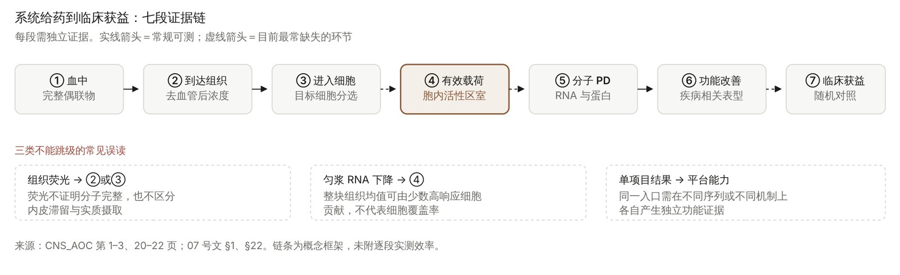
附-C F01（原图存档）
/ 附录
原图保留不等于事实已更新；正文如有改绘版以正文为准。

Slide 62
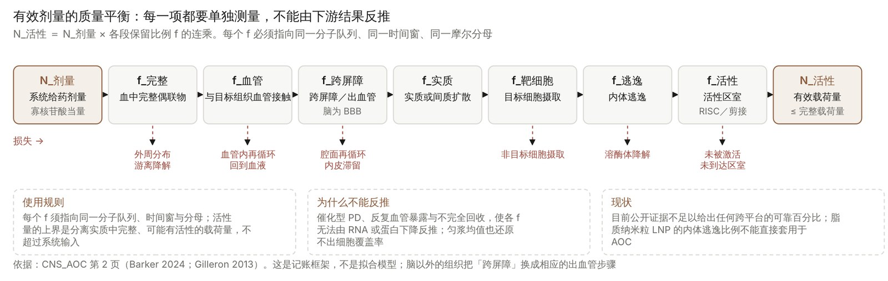
附-C F02（原图存档）
/ 附录
原图保留不等于事实已更新；正文如有改绘版以正文为准。

Slide 63
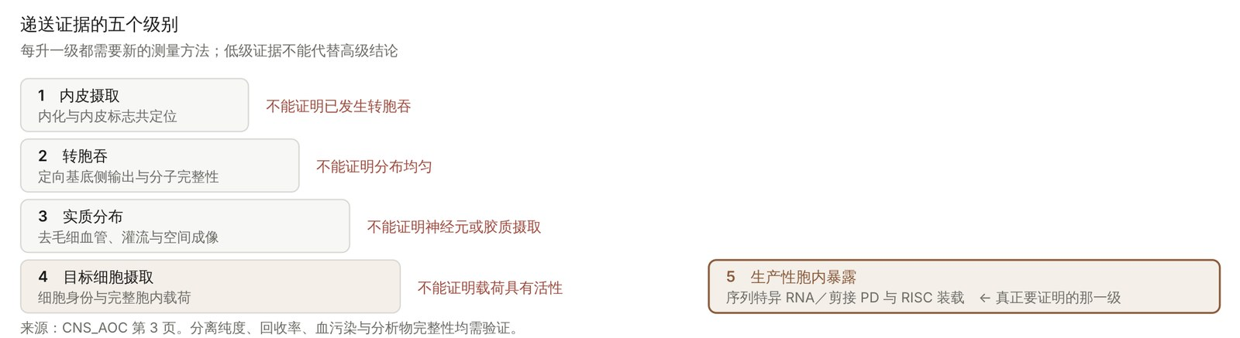
附-C F03（原图存档）
/ 附录
原图保留不等于事实已更新；正文如有改绘版以正文为准。

Slide 64
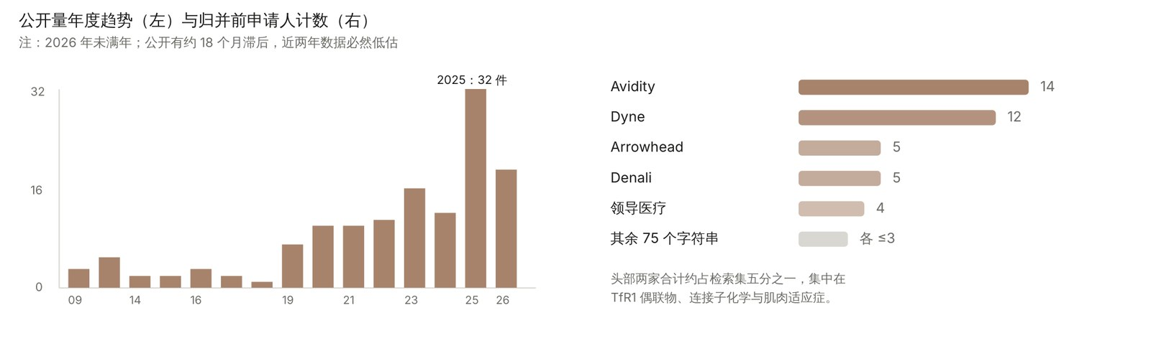
附-C F04（原图存档）
/ 附录
原图保留不等于事实已更新；正文如有改绘版以正文为准。

Slide 65
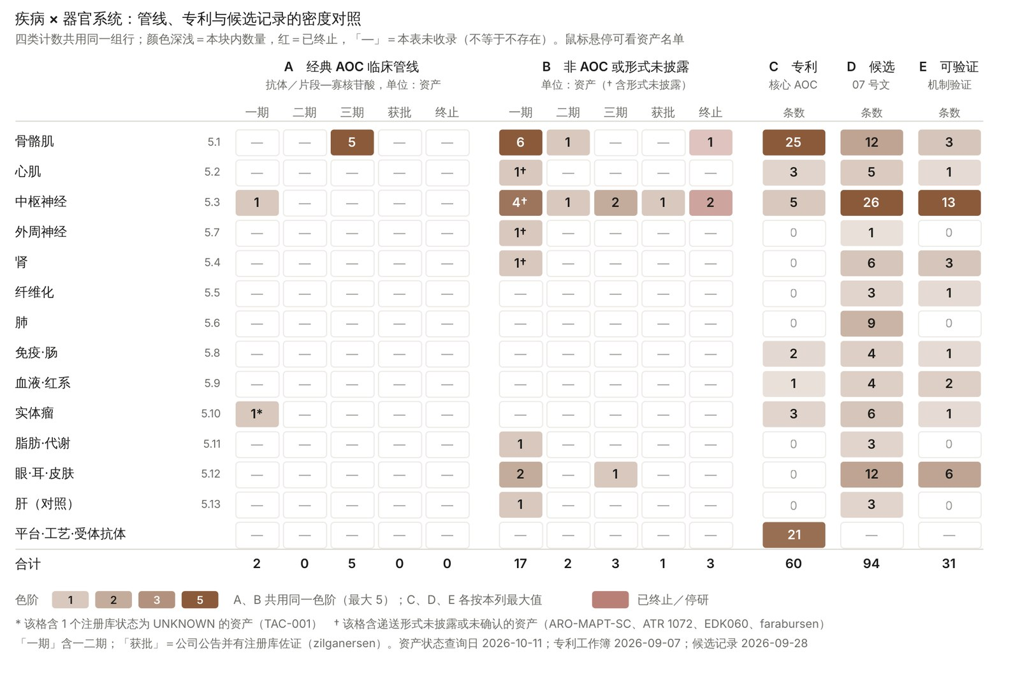
附-C F05（原图存档）
/ 附录
原图保留不等于事实已更新；正文如有改绘版以正文为准。

Slide 66
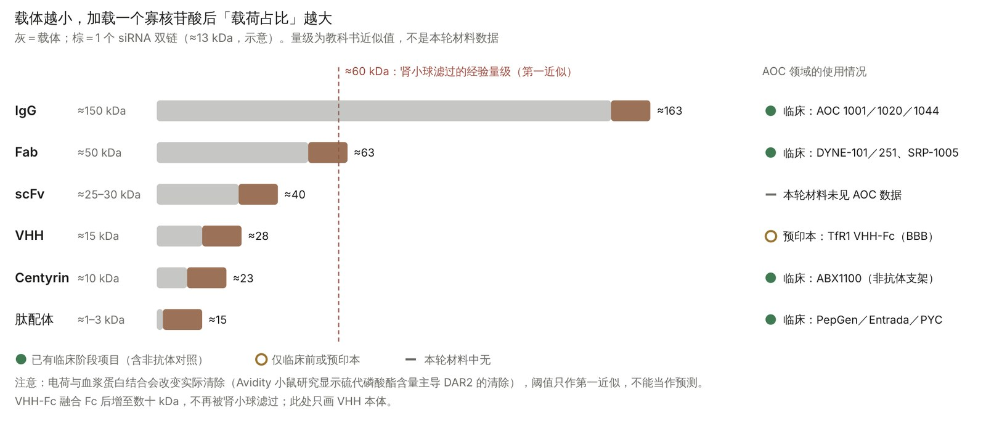
附-C F06（原图存档）
/ 附录
原图保留不等于事实已更新；正文如有改绘版以正文为准。

Slide 67
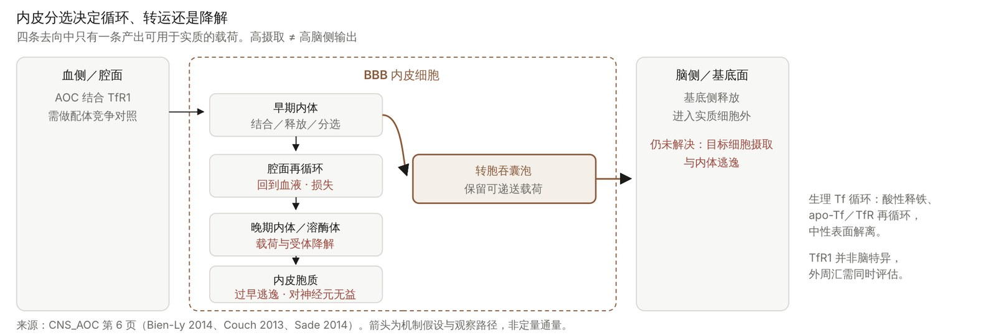
附-C F07（原图存档）
/ 附录
原图保留不等于事实已更新；正文如有改绘版以正文为准。

Slide 68
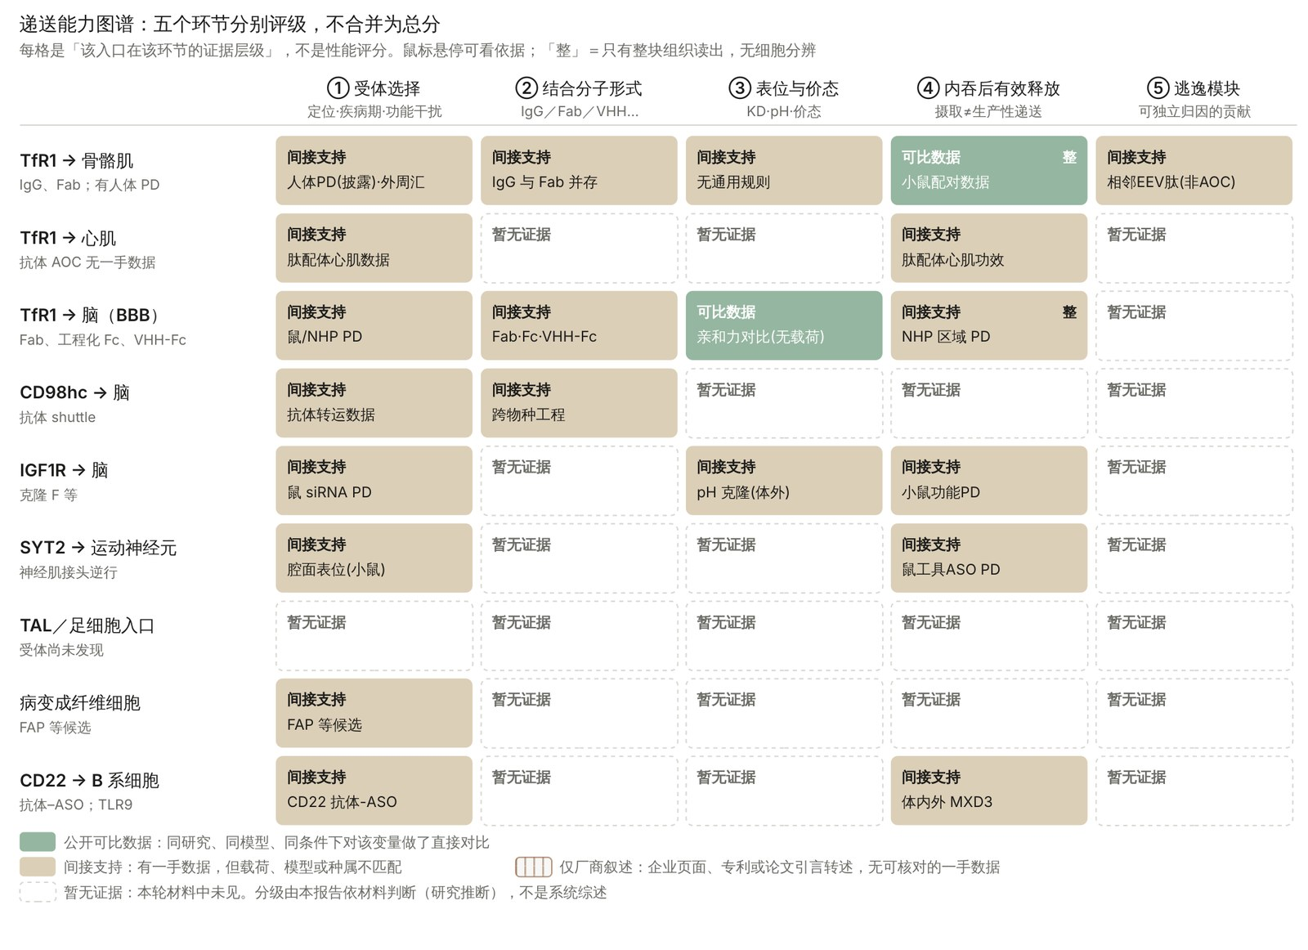
附-C F08（原图存档）
/ 附录
原图保留不等于事实已更新；正文如有改绘版以正文为准。

Slide 69
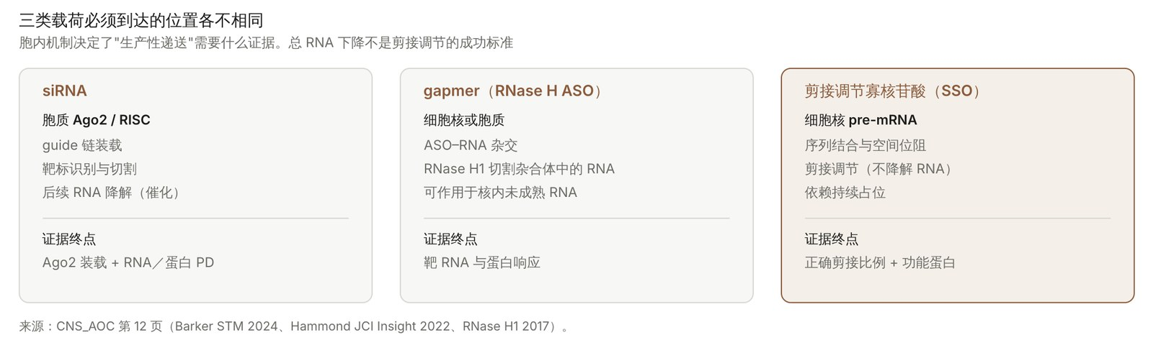
附-C F09（原图存档）
/ 附录
原图保留不等于事实已更新；正文如有改绘版以正文为准。

Slide 70
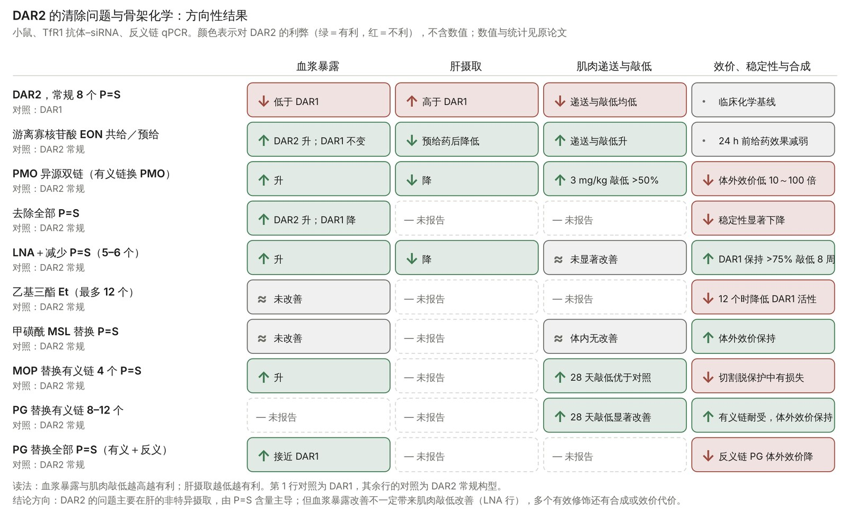
附-C F10（原图存档）
/ 附录
原图保留不等于事实已更新；正文如有改绘版以正文为准。

Slide 71
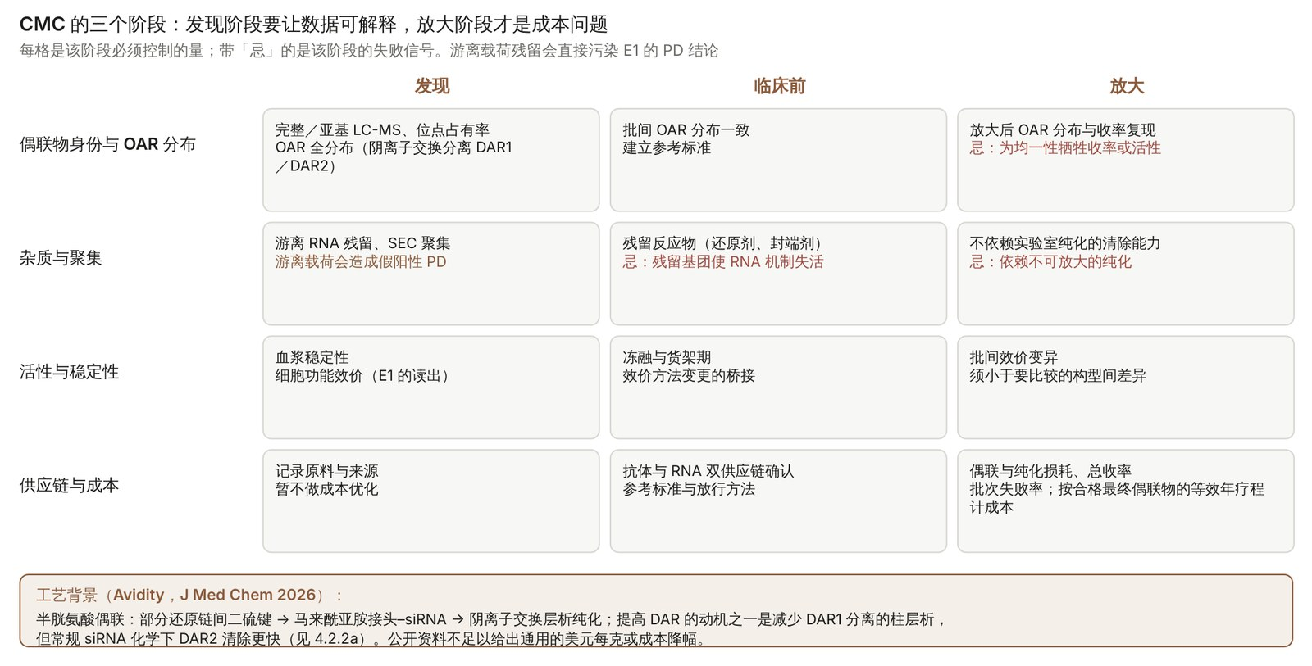
附-C F11（原图存档）
/ 附录
原图保留不等于事实已更新；正文如有改绘版以正文为准。

Slide 72
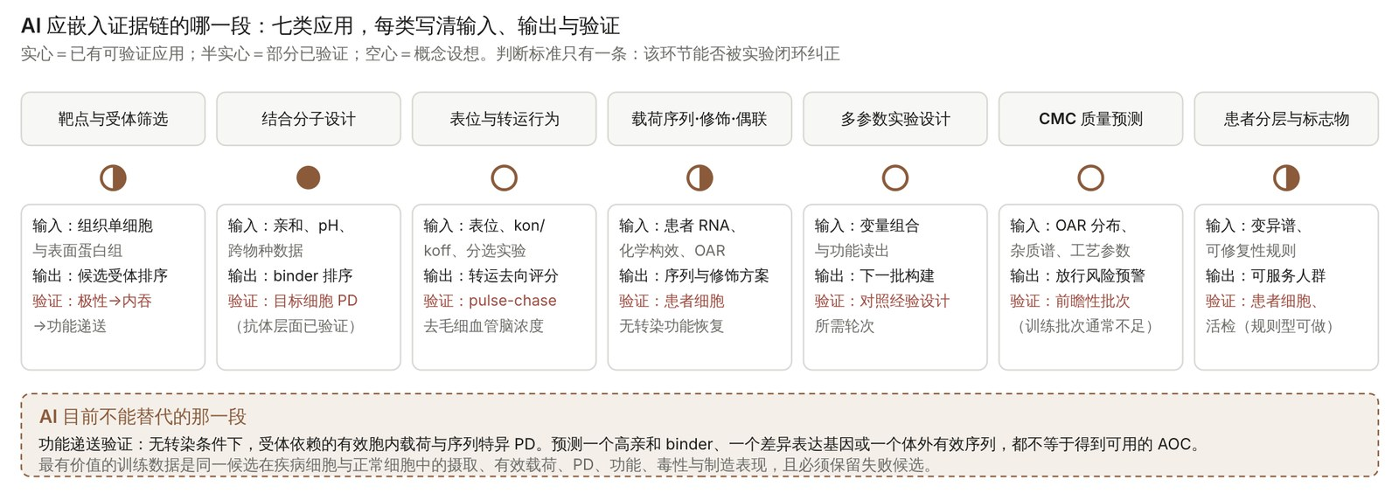
附-C F12（原图存档）
/ 附录
原图保留不等于事实已更新；正文如有改绘版以正文为准。

Slide 73
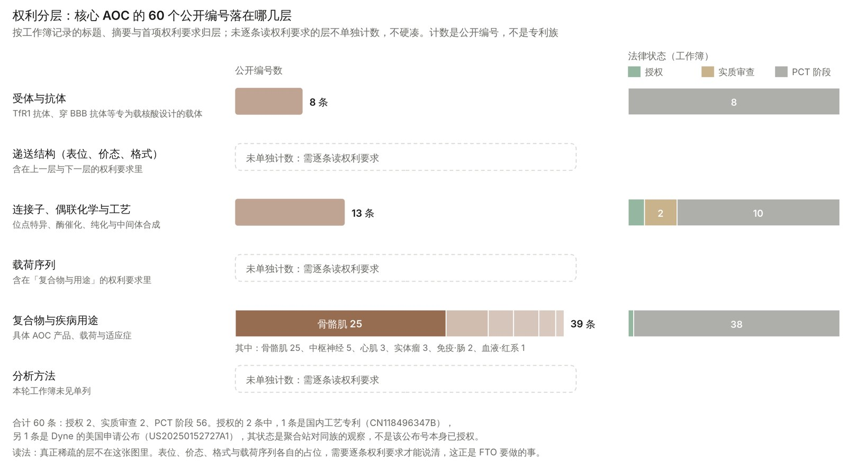
附-C F13（原图存档）
/ 附录
原图保留不等于事实已更新；正文如有改绘版以正文为准。

Slide 74
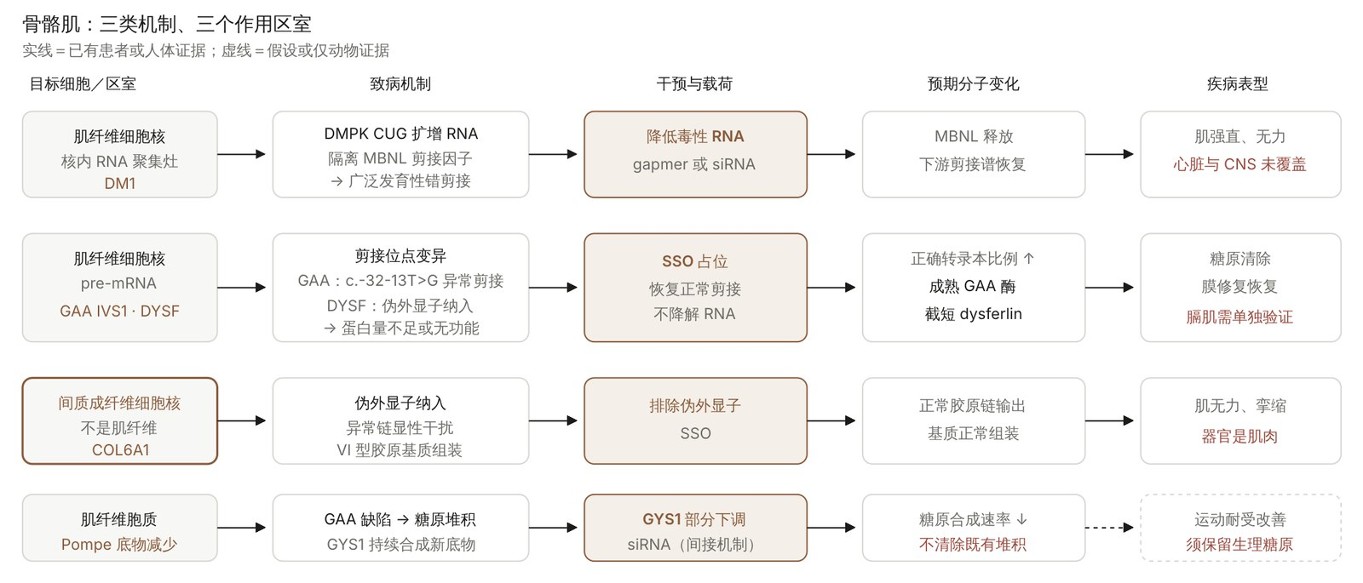
附-C F14（原图存档）
/ 附录
原图保留不等于事实已更新；正文如有改绘版以正文为准。

Slide 75
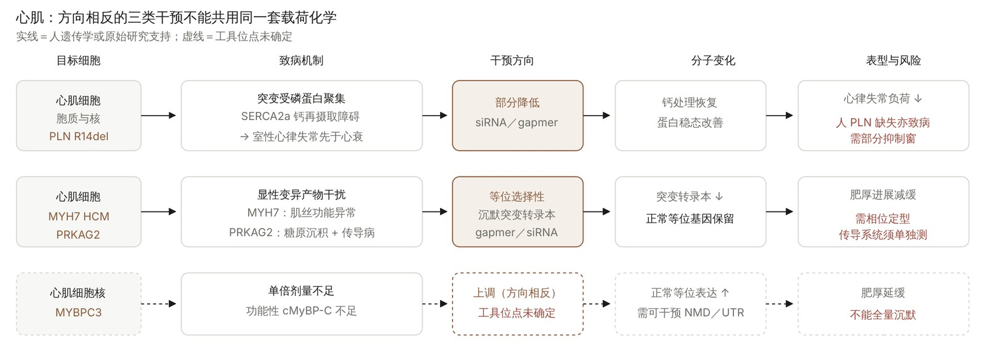
附-C F15（原图存档）
/ 附录
原图保留不等于事实已更新；正文如有改绘版以正文为准。

Slide 76
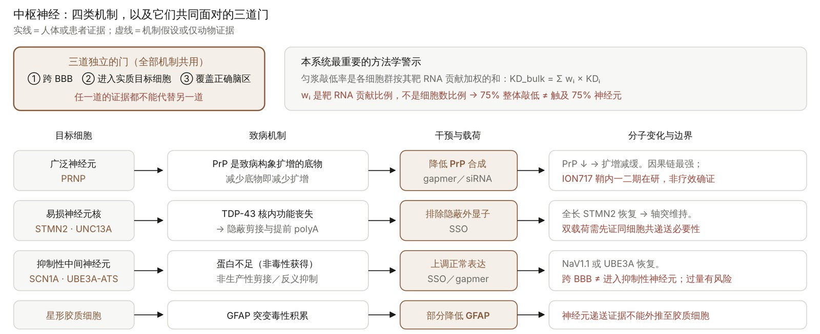
附-C F16（原图存档）
/ 附录
原图保留不等于事实已更新；正文如有改绘版以正文为准。

Slide 77
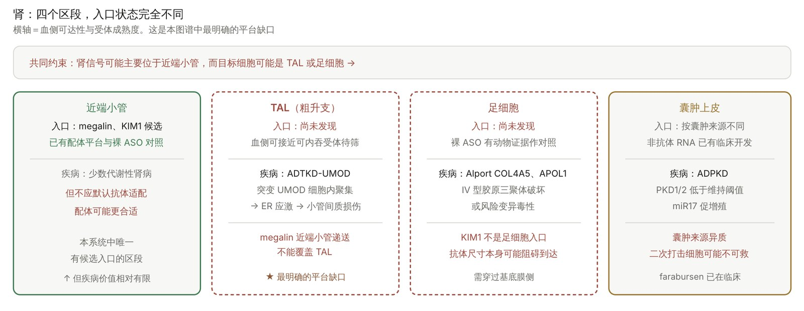
附-C F17（原图存档）
/ 附录
原图保留不等于事实已更新；正文如有改绘版以正文为准。

Slide 78
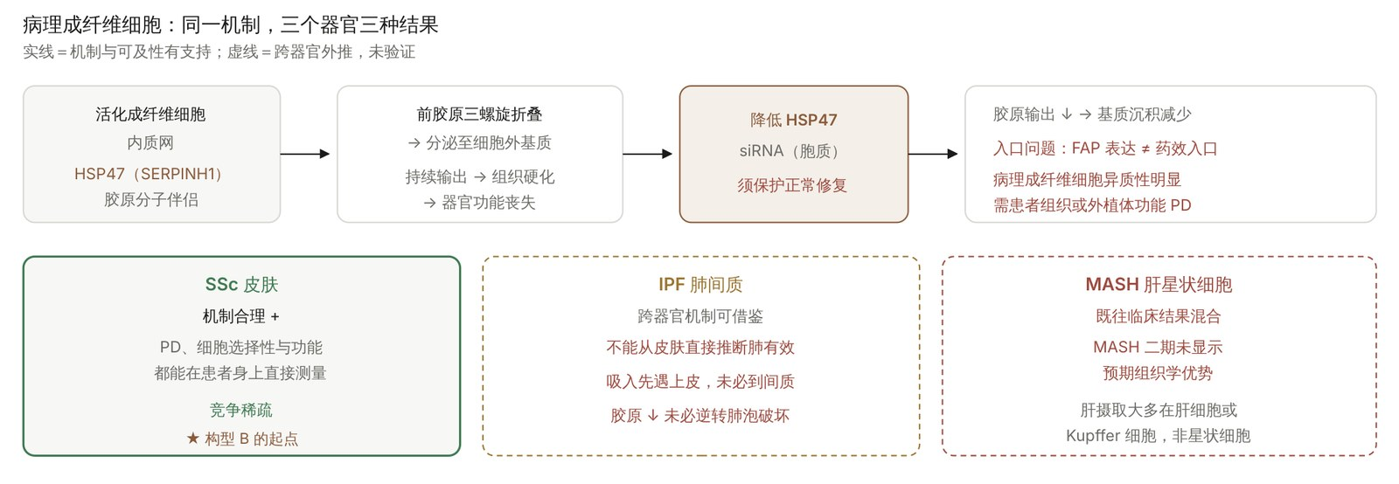
附-C F18（原图存档）
/ 附录
原图保留不等于事实已更新；正文如有改绘版以正文为准。

Slide 79

附-C F19（原图存档）
/ 附录
原图保留不等于事实已更新；正文如有改绘版以正文为准。

Slide 80

附-C F20（原图存档）
/ 附录
原图保留不等于事实已更新；正文如有改绘版以正文为准。

Slide 81

附-C F21（原图存档）
/ 附录
原图保留不等于事实已更新；正文如有改绘版以正文为准。

Slide 82

附-C F22（原图存档）
/ 附录
原图保留不等于事实已更新；正文如有改绘版以正文为准。

Slide 83

附-C F23（原图存档）
/ 附录
原图保留不等于事实已更新；正文如有改绘版以正文为准。

Slide 84

附-C F24（原图存档）
/ 附录
原图保留不等于事实已更新；正文如有改绘版以正文为准。

Slide 85

附-C F25（原图存档）
/ 附录
原图保留不等于事实已更新；正文如有改绘版以正文为准。

Slide 86

附-C F26（原图存档）
/ 附录
原图保留不等于事实已更新；正文如有改绘版以正文为准。

