Slide 1
Lable & Track Obejects (Sprint 2)
Oct 25 2017
https://github.com/EricZhengAZ/Lable-Track1EC601
https://trello.com/b/4vhNMqk9/label-track-objects-products

Slide 2
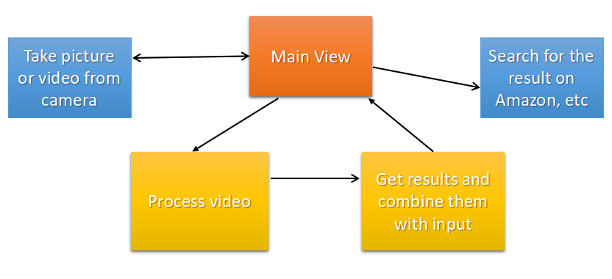
System Diagram
*

Slide 3
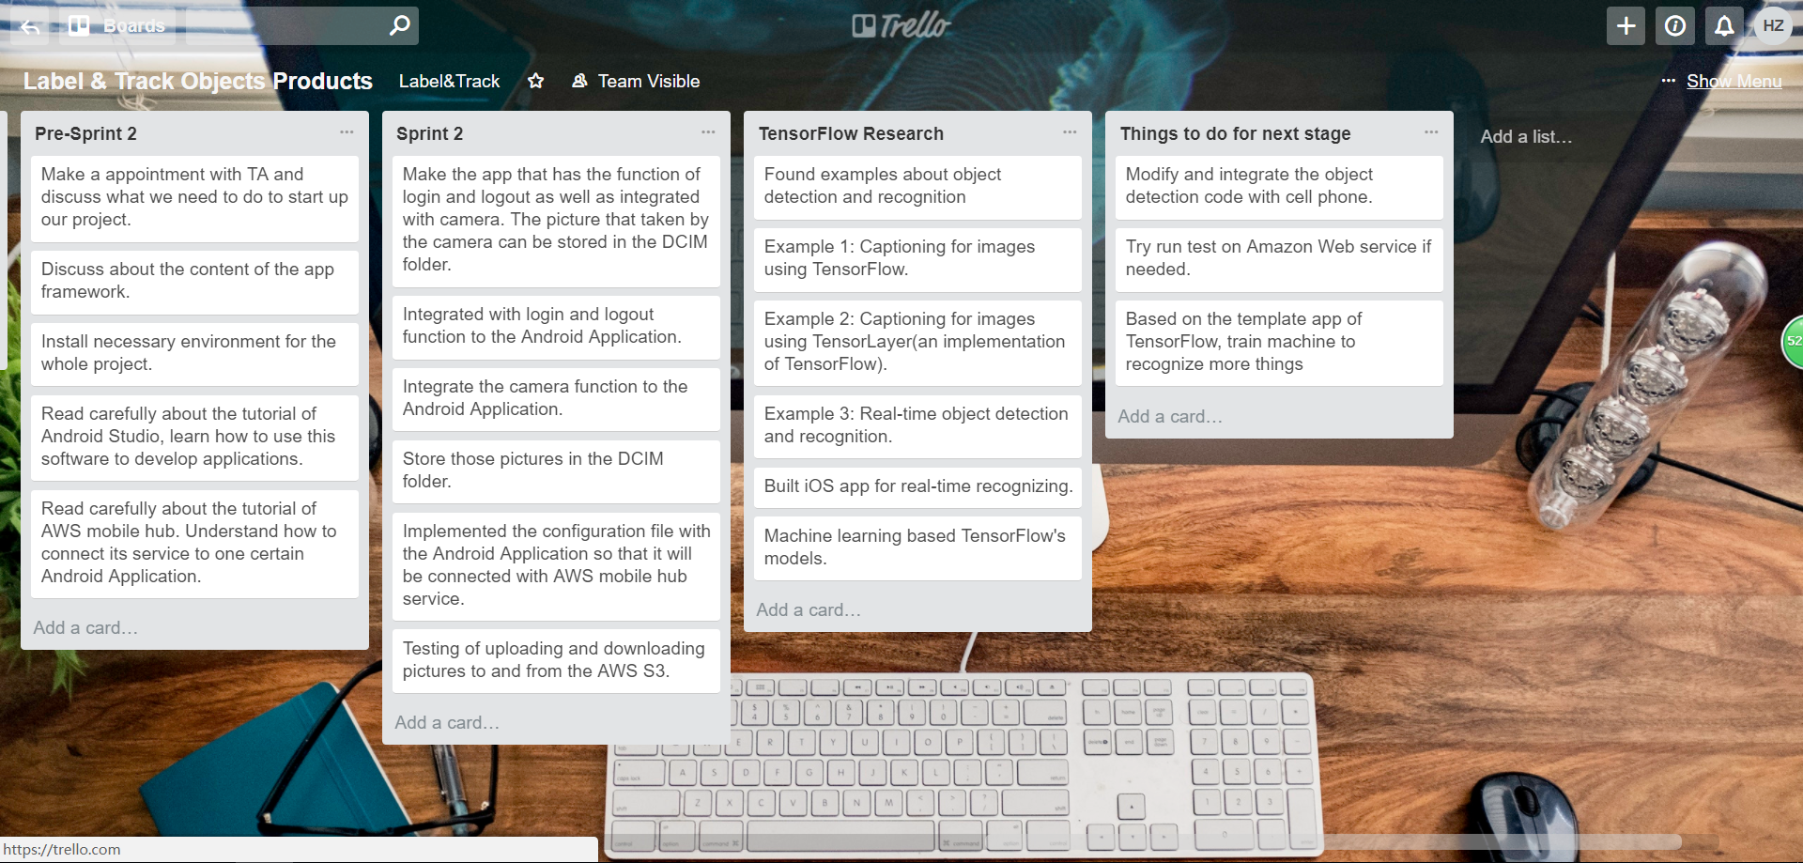
Trello Sprint 2 Diagram
*

Slide 4
Accomplishments
*
Use Tensorflow examples to build our first demo
Activate camera functionality
Real-time object recognition
Read out the most possible result

Slide 5
Challenges
*
Machine learning algorithm
Training our own model
Connect the appilication with online shopping website and search for the result.

Slide 6
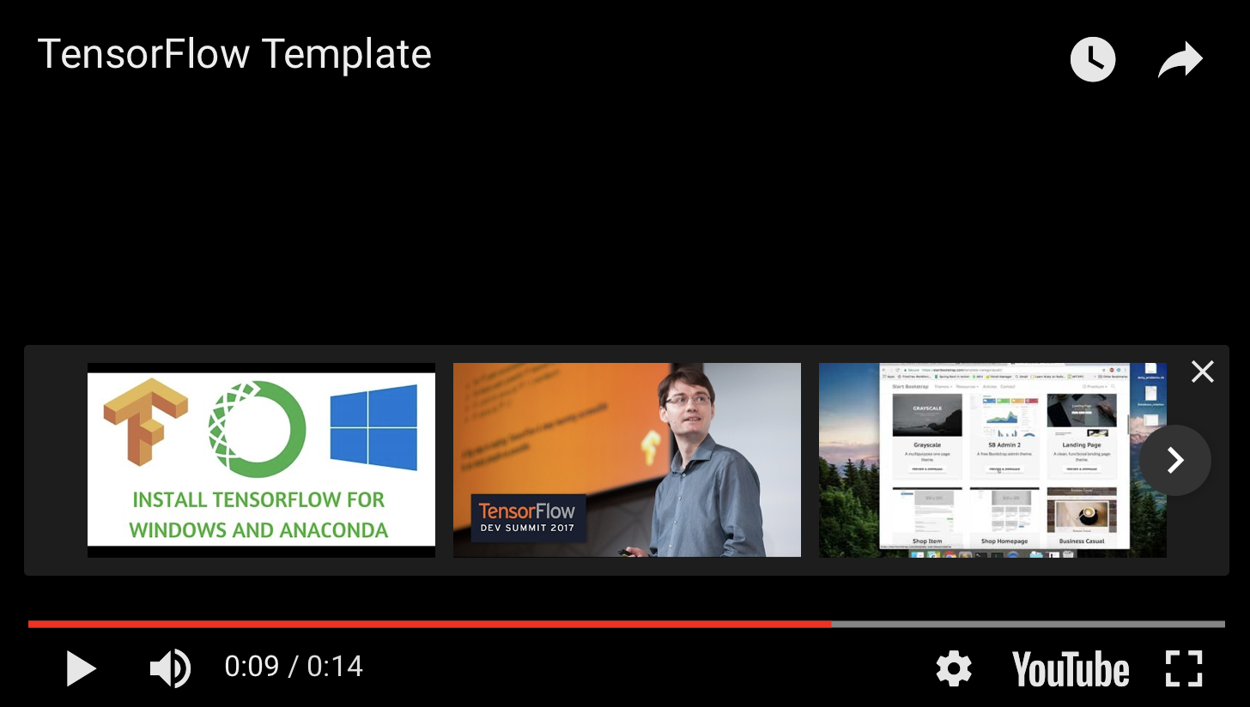
DEMO
*
https://www.youtube.com/watch?v=pd1F3J8evDU
https://www.youtube.com/watch?v=pd1F3J8evDU

Slide 7
Next Sprint Plan
*
Building our own model of best sellers on Amazon
Training for those models
Develop more user-friendly UI for shopping purpose

Slide 8
THANK YOU
*

