Slide 1
Chai Store
Web Server Programming
BSc (Hons) in Multimedia Applications Development
Erica Chai
20063209

Slide 2
Overview
Chai Store allows users to buy and sell items online.

Slide 3
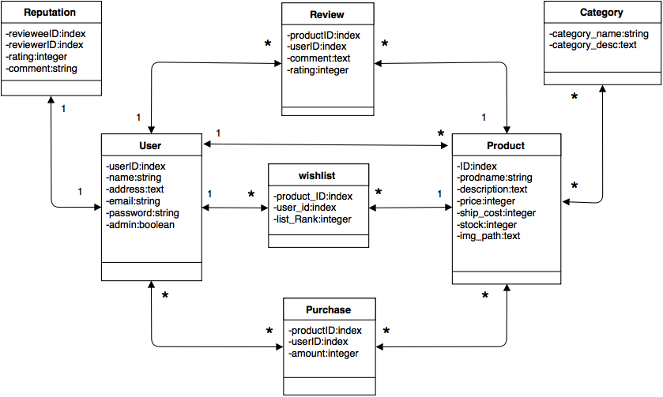
Data Model

Slide 4
User Features & User Interface

Slide 5
User Features
View all Products [Shop]
Sign Up
Login
Add Products
Edit and Update Products
Like/Dislike Products
Purchase Products
Add Products to Wish list
View Wish list and Purchases
Review User
View User Profiles
Edit and Update User details
Admin - View all Profiles
Admin - Delete User Profiles

Slide 6
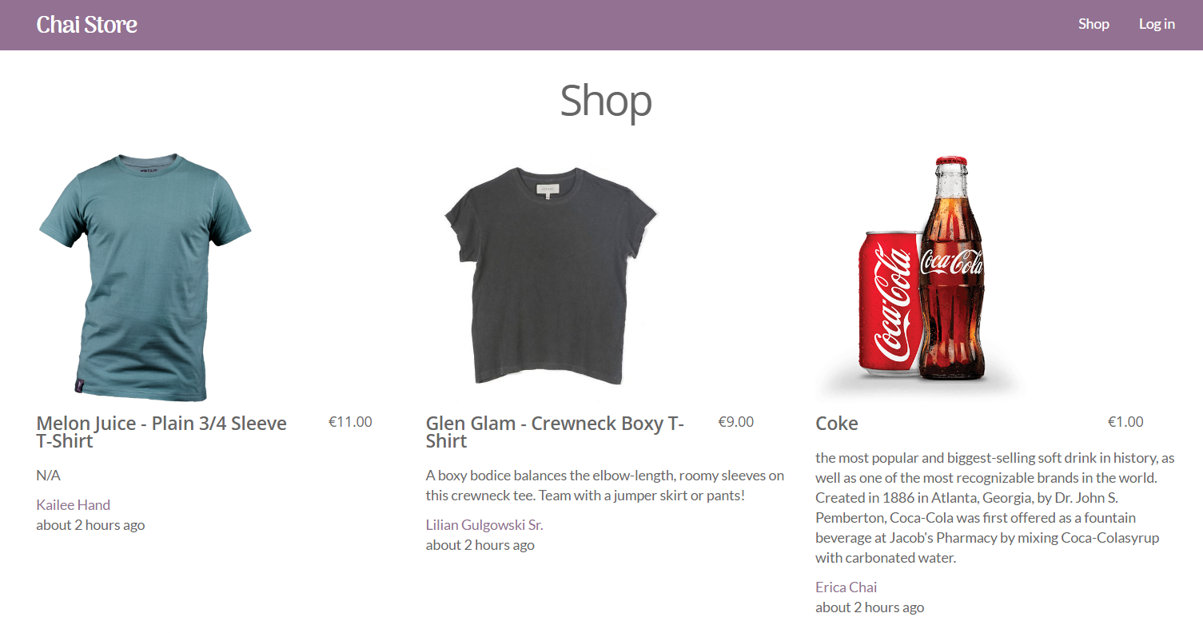
Index/Shop Page - View all products available to purchase. Must be logged in before any purchases can be made.

Slide 7
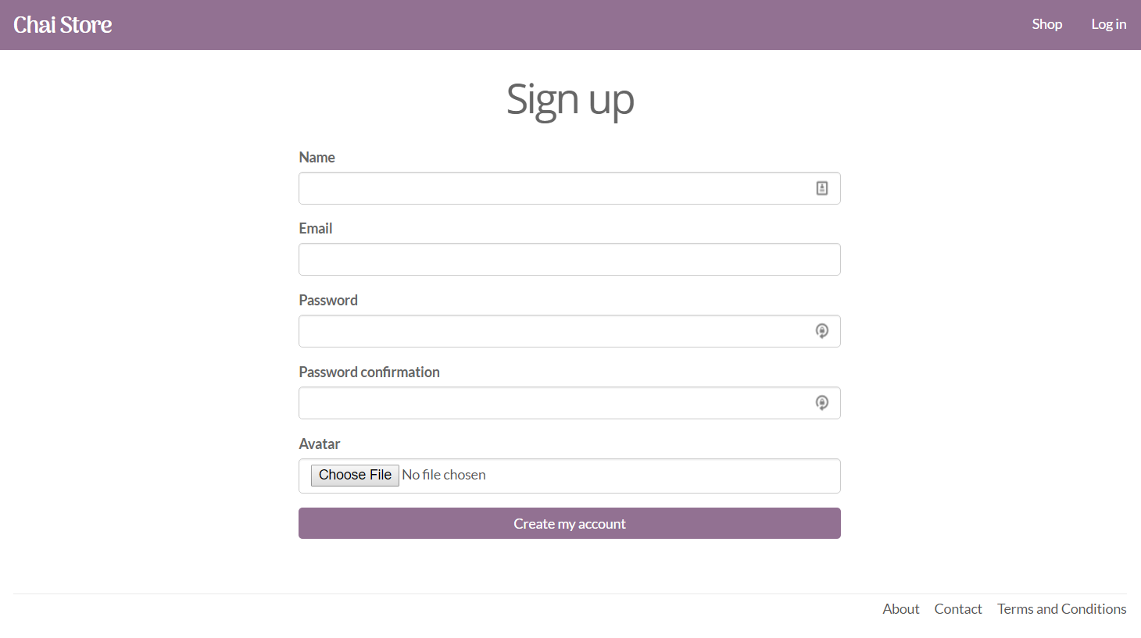
Sign Up Page - Allows the user to sign up to the web application.

Slide 8
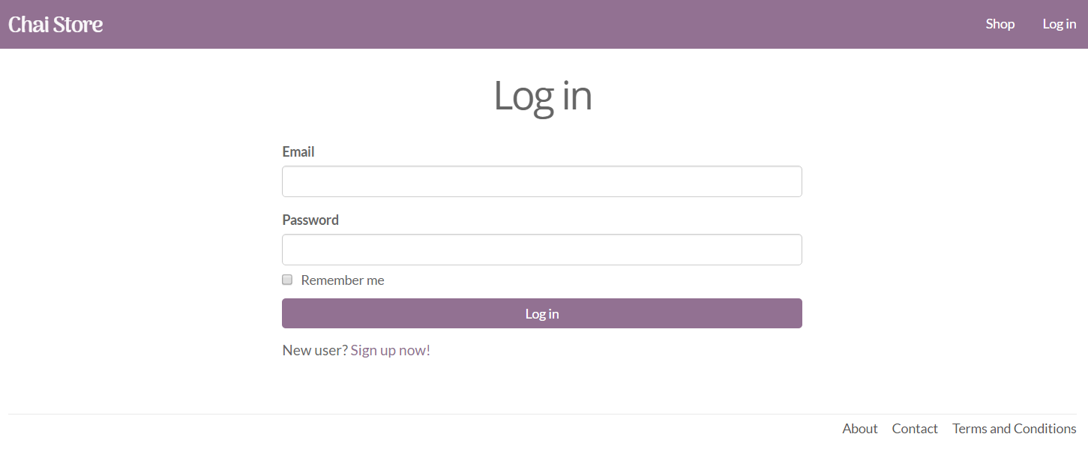
Login Page - Users can log into their account once an account has been created. A ‘remember me button’ will cache a cookie into the web browser and remember the users details.

Slide 9
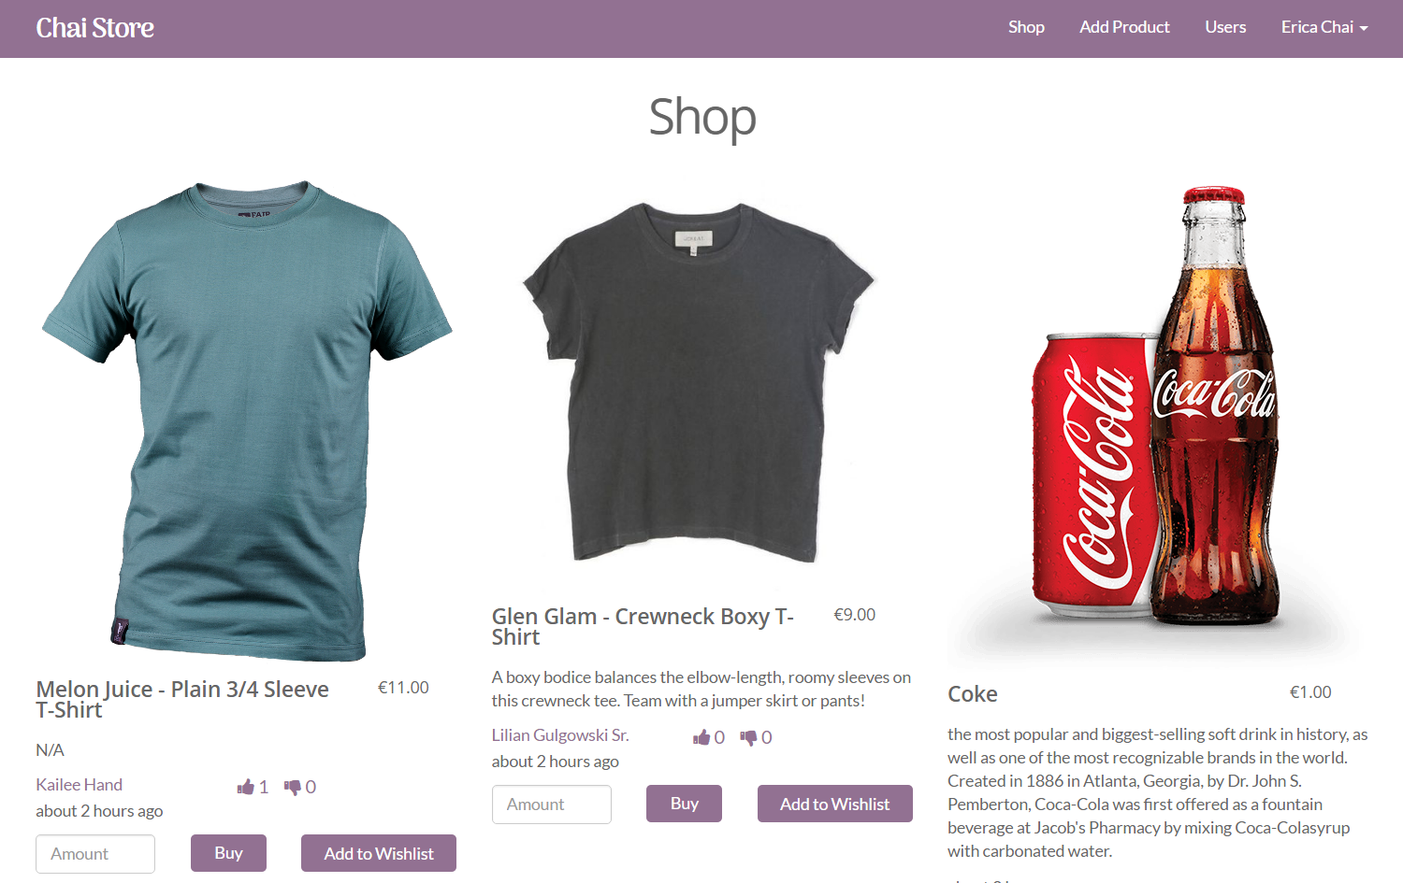
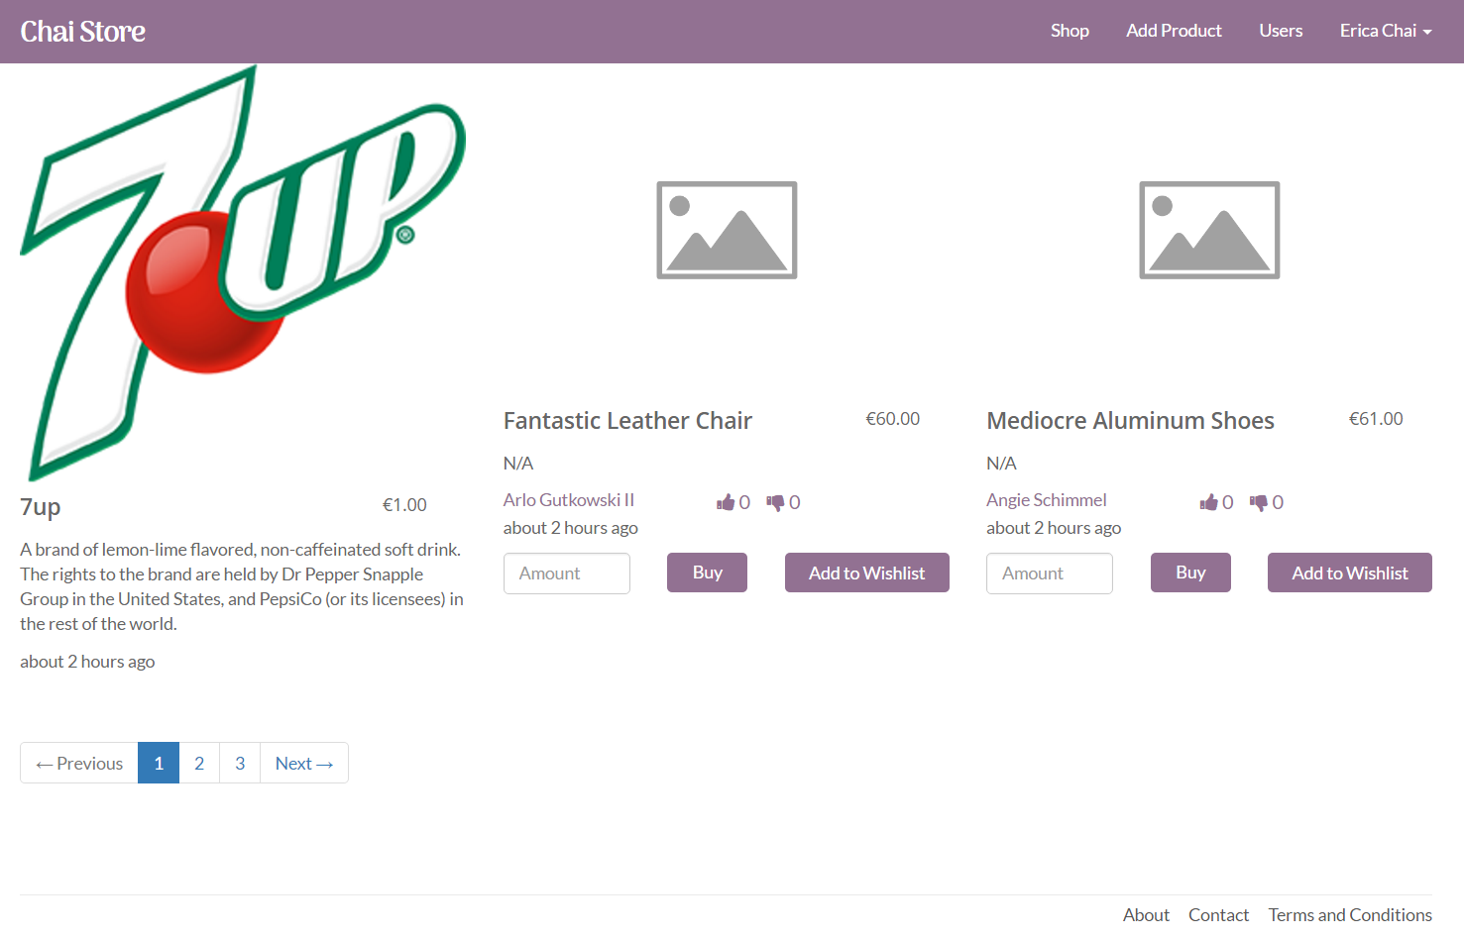
Shop Page – Changes are made to the shop page once a user has logged in. They can now buy other users products, add items to their wish lists, and give items a like or dislike from the homepage. Products can only be liked once. Buttons to purchase and like their own products have been hidden. Pagination has also been added, showing 6 products a page.

Slide 10
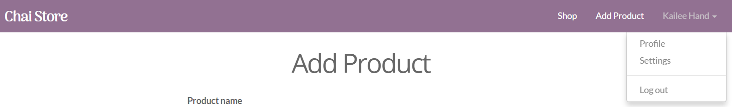
Navigation bar - Navigation bar updates on login. First navigation prompts the user to login. Second navigation bar is for the admin who can view all users in a single page. Third navigation bar is for regular users. The dropdown menu is available to both users.

Slide 11
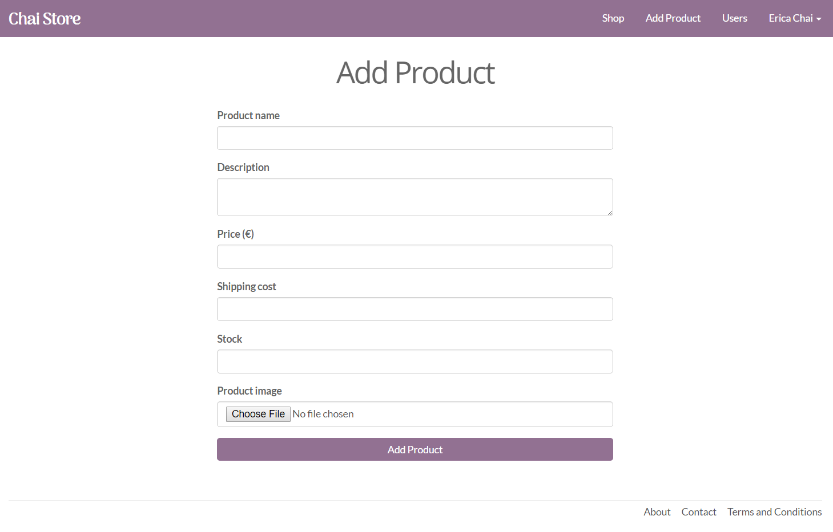
Add Product - Once logged in, users can add products. After adding a product, they are redirected to the shop page.

Slide 12
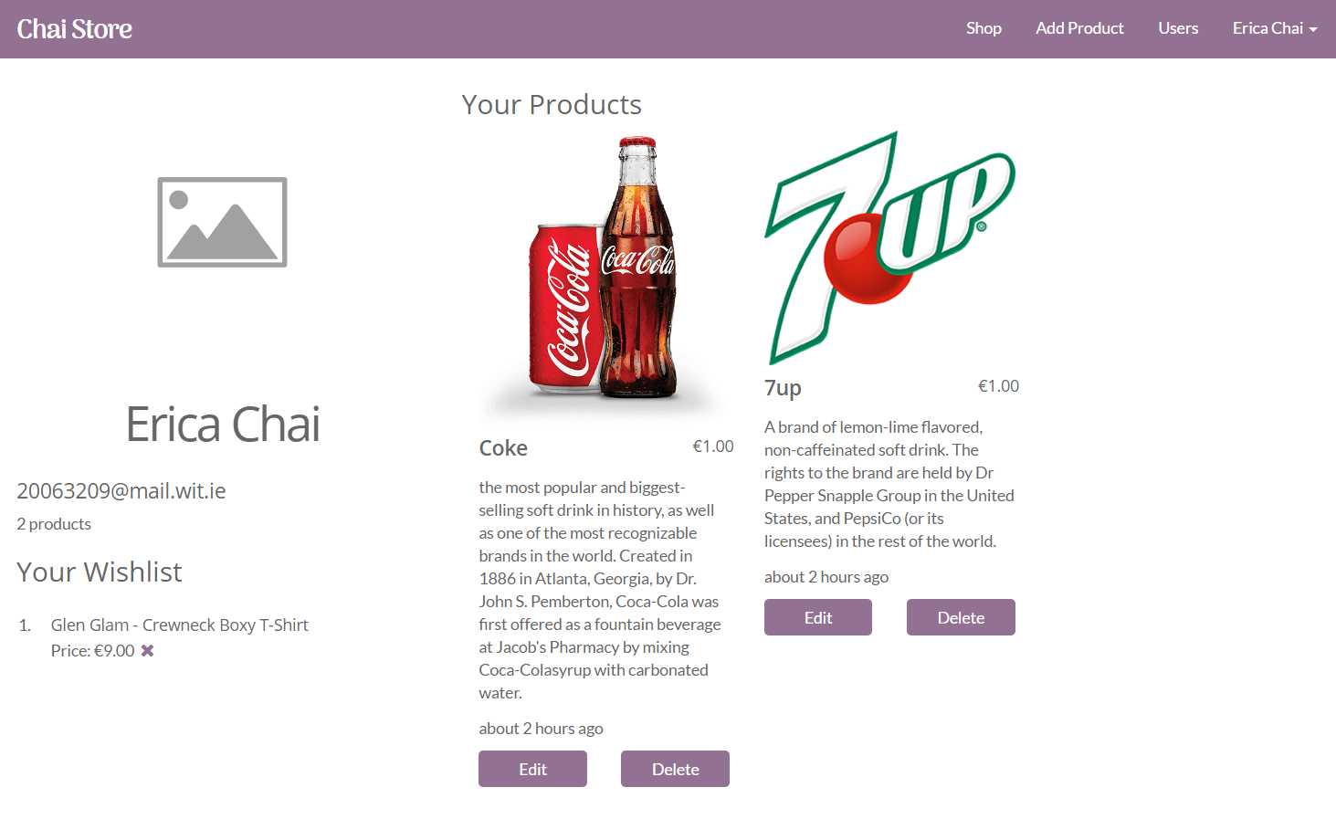
Logged in User Page - The logged in users profile page. Their personal details and products they created are displayed. They can edit and update a product from this page or delete products.

Slide 13
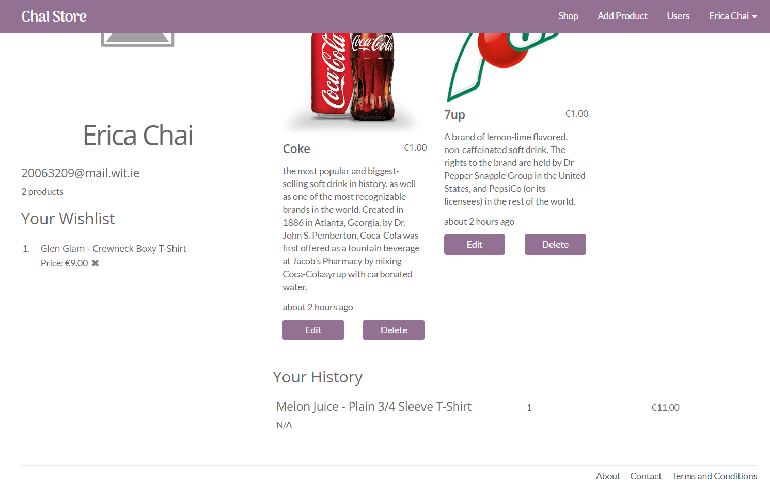
Logged in User Page - The profile page also lists the items of their wish lists which they can remove with the ‘x’. And a history of previously purchased items, listing the name of the product, the description, amount they purchases, and how much it cost.

Slide 14
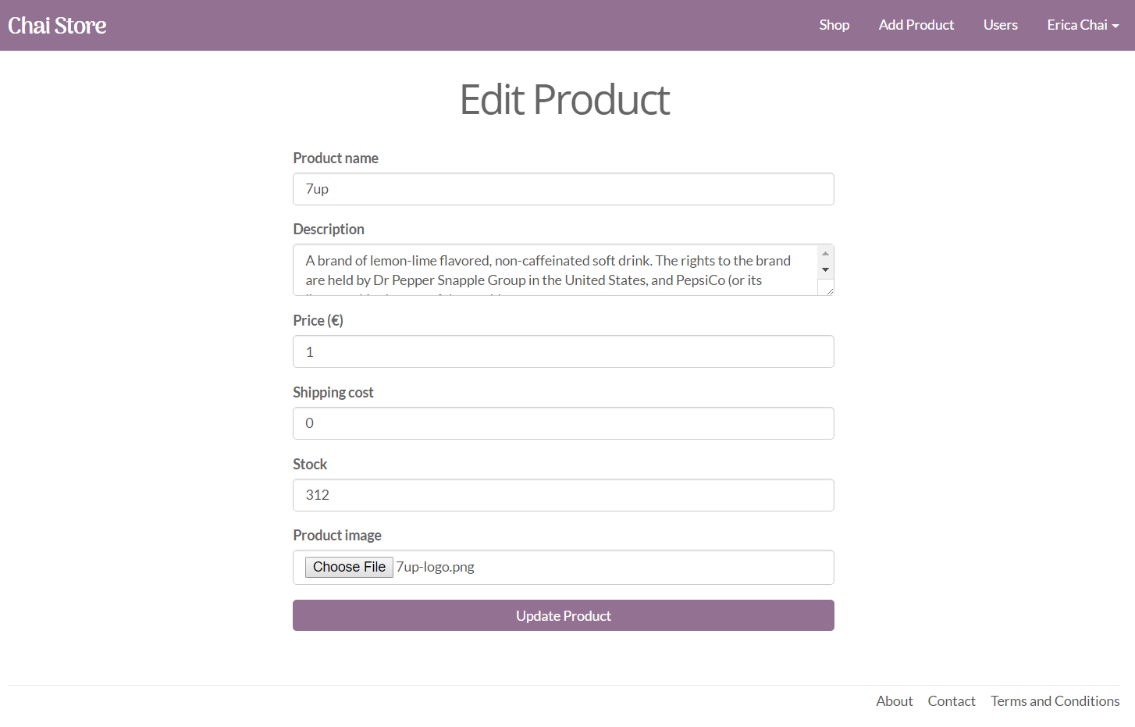
Edit Page - The users can edit and update their own products on this page.

Slide 15
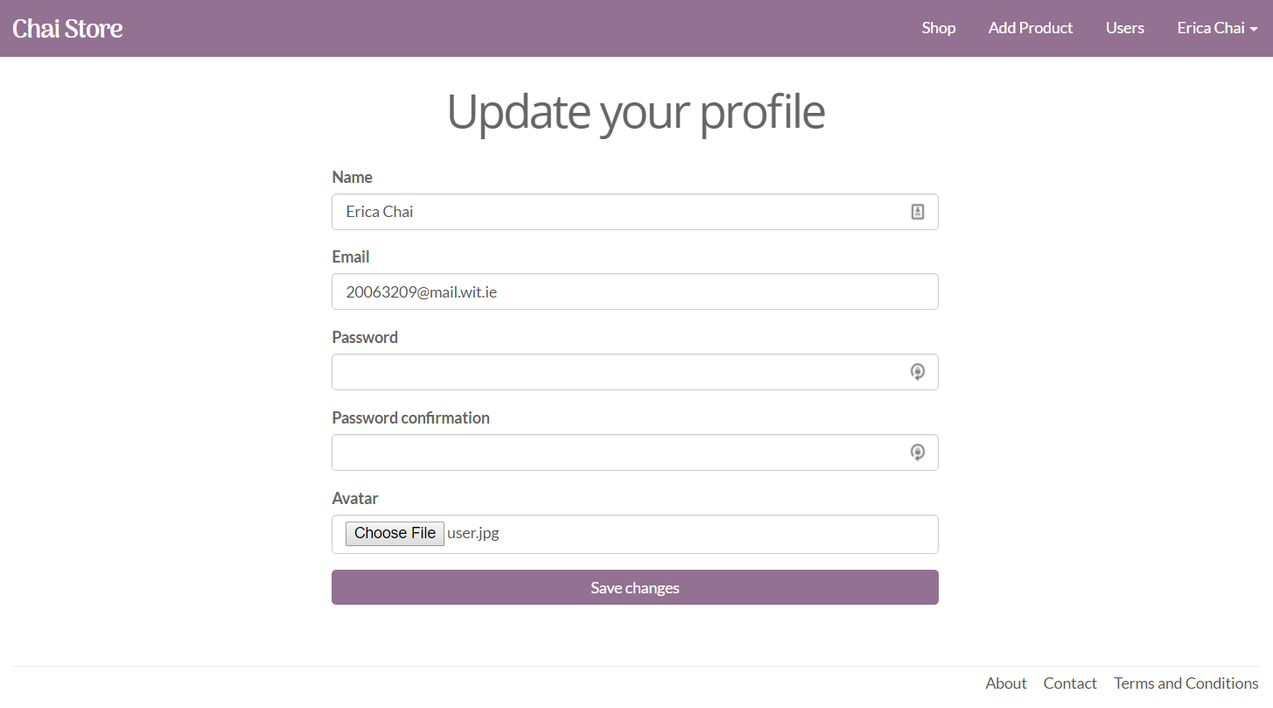
Settings Page – From the settings option in the navigation bar, a user can update the content of their user profile. They are not required to add in the password each time.

Slide 16
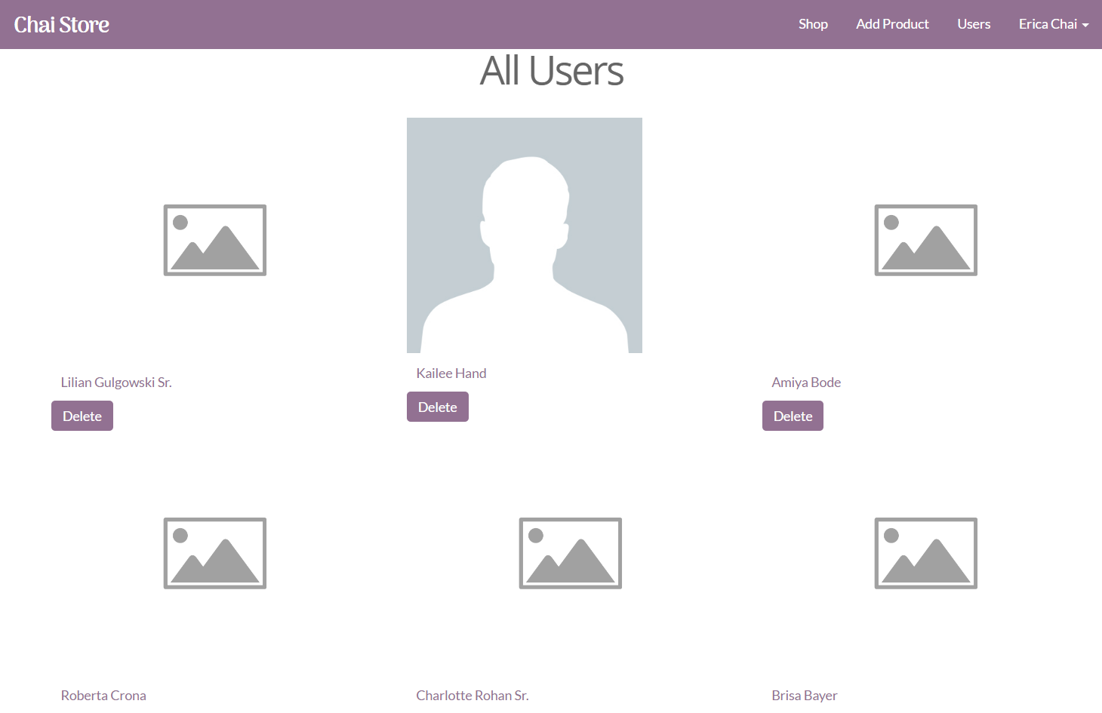
All users - Only available to the admin user, they can view a all the users available and delete their account.

Slide 17
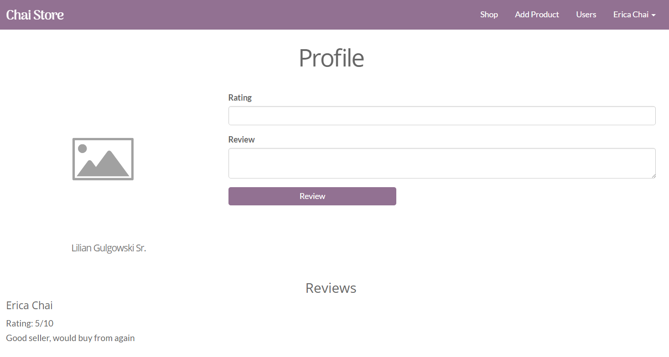
An individual user profile - Here a user can visit another users profile page. They can rate and review the performance on a seller or view the reviews added by other users.

Slide 18
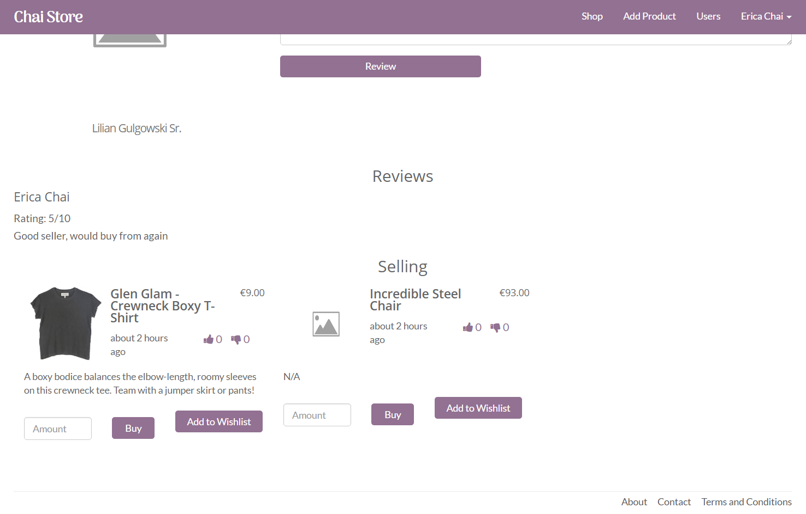
An individual user profile - This page also lists the products this seller has available. The buyer can buy products from this page or add them to their wish list.

Slide 19
Independent Learning

Slide 20
3rd Party Gems
Faker - used to create content for the website.
font-awesome-rails - Adds font awesome icons which are used around the store.
acts_as_votable - Adds the feature to like/dislike products.
will_paginate - Adds pagination to the pages.
bootstrap-will_paginate – Styles the pagination in bootstraps style
Carrierwave and mini_magick - Used together, images can be uploaded and stored.

Slide 21
Hosting Deployment
Heroku.
Visit: https://infinite-chamber-51589.herokuapp.com/

