Slide 1


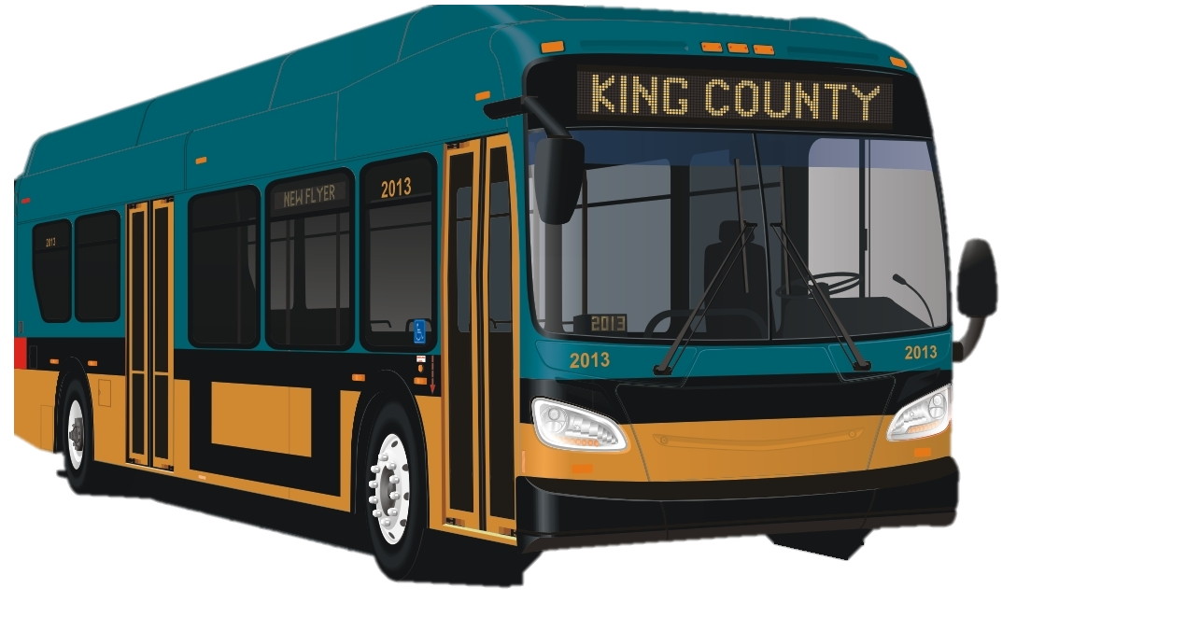
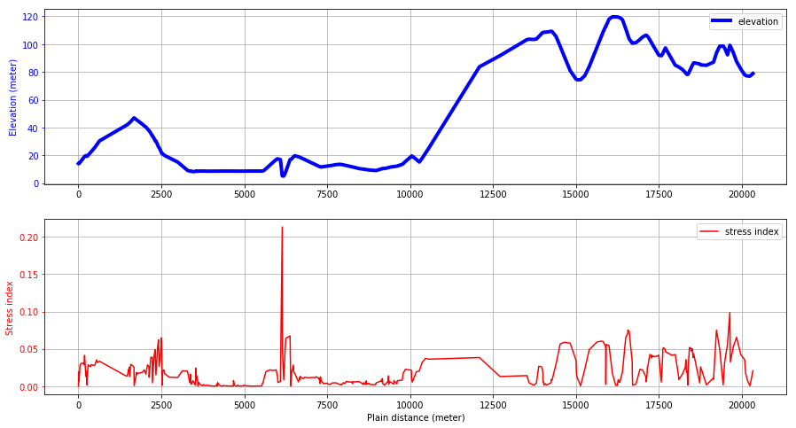
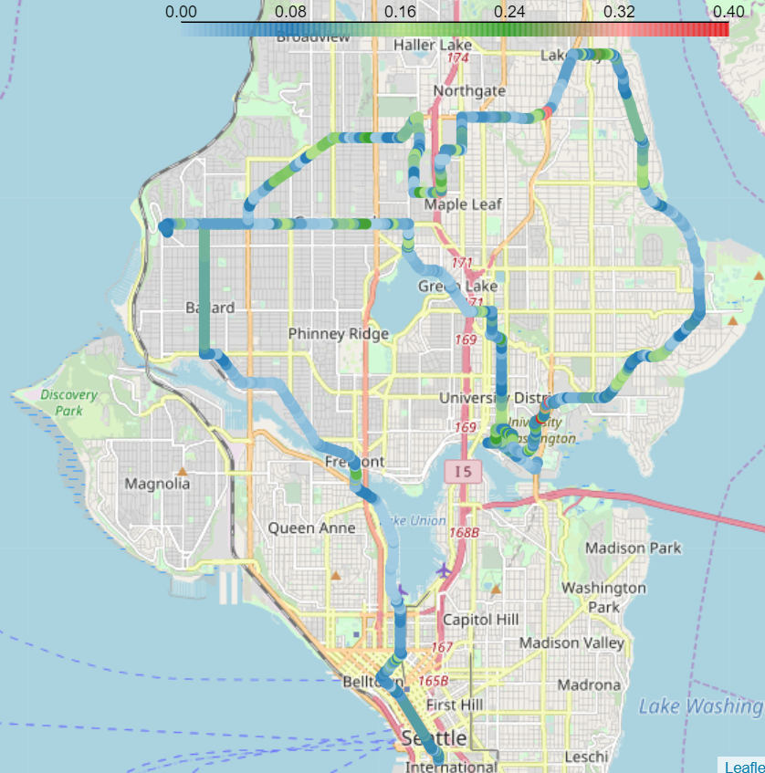
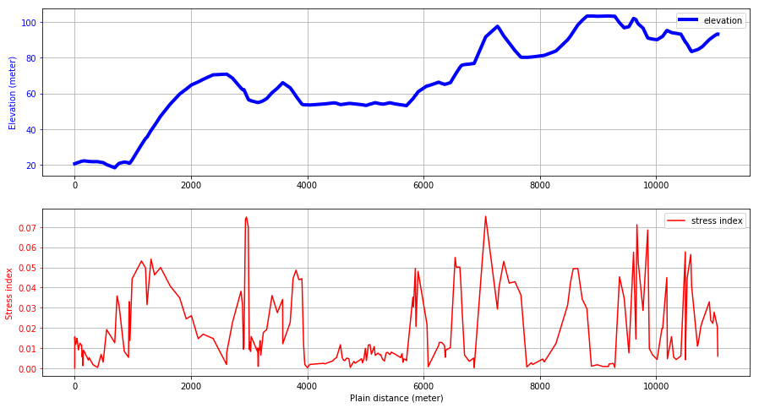
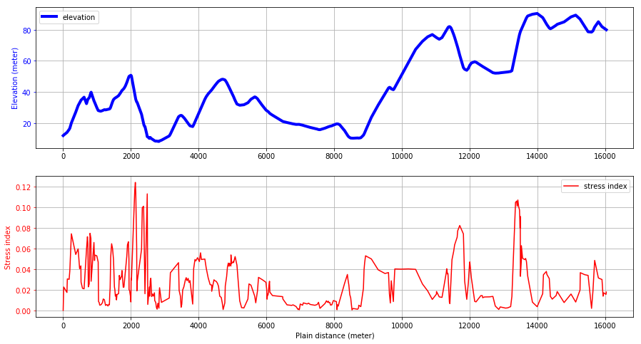
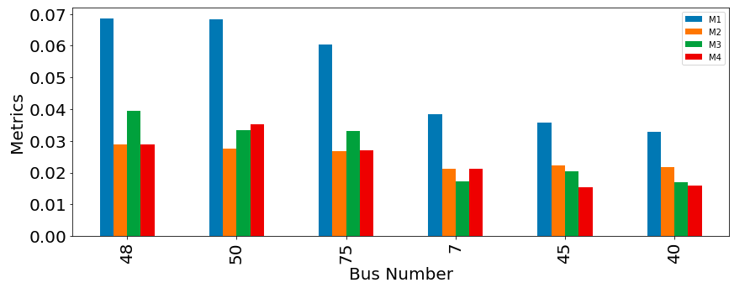


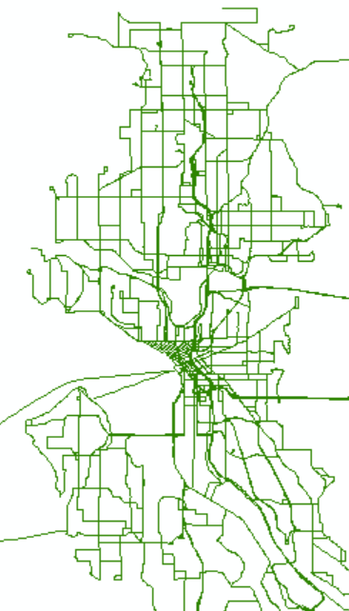
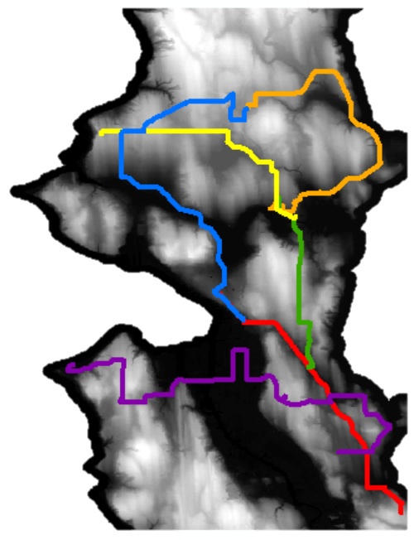
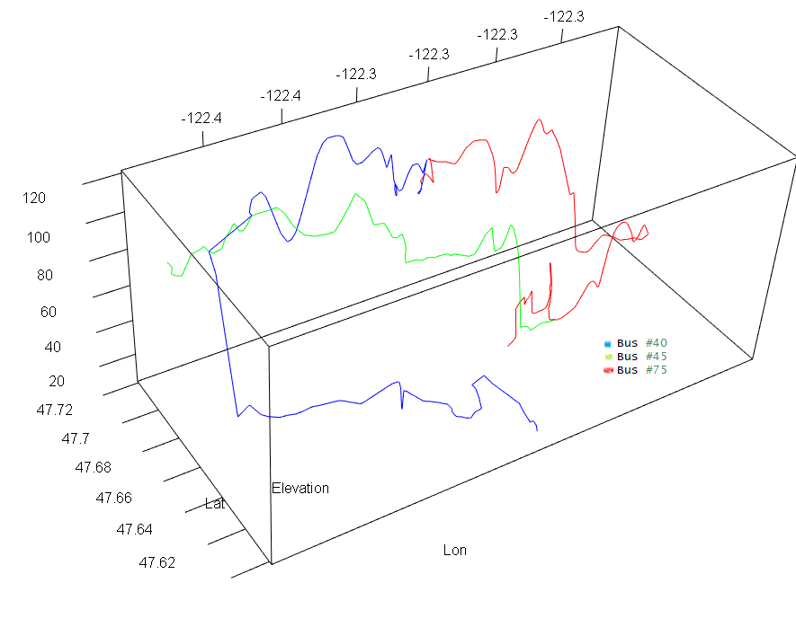


Route_Dynamics: An open-source package for visualizing and ranking transit routes
Atinuke Ademola-Idowu, Erica E. Eggleton, Yohan Min, Kaiming Tao
Purpose
Results
Driving up and down hills is a source of stress for batteries in electrified vehicles due to high charge/discharge rates. This software uses geographic information systems (GIS) data to determine the elevation profiles for King County Metro bus routes and ranks the difficulty based on road grade. This package can also be used as a component for a predictive battery degradation model.
Data Analysis Output
Visualization Output
Road Grade
40
40
75
45
Work Flow / Packages
Read Data
Process Data
Analyze Data
Visualize Data
45
Bus route coordinates from King County Metro
Re-trace routes to extract only one-way bus routes
Extract elevation data for each bus route and merge with route coordinates into a GeoJson format
Display selected bus routes on map using colors to represent elevation gradient
45
75
Elevation data for the King County area from Washington Department of Natural Resources
Convert elevation data to coordinate system used by bus routes.
Display plots of selected bus routes’ actual elevation and absolute road grade
Calculate route elevation gradient and compute different stress metrics
75
40
Packages
Above: The package produces a map, either within a notebook or saved as an HTML file, that shows the selected routes and road grade.
Geopandas
Rasterio
ArcGIS/ArcMap
Geopandas
Rasterio
Geopandas
Shapely
Geopy
Pandas
Rasterstats
Folium
Matplotlib
Branca
Above: The package produces elevation profiles and the absolute road grade profiles for each route that is called.
Right: The package experiments with various metrics to rank route difficulty for the bus batteries.
Route Ranking
Current ranking metrics included in software:
$Metric 1=\frac{\sum{grade}}{route distance }$
$Metric 2= \sum{\frac{\left|Elevation difference between points\right|}{route distance}}$
$Metric 3=$ $\frac{\sum{Uphill grade}}{route distance}$
$Metric 4= \frac{\sum{Downhill grade}}{route distance}$
Input Data Types and Cleaning
Future Work
Clean
Routes
Add more points (e.g. interpolation) for higher resolution along the route for a smoother elevation profile and more accurate ranking metric
Combine elevation surface and terrain models to account for bridges and overpasses
Create Python package for data cleaning to minimize the need for ArcMap
Add more stress parameters (mass, velocity, acceleration, weather conditions) to get a better estimate of battery fatigue
Bus routes: Shapefile (.shp) [1]
Elevation: Raster file (.tif) [2]
3D Visual of three routes
References: [1] King County GIS Data Portal. (2017, April), [2] WA Department of Natural Resources, Lidar Portal. (2016)

