Slide 1


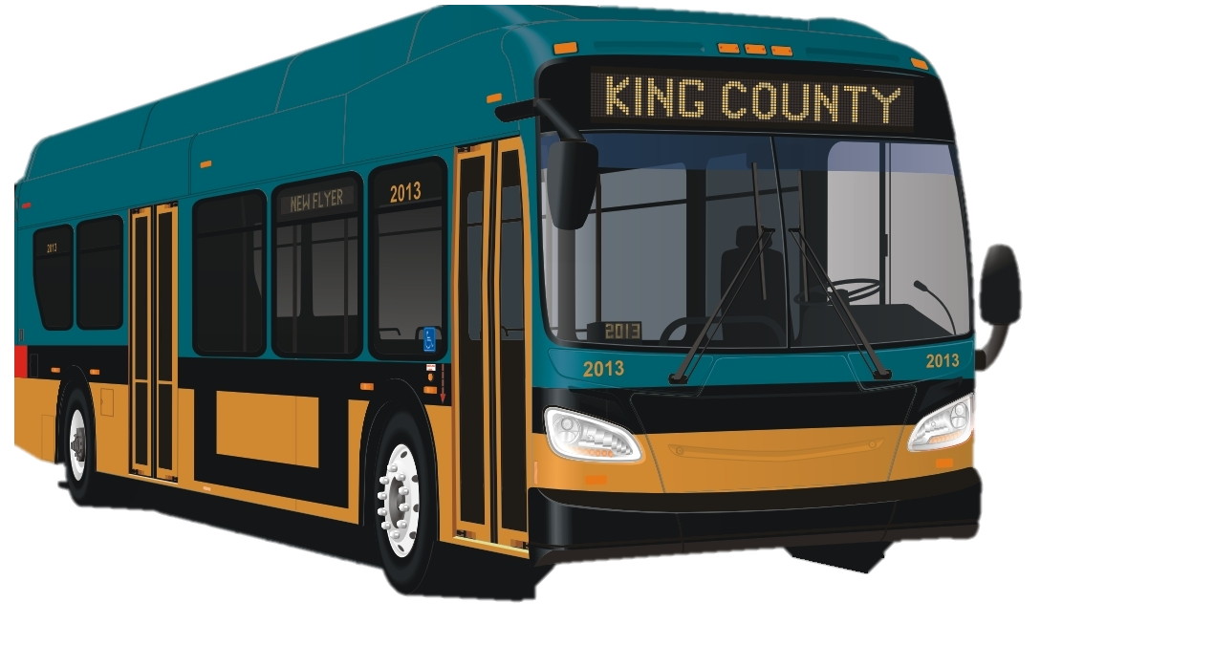

Route_Dynamics: An open-source package for predicting battery load on King County Metro Bus routes
Ryan Carlin, Erica E. Eggleton, Harrison Goldwyn
Purpose
Results
Work Flow / Packages
Input Data Types and Cleaning
Future Work
Add more points (e.g. interpolation) for higher resolution along the route for a smoother elevation profile and more accurate ranking metric
Combine elevation surface and terrain models to account for bridges and overpasses
Create Python package for data cleaning to minimize the need for ArcMap
Add more stress parameters (mass, velocity, acceleration, weather conditions) to get a better estimate of battery fatigue
References: [1] King County GIS Data Portal. (2017, April), [2] WA Department of Natural Resources, Lidar Portal. (2016)

