Slide 1
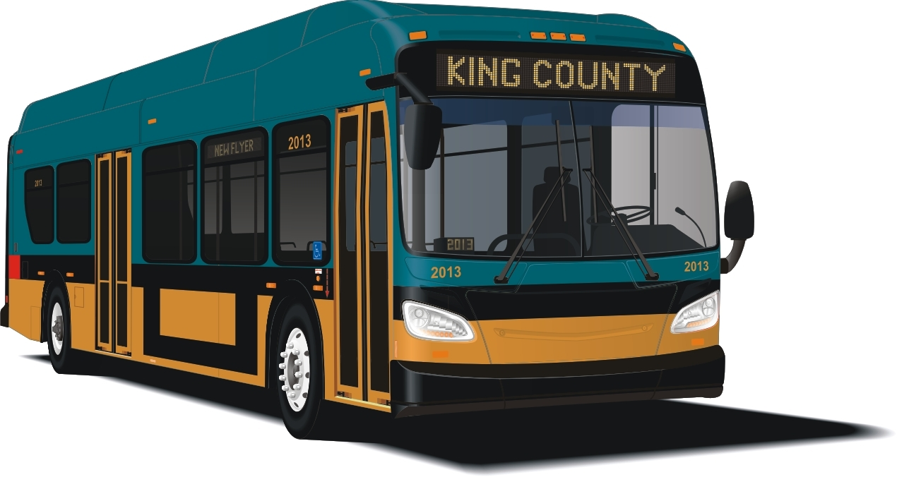
Route Dynamics: Visualizing King County Metro Bus Routes
Erica E. Eggleton,
Motivation
How the Package Works
Data Cleaning
Future Work
References:

