Slide 1


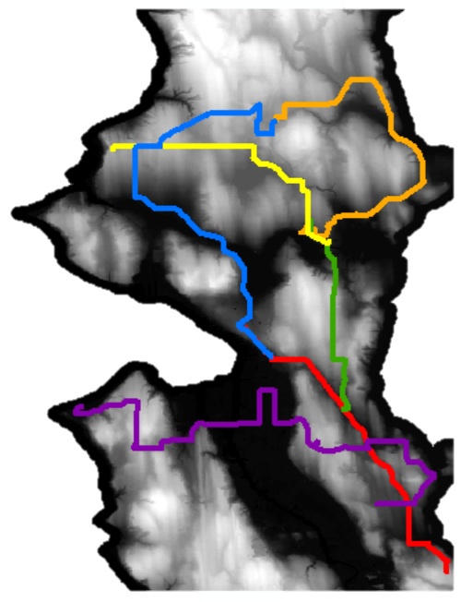
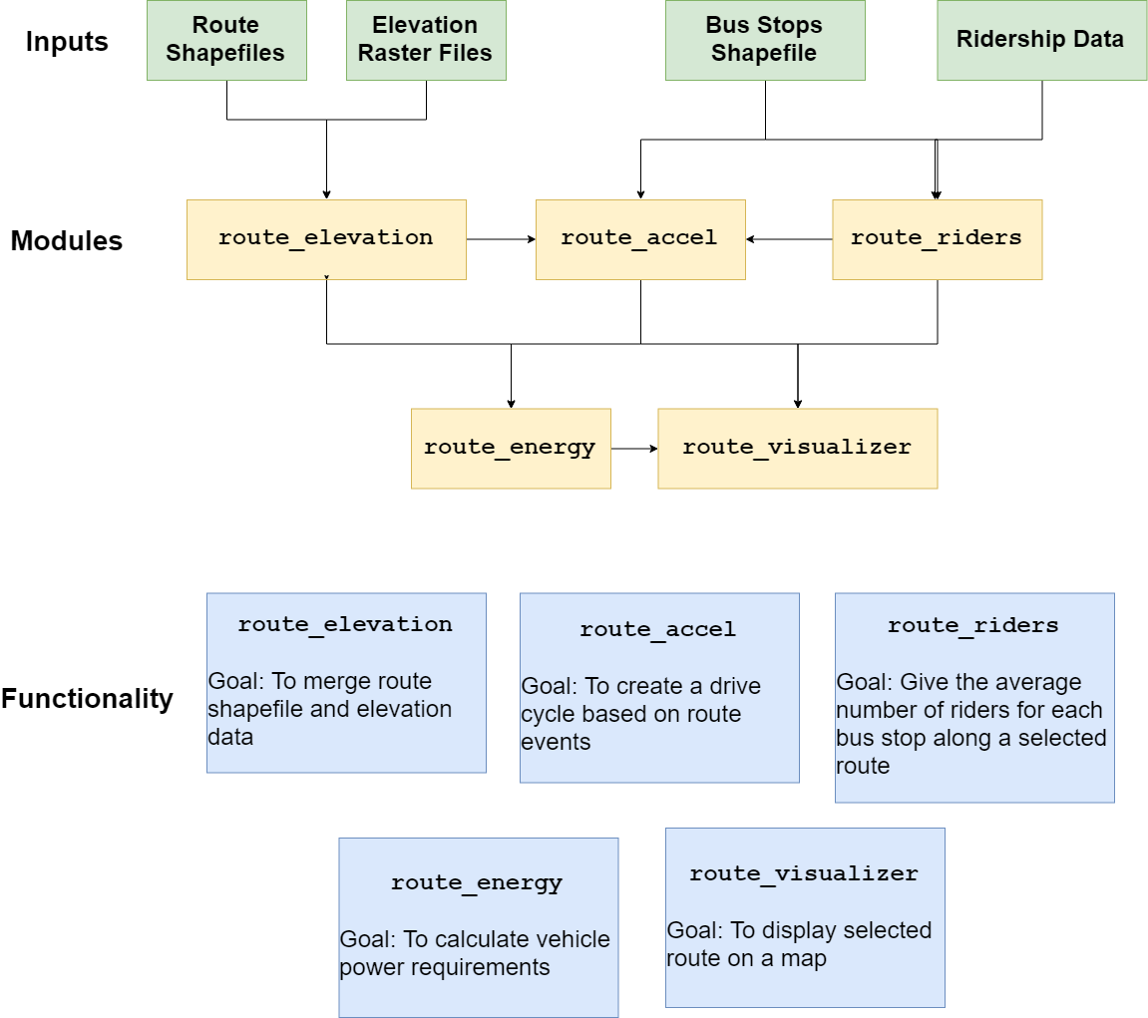
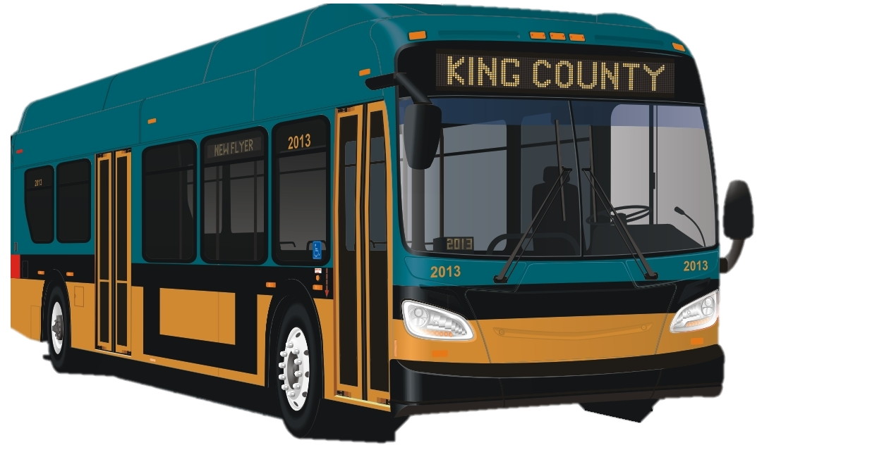
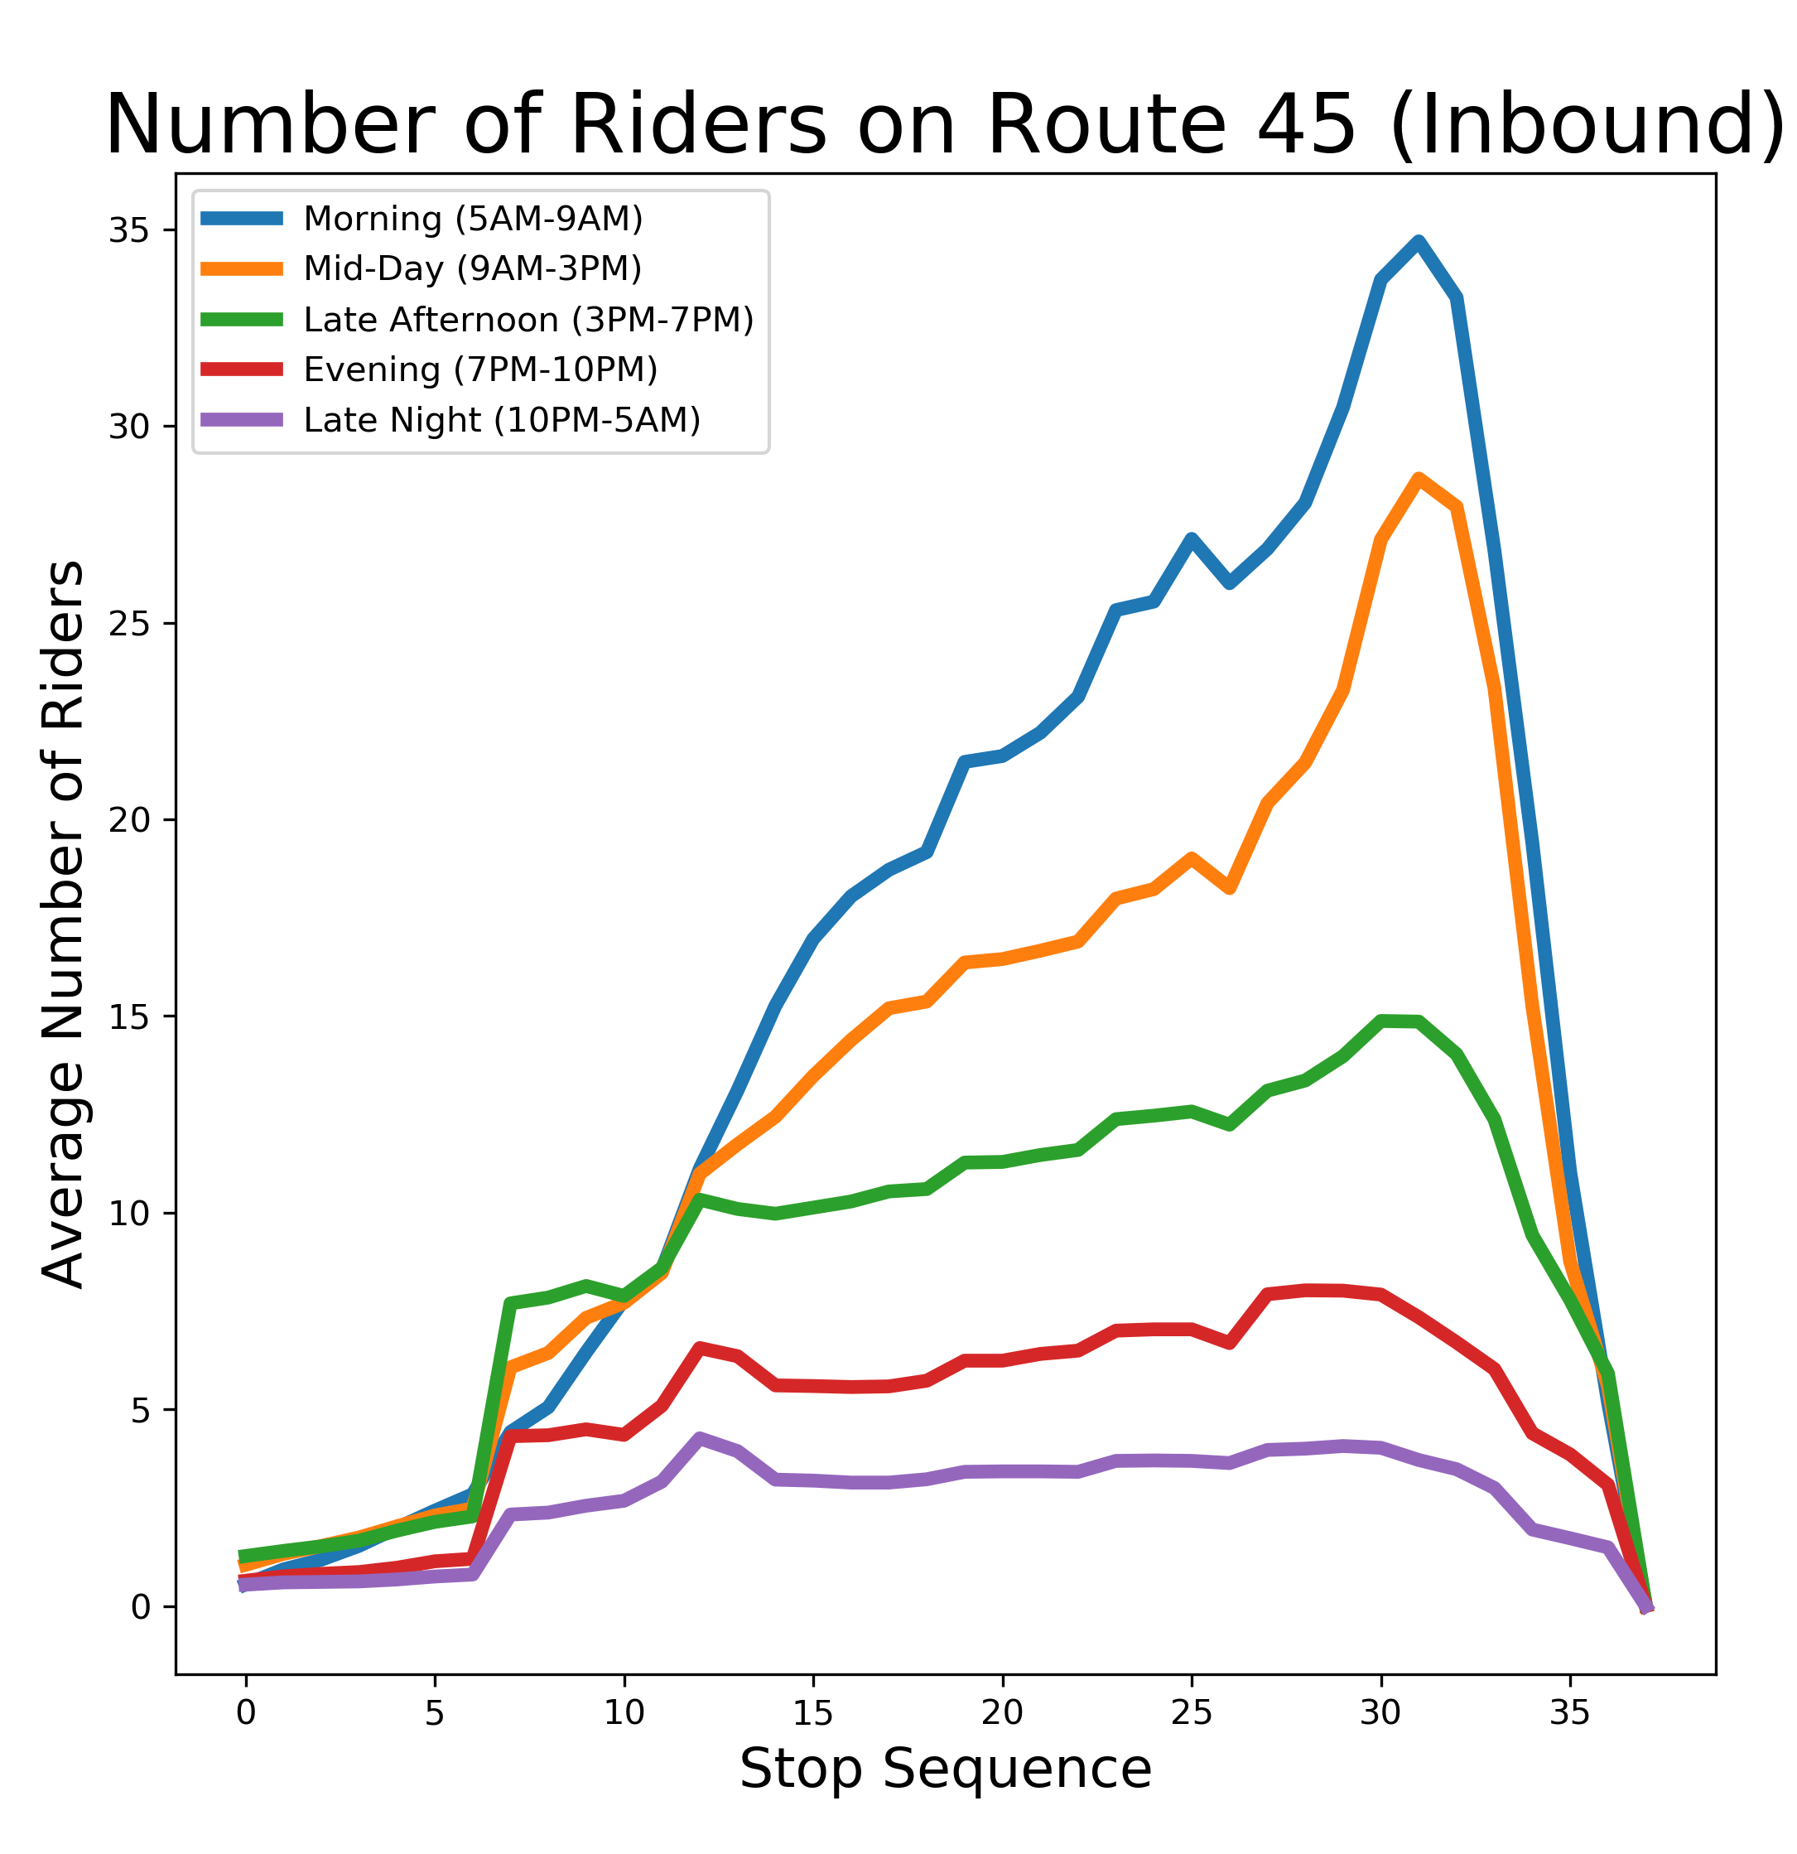


route_dynamics
An open-source package for predicting battery load on King County Metro Bus routes
Ryan Carlin, Erica E. Eggleton, Harrison Goldwyn

